Slide 1

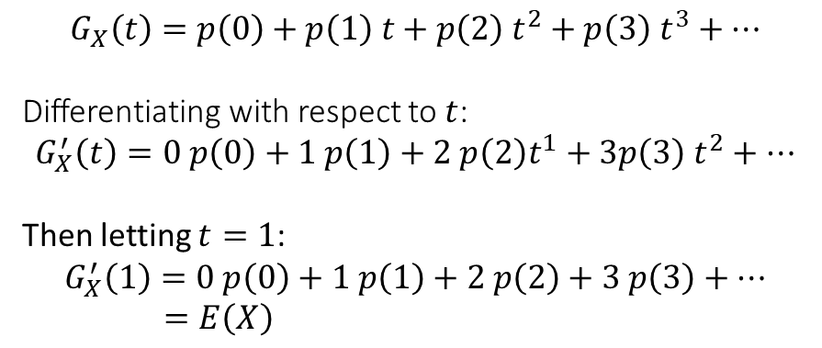
Calculating $E(X)$ and $Var\left(X\right)$
Another advantage of probability generating functions is that they often make $E(X)$ and $Var\left(X\right)$ easier to find.
$$G_{X}\left(t\right)=p\left(0\right)+p\left(1\right) t+p\left(2\right) t^{2}+p\left(3\right) t^{3}+…$$
Differentiating with respect to $t$:
$$G_{X}^{′}\left(t\right)=0 p\left(0\right)+1 p\left(1\right)+2 p\left(2\right)t^{1}+3p\left(3\right) t^{2}+…$$
Then letting $t=1$:
$$G_{X}^{′}\left(1\right)=0 p\left(0\right)+1 p\left(1\right)+2 p\left(2\right)+3 p\left(3\right)+… \\ =E\left(X\right)$$
?
?
?
! $E\left(X\right)=G_{X}^{′}\left(1\right)$

Slide 2
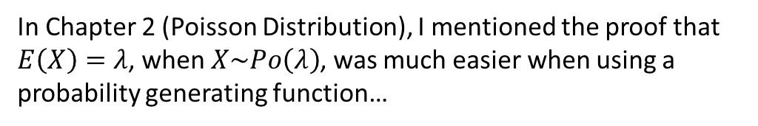

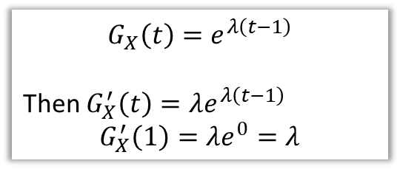
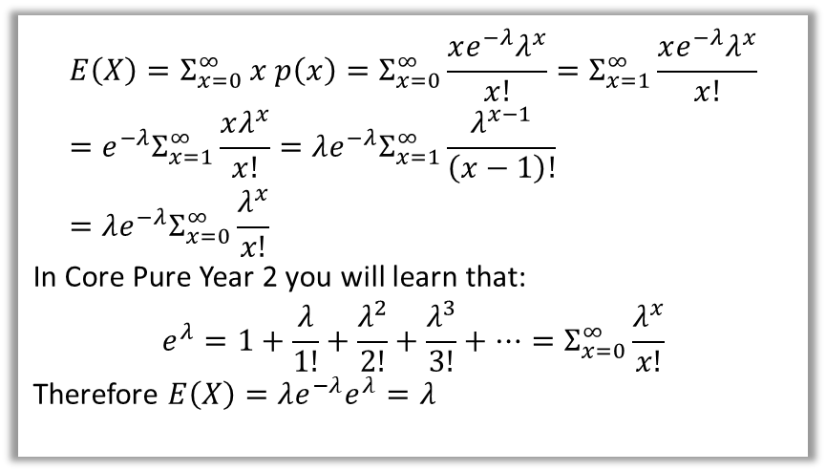
Calculating $E(X)$ and $Var\left(X\right)$
In Chapter 2 (Poisson Distribution), I mentioned the proof that $E\left(X\right)=λ$, when $X\sim Po\left(λ\right)$, was much easier when using a probability generating function…
Proof using original distribution:
(as seen in my Chapter 2 slides)
Proof using pgf:
?
$$E\left(X\right)=Σ_{x=0}^{∞} x p\left(x\right)=Σ_{x=0}^{∞}\frac{xe^{−λ}λ^{x}}{x!}=Σ_{x=1}^{∞}\frac{xe^{−λ}λ^{x}}{x!} \\ =e^{−λ}Σ_{x=1}^{∞}\frac{xλ^{x}}{x!}=λe^{−λ}Σ_{x=1}^{∞}\frac{λ^{x−1}}{\left(x−1\right)!} \\ =λe^{−λ}Σ_{x=0}^{∞}\frac{λ^{x}}{x!}$$
In Core Pure Year 2 you will learn that:
$$e^{λ}=1+\frac{λ}{1!}+\frac{λ^{2}}{2!}+\frac{λ^{3}}{3!}+…=Σ_{x=0}^{∞}\frac{λ^{x}}{x!}$$
Therefore $E\left(X\right)=λe^{−λ}e^{λ}=λ$
$$G_{X}\left(t\right)=e^{λ\left(t−1\right)}$$
Then $G_{X}^{′}\left(t\right)=λe^{λ\left(t−1\right)}$
$$G_{X}^{′}\left(1\right)=λe^{0}=λ$$
HOLY FREAKIN’ PAPA SMURF
We can similarly easily derive $E\left(X\right)=np$ for the Binomial distribution, and so on.

Slide 3
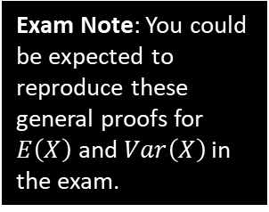


Calculating $E(X)$ and $Var\left(X\right)$
?
$$G_{X}\left(t\right)=Σt^{x}P\left(X=x\right) =E(t^{X}) \\ G_{X}^{′}\left(t\right)=Σxt^{x−1}P\left(X=x\right) =E\left(Xt^{X−1}\right) \\ G_{X}^{′′}\left(t\right)=Σx\left(x−1\right)t^{x−2}P\left(X=x\right) =E\left(X\left(X−1\right)t^{X−2}\right) \\ G^{′′}\left(1\right)=Σx\left(x−1\right)P\left(X=x\right) =E\left(X\left(X−1\right)\right)=E\left(X^{2}−X\right)=E\left(X^{2}\right)−E(X)$$
Thus:
$$Var\left(X\right)=E\left(X^{2}\right)−E{\left(X\right)}^{2} \\ =G^{′′}\left(1\right)+E\left(X\right)−E{\left(X\right)}^{2} \\ =G^{′′}\left(1\right)+G_{X}^{′}\left(1\right)−{\left(G_{X}^{′}\left(1\right)\right)}^{2}$$
?
?
?
?
?
Exam Note: You could be expected to reproduce these general proofs for $E\left(X\right)$ and $Var\left(X\right)$ in the exam.
! $Var\left(X\right)=G_{X}^{′′}\left(1\right)+G_{X}^{′}\left(1\right)−{\left(G_{X}^{′}\left(1\right)\right)}^{2}$

Slide 4
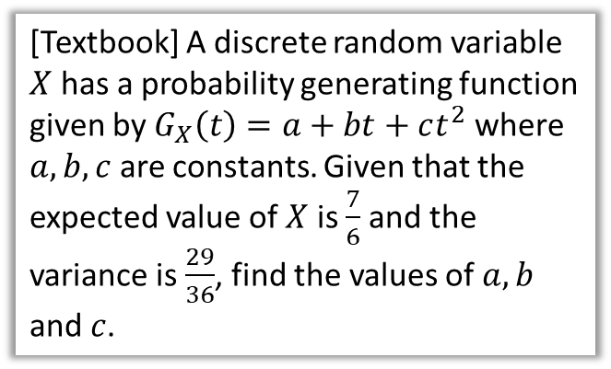
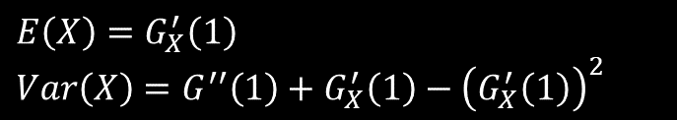

Examples
$$E\left(X\right)=G_{X}^{′}\left(1\right)$$
$$Var\left(X\right)=G^{′′}\left(1\right)+G_{X}^{′}\left(1\right)−{\left(G_{X}^{′}\left(1\right)\right)}^{2}$$
[Textbook] A discrete random variable $X$ has a probability generating function given by $G_{X}\left(t\right)=a+bt+ct^{2}$ where $a,b,c$ are constants. Given that the expected value of $X$ is $\frac{7}{6}$ and the variance is $\frac{29}{36}$, find the values of $a,b$ and $c$.
?
$G_{X}^{′}\left(t\right)=b+2ct$
$G_{X}^{′′}\left(t\right)=2c$
$G_{X}\left(1\right)=a+b+c=1$
$G_{X}^{′}\left(1\right)=b+2c=\frac{7}{6}$
$G_{X}^{′′}\left(1\right)=2c$
$$Var\left(X\right)=G_{X}^{′′}\left(1\right)+G_{X}^{′}\left(1\right)−{\left(G_{X}^{′}\left(1\right)\right)}^{2} \\ \frac{29}{36}=2c+\frac{7}{6}−{\left(\frac{7}{6}\right)}^{2}$$
Solving these simultaneous equations gives
$a=\frac{1}{3}, b=\frac{1}{6}, c=\frac{1}{2}$

Slide 5
Exercise 7C
Pearson Further Statistics 1
Pages 137-138
Complete before the lesson Q1-3
In Class:
Green Q4
Amber Q5-9
Red Q10-15 & Challenge

