Slide 1

CorePure1 Chapter 1 ::
Complex Numbers
jfrost@tiffin.kingston.sch.uk
www.drfrostmaths.com
@DrFrostMaths
Last modified: 4th September 2018

Slide 2








www.drfrostmaths.com
Everything is completely free.
Why not register?
Register now to interactively practise questions on this topic, including past paper questions and extension questions (including MAT + UKMT).
Teachers: you can create student accounts (or students can register themselves), to set work, monitor progress and even create worksheets.
With questions by:
Dashboard with points, trophies, notifications and student progress.
Questions organised by topic, difficulty and past paper.
Teaching videos with topic tests to check understanding.

Slide 3

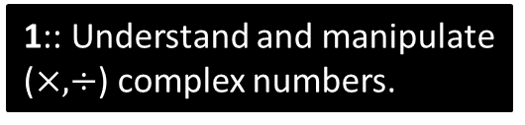
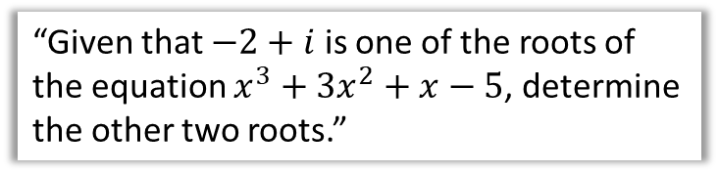
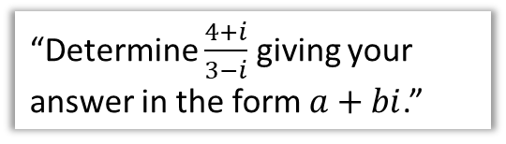
Chapter Overview
1:: Understand and manipulate ($×, ÷$) complex numbers.
2:: Find complex solutions to quadratic equations.
“Determine $\frac{4+i}{3−i}$ giving your answer in the form $a+bi$.”
“Solve $x^{2}+3x+5=0$.”
3:: Find complex solutions to cubic and quartic equations.
“Given that $−2+i$ is one of the roots of the equation $x^{3}+3x^{2}+x−5$, determine the other two roots.”

Slide 4
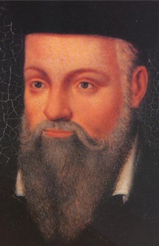
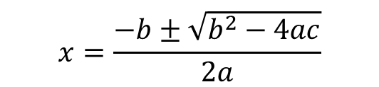
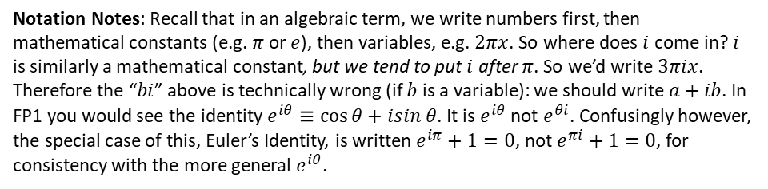
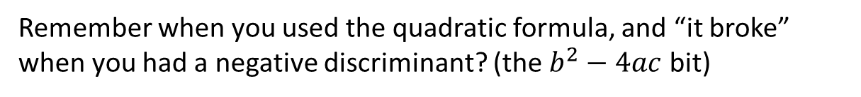
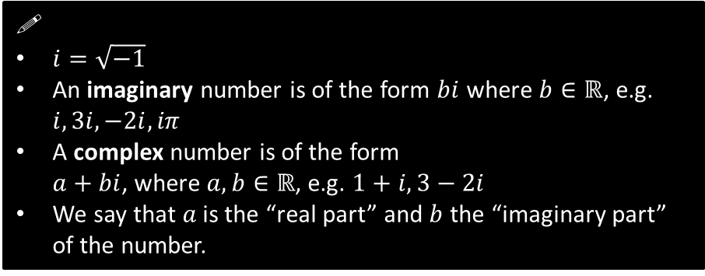
Why complex numbers?
Remember when you used the quadratic formula, and “it broke” when you had a negative discriminant? (the $b^{2}−4ac$ bit)
$$x=\frac{−b±\sqrt{b^{2}−4ac}}{2a}$$
By adding $i=\sqrt{−1}$ to our number system, we can then represent roots of quadratics that we couldn’t previously do so with “real” numbers (i.e. numbers in $ℝ$).
!
$i=\sqrt{−1}$
An imaginary number is of the form $bi$ where $b∈ℝ$, e.g. $i, 3i, −2i, iπ$
A complex number is of the form
$a+bi$, where $a,b∈ℝ$, e.g. $1+i, 3−2i$
We say that $a$ is the “real part” and $b$ the “imaginary part” of the number.
Complex numbers were originally introduced by the Italian mathematician Cardano in the 1500s for this very purpose, i.e. to represent the roots of polynomials which weren’t ‘real’.
Notation Notes: Recall that in an algebraic term, we write numbers first, then mathematical constants (e.g. $π$ or $e$), then variables, e.g. $2πx$. So where does $i$ come in? $i$ is similarly a mathematical constant, but we tend to put $i$ after $π$. So we’d write $3πix$. Therefore the “$bi$” above is technically wrong (if $b$ is a variable): we should write $a+ib$. In FP1 you would see the identity $e^{iθ}≡\cos{θ}+isin θ$. It is $e^{iθ}$ not $e^{θi}$. Confusingly however, the special case of this, Euler’s Identity, is written $e^{iπ}+1=0$, not $e^{πi}+1=0$, for consistency with the more general $e^{iθ}$.

Slide 5
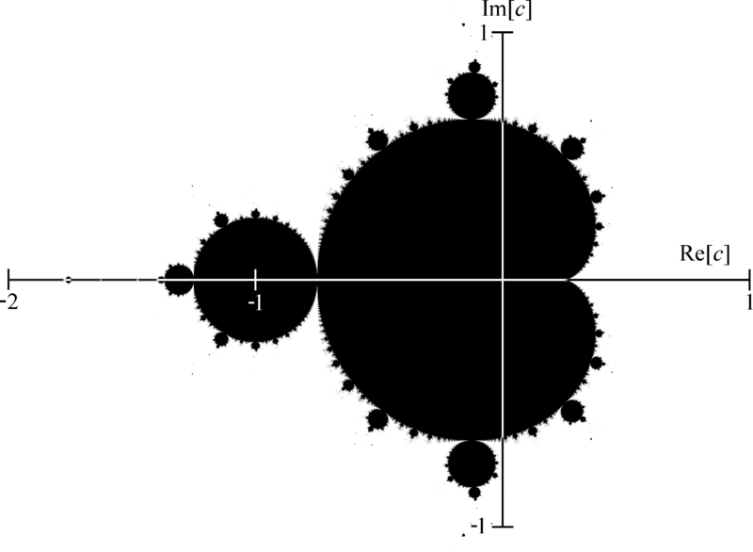
Other Practical Applications
1
Fractals
A Mandelbrot Set is the most popular ‘fractal’. We’ll see how it works in the next slide…
2
Analytic Number Theory
Number Theory is the study of integers. Analytic Number Theory treats integers as reals/complex numbers to use other (‘analytic’) methods to study them. For example, the Riemann Zeta Function allows complex numbers as inputs, and is closely related to the distribution of prime numbers.
3
Physics and Engineering
Used in Signal Analysis, Quantum Mechanics, Fluid Dynamics, Relativity, Control Theory...

Slide 6
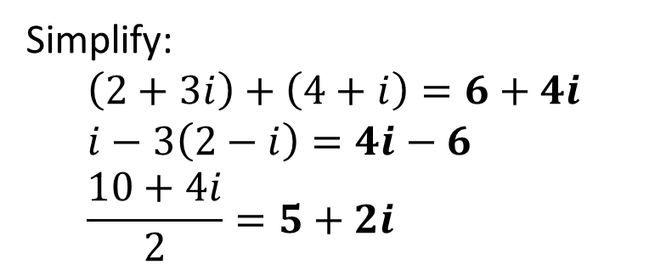

Complex Number Basics
Write the following in terms of $i$:
$$\sqrt{−36}=\sqrt{36}\sqrt{−1}=6i \\ \sqrt{−4}=2i \\ \sqrt{−7}=\sqrt{7}i$$
?
?
?
Simplify:
$$\left(2+3i\right)+\left(4+i\right)=6+4i \\ i−3\left(2−i\right)=4i−6 \\ \frac{10+4i}{2}=5+2i$$
?
?
?

Slide 7
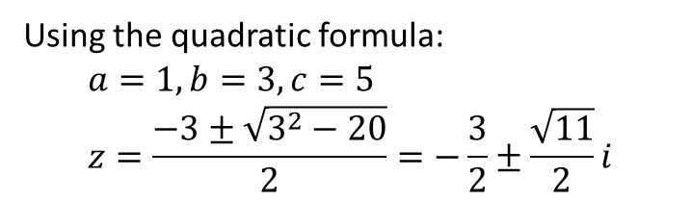

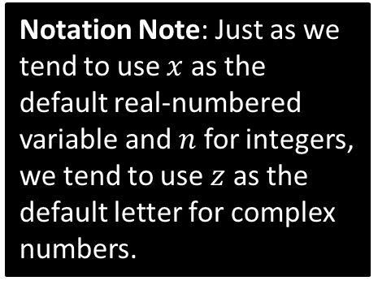


Solving Quadratic Equations
Solve $z^{2}+25=0$
Notation Note: Just as we tend to use $x$ as the default real-numbered variable and $n$ for integers, we tend to use $z$ as the default letter for complex numbers.
?
$$z^{2}=−25 \\ z=±5i$$
Solve $z^{2}+3z+5=0$
?
Using the quadratic formula:
$$a=1, b=3, c=5 \\ z=\frac{−3±\sqrt{3^{2}−20}}{2}=−\frac{3}{2}±\frac{\sqrt{11}}{2}i$$

Slide 8
Exercises 1A-1B
Pearson Core Pure Mathematics Book 1
Page 3, 4-5
Complete before the lesson Q1-3 from Ex1A&B
In Class:
Green Ex1A Q4-6
Amber Ex1A Q7-8 & Ex1B Q4
Red Ex1B Q5 & 6

Slide 9

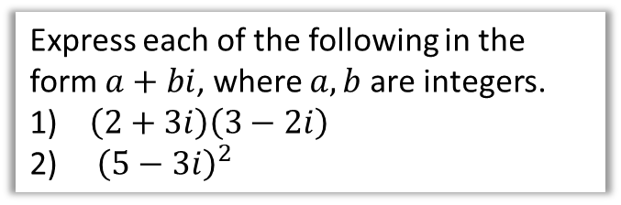


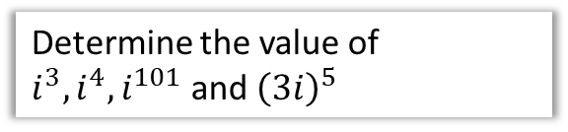

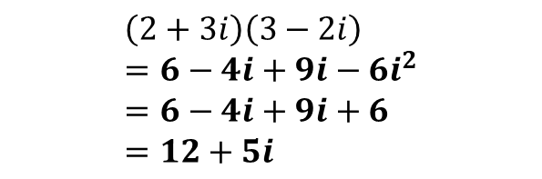
Multiplying Complex Numbers
Given that $i=\sqrt{−1}$, it follows that $i^{2}=−1$
Express each of the following in the form $a+bi$, where $a,b$ are integers.
$\left(2+3i\right)\left(3−2i\right)$
${\left(5−3i\right)}^{2}$
Determine the value of $i^{3}, i^{4}, i^{101}$ and ${\left(3i\right)}^{5}$
$$i^{3} \\ =i×i×i \\ =−1×i=−i$$
$$i^{4} \\ =i×i×i×i \\ =−1×−1=1$$
$$i^{101} \\ ={\left(i^{4}\right)}^{25}×i \\ =i$$
$${\left(3i\right)}^{5}=243i^{5}=243i$$
?
$$\left(2+3i\right)\left(3−2i\right) \\ =6−4i+9i−6i^{2} \\ =6−4i+9i+6 \\ =12+5i$$
?
?
We can therefore see that for increasing powers of $i$, we obtain $i, −1, −i, 1$ where $i^{k}=1$ if $k$ is a multiple of 4.
$${\left(5−3i\right)}^{2} \\ =\left(5−3i\right)\left(5−3i\right) \\ =25−30i+9i^{2} \\ =25−30i−9 \\ =16−30i$$
?
?
?

Slide 10



Test Your Understanding
Edexcel FP1 June 2010
Expand and simplify ${\left(1+i\right)}^{3}$
?
$$1+3i+3i^{2}+i^{3} \\ =1+3i−3−i \\ =−2+2i$$

Slide 11
Exercise 1C
Pearson Core Pure Mathematics Book 1
Page 6
Complete before the lesson Q1-2
In Class:
Green Q3-4
Amber Q5-7
Red Q8 & 9 & challenge

Slide 12

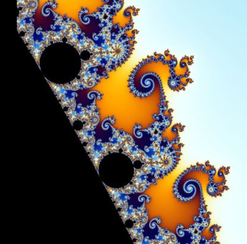

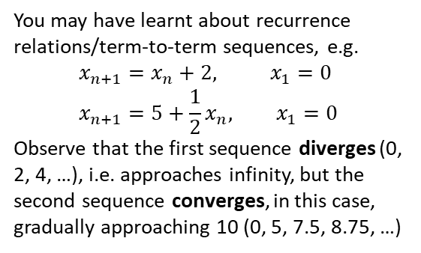

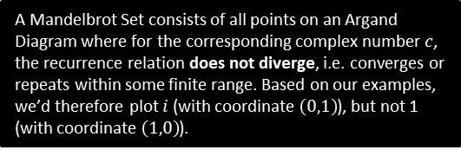

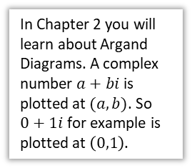
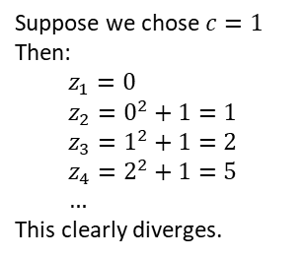

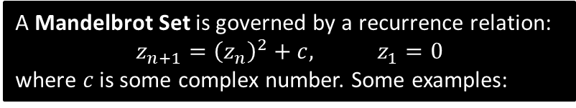


Just for your interest…
How do Mandelbrot sets work?
You may have learnt about recurrence relations/term-to-term sequences, e.g.
$$x_{n+1}=x_{n}+2, x_{1}=0 \\ x_{n+1}=5+\frac{1}{2}x_{n}, x_{1}=0$$
Observe that the first sequence diverges (0, 2, 4, …), i.e. approaches infinity, but the second sequence converges, in this case, gradually approaching 10 (0, 5, 7.5, 8.75, …)
A Mandelbrot Set is governed by a recurrence relation:
$$z_{n+1}={\left(z_{n}\right)}^{2}+c, z_{1}=0$$
where $c$ is some complex number. Some examples:
Suppose we chose $c=1$
Then:
$$z_{1}=0 \\ z_{2}=0^{2}+1=1 \\ z_{3}=1^{2}+1=2 \\ z_{4}=2^{2}+1=5 \\ …$$
This clearly diverges.
Suppose we chose $c=i$
Then:
$$z_{1}=0 \\ z_{2}=0^{2}+i=i \\ z_{3}=i^{2}+i=−1+i \\ z_{4}={\left(−1+i\right)}^{2}+i=−i \\ z_{5}={\left(−i\right)}^{2}+i=−1+i \\ …$$
This clearly alternates. While it doesn’t converge, the value remains bounded within some finite range.
$$Im\left(z\right)$$
In Chapter 2 you will learn about Argand Diagrams. A complex number $a+bi$ is plotted at $(a,b)$. So $0+1i$ for example is plotted at $\left(0,1\right)$.
$$1$$
Yes!
No!
$$Re\left(z\right)$$
By considering all possible values of $c$, we end up with this remarkable fractal pattern…
We can get a coloured diagram by setting the colour to be the rate at which the recurrence diverges (black meaning it doesn’t diverge).
$$1$$
A Mandelbrot Set consists of all points on an Argand Diagram where for the corresponding complex number $c$, the recurrence relation does not diverge, i.e. converges or repeats within some finite range. Based on our examples, we’d therefore plot $i$ (with coordinate $\left(0,1\right)$), but not 1 (with coordinate $\left(1,0\right)$).

Slide 13
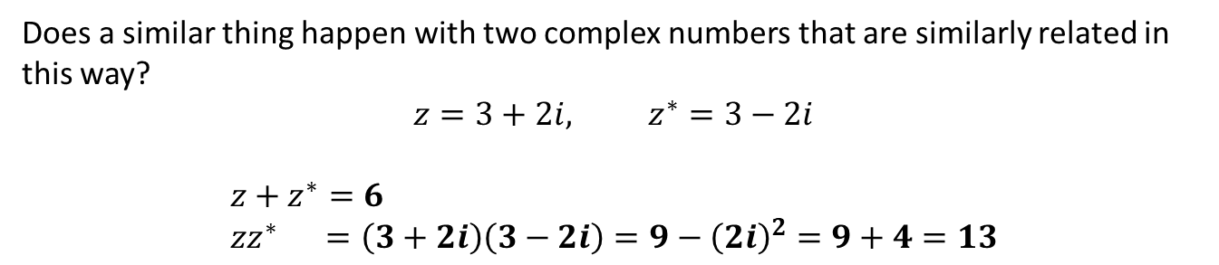
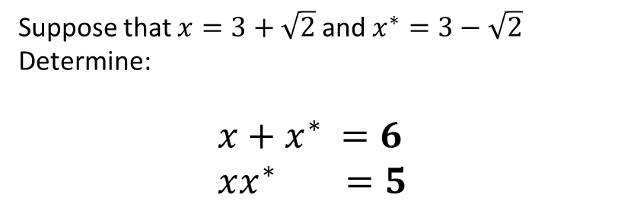
Complex Conjugation
Suppose that $x=3+\sqrt{2}$ and $x^{∗}=3−\sqrt{2}$
Determine:
$$x+x^{∗} =6 \\ xx^{∗} =5$$
?
?
What do you notice about both results?
They are both rational/surd-free! The second result in particular is useful, because we saw in Pure Year 1/GCSE that it gives us a means to rationalise a denominator.
?
Does a similar thing happen with two complex numbers that are similarly related in this way?
$$z=3+2i, z^{∗}=3−2i$$
$$z+z^{∗}=6 \\ zz^{∗} =\left(3+2i\right)\left(3−2i\right)=9−{\left(2i\right)}^{2}=9+4=13$$
?
?
What do you notice about both results?
They are both real! This similarly gives us a way to “real”-ise a denominator, and thus do division of complex numbers…
?

Slide 14
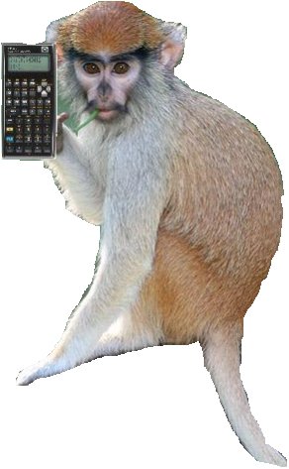

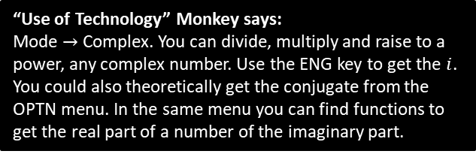


Complex Conjugation
! If $z=a+bi$ then $z^{∗}=a−bi$ is the complex conjugate of $z$.
Write $\frac{5+4i}{2−3i}$ in the form $a+bi$.
?
As with rationalise denominators of surds, we multiple numerator and denominator by the conjugate of the denominator.
$$\frac{5+4i}{2−3i}×\frac{2+3i}{2+3i}=\frac{10+15i+8i−12}{4−{\left(3i\right)}^{2}} \\ =\frac{23i−2}{13} \\ =−\frac{2}{13}+\frac{23}{13}i$$
?
?
Fro Speed Tip: It is useful to remember that:
$$\left(a+bi\right)\left(a−bi\right)=a^{2}+b^{2}$$
?
“Use of Technology” Monkey says:
Mode $→$ Complex. You can divide, multiply and raise to a power, any complex number. Use the ENG key to get the $i$. You could also theoretically get the conjugate from the OPTN menu. In the same menu you can find functions to get the real part of a number of the imaginary part.

Slide 15
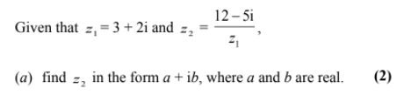

Test Your Understanding
FP1 (Old) Jan 2009 Q9
?
$$\frac{12−5i}{3+2i}×\frac{3−2i}{3−2i}=\frac{36−24i−15i−10}{9+4} \\ =\frac{26−39i}{13} \\ =2−3i$$

Slide 16
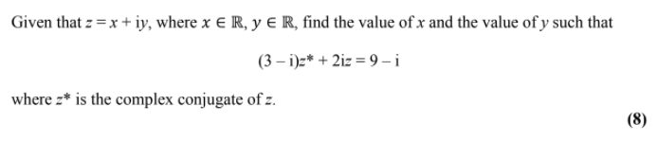
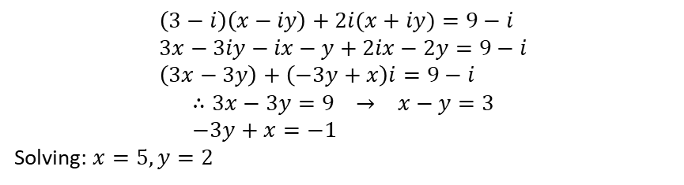
Exercise 1D
Pearson Core Pure Mathematics Book 1
Pages 7-8
Complete before the lesson Q1-3
In Class:
Green Q4-6
Amber Q7-10
Red Q11-14 & Ext
Edexcel FP1(Old) June 2013 Q9
?
$$\left(3−i\right)\left(x−iy\right)+2i(x+iy)=9−i \\ 3x−3iy−ix−y+2ix−2y=9−i \\ \left(3x−3y\right)+\left(−3y+x\right)i=9−i$$
$$∴3x−3y=9 → x−y=3 \\ −3y+x=−1$$
Solving: $x=5, y=2$

Slide 17
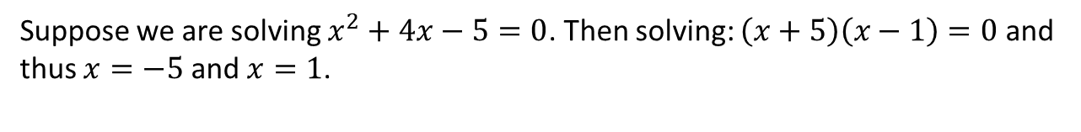
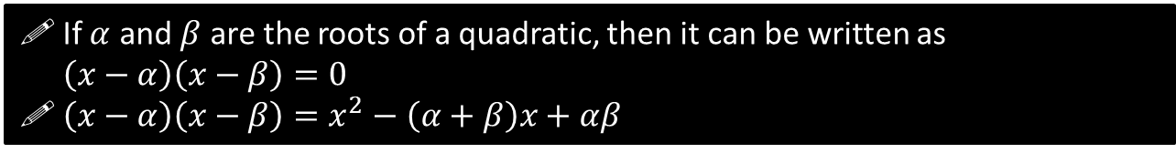
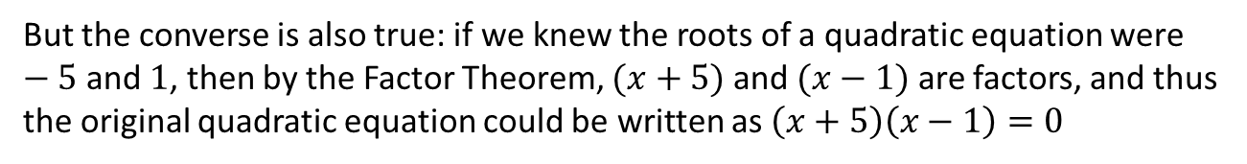
Roots of Quadratics
Suppose we are solving $x^{2}+4x−5=0$. Then solving: $\left(x+5\right)\left(x−1\right)=0$ and thus $x=−5$ and $x=1$.
But the converse is also true: if we knew the roots of a quadratic equation were $−5$ and $1$, then by the Factor Theorem, $(x+5)$ and $(x−1)$ are factors, and thus the original quadratic equation could be written as $\left(x+5\right)\left(x−1\right)=0$
If $α$ and $β$ are the roots of a quadratic, then it can be written as
$\left(x−α\right)\left(x−β\right)=0$
$\left(x−α\right)\left(x−β\right)=x^{2}−\left(α+β\right)x+αβ$
If one of the roots of a quadratic was $3+4i$, do we know the other root?
It must be its complex conjugate $3−4i$. Can you prove why?
If $α$ is the root of a quadratic equation with real coefficients and $α$ is a complex number, then the other root must be its complex conjugate, $α^{∗}$.

Slide 18


Proof that Roots Come in Complex Conjugates
Prove that complex roots of a quadratic, with real coefficients, come in complex conjugates.
Proof 1:
When we use the quadratic formula:
$$x=\frac{−b±\sqrt{b^{2}−4ac}}{2a} \\ =−\frac{b}{2a}±\frac{\sqrt{b^{2}−4ac}}{2a} \\ =−\frac{b}{2a}±\left(\frac{\sqrt{4ac−b^{2}}}{2a}\right)i$$
We can see the real part (before the $±$) is the same (provided that $a,b$ are real), so if one root is complex, the other is its conjugate.
Proof 2:
$$\left(x−α\right)\left(x−β\right)=x^{2}−\left(α+β\right)x+αβ$$
In order to be a quadratic with real coefficients, $α+β$ and $αβ$ must be real.
Let $α=a_{1}+b_{1}i,$and$β=a_{2}+b_{2}i$
Then $α+β=\left(a_{1}+a_{2}\right)+\left(b_{1}+b_{2}\right)i$
If we require this to be real then
$b_{1}+b_{2}=0$ and therefore $b_{2}=−b_{1}$.
Also:
$$αβ=\left(a_{1}+b_{1}i\right)\left(a_{2}+b_{2}i\right) \\ =\left(a_{1}a_{2}−b_{1}b_{2}\right)+\left(a_{1}b_{2}+a_{2}b_{1}\right)i$$
In order for this to be real, $a_{1}b_{2}+a_{2}b_{1}=0$
But $b_{2}=−b_{1}$ therefore:
$$−a_{1}b_{1}+a_{2}b_{1}=0 \\ b_{1}\left(a_{2}−a_{1}\right)=0$$
Thus either $b_{1}=b_{2}=0$ (i.e. the roots weren’t complex) or $a_{2}=a_{1}$, which combined with $b_{2}=−b_{1}$, means the roots are conjugates.
?
?

Slide 19

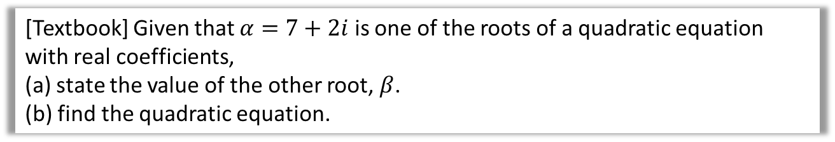
Example Question
[Textbook] Given that $α=7+2i$ is one of the roots of a quadratic equation with real coefficients,
(a) state the value of the other root, $β$.
(b) find the quadratic equation.
a
$β=7−2i$
Slow way:
$$\left(z−\left(7−2i\right)\right)\left(z−\left(7+2i\right)\right)=0 \\ z^{2}−\left(7+2i\right)z−\left(7−2i\right)z+\left(7−2i\right)\left(7+2i\right)=0 \\ z^{2}−7z+2iz−7z−2iz+7−14i+14i+4=0 \\ z^{2}−14z+53=0$$
Quick (preferred) way:
Using $α=7+2i$ , $β=7−2i$ combined with $z^{2}−\left(α+β\right)z+αβ=0$:
(recalling that $\left(a+bi\right)\left(a−bi\right)=a^{2}+b^{2}$)
$$z^{2}−\left(7+7\right)z+\left(7^{2}+2^{2}\right)=0 \\ z^{2}−14z+53=0$$
?
b
?

Slide 20
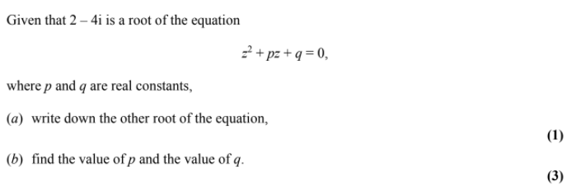
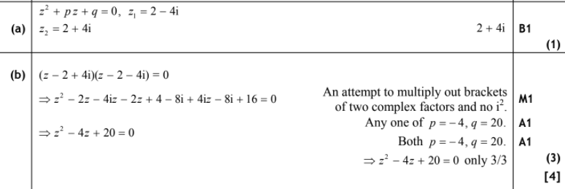
Test Your Understanding
FP1 (Old) Jan 2011 Q4
?
?

Slide 21
Exercise 1E
Pearson Core Pure Mathematics Book 1
Pages 9-10
Complete before the lesson Q1-3
In Class:
Green Q4&5
Amber Q6&7
Red Q8 & 9

Slide 22





Roots of Cubic and Quartic Equations
The same principle applies to polynomials of higher degree, e.g. cubics and quartics.
All complex roots come in conjugate pairs.
A cubic equation always has three roots (by the Fundamental Law of Algebra). These roots may be repeated, and not all may be real roots…
$$y$$
$$y$$
$$y$$
$$x$$
$$x$$
$$x$$
?
Comment on the 3 roots
?
Comment on the 3 roots
?
Comment on the 3 roots
3 real roots.
1 real root.
2 complex roots (which are conjugates)
3 real roots, but two of them the same value (i.e. repeated root).

Slide 23

Roots of Cubic and Quartic Equations
And the same with quartics…
$$y$$
$$y$$
$$y$$
$$x$$
$$x$$
$$x$$
?
Comment on the 4 roots
?
Comment on the 4 roots
?
Comment on the 4 roots
2 real roots.
2 complex roots (a conjugate pair)
4 real roots.
Two of them with the same value.
0 real roots.
2 pairs of complex conjugate roots.

Slide 24

Example Question
[Textbook] Given that $3+i$ is a root of the quartic equation
$2z^{4}−3z^{3}−39z^{2}+120z−50=0$, solve the equation completely.
?
Another root is $3−i$.
So $\left(z−\left(3+i\right)\right)\left(z−\left(3−i\right)\right)$
$$=z^{2}−\left(3+3\right)z+\left(3^{2}+1^{2}\right) \\ =z^{2}−6z+10$$
is a factor of $2z^{4}−3z^{3}−39z^{2}+120z−50$
$$\left(z^{2}−6z+10\right)\left(…\right)=2z^{4}−3z^{3}−39z^{2}+120z−50$$
Use (mostly) common sense to determine the other bracket:
It must start with $2z^{2}$ in order to get the $2z^{4}$ term in the expansion.
It must end with -5 to get the -50 term.
So we know second bracket is of form $(2z^{2}+az−5)$.
To work out the $a$ we need to compare either $z^{3}, z^{2}$ or $z$ terms in the expansion, say for example the $−3z^{3}$ term:
$a−12=−3 → a=9$
$$∴\left(z^{2}−6z+10\right)\left(2z^{2}+9z−5\right)=0$$
Solving $2z^{2}+9z−5=0 → z=\frac{1}{2}, z=−5$
So roots are $\frac{1}{2}, −5, 3+i, 3−i$
You could also use algebraic long division, but I’ve always favoured determining the second bracket by intuition as per the left.

Slide 25


Example Question
[Textbook] Show that $z^{2}+4$ is a factor of $z^{4}−2z^{3}+21z^{2}−8z+68$
Hence solve the equation $z^{4}−2z^{3}+21z^{2}−8z+68=0$
?
$$z^{4}−2z^{3}+21z^{2}−8z+68=\left(z^{2}+4\right)\left(z^{2}+az+17\right)$$
Comparing $z^{3}$ terms:
$$−2=a$$
$$∴z^{4}−2z^{3}+21z^{2}−8z+68=\left(z^{2}+4\right)\left(z^{2}−2z+17\right)$$
Solving $z^{2}+4=0$:
$$z^{2}=−4 \\ z=±2i$$
Solving $z^{2}−2z+17$:
$$z=1±4i$$

Slide 26
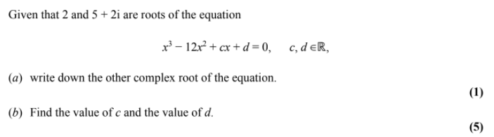
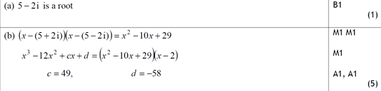
Test Your Understanding
FP1 (Old) Jan 2010 Q6
?
?

Slide 27
Exercise 1F
Pearson Core Pure Mathematics Book 1
Pages 13-14
Complete before the lesson Q1-3
In Class:
Green Q4-8 any 2
Amber Q9-10
Red Q11-12 & challenge

