Slide 1
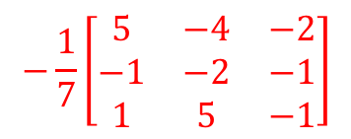

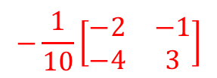
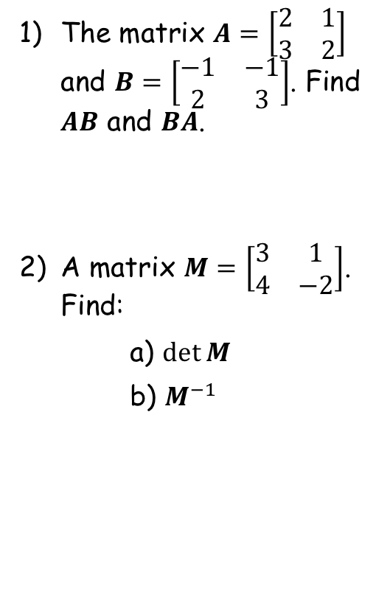

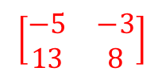

Prior Knowledge Check
The matrix $A=\left[\begin{matrix}2 & 1 \\ 3 & 2\end{matrix}\right]$ and $B=\left[\begin{matrix}−1 & −1 \\ 2 & 3\end{matrix}\right]$. Find $AB$ and $BA$.
A matrix $M=\left[\begin{matrix}3 & 1 \\ 4 & −2\end{matrix}\right]$. Find:
a) $\det{M}$
b) $M^{−1}$
3) A matrix $A=\left[\begin{matrix}−1 & 2 & 0 \\ 0 & 1 & −1 \\ 1 & 3 & 2\end{matrix}\right]$.
Use your calculator to find $A^{−1}$
$$\left[\begin{matrix}0 & 1 \\ 1 & 3\end{matrix}\right]$$
$$\left[\begin{matrix}−5 & −3 \\ 13 & 8\end{matrix}\right]$$
$$−\frac{1}{7}\left[\begin{matrix}5 & −4 & −2 \\ −1 & −2 & −1 \\ 1 & 5 & −1\end{matrix}\right]$$
$$−10$$
$$−\frac{1}{10}\left[\begin{matrix}−2 & −1 \\ −4 & 3\end{matrix}\right]$$

Slide 2
Linear Transformations
You can use matrices to describe linear transformations
You will be familiar with transformations from GCSE (reflection, rotation, translation and enlargements)
A transformation moves all points (x,y) in a plane according to some rule
The new points are known as the image.
7A

Slide 3




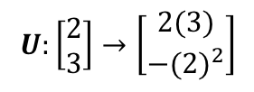








Linear Transformations
You can use matrices to describe linear transformations
The three transformations S, T and U are defined below. Find the image of the point (2,3) under each of these transformations.
$$T:\left[\begin{matrix}x \\ y\end{matrix}\right]→\left[\begin{matrix}2x−y \\ x+y\end{matrix}\right]$$
You can write the coordinate as a vector (ie the directions from (0,0))
→ Sub in values
$$T:\left[\begin{matrix}2 \\ 3\end{matrix}\right]→\left[\begin{matrix}2\left(2\right)−3 \\ 2+3\end{matrix}\right]$$
$$=\left[\begin{matrix}1 \\ 5\end{matrix}\right]$$
Calculate
$$=\left(1,5\right)$$
$$S:\left[\begin{matrix}x \\ y\end{matrix}\right]→\left[\begin{matrix}x+4 \\ y−1\end{matrix}\right]$$
$$T:\left[\begin{matrix}x \\ y\end{matrix}\right]→\left[\begin{matrix}2x−y \\ x+y\end{matrix}\right]$$
$$U:\left[\begin{matrix}x \\ y\end{matrix}\right]→\left[\begin{matrix}2y \\ −x^{2}\end{matrix}\right]$$
$$U:\left[\begin{matrix}x \\ y\end{matrix}\right]→\left[\begin{matrix}x+4 \\ y−1\end{matrix}\right]$$
You can write the coordinate as a vector (ie the directions from (0,0))
→ Sub in values
$$U:\left[\begin{matrix}2 \\ 3\end{matrix}\right]→\left[\begin{matrix}2(3) \\ −{(2)}^{2}\end{matrix}\right]$$
$$S:\left[\begin{matrix}x \\ y\end{matrix}\right]→\left[\begin{matrix}x+4 \\ y−1\end{matrix}\right]$$
You can write the coordinate as a vector (ie the directions from (0,0))
→ Sub in values
$$=\left[\begin{matrix}6 \\ −4\end{matrix}\right]$$
Calculate
$$S:\left[\begin{matrix}2 \\ 3\end{matrix}\right]→\left[\begin{matrix}2+4 \\ 3−1\end{matrix}\right]$$
$$=\left(6,−4\right)$$
$$=\left[\begin{matrix}6 \\ 2\end{matrix}\right]$$
Calculate
$$=\left(6,2\right)$$
7A

Slide 4




Linear Transformations
You can use matrices to describe linear transformations
→ A linear transformation has two properties
It only involves linear transformations of x and y (so no powers)
The origin, (0,0) is not moved by the transformation
$$S:\left[\begin{matrix}x \\ y\end{matrix}\right]→\left[\begin{matrix}x+4 \\ y−1\end{matrix}\right]$$
$$S:\left[\begin{matrix}x \\ y\end{matrix}\right]→\left[\begin{matrix}x+4 \\ y−1\end{matrix}\right]$$
$$T:\left[\begin{matrix}x \\ y\end{matrix}\right]→\left[\begin{matrix}2x−y \\ x+y\end{matrix}\right]$$
Only involves linear transformations
The origin is not moved
$$U:\left[\begin{matrix}x \\ y\end{matrix}\right]→\left[\begin{matrix}2y \\ −x^{2}\end{matrix}\right]$$
$$T:\left[\begin{matrix}x \\ y\end{matrix}\right]→\left[\begin{matrix}2x−y \\ x+y\end{matrix}\right]$$
Only involves linear transformations
The origin is not moved
$$U:\left[\begin{matrix}x \\ y\end{matrix}\right]→\left[\begin{matrix}2y \\ −x^{2}\end{matrix}\right]$$
Only involves linear transformations
The origin is not moved
So T is the only linear transformation here!
7A

Slide 5











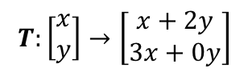
Linear Transformations
$$T:\left[\begin{matrix}x \\ y\end{matrix}\right]→\left[\begin{matrix}2y+x \\ 3x\end{matrix}\right]$$
You can use matrices to describe linear transformations
The linear transformation:
Can be represented by the matrix:
Since:
Find matrices to represent these linear transformations:
Write in the form shown to the right for S
$$T:\left[\begin{matrix}x \\ y\end{matrix}\right]→\left[\begin{matrix}x+2y \\ 3x+0y\end{matrix}\right]$$
Just write the numbers in their respective positions
$$S:\left[\begin{matrix}x \\ y\end{matrix}\right]→\left[\begin{matrix}ax+by \\ cx+dy\end{matrix}\right]$$
$$T=\left[\begin{matrix}1 & 2 \\ 3 & 0\end{matrix}\right]$$
$$M=\left[\begin{matrix}a & b \\ c & d\end{matrix}\right]$$
$$= \left[\begin{matrix}ax+by \\ cx+dy\end{matrix}\right]$$
$$V:\left[\begin{matrix}x \\ y\end{matrix}\right]→\left[\begin{matrix}−2y \\ 3x+y\end{matrix}\right]$$
$$\left[\begin{matrix}a & b \\ c & d\end{matrix}\right]\left[\begin{matrix}x \\ y\end{matrix}\right]$$
Write in the form shown to the right for S
$$V:\left[\begin{matrix}x \\ y\end{matrix}\right]→\left[\begin{matrix}0x−2y \\ 3x+y\end{matrix}\right]$$
Just write the numbers in their respective positions
$$T:\left[\begin{matrix}x \\ y\end{matrix}\right]→\left[\begin{matrix}2y+x \\ 3x\end{matrix}\right]$$
$$V=\left[\begin{matrix}0 & −2 \\ 3 & 1\end{matrix}\right]$$
$$V:\left[\begin{matrix}x \\ y\end{matrix}\right]→\left[\begin{matrix}−2y \\ 3x+y\end{matrix}\right]$$
7A

Slide 6
















Linear Transformations
You can use matrices to describe linear transformations
The square S has coordinates (1,1), (3,1), (3,3) and (1,3).
Find the coordinates of the vertices of the image of S after the transformation given by the matrix:
→ Write the coordinates of the vertices as vectors, and combine them into a 2x4 matrix…
→ Now multiply the transformation matrix by the coordinates!
$$\left[\begin{matrix}−1 & 2 \\ 2 & 1\end{matrix}\right]$$
$$\left[\begin{matrix}\begin{matrix}1 & 3 \\ 1 & 1\end{matrix} & \begin{matrix}3 & 1 \\ 3 & 3\end{matrix}\end{matrix}\right]$$
(2 x 2)
x
(2 x 4)
=
(2 x 4)
$$\left[\begin{matrix}−1 & 2 \\ 2 & 1\end{matrix}\right]$$
$$\left[\begin{matrix}\begin{matrix}1 & 3 \\ 1 & 1\end{matrix} & \begin{matrix}3 & 1 \\ 3 & 3\end{matrix}\end{matrix}\right]=\left[\begin{matrix}\begin{matrix} & \\ & \end{matrix} & \begin{matrix} & \\ & \end{matrix}\end{matrix}\right]$$
$$\left(−1×1\right)+(2×1)$$
$$\left(−1×3\right)+(2×1)$$
$$\left(−1×3\right)+(2×3)$$
$$\left(−1×1\right)+(2×3)$$
$$M=\left[\begin{matrix}−1 & 2 \\ 2 & 1\end{matrix}\right]$$
$$\left(2×1\right)+(1×1)$$
$$\left(2×3\right)+(1×1)$$
$$\left(2×3\right)+(1×3)$$
$$\left(2×1\right)+(1×3)$$
$$=\left[\begin{matrix}\begin{matrix}1 & −1 \\ 3 & 7\end{matrix} & \begin{matrix}3 & 5 \\ 9 & 5\end{matrix}\end{matrix}\right]$$
$$\left[\begin{matrix}\begin{matrix}1 & 3 \\ 1 & 1\end{matrix} & \begin{matrix}3 & 1 \\ 3 & 3\end{matrix}\end{matrix}\right]$$
So the new vertices will be at:
$$Coordinate matrix:$$
(1,3), (-1,7), (3,9) and (5,5)
7A

Slide 7
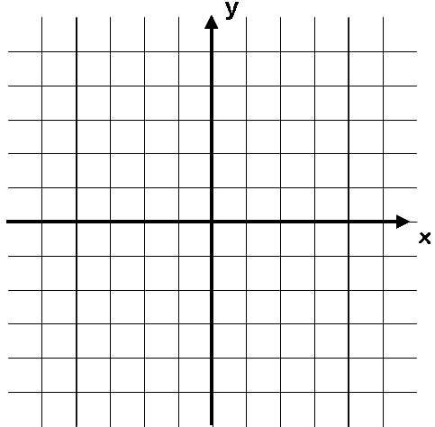
Linear Transformations
You can use matrices to describe linear transformations
Original Vertices
New Vertices
(1,1), (3,1), (3,3) and (1,3)
(1,3), (-1,7), (3,9) and (5,5)
10
10
-10
10
-10
10
-10
-10
7A

Slide 8
Exercise 7A
Pearson Pure Mathematics Year 1/AS
Pages 3-5
Complete before the lesson Q1-3
In Class:
Green Q4-6
Amber Q7-8
Red Q9-10 & challenge

