Slide 1


APPROXIMATING BINOMIAL WITH POISSON
If X ~ B(n, p) and n is large (>50) and p is small (<0.1)
Then you can approximate X using the Poisson distribution where λ = np
$$X \sim B\left(n, p\right) ≈$$
$$Y \sim Po(np)$$

Slide 2





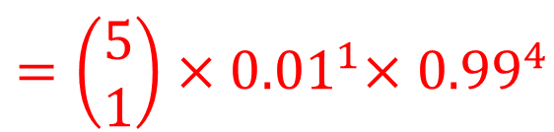






The probability that a component coming off a production line is faulty is 0.01.
If a sample of size 5 is taken, find the probability that one of the components is faulty.
What is the probability that a batch of 250 of these components has more than 3 faulty components in it?
$$(a)$$
$$X \sim B(5, 0.01)$$
$$=\left(\begin{aligned}5 \\ 1\end{aligned}\right){×0.01}^{1}×{0.99}^{4}$$
$$P(X=1)$$
$$=0.0480$$
$$(b)$$
$$X \sim B(250, 0.01)$$
$$Y \sim Po(2.5)$$
$$P(Y>3)$$
$$=1−P(Y ≤3)$$
$$=1−0.7576$$
$$=0.2424$$

Slide 3
Poisson approximation of Binomial
If E(X) Var(X) then B(n,p) can be approximated by Po(np)
This can be used when n is larger than the tables provide
Eg use a Poisson approximation to find P(X≤6) for X ~ B(500,0.02)
When does this give a good approximation?
One of the properties of the Poisson Distribution is that E(X) = Var(X) = λ
You have seen that the Binomial Distribution B(n,p) has:
So E(X) is close to Var(X) when p is very small, so that 1-p is almost 1.
Conversely, if p is close to 1, the approximation is also better.
The approximation is also better when n is large, for reasons beyond the scope of S2
Now try Review Exercise 1, p64-67, Q2, 6, 13

Slide 4
2a)
b)
6)
13a) n large, p small
d)
b)
c)
e)

Slide 5
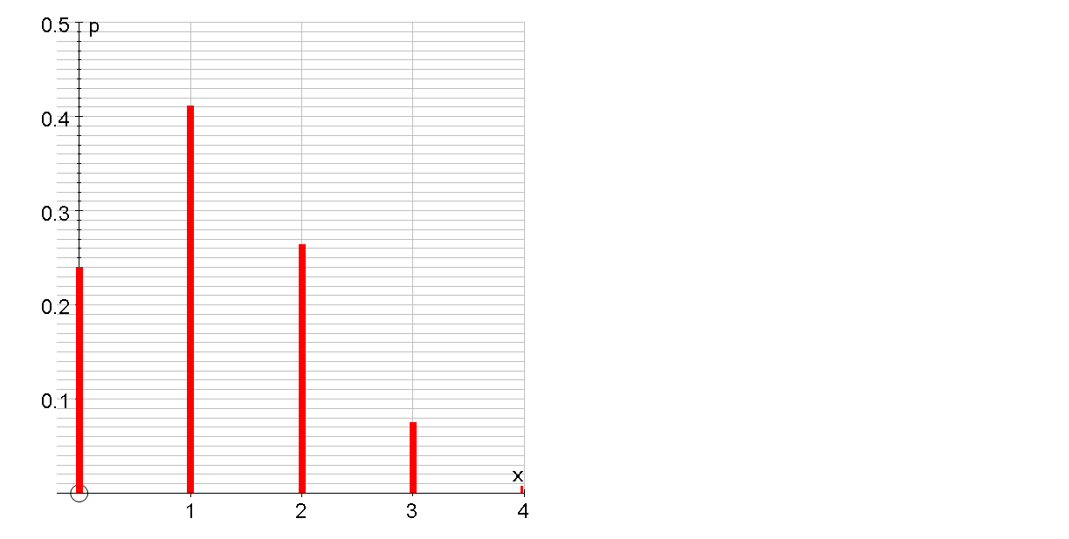
WB1. In a town, 30% of residents listen to the local radio station. Four residents are chosen at random.
(a) State the distribution of the random variable X, the number of these four residents that listen to local radio.
(b) On graph paper, draw the probability distribution of X.
For the Binomial distribution
x | P(X=x)
(c) Write down the most likely number of these four residents that listen to the local radio station.
(d) Find E(X) and Var (X).

Slide 6
WB2(a) State two conditions under which a random variable can be modelled by a binomial distribution.
2 possible outcomes
Probability of success is constant
Fixed number of trials
In the production of a certain electronic component it is found that 10% are defective.
The component is produced in batches of 20.
(b) Write down a suitable model for the distribution of defective components in a batch.
A supplier buys 100 components.
The supplier will receive a refund if there are more than 15 defective components.
(f) Using a suitable approximation, find the probability that the supplier will receive a refund.
Find the probability that a batch contains
(c) no defective components,
(d) more than 6 defective components.
If
(e) Find the mean and the variance of the defective components in a batch.
use the approximation

Slide 7
WB3 Accidents on a particular stretch of motorway occur at an average rate of 1.5 per week (a) Write down a suitable model to represent the number of accidents per week on this stretch of motorway.
Find the probability that
(b) there will be 2 accidents in the same week,
For the Poisson distribution
(c) there is at least one accident per week for 3 consecutive weeks,
(d) there are more than 4 accidents in a 2 week period.
Now try Ex2B
Redefine X = number of accidents in 2 week period

Slide 8
WB4(a) Write down two conditions needed to be able to approximate the binomial distribution by the Poisson distribution.
If
use the approximation
This happens when n is large and p is small
A researcher has suggested that 1 in 150 people is likely to catch a particular virus. Assuming that a person catching the virus is independent of any other person catching it,
(b) find the probability that in a random sample of 12 people, exactly 2 of them catch the virus.
For the Binomial distribution
(c) Estimate the probability that in a random sample of 1200 people fewer than 7 catch the virus.

Slide 9
Do weaker players have a better chance of winning shorter or longer matches?
For example, does a weaker table-tennis player have a better chance of winning over three games or five games?
Suppose the weaker player has the same probability p of winning any one game
Let P(x) = the probability of winning in x games
Best of 3
Best of 5

Slide 10
Exercise 2G
Pearson Further Statistics 1
Pages 36-38
Complete before the lesson Q1-3
In Class:
Green Q4-7
Amber Q8-10
Red Q11-15

