Slide 1
Modelling with
Differential Equations
Twitter: @Owen134866
www.mathsfreeresourcelibrary.com

Slide 2
Teachings for
Exercise 8D

Slide 3


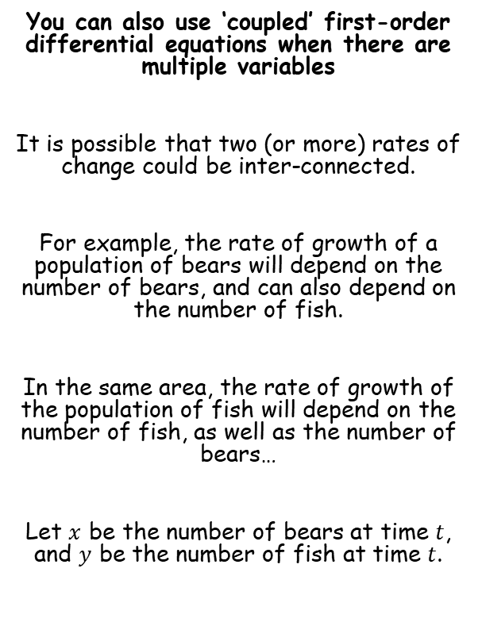



Modelling with Differential Equations
$$Ae^{m_{1}x}+Be^{m_{2}x}$$
$$(A+Bx)e^{mx}$$
$$e^{px}\left(Acosqx+Bsinqx\right)$$
These two rates of change are interlinked!
$$\frac{dx}{dt}=ax+by+f(t)$$
You can also use ‘coupled’ first-order differential equations when there are multiple variables
It is possible that two (or more) rates of change could be inter-connected.
For example, the rate of growth of a population of bears will depend on the number of bears, and can also depend on the number of fish.
In the same area, the rate of growth of the population of fish will depend on the number of fish, as well as the number of bears…
Let $x$ be the number of bears at time $t$, and $y$ be the number of fish at time $t$.
And is also proportional to other factors (eg climate)
The rate of change of the number of bears
Is proportional to the number of bears
Is also proportional to the number of fish
$$\frac{dy}{dt}=cx+dy+g(t)$$
And is also proportional to other factors (eg climate)
The rate of change of the number of fish
Is proportional to the number of bears
Is also proportional to the number of fish
8D

Slide 4



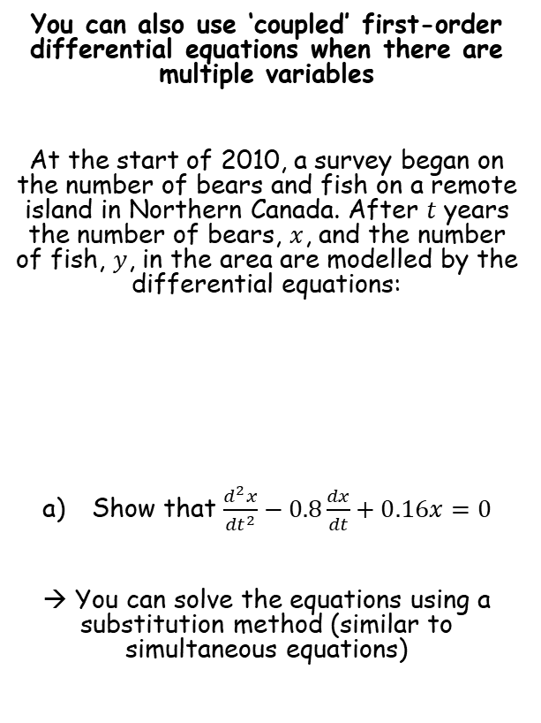



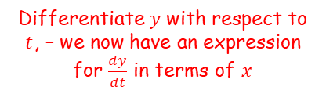


Modelling with Differential Equations
$$Ae^{m_{1}x}+Be^{m_{2}x}$$
$$(A+Bx)e^{mx}$$
$$e^{px}\left(Acosqx+Bsinqx\right)$$
$$\frac{dx}{dt}=0.3x+0.1y$$
You can also use ‘coupled’ first-order differential equations when there are multiple variables
At the start of 2010, a survey began on the number of bears and fish on a remote island in Northern Canada. After $t$ years the number of bears, $x$, and the number of fish, $y$, in the area are modelled by the differential equations:
Show that $\frac{d^{2}x}{{dt}^{2}}−0.8\frac{dx}{dt}+0.16x=0$
→ You can solve the equations using a substitution method (similar to simultaneous equations)
Multiply by 10
$$10\frac{dx}{dt}=3x+y$$
Rearrange – we now have an expression for $y$ in terms of $x$
$$y=10\frac{dx}{dt}−3x$$
Differentiate $y$ with respect to $t$, – we now have an expression for $\frac{dy}{dt}$ in terms of $x$
$$\frac{dy}{dt}=10\frac{d^{2}x}{{dt}^{2}}−3\frac{dx}{dt}$$
$$\frac{dx}{dt}=0.3x+0.1y$$
Now we can replace all the $y$ terms in the second equation with expressions in $x$…
$$\frac{dy}{dt}=−0.1x+0.5y$$
8D

Slide 5

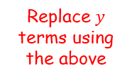





Modelling with Differential Equations
$$Ae^{m_{1}x}+Be^{m_{2}x}$$
$$(A+Bx)e^{mx}$$
$$e^{px}\left(Acosqx+Bsinqx\right)$$
$$y=10\frac{dx}{dt}−3x$$
$$\frac{dy}{dt}=10\frac{d^{2}x}{{dt}^{2}}−3\frac{dx}{dt}$$
You can also use ‘coupled’ first-order differential equations when there are multiple variables
At the start of 2010, a survey began on the number of bears and fish on a remote island in Northern Canada. After $t$ years the number of bears, $x$, and the number of fish, $y$, in the area are modelled by the differential equations:
Show that $\frac{d^{2}x}{{dt}^{2}}−0.8\frac{dx}{dt}+0.16x=0$
→ You can solve the equations using a substitution method (similar to simultaneous equations)
Now we can replace all the $y$ terms in the second equation with expressions in $x$…
$$\frac{dy}{dt}=−0.1x+0.5y$$
Replace $y$ terms using the above
$$10\frac{d^{2}x}{{dt}^{2}}−3\frac{dx}{dt}=−0.1x+0.5\left(10\frac{dx}{dt}−3x\right)$$
Expand the bracket
$$\frac{dx}{dt}=0.3x+0.1y$$
$$10\frac{d^{2}x}{{dt}^{2}}−3\frac{dx}{dt}=−0.1x+5\frac{dx}{dt}−1.5x$$
Rearrange
$$\frac{dy}{dt}=−0.1x+0.5y$$
$$10\frac{d^{2}x}{{dt}^{2}}−8\frac{dx}{dt}+1.6x=0$$
Divide by 10
$$\frac{d^{2}x}{{dt}^{2}}−0.8\frac{dx}{dt}+0.16x=0$$
8D

Slide 6

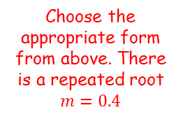
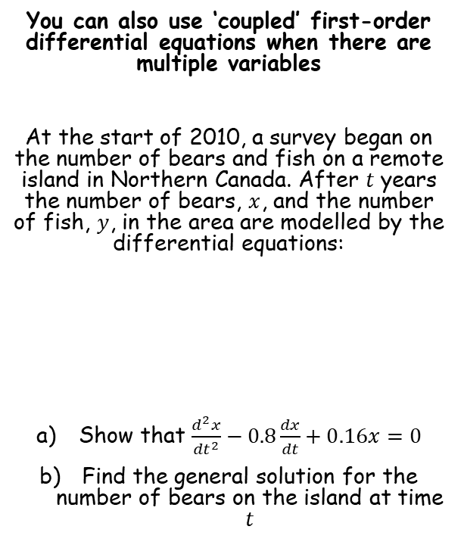




Modelling with Differential Equations
$$Ae^{m_{1}x}+Be^{m_{2}x}$$
$$(A+Bx)e^{mx}$$
$$e^{px}\left(Acosqx+Bsinqx\right)$$
$$x=(A+Bt)e^{0.4t}$$
$$\frac{d^{2}x}{{dt}^{2}}−0.8\frac{dx}{dt}+0.16x=0$$
You can also use ‘coupled’ first-order differential equations when there are multiple variables
At the start of 2010, a survey began on the number of bears and fish on a remote island in Northern Canada. After $t$ years the number of bears, $x$, and the number of fish, $y$, in the area are modelled by the differential equations:
Show that $\frac{d^{2}x}{{dt}^{2}}−0.8\frac{dx}{dt}+0.16x=0$
Find the general solution for the number of bears on the island at time $t$
Write the auxiliary equation
$$m^{2}−0.8m+0.16=0$$
Solve
$$m=0.4$$
Choose the appropriate form from above. There is a repeated root $m=0.4$
$$x=(A+Bt)e^{0.4t}$$
$$\frac{dx}{dt}=0.3x+0.1y$$
$$\frac{dy}{dt}=−0.1x+0.5y$$
8D

Slide 7


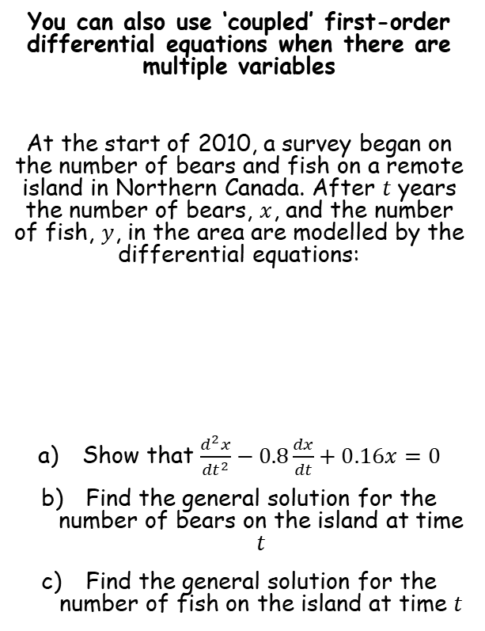



Modelling with Differential Equations
$$Ae^{m_{1}x}+Be^{m_{2}x}$$
$$(A+Bx)e^{mx}$$
$$e^{px}\left(Acosqx+Bsinqx\right)$$
$$x=(A+Bt)e^{0.4t}$$
$$x=(A+Bt)e^{0.4t}$$
Differentiate using the product rule
You can also use ‘coupled’ first-order differential equations when there are multiple variables
At the start of 2010, a survey began on the number of bears and fish on a remote island in Northern Canada. After $t$ years the number of bears, $x$, and the number of fish, $y$, in the area are modelled by the differential equations:
Show that $\frac{d^{2}x}{{dt}^{2}}−0.8\frac{dx}{dt}+0.16x=0$
Find the general solution for the number of bears on the island at time $t$
Find the general solution for the number of fish on the island at time $t$
$$\frac{dx}{dt}=\left(A+Bt\right)\frac{d}{dt}\left(e^{0.4t}\right)+\frac{d}{dt}\left(A+Bt\right)\left(e^{0.4t}\right)$$
Calculate differentials
$$\frac{dx}{dt}=0.4\left(A+Bt\right)e^{0.4t}+B\left(e^{0.4t}\right)$$
Expand
$$\frac{dx}{dt}=0.4Ae^{0.4t}+0.4Bte^{0.4t}+Be^{0.4t}$$
$$\frac{dx}{dt}=0.3x+0.1y$$
Now we can replace all the $x$ terms in the first equation with expressions in $y$…
$$\frac{dy}{dt}=−0.1x+0.5y$$
8D

Slide 8



Modelling with Differential Equations
$$Ae^{m_{1}x}+Be^{m_{2}x}$$
$$(A+Bx)e^{mx}$$
$$e^{px}\left(Acosqx+Bsinqx\right)$$
$$x=(A+Bt)e^{0.4t}$$
$$y=Ae^{0.4t}+Bte^{0.4t}+10Be^{0.4t}$$
$$\frac{dx}{dt}=0.4Ae^{0.4t}+0.4Bte^{0.4t}+Be^{0.4t}$$
$$x=(A+Bt)e^{0.4t}$$
You can also use ‘coupled’ first-order differential equations when there are multiple variables
At the start of 2010, a survey began on the number of bears and fish on a remote island in Northern Canada. After $t$ years the number of bears, $x$, and the number of fish, $y$, in the area are modelled by the differential equations:
Show that $\frac{d^{2}x}{{dt}^{2}}−0.8\frac{dx}{dt}+0.16x=0$
Find the general solution for the number of bears on the island at time $t$
Find the general solution for the number of fish on the island at time $t$
Now we can replace all the $x$ terms in the first equation with expressions in $y$…
$$\frac{dx}{dt}=0.3x+0.1y$$
Replace
$$0.4Ae^{0.4t}+0.4Bte^{0.4t}+Be^{0.4t}=0.3(A+Bt)e^{0.4t}+0.1y$$
Expand
$$\frac{dx}{dt}=0.3x+0.1y$$
$$0.4Ae^{0.4t}+0.4Bte^{0.4t}+Be^{0.4t}=0.3Ae^{0.4t}+0.3Bte^{0.4t}+0.1y$$
Rearrange
$$0.1Ae^{0.4t}+0.1Bte^{0.4t}+Be^{0.4t}=0.1y$$
$$\frac{dy}{dt}=−0.1x+0.5y$$
Multiply by 10
$$Ae^{0.4t}+Bte^{0.4t}+10Be^{0.4t}=y$$
8D

Slide 9




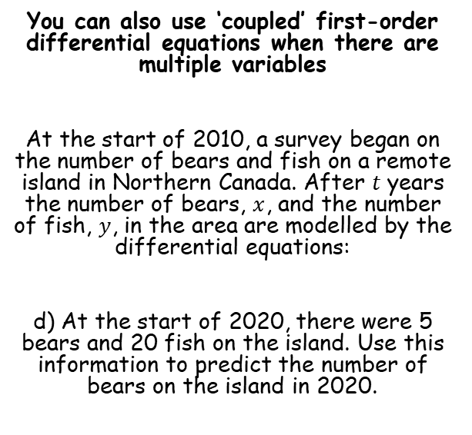







Modelling with Differential Equations
$$Ae^{m_{1}x}+Be^{m_{2}x}$$
$$(A+Bx)e^{mx}$$
$$e^{px}\left(Acosqx+Bsinqx\right)$$
$$x=(A+Bt)e^{0.4t}$$
$$x=(5+1.5t)e^{0.4t}$$
$$y=Ae^{0.4t}+Bte^{0.4t}+10Be^{0.4t}$$
Use the number of bears in one equation
$$y=5e^{0.4t}+1.5te^{0.4t}+15e^{0.4t}$$
You can also use ‘coupled’ first-order differential equations when there are multiple variables
At the start of 2010, a survey began on the number of bears and fish on a remote island in Northern Canada. After $t$ years the number of bears, $x$, and the number of fish, $y$, in the area are modelled by the differential equations:
d) At the start of 2020, there were 5 bears and 20 fish on the island. Use this information to predict the number of bears on the island in 2020.
$$x=(A+Bt)e^{0.4t}$$
When $t=0$, $x=5$
$$5=(A+B(0))e^{0.4(0)}$$
Calculate
$$5=A$$
Now we can use the number of fish with our other equation
$$y=Ae^{0.4t}+Bte^{0.4t}+10Be^{0.4t}$$
When $t=0$, $y=20$
$$20=Ae^{0.4(0)}+B(0)e^{0.4(0)}+10Be^{0.4(0)}$$
Simplify
$$20=A+10B$$
We know $A=5$
$$1.5=B$$
We can update our equations now…
8D

Slide 10



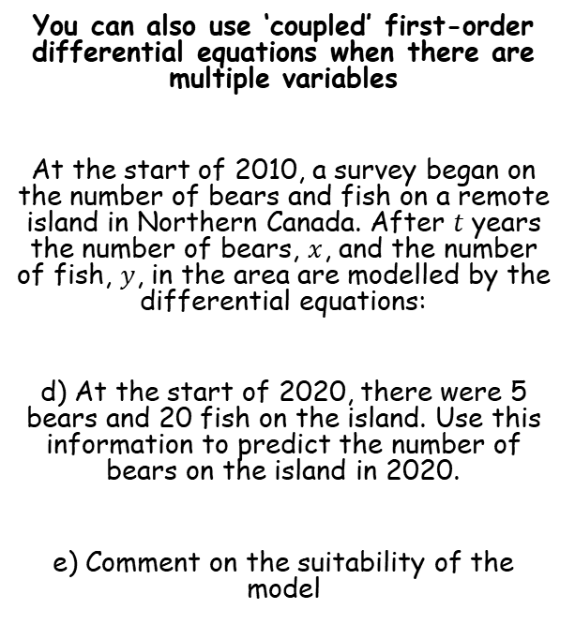

Modelling with Differential Equations
$$Ae^{m_{1}x}+Be^{m_{2}x}$$
$$(A+Bx)e^{mx}$$
$$e^{px}\left(Acosqx+Bsinqx\right)$$
$$x=(5+1.5t)e^{0.4t}$$
$$y=5e^{0.4t}+1.5te^{0.4t}+15e^{0.4t}$$
$$x=(5+1.5t)e^{0.4t}$$
You can also use ‘coupled’ first-order differential equations when there are multiple variables
At the start of 2010, a survey began on the number of bears and fish on a remote island in Northern Canada. After $t$ years the number of bears, $x$, and the number of fish, $y$, in the area are modelled by the differential equations:
d) At the start of 2020, there were 5 bears and 20 fish on the island. Use this information to predict the number of bears on the island in 2020.
e) Comment on the suitability of the model
In 2020, $t=10$
$$x=(5+1.5(10))e^{0.4(10)}$$
Calculate
$$x=1092$$
→ The model predicts that the number of bears (and fish) will grow without limit, which is unrealistic
8D

Slide 11



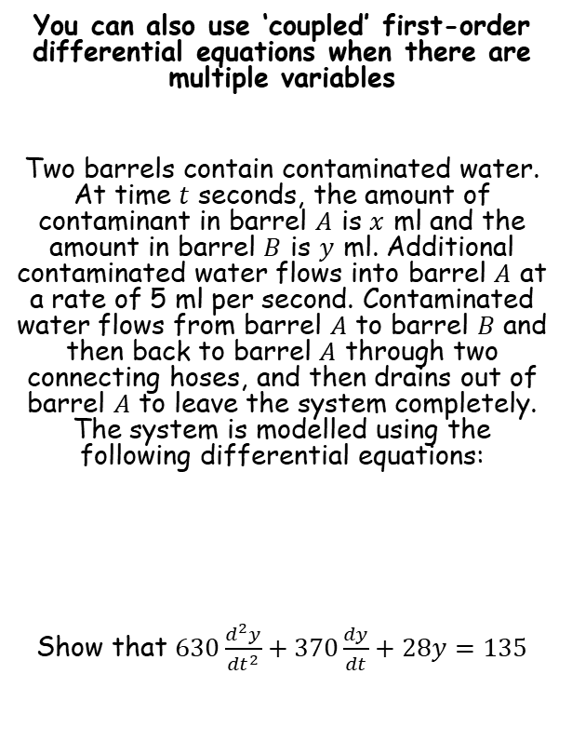






Modelling with Differential Equations
$$\frac{dy}{dt}=\frac{3}{70}x−\frac{4}{9}y$$
You can also use ‘coupled’ first-order differential equations when there are multiple variables
Two barrels contain contaminated water. At time $t$ seconds, the amount of contaminant in barrel $A$ is $x$ ml and the amount in barrel $B$ is $y$ ml. Additional contaminated water flows into barrel $A$ at a rate of 5 ml per second. Contaminated water flows from barrel $A$ to barrel $B$ and then back to barrel $A$ through two connecting hoses, and then drains out of barrel $A$ to leave the system completely. The system is modelled using the following differential equations:
Show that $630\frac{d^{2}y}{{dt}^{2}}+370\frac{dy}{dt}+28y=135$
Rearrange
$$\frac{dy}{dt}+\frac{4}{9}y=\frac{3}{70}x$$
Multiply by 70
$$70\frac{dy}{dt}+\frac{280}{9}y=3x$$
Divide by 3
$$\frac{70}{3}\frac{dy}{dt}+\frac{280}{27}y=x$$
Differentiate $x$ with respect to $t$
$$\frac{70}{3}\frac{d^{2}y}{dt^{2}}+\frac{280}{27}\frac{dy}{dt}=\frac{dx}{dt}$$
→ We can now replace these in the first equation
$$\frac{dx}{dt}=5+\frac{4}{9}y−\frac{1}{7}x$$
$$\frac{dy}{dt}=\frac{3}{70}x−\frac{4}{9}y$$
We need to replace $x$ terms with $y$ terms…
8D

Slide 12










Modelling with Differential Equations
$$x=\frac{70}{3}\frac{dy}{dt}+\frac{280}{27}y$$
$$\frac{dx}{dt}=\frac{70}{3}\frac{d^{2}y}{dt^{2}}+\frac{280}{27}\frac{dy}{dt}$$
You can also use ‘coupled’ first-order differential equations when there are multiple variables
Two barrels contain contaminated water. At time $t$ seconds, the amount of contaminant in barrel $A$ is $x$ ml and the amount in barrel $B$ is $y$ ml. Additional contaminated water flows into barrel $A$ at a rate of 5 ml per second. Contaminated water flows from barrel $A$ to barrel $B$ and then back to barrel $A$ through two connecting hoses, and then drains out of barrel $A$ to leave the system completely. The system is modelled using the following differential equations:
Show that $630\frac{d^{2}y}{{dt}^{2}}+370\frac{dy}{dt}+28y=135$
→ We can now replace these in the first equation
$$\frac{dx}{dt}=5+\frac{4}{9}y−\frac{1}{7}x$$
Replace
$$\frac{70}{3}\frac{d^{2}y}{dt^{2}}+\frac{280}{27}\frac{dy}{dt}=5+\frac{4}{9}y−\frac{1}{7}\left(\frac{70}{3}\frac{dy}{dt}+\frac{280}{27}y\right)$$
Expand bracket
$$\frac{70}{3}\frac{d^{2}y}{dt^{2}}+\frac{280}{27}\frac{dy}{dt}=5+\frac{4}{9}y−\frac{10}{3}\frac{dy}{dt}−\frac{40}{27}y$$
Add $\frac{10}{3}\frac{dy}{dt}$, group $y$ terms on right
$$\frac{70}{3}\frac{d^{2}y}{dt^{2}}+\frac{370}{27}\frac{dy}{dt}=5−\frac{28}{27}y$$
Add $\frac{28}{27}y$
$$\frac{70}{3}\frac{d^{2}y}{dt^{2}}+\frac{370}{27}\frac{dy}{dt}+\frac{28}{27}y=5$$
$$\frac{dx}{dt}=5+\frac{4}{9}y−\frac{1}{7}x$$
$$\frac{dy}{dt}=\frac{3}{70}x−\frac{4}{9}y$$
Multiply by 27
$$630\frac{d^{2}y}{dt^{2}}+370\frac{dy}{dt}+28y=135$$
8D

Slide 13
Exercise 8D
Pearson Core Pure Year 2
Pages 188-190
Complete before the lesson Q1
In Class:
Green Q2-3
Amber Q4-6
Red Q7-8 & Challenge

