Slide 1

P1 Chapter 3 :: Equations and Inequalities
jfrost@tiffin.kingston.sch.uk
www.drfrostmaths.com
@DrFrostMaths
Last modified: 23rd July 2018

Slide 2








www.drfrostmaths.com
Everything is completely free.
Why not register?
Register now to interactively practise questions on this topic, including past paper questions and extension questions (including MAT + UKMT).
Teachers: you can create student accounts (or students can register themselves), to set work, monitor progress and even create worksheets.
With questions by:
Dashboard with points, trophies, notifications and student progress.
Questions organised by topic, difficulty and past paper.
Teaching videos with topic tests to check understanding.

Slide 3
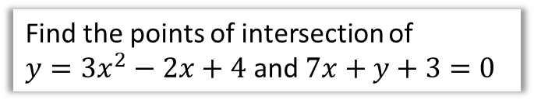
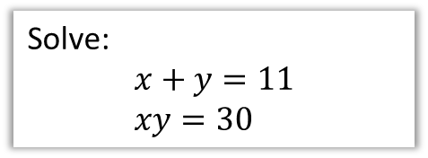
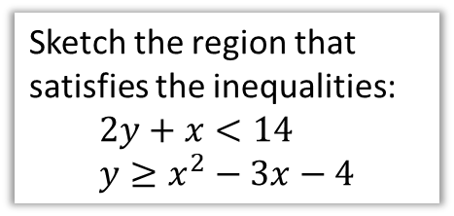
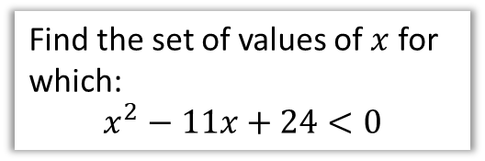
Chapter Overview
There is little new content in this chapter since GCSE.
1:: Simultaneous Equations
2:: Simultaneous Equations using Graphs
Solve:
$$x+y=11 \\ xy=30$$
Find the points of intersection of
$y=3x^{2}−2x+4$ and $7x+y+3=0$
NEW! (since GCSE)
You may have to use the discriminant to show that the two graphs have no points of intersection.
3:: Solving Inequalities
4:: Sketching Inequalities
Find the set of values of $x$ for which:
$$x^{2}−11x+24<0$$
Sketch the region that satisfies the inequalities:
$$2y+x<14 \\ y≥x^{2}−3x−4$$
NEW! (since GCSE, and new to A Level 2017+)
Use set notation to represent solutions to inequalities.

Slide 4




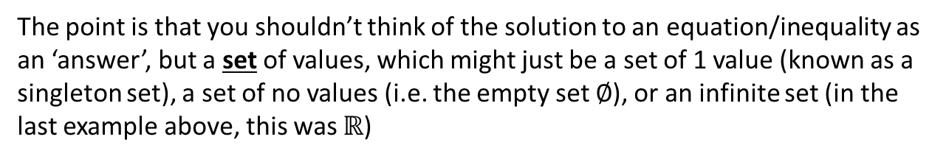

Solutions sets
The solution(s) to an equation may be:
A single value:
$$2x+1=5$$
Multiple values:
$$x^{2}+3x+2=0$$
An infinitely large set of values:
$$x>3$$
No (real) values!
$$x^{2}=−1$$
Every value!
$$x^{2}+x=x\left(x+1\right)$$
The point is that you shouldn’t think of the solution to an equation/inequality as an ‘answer’, but a set of values, which might just be a set of 1 value (known as a singleton set), a set of no values (i.e. the empty set $∅$), or an infinite set (in the last example above, this was $ℝ$)
! The solutions to an equation are known as the solution set.

Slide 5

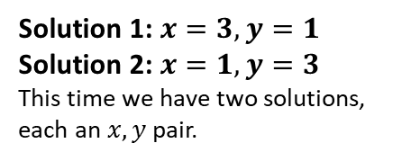


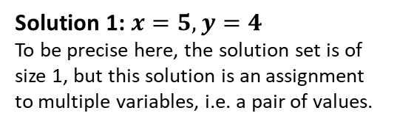
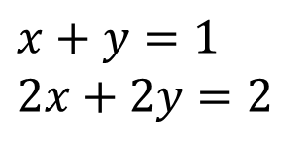
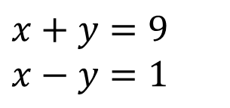
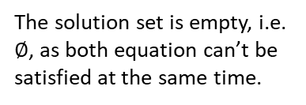
Solutions sets
For simultaneous equations, the same is true, except each ‘solution’ in the solution set is an assignment to multiple variables.
All equations have to be satisfied at the same time, i.e. ‘simultaneously’.
Scenario
Example
Solution Set
?
?
A single solution:
$$x+y=9 \\ x−y=1$$
Solution 1: $x=5, y=4$
To be precise here, the solution set is of size 1, but this solution is an assignment to multiple variables, i.e. a pair of values.
?
?
$$x^{2}+y^{2}=10 \\ x+y=4$$
Solution 1: $x=3, y=1$
Solution 2: $x=1, y=3$
This time we have two solutions, each an $x,y$ pair.
Two solutions:
?
?
$$x+y=1 \\ x+y=3$$
The solution set is empty, i.e. $∅$, as both equation can’t be satisfied at the same time.
Textbook Error Pg39: “Linear simultaneous equations in two unknowns have one set of values that will make a pair of equations true at the same time.”
There are two separate errors in this statement – I’ll let you work out what! (Hint: underlined)
No solutions:
?
?
Infinitely large set of solutions:
$$x+y=1 \\ 2x+2y=2$$
Solution 1: $x=0, y=1$
Solution 2: $x=1, y=0$
Solution 3: $x=2, y=−1$
Solution 4: $x=0.5, y=0.5$
… Infinite possibilities!

Slide 6
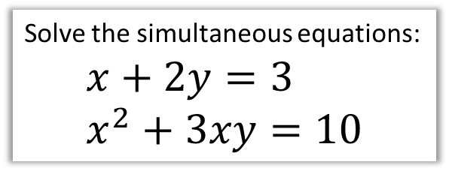

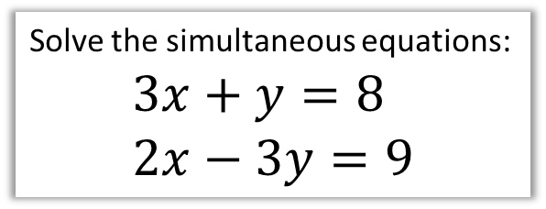

1 :: Simultaneous Equations
Recap!
Solve the simultaneous equations:
$$3x+y=8 \\ 2x−3y=9$$
Solve the simultaneous equations:
$$x+2y=3 \\ x^{2}+3xy=10$$
We can’t use elimination this time as nothing would cancel.
We instead:
Rearrange linear equation to make $x$ or $y$ the subject.
Substitute into quadratic equation and solve.
$$x=3−2y$$
Substitute into other equation:
$${\left(3−2y\right)}^{2}+3y\left(3−2y\right)=10 \\ …2y^{2}+3y+1=0 \\ \left(2y+1\right)\left(y+1\right)=0 \\ y=−\frac{1}{2} → x=4 \\ y=−1 → x=5$$
We can either use substitution (i.e. making $x$ or $y$ the subject of one equation, and substituting it into the other) or elimination, but the latter is easier for linear equations.
$$9x+3y=24 \\ 2x−3y=9$$
Adding the two equations to ‘eliminate’ $y$:
$$11x=33 → x=3$$
Substituting into first equation:
$$27+3y=24 → y=−1$$
?
?

Slide 7

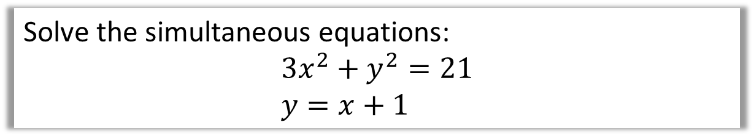
Test Your Understanding
Solve the simultaneous equations:
$$3x^{2}+y^{2}=21 \\ y=x+1$$
?
$$3x^{2}+{\left(x+1\right)}^{2}=21 \\ 3x^{2}+x^{2}+2x+1=21 \\ 4x^{2}+2x−20=0 \\ 2x^{2}+x−10=0 \\ \left(2x+5\right)\left(x−2\right)=0 \\ x=−\frac{5}{2} or x=2 \\ y=−\frac{3}{2} or y=3$$

Slide 8
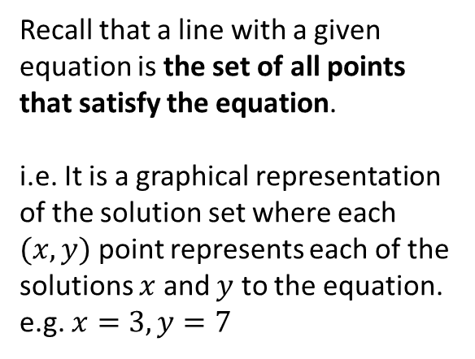
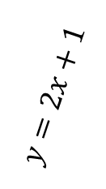
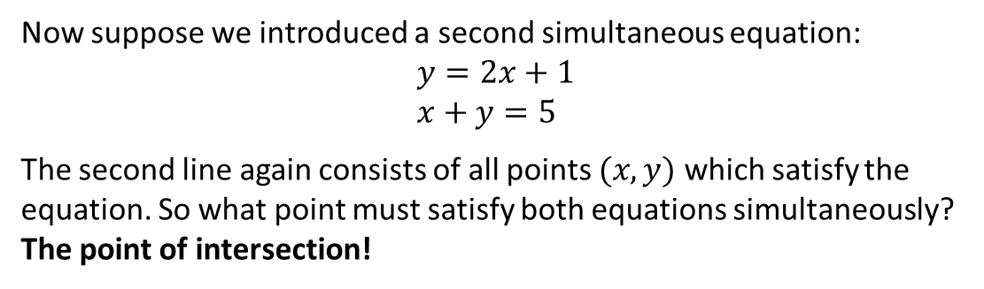
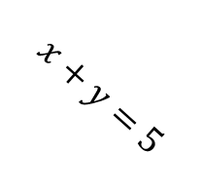
Simultaneous Equations and Graphs
Recall that a line with a given equation is the set of all points that satisfy the equation.
i.e. It is a graphical representation of the solution set where each $(x,y)$ point represents each of the solutions $x$ and $y$ to the equation. e.g. $x=3, y=7$
$$x+y=5$$
$$y=2x+1$$
Now suppose we introduced a second simultaneous equation:
$$y=2x+1 \\ x+y=5$$
The second line again consists of all points $(x,y)$ which satisfy the equation. So what point must satisfy both equations simultaneously?
The point of intersection!
?

Slide 9
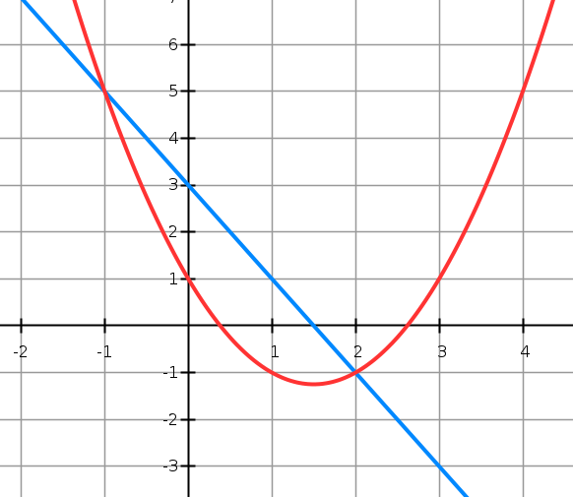
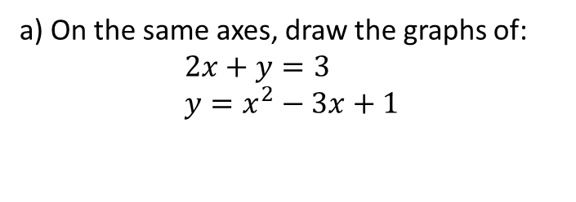

Example
a) On the same axes, draw the graphs of:
$$2x+y=3 \\ y=x^{2}−3x+1$$
b) Use your graph to write down the solutions to the simultaneous equations.
$$x=−1, y=5 or \\ x=2, y=−1$$
(We could always substitute into the original equations to check they work)
c) What algebraic method (perhaps thinking about the previous chapter), could we have used to show the graphs would have intersected twice?
Substituting linear equation into quadratic:
$$y=3−2x \\ ∴3−2x=x^{2}−3x+1 \\ x^{2}−x−2=0$$
Since there were two points of intersection, the equation must have two distinct solutions. Thus $b^{2}−4ac>0$
$$a=1, b=−1, c=−2 \\ 1+8=9>0$$
Thus the quadratic has two distinct solutions, i.e. we have two points of intersection.
? b
? a
? c

Slide 10
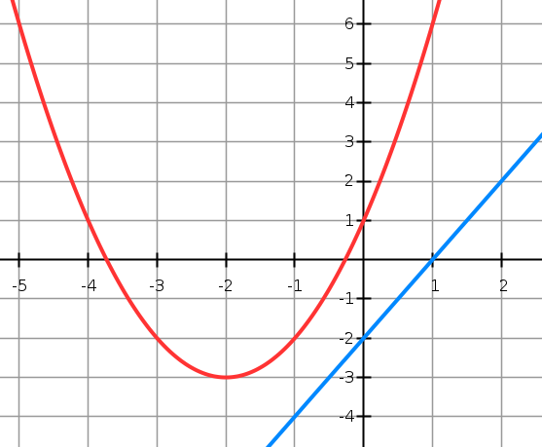
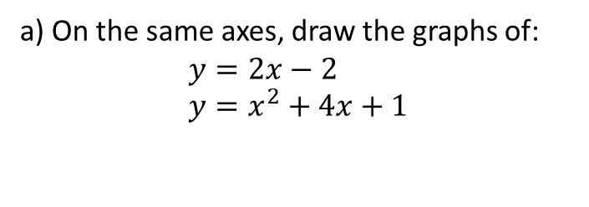

Another Example
a) On the same axes, draw the graphs of:
$$y=2x−2 \\ y=x^{2}+4x+1$$
b) Prove algebraically that the lines never meet.
When we try to solve simultaneously by substitution, the equation must have no solutions.
$$x^{2}+4x+1=2x−2 \\ x^{2}+2x+3=0$$
$$a=1, b=2, c=3 \\ b^{2}−4ac=4−12=−8$$
$−8<0$ therefore no solutions, and therefore no points of intersection.
? b
? a

Slide 11

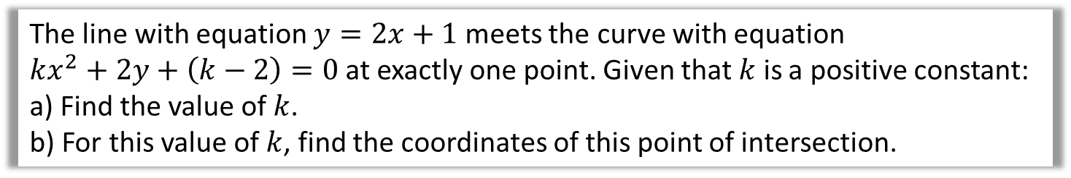
Final Example
The line with equation $y=2x+1$ meets the curve with equation
$kx^{2}+2y+\left(k−2\right)=0$ at exactly one point. Given that $k$ is a positive constant:
a) Find the value of $k$.
b) For this value of $k$, find the coordinates of this point of intersection.
Substituting:
$$kx^{2}+2\left(2x+1\right)+k−2=0 \\ kx^{2}+4x+2+k−2=0 \\ kx^{2}+4x+k=0$$
Since one point of intersection, equation has one solution, so $b^{2}−4ac=0$.
$$a=k, b=4, c=k \\ 16−4k^{2}=0 \\ k=±2$$
But $k$ is positive so $k=2$.
When $k=2$, $2x^{2}+4x+2=0$
$$x^{2}+2x+1=0 \\ {\left(x+1\right)}^{2}=0 → x=−1 \\ y=2\left(−1\right)+1=−1 → (−1,−1)$$
a
? a
We can breathe a sigh of relief as we were expecting one solution only.
? a
b

Slide 12
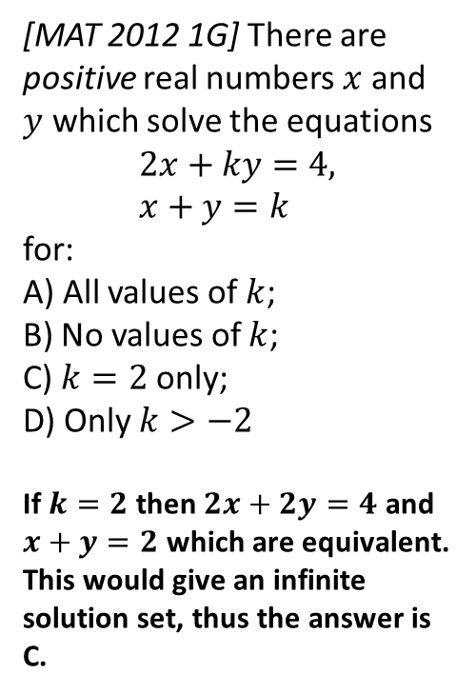
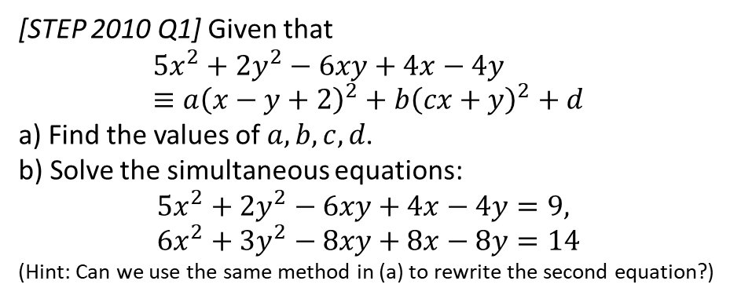

Exercise 3B/ C (Assume Ex3A is prior knowledge)
Pearson Pure Mathematics Year 1/AS Pages 40, 41
Complete before the lesson Ex3B Q2-4
Green Complete Ex3B
Amber Ex3C Q1-6
Red Ex3C Q7-9
Extension
2
[STEP 2010 Q1] Given that
$$5x^{2}+2y^{2}−6xy+4x−4y≡a{\left(x−y+2\right)}^{2}+b{\left(cx+y\right)}^{2}+d$$
a) Find the values of $a,b,c,d$.
b) Solve the simultaneous equations:
$$5x^{2}+2y^{2}−6xy+4x−4y=9, \\ 6x^{2}+3y^{2}−8xy+8x−8y=14$$
(Hint: Can we use the same method in (a) to rewrite the second equation?)
1
[MAT 2012 1G] There are positive real numbers $x$ and $y$ which solve the equations
$$2x+ky=4, \\ x+y=k$$
for:
A) All values of $k$;
B) No values of $k$;
C) $k=2$ only;
D) Only $k>−2$
If $k=2$ then $2x+2y=4$ and $x+y=2$ which are equivalent. This would give an infinite solution set, thus the answer is C.
a) Expanding RHS:
$$\left(a+bc^{2}\right)x^{2}+\left(a+b\right)y^{2}+\left(−2a+2bc\right)xy+4ax−4ay+(4a+d)$$
Comparing coefficients: $a=1, b=1, c=−2, d=−4$
b) ${\left(x−y+2\right)}^{2}+{\left(−2x+y\right)}^{2}−4=9$
Using method in (a): $2{\left(x−y+2\right)}^{2}+{\left(−2x+y\right)}^{2}−8=14$
Subtracting yields $y−2x=±2$ and $x−y+2=±3$
We have to consider each of 4 possibilities.
Final solution set: $x=−3, y=−4 or x=1, y=0$
or $x=3, y=8 or x=7,y=12$
? a
?
? b

Slide 13
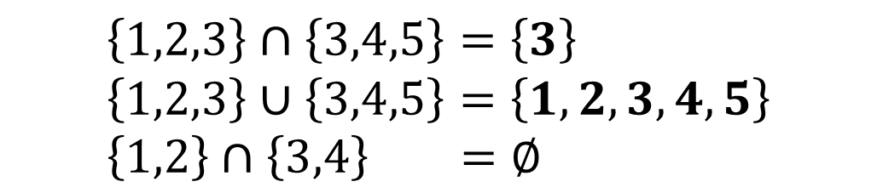
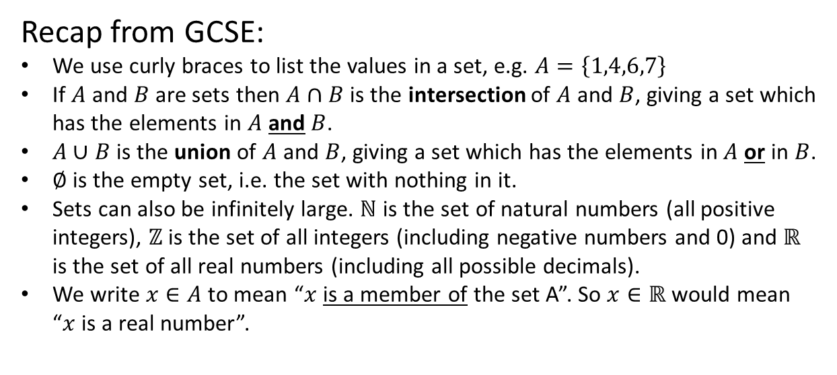
Set Builder Notation
Recall that a set is a collection of values such that:
The order of values does not matter.
There are no duplicates.
Froflection: Sets seem sensible for listing solutions to an equation, as the order doesn’t matter.
Recap from GCSE:
We use curly braces to list the values in a set, e.g. $A=\left\{1,4,6,7\right\}$
If $A$ and $B$ are sets then $A∩B$ is the intersection of $A$ and $B$, giving a set which has the elements in $A$ and $B$.
$A∪B$ is the union of $A$ and $B$, giving a set which has the elements in $A$ or in $B$.
$∅$ is the empty set, i.e. the set with nothing in it.
Sets can also be infinitely large. $ℕ$ is the set of natural numbers (all positive integers), $ℤ$ is the set of all integers (including negative numbers and 0) and $ℝ$ is the set of all real numbers (including all possible decimals).
We write $x∈A$ to mean “$x$ is a member of the set A”. So $x∈ℝ$ would mean “$x$ is a real number”.
?
$$\left\{1,2,3\right\}∩\left\{3,4,5\right\}=\left\{3\right\} \\ \left\{1,2,3\right\}∪\left\{3,4,5\right\}=\left\{1,2,3,4,5\right\} \\ \left\{1,2\right\}∩\left\{3,4\right\} =∅$$
?
?

Slide 14

Set Builder Notation
It is possible to construct sets without having to explicitly list its values. We use:
The | or : means “such that”.
$$\left\{expr \right| condition \}$$
or $\{expr : condition \}$
Can you guess what sets the following give?
(In words “All numbers $2x$ such that $x$ is an integer)
?
$$\left\{2x :x∈ℤ\right\}=\{0,2,−2,4,−4,6,−6,…\}$$
i.e. The set of all even numbers!
?
$$\left\{2^{x} :x∈ℕ\right\}=\{2,4,8,16,32,…\}$$
?
$$\left\{xy: x,y are prime\right\}=\{4,6,10,14,15,…\}$$
i.e. All possible products of two primes.
We previously talked about ‘solutions sets’, so set builder notation is very useful for specifying the set of solutions!

Slide 15

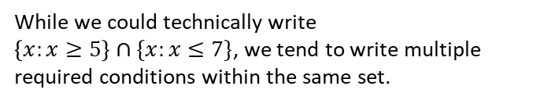



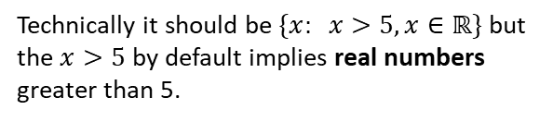
Set Builder Notation
Can you use set builder notation to specify the following sets?
?
All odd numbers.
$$\{2x+1 : x∈ℤ\}$$
All (real) numbers greater than 5.
$$\{x: x>5\}$$
?
Technically it should be $\{x: x>5,x∈ℝ\}$ but the $x>5$ by default implies real numbers greater than 5.
All (real) numbers less than 5 or greater than 7.
$$\left\{x: x<5\right\}∪\{x:x>7\}$$
?
We combine the two sets together.
All (real) numbers between 5 and 7 inclusive.
$$\left\{x: 5≤x≤7\right\}$$
?
While we could technically write
$\left\{x:x≥5\right\}∩\{x:x≤7\}$, we tend to write multiple required conditions within the same set.

Slide 16







Recap of linear inequalities
Inequality
Solution Set
?
$$2x+1>5$$
$$\{x :x>2\}$$
?
$$3\left(x−5\right)≥5−2(x−8)$$
$$\{x :x≥7.2\}$$
?
Fro Note: Multiplying or both sides of an inequality by a negative number reverses the direction.
$$−x≥2$$
$$\{x :x≤−2\}$$
Combining Inequalities:
If $x<3$ and $2≤x<4$, what is the combined solution set?
? Fro Hint
? Solution
2
3
4
$$2≤x<3$$
If both inequalities have to be satisfied, we have to be on both lines. Place your finger vertically and scan across.

Slide 17

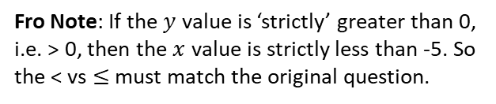



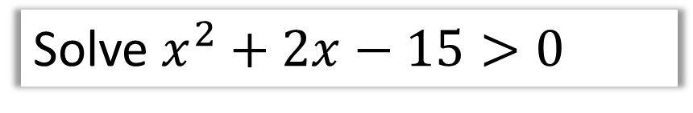

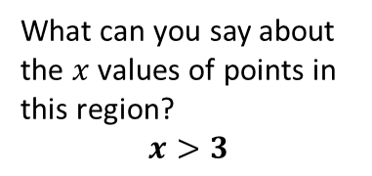

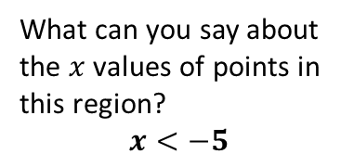

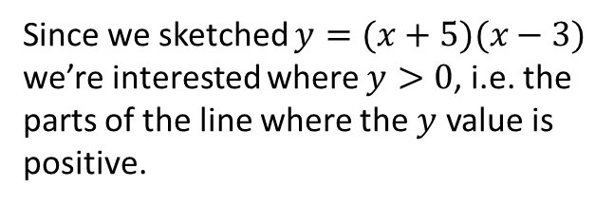
RECAP :: Solving Quadratic Inequalities
Solve $x^{2}+2x−15>0$
Step 1: Get 0 on one side
(already done!)
?
$$\left(x+5\right)\left(x−3\right)>0$$
Step 2: Factorise
Step 3: Sketch and reason
$$y$$
$$y=(x+5)(x−3)$$
Since we sketched $y=(x+5)(x−3)$
we’re interested where $y>0$, i.e. the parts of the line where the $y$ value is positive.
$$x$$
$$−5$$
$$3$$
Click to Fro-Bolden >
What can you say about the $x$ values of points in this region?
$$x<−5$$
What can you say about the $x$ values of points in this region?
$$x>3$$
?
$$\left\{x:x<−5\right\}∪\{x:x>3\}$$
Fro Note: If the $y$ value is ‘strictly’ greater than 0, i.e. > 0, then the $x$ value is strictly less than -5. So the < vs $≤$ must match the original question.
?
?

Slide 18


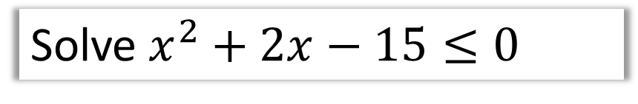
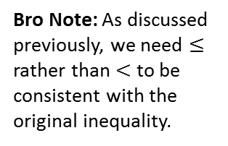

Solving Quadratic Inequalities
Solve $x^{2}+2x−15≤0$
Step 1: Get 0 on one side
(already done!)
$$\left(x+5\right)\left(x−3\right)≤0$$
Step 2: Factorise
Step 3: Sketch and reason
$$y$$
? Sketch with
highlighted region
$$y=(x+5)(x−3)$$
? Final solution
$$x$$
$$\{x : −5≤x≤3\}$$
$$−5$$
$$3$$
Again, what can we say about the $x$ value of any point in this region?
Bro Note: As discussed previously, we need $≤$ rather than $<$ to be consistent with the original inequality.

Slide 19
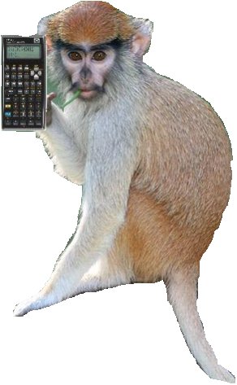
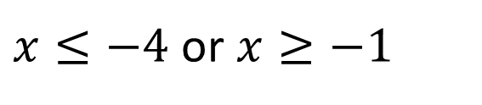




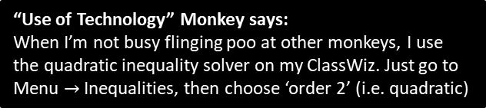









Further Examples
Solve $x^{2}+5x≥−4$
$$x^{2}+5x+4≥0 \\ \left(x+4\right)\left(x+1\right)≥0$$
Solve $x^{2}<9$
$$x^{2}−9<0 \\ \left(x+3\right)\left(x−3\right)<0$$
?
?
$$y$$
$$y$$
$$y=(x+4)(x+1)$$
$$y=(x+3)(x−3)$$
$$x$$
$$3$$
$$x$$
$$−4$$
$$−1$$
$$−3$$
$x≤−4$ or $x≥−1$
$$−3<x<3$$
Fro Note: The most common error I’ve seen students make with quadratic inequalities is to skip the ‘sketch step’. Sod’s Law states that even though you have a 50% chance of getting it right without a sketch (presuming you’ve factorised correctly), you will get it wrong.
“Use of Technology” Monkey says:
When I’m not busy flinging poo at other monkeys, I use the quadratic inequality solver on my ClassWiz. Just go to Menu $→$ Inequalities, then choose ‘order 2’ (i.e. quadratic)

Slide 20





Test Your Understanding
Edexcel C1 May 2010 Q3
?
?
?
Edexcel C1 June 2008 Q8
Fro Note: What often confuses students is that the original equation has no solutions, but the inequality $q^{2}+8q<0$ did have solutions. But think carefully what we’ve done: We’ve found the solutions for $q$ that result in the original equation not having any solutions for $x$. These are different variables, so have different solutions sets, even if the solution set of $q$ influences the solution set of $x$.
?
?

Slide 21







Deal with inequalities with a division by $x$
Find the set of values for which $\frac{6}{x}>2, x≠0$
Spec Note: This is an example in the textbook, although it is ambiguous whether this type of question is in the new specification. Dealing with an $x$ in the denominator within an inequality is a skill previously in the old Further Pure 2 module.
But you never really know!
Why can’t we just multiply both sides by $x$?
We earlier saw that multiplying by a negative number would flip the inequality, but multiplying by a positive number would not. Since we don’t know $x$, we don’t know whether the inequality would flip or not!
Once solution is to sketch $y=\frac{6}{x}$ and $y=2$, find the points of intersection and reason about the graph (see next section, “Inequalities on Graphs”), but an easier way is to multiply both sides by $x^{2}$, because it is guaranteed to be positive:
?
$$y$$
? Solution
$$6x>2x^{2} \\ 2x^{2}−6x<0 \\ x^{2}−3x<0 \\ x\left(x−3\right)<0 \\ 0<x<3$$
$$y=x(x−3)$$
$$3$$
$$x$$
$$0$$

Slide 22
Exercise 3D/3E
Pearson Pure Mathematics Year 1/AS
Page 47-48, 50-51
Complete before the lesson Ex3D Q1-2 & Ex3E Q1-3 a-d only
Green Ex3D Q3 & Challenge
Amber Ex3E Q4-6
Red Ex3E Q7-9

Slide 23










Inequalities on Graphs
(New to the 2017 spec)
$$y$$
When we solved quadratic inequalities, e.g. $\left(x+5\right)\left(x−3\right)>0$
We plotted $y=(x+5)(x−3)$ and observed the values of $x$ for which $y>0$.
Can we use a similar method when we don’t have 0 on one side?
$$y=(x+5)(x−3)$$
$$x$$
$$−5$$
$$3$$
Example: $L_{1}$ has equation $y=12+4x$. $L_{2}$ has equation $y=x^{2}$.
The diagram shows a sketch of $L_{1}$ and $L_{2}$ on the same axes.
Find the coordinates of $P_{1}$ and $P_{2}$, the points of intersection.
Hence write down the solution to the inequality $12+4x>x^{2}$.
$$y$$
a
Solve simultaneously to find points of intersection:
$$x^{2}=12+4x \\ x^{2}−4x−12=0 \\ x=6, x=−2 → y=36, y=4 \\ P_{1}\left(−2,4\right), P_{2}\left(6,36\right)$$
?
$$P_{2}$$
$$y=12+4x$$
$$y=x^{2}$$
$$P_{1}$$
When $12+4x>x^{2}$ the $L_{1}$ graph is above the $L_{2}$ graph. This happens when $−2<x<6$.
$$x$$
b
?
$$−2$$
$$6$$

Slide 24









Inequality Regions
On graph paper, shade the region that satisfies the inequalities:
$$2y+x<14 \\ y≥x^{2}−3x−4$$
You did this at GCSE, the only difference here being that the graphs involved might not be straight lines.
?
Step 1: Imagine inequalities as equations and sketch.
Step 2:
An inequality involving $x$ and $y$ represents a 2D region in space.
Identify the correct side of each line each inequality represents.
$$y$$
$$y=x^{2}−3x−4$$
$$2y+x=14$$
Click to Frosketch >
$$x$$
$$−1$$
$$4$$
Fro Tip: To quickly sketch $2y+x=14$, consider what happens when $x$ is $0$ and when $y$ is 0.
Fro Tip: Make sure $y$ is on the side where it is positive.
If $y$ is on the smaller side, you’re below the line.
If $y$ is on the greater side, you’re above the line.

Slide 25
Exercise 3F/3G
Pearson Pure Mathematics Year 1/AS
Page 53, 55
Complete before the lesson Ex3F Q1 & Ex3G Q1-4
Green Ex3F Q2-3 & Challenge
Amber Ex3G Q5-6
Red Ex3G Q7-8

