Slide 1
Year 1 Pure Mathematics
Exponentials and Logs
- Laws and Equations
Chapter 14
(Part 4 of 7)

Slide 2
Logarithms - Laws of Logs
There are three laws of logs you need to know.
You use these laws to so you can
write multiple logs as a single log.
1) Multiplication Law
2) Division Law
3) Power Law

Slide 3
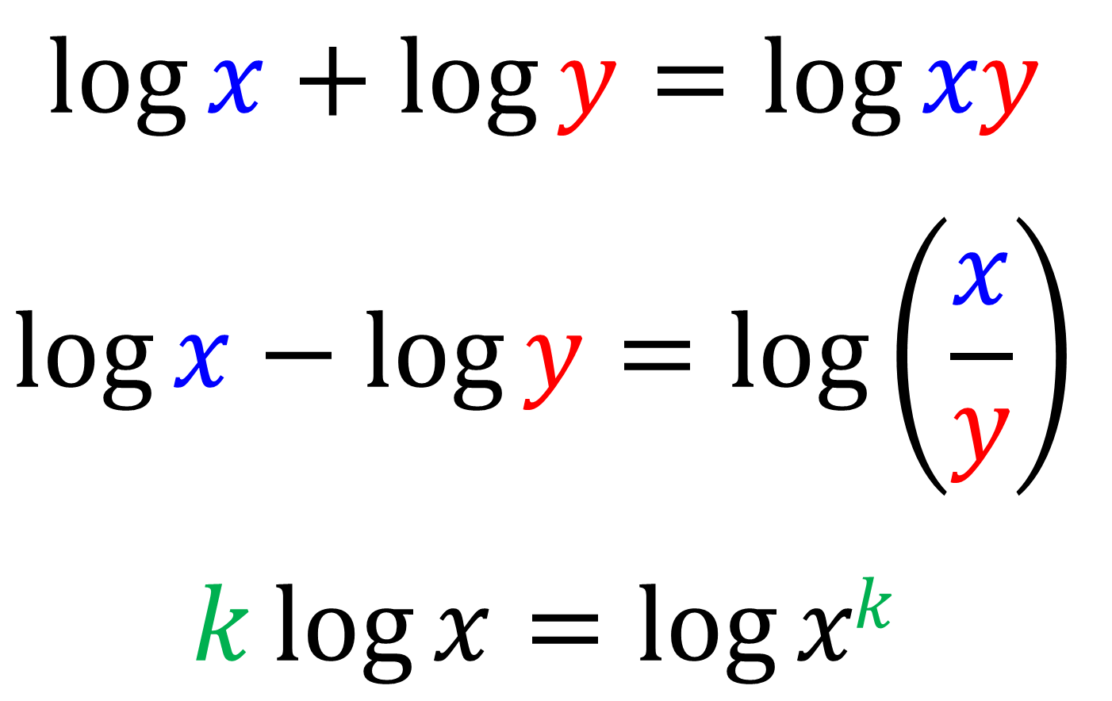
Logarithms - Laws of Logs
$$\log{x}+\log{y}=\log{xy}$$
$$\log{x}−\log{y}=\log\left(\frac{x}{y}\right)$$
$$k\log{x}=\log{xk}$$

Slide 4
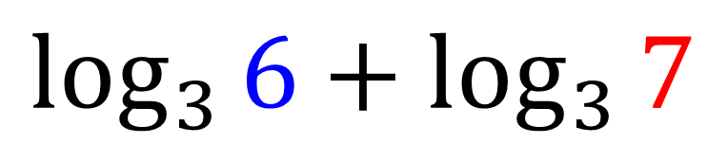

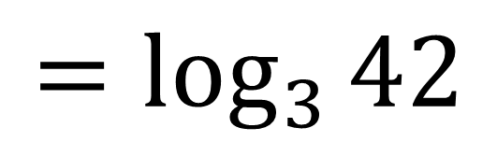
Logarithms - Laws of Logs
Multiplication Law
$$\log{x}+\log{y}=\log{xy}$$
$$\log_{3}{6}+\log_{3}{7}$$
$$=\log_{3}{42}$$

Slide 5
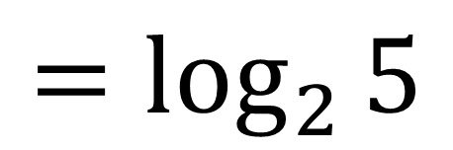
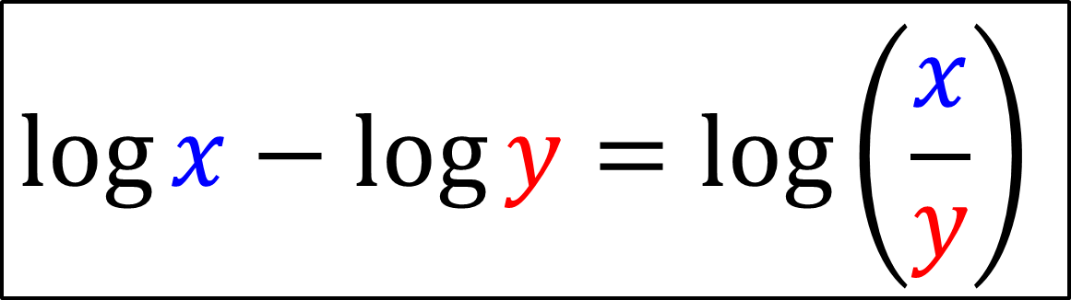
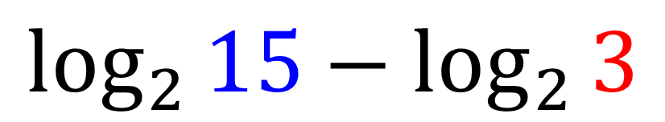
Logarithms - Laws of Logs
Division Law
$$\log{x}−\log{y}=\log\left(\frac{x}{y}\right)$$
$$\log_{2}{15}−\log_{2}{3}$$
$$=\log_{2}{5}$$

Slide 6
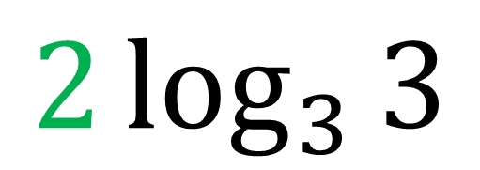
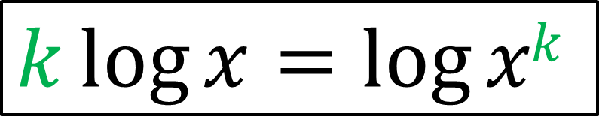
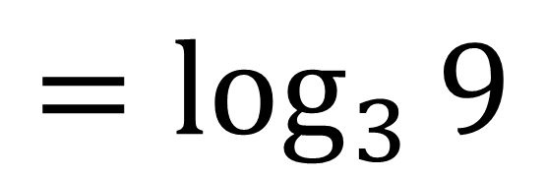
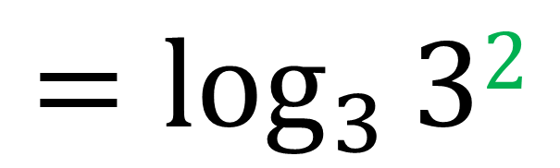
Logarithms - Laws of Logs
Power Law
$$k\log{x}=\log{xk}$$
$$2\log_{3}{3}$$
$$=\log_{3}{32}$$
$$=\log_{3}{9}$$

Slide 7
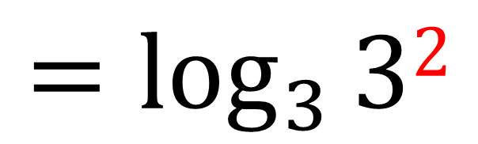
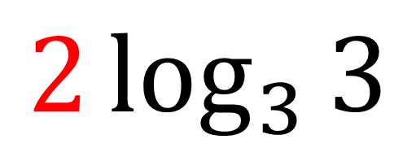
Logarithms - Laws of Logs
Before you can use
the multiplication and division law,
you need to make sure they have no coefficient.
Therefore use the power law before you apply the multiplication and division laws.
$$2\log_{3}{3}$$
$$=\log_{3}{32}$$

Slide 8
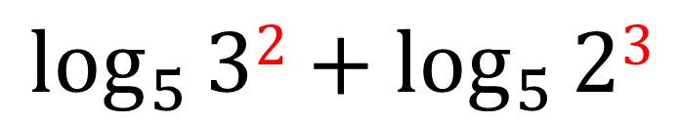
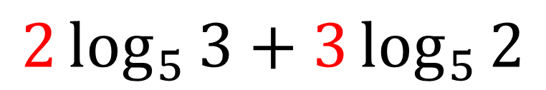
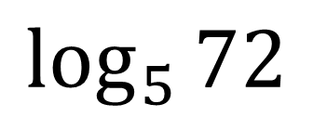
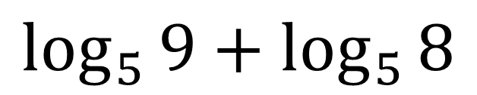
Logarithms - Laws of Logs
Write as a single log:
$$2\log_{5}{3}+3\log_{5}{2}$$
$$\log_{5}{32}+\log_{5}{23}$$
$$\log_{5}{9}+\log_{5}{8}$$
$$\log_{5}{72}$$

Slide 9
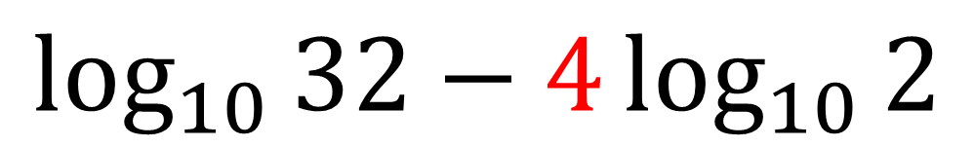
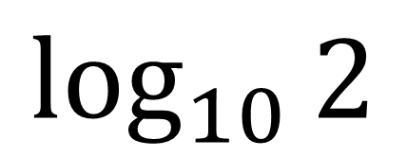
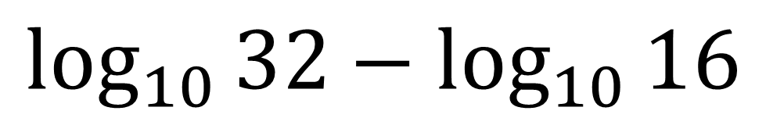
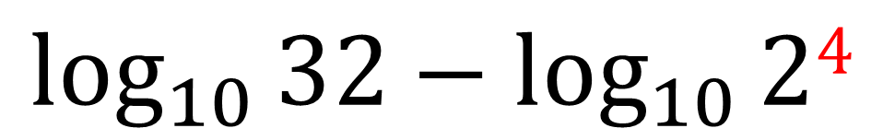
Logarithms - Laws of Logs
Write as a single log:
$$\log_{10}{32}−4\log_{10}{2}$$
$$\log_{10}{32}−\log_{10}{24}$$
$$\log_{10}{32}−\log_{10}{16}$$
$$\log_{10}{2}$$

Slide 10
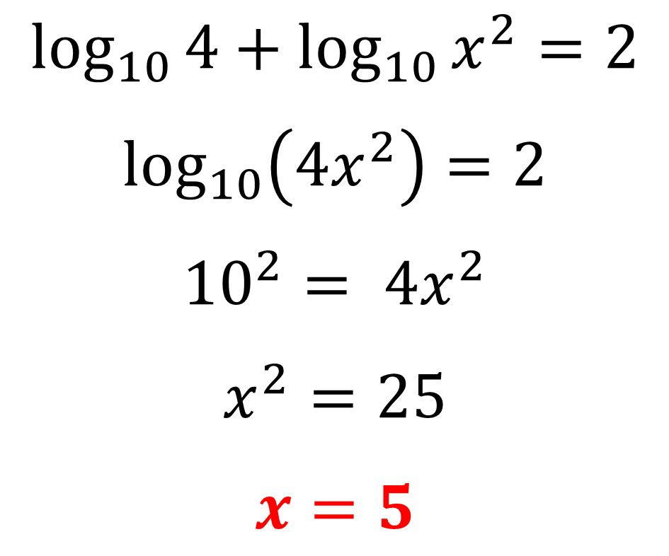
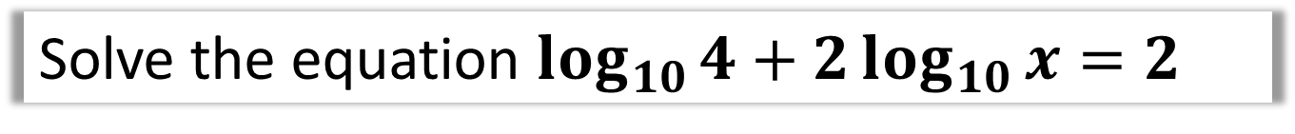
Solving Logarithms Equations
Solve the equation $\log_{10}{4}+2\log_{10}{x}=2$
The strategy is to write the question as a single log.
$$\log_{10}{4}+\log_{10}{x^{2}}=2$$
$$\log_{10}\left(4x^{2}\right)=2$$
$${10}^{2}= 4x^{2}$$
$$x^{2}=25$$
$$x=5$$

Slide 11
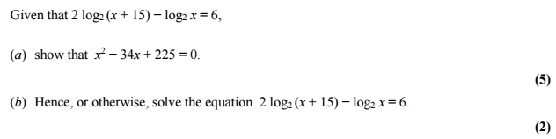
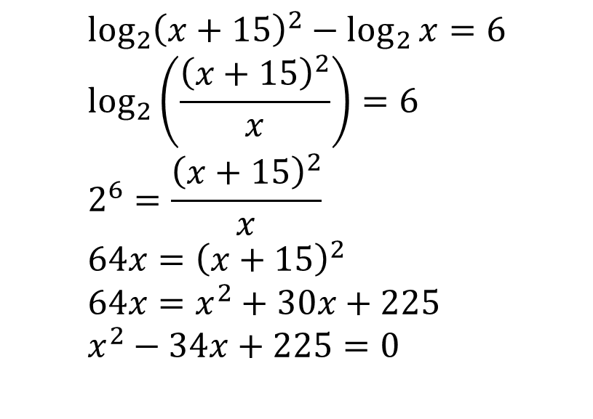
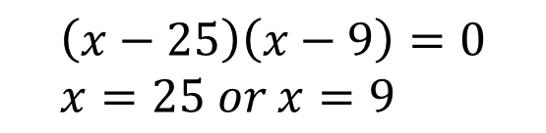
Solving Logarithms Equations – Exam Question
$$\log_{2}{{\left(x+15\right)}^{2}}−\log_{2}{x}=6 \\ \log_{2}\left(\frac{{\left(x+15\right)}^{2}}{x}\right)=6 \\ 2^{6}=\frac{{\left(x+15\right)}^{2}}{x} \\ 64x={\left(x+15\right)}^{2} \\ 64x=x^{2}+30x+225 \\ x^{2}−34x+225=0$$
a
b
$$\left(x−25\right)\left(x−9\right)=0 \\ x=25 or x=9$$

Slide 12
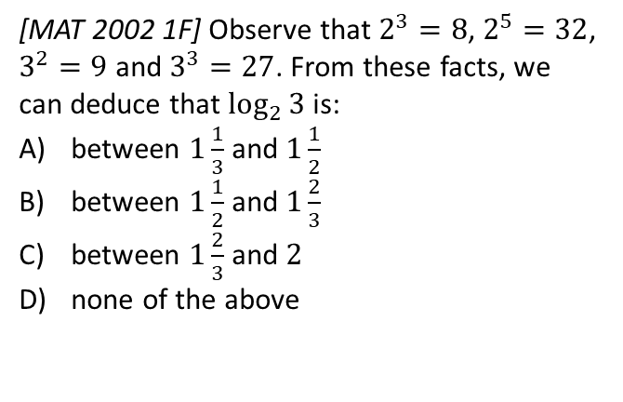
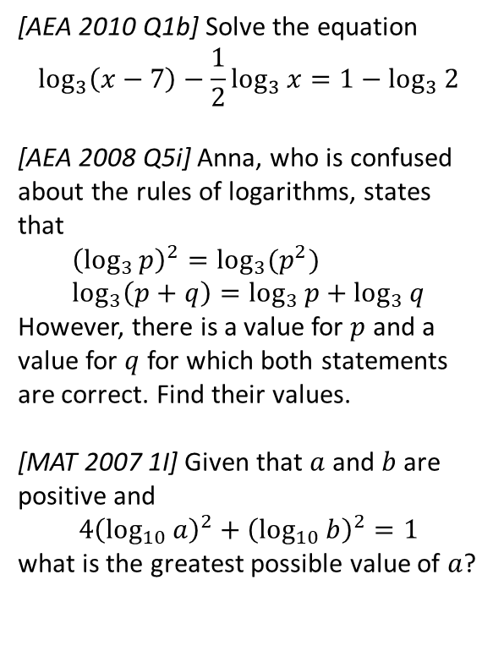
Exercise 14E
Complete before the lesson Q1
Green Q2
Amber Q3
Red
Pearson Pure Mathematics
Pages 323-324
These are all strictly non-calculator!
Extension
[MAT 2002 1F] Observe that $2^{3}=8$, $2^{5}=32$, $3^{2}=9$ and $3^{3}=27$. From these facts, we can deduce that $\log_{2}{3}$ is:
between $1\frac{1}{3}$ and $1\frac{1}{2}$
between $1\frac{1}{2}$ and $1\frac{2}{3}$
between $1\frac{2}{3}$ and $2$
none of the above
4
1
[AEA 2010 Q1b] Solve the equation
$$\log_{3}\left(x−7\right)−\frac{1}{2}\log_{3}{x}=1−\log_{3}{2}$$
[AEA 2008 Q5i] Anna, who is confused about the rules of logarithms, states that
$${\left(\log_{3}{p}\right)}^{2}=\log_{3}{(p^{2}}) \\ \log_{3}\left(p+q\right)=\log_{3}{p}+\log_{3}{q}$$
However, there is a value for $p$ and a value for $q$ for which both statements are correct. Find their values.
[MAT 2007 1I] Given that $a$ and $b$ are positive and
$$4{\left(\log_{10}{a}\right)}^{2}+{\left(\log_{10}{b}\right)}^{2}=1$$
what is the greatest possible value of $a$?
2
Complete before the lesson Ex3B Q2-4
Green Complete Ex3B
Amber Ex3C Q1-6
Red Ex3C Q7-9
3

