Slide 1
Year 2 Applied Mathematics
Further Kinematics
- Vectors
Chapter 8
(Part 1 of 4)

Slide 2
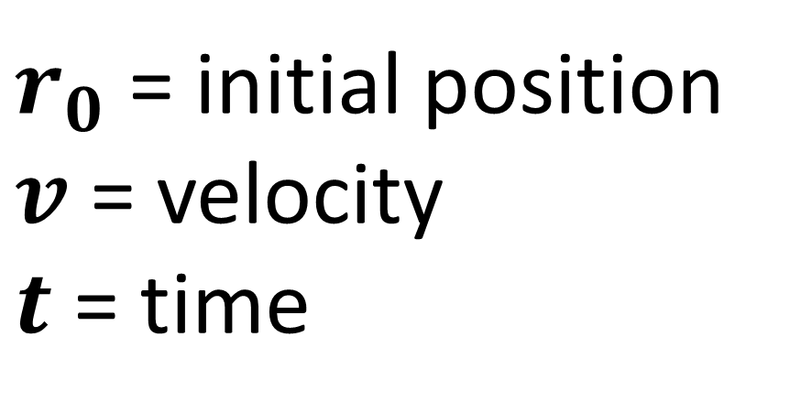

Vectors
To describe the motion of a particle
you can use the equation:
$$r=r_{0}+vt$$
$r_{0}$ = initial position
$v$ = velocity
$t$ = time

Slide 3
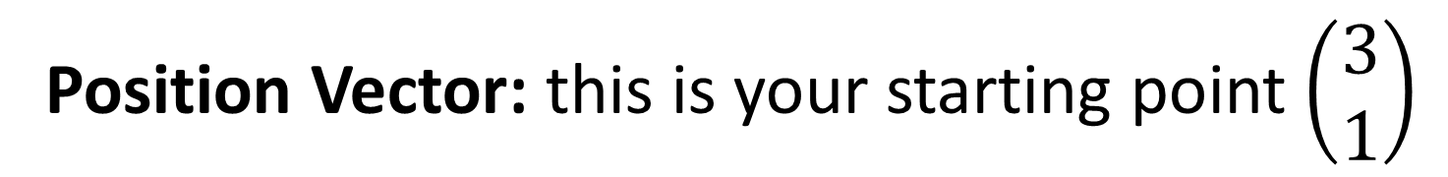
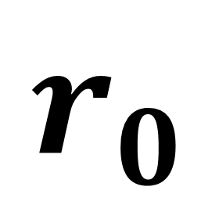
Vectors
$$r_{0}$$
Position Vector: this is your starting point $\left(\begin{matrix}3 \\ 1\end{matrix}\right)$
1
0
3

Slide 4

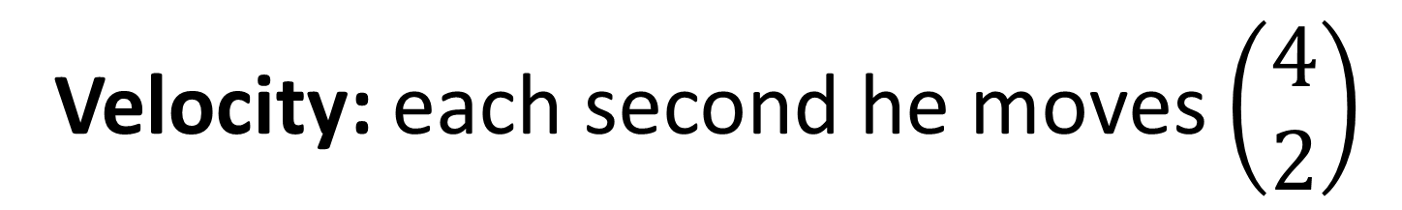



Vectors
$$v$$
Velocity: each second he moves $\left(\begin{matrix}4 \\ 2\end{matrix}\right)$
$$\left({4 \atop 2}\right)$$
$$\left({4 \atop 2}\right)$$
1
$$\left({4 \atop 2}\right)$$
0
3

Slide 5
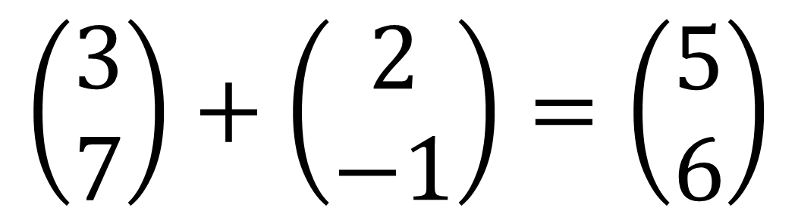
Vector Notation
Make life easier for yourself by using column vectors.
$$\left(3i+7j\right)+\left(2i−j\right)=\left(5i+6j\right)$$
or
$$\left(\begin{matrix}3 \\ 7\end{matrix}\right)+\left(\begin{matrix}2 \\ −1\end{matrix}\right)=\left(\begin{matrix}5 \\ 6\end{matrix}\right)$$

Slide 6
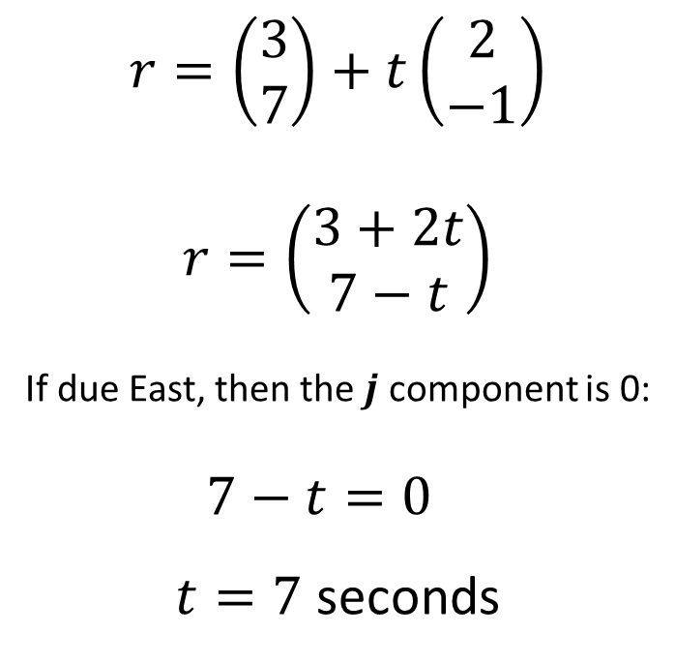
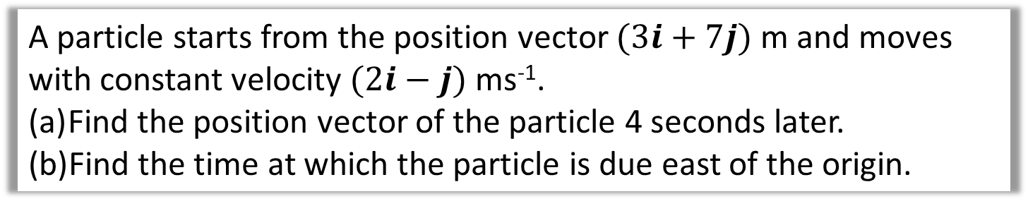
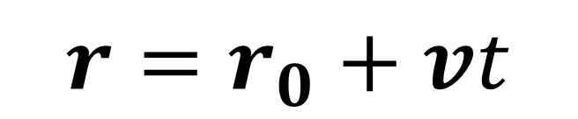
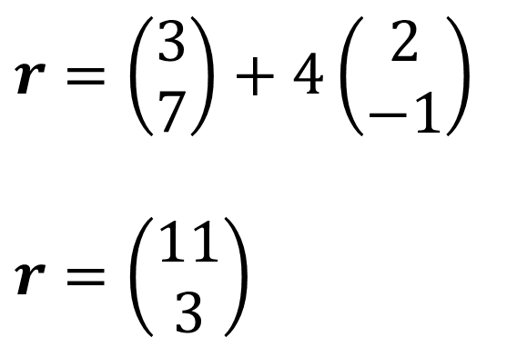
Vectors – Example A
A particle starts from the position vector $(3i+7j)$ m and moves with constant velocity $(2i−j)$ ms⁻¹.
Find the position vector of the particle 4 seconds later.
Find the time at which the particle is due east of the origin.
b
a
$$r=\left(\begin{matrix}3 \\ 7\end{matrix}\right)+t\left(\begin{matrix}2 \\ −1\end{matrix}\right)$$
$$r=\left(\begin{matrix}3+2t \\ 7−t\end{matrix}\right)$$
If due East, then the $j$ component is 0:
$$7−t=0$$
$t=7$ seconds
$$r=r_{0}+vt$$
$$r=\left(\begin{matrix}3 \\ 7\end{matrix}\right)+4\left(\begin{matrix}2 \\ −1\end{matrix}\right)$$
$$r=\left(\begin{matrix}11 \\ 3\end{matrix}\right)$$

Slide 7

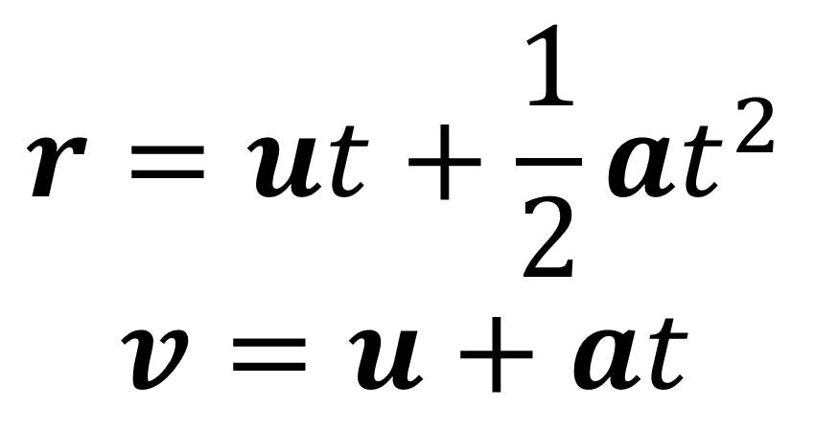
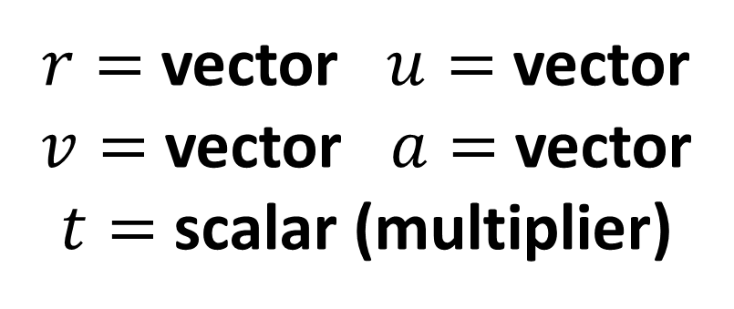
Vectors – Vectors and $suvat$
Some $suvat$ equations work with vectors.
We use $r$ instead of $s$ for displacement.
$$r=ut+\frac{1}{2}at^{2} \\ v=u+at$$
$r=$ vector $u=$ vector
$v=$ vector $a=$ vector
$t=$ scalar (multiplier)

Slide 8
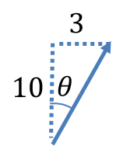
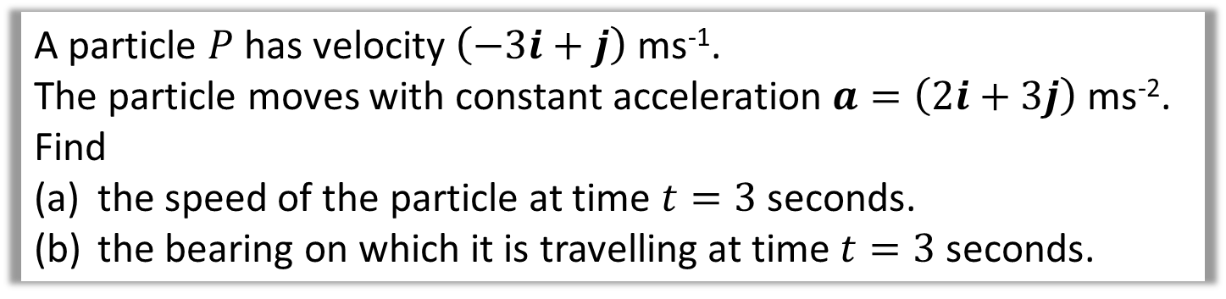
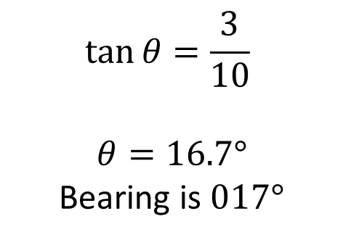
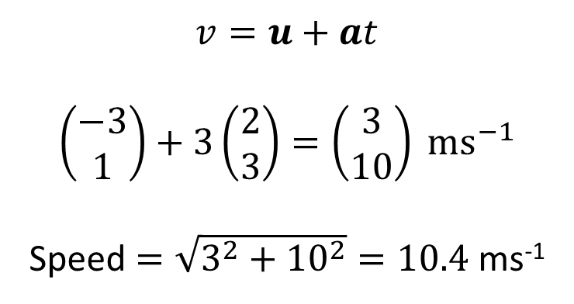
Vectors – Vectors and $suvat$ Example B
A particle $P$ has velocity $\left(−3i+j\right)$ ms⁻¹.
The particle moves with constant acceleration $a=\left(2i+3j\right)$ ms⁻². Find
the speed of the particle at time $t=3$ seconds.
the bearing on which it is travelling at time $t=3$ seconds.
a
b
$$v=u+at$$
$$\left(\begin{matrix}−3 \\ 1\end{matrix}\right)+3\left(\begin{matrix}2 \\ 3\end{matrix}\right)=\left(\begin{matrix}3 \\ 10\end{matrix}\right) ms^{−1}$$
Speed $=\sqrt{3^{2}+{10}^{2}}=10.4$ ms⁻¹
$$\tan{θ}=\frac{3}{10}$$
$$θ=16.7°$$
Bearing is $017°$

Slide 9
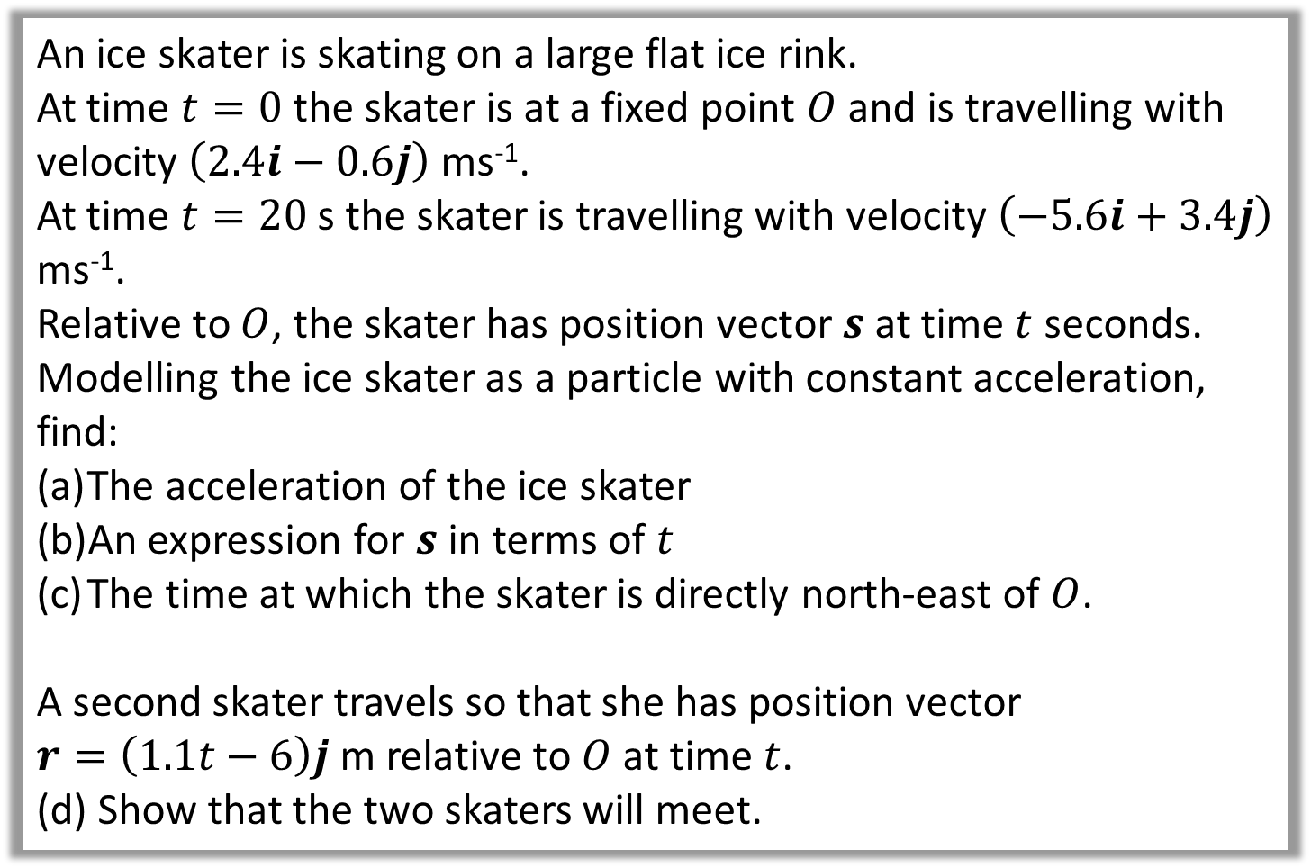
Vectors – Vectors and $suvat$ Example C
An ice skater is skating on a large flat ice rink.
At time $t=0$ the skater is at a fixed point $O$ and is travelling with velocity $\left(2.4i−0.6j\right)$ ms⁻¹.
At time $t=20$ s the skater is travelling with velocity $\left(−5.6i+3.4j\right)$ ms⁻¹.
Relative to $O$, the skater has position vector $s$ at time $t$ seconds.
Modelling the ice skater as a particle with constant acceleration, find:
The acceleration of the ice skater
An expression for $s$ in terms of $t$
The time at which the skater is directly north-east of $O$.
A second skater travels so that she has position vector
$r=\left(1.1t−6\right)j$ m relative to $O$ at time $t$.
(d) Show that the two skaters will meet.

Slide 10
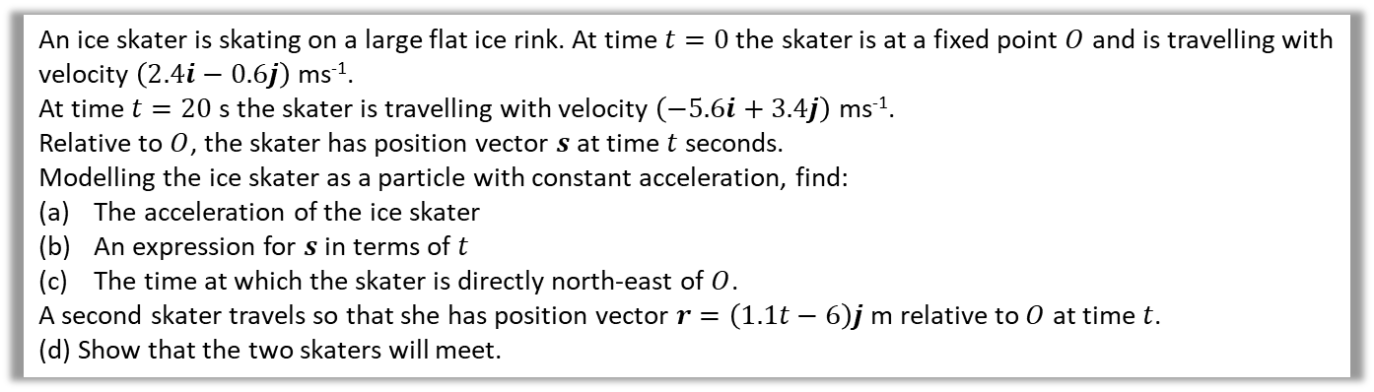
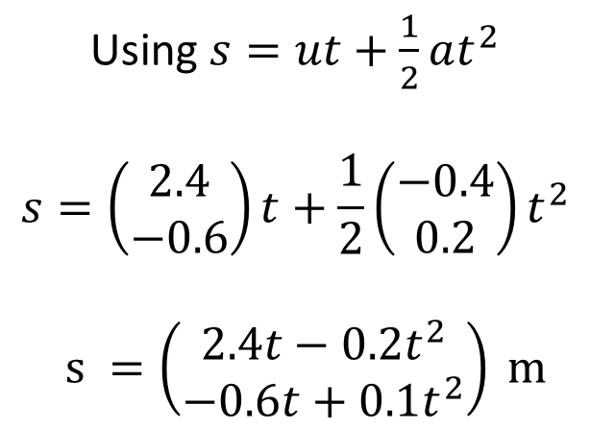
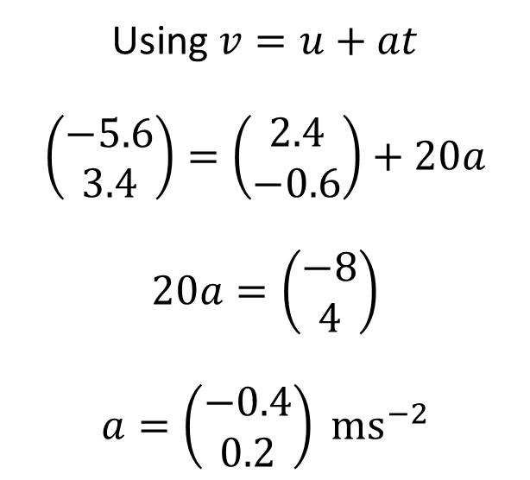
Vectors – Vectors and $suvat$ Example C
An ice skater is skating on a large flat ice rink. At time $t=0$ the skater is at a fixed point $O$ and is travelling with velocity $\left(2.4i−0.6j\right)$ ms⁻¹.
At time $t=20$ s the skater is travelling with velocity $\left(−5.6i+3.4j\right)$ ms⁻¹.
Relative to $O$, the skater has position vector $s$ at time $t$ seconds.
Modelling the ice skater as a particle with constant acceleration, find:
The acceleration of the ice skater
An expression for $s$ in terms of $t$
The time at which the skater is directly north-east of $O$.
A second skater travels so that she has position vector $r=\left(1.1t−6\right)j$ m relative to $O$ at time $t$.
(d) Show that the two skaters will meet.
Using $v=u+at$
$$\left(\begin{matrix}−5.6 \\ 3.4\end{matrix}\right)=\left(\begin{matrix}2.4 \\ −0.6\end{matrix}\right)+20a$$
$$20a=\left(\begin{matrix}−8 \\ 4\end{matrix}\right)$$
$$a=\left(\begin{matrix}−0.4 \\ 0.2\end{matrix}\right) ms^{−2}$$
Using $s=ut+\frac{1}{2}at^{2}$
$$s=\left(\begin{matrix}2.4 \\ −0.6\end{matrix}\right)t+\frac{1}{2}\left(\begin{matrix}−0.4 \\ 0.2\end{matrix}\right)t^{2}$$
$$s =\left(\begin{matrix}2.4t−0.2t^{2} \\ −0.6t+0.1t^{2}\end{matrix}\right) m$$
a
b

Slide 11

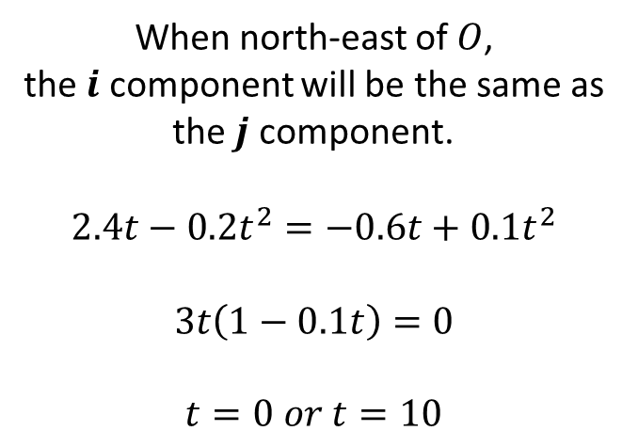
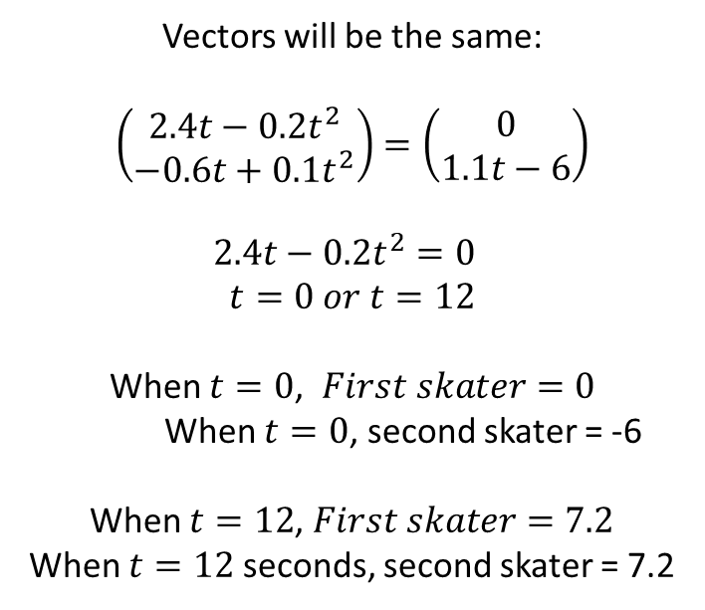
Vectors – Vectors and $suvat$ Example C
An ice skater is skating on a large flat ice rink. At time $t=0$ the skater is at a fixed point $O$ and is travelling with velocity $\left(2.4i−0.6j\right)$ ms⁻¹.
At time $t=20$ s the skater is travelling with velocity $\left(−5.6i+3.4j\right)$ ms⁻¹.
Relative to $O$, the skater has position vector $s$ at time $t$ seconds.
Modelling the ice skater as a particle with constant acceleration, find:
The acceleration of the ice skater
An expression for $s$ in terms of $t$
The time at which the skater is directly north-east of $O$.
A second skater travels so that she has position vector $r=\left(1.1t−6\right)j$ m relative to $O$ at time $t$.
(d) Show that the two skaters will meet.
Vectors will be the same:
$$\left(\begin{matrix}2.4t−0.2t^{2} \\ −0.6t+0.1t^{2}\end{matrix}\right)=\left(\begin{matrix}0 \\ 1.1t−6\end{matrix}\right)$$
$$2.4t−0.2t^{2}=0$$
$$t=0 or t=12$$
When $t=0$, $First skater=0$
When $t=0$, second skater = -6
When $t=12$, $First skater=7.2$
When $t=12$ seconds, second skater = 7.2
c
d
When north-east of $O$,
the $i$ component will be the same as
the $j$ component.
$$2.4t−0.2t^{2}=−0.6t+0.1t^{2}$$
$$3t\left(1−0.1t\right)=0$$
$$t=0 or t=10$$

Slide 12
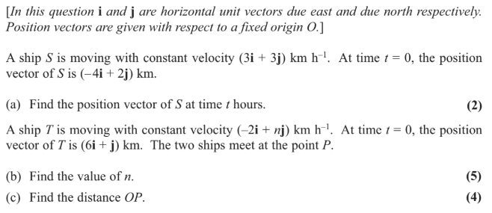
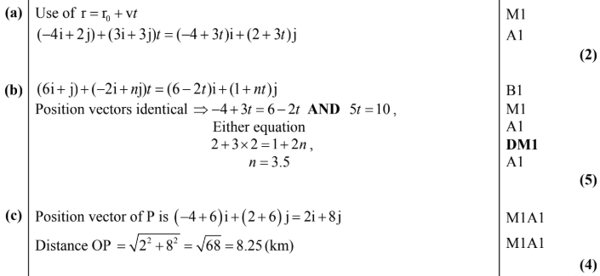
Test Your Understanding
Edexcel M1(Old) May 2013(R) Q6
?
?
?

Slide 13
Exercise 8A
Pearson Stats/Mechanics Year 2
Pages 162-164
Complete before the lesson Q1-3
In Class:
Green Q4-9
Amber Q10-11
Red Q12-13 & Challenge

