Slide 1
Year 1 Pure Mathematics
Integration
- Limits
Chapter 13
(Part 2 of 2)

Slide 2







Integration – Area Under a Graph
The most useful use of integration is that
it finds the area under a graph.
$$y$$
speed
$$?$$
$$Area=distance$$
$$Area=distance$$
$$x$$
$$1$$
$$5$$
time

Slide 3

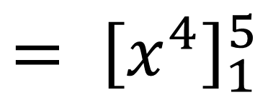
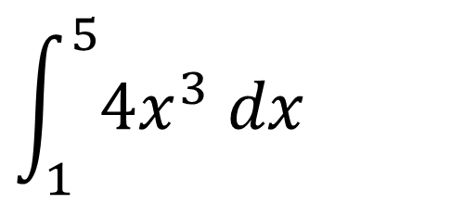

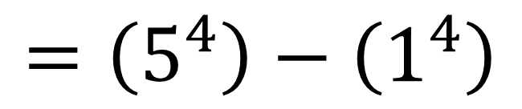

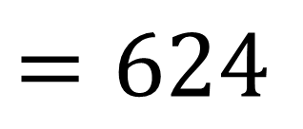

Integration – Area Under a Graph
$$\int_{1}^{5}{4x^{3} dx}$$
$$y$$
$$?$$
$$Area=distance$$
$${= \left[x^{4}\right]}_{1}^{5}$$
$$x$$
$$1$$
$$5$$
$$=\left(5^{4}\right)−\left(1^{4}\right)$$
$$=624$$

Slide 4
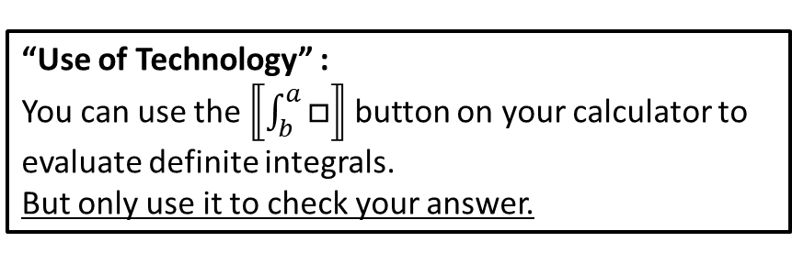


Integration – Limits
$$={\left[\frac{1}{3}x^{3}+x\right]}_{−3}^{3}$$
$$\int_{−3}^{3}{x^{2}+1 dx} \\ =\left(\frac{1}{3}{\left(3\right)}^{3}+3\right)−\left(\frac{1}{3}{\left(−3\right)}^{3}−3\right)$$
$$=12−−12$$
$$=24$$
“Use of Technology” :
You can use the $⟦\int_{b}^{a}{□}⟧$ button on your calculator to evaluate definite integrals.
But only use it to check your answer.

Slide 5
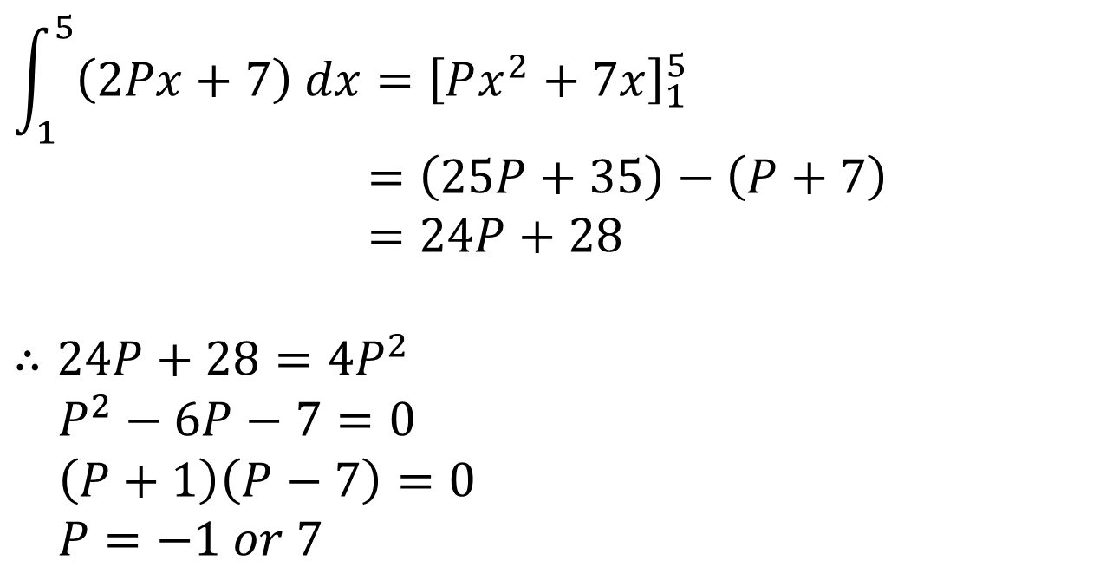
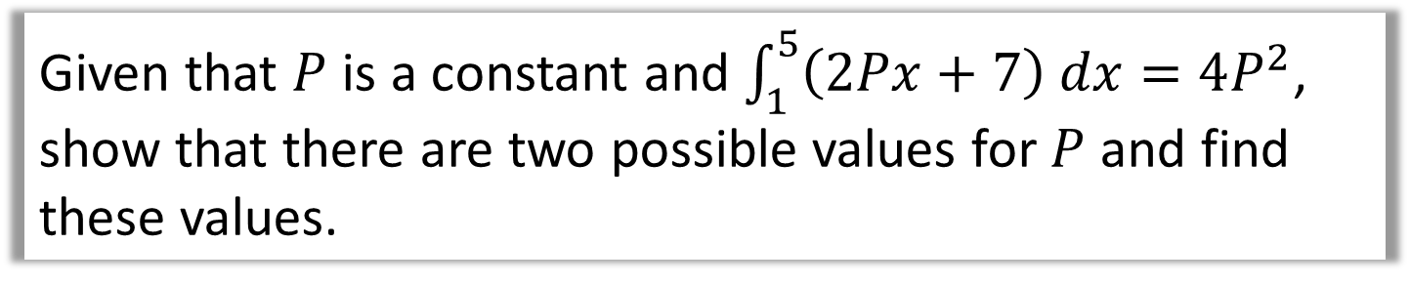
Integration – Problem Solving
Given that $P$ is a constant and $\int_{1}^{5}{\left(2Px+7\right) dx}=4P^{2}$,
show that there are two possible values for $P$ and find these values.
$$\int_{1}^{5}{\left(2Px+7\right) dx}={\left[Px^{2}+7x\right]}_{1}^{5} \\ =\left(25P+35\right)−\left(P+7\right) \\ =24P+28$$
$$∴24P+28=4P^{2} \\ P^{2}−6P−7=0 \\ \left(P+1\right)\left(P−7\right)=0 \\ P=−1 or 7$$

Slide 6
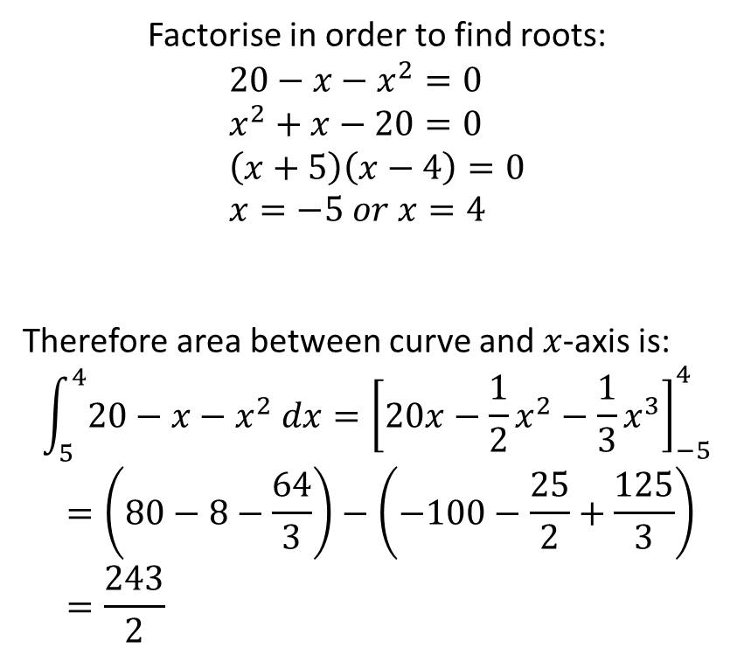

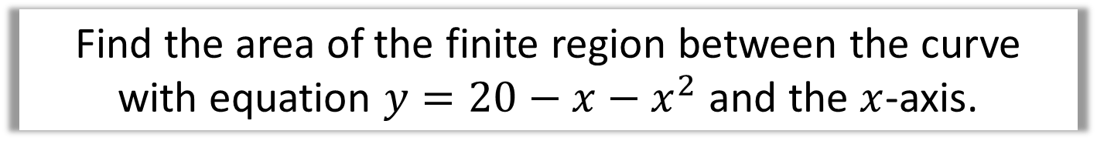



Integration – Area Under a Graph
Find the area of the finite region between the curve with equation $y=20−x−x^{2}$ and the $x$-axis.
$$y$$
Factorise in order to find roots:
$$20−x−x^{2}=0 \\ x^{2}+x−20=0 \\ \left(x+5\right)\left(x−4\right)=0 \\ x=−5 or x=4$$
Therefore area between curve and $x$-axis is:
$$\int_{5}^{4}{20−x−x^{2} dx}={\left[20x−\frac{1}{2}x^{2}−\frac{1}{3}x^{3}\right]}_{−5}^{4} \\ =\left(80−8−\frac{64}{3}\right)−\left(−100−\frac{25}{2}+\frac{125}{3}\right) \\ =\frac{243}{2}$$
$$−5$$
$$4$$
$$x$$

Slide 7
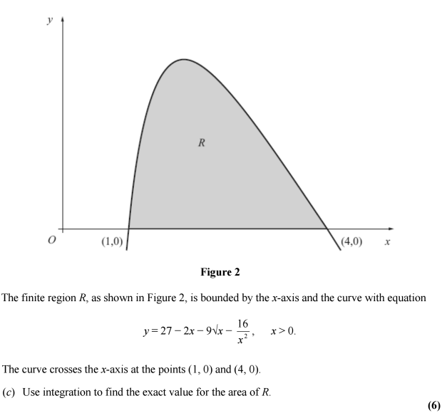
Integration – Area Under a Graph
Solution: -12

Slide 8

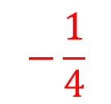
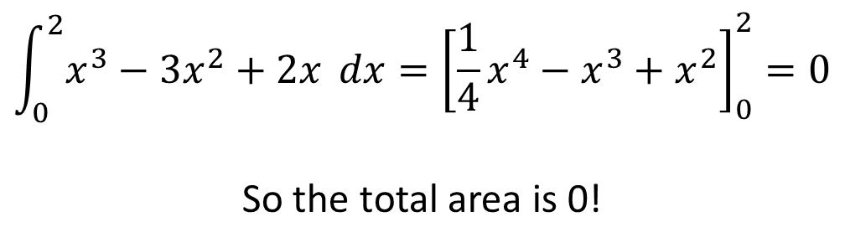


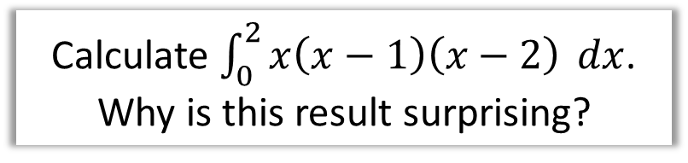

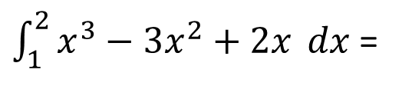

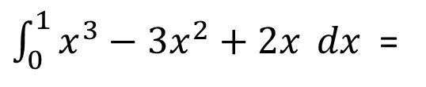


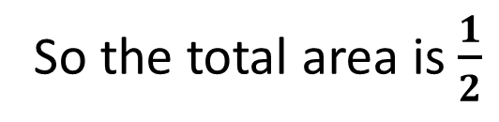
Integration – Area Under a Graph
Calculate $\int_{0}^{2}{x\left(x−1\right)\left(x−2\right)} dx$.
Why is this result surprising?
$$y$$
$$\int_{0}^{2}{x^{3}−3x^{2}+2x} dx={\left[\frac{1}{4}x^{4}−x^{3}+x^{2}\right]}_{0}^{2}=0$$
So the total area is 0!
$$\frac{1}{4}$$
$$x$$
$\int_{0}^{1}{x^{3}−3x^{2}+2x} dx$ =
$$\frac{1}{4}$$
$$1$$
$$−\frac{1}{4}$$
$$2$$
$\int_{1}^{2}{x^{3}−3x^{2}+2x} dx$ =
$$−\frac{1}{4}$$
So the total area is $\frac{1}{2}$

Slide 9

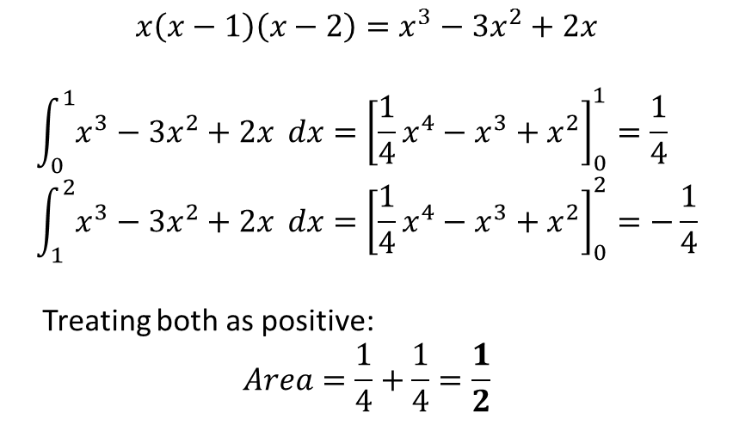
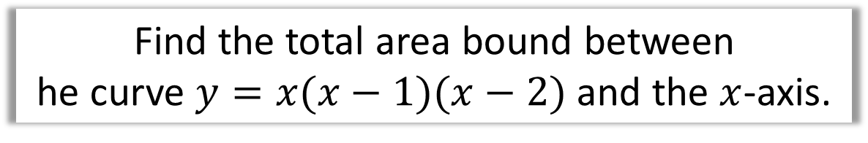



Integration – Area Under a Graph
Find the total area bound between
he curve $y=x(x−1)(x−2)$ and the $x$-axis.
$$y$$
$$x$$
$$1$$
$$2$$
$$x\left(x−1\right)\left(x−2\right)=x^{3}−3x^{2}+2x$$
$$\int_{0}^{1}{x^{3}−3x^{2}+2x} dx={\left[\frac{1}{4}x^{4}−x^{3}+x^{2}\right]}_{0}^{1}=\frac{1}{4} \\ \int_{1}^{2}{x^{3}−3x^{2}+2x} dx={\left[\frac{1}{4}x^{4}−x^{3}+x^{2}\right]}_{0}^{2}=−\frac{1}{4}$$
Treating both as positive:
$$Area=\frac{1}{4}+\frac{1}{4}=\frac{1}{2}$$

Slide 10
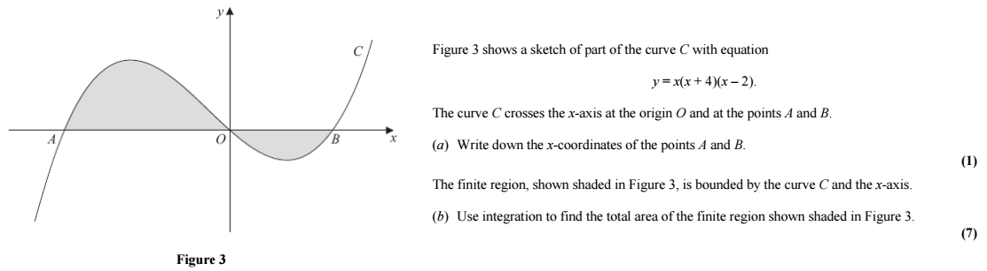
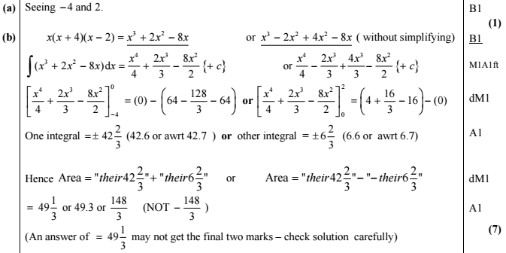
Integration – Exam Question

Slide 11







Integration - Areas between curves and lines
How could we find the area between the line and the curve?
$$y$$
$$y=x$$
$$?$$
Answer = $\frac{9}{2}$
$$y=x\left(4−x\right)$$
$$0$$
$$3$$
Step 1: Work out
the area under the graph
Step 2: Work out
the area of the triangle
Step 3: Area under the graph subtract the triangle

Slide 12
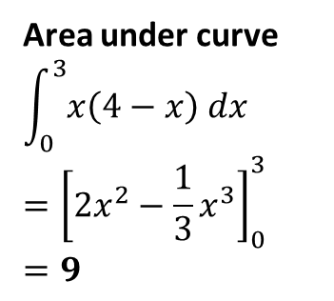
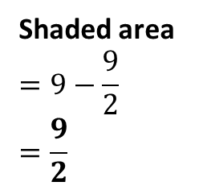
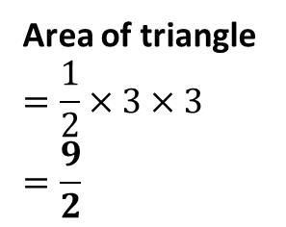
Integration - Areas between curves and lines
How could we find the area between the line and the curve?
$$y$$
$$y=x$$
$$?$$
$$y=x\left(4−x\right)$$
$$0$$
$$3$$
Step 1: Work out
the area under the graph
Step 2: Work out
the area of the triangle
Step 3: Area under the graph subtract the triangle
Area under curve
$$\int_{0}^{3}{x\left(4−x\right) dx}$$
$$={\left[2x^{2}−\frac{1}{3}x^{3}\right]}_{0}^{3}$$
$$=9$$
Area of triangle
$$=\frac{1}{2}×3×3$$
$$=\frac{9}{2}$$
Shaded area
$$=9−\frac{9}{2}$$
$$=\frac{9}{2}$$

Slide 13

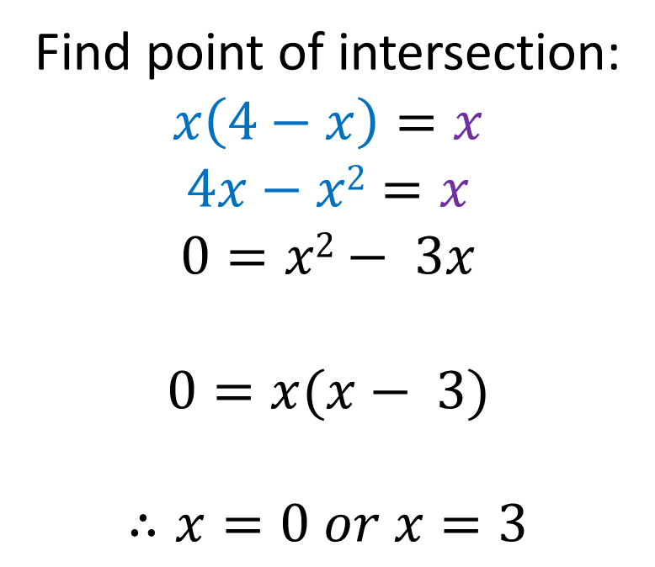




Integration - Areas between curves and lines
How can you find the point of intersection if you are not told it?
Find point of intersection:
$$x\left(4−x\right)=x$$
$$4x−x2=x$$
$$0=x2− 3x$$
$$0=x(x− 3)$$
$$∴x=0 or x=3$$
$$y$$
$$y=x$$
$$y=x\left(4−x\right)$$
$$0$$
$$?$$

Slide 14


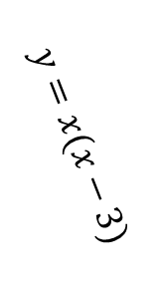
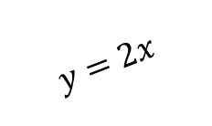





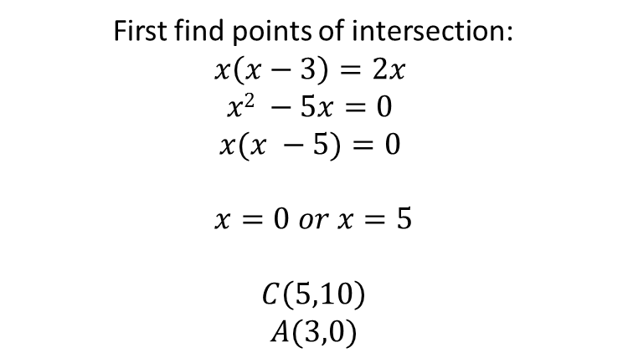
Integration - Areas between curves and lines
First find points of intersection:
$$x\left(x−3\right)=2x$$
$$x2 −5x=0$$
$$x(x −5)=0$$
$$x=0 or x=5$$
$$C\left(5,10\right)$$
$$A(3,0)$$
$$y=x(x−3)$$
$$C$$
$$y=2x$$
$$O$$
$$A$$
$$B$$
Area of triangle $OBC=\frac{1}{2}×5×10=25$
Area under $AC$: $\int_{3}^{5}{x\left(x−3\right)dx}= …=\frac{26}{3}$
Shaded area $=25−\frac{26}{3}=\frac{49}{3}$

Slide 15
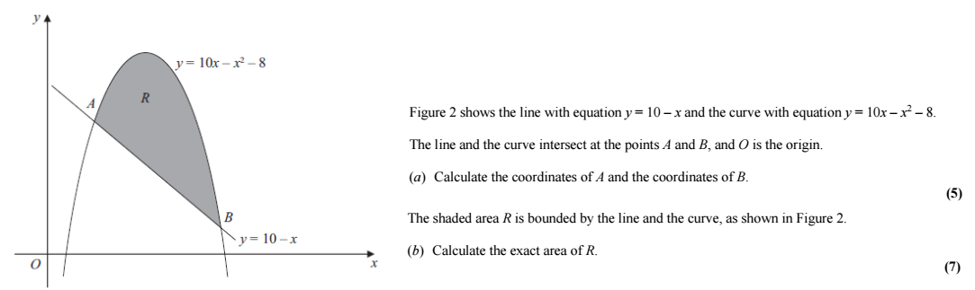
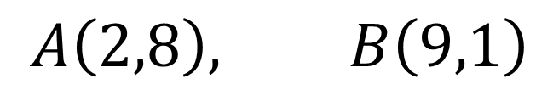
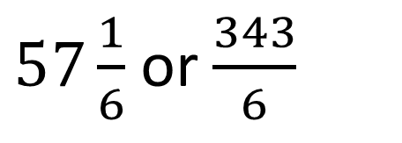
Integration - Areas between curves and lines
$$A\left(2,8\right), B\left(9,1\right)$$
a
$57\frac{1}{6}$ or $\frac{343}{6}$
b

Slide 16
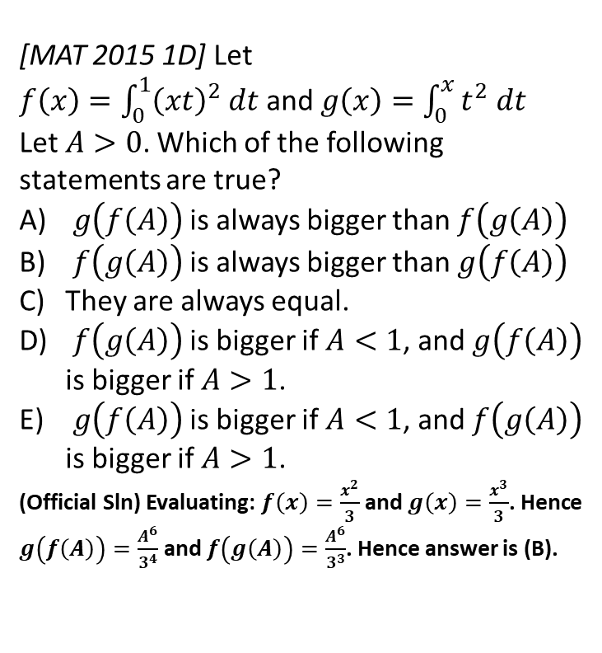

Exercise 13D
Pearson Pure Mathematics Year 1/AS
Page 297
(Classes in a rush may want to skip this exercise and go to the next section, which continues definite integration, but in the context of areas under graphs).
Extension
2
[MAT 2015 1D] Let
$f\left(x\right)=\int_{0}^{1}{{\left(xt\right)}^{2} dt}$ and $g\left(x\right)=\int_{0}^{x}{t^{2} dt}$
Let $A>0$. Which of the following statements are true?
$g\left(f\left(A\right)\right)$ is always bigger than $f\left(g\left(A\right)\right)$
$f\left(g\left(A\right)\right)$ is always bigger than $g\left(f\left(A\right)\right)$
They are always equal.
$f\left(g\left(A\right)\right)$ is bigger if $A<1$, and $g\left(f\left(A\right)\right)$ is bigger if $A>1$.
$g\left(f\left(A\right)\right)$ is bigger if $A<1$, and $f\left(g\left(A\right)\right)$ is bigger if $A>1$.
(Official Sln) Evaluating: $f\left(x\right)=\frac{x^{2}}{3}$ and $g\left(x\right)=\frac{x^{3}}{3}$. Hence $g\left(f\left(A\right)\right)=\frac{A^{6}}{3^{4}}$ and $f\left(g\left(A\right)\right)=\frac{A^{6}}{3^{3}}$. Hence answer is (B).
1
[MAT 2009 1A] The smallest value of
$$I\left(a\right)=\int_{0}^{1}{{\left(x^{2}−a\right)}^{2} dx}$$
as $a$ varies, is what?
$$I\left(a\right)=\int_{0}^{1}{x^{4}−2ax^{2}+a^{2}} dx \\ ={\left[\frac{1}{5}x^{5}−\frac{2}{3}ax^{3}+\frac{1}{3}a^{3}\right]}_{0}^{1} \\ =\frac{1}{5}−\frac{2}{3}a+a^{2}$$
We then use differentiation or completing the square to find that the minimum value of $\frac{1}{5}−\frac{2}{3}a+a^{2}$ is $\frac{4}{45}$.
?
?

Slide 17
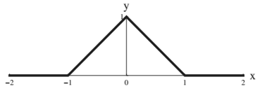

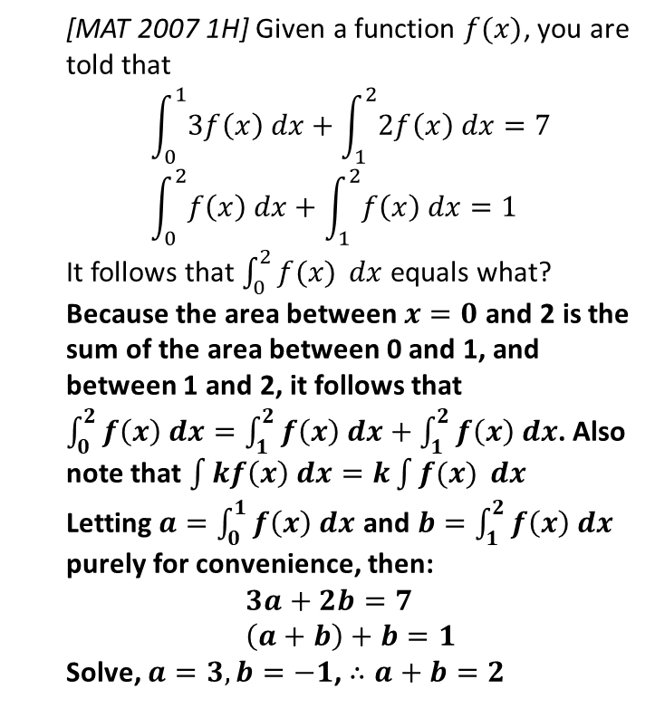
Exercise 13E
Complete before the lesson Q1
Green Q2
Amber Q3
Red
Pearson Pure Mathematics
Pages 299-300
Extension
2
[MAT 2011 1G]
A graph of the function $y=f\left(x\right)$ is sketched on the axes below:
What is the value of $\int_{−1}^{1}{f(x^{2}−1)} dx$?
We first need to reflect on what part of the function $f$ we’re actually using. $x$ in the integral varies between -1 and 1, thus $x^{2}−1$, i.e. the input of $f$, varies between -1 and 0.
We’re therefore only using the left half of the graph, and thus $f\left(x\right)=x+1$
$$∴\int_{−1}^{1}{f(x^{2}−1)} dx=\int_{−1}^{1}{\left(x^{2}−1\right)+1 dx} \\ ={\left[\frac{1}{3}x^{3}\right]}_{−1}^{1}=\left(\frac{1}{3}\right)−\left(−\frac{1}{3}\right)=\frac{2}{3}$$
1
[MAT 2007 1H] Given a function $f(x)$, you are told that
$$\int_{0}^{1}{3f\left(x\right) dx}+\int_{1}^{2}{2f\left(x\right) dx}=7 \\ \int_{0}^{2}{f\left(x\right) dx}+\int_{1}^{2}{f\left(x\right) dx}=1$$
It follows that $\int_{0}^{2}{f(x)} dx$ equals what?
Because the area between $x=0$ and 2 is the sum of the area between 0 and 1, and between 1 and 2, it follows that $\int_{0}^{2}{f\left(x\right) dx}=\int_{1}^{2}{f\left(x\right) dx}+\int_{1}^{2}{f\left(x\right) dx}$. Also note that $\int{kf\left(x\right) dx}=k\int{f(x)} dx$
Letting $a=\int_{0}^{1}{f\left(x\right) dx}$ and $b=\int_{1}^{2}{f\left(x\right) dx}$ purely for convenience, then:
$$3a+2b=7 \\ \left(a+b\right)+b=1$$
Solve, $a=3, b=−1$, $∴a+b=2$
?
?

Slide 18

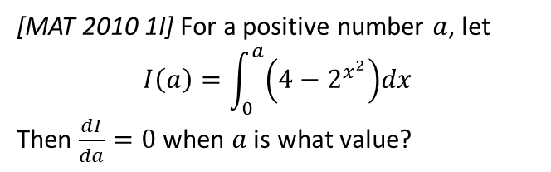



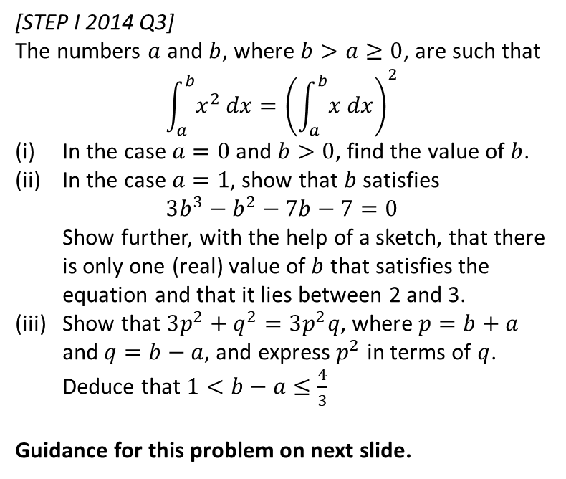


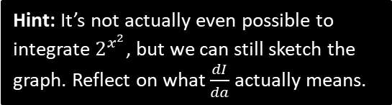

Exercise 13F
Complete before the lesson Q1
Green Q2
Amber Q3
Red
Pearson Pure Mathematics Year 1/AS
Pages 301-302
Extension
Hint: It’s not actually even possible to integrate $2^{x^{2}}$, but we can still sketch the graph. Reflect on what $\frac{dI}{da}$ actually means.
1
[MAT 2010 1I] For a positive number $a$, let
$$I\left(a\right)=\int_{0}^{a}{\left(4−2^{x^{2}}\right)dx}$$
Then $\frac{dI}{da}=0$ when $a$ is what value?
2
[STEP I 2014 Q3]
The numbers $a$ and $b$, where $b>a≥0$, are such that
$$\int_{a}^{b}{x^{2} dx}={\left(\int_{a}^{b}{x dx}\right)}^{2}$$
In the case $a=0$ and $b>0$, find the value of $b$.
In the case $a=1$, show that $b$ satisfies
$3b^{3}−b^{2}−7b−7=0$
Show further, with the help of a sketch, that there is only one (real) value of $b$ that satisfies the equation and that it lies between 2 and 3.
Show that $3p^{2}+q^{2}=3p^{2}q$, where $p=b+a$ and $q=b−a$, and express $p^{2}$ in terms of $q$. Deduce that $1<b−a≤\frac{4}{3}$
Guidance for this problem on next slide.
?
$$y$$
$I\left(a\right)$ represents the area from $x=0$ up to $a$.
$$I\left(a\right)$$
$$y=4−2^{x^{2}}$$
$$x$$
$$a$$
$\frac{dI}{da}$ represents the rate of change of area as $a$ increases. Thus if $\frac{dI}{da}=0$, the area is not changing. This must happen at the $x$-intercept of the graph, because once the curve goes negative, the total area will start to decrease.
$$4−2^{x^{2}}=0 → x=\sqrt{2}$$
The answer is $a=\sqrt{2}$.

Slide 19

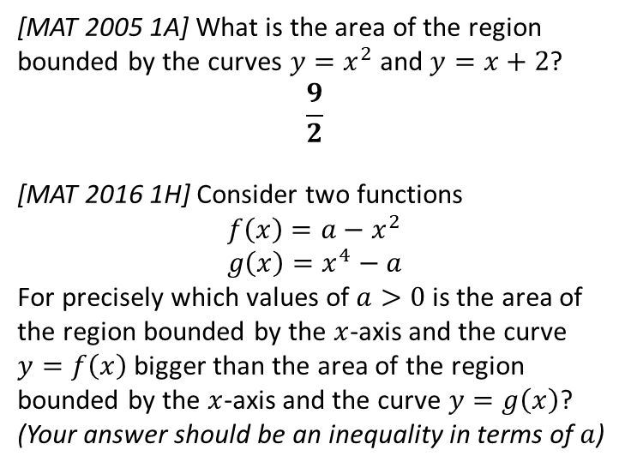
Exercise 13G
Complete before the lesson Q1
Green Q2
Amber Q3
Red
Pearson Pure Mathematics
Pages 304-306
Extension
[MAT 2005 1A] What is the area of the region bounded by the curves $y=x^{2}$ and $y=x+2$?
$$\frac{9}{2}$$
[MAT 2016 1H] Consider two functions
$$f\left(x\right)=a−x^{2} \\ g\left(x\right)=x^{4}−a$$
For precisely which values of $a>0$ is the area of the region bounded by the $x$-axis and the curve $y=f\left(x\right)$ bigger than the area of the region bounded by the $x$-axis and the curve $y=g\left(x\right)$?
(Your answer should be an inequality in terms of $a$)
? 2
1
(Official solution)
The area bounded by the $x$-axis and the curve $y=f\left(x\right)$, $A_{1}$ is equal to
$$A_{1}=\int_{\sqrt{a}}^{\sqrt{a}}{f(x)} dx=\frac{4}{3}a^{\frac{3}{2}}$$
whilst the area bounded by the $x$-axis and the curve $y=g\left(x\right)$, $A_{2}$ is equal to
$$A_{2}=\left|\int_{−\sqrt[4]{a}}^{\sqrt[4]{a}}{g\left(x\right)dx} \right|=\frac{8}{5}a^{\frac{5}{4}}$$
We require an $a$ such that $A_{1}>A_{2}$ so
$$\frac{4}{3}a^{\frac{3}{2}}>\frac{8}{5}a^{\frac{5}{4}} \\ 20a^{\frac{6}{4}}>24a^{\frac{5}{4}} \\ a^{\frac{1}{4}}>\frac{6}{5}$$
and so the answer is (e).
? 1
2
Complete before the lesson Ex3B Q2-4
Green Complete Ex3B
Amber Ex3C Q1-6
Red Ex3C Q7-9

