Slide 1
Year 1 Applied Mathematics
Hypothesis Testing
- Writing a Hypothesis
Chapter 7
(Part 1 of 5)

Slide 2
Hypothesis Testing
You are trying to determine if a dice is
biased towards the number 6.
You roll the dice 12 times and get 12 sixes.
Is the dice biased?
You are told the probability of getting a six
12 times out of 12
of an unbiased dice is 0.000000000459%.
What do you think now?

Slide 3
Hypothesis Testing
You roll the dice 12 times and get 8 sixes.
Is the dice biased?
You are told the probability of getting a six
8 or more times out of 12
of an unbiased dice is 0.00793%.
What do you think now?

Slide 4
Hypothesis Testing
Now you roll the dice 12 times
and get 5 sixes.
Is the dice biased?
You are told the probability of getting a six
5 or more times out of 12
of an unbiased dice is 3.62%.
What do you think now?

Slide 5
Hypothesis Testing
Now you roll the dice 12 times
and get 4 sixes.
Is the dice biased?
You are told the probability of getting a six
4 or more times out of 12
of an unbiased dice is 12.51%.
What do you think now?

Slide 6
Hypothesis Testing
You roll the dice 12 times and get 3 sixes.
Is the dice biased?
You are told the probability of getting a six
3 or more times out of 12
of an unbiased dice is 32.3%.
What do you think now?

Slide 7
Hypothesis Testing
Hypothesis testing in a nutshell then is:
1) You have some hypothesis you wish to see if it is true.
The dice is fair
2) You collect a data sample
Roll the dice 12 times and record number of heads
3) You calculate the probability of your sample happening.
Look at the chance of getting the sample result on a fair dice.
4) If that sample is extremely unlikely to have happened, then we conclude that our hypothesis is not correct.
If it below 5% chance of happening
it is unlikely to be a fair dice.

Slide 8
Hypothesis Testing
Two types of Hypothesis:
– Null Hypothesis (H_{o})
(State what probability is normally expected)
– Alternative Hypothesis (H₁)
(This hypothesis is accepted if H_{o} is rejected)

Slide 9
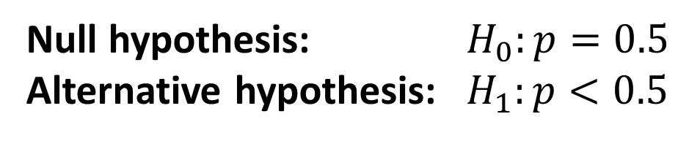
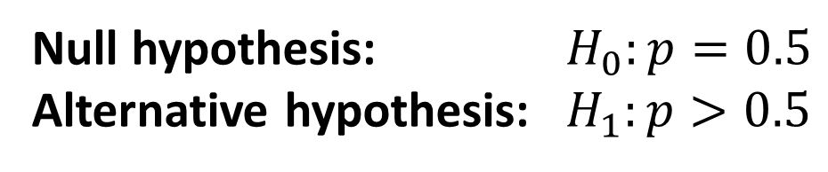
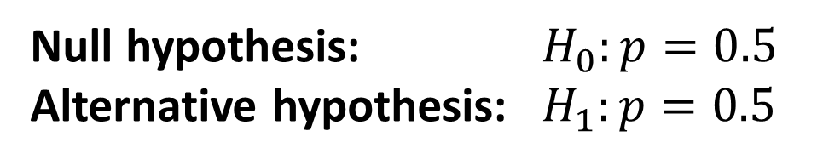
Hypothesis Testing - Null and Alternative
A coin is flipped and the number of heads are recorded.
I believe a coin is biased towards heads
Null hypothesis: $H_{0}:p=0.5$
Alternative hypothesis: $H_{1}:p>0.5$
I believe a coin is biased towards tails
Null hypothesis: $H_{0}:p=0.5$
Alternative hypothesis: $H_{1}:p<0.5$
I believe a coin is biased.
Null hypothesis: $H_{0}:p=0.5$
Alternative hypothesis: $H_{1}:p=0.5$

Slide 10
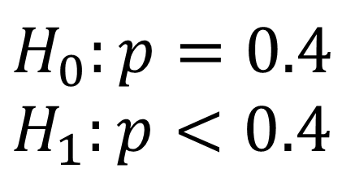
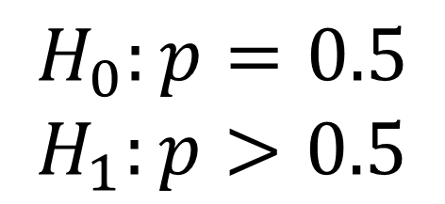
Hypothesis Testing - Null and Alternative
John wants to see whether a coin is biased towards coming down heads. He tosses the coin and counts the number of times it lands on heads. Write down two suitable hypotheses.
$$H_{0}:p=0.5$$
$$H_{1}:p>0.5$$
An election candidate believes she has the support of 40% of the residents in a particular town. A researcher wants to test whether the candidate is over-estimating her support.
Write down two suitable hypotheses.
$$H_{0}:p=0.4 \\ H_{1}:p<0.4$$

Slide 11
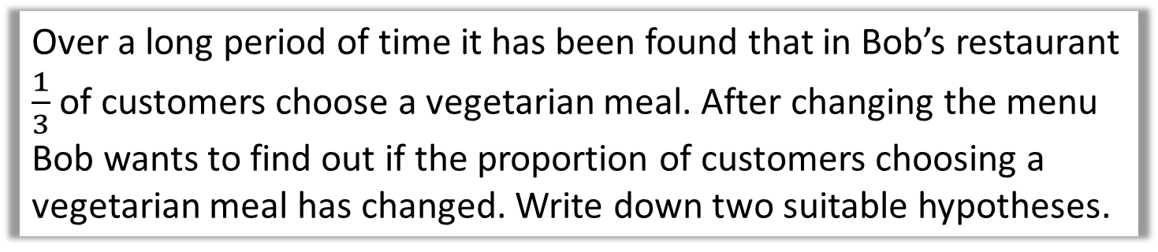
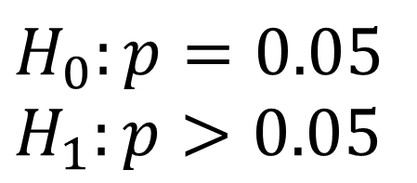
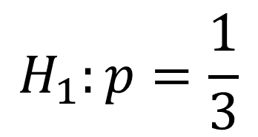
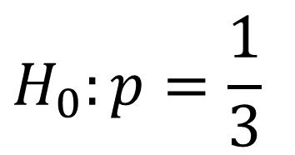
Hypothesis Testing - Null and Alternative
In the UK, 5% of students turn up late to school each day.
Mr Hameed wishes to determine if Piffin School has a problem with attendance. Write down two suitable hypotheses.
$$H_{0}:p=0.05 \\ H_{1}:p>0.05$$
Over a long period of time it has been found that in Bob’s restaurant $\frac{1}{3}$ of customers choose a vegetarian meal. After changing the menu Bob wants to find out if the proportion of customers choosing a vegetarian meal has changed. Write down two suitable hypotheses.
$$H_{0}:p=\frac{1}{3}$$
$$H_{1}:p=\frac{1}{3}$$

Slide 12
Exercise 7A
Pearson Pure Mathematics Year 1/AS
Pages 100-101
Complete before the lesson Q1-3
In Class:
Amber Q4
Red Q5-6

