Slide 1
Year 2 Pure Mathematics
Integration
- Finding Areas
Chapter 11
(Part 8 of 11)

Slide 2
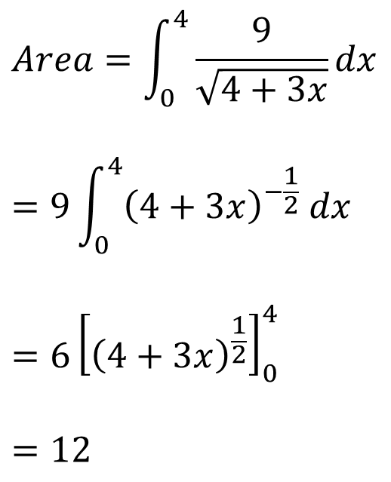


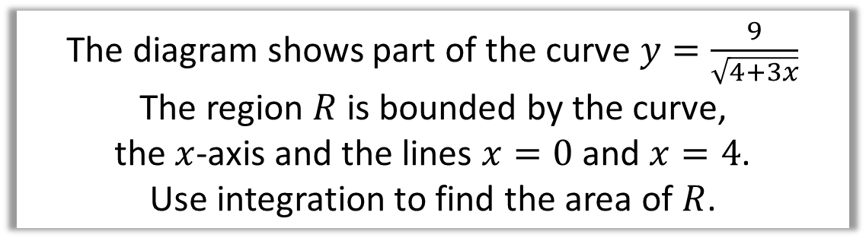
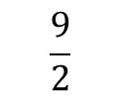


Area under a curve
The diagram shows part of the curve $y=\frac{9}{\sqrt{4+3x}}$
The region $R$ is bounded by the curve,
the $x$-axis and the lines $x=0$ and $x=4$.
Use integration to find the area of $R$.
$$Area=\int_{0}^{4}{\frac{9}{\sqrt{4+3x}}dx}$$
$$=9\int_{0}^{4}{{\left(4+3x\right)}^{−\frac{1}{2}} dx}$$
$$=6{\left[{\left(4+3x\right)}^{\frac{1}{2}}\right]}_{0}^{4}$$
$$=12$$
$$y$$
$$\frac{9}{2}$$
$$R$$
$$4$$
$$x$$

Slide 3
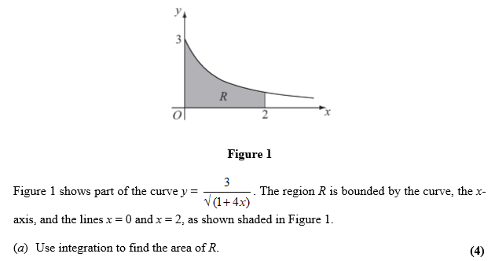
Area under a curve

Slide 4
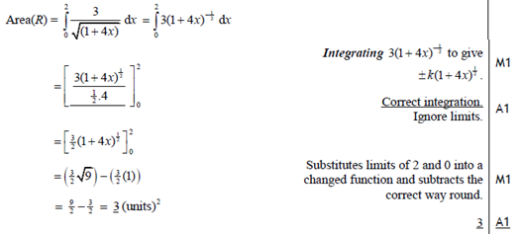
Area under a curve

Slide 5




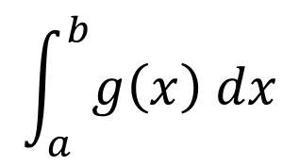





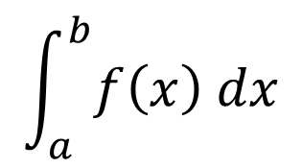









Area between two curves
$$y$$
$$y=f\left(x\right)$$
$$R$$
=
$$y=g\left(x\right)$$
$$a$$
$$x$$
$$b$$
-
$$y$$
$$y$$
$$y=f\left(x\right)$$
$$y=f\left(x\right)$$
$$R$$
$$y=g\left(x\right)$$
$$y=g\left(x\right)$$
$$a$$
$$x$$
$$x$$
$$b$$
$$a$$
$$b$$
$$\int_{a}^{b}{f\left(x\right) dx}$$
Area under top curve
minus
Area under bottom curve.
$$\int_{a}^{b}{g\left(x\right) dx}$$

Slide 6
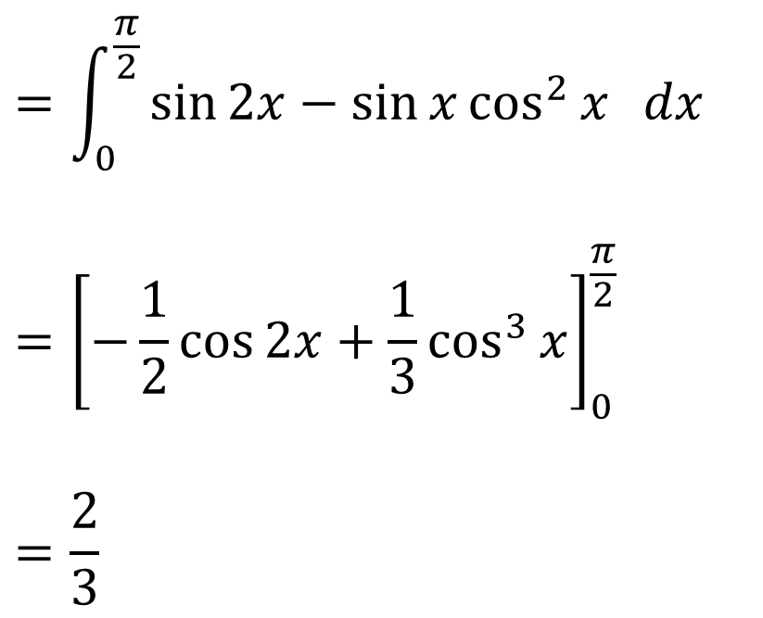
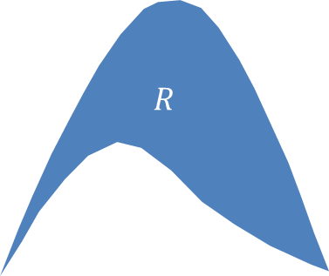

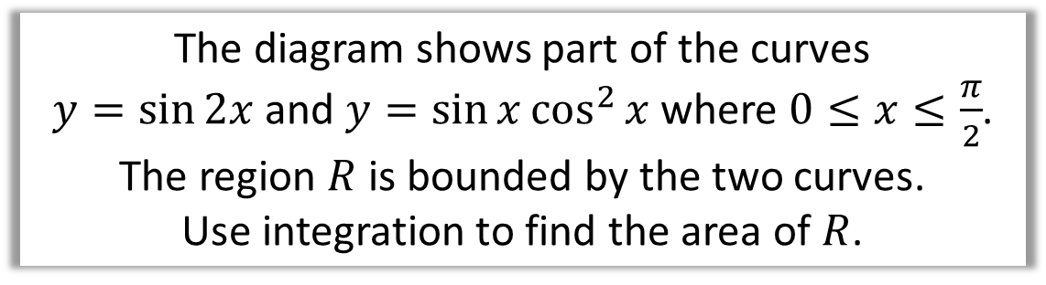



Area between two curves
The diagram shows part of the curves
$y=\sin{2x}$ and $y=\sin{x}\cos^{2}{x}$ where $0≤x≤\frac{π}{2}$.
The region $R$ is bounded by the two curves.
Use integration to find the area of $R$.
$$=\int_{0}^{\frac{π}{2}}{\sin{2x}−\sin{x}\cos^{2}{x} dx}$$
$$={\left[−\frac{1}{2}\cos{2x}+\frac{1}{3}\cos^{3}{x}\right]}_{0}^{\frac{π}{2}}$$
$$=\frac{2}{3}$$
$$y$$
$$y=\sin{2x}$$
$$R$$
$$y=\sin{x}\cos^{2}{x}$$
$$x$$

Slide 7
Exercise 11H
Pearson Pure Mathematics Year 2/AS
Pages 314-317
Complete before the lesson Q1-2
In Class:
Green Q3-4
Amber Q5-7
Red Q8-11 & Challenge

