Slide 1
Year 2 Applied Mathematics
Moments
- Tilting
Chapter 4
(Part 5 of 5)

Slide 2
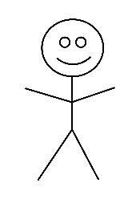



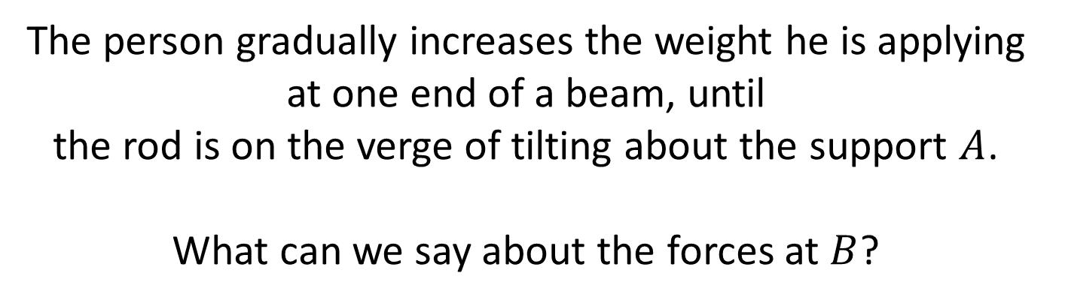
Tilting
$$A$$
$$B$$
The person gradually increases the weight he is applying at one end of a beam, until
the rod is on the verge of tilting about the support $A$.
What can we say about the forces at $B$?
The rod is about to lift off pivot $B$,
so there must be no reaction force at this support

Slide 3



Tilting
$$A$$
$$B$$
On the point of tilting
$$A$$

Slide 4
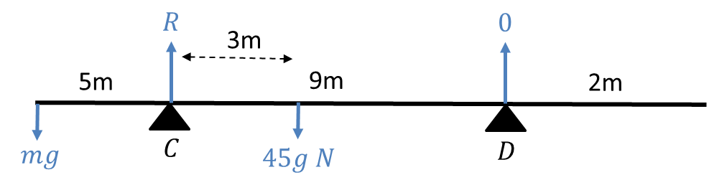
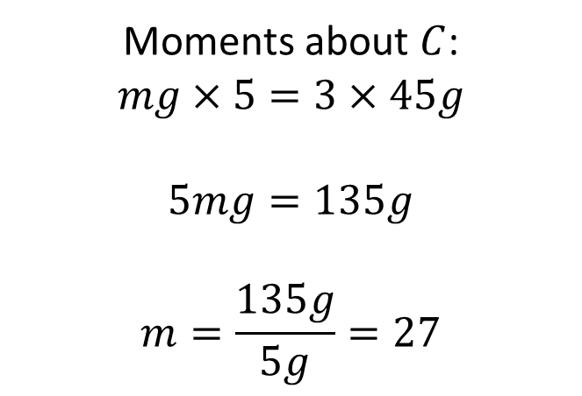
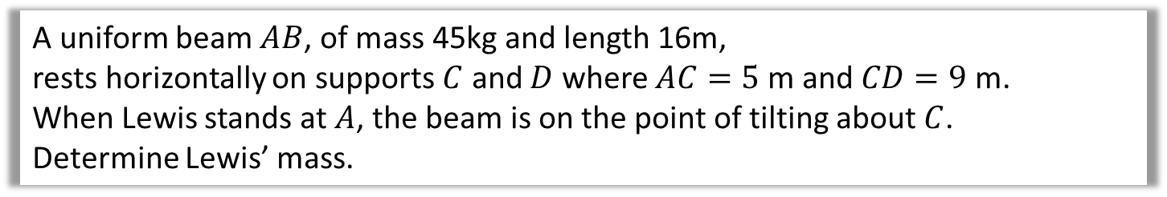
Tilting
A uniform beam $AB$, of mass 45kg and length 16m,
rests horizontally on supports $C$ and $D$ where $AC=5$ m and $CD=9$ m.
When Lewis stands at $A$, the beam is on the point of tilting about $C$.
Determine Lewis’ mass.
Moments about $C$:
$$mg×5=3×45g$$
$$5mg=135g$$
$$m=\frac{135g}{5g}=27$$

Slide 5
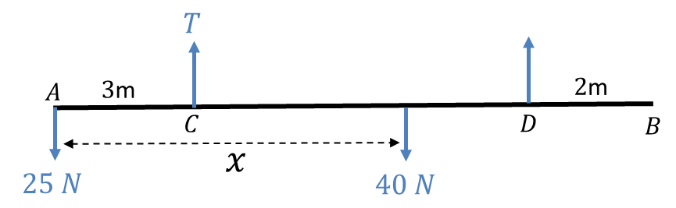
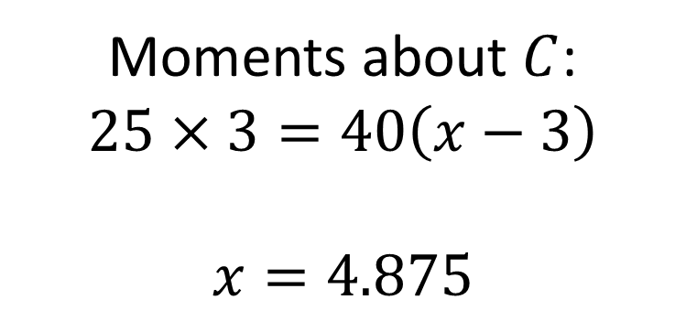
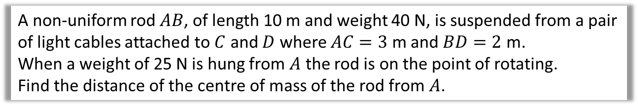

Tilting - Suspended System
A non-uniform rod $AB$, of length 10 m and weight 40 N, is suspended from a pair of light cables attached to $C$ and $D$ where $AC=3$ m and $BD=2$ m.
When a weight of 25 N is hung from $A$ the rod is on the point of rotating.
Find the distance of the centre of mass of the rod from $A$.
$$0 N$$
Moments about $C$:
$$25×3=40\left(x−3\right)$$
$$x=4.875$$

Slide 6
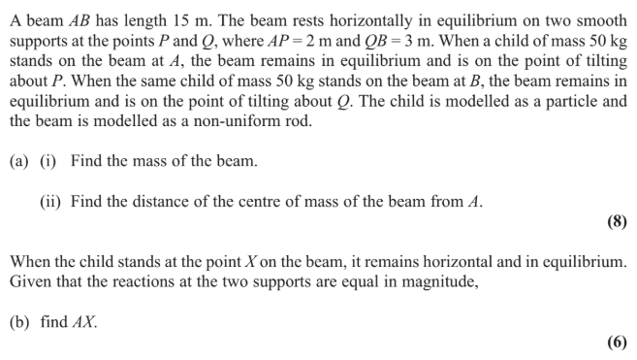
Tilting

Slide 7
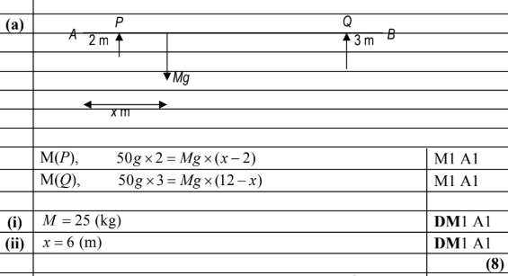
Tilting
a

Slide 8
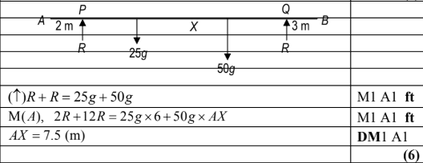
Tilting
b

Slide 9
Test Your Understanding
Edexcel M1(Old) May 2013 Q6
a
?
b
?

Slide 10
Exercise 4E
Pearson Stats/Mechanics Year 2
Page 84-85
Complete before the lesson Q1-3
In Class:
Green Q4
Amber Q5
Red Q6-7

