Slide 1
Methods in Calculus
Twitter: @Owen134866
www.mathsfreeresourcelibrary.com

Slide 2
Teachings for
Exercise 3C

Slide 3






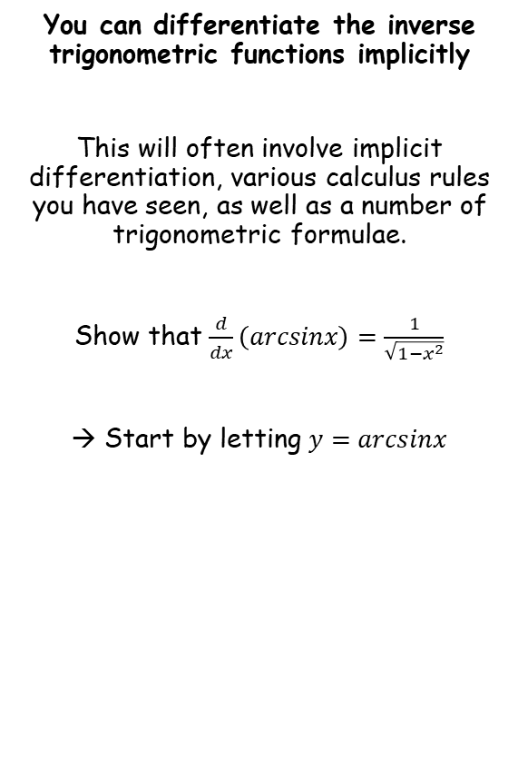









Methods in Calculus
You can differentiate the inverse trigonometric functions implicitly
This will often involve implicit differentiation, various calculus rules you have seen, as well as a number of trigonometric formulae.
Show that $\frac{d}{dx}\left(arcsinx\right)=\frac{1}{\sqrt{1−x^{2}}}$
→ Start by letting $y=arcsinx$
$$y=arcsinx$$
Take sine of both sides
$$siny=sin\left(arcsinx\right)$$
Simplify right side
$$siny=x$$
Differentiate implicitly
$$cosy\frac{dy}{dx}=1$$
Divide by $cosy$
$$\frac{dy}{dx}=\frac{1}{cosy}$$
Replace $cosy$ with an expression in sine
$$\frac{dy}{dx}=\frac{1}{\sqrt{1−\sin^{2}y}}$$
We know that $siny=x$
$$\frac{dy}{dx}=\frac{1}{\sqrt{1−x^{2}}}$$
$$\sin^{2}y+\cos^{2}y≡1$$
Subtract $\sin^{2}y$
$$\cos^{2}y≡1−\sin^{2}y$$
Square root both sides
You should try to show similar result for $cosx$ and $tanx$!
$$cosy≡\sqrt{1−\sin^{2}y}$$
3C

Slide 4






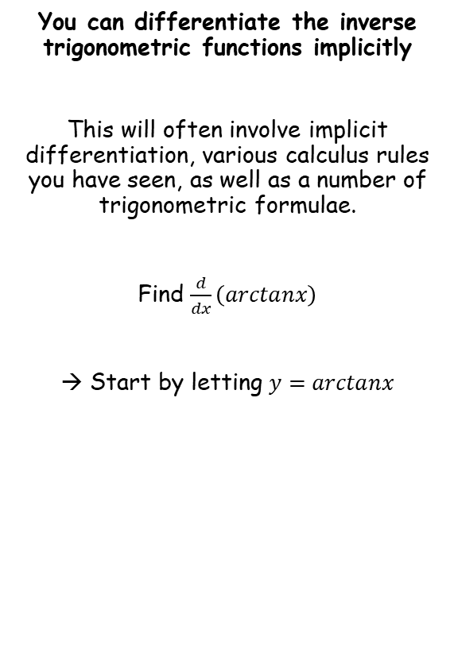









Methods in Calculus
$$\frac{d}{dx}\left(arcsinx\right)=\frac{1}{\sqrt{1−x^{2}}}$$
$$\frac{d}{dx}\left(arctanx\right)=\frac{1}{1+x^{2}}$$
$$\frac{d}{dx}\left(arccosx\right)=−\frac{1}{\sqrt{1−x^{2}}}$$
You can differentiate the inverse trigonometric functions implicitly
This will often involve implicit differentiation, various calculus rules you have seen, as well as a number of trigonometric formulae.
Find $\frac{d}{dx}\left(arctanx\right)$
→ Start by letting $y=arctanx$
$$y=arctanx$$
Therefore…
$$tany=x$$
Differentiate implicitly
$$\sec^{2}y\frac{dy}{dx}=1$$
Divide by $\sec^{2}y$
$$\frac{dy}{dx}=\frac{1}{\sec^{2}y}$$
Replace $\sec^{2}y$with an expression in tan
$$\frac{dy}{dx}=\frac{1}{\tan^{2}y+1}$$
We know that $tany=x$
$$\frac{dy}{dx}=\frac{1}{x^{2}+1}$$
$$\sin^{2}y+\cos^{2}y≡1$$
Divide all by $\cos^{2}y$
$$\tan^{2}y+1≡\sec^{2}y$$
You are given all the results above in the formula booklet!
3C

Slide 5



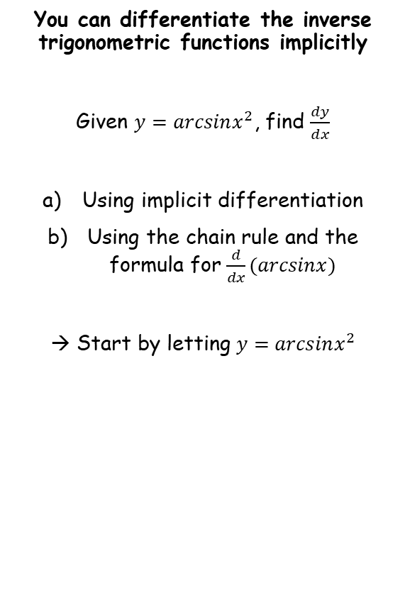






Methods in Calculus
$$\frac{d}{dx}\left(arcsinx\right)=\frac{1}{\sqrt{1−x^{2}}}$$
$$\frac{d}{dx}\left(arctanx\right)=\frac{1}{1+x^{2}}$$
$$\frac{d}{dx}\left(arccosx\right)=−\frac{1}{\sqrt{1−x^{2}}}$$
You can differentiate the inverse trigonometric functions implicitly
Given $y=arcsinx^{2}$, find $\frac{dy}{dx}$
Using implicit differentiation
Using the chain rule and the formula for $\frac{d}{dx}(arcsinx)$
→ Start by letting $y=arcsinx^{2}$
$$y=arcsinx^{2}$$
Rewrite…
$$siny=x^{2}$$
Differentiate implicitly
$$cosy\frac{dy}{dx}=2x$$
Divide by $cosy$
$$\frac{dy}{dx}=\frac{2x}{cosy}$$
Replace $cosy$ with an expression in sine
$$\frac{dy}{dx}=\frac{1}{\sqrt{1−\sin^{2}y}}$$
We know that $siny=x^{2}$
$$\frac{dy}{dx}=\frac{2x}{\sqrt{1−x^{4}}}$$
3C

Slide 6




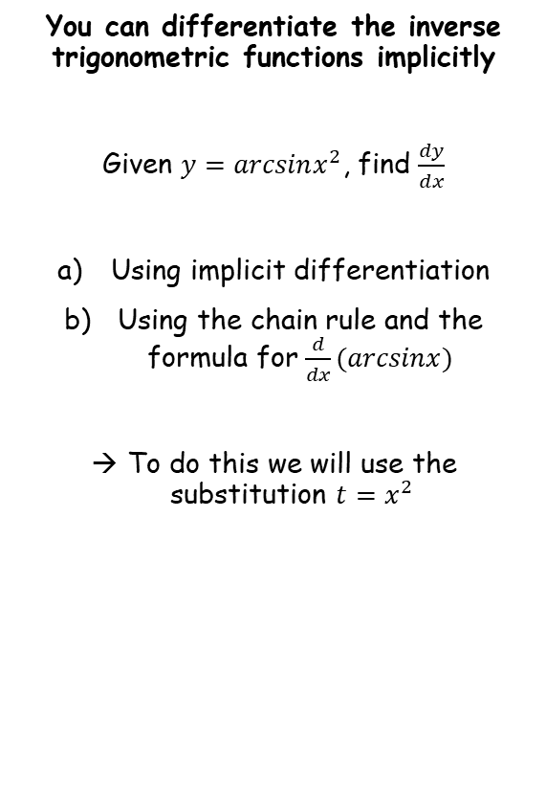








Methods in Calculus
$$\frac{d}{dx}\left(arcsinx\right)=\frac{1}{\sqrt{1−x^{2}}}$$
$$\frac{d}{dx}\left(arctanx\right)=\frac{1}{1+x^{2}}$$
$$\frac{d}{dx}\left(arccosx\right)=−\frac{1}{\sqrt{1−x^{2}}}$$
You can differentiate the inverse trigonometric functions implicitly
Given $y=arcsinx^{2}$, find $\frac{dy}{dx}$
Using implicit differentiation
Using the chain rule and the formula for $\frac{d}{dx}(arcsinx)$
To do this we will use the substitution ${t=x}^{2}$
$$y=arcsinx^{2}$$
Use the substitution $t=x^{2}$
$$y=arcsint$$
$$\frac{dy}{dt}=\frac{1}{\sqrt{1−t^{2}}}$$
Differentiate using the result above
Now we can use the chain rule
$$\frac{dy}{dx}=\frac{dy}{dt}×\frac{dt}{dx}$$
Sub in $\frac{dy}{dt}$ and $\frac{dt}{dx}$
$$=\frac{1}{\sqrt{1−t^{2}}}×2x$$
Combine
$$t=x^{2}$$
$$=\frac{2x}{\sqrt{1−t^{2}}}$$
Differentiate
$$\frac{dt}{dx}=2x$$
Use the substitution $t=x^{2}$
$$=\frac{2x}{\sqrt{1−x^{4}}}$$
3C

Slide 7












Methods in Calculus
$$\frac{d}{dx}\left(arcsinx\right)=\frac{1}{\sqrt{1−x^{2}}}$$
$$\frac{d}{dx}\left(arctanx\right)=\frac{1}{1+x^{2}}$$
$$\frac{d}{dx}\left(arccosx\right)=−\frac{1}{\sqrt{1−x^{2}}}$$
$$y=arctan\left(\frac{1−x}{1+x}\right)$$
You can differentiate the inverse trigonometric functions implicitly
Given $y=arctan\left(\frac{1−x}{1+x}\right)$, find $\frac{dy}{dx}$
Rewrite
$$tany=\frac{1−x}{1+x}$$
Differentiate. You will need to do this implicitly for the left, and use the quotient rule for the right
$$\sec^{2}y\frac{dy}{dx}=$$
$$−\frac{2}{{\left(1+x\right)}^{2}}$$
$$u=1−x$$
$$v=1+x$$
Differentiate
Differentiate
$$\frac{du}{dx}=−1$$
$$\frac{dv}{dx}=1$$
$$\frac{dy}{dx}=\frac{v\frac{du}{dx}−u\frac{dv}{dx}}{v^{2}}$$
Sub in values
$$=\frac{\left(1+x\right)\left(−1\right)−\left(1−x\right)(1)}{{\left(1+x\right)}^{2}}$$
Simplify
$$=−\frac{2}{{\left(1+x\right)}^{2}}$$
3C

Slide 8
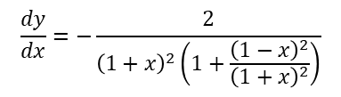

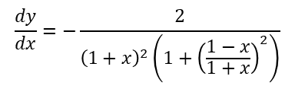






Methods in Calculus
$$\frac{d}{dx}\left(arcsinx\right)=\frac{1}{\sqrt{1−x^{2}}}$$
$$\frac{d}{dx}\left(arctanx\right)=\frac{1}{1+x^{2}}$$
$$\frac{d}{dx}\left(arccosx\right)=−\frac{1}{\sqrt{1−x^{2}}}$$
$$y=arctan\left(\frac{1−x}{1+x}\right)$$
You can differentiate the inverse trigonometric functions implicitly
Given $y=arctan\left(\frac{1−x}{1+x}\right)$, find $\frac{dy}{dx}$
Rewrite
$$tany=\frac{1−x}{1+x}$$
Differentiate. You will need to do this implicitly for the left, and use the quotient rule for the right
$$\sec^{2}y\frac{dy}{dx}=$$
$$−\frac{2}{{\left(1+x\right)}^{2}}$$
Divide by $\sec^{2}y$
$$\frac{dy}{dx}=−\frac{2}{{\left(1+x\right)}^{2}\left(\sec^{2}y\right)}$$
Use $1+\tan^{2}y≡\sec^{2}y$
$$\frac{dy}{dx}=−\frac{2}{{\left(1+x\right)}^{2}\left({1+tan}^{2}y\right)}$$
We know that $tany=\frac{1−x}{1+x}$
$$\frac{dy}{dx}=−\frac{2}{{\left(1+x\right)}^{2}\left(1+{\left(\frac{1−x}{1+x}\right)}^{2}\right)}$$
Square the fraction in the bracket
$$\frac{dy}{dx}=−\frac{2}{{\left(1+x\right)}^{2}\left(1+\frac{{\left(1−x\right)}^{2}}{{\left(1+x\right)}^{2}}\right)}$$
Expand the double bracket on the denominator
$$\frac{dy}{dx}=−\frac{2}{{\left(1+x\right)}^{2}+{\left(1−x\right)}^{2}}$$
Simplify the denominator
$$\frac{dy}{dx}=−\frac{2}{{1+x}^{2}}$$
3C

Slide 9







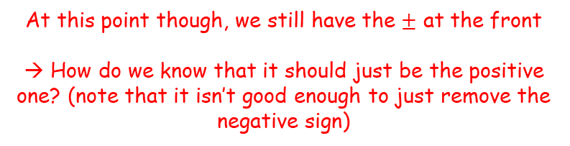



Methods in Calculus
$$\frac{d}{dx}\left(arcsinx\right)=\frac{1}{\sqrt{1−x^{2}}}$$
$$\frac{d}{dx}\left(arctanx\right)=\frac{1}{1+x^{2}}$$
$$\frac{d}{dx}\left(arccosx\right)=−\frac{1}{\sqrt{1−x^{2}}}$$
You can differentiate the inverse trigonometric functions implicitly
Show that:
$$sin\left(arccosx\right)=\sqrt{1−x^{2}}$$
Start by letting $y=arccosx$…
$$y=arccosx$$
Rewrite
$$cosy=x$$
$$sin\left(arccosx\right)$$
Use $y=arccosx$
$$=siny$$
Replace using $\sin^{2}y+\cos^{2}y≡1$
$$=±\sqrt{1−\cos^{2}y}$$
Use $cosy=x$
$$=±\sqrt{1−x^{2}}$$
At this point though, we still have the $±$ at the front
→ How do we know that it should just be the positive one? (note that it isn’t good enough to just remove the negative sign)
3C

Slide 10
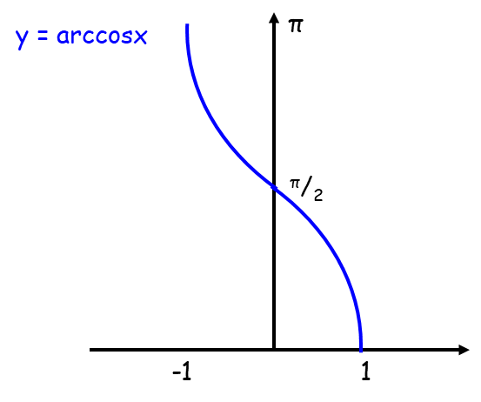





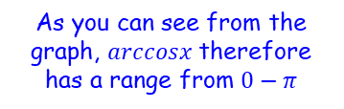
Methods in Calculus
$$\frac{d}{dx}\left(arcsinx\right)=\frac{1}{\sqrt{1−x^{2}}}$$
$$\frac{d}{dx}\left(arctanx\right)=\frac{1}{1+x^{2}}$$
$$\frac{d}{dx}\left(arccosx\right)=−\frac{1}{\sqrt{1−x^{2}}}$$
You can differentiate the inverse trigonometric functions implicitly
Show that:
$$sin\left(arccosx\right)=\sqrt{1−x^{2}}$$
$$y=arccosx$$
Rewrite
$$cosy=x$$
$arccosx$ has a range from $0−π$
$$sin\left(arccosx\right)$$
Use $y=arccosx$
$$=siny$$
Replace using $\sin^{2}y+\cos^{2}y≡1$
The function $y=arccosx$ is defined for the domain $−1≤x≤1$
$$=±\sqrt{1−\cos^{2}y}$$
Use $cosy=x$
$$y$$
$$=±\sqrt{1−x^{2}}$$
As you can see from the graph, $arccosx$ therefore has a range from $0−π$
$$x$$
3C

Slide 11
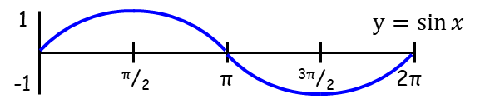



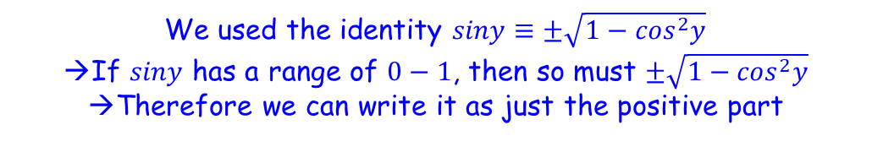
Methods in Calculus
$$\frac{d}{dx}\left(arcsinx\right)=\frac{1}{\sqrt{1−x^{2}}}$$
$$\frac{d}{dx}\left(arctanx\right)=\frac{1}{1+x^{2}}$$
$$\frac{d}{dx}\left(arccosx\right)=−\frac{1}{\sqrt{1−x^{2}}}$$
You can differentiate the inverse trigonometric functions implicitly
Show that:
$$sin\left(arccosx\right)=\sqrt{1−x^{2}}$$
$$y=arccosx$$
Rewrite
$$cosy=x$$
$arccosx$ has a range from $0−π$
$$sin\left(arccosx\right)$$
Use $y=arccosx$
$$=siny$$
Replace using $\sin^{2}y+\cos^{2}y≡1$
$$=\sqrt{1−\cos^{2}y}$$
$$=±\sqrt{1−\cos^{2}y}$$
So we are doing sine of a value from $0−π$
Use $cosy=x$
$$=\sqrt{1−x^{2}}$$
$$=±\sqrt{1−x^{2}}$$
So the value of $siny$ must be in the range $0−1$
We used the identity $siny≡±\sqrt{1−\cos^{2}y}$
If $siny$ has a range of $0−1$, then so must $±\sqrt{1−\cos^{2}y}$
Therefore we can write it as just the positive part
3C

Slide 12
Methods in Calculus
$$\frac{d}{dx}\left(arcsinx\right)=\frac{1}{\sqrt{1−x^{2}}}$$
$$\frac{d}{dx}\left(arctanx\right)=\frac{1}{1+x^{2}}$$
$$\frac{d}{dx}\left(arccosx\right)=−\frac{1}{\sqrt{1−x^{2}}}$$
You can differentiate the inverse trigonometric functions implicitly
Show that:
$$sin\left(arccosx\right)=\sqrt{1−x^{2}}$$
$$y=arccosx$$
Rewrite
$$cosy=x$$
$$sin\left(arccosx\right)$$
Use $y=arccosx$
$$=siny$$
Replace using $\sin^{2}y+\cos^{2}y≡1$
$$=\sqrt{1−\cos^{2}y}$$
Use $cosy=x$
$$=\sqrt{1−x^{2}}$$
It is really important that you show this, rather than just assuming/trying to gloss over the explanation!
3C

Slide 13
Exercise 3C
Pearson Core Pure Year 2
Pages 61-62
Complete before the lesson Q1
In Class:
Green Q2-4
Amber Q5-6
Red Q7-11

