Slide 1

MechYr1 Chapter 11 ::
Variable Acceleration
jfrost@tiffin.kingston.sch.uk
www.drfrostmaths.com
@DrFrostMaths
Last modified: 5th August 2018

Slide 2








www.drfrostmaths.com
Everything is completely free.
Why not register?
Register now to interactively practise questions on this topic, including past paper questions and extension questions (including MAT + UKMT).
Teachers: you can create student accounts (or students can register themselves), to set work, monitor progress and even create worksheets.
With questions by:
Dashboard with points, trophies, notifications and student progress.
Questions organised by topic, difficulty and past paper.
Teaching videos with topic tests to check understanding.

Slide 3


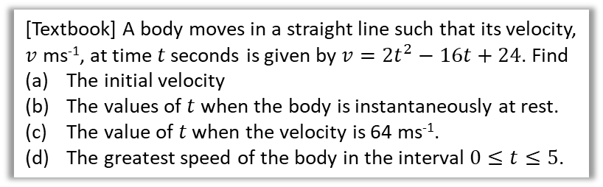
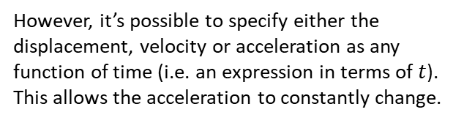

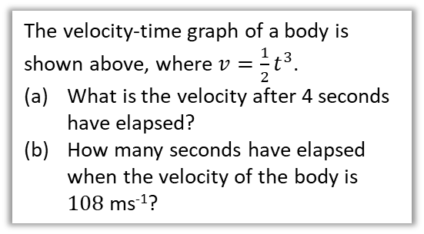
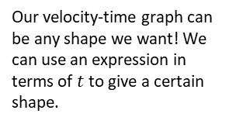
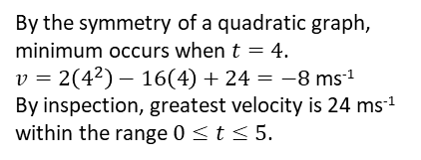
Functions of time
constant acceleration
no acceleration
Up to now, the acceleration has always been constant in any particular period of time…
velocity
constant deceleration
time
Our velocity-time graph can be any shape we want! We can use an expression in terms of $t$ to give a certain shape.
However, it’s possible to specify either the displacement, velocity or acceleration as any function of time (i.e. an expression in terms of $t$). This allows the acceleration to constantly change.
velocity
$$v=\frac{1}{2}t^{3}$$
time
The velocity-time graph of a body is shown above, where $v=\frac{1}{2}t^{3}$.
What is the velocity after 4 seconds have elapsed?
How many seconds have elapsed when the velocity of the body is $108$ ms⁻¹?
[Textbook] A body moves in a straight line such that its velocity, $v$ ms⁻¹, at time $t$ seconds is given by $v=2t^{2}−16t+24$. Find
The initial velocity
The values of $t$ when the body is instantaneously at rest.
The value of $t$ when the velocity is 64 ms⁻¹.
The greatest speed of the body in the interval $0≤t≤5$.
d
?
a
When $t=0, v=24$ ms⁻¹.
$$0=2t^{2}−16t+24 \\ t^{2}−8t+12=0$$
$→ t=2$ or $t=6$.
$$64=2t^{2}−16t+24 \\ t^{2}−8t−20=0$$
$→ t=10$ or $t=−2$
24
?
b
?
$v=\frac{1}{2}×4^{3}=32$ ms⁻¹
$$108=\frac{1}{2}t^{3}$$
$t^{3}=216 → t=6$ s
2
6
a
?
(4,-8)
c
?
By the symmetry of a quadratic graph, minimum occurs when $t=4$.
$v=2\left(4^{2}\right)−16\left(4\right)+24=−8$ ms⁻¹
By inspection, greatest velocity is 24 ms⁻¹ within the range $0≤t≤5$.
b
?

Slide 4
Exercise 11A
Pearson Stats/Mechanics Year 1
Page 184
Complete before the lesson Q1-2
In Class:
Green Q3-5
Red Q6-8

Slide 5

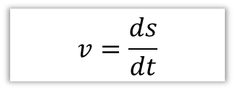

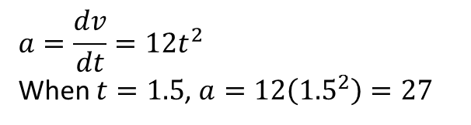
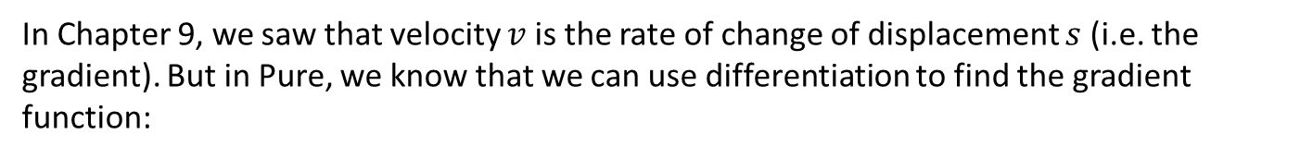


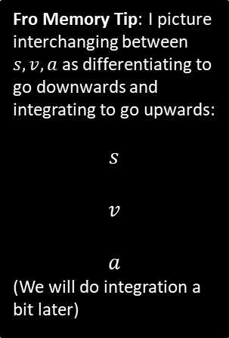
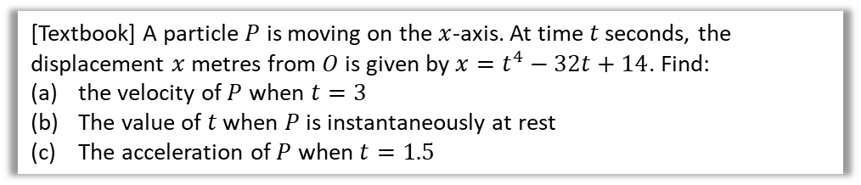
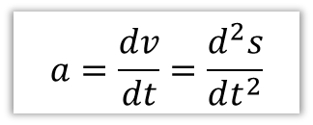

Using Differentiation
In Chapter 9, we saw that velocity $v$ is the rate of change of displacement $s$ (i.e. the gradient). But in Pure, we know that we can use differentiation to find the gradient function:
Fro Memory Tip: I picture interchanging between $s,v,a$ as differentiating to go downwards and integrating to go upwards:
$$s$$
$$v$$
$$a$$
(We will do integration a bit later)
$$v=\frac{ds}{dt}$$
and similarly…
$$a=\frac{dv}{dt}=\frac{d^{2}s}{dt^{2}}$$
?
?
velocity is the rate of change of displacement
acceleration is the rate of change of velocity
$$∫v dt$$
$$\frac{d}{dt}$$
[Textbook] A particle $P$ is moving on the $x$-axis. At time $t$ seconds, the displacement $x$ metres from $O$ is given by $x=t^{4}−32t+14$. Find:
the velocity of $P$ when $t=3$
The value of $t$ when $P$ is instantaneously at rest
The acceleration of $P$ when $t=1.5$
$$∫a dt$$
$$\frac{d}{dt}$$
$$v=\frac{dx}{dt}=4t^{3}−32$$
When $t=3, v=4\left(3^{3}\right)−32=76$ ms⁻²
$$4t^{3}−32=0 → t=2$$
$$a=\frac{dv}{dt}=12t^{2}$$
When $t=1.5$, $a=12\left({1.5}^{2}\right)=27$
a
?
c
?
b
?

Slide 6

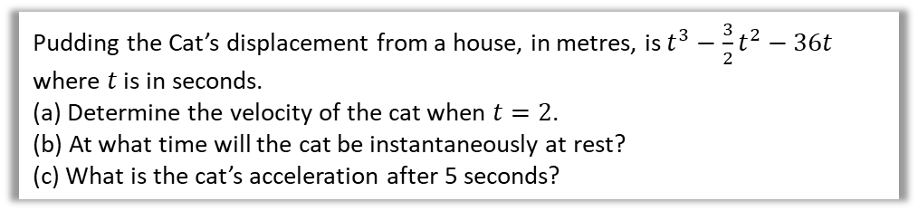

Test Your Understanding
Pudding the Cat’s displacement from a house, in metres, is $t^{3}−\frac{3}{2}t^{2}−36t$ where $t$ is in seconds.
(a) Determine the velocity of the cat when $t=2$.
(b) At what time will the cat be instantaneously at rest?
(c) What is the cat’s acceleration after 5 seconds?
a
$$s=t^{3}−\frac{3}{2}t^{2}−36t \\ v=3t^{2}−3t−36$$
When $t=2$, $v=3\left(2^{2}\right)−3\left(2\right)−36=−30$ ms⁻¹
When $v=0$, $3t^{2}−3t−36=0$
$$t^{2}−t−12=0 \\ \left(t+3\right)\left(t−4\right)=0$$
$t=4$ s
$$a=6t−3$$
When $t=5$, $a=30−3=27$ ms⁻²
?
b
?
c
?

Slide 7
Exercise 11B
Pearson Stats/Mechanics Year 1
Page 185-186
Complete before the lesson Q1
In Class:
Green Q2-3
Red Q4-6

Slide 8

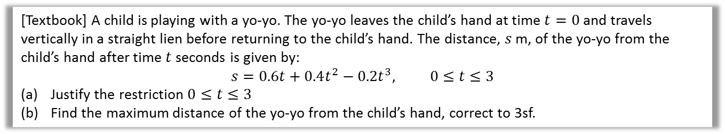

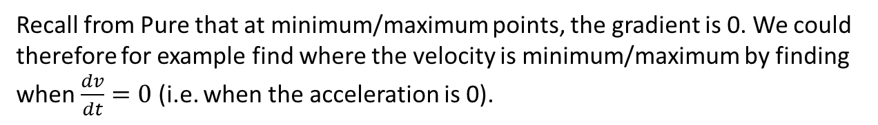




Maxima and Minima Problems
Recall from Pure that at minimum/maximum points, the gradient is 0. We could therefore for example find where the velocity is minimum/maximum by finding when $\frac{dv}{dt}=0$ (i.e. when the acceleration is 0).
[Textbook] A child is playing with a yo-yo. The yo-yo leaves the child’s hand at time $t=0$ and travels vertically in a straight lien before returning to the child’s hand. The distance, $s$ m, of the yo-yo from the child’s hand after time $t$ seconds is given by:
$$s=0.6t+0.4t^{2}−0.2t^{3}, 0≤t≤3$$
Justify the restriction $0≤t≤3$
Find the maximum distance of the yo-yo from the child’s hand, correct to 3sf.
$$s=\frac{1}{5}t\left(3+2t−t^{2}\right)=\frac{1}{5}t\left(3−t\right)\left(1+t\right)$$
$s$ is maximised when $\frac{ds}{dt}=0$.
$$\frac{ds}{dt}=0.6+0.8t−0.6t^{2}=0 \\ 3t^{2}−4t−3=0 \\ t=\frac{4±\sqrt{52}}{6}=1.8685 or −0.5351$$
$s=0.6\left(1.8685\right)+…=1.21$ m (3sf)
a
?
b
?
$$s$$
From the graph, we can see that for non-negative times ($t≥0$), $s$ is only positive for $0≤t≤3$.
$$3$$
$$t$$

Slide 9

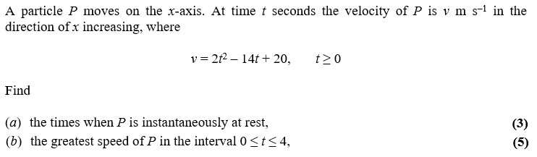
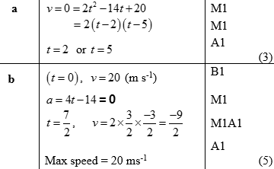
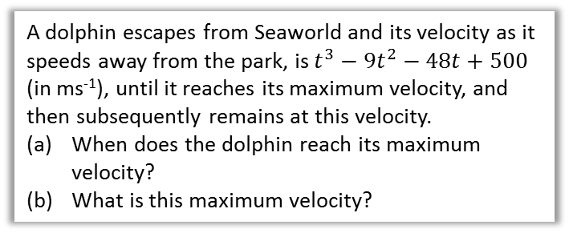

Test Your Understanding
a
?
A dolphin escapes from Seaworld and its velocity as it speeds away from the park, is $t^{3}−9t^{2}−48t+500$ (in ms⁻¹), until it reaches its maximum velocity, and then subsequently remains at this velocity.
When does the dolphin reach its maximum velocity?
What is this maximum velocity?
At the maximum velocity, $\frac{dv}{dt}=0$
$$\frac{dv}{dt}=3t^{2}−18t−48=0 \\ t^{2}−6t−16=0 \\ \left(t−8\right)\left(t+2\right)=0 \\ t=8$$
$$v=8^{3}−9\left(8^{2}\right)−48\left(8\right)+3$$
$=52$ ms⁻¹
b
?
Edexcel M2 June 2013 Q3a,b
a
?
b
?

Slide 10
Exercise 11C
Pearson Stats/Mechanics Year 1
Page 187-188
Complete before the lesson Q1
In Class:
Green Q2-3
Amber Q4
Red Q5-6

Slide 11

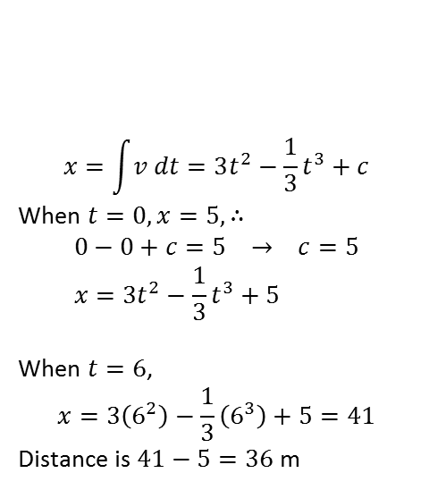

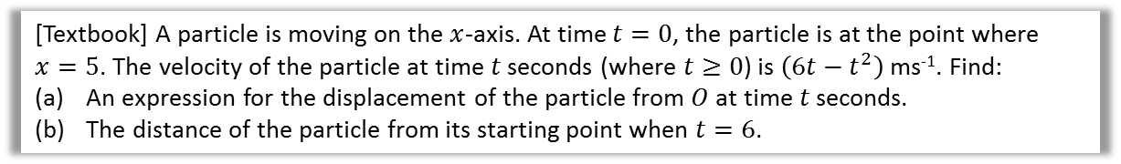


Using Integration
$$s$$
$$v$$
$$a$$
Differentiating (with respect to time) gets us from displacement to velocity, and from velocity to acceleration.
So naturally, integrating (with respect to time) gets us from acceleration to velocity, and from velocity to displacement. As mentioned earlier, it’s helpful to picture the graph on the left, where we move down to differentiate and up to integrate.
$$∫v dt$$
$$\frac{d}{dt}$$
$$∫a dt$$
$$\frac{d}{dt}$$
[Textbook] A particle is moving on the $x$-axis. At time $t=0$, the particle is at the point where $x=5$. The velocity of the particle at time $t$ seconds (where $t≥0$) is $\left(6t−t^{2}\right)$ ms⁻¹. Find:
An expression for the displacement of the particle from $O$ at time $t$ seconds.
The distance of the particle from its starting point when $t=6$.
a
$$x=\int{v dt}=3t^{2}−\frac{1}{3}t^{3}+c$$
When $t=0, x=5, ∴$
$$0−0+c=5 → c=5 \\ x=3t^{2}−\frac{1}{3}t^{3}+5$$
When $t=6$,
$$x=3\left(6^{2}\right)−\frac{1}{3}\left(6^{3}\right)+5=41$$
Distance is $41−5=36$ m
?
Recall in Pure Year 1 that we can find the constant of integration by using known values.
b
?

Slide 12





Further Example
[Textbook] A particle travels in a straight line. After $t$ seconds its velocity, $v$ ms⁻¹, is given by $v=5−3t^{2}$, $t≥0$. Find the distance travelled by the particle in the third second of its motion.
?
$$s=\int_{2}^{3}{\left(5−3t^{2}\right) dt} \\ ={\left[5t−t^{3}\right]}_{2}^{3}=\left(15−27\right)−\left(10−8\right) \\ =−12−2=−14$$
Distance travelled is 14 m.
$$v$$
$$2$$
$$3$$
$$t$$

Slide 13
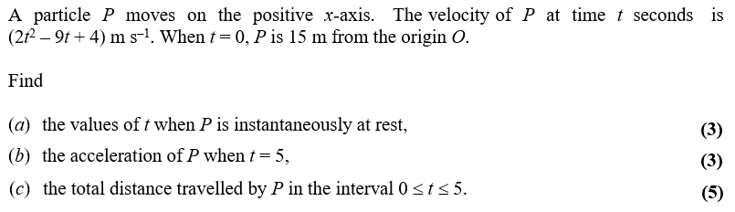
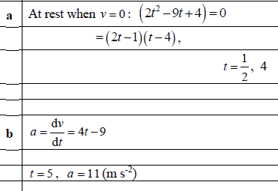
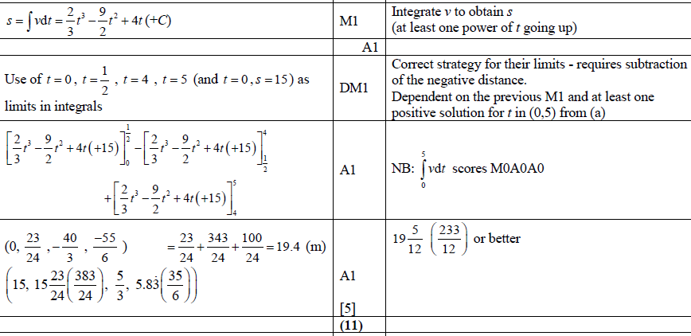

Further Example
Edexcel M2 June 2015 Q6
Warning: recall that if the curve goes above and below the $x$-axis, we need to find each area separately.
a
?
b
?
c
?

Slide 14
Exercise 11D
Pearson Stats/Mechanics Year 1
Page 189-191
Complete before the lesson Q1
In Class:
Green Q2-4
Amber Q5-8
Red Q9-12 & Challenge

Slide 15
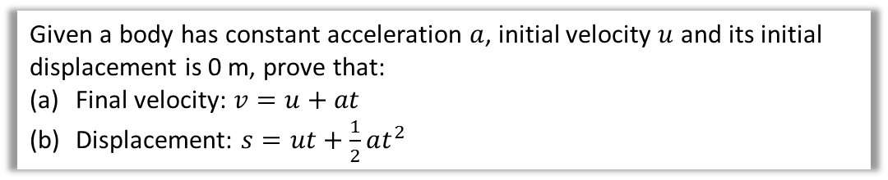
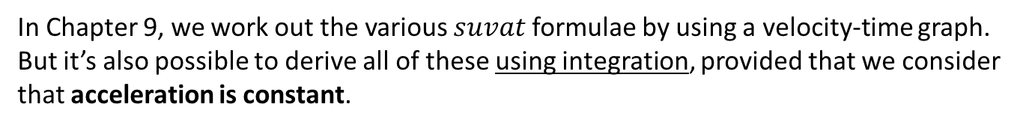
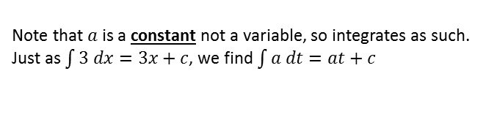
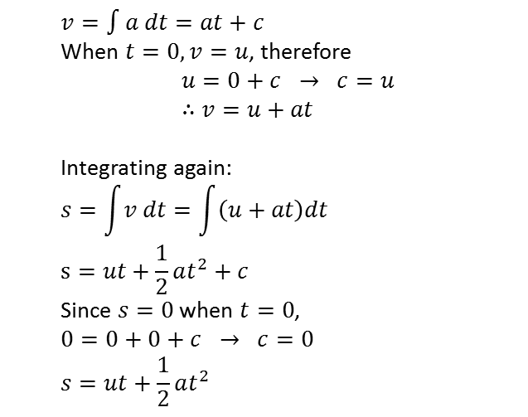
Constant acceleration formulae
In Chapter 9, we work out the various $suvat$ formulae by using a velocity-time graph.
But it’s also possible to derive all of these using integration, provided that we consider that acceleration is constant.
Given a body has constant acceleration $a$, initial velocity $u$ and its initial displacement is 0 m, prove that:
Final velocity: $v=u+at$
Displacement: $s=ut+\frac{1}{2}at^{2}$
a
?
Note that $a$ is a constant not a variable, so integrates as such. Just as $\int{3 dx=3x+c}$, we find $\int{a dt}=at+c$
$$v=∫a dt=at+c$$
When $t=0, v=u$, therefore
$$u=0+c → c=u \\ ∴v=u+at$$
Integrating again:
$$s=\int{v dt}=\int{\left(u+at\right)dt} \\ s=ut+\frac{1}{2}at^{2}+c$$
Since $s=0$ when $t=0$,
$$0=0+0+c → c=0 \\ s=ut+\frac{1}{2}at^{2}$$
b
?
Again, because $u$ is fixed, we can treat it as a constant.

Slide 16
Exercise 11E
Pearson Stats/Mechanics Year 1
Pages 192-193
Complete before the lesson Q1
In Class:
Amber Q2-3
Red Q4-6

Slide 17
The End

