Slide 1
Year 1 Applied Mathematics
Constant Acceleration
- Distance Time Graphs
Chapter 9
(Part 1 of 4)

Slide 2
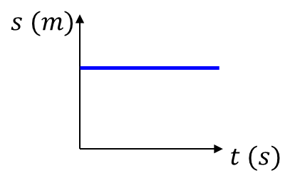
Displacement-Time Graphs
Describe the motion of each object:
Object is stationary.

Slide 3
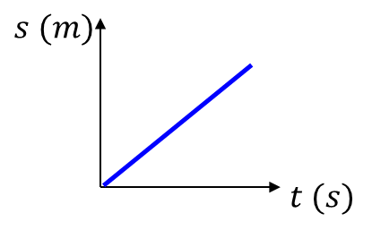
Displacement-Time Graphs
Describe the motion of each object:
Object is moving with constant velocity.

Slide 4
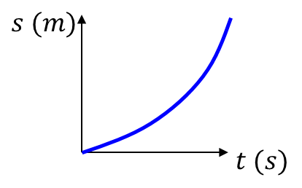
Displacement-Time Graphs
Describe the motion of each object:
Object is accelerating.

Slide 5
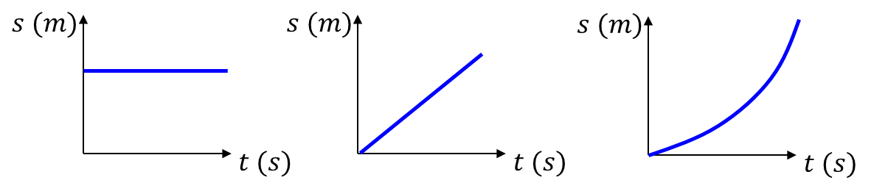

Displacement-Time Graphs
Velocity is the gradient of line
Distance travelled
Time taken
Average Speed $=$

Slide 6






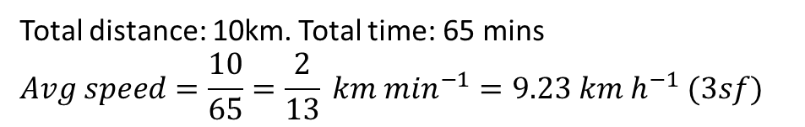
Displacement-Time Graphs - Example
A cyclist rides in a straight line for 20 minutes. She waits for half an hour,
then returns in a straight line to her starting point in 15 minutes.
This is a displacement-time graph for her journey.
Work out the average velocity for each stage of the journey in km h⁻¹.
Write down the average velocity for the whole journey.
Work out average speed for the whole journey.
$$d (km)$$
$$A$$
$$B$$
5
$$O$$
$$C$$
20
50
65
$$t (mins)$$
a
$OA: \frac{5}{20}=0.25 km \min^{−1}=15km h^{−1}$ $AB:0 km h^{−1} BC:−\frac{5}{15}=−\frac{1}{3} km \min^{−1}=20 km h^{−1}$
b
0 (as displacement is 0)
c
Total distance: 10km. Total time: 65 mins
$$Avg speed=\frac{10}{65}=\frac{2}{13} km \min^{−1}=9.23 km h^{−1} (3sf)$$

Slide 7
Exercise 9A
Pearson Stats/Mechanics Year 1
Pages 132-133
(Classes in a rush may wish to skip this exercise)
Complete before the lesson Q1-2
In Class:
Green Q3
Amber Q4

