Slide 1

P2 Chapter 9 :: Differentiation
jfrost@tiffin.kingston.sch.uk
www.drfrostmaths.com
@DrFrostMaths
Last modified: 6th September 2018

Slide 2








www.drfrostmaths.com
Everything is completely free.
Why not register?
Register now to interactively practise questions on this topic, including past paper questions and extension questions (including MAT + UKMT).
Teachers: you can create student accounts (or students can register themselves), to set work, monitor progress and even create worksheets.
With questions by:
Dashboard with points, trophies, notifications and student progress.
Questions organised by topic, difficulty and past paper.
Teaching videos with topic tests to check understanding.

Slide 3
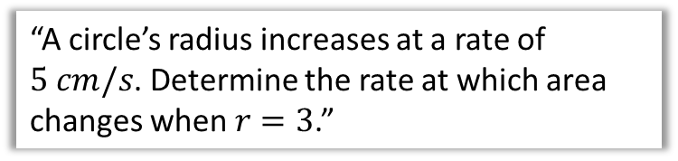
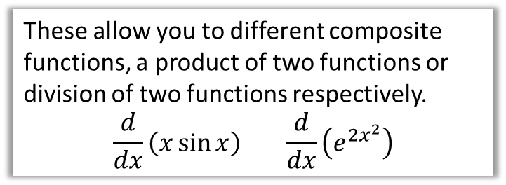
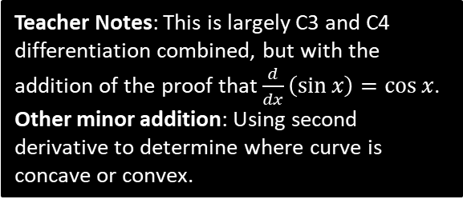
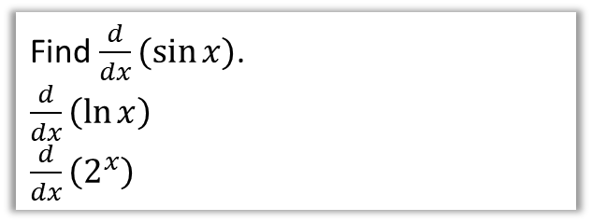
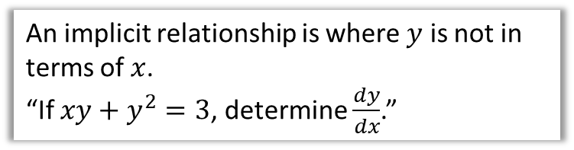
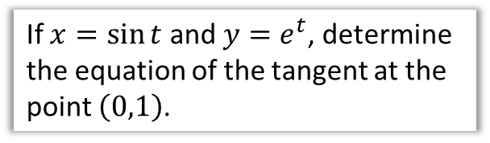
Chapter Overview
In Year 1 the expressions you could differentiation were somewhat limited: only terms of the form $ax^{n}$.
2:: Use chain, product and quotient rules.
1:: Differentiate trigonometric, exponential and log functions.
These allow you to different composite functions, a product of two functions or division of two functions respectively.
$$\frac{d}{dx}\left(x\sin{x}\right) \frac{d}{dx}\left(e^{2x^{2}}\right)$$
Find $\frac{d}{dx}(\sin{x})$.
$\frac{d}{dx}\left(\ln{x}\right)$
$\frac{d}{dx}\left(2^{x}\right)$
4:: Implicit Differentiation
3:: Differentiate parametric equations.
An implicit relationship is where $y$ is not in terms of $x$.
“If $xy+y^{2}=3$, determine $\frac{dy}{dx}$.”
If $x=\sin{t}$ and $y=e^{t}$, determine the equation of the tangent at the point $\left(0,1\right)$.
5:: Rates of change
Teacher Notes: This is largely C3 and C4 differentiation combined, but with the addition of the proof that $\frac{d}{dx}\left(\sin{x}\right)=\cos{x}$.
Other minor addition: Using second derivative to determine where curve is concave or convex.
“A circle’s radius increases at a rate of $5 cm/s$. Determine the rate at which area changes when $r=3$.”

Slide 4
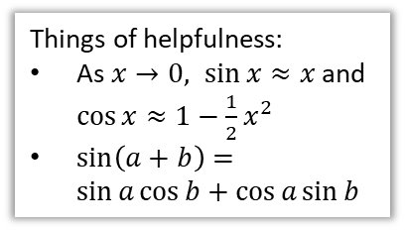
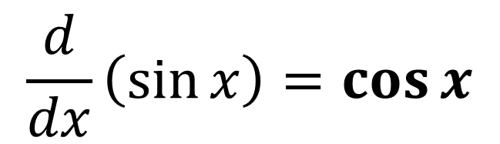
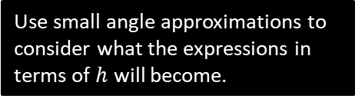


Differentiating trigonometric functions
$$\frac{d}{dx}\left(\sin{x}\right)=\cos{x}$$
?
Things of helpfulness:
As $x→0, \sin{x}≈x$ and $\cos{x}≈1−\frac{1}{2}x^{2}$
$\sin\left(a+b\right)=\sin{a}\cos{b}+\cos{a}\sin{b}$
Yes, you could be tested on this!
Proof
If $y=f(x)$ then $\frac{dy}{dx}=\lim_{h→0}{\frac{f\left(x+h\right)−f\left(x\right)}{h}}$
$$=\lim_{h→0}{\frac{\sin\left(x+h\right)−\sin\left(x\right)}{h}} \\ =\lim_{h→0}{\frac{\sin\left(x\right)\cos\left(h\right)+\cos\left(x\right)\sin\left(h\right)−\sin\left(x\right)}{h}} \\ =\lim_{h→0}\left(\left(\frac{\cos{h}−1}{h}\right)\sin{x}+\left(\frac{\sin{h}}{h}\right)\cos{x}\right)$$
Since $\lim_{h→0}{\sin{h}}≈h$, $∴$ $\lim_{h→0}{\frac{\sin{h}}{h}}≈\lim_{h→0}{\frac{h}{h}}=1$
Similarly, $\lim_{h→0}{\frac{\cos{h}−1}{h}}≈\lim_{h→0}{\frac{1−\frac{1}{2}h^{2}−1}{h}}=\lim_{h→0}{(−\frac{1}{2}h}) →0$
$$∴\frac{dy}{dx}=\lim_{h→0}\left(0\sin{x}+1\cos{x}\right)=\cos{x}$$
?
?
Use addition formula.
?
Collect $\sin{x}$ terms and $\cos{x}$ terms together.
?
Use small angle approximations to consider what the expressions in terms of $h$ will become.
?

Slide 5
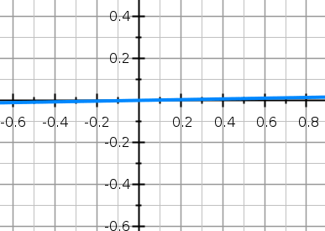
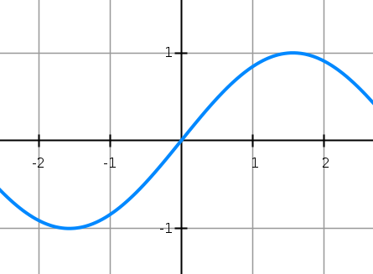

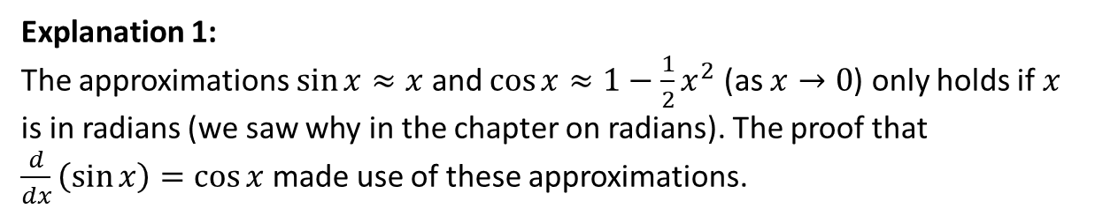



Why does this result only hold in radians?
Explanation 1:
The approximations $\sin{x}≈x$ and $\cos{x}≈1−\frac{1}{2}x^{2}$ (as $x→0$) only holds if $x$ is in radians (we saw why in the chapter on radians). The proof that $\frac{d}{dx}\left(\sin{x}\right)=\cos{x}$ made use of these approximations.
Explanation 2:
We can see by observation if we look at the graph of $\sin{x}$ in radians and in degrees.
$$y=\sin{x}$$
using radians
$$y=\sin{x}$$
using degrees
However when $x$ is in degrees, and again using the same scale for both axes, we can clearly see the gradient is much lower than 1.
If $\frac{d}{dx}\left(\sin{x}\right)=\cos{x}$ then the gradient when $x=0$ is $\cos{0}=1$. This looks right from the graph.

Slide 6

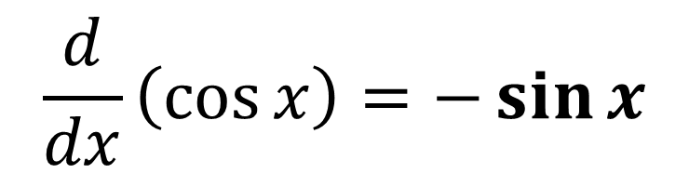

Differentiating trigonometric functions
$$\frac{d}{dx}\left(\cos{x}\right)=−\sin{x}$$
?
Fro Memory Tip: The way I picture this in my head is this:
where moving ‘down’ is differentiating and moving up is integrating. If it’s the ‘wrong’ function (differentiating cos or integrating sin) the sign changes.
$$\sin{x}$$
$$\cos{x}$$

Slide 7
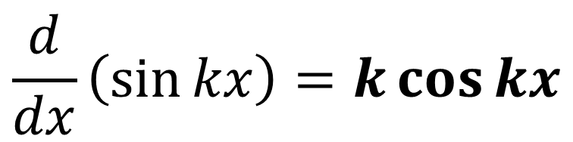
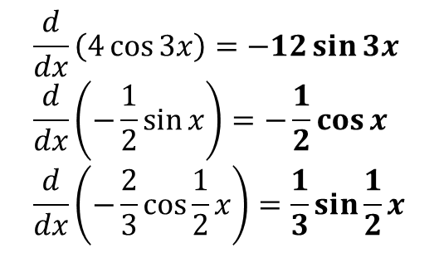
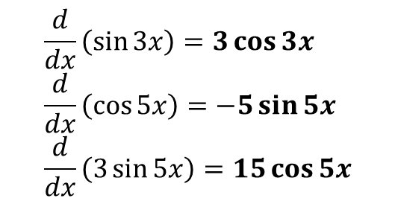
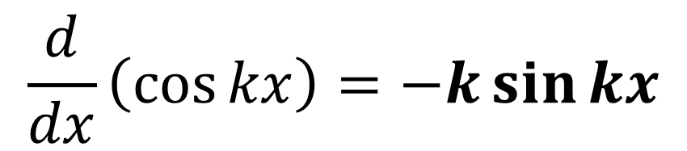
Differentiating $\sin{kx}$ and $\cos{kx}$
?
$$\frac{d}{dx}\left(\sin{kx}\right)=k\cos{kx}$$
$$\frac{d}{dx}\left(\cos{kx}\right)=−k\sin{kx}$$
?
Fro Note: This is not a rule in itself but a specific case of the ‘chain rule’ which we’ll see later this chapter.
Quickfire Questions:
$$\frac{d}{dx}\left(\sin{3x}\right)=3\cos{3x} \\ \frac{d}{dx}\left(\cos{5x}\right)=−5\sin{5x} \\ \frac{d}{dx}\left(3\sin{5x}\right)=15\cos{5x}$$
$$\frac{d}{dx}\left(4\cos{3x}\right)=−12\sin{3x} \\ \frac{d}{dx}\left(−\frac{1}{2}\sin{x}\right)=−\frac{1}{2}\cos{x} \\ \frac{d}{dx}\left(−\frac{2}{3}\cos{\frac{1}{2}x}\right)=\frac{1}{3}\sin{\frac{1}{2}x}$$
?
?
?
?
?
?

Slide 8

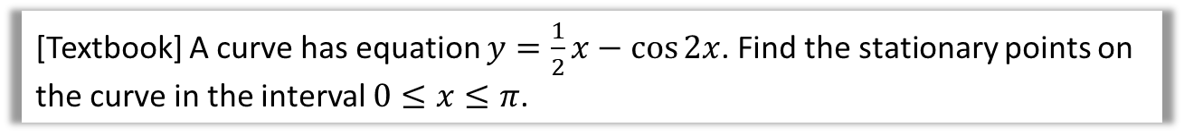
Example
[Textbook] A curve has equation $y=\frac{1}{2}x−\cos{2x}$. Find the stationary points on the curve in the interval $0≤x≤π$.
?
$$\frac{dy}{dx}=\frac{1}{2}+2\sin{2x}=0 \\ 2\sin{2x}=−\frac{1}{2} \\ \sin{2x}=−\frac{1}{4} \\ 2x=−0.2527, 3.3943, 6.0305 \\ x=1.697, 3.015$$
When $x=1.697, y=\frac{1}{2}\left(1.697\right)−\cos\left(2×1.697\right)=1.82$
When $x=3.015, y=0.539$

Slide 9

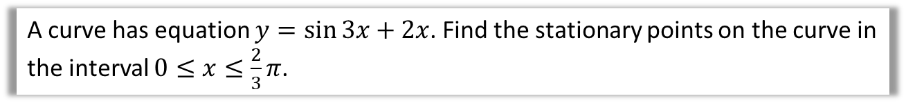
Test Your Understanding
A curve has equation $y=\sin{3x}+2x$. Find the stationary points on the curve in the interval $0≤x≤\frac{2}{3}π$.
?
$$\frac{dy}{dx}=3cos 3x+2=0 \\ 3\cos{3x}=−2 \\ \cos{3x}=−\frac{2}{3} \\ 3x=2.3005, 3.9827 \\ x=0.7668, 1.3276$$
When $x=0.7668, y=2.279$
When $x=1.3276, y=1.910$

Slide 10
Exercise 9A
Pearson Pure Mathematics Year 2/AS
Page 234
Complete before the lesson Q4, 6 & 7
In Class:
Green Q8
Amber Q9
Red Q10 & Challenge

Slide 11
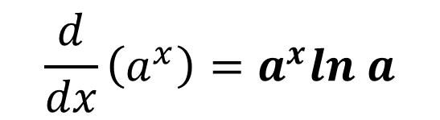
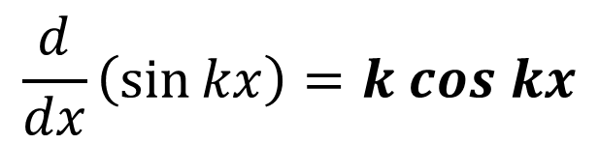
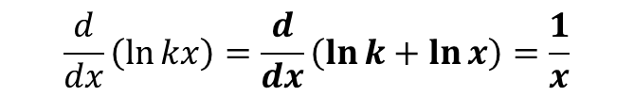
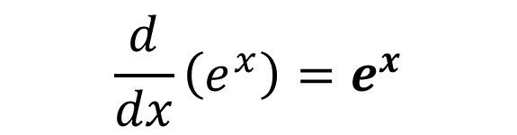
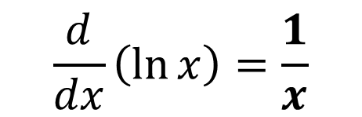
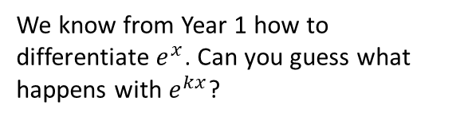
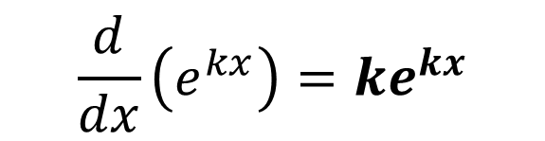
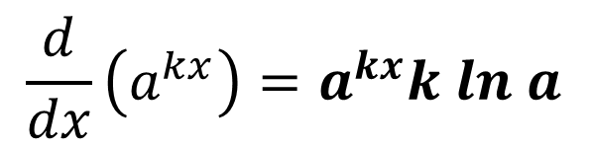
Differentiation exponential and log functions
We know from Year 1 how to differentiate $e^{x}$. Can you guess what happens with $e^{kx}$?
$$\frac{d}{dx}\left(e^{x}\right)=e^{x}$$
?
$$\frac{d}{dx}\left(e^{kx}\right)=ke^{kx}$$
?
$$\frac{d}{dx}\left(\sin{kx}\right)=k cos kx$$
?
$$\frac{d}{dx}\left(\ln{kx}\right)=\frac{d}{dx}\left(\ln{k}+\ln{x}\right)=\frac{1}{x}$$
$$\frac{d}{dx}\left(\ln{x}\right)=\frac{1}{x}$$
?
i.e. Scaling the input of a log does not affect the gradient.
This variant occurs regularly in exams!
$$\frac{d}{dx}\left(a^{x}\right)=a^{x}ln a$$
i.e. When we differentiate an exponential function, we multiply by ln of the base.
We will prove this after we cover implicit differentiation.
?
$$\frac{d}{dx}\left(a^{kx}\right)=a^{kx}k ln a$$
?

Slide 12

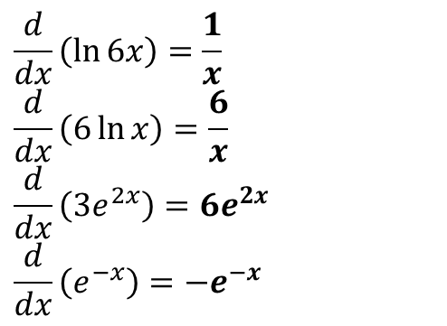
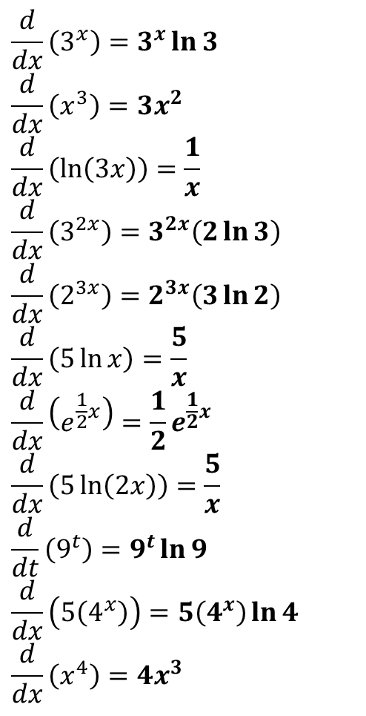

Quickfire Questions
$$\frac{d}{dx}\left(3^{x}\right)=3^{x}\ln{3} \\ \frac{d}{dx}\left(x^{3}\right)=3x^{2} \\ \frac{d}{dx}\left(\ln\left(3x\right)\right)=\frac{1}{x} \\ \frac{d}{dx}\left(3^{2x}\right)=3^{2x}\left(2\ln{3}\right) \\ \frac{d}{dx}\left(2^{3x}\right)=2^{3x}\left(3\ln{2}\right) \\ \frac{d}{dx}\left(5\ln{x}\right)=\frac{5}{x} \\ \frac{d}{dx}\left(e^{\frac{1}{2}x}\right)=\frac{1}{2}e^{\frac{1}{2}x} \\ \frac{d}{dx}\left(5\ln\left(2x\right)\right)=\frac{5}{x} \\ \frac{d}{dt}\left(9^{t}\right)=9^{t}\ln{9} \\ \frac{d}{dx}\left(5\left(4^{x}\right)\right)=5\left(4^{x}\right)\ln{4} \\ \frac{d}{dx}\left(x^{4}\right)=4x^{3}$$
?
?
$$\frac{d}{dx}\left(\ln{6x}\right)=\frac{1}{x} \\ \frac{d}{dx}\left(6\ln{x}\right)=\frac{6}{x}$$
$$\frac{d}{dx}\left(3e^{2x}\right)=6e^{2x} \\ \frac{d}{dx}\left(e^{−x}\right)=−e^{−x}$$
?
?
?
?
?
?
?
bun pun intended
‘Meatier’ Example:
?
A rabbit population $P$ after $t$ years can be modelled using $P=1000(2^{t})$. Determine after how many years the rate of population increase will reach 20,000 rabbits per year.
$$\frac{dP}{dt}=1000\left(2^{t}\right)\ln{2}=20 000 \\ 2^{t}=\frac{20000}{1000\ln{2}}=\frac{20}{\ln{2}} \\ t=\log_{2}\left(\frac{20}{\ln{2}}\right)=4.85 years (3sf)$$
?
?
?
?
?
?

Slide 13
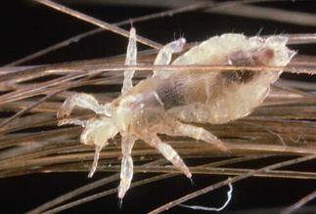
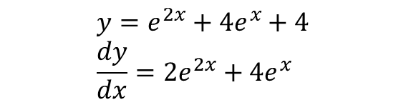


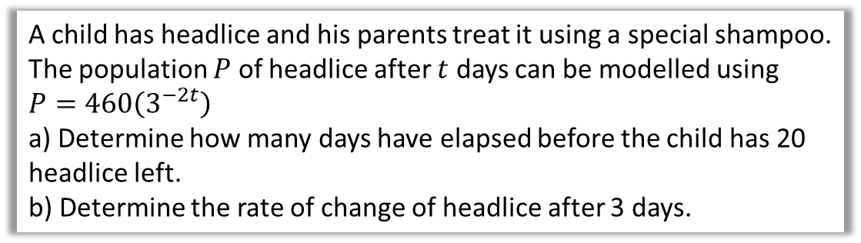
Test Your Understanding
Differentiate ${y=\left(e^{x}+2\right)}^{2}$ (Hint: Expand first)
?
$$y=e^{2x}+4e^{x}+4 \\ \frac{dy}{dx}=2e^{2x}+4e^{x}$$
This one is a bit of a headscratcher (pun intended)
A child has headlice and his parents treat it using a special shampoo. The population $P$ of headlice after $t$ days can be modelled using $P=460\left(3^{−2t}\right)$
a) Determine how many days have elapsed before the child has 20 headlice left.
b) Determine the rate of change of headlice after 3 days.
?
a
$$20=460\left(3^{−2t}\right) \\ 3^{−2t}=\frac{1}{23} \\ −2t=\log_{3}\left(\frac{1}{23}\right)=−2.85… \\ t=1.43 days$$
b
$$\frac{dP}{dt}=−920\left(3^{−2t}\right)\ln{3}$$
When $t=3$,
$$\frac{dP}{dt}=−920\left(3^{−6}\right)\ln{3}=−1.39 headlice/day$$
?

Slide 14
Exercise 9B
Pearson Pure Mathematics Year 2/AS
Pages 236-237
Complete before the lesson Q1-2
In Class:
Green Q3-6
Amber Q7-8
Red Q9-12 & Challenge

Slide 15
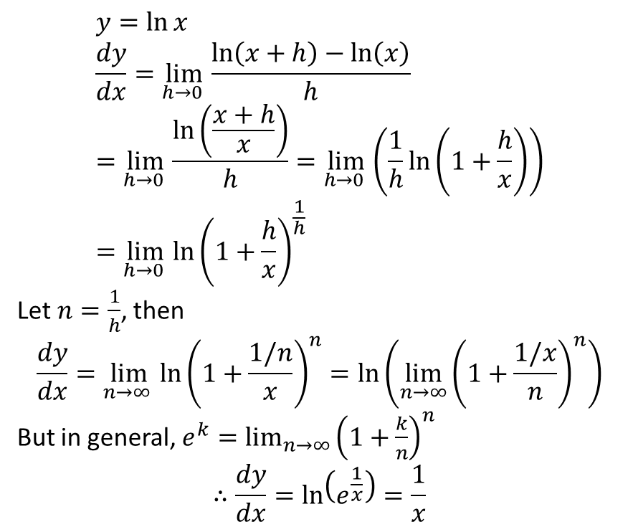


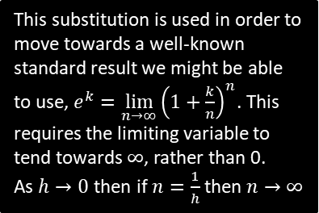
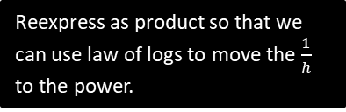

Just For Your Interest…
Prove by first principles that $\frac{d}{dx}\left(\ln{x}\right)=\frac{1}{x}$
$$y=\ln{x} \\ \frac{dy}{dx}=\lim_{h→0 }{\frac{\ln\left(x+h\right)−\ln\left(x\right)}{h}} \\ =\lim_{h→0 }{\frac{\ln\left(\frac{x+h}{x}\right)}{h}}=\lim_{h→0 }\left(\frac{1}{h}\ln\left(1+\frac{h}{x}\right)\right) \\ =\lim_{h→0 }{{\ln\left(1+\frac{h}{x}\right)}^{\frac{1}{h}}}$$
Let $n=\frac{1}{h}$, then
$$\frac{dy}{dx}=\lim_{n→∞ }{{\ln\left(1+\frac{1/n}{x}\right)}^{n}}=\ln\left(\lim_{n→∞}{{\left(1+\frac{1/x}{n}\right)}^{n}}\right)$$
But in general, $e^{k}=\lim_{n→∞}{{\left(1+\frac{k}{n}\right)}^{n}}$
$$∴\frac{dy}{dx}=\ln\left(e^{\frac{1}{x}}\right)=\frac{1}{x}$$
Using $\lim_{h→0}{\frac{f\left(x+h\right)−f\left(x\right)}{h}}$
Reexpress as product so that we can use law of logs to move the $\frac{1}{h}$ to the power.
This substitution is used in order to move towards a well-known standard result we might be able to use, $e^{k}=\lim_{n→∞}{{\left(1+\frac{k}{n}\right)}^{n}}$. This requires the limiting variable to tend towards $∞$, rather than 0.
As $h→0$ then if $n=\frac{1}{h}$ then $n→∞$
One of the ‘laws of limits’:
$$\lim_{x→a}{\ln\left(f\left(x\right)\right)}=ln⁡(\lim_{x→a}\left(f\left(x\right)\right)$$

Slide 16

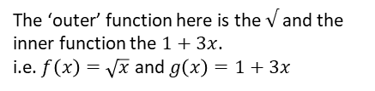
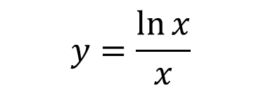




Differentiating combinations of functions
Functions can interact in different ways…
How to differentiate
1
Composite Function
i.e. of form $y=f\left(g\left(x\right)\right)$
$$y=\sqrt{1+3x}$$
The Chain Rule (Ex9C)
The ‘outer’ function here is the $√$ and the inner function the $1+3x$.
i.e. $f\left(x\right)=\sqrt{x}$ and $g\left(x\right)=1+3x$
2
Product of Two Functions
The Product Rule (Ex9D)
i.e. of form $y=f\left(x\right)g\left(x\right)$
$$y=x\sin{2x}$$
3
Division (i.e. “Quotient”) of Two Functions
i.e. of form $y=\frac{f\left(x\right)}{g\left(x\right)}$
The Quotient Rule (Ex9E)
$$y=\frac{\ln{x}}{x}$$

Slide 17
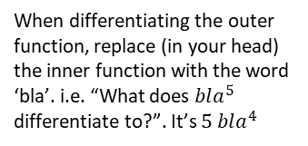
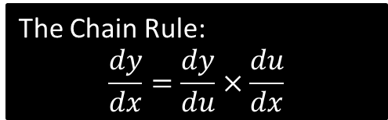
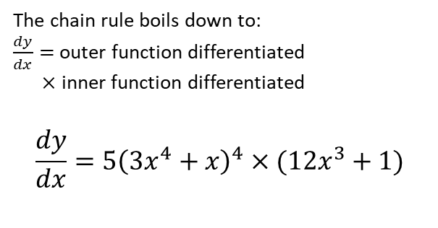



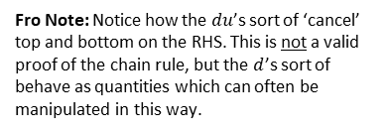
The Chain Rule
The chain rule allows us to differentiate a composite function, i.e. a function within a function.
$$y={\left(3x^{4}+x\right)}^{5}$$
The Chain Rule:
$$\frac{dy}{dx}=\frac{dy}{du}×\frac{du}{dx}$$
Fro Note: Notice how the $du$’s sort of ‘cancel’ top and bottom on the RHS. This is not a valid proof of the chain rule, but the $d$’s sort of behave as quantities which can often be manipulated in this way.
Doing it mentally in one go:
(aka the ‘bla method’)
Full Method:
?
Let $u=3x^{4}+x$
$$\frac{du}{dx}=12x^{3}+1$$
$$y=u^{5} \\ \frac{dy}{du}=5u^{4}=5{\left(3x^{4}+x\right)}^{4} \\ ∴\frac{dy}{dx}=\frac{dy}{du}×\frac{du}{dx} \\ =5{\left(3x^{4}+x\right)}^{4}\left(12x^{3}+1\right)$$
In the Chain Rule, $u$ represents the inner function.
The chain rule boils down to:
$\frac{dy}{dx}=$outer function differentiated
$×$ inner function differentiated
$$\frac{dy}{dx}=5{\left(3x^{4}+x\right)}^{4}×(12x^{3}+1)$$
This represents the ‘outer’ function.
?
?
When differentiating the outer function, replace (in your head) the inner function with the word ‘bla’. i.e. “What does $bla^{5}$ differentiate to?”. It’s $5 bla^{4}$
Now differentiate the inner function, i.e. the ‘bla’.

Slide 18




























Further Practice
Outer Function Differentiated
Inner Function Differentiated
$$\frac{dy}{dx}=$$
?
?
$$y={\left(x^{2}+1\right)}^{3}$$
$$3{\left(x^{2}+1\right)}^{2}$$
$$×$$
$$2x$$
The outer function is “$bla^{3}$”
$$\frac{dy}{dx}=$$
$$\frac{1}{x}$$
$$y={\left(\ln{x}\right)}^{3}$$
?
$$×$$
?
$$3{\left(\ln{x}\right)}^{2}$$
The outer function is again “$bla^{3}$”
$$\frac{dy}{dx}=$$
?
$$\left(2x+1\right)$$
$$y=e^{x^{2}+x}$$
$$e^{x^{2}+x}$$
$$×$$
?
The outer function is “$e^{bla}$”
$$\frac{dy}{dx}=$$
$$y={\left(2^{x}+1\right)}^{2}$$
?
$$×$$
?
$$2(2^{x}+1)$$
$$2^{x}\ln{2}$$
$$\frac{dy}{dx}=$$
$$\frac{1}{\sin{x}}$$
?
$$y=\ln\left(\sin{x}\right)$$
$$×$$
?
$$\cos{x}$$

Slide 19


























Yet Further Practice
Outer Function Differentiated
Inner Function Differentiated
$$\frac{dy}{dx}=$$
?
?
$$\cos{5x}$$
$$×$$
$$y=\sin{5x}$$
$$5$$
This is consistent with what we learned earlier in the chapter.
The outer function is “$\sin{bla}$”
?
$$\frac{dy}{dx}=$$
$$y=\sin^{2}{x}={\left(\sin{x}\right)}^{2}$$
?
$$×$$
?
$$2\sin{x}$$
$$\cos{x}$$
Fro Tip: When differentiating a trig function to a power, always rewrite using a bracket first.
$$y=\sqrt{x+1}={\left(x+1\right)}^{\frac{1}{2}}$$
$$\frac{dy}{dx}=$$
$$\frac{1}{2}{\left(x+1\right)}^{−\frac{1}{2}}$$
?
?
?
$$×$$
$$1$$
Here we had to use the Chain Rule twice!
?
$$\frac{dy}{dx}=$$
?
$$y=\cos^{3}{2x}={\left(\cos{2x}\right)}^{3}$$
?
$$3{\left(\cos{2x}\right)}^{2}$$
$$×$$
$$\left(−2\sin{2x}\right)$$
$$y=e^{e^{x}}$$
$$\frac{dy}{dx}=$$
?
?
$$e^{e^{x}}$$
$$×$$
$$e^{x}$$

Slide 20





Test Your Understanding
C3 June 2011 Q1a
In general:
$$\frac{d}{dx}(\ln\left(f\left(x\right)\right)=\frac{f^{′}\left(x\right)}{f\left(x\right)}$$
?
$$\frac{dy}{dx}=\frac{1}{x^{2}+3x+5}×\left(2x+3\right)=\frac{2x+3}{x^{2}+3x+5}$$
[Textbook] Given that $y=\sqrt{5x^{2}+1}$, find $\frac{dy}{dx}$ at $\left(4,9\right)$
?
$$y={\left(5x^{2}+1\right)}^{\frac{1}{2}} \\ \frac{dy}{dx}=\frac{1}{2}{\left(5x^{2}+1\right)}^{−\frac{1}{2}}×10x$$
When $x=4$,
$$\frac{dy}{dx}=\frac{1}{2}{\left(5\left(4^{2}\right)+1\right)}^{−\frac{1}{2}}×10\left(4\right)=\frac{20}{9}$$

Slide 21



$$dx/dy$$
Proof: By the chain rule:
$$\frac{dy}{dy}=\frac{dy}{dx}×\frac{dx}{dy}$$
But $\frac{dy}{dy}=\frac{d}{dy}\left(y\right)=1$. $∴\frac{dy}{dx}=1÷\frac{dx}{dy}$
! $\frac{dy}{dx}=\frac{1}{\left(\frac{dx}{dy}\right)}$
Sometimes we might have $x$ in terms of $y$, but we want to find $\frac{dy}{dx}$.
Find $\frac{dy}{dx}$ when $x=2y^{2}+y$
$$\frac{dx}{dy}=4y+1 \\ \frac{dy}{dx}=\frac{1}{4y+1}$$
Find the gradient of $x={\left(1+2y\right)}^{3}$ when $y=1$
$$\frac{dx}{dy}=6{\left(1+2y\right)}^{2} → \frac{dy}{dx}=\frac{1}{6{\left(1+2y\right)}^{2}}$$
$$m=\frac{1}{6{\left(1+2\right)}^{2}}=\frac{1}{54}$$
?
?

Slide 22

Exercise 9C
Pearson Pure Mathematics Year 2/AS
Pages 239-240
Complete before the lesson Q1-3
In Class:
Green Q4-5
Amber Q6-9
Red Q10-13 & Challenge & Ext
Extension:
[STEP I 2014 Q4] An accurate clock has an hour hand of length $a$ and a minute hand of length $b$ (where $b>a$), both measured from the pivot at the centre of the clock face. Let $x$ be the distance between the ends of the hands when the angle between the hands is $θ$, where $0≤θ<π$.
Show that the rate of increase of $x$ is greatest when $x={\left(b^{2}−a^{2}\right)}^{\frac{1}{2}}$.
In the case when $b=2a$ and the clock starts at mid-day (with both hands pointing vertically upwards), show that this occurs for the first time a little less than 11 minutes later.

Slide 23







The Product Rule
As mentioned previously, the product rule is used, unsurprisingly, when we have a product of two functions.
! The product rule:
If $y=uv$ then $\frac{dy}{dx}=u\frac{dv}{dx}+v\frac{du}{dx}$
This is quite easy to remember. Differentiate one of the things but leave the other. Then do the other way round. Then add!
Since addition is commutative, it doesn’t matter which way round we do it.
If $y=x^{2}\sin{x}$, determine $\frac{dy}{dx}$
?
Write out $u=…, v=…$ then differentiate each.
Fro Tip: While with the chain rule I encourage you to put the bits together without writing out $u=$, in contrast, with the product rule I do encourage you to write out in full as per the left. This is because each of $u$ and $v$ can be more complicated to differentiate – it thus helps you avoid trying to do too much at once.
$$u=x^{2} v=\sin{x} \\ \frac{du}{dx}=2x \frac{dv}{dx}=\cos{x} \\ \frac{dy}{dx}=x^{2}\cos{x}+2x\sin{x}$$
Sub into product rule.
If $y=xe^{2x}$, determine the coordinates of the turning point.
?
$$u=x v=e^{2x} \\ \frac{du}{dx}=1 \frac{dv}{dx}=2e^{2x} \\ \frac{dy}{dx}=2xe^{2x}+e^{2x}=0$$
$$e^{2x}\left(2x+1\right)=0$$
But $e^{2x}≠0$
$$∴2x+1=0 → x=−\frac{1}{2}$$
$$y=−\frac{1}{2}e^{−1}=−\frac{1}{2e} → \left(−\frac{1}{2},−\frac{1}{2e}\right)$$
It’s typical to factorise when finding a turning point.
The fact that exponential terms can never be 0 comes up frequently in exams.

Slide 24





Product + Chain Rule Examples
[Textbook] If $y=e^{4x}\sin^{2}{3x}$, show that $\frac{dy}{dx}=e^{4x}\sin{3x}\left(A\cos{3x}+B\sin{3x}\right)$, where $A$ and $B$ are constants to be determined.
?
$$u=e^{4x} v={\left(\sin{3x}\right)}^{2} \\ \frac{du}{dx}=4e^{4x} \frac{dv}{dx}=2\sin{3x}×3\cos{3x}=6\sin{3x}\cos{3x}$$
$$\frac{dy}{dx}=6e^{4x}\sin{3x}\cos{3x}+4e^{4x}{\left(\sin{3x}\right)}^{2} \\ =e^{4x}\sin{3x}\left(6\cos{3x}+4\sin{3x}\right)$$
[Textbook] Given that $f\left(x\right)=x^{2}\sqrt{3x−1}$, find $f′(x)$
$$u=x^{2} v={\left(3x−1\right)}^{\frac{1}{2}} \\ \frac{du}{dx}=2x \frac{dv}{dx}=\frac{1}{2}{\left(3x−1\right)}^{−\frac{1}{2}}×3=\frac{3}{2}{\left(3x−1\right)}^{−\frac{1}{2}} \\ \frac{dy}{dx}=\frac{3}{2}x^{2}{\left(3x−1\right)}^{−\frac{1}{2}}+2x{\left(3x−1\right)}^{\frac{1}{2}} \\ =\frac{1}{2}x{\left(3x−1\right)}^{−\frac{1}{2}}\left[3x+4\left(3x−1\right)\right] \\ =\frac{1}{2}x{\left(3x−1\right)}^{−\frac{1}{2}}\left(15x −4\right) \\ =\frac{x\left(15x−4\right)}{2\sqrt{3x−1}}$$
?
This is when the manipulation is a little tricky. Remember to:
Factor out the smallest power, in this case $−\frac{1}{2}$. Since a power of $\frac{1}{2}$ is 1 more than $−\frac{1}{2}$, we have an extra $\left(3x−1\right)$
Factor out the fraction. $\frac{1}{2}$ goes into both $\frac{3}{2}$ and 2.
This last step is optional. Try to avoid negative powers, and $√$ is tidier.

Slide 25




Test Your Understanding
Edexcel C3 Jan 2012 Q1a
?
Edexcel C3 June 2013 Q5(c)
Examiner’s Report: “Perhaps the most challenging question in the paper”. And this is on a paper described as having “a level of demand higher than any previous C3 paper”.
So it’s DAMN FRIKKIN’ HARD. 😐😐
$$\frac{dy}{dx}=\frac{1}{6x{\left(x−1\right)}^{\frac{1}{2}}}$$
Find $\frac{d^{2}y}{dx^{2}}$, simplifying your answer.
$$\frac{dy}{dx}=\frac{1}{6}x^{−1}{\left(x−1\right)}^{−\frac{1}{2}}$$
$$\frac{d^{2}y}{dx^{2}}=−\frac{1}{6}x^{−2}{\left(x−1\right)}^{−\frac{1}{2}}−\frac{1}{12}x^{−1}{\left(x−1\right)}^{−\frac{3}{2}}$$
$$=−\frac{1}{12}x^{−2}{\left(x−1\right)}^{−\frac{3}{2}}\left(2\left(x−1\right)+x\right) \\ =\frac{2−3x}{12x^{2}{\left(x−1\right)}^{\frac{3}{2}}}$$
?

Slide 26
Exercise 9D
Pearson Pure Mathematics Year 2/AS
Page 242
Complete before the lesson Q1-3
In Class:
Green Q4-6
Amber Q7-8
Red Q9-10 & Challenge

Slide 27



The Quotient Rule
Just as we use the ‘product rule’ to differentiate a ‘product’, we use the ‘quotient rule’ to differentiate a ‘quotient’ (i.e. division).
?
$$y=\frac{u}{v}=uv^{−1} \\ \frac{dy}{dx}=−uv^{−2}\frac{dv}{dx}+\frac{du}{dx}v^{−1} \\ =v^{−2}\left(v\frac{du}{dx}−u\frac{dv}{dx}\right) \\ =\frac{v\frac{du}{dx}−u\frac{dv}{dx}}{v^{2}}$$
?
?
?
! The quotient rule:
If $y=\frac{u}{v}$ then $\frac{dy}{dx}=\frac{v\frac{du}{dx}−u\frac{dv}{dx}}{v^{2}}$
Memorisation Tips: “Bottoms first!” The denominator ($v$) is the first term seen in the new denominator and numerator. The denominator gets squared. Note that in the numerator, we have $−$ instead of the $+$ seen in the Product Rule.

Slide 28



Examples
[Textbook] If $y=\frac{x}{2x+5}$, find $\frac{dy}{dx}$
$$u=x v=2x+5 \\ \frac{du}{dx}=1 \frac{dv}{dx}=2 \\ \frac{dy}{dx}=\frac{1\left(2x+5\right)−2x}{{\left(2x+5\right)}^{2}}=\frac{5}{{\left(2x+5\right)}^{2}}$$
?
Layout just like you would with the Product Rule.
[Textbook] Find the stationary point of $y=\frac{\sin{x}}{e^{2x}}$ , $0<x<π$
?
$$u=\sin{x}, v=e^{2x} \\ \frac{du}{dx}=\cos{x}, \frac{dv}{dx}=2e^{2x} \\ \frac{dy}{dx}=\frac{e^{2x}\cos{x}−2\sin{x} \left(e^{2x}\right)}{e^{4x}}=0$$
$$e^{2x}\cos{x}−2\sin{x}\left(e^{2x}\right)=0 \\ e^{2x}\left(\cos{x}−2\sin{x}\right)=0 \\ e^{2x}≠0 ∴\cos{x}=2\sin{x} \\ \tan{x}=\frac{1}{2} → x=0.464 \left(3sf\right) \\ y=\frac{\sin\left(0.464\right)}{e^{2×0.464}}=0.177 (3sf)$$
Whenever you have “fraction = 0”, you can just multiply through by denominator.
As per advice earlier this chapter, try to factorise whenever you have 0 on one side.
As per trig chapter, divide by $\cos{x}$ whenever you have a mix of $\sin{x}$ and $\cos{x}$.

Slide 29




Test Your Understanding
Edexcel C3 Jan 2012 Q1a
?
$$\frac{4x\cos{4x}−3\sin{4x}}{x^{4}}$$
Edexcel C3 June 2012 Q3
?

Slide 30

Exercise 9E
Pearson Pure Mathematics Year 2/AS
Pages 244-245
Complete before the lesson Q1-3
In Class:
Green Q4-6
Amber Q7-10
Red Q11-12 & Ext
Extension
[STEP I 2010 Q2] The curve $y=\left(\frac{x−a}{x−b}\right)e^{x}$, where $a$ and $b$ are constants, has two stationary points. Show that
$$a−b<0 or a−b>4$$
Show that, in the case $a=0$ and $b=\frac{1}{2}$, there is one stationary point on either side of the curve’s vertical asymptote, and sketch the curve.
Sketch the curve in the case $a=\frac{9}{2}$ and $b=0$.

Slide 31








Differentiating other trigonometric functions
Differentiate $y=\tan{x}$
?
$$y=\frac{\sin{x}}{\cos{x}} \\ u=\sin{x} v=\cos{x} \\ \frac{du}{dx}=\cos{x} \frac{dv}{dx}=−\sin{x} \\ \frac{dy}{dx}=\frac{\cos^{2}{x}+\sin^{2}{x}}{\cos^{2}{x}}=\frac{1}{\cos^{2}{x}}=\sec^{2}{x}$$
Use definition of $\tan{x}$
Use quotient rule.
! More generally: $\frac{d}{dx}\left(\tan{kx}\right)=k\sec^{2}{kx}$
Fro Tip: This is in the formula booklet, but I HIGHLY encourage your to memorise it to save you time in the exam.
Differentiate $y=\sec{x}$
?
$$y=\frac{1}{\cos{x}}={\left(\cos{x}\right)}^{−1} \\ \frac{dy}{dx}=−{\left(\cos{x}\right)}^{−2}×\left(−\sin{x}\right) \\ =\frac{\sin{x}}{\cos^{2}{x}}=\frac{1}{\cos{x}}×\frac{\sin{x}}{\cos{x}}=\sec{x}\tan{x}$$
Fro Tip: We could have always used the quotient rule on $\frac{1}{\cos{x}}$. However, I tend to the find the chain rule is marginally simpler if the numerator is a constant.
! More generally: $\frac{d}{dx}\left(\sec{kx}\right)=k\sec{kx}\tan{kx}$

Slide 32






Differentiating other trigonometric functions
$$\frac{d}{dx}\left(\tan{x}\right)=\sec^{2}{x} \\ \frac{d}{dx}\left(\sec{x}\right)=\sec{x}\tan{x}$$
$$\frac{d}{dx}\left(\cot{x}\right)={−cosec}^{2}{x} \\ \frac{d}{dx}\left(\operatorname{cosec}{x}\right)=−\operatorname{cosec}{x}\cot{x}$$
Memory Tip: To memorise the two on the right, notice that when we ‘co’ the two on the left, it ‘co’s each term in the derivative, but also negates it.
Differentiate
$y=\frac{cosec 2x}{x^{2}}$
$y=\sec^{3}{x}$
b
$$y={\left(\sec{x}\right)}^{3} \\ \frac{dy}{dx}=3{\left(\sec{x}\right)}^{2}×\sec{x}\tan{x} \\ =3\sec^{3}{x}\tan{x}$$
?
a
$$u=cosec 2x v=x^{2} \\ \frac{du}{dx}=−2cosec 2x\cot{2x} \frac{dv}{dx}=2x \\ \frac{dy}{dx}=\frac{−2x^{2}cosec 2x\cot{2x}−2x cosec 2x}{x^{4}}$$
?
Observation: Notice that when differentiating a power of $sec$, the power stays the same. This will be relevant when we come to integration.

Slide 33


Test Your Understanding So Far
Edexcel C3 June 2013(R) Q5b
?
$$\frac{d}{dx}\left({\left(\sec{3x}\right)}^{2}\right)=2\sec{3x}×3\sec{3x}\tan{3x} \\ =6\sec^{2}{3x}\tan{3x} \\ =6\left(1+\tan^{2}{3x}\right)\tan{3x} \\ =6\left(\tan{3x}+\tan^{3}{3x}\right)$$

Slide 34




Making use of $1÷dx/dy$
Often in exam questions, you will be given $x$ in terms of $y$, but want to find $\frac{dy}{dx}$ in terms of $x$.
The key is to make use of an appropriate trig identity, e.g:
$$\sin^{2}{x}+\cos^{2}{x}≡1 1+\tan^{2}{x}≡\sec^{2}{x}$$
Given that $x=\tan{y}$, express $\frac{dy}{dx}$ in terms of $x$.
?
$$\frac{dx}{dy}=\sec^{2}{y}$$
$$\frac{dy}{dx}=\frac{1}{\sec^{2}{y}}$$
Note that $1+\tan^{2}{y}≡\sec^{2}{y}$
$$=\frac{1}{1+\tan^{2}{y}}=\frac{1}{1+x^{2}}$$
You might be tempted to put $\frac{dy}{dx}=\cos^{2}{y}$, but there’s not a relationship between $\cos^{2}{y}$ and $\tan{y}$ that would enable us to later get $x$ into the equation.
Using $1+\tan^{2}{y}≡\sec^{2}{y}$ is sensible because we know that $x=\tan{y}$.

Slide 35






Further Examples
Show that if $y=\arcsin{x}$, then $\frac{dy}{dx}=\frac{1}{\sqrt{1−x^{2}}}$
?
$$y=\arcsin{x} \\ x=\sin{y} \\ \frac{dx}{dy}=\cos{y} \\ \frac{dy}{dx}=\frac{1}{\cos{y}}$$
We know that $sin^{2}y+cos^{2}y≡1$
$$=\frac{1}{\sqrt{1−\sin^{2}{y}}}=\frac{1}{\sqrt{1−x^{2}}}$$
Remember that we’re trying to turn $\cos{y}$ into an expression in terms of $x$; we have to use $x=\sin{y}$ in some way. You then might think “Oh, I know an identity that relates $\cos{y}$ and $\sin{y}$!”
!
$$\frac{d}{dx}\left(\arcsin{x}\right)=\frac{1}{\sqrt{1−x^{2}}} \\ \frac{d}{dx}\left(\arccos{x}\right)=−\frac{1}{\sqrt{1−x^{2}}} \\ \frac{d}{dx}\left(\arctan{x}\right)=\frac{1}{1+x^{2}}$$
Given that $y=\arcsin{x^{2}}$ find $\frac{dy}{dx}$
?
Using the chain rule:
$$\frac{dy}{dx}=\frac{1}{\sqrt{1−{\left(x^{2}\right)}^{2}}}×2x \\ =\frac{2x}{\sqrt{1−x^{4}}}$$

Slide 36




Test Your Understanding
Edexcel C3 Jan 2011 Q8b,c
[Textbook] Given that
$y=\arctan\left(\frac{1−x}{1+x}\right)$, find $\frac{dy}{dx}$
?
(Let’s use the ‘full’ Chain Rule method this time)
Let $u=\frac{1−x}{1+x}$
$$\frac{du}{dx}=…=−\frac{2}{{\left(1+x\right)}^{2}}$$
$$y=\arctan{u} \\ ∴\frac{dy}{du}=\frac{1}{1+u^{2}}$$
By the Chain Rule:
$$\frac{dy}{dx}=\frac{dy}{du}×\frac{du}{dx} \\ =\frac{1}{1+u^{2}}×\left(−\frac{2}{{\left(1+x\right)}^{2}}\right) \\ =… \\ =−\frac{1}{1+x^{2}}$$
?

Slide 37

Exercise 9F
Pearson Pure Mathematics Year 2/AS
Pages 249-251
Complete before the lesson Q1-4
Green Q5-7
Amber Q8-10
Red Q11-12 & Ext
[STEP I 2011 Q3] Prove the identity
$$4\sin{θ}\sin\left(\frac{1}{3}π−θ\right)\sin\left(\frac{1}{3}π+θ\right)=\sin{3θ} (∗)$$
By differentiating (*) or otherwise, show that
$\cot{\frac{1}{9}π}−\cot{\frac{2}{9}π}+\cot{\frac{4}{9}π}=\sqrt{3}$
By setting $θ=\frac{1}{6}π−φ$ in $(∗)$, or otherwise, obtain a similar identity for $\cos{3θ}$ and deduce that
$\cot{θ}\cot\left(\frac{1}{3}π−θ\right)\cot\left(\frac{1}{3}π+θ\right)=\cot{3θ}$
Show that
$cosec\frac{1}{9}π−cosec\frac{5}{9}π+cosec\frac{7}{9}π=2\sqrt{3}$

Slide 38






Parametric Differentiation
Recall from the previous chapter that parametric equations are when we define each of $x$ and $y$ (and possibly $z$) in terms of some separate parameter, e.g. $t$.
! If $x$ and $y$ are given as functions of a parameter $t$, then
$$\frac{dy}{dx}=\frac{dy/dt}{dx/dt}$$
Proof: By Chain Rule: $\frac{dy}{dt}=\frac{dy}{dx}×\frac{dx}{dt}$
Then rearrange.
[Textbook] Find the gradient at the point $P$ where $t=2$, on the curve given parametrically by
$$x=t^{3}+t, y=t^{2}+1, t∈ℝ$$
[Textbook] Find the equation of the normal at the point $P$ where $θ=\frac{π}{6}$, to the curve with parametric equations $x=3\sin{θ}, y=5\cos{θ}$
?
$$\frac{dx}{dθ}=3\cos{θ}, \frac{dy}{dθ}=−5\sin{θ} 0≤θ<2π$$
$$∴ \frac{dy}{dx}=−\frac{5\sin{θ}}{3\cos{θ}}=−\frac{5}{3}\tan{θ}$$
When $θ=\frac{π}{6}$,
$\frac{dy}{dx}=−\frac{5}{3\sqrt{3}}$ , $y=5\cos{\frac{π}{6}}=\frac{5\sqrt{3}}{2}$, $x=\frac{3}{2}$
$∴$ Equation of normal:
$$y−\frac{5\sqrt{3}}{2}=\frac{3\sqrt{3}}{5}\left(x−\frac{3}{2}\right)$$
?
$$\frac{dy}{dt}=2t \frac{dx}{dt}=3t^{2}+1 \\ ∴\frac{dy}{dx}=\frac{2t}{3t^{2}+1}$$
When $t=2,\frac{dy}{dx}=\frac{4}{13}$

Slide 39



Test Your Understanding
C4 June 2012 Q6
?
?

Slide 40
Exercise 9G
Pearson Pure Mathematics Year 2/AS
Pages 252-254
Complete before the lesson Q1 (any 5) also Q2 &3
In Class:
Green Q4-5
Amber Q6-9
Red Q10-11

Slide 41






Implicit Differentiation
You’re used to differentiating expressions where $y$ is the subject, e.g. $y=x^{2}+3x$. The relationship between $x$ and $y$ is ‘explicit’ in the sense we can directly calculate $y$from $x$.
But what about implicit relations, e.g:
$$x^{2}+y^{2}=8x or \cos\left(x+y\right)=\sin{y}$$
MIND-BLOWING MOMENT
$$y=x^{2} \\ \frac{dy}{dx}=2x$$
$$\frac{d}{dx}$$
$$\frac{d}{dx}$$
When seeing $y=x^{2}$ and differentiating, you probably think you’re just differentiating the $x^{2}$. But in fact, you’re differentiating both sides of the equation! (with respect to $x$)
$y$ (by definition) differentiates to $\frac{dy}{dx}$
To differentiate implicitly you only need to know 2 things:
Differentiate each side of the equation (using chain rule if necessary).
Remember that $y$ differentiated with respect to $x$ is, by definition, $\frac{dy}{dx}$

Slide 42










Examples
Use chain rule. “bla squared” differentiated is “2 bla” (i.e. $2y$). And the inner function (i.e. just $y$) differentiated is $\frac{dy}{dx}$. Multiply them together and hey presto.
In general, when differentiating a function of $y$, but with respect to $x$, slap a $\frac{dy}{dx}$ on the end. i.e.
$$\frac{d}{dx}\left(f\left(y\right)\right)=f^{′}\left(y\right)\frac{dy}{dx}$$
?
$$\frac{d}{dx}\left(y^{2}\right)=2y\frac{dy}{dx}$$
?
?
?
$$\frac{d}{dx}\left(xy\right)=x\frac{dy}{dx}+y$$
$$\frac{d}{dx}\left(\sin{y}\right)=cos y\frac{dy}{dx}$$
$$\frac{d}{dx}\left(e^{y}\right)=e^{y}\frac{dy}{dx}$$
?
$$\frac{d}{dx}\left(e^{x^{2}y}\right)=\left(x^{2}\frac{dy}{dx}+2xy\right)e^{x^{2}y}$$
You might be wondering, “If $ax$ differentiates to $a$ (where $a$ is a constant), why doesn’t $xy$ differentiate to $y$?”
It’s because $y$ is not a constant.
Exam Note: $\frac{d}{dx}(xy)$ is incredibly common.
?
$$\frac{d}{dx}\left(\tan\left(x+y\right)\right)=\left(1+\frac{dy}{dx}\right)\sec^{2}\left(x+y\right)$$
?
$$\frac{d}{dx}\left(x^{2}+\cos{y}\right)=2x−\sin{y}\frac{dy}{dx}$$

Slide 43






Meatier Examples
[Textbook] Find $\frac{dy}{dx}$ in terms of $x$ and $y$ where $x^{3}+x+y^{3}+3y=6$
?
$$3x^{2}+1+3y^{2}\frac{dy}{dx}+3\frac{dy}{dx}=0 \\ 3y^{2}\frac{dy}{dx}+3\frac{dy}{dx}=−3x^{2}−1 \\ \frac{dy}{dx}\left(3y^{2}+3\right)=−3x^{2}−1 \\ \frac{dy}{dx}=\frac{−3x^{2}−1}{3y^{2}+3}$$
Differentiate both sides of the equation with respect to $x$ (Common error: Forgetting the 6 becomes 0)
Make $\frac{dy}{dx}$ the subject (in the manner you would do at GCSE)
[Textbook] Find the value of $\frac{dy}{dx}$ at the point $(1,1)$, where $e^{2x}\ln{y}=x+y−2$
?
$$2e^{2x}\ln{y}+e^{2x}\left(\ln{y}\frac{dy}{dx}\right)=1+\frac{dy}{dx}$$
When $x=1, y=1$,
$$e^{2}\frac{dy}{dx}=1+\frac{dy}{dx} \\ \left(e^{2}−1\right)\frac{dy}{dx}=1 \\ \frac{dy}{dx}=\frac{1}{e^{2}−1}$$
Fro Tip: Substitute in sooner rather than later. (i.e. No need to make $\frac{dy}{dx}$ the subject first)
Frobservation: In Year 1 differentiation, you only ever needed the $x$ value to calculate the gradient a particular point. In Year 2 the gradient can depend on $x$ and $y$.

Slide 44




Test Your Understanding
C4 Jan 2008 Q5
Hint for (b): Solve simultaneously with original equation.
C4 June 2014(R) Q3
$−512−4y^{2}=−96y$
$y^{2}−24y+128=0$
$\left(y−16\right)\left(y−8\right)=0$
Gives point $\left(−8,16\right), \left(−8,8\right)$
Implicitly differentiating:
$3x^{2}−8y\frac{dy}{dx}=12x\frac{dy}{dx}+12y$
$\frac{dy}{dx}$ not needed, but it’s $\frac{3x^{2}−12y}{12x+8y}$
If $x=−8, y=16,\frac{dy}{dx}=−3$
If $x=−8, y=8,\frac{dy}{dx}=0$
?
?
?
?
Exam Note: This type of question was quite common.

Slide 45
Exercise 9H
Pearson Pure Mathematics Year 2/AS
Pages 255-256
Complete before the lesson Q3-5
In Class:
Green Q6-8
Amber Q9-10
Red Q11 & Challenge

Slide 46



Using the second derivative
In my Year 1 slides you may remember that a point of inflection was where the concavity of a curve changes, i.e. concave to convex or vice versa, or informally, ‘swerving one way to swerving the other’.
Memorisation tip: Mentally visualise a positive cubic (i.e. uphill) and put ‘concave’ and ‘convex is alphabetical order.
In this region the gradient, although initially negative, is still also increasing. The curve is swerving left.
We say the curve is concave when it is swerving right: we can see the gradient is always decreasing, i.e. the change in the gradient is negative.
! $f(x)$ convex when $f^{′′}\left(x\right)≤0$
At point of inflection, the gradient is not changing, i.e. the gradient of the gradient is 0. Note that points of inflection (as with this example) are not necessarily stationary points.
! $f(x)$ concave when $f^{′′}\left(x\right)≤0$
! Point of inflection when $f^{′′}\left(x\right)=0$

Slide 47






Examples
[Textbook] Find the interval on which the function $f\left(x\right)=x^{3}+4x+3$ is concave.
[Textbook] Show that $f\left(x\right)=e^{2x}+x^{2}$ is convex for all real values of $x$.
?
?
$$f^{′}\left(x\right)=2e^{2x}+2x \\ f^{′′}\left(x\right)=4e^{2x}+2$$
$e^{2x}>0$ for all $x∈ℝ$
$∴f^{′′}\left(x\right)>0$ for all $x∈ℝ$therefore convex for all $x∈ℝ$
$$f′\left(x\right)=3x^{2}+4 \\ f^{′′}\left(x\right)=6x$$
Concave $∴6x≤0$
$$x≤0$$
[Textbook] The curve $C$ has equation $y=x^{3}−2x^{2}−4x+5$
Find the coordinates of the point of inflection.
?
$$\frac{dy}{dx}=3x^{2}−4x−4 \frac{d^{2}y}{dx^{2}}=6x−4$$
Point of inflection $∴6x−4=0$
$$x=\frac{2}{3} \\ ∴y={\left(\frac{2}{3}\right)}^{3}−2{\left(\frac{2}{3}\right)}^{2}−4\left(\frac{2}{3}\right)+5=\frac{47}{27} \\ \left(\frac{2}{3},\frac{47}{27}\right)$$

Slide 48
Exercise 9I
Pearson Pure Mathematics Year 2/AS
Pages 259-261
Complete before the lesson Q1-3
In Class:
Green Q4-5
Amber Q6-8
Red Q9-11 & Challenge

Slide 49














Relating Rates of Change
Q
Determine the rate of change of the area $A$ of a circle when the radius $r=3$cm, given that the radius is changing at a rate of $5 cm s^{−1}$.
Firstly, how would we represent…
Fro Tip: Whenever you see the word ‘rate’, think $/dt$
$$\frac{dA}{dt}$$
?
“the rate of change of the area $A$”
$$\frac{dr}{dt}=5$$
“the rate of change of the radius $r$ is 5”
?
?
“the area $A$ of a circle”
$$A=πr^{2}$$
Then by Chain Rule:
$$dr$$
$$\frac{dA}{dt}= ×$$
First copy top and bottom into the diagonals…
$$dA$$
Click for Fromanimation
$$dt$$
$$dr$$
$$=2πr×5 \\ =2π\left(3\right)×5 \\ =30π$$
…Then fill in the gaps with whatever variable you didn’t use.
?

Slide 50



Further Example
Edexcel C4 June 2008 Q3
It’s common to have a second part of the question where you have to connect further rates.
?
?

Slide 51





Test Your Understanding
June 2012 Q2
Fro Tip: Don’t forget that if you know $\frac{dV}{dx}$ then $\frac{dx}{dV}=\frac{1}{dV/dx}$
$$V=x^{3} \\ \frac{dV}{dx}=3x^{2}$$
?
?
$$\frac{dx}{dt}=\frac{dx}{dV}×\frac{dV}{dt}=\frac{1}{3×8^{2}}×0.048=0.00025$$
?
$$A=6x^{2} \\ \frac{dA}{dx}=12x \\ \frac{dA}{dt}=\frac{dA}{dx}×\frac{dx}{dt}=\left(12×8\right)×0.00025=0.024$$

Slide 52

Exercise 9J
Pearson Pure Mathematics Year 2/AS
Pages 263-264
Note: I have skipped out the content on ‘setting up differential equations’ as I think it’s better to do this in the Integration chapter. You therefore won’t be able to yet do Q5, Q8, Q9, Q12, Q14.
Extension:
[STEP I 2009 Q5] A right circular cone has base radius $r$, height $h$ and slant height $l$. Its volume $V$, and the area $A$ of its curved surface, are given by
$$V=\frac{1}{3}πr^{2}h, A=πrl$$
Given that $A$ is fixed and $r$ is chosen so that $V$ is at its stationary value, show that $A^{2}=3π^{2}r^{4}$ and that $l=\sqrt{3}r$.
Given, instead, that $V$ is fixed and $r$ is chosen so that $A$ is at its stationary value, find $h$ in terms of $r$.
Solution to (ii): $h=\sqrt{2} r$
Complete before the lesson Q1-4
In Class:
Amber Q5-9
Red Q10-14
?

