Slide 1




Linear Transformations
You can use inverse matrices to reverse the effect of a linear transformation
The triangle T has vertices at A, B and C. The matrix:
transforms T to the triangle T’ with vertices at (4,3), (4,10) and (-4,-3).
Find the coordinates of the points A, B and C
Let the coordinates of the original triangle, T, be given by matrix ‘X’
So the matrix M, multiplied by the original coordinates, X, gives us the new set of coordinates…
$$MX=\left[\begin{matrix}\begin{matrix}4 & 4 & −4\end{matrix} \\ \begin{matrix}3 & 10 & −3\end{matrix}\end{matrix}\right]$$
Multiply both sides by M⁻¹ (as before, ensure it is in the same ‘position’)
$$M^{−1}MX=M^{−1}\left[\begin{matrix}\begin{matrix}4 & 4 & −4\end{matrix} \\ \begin{matrix}3 & 10 & −3\end{matrix}\end{matrix}\right]$$
M⁻¹M is just the identity matrix and can be cancelled out!
$$M=\left[\begin{matrix}4 & −1 \\ 3 & 1\end{matrix}\right]$$
$$X=M^{−1}\left[\begin{matrix}\begin{matrix}4 & 4 & −4\end{matrix} \\ \begin{matrix}3 & 10 & −3\end{matrix}\end{matrix}\right]$$
So to find the original set of coordinates, we have to multiply the final set of coordinates by the inverse of the matrix that created them!
7F

Slide 2










Linear Transformations
You can use inverse matrices to reverse the effect of a linear transformation
The triangle T has vertices at A, B and C. The matrix:
transforms T to the triangle T’ with vertices at (4,3), (4,10) and (-4,-3).
Find the coordinates of the points A, B and C
Let the coordinates of the original triangle, T, be given by matrix ‘X’
So the matrix M, multiplied by the original coordinates, X, gives us the new set of coordinates…
$$M=\left[\begin{matrix}4 & −1 \\ 3 & 1\end{matrix}\right]$$
$$X=M^{−1}\left[\begin{matrix}\begin{matrix}4 & 4 & −4\end{matrix} \\ \begin{matrix}3 & 10 & −3\end{matrix}\end{matrix}\right]$$
$$det\left(M\right)=ad−bc$$
Replace values
$$=(4×1)−(3×−1)$$
$$M=\left[\begin{matrix}4 & −1 \\ 3 & 1\end{matrix}\right]$$
Calculate
$$=7$$
Now we can fill in the parts of M⁻¹
Swap a and d around
Reverse the signs of b and c
$$1$$
$$1$$
$$M^{−1}=\frac{1}{7}\left[\begin{matrix} & \\ & \end{matrix}\right]$$
$$−3$$
$$4$$
7F

Slide 3












Linear Transformations
You can use inverse matrices to reverse the effect of a linear transformation
The triangle T has vertices at A, B and C. The matrix:
transforms T to the triangle T’ with vertices at (4,3), (4,10) and (-4,-3).
Find the coordinates of the points A, B and C
Let the coordinates of the original triangle, T, be given by matrix ‘X’
So the matrix M, multiplied by the original coordinates, X, gives us the new set of coordinates…
$$M^{−1}=\frac{1}{7}\left[\begin{matrix}1 & 1 \\ −3 & 4\end{matrix}\right]$$
$$X=M^{−1}\left[\begin{matrix}\begin{matrix}4 & 4 & −4\end{matrix} \\ \begin{matrix}3 & 10 & −3\end{matrix}\end{matrix}\right]$$
$$X=M^{−1}\left[\begin{matrix}\begin{matrix}4 & 4 & −4\end{matrix} \\ \begin{matrix}3 & 10 & −3\end{matrix}\end{matrix}\right]$$
Replace M⁻¹
$$X=\frac{1}{7}\left[\begin{matrix}1 & 1 \\ −3 & 4\end{matrix}\right]\left[\begin{matrix}\begin{matrix}4 & 4 & −4\end{matrix} \\ \begin{matrix}3 & 10 & −3\end{matrix}\end{matrix}\right]$$
$$M=\left[\begin{matrix}4 & −1 \\ 3 & 1\end{matrix}\right]$$
Ignore the ¹/₇ and just multiply the matrices
(2 x 2)
x
(2 x 3)
=
(2 x 3)
$$\frac{1}{7}\left[\begin{matrix}1 & 1 \\ −3 & 4\end{matrix}\right]\left[\begin{matrix}\begin{matrix}4 & 4 & −4\end{matrix} \\ \begin{matrix}3 & 10 & −3\end{matrix}\end{matrix}\right]=\frac{1}{7}\left[\begin{matrix}\begin{matrix} & & \end{matrix} \\ \begin{matrix} & & \end{matrix}\end{matrix}\right]$$
$$\left(1×4\right)+(1×3)$$
$$\left(1×4\right)+(1×10)$$
$$\left(1×−4\right)+(1×−3)$$
$$\left(−3×4\right)+(4×3)$$
$$\left(−3×4\right)+(4×10)$$
$$\left(−3×−4\right)+(4×−3)$$
$$X=\frac{1}{7}\left[\begin{matrix}\begin{matrix}7 & 14 & −7\end{matrix} \\ \begin{matrix}0 & 28 & 0\end{matrix}\end{matrix}\right]$$
Multiply all parts of the matrix by ¹/₇
$$X=\left[\begin{matrix}\begin{matrix}1 & 2 & −1\end{matrix} \\ \begin{matrix}0 & 4 & 0\end{matrix}\end{matrix}\right]$$
Original coordinates were: (1,0), (2,4) and (-1,0)
7F

Slide 4



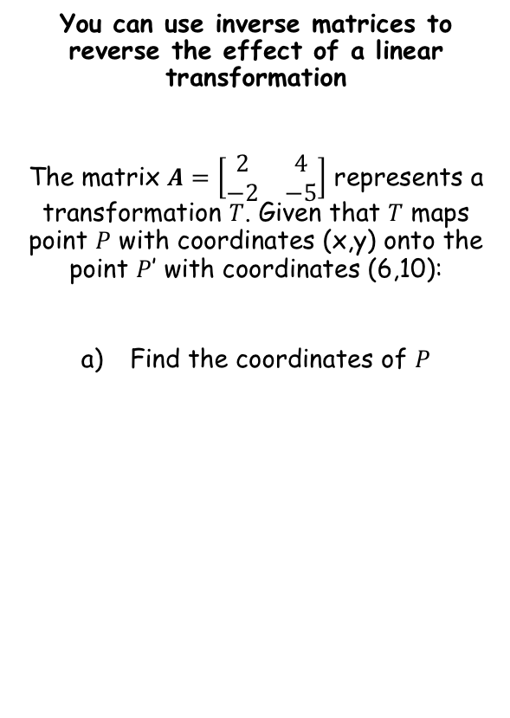



Linear Transformations
$$A\left[\begin{matrix}x \\ y\end{matrix}\right]=\left[\begin{matrix}6 \\ 10\end{matrix}\right]$$
You can use inverse matrices to reverse the effect of a linear transformation
The matrix $A=\left[\begin{matrix}2 & 4 \\ −2 & −5\end{matrix}\right]$ represents a transformation $T$. Given that $T$ maps point $P$ with coordinates (x,y) onto the point $P$’ with coordinates (6,10):
Find the coordinates of $P$
Multiply both by the inverse of A, at the start
$$A^{−1}A\left[\begin{matrix}x \\ y\end{matrix}\right]=A^{−1}\left[\begin{matrix}6 \\ 10\end{matrix}\right]$$
The left side simplifies
$$\left[\begin{matrix}x \\ y\end{matrix}\right]=A^{−1}\left[\begin{matrix}6 \\ 10\end{matrix}\right]$$
So we need to multiply the inverse of A by the coordinate matrix
→ Find the inverse matrix using your calculator…
(35,-16)
$$A^{−1}=\left[\begin{matrix}2.5 & 2 \\ −1 & −1\end{matrix}\right]$$
Multiply the inverse by the coordinates
$$\left[\begin{matrix}2.5 & 2 \\ −1 & −1\end{matrix}\right]\left[\begin{matrix}6 \\ 10\end{matrix}\right]$$
Calculate
$$=\left[\begin{matrix}35 \\ −16\end{matrix}\right]$$
7F

Slide 5

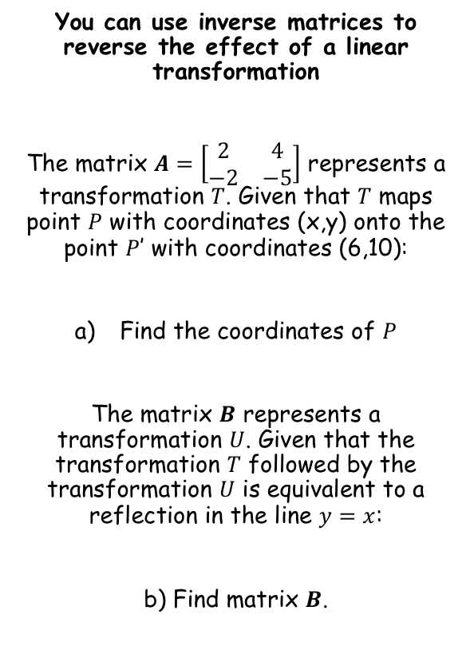

Linear Transformations
y = x
You can use inverse matrices to reverse the effect of a linear transformation
The matrix $A=\left[\begin{matrix}2 & 4 \\ −2 & −5\end{matrix}\right]$ represents a transformation $T$. Given that $T$ maps point $P$ with coordinates (x,y) onto the point $P$’ with coordinates (6,10):
Find the coordinates of $P$
The matrix $B$ represents a transformation $U$. Given that the transformation $T$ followed by the transformation $U$ is equivalent to a reflection in the line $y=x$:
b) Find matrix $B$.
(0,1)
(0,1)
(1,0)
(1,0)
(35,-16)
$$Original pair: \left[\begin{matrix}1 & 0 \\ 0 & 1\end{matrix}\right]$$
Just replace the coordinates in the matrix…
$$New pair: \left[\begin{matrix}0 & 1 \\ 1 & 0\end{matrix}\right]$$
So this matrix is a reflection in the line $y=x$
7F

Slide 6








Linear Transformations
You can use inverse matrices to reverse the effect of a linear transformation
The matrix $A=\left[\begin{matrix}2 & 4 \\ −2 & −5\end{matrix}\right]$ represents a transformation $T$. Given that $T$ maps point $P$ with coordinates (x,y) onto the point $P$’ with coordinates (6,10):
Find the coordinates of $P$
The matrix $B$ represents a transformation $U$. Given that the transformation $T$ followed by the transformation $U$ is equivalent to a reflection in the line $y=x$:
b) Find matrix $B$.
So A followed by B equals the matrix for the reflection in $y=x$
$$BA=\left[\begin{matrix}0 & 1 \\ 1 & 0\end{matrix}\right]$$
Multiply by the inverse of A, at the end
$$BAA^{−1}=\left[\begin{matrix}0 & 1 \\ 1 & 0\end{matrix}\right]A^{−1}$$
The left side simplifies
$$B=\left[\begin{matrix}0 & 1 \\ 1 & 0\end{matrix}\right]A^{−1}$$
We know the inverse of A from part a)
(35,-16)
$$B=\left[\begin{matrix}0 & 1 \\ 1 & 0\end{matrix}\right]\left[\begin{matrix}2.5 & 2 \\ −1 & −1\end{matrix}\right]$$
Calculate
$$B=\left[\begin{matrix}−1 & −1 \\ 2.5 & 2\end{matrix}\right]$$
$$Reflection in y=x$$
$$\left[\begin{matrix}0 & 1 \\ 1 & 0\end{matrix}\right]$$
7F

Slide 7
Exercise 7F
Pearson Pure Mathematics Year 1/AS
Pages 3-5
Complete before the lesson Q1-3
In Class:
Green Q4-6
Amber Q7-9
Red Q10-12

