Slide 1
Year 2 Applied Mathematics
Moments
- Equilibrium
Chapter 4
(Part 3 of 5)

Slide 2
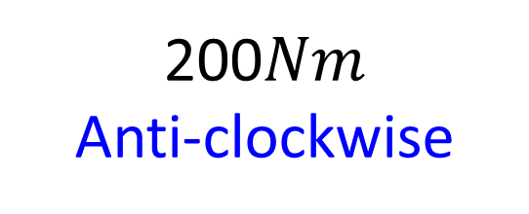


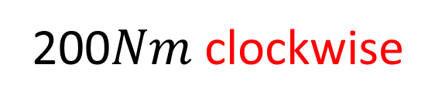



Moments - Equilibrium
Work out both moments.
$$F=20N$$
200$Nm$ clockwise
$$10m$$
$$P$$
$$16m$$
$$F=12.5N$$
200$Nm$
Anti-clockwise
What do you notice?

Slide 3
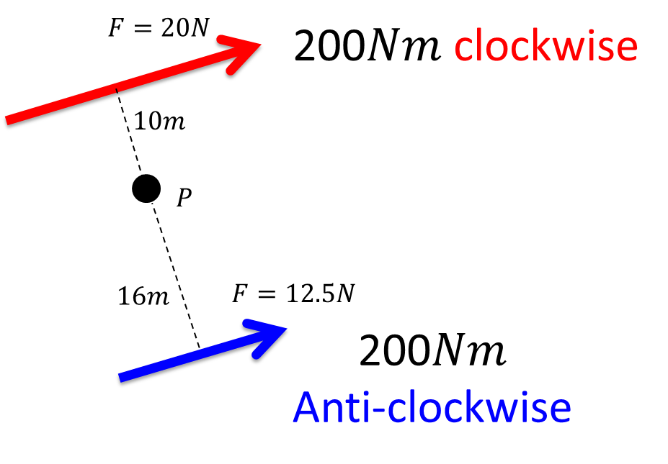
Moments - Equilibrium
Moments in Equilibrium
No rotation.
Clockwise moment = Anticlockwise moment

Slide 4



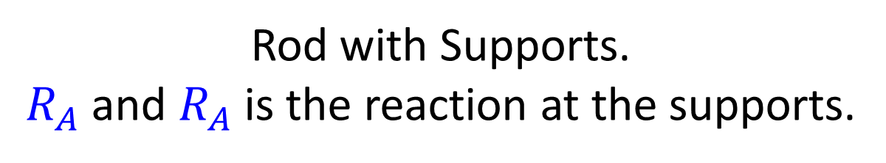
Moments - Equilibrium
Uniform Rod
Its centre of mass is at its centre and
the weight acts at a single point.
$$mg$$
$$R_{A}$$
$$R_{B}$$
Rod with Supports.
$R_{A}$ and $R_{A}$ is the reaction at the supports.

Slide 5



Moments - Equilibrium
$$R_{A}$$
$$R_{B}$$
$$mg$$
If a rigid body (i.e. rod) is in equilibrium then:
i) the resultant force of the moments is 0.
ii) the resultant forces acting vertically will equal 0.

Slide 6
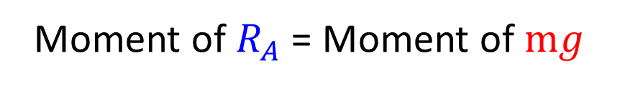

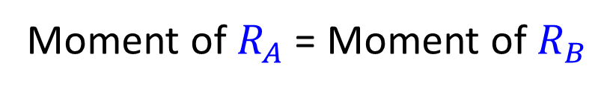


Moments - Equilibrium
$$R_{A}$$
$$R_{B}$$
B
A
C
$$mg$$
Moments (A)
Moment of $R_{A}$ + Moment of $R_{B}$ = Moment of $mg$
Moments (B)
Moment of $R_{A}$ = Moment of $R_{B}$
Moments (C)
Moment of $R_{A}$ = Moment of $mg$

Slide 7
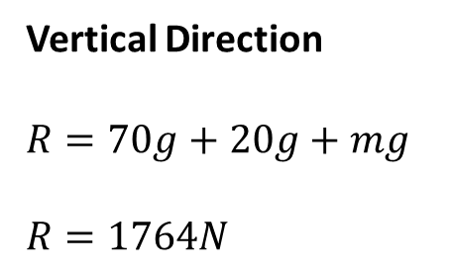

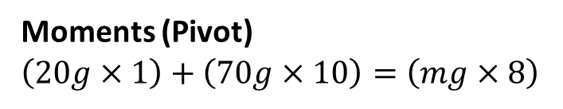



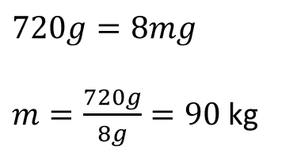
Moments - Equilibrium
Lewis and Tom are on a uniform seesaw of mass 20kg.
Lewis weighs 70kg and is 10m from the pivot.
Tom is 8m from the pivot. The seesaw remains horizontal.
a) Determine the reaction force at the pivot of the seesaw.
b) Determine Tom’s mass.
10m
9m
$$R$$
8m
$$70g$$
$$20g$$
$$mg$$
Moments (Pivot)
$$\left(20g×1\right)+\left(70g×10\right)=\left(mg×8\right)$$
Vertical Direction
$$R=70g+20g+mg$$
$$R=1764N$$
$$720g=8mg$$
$m=\frac{720g}{8g}=90$ kg

Slide 8





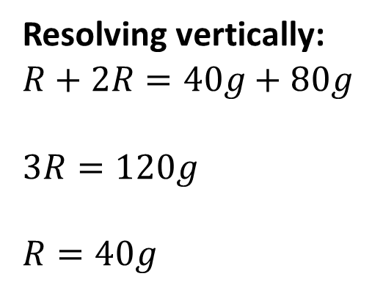
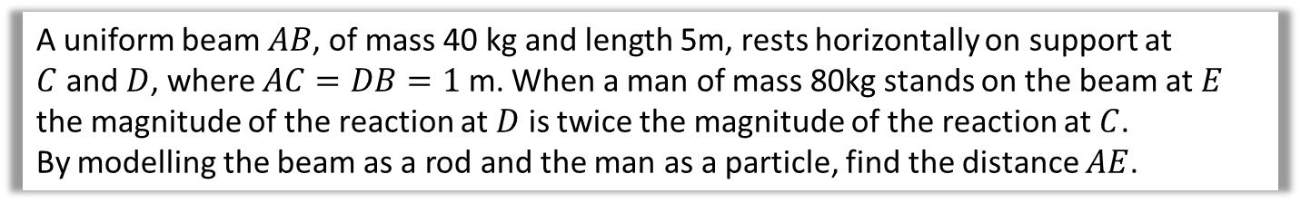
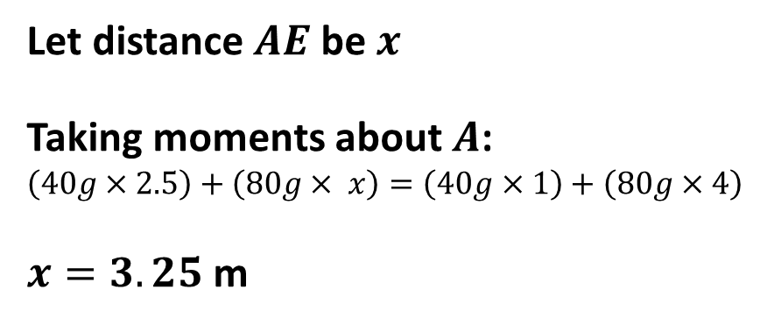








Moments - Equilibrium
A uniform beam $AB$, of mass 40 kg and length 5m, rests horizontally on support at
$C$ and $D$, where $AC=DB=1$ m. When a man of mass 80kg stands on the beam at $E$ the magnitude of the reaction at $D$ is twice the magnitude of the reaction at $C$.
By modelling the beam as a rod and the man as a particle, find the distance $AE$.
$$x$$
$$R$$
$$2R$$
$$A$$
$$C$$
$$D$$
$$B$$
$1$m
$1.5$m
$$E$$
$1$m
$$40g$$
$$80g$$
Resolving vertically:
$$R+2R=40g+80g$$
$$3R=120g$$
$$R=40g$$
Let distance $AE$ be $x$
Taking moments about $A$:
$$\left(40g×2.5\right)+\left(80g× x\right)=\left(40g×1\right)+\left(80g×4\right)$$
$x=3.25$ m

Slide 9
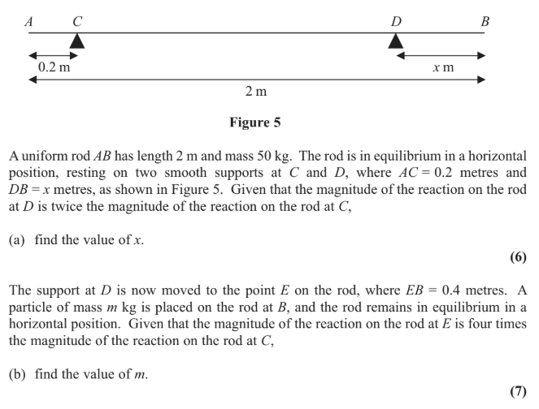
Moments – Equation Question

Slide 10
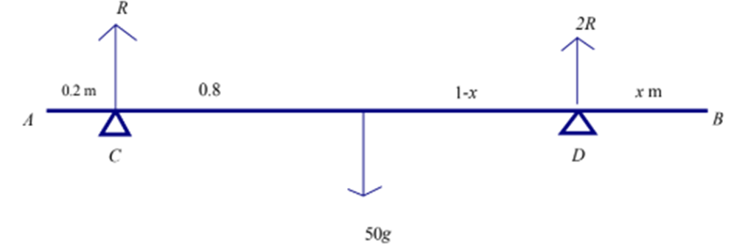
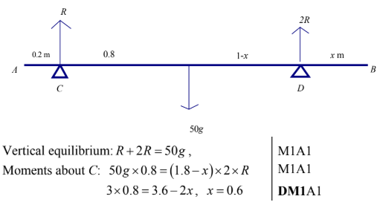
Moments – Exam Question (Answer)

Slide 11
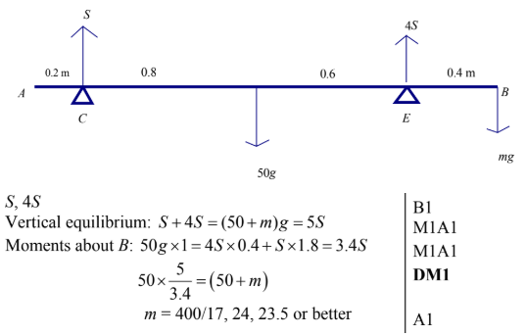
Test Your Understanding
Edexcel M1(Old) May 2013(R) Q8
a
?
b
?

Slide 12
Exercise 4C
Pearson Stats/Mechanics Year 2
Page 78-80
Complete before the lesson Q1-2
In Class:
Green Q3-5
Amber Q6-8
Red Q9-11 & Challenge

