Slide 1
Year 1 Applied Mathematics
Forces and Motions
- Vectors
Chapter 10
(Part 2 of 4)

Slide 2
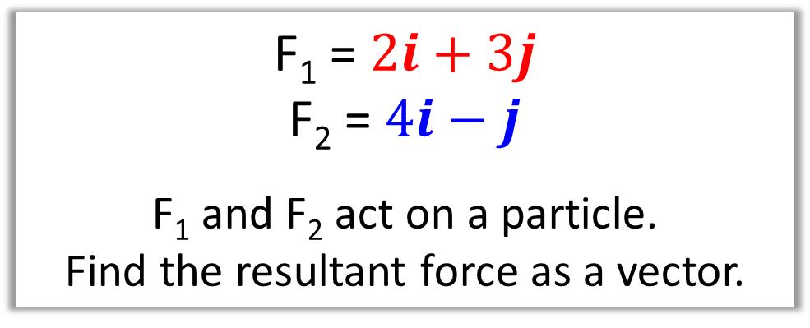
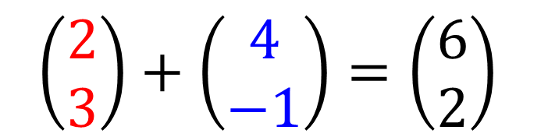
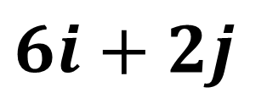
Forces as Vectors
You can find the resultant of two or more forces
given as vectors by adding the vectors.
F₁ = $2i+3j$
F₂ = $4i−j$
F₁ and F₂ act on a particle.
Find the resultant force as a vector.
$$\left(\begin{matrix}2 \\ 3\end{matrix}\right)+\left(\begin{matrix}4 \\ −1\end{matrix}\right)=\left(\begin{matrix}6 \\ 2\end{matrix}\right)$$
Resultant force Vector =
$6i+2j$

Slide 3
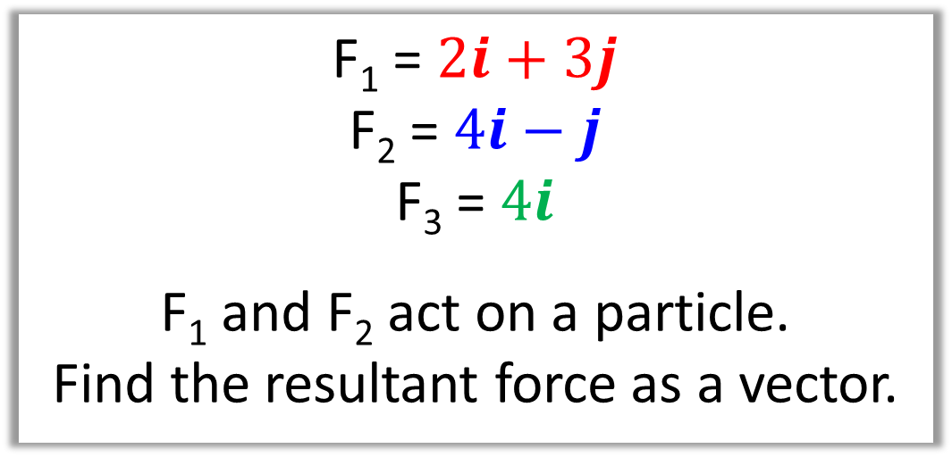
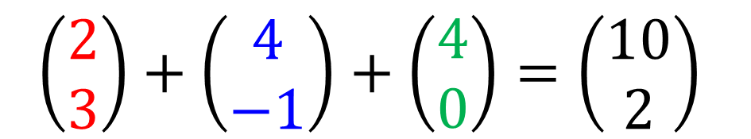
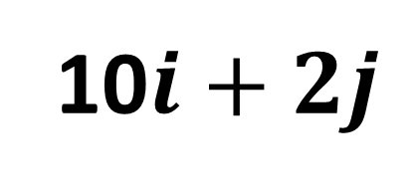
Forces as Vectors
F₁ = $2i+3j$
F₂ = $4i−j$
F₃ = $4i$
F₁ and F₂ act on a particle.
Find the resultant force as a vector.
$$\left(\begin{matrix}2 \\ 3\end{matrix}\right)+\left(\begin{matrix}4 \\ −1\end{matrix}\right)+\left(\begin{matrix}4 \\ 0\end{matrix}\right)=\left(\begin{matrix}10 \\ 2\end{matrix}\right)$$
10$i+2j$
Resultant force Vector =

Slide 4
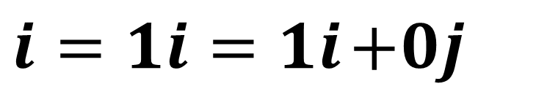

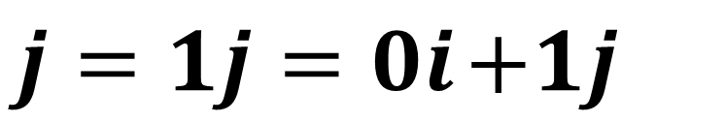

Forces as Vectors
The vector $i$ is due east
$i=1i=1i$ $+0j$
The vector $j$ is due north
$j=1j=0i$ $+1j$

Slide 5
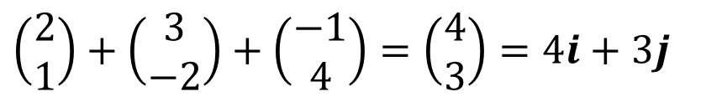
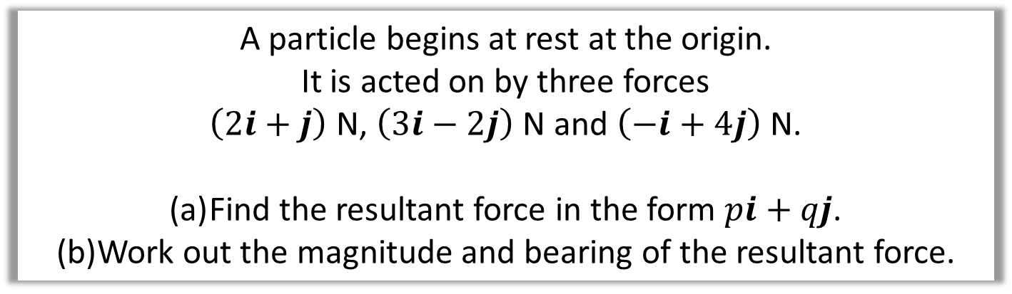
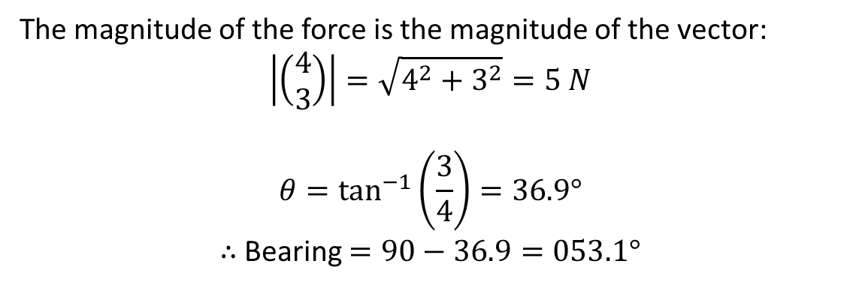

Forces as Vectors
A particle begins at rest at the origin.
It is acted on by three forces
$\left(2i+j\right)$ N, $\left(3i−2j\right)$ N and $\left(−i+4j\right)$ N.
Find the resultant force in the form $pi+qj$.
Work out the magnitude and bearing of the resultant force.
a
$$\left(\begin{matrix}2 \\ 1\end{matrix}\right)+\left(\begin{matrix}3 \\ −2\end{matrix}\right)+\left(\begin{matrix}−1 \\ 4\end{matrix}\right)=\left(\begin{matrix}4 \\ 3\end{matrix}\right)=4i+3j$$
b
The magnitude of the force is the magnitude of the vector:
$$\left|\left(\begin{matrix}4 \\ 3\end{matrix}\right)\right|=\sqrt{4^{2}+3^{2}}=5 N$$
$$θ=\tan^{−1}\left(\frac{3}{4}\right)=36.9°$$
$∴$ Bearing $=90−36.9=053.1°$
3
$$θ$$
4

Slide 6
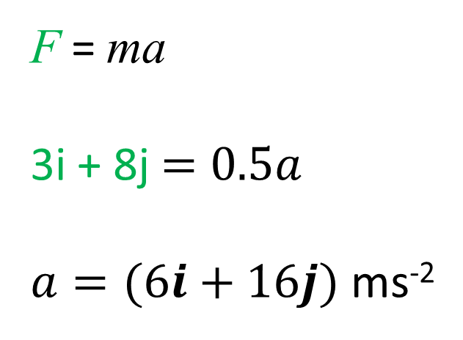
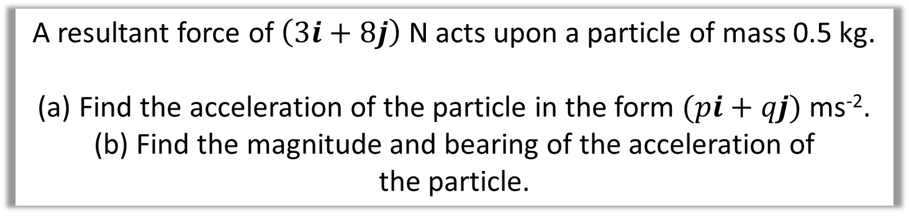

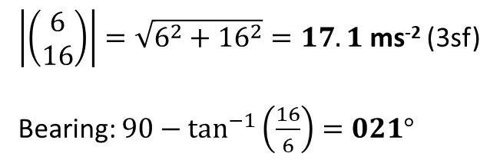
Forces as Vectors
A resultant force of $\left(3i+8j\right)$ N acts upon a particle of mass 0.5 kg.
Find the acceleration of the particle in the form $(pi+qj)$ ms⁻².
Find the magnitude and bearing of the acceleration of
the particle.
F = ma
3i + 8j$=0.5a$
$a=(6i+16j)$ ms⁻²
a
b
16
$$θ$$
6
$\left|\left(\begin{matrix}6 \\ 16\end{matrix}\right)\right|=\sqrt{6^{2}+{16}^{2}}=17.1$ ms⁻² (3sf)
Bearing: $90−\tan^{−1}\left(\frac{16}{6}\right)=021°$

Slide 7
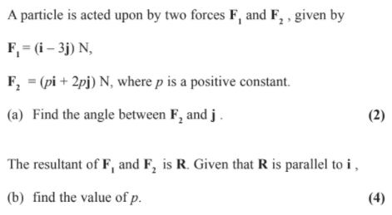
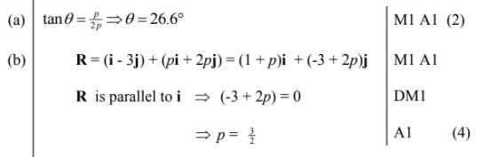
Forces as Vectors

Slide 8
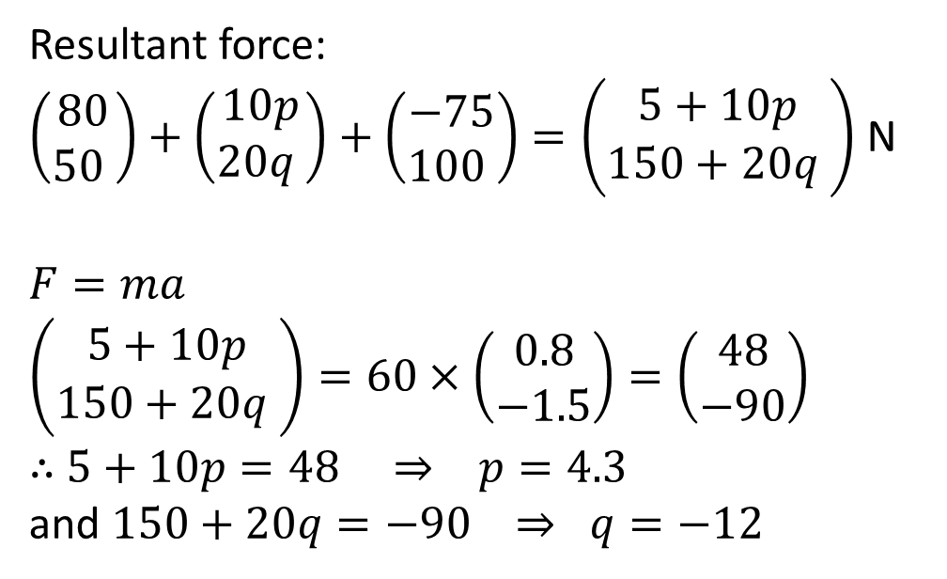
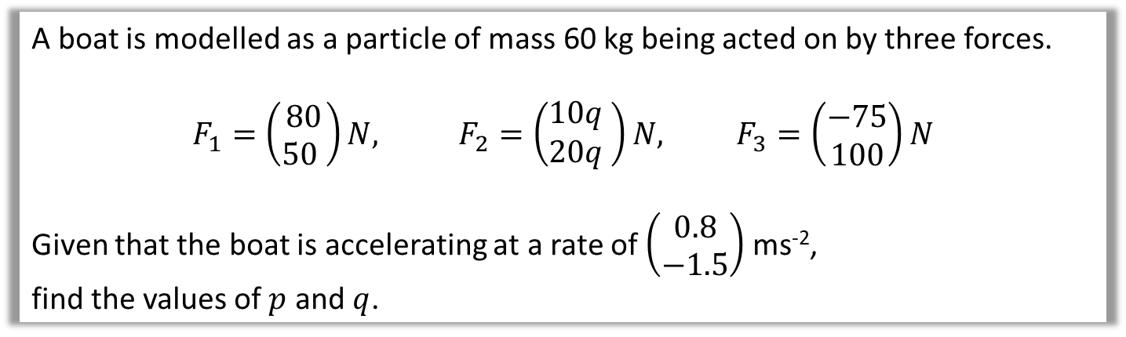
Forces as Vectors
A boat is modelled as a particle of mass 60 kg being acted on by three forces.
$$F_{1}=\left(\begin{matrix}80 \\ 50 \end{matrix}\right)N, F_{2}=\left(\begin{matrix}10q \\ 20q\end{matrix} \right)N, F_{3}=\left(\begin{matrix}−75 \\ 100\end{matrix}\right)N$$
Given that the boat is accelerating at a rate of $\left(\begin{matrix}0.8 \\ −1.5\end{matrix}\right)$ ms⁻²,
find the values of $p$ and $q$.
Resultant force:
$\left(\begin{matrix}80 \\ 50 \end{matrix}\right)+\left(\begin{matrix}10p \\ 20q \end{matrix}\right)+\left(\begin{matrix}−75 \\ 100 \end{matrix}\right)=\left(\begin{matrix}5+10p \\ 150+20q \end{matrix}\right)$ N
$F=ma$
$$\left(\begin{matrix}5+10p \\ 150+20q \end{matrix}\right)=60×\left(\begin{matrix}0.8 \\ −1.5\end{matrix}\right)=\left(\begin{matrix}48 \\ −90\end{matrix}\right)$$
$∴$ $5+10p=48 ⇒ p=4.3$
and $150+20q=−90 ⇒ q=−12$

Slide 9
Exercise 10D
Pearson Stats/Mechanics Year 1
Pages 167-169
Complete before the lesson Q1-2
In Class:
Green Q3-5
Amber Q6-7
Red Q8-10 & Challenge

