Slide 1
Year 1 Pure Mathematics
Circles
- Midpoints and Bisectors
Chapter 6
(Part 1 of 5)

Slide 2
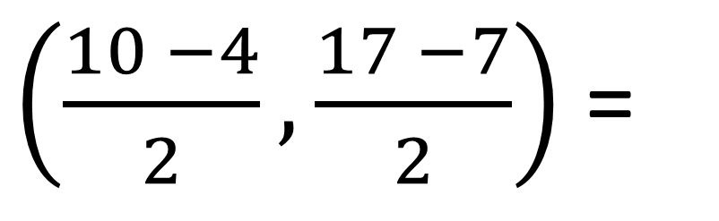
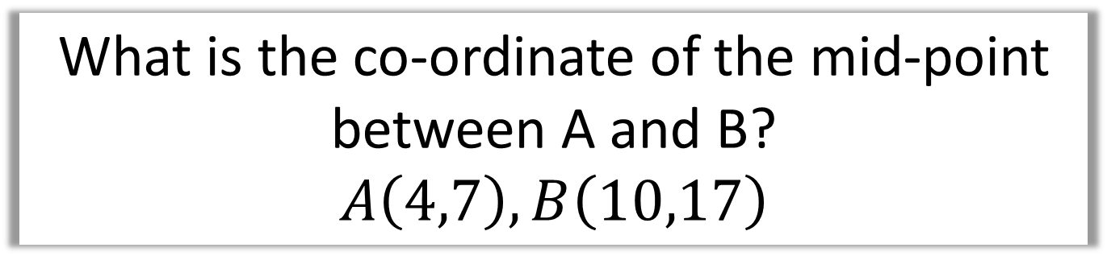
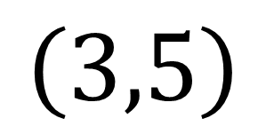
Circles - Mid-points
What is the co-ordinate of the mid-point
between A and B?
$$A\left(4,7\right), B\left(10,17\right)$$
$\left(\frac{10 −4}{2},\frac{17 −7}{2}\right)$ =
$$\left(3,5\right)$$

Slide 3
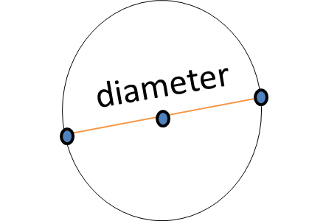
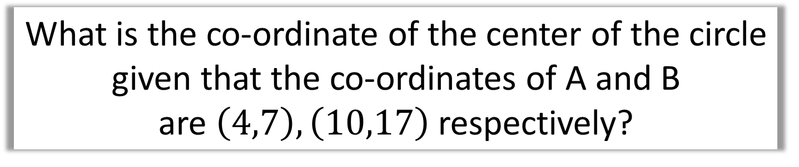
Circles - Mid-points
What is the co-ordinate of the center of the circle
given that the co-ordinates of A and B
are $\left(4,7\right),\left(10,17\right)$ respectively?
B
A

Slide 4
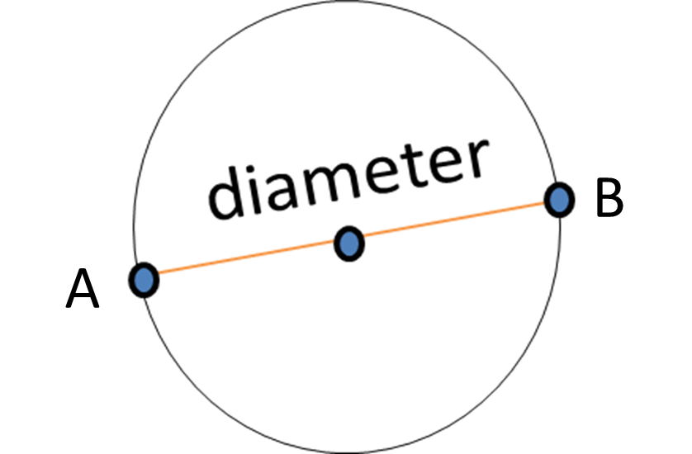
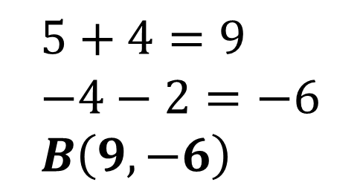
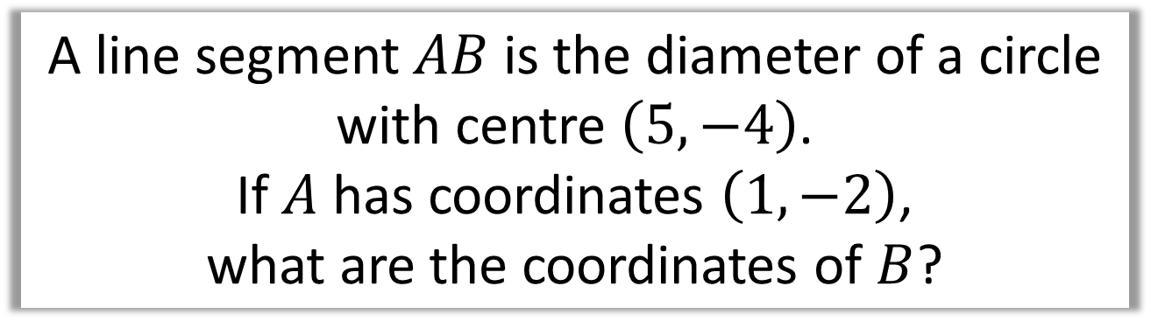
Circles – Mid-points
A line segment $AB$ is the diameter of a circle
with centre $\left(5,−4\right)$.
If $A$ has coordinates $\left(1,−2\right)$,
what are the coordinates of $B$?
$$5+4=9 \\ −4−2=−6 \\ B\left(9,−6\right)$$

Slide 5
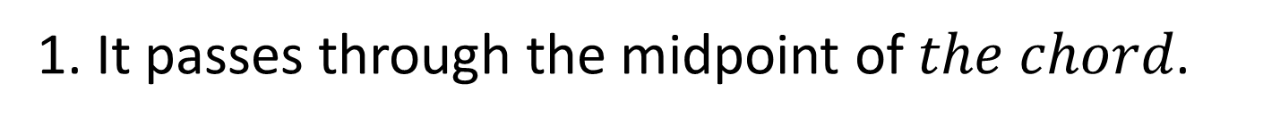
Circles - Perpendicular Bisectors
What is the relationship between
the diameter and the chord?
chord
diameter
1. It passes through the midpoint of $the chord$.
2. They are perpendicular to each other.

Slide 6
Exercise 6A/6B
Pearson Pure Mathematics Year 1/AS
Page 115, 116-117
Complete before the lesson Q1 in both
Green Ex6A odd questions
Amber Ex6B complete
Red Challenges from both

