Slide 1
Year 2 Pure Mathematics
Probability
- Venn Diagrams
Chapter 6 (Part 2)

Slide 2
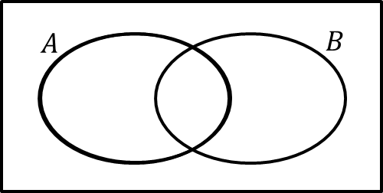
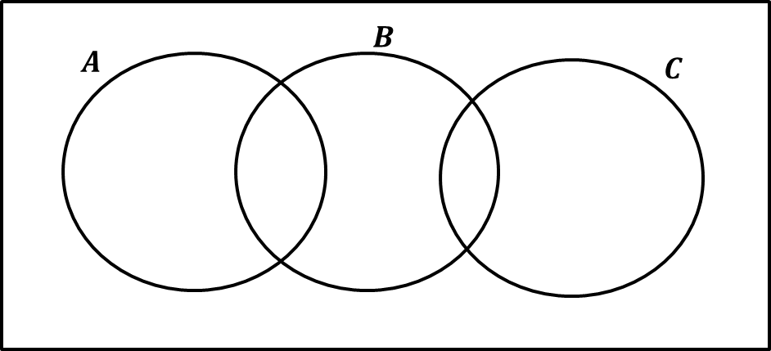
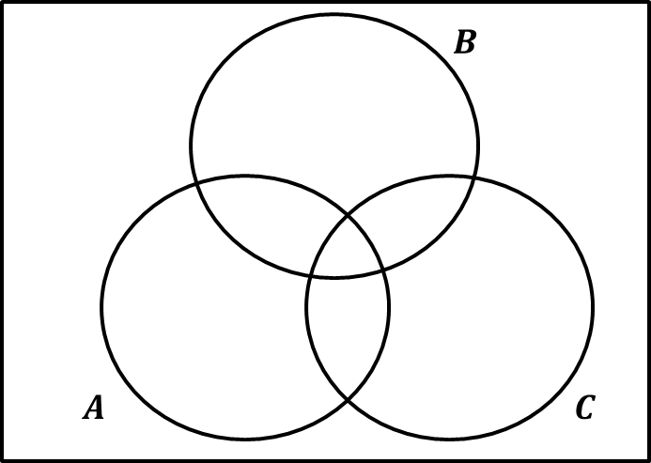
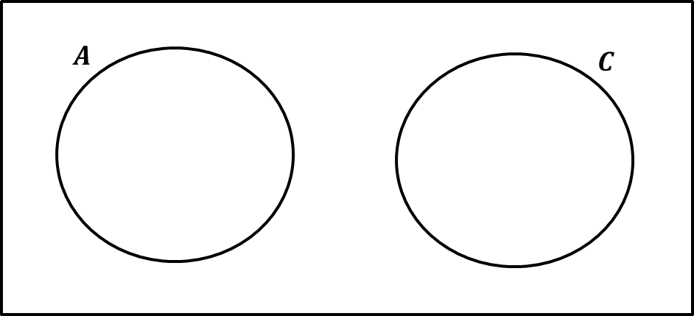
Venn Diagrams
Venn Diagrams allow us to combine events.

Slide 3

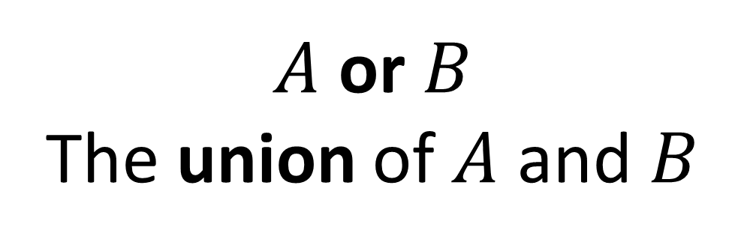

Venn Diagrams
$A$ or $B$
The union of $A$ and $B$
$$A$$
$$B$$

Slide 4


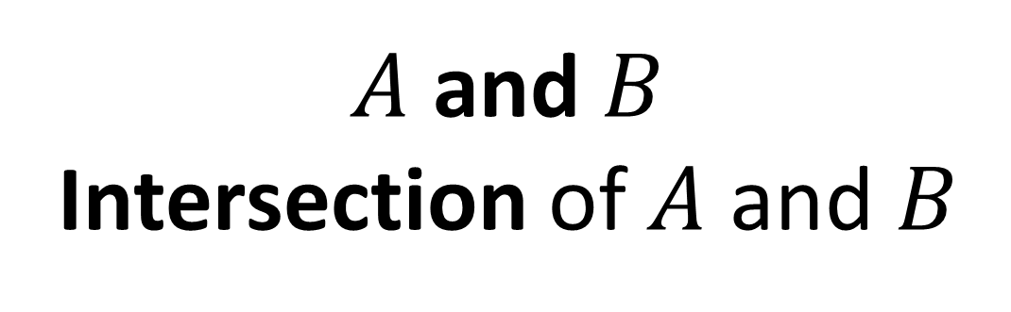
Venn Diagrams
$A$ and $B$
Intersection of $A$ and $B$
$$A$$
$$B$$

Slide 5

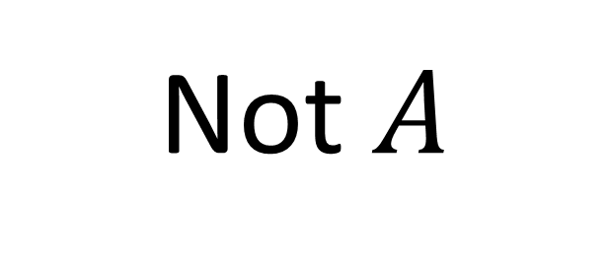

Venn Diagrams
Not $A$
$$A$$
$$B$$

Slide 6

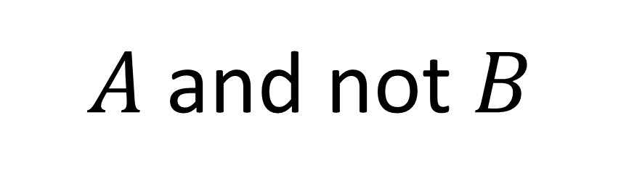

Venn Diagrams
$A$ and not $B$
$$A$$
$$B$$

Slide 7


Venn Diagrams
In a class of 30 students, 7 are in the choir,
5 are in the school band and 2 are in the choir and the band.
A student is chosen at random from the class.
Draw a Venn diagram to represent this information.
2 + y = 7
$$B$$
$$C$$
y = 5
x
y
2
2 + x = 5
z
x = 3
x + 2 + y + z = 30
z = 3

Slide 8


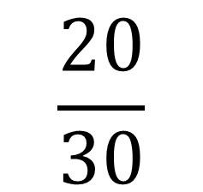
Venn Diagrams
A student is chosen at random from the class.
What is the probability the student is
not in the choir or the band?
$$B$$
$$C$$
$$\frac{20}{30}$$
3
5
2
20

Slide 9
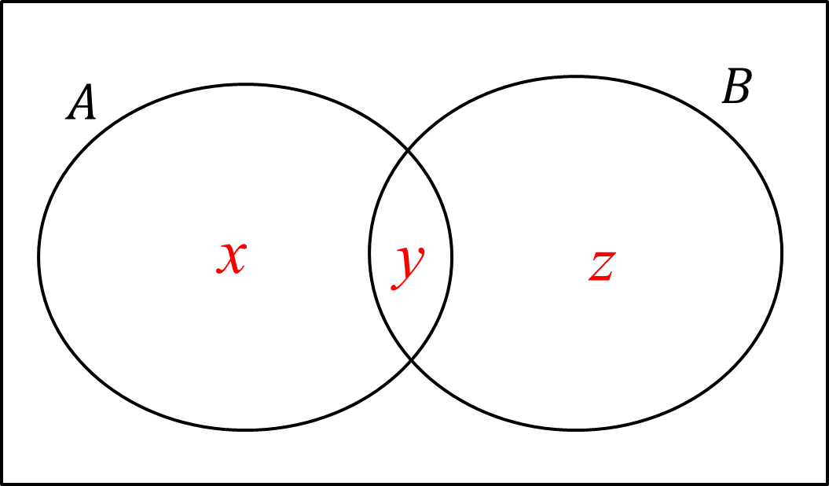
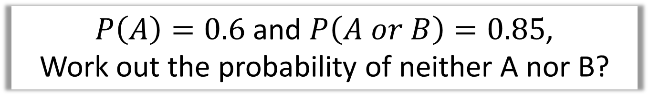
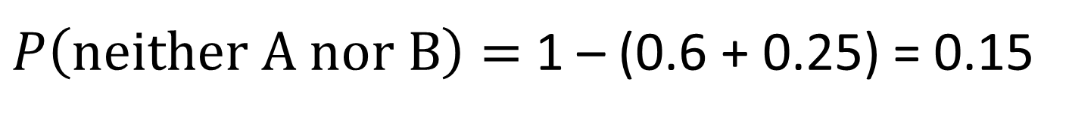
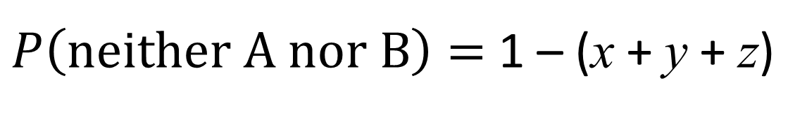
Venn Diagrams
$P\left(A\right)=0.6$ and $P\left(A or B\right)=0.85$,
Work out the probability of neither A nor B?
x + y = 0.6
x + y + z = 0.85
0.6 + z = 0.85
z = 0.25
$P\left(neither A nor B\right)=$ 1 – (x + y + z)
$P\left(neither A nor B\right)=$ 1 – (0.6 + 0.25) = 0.15

Slide 10





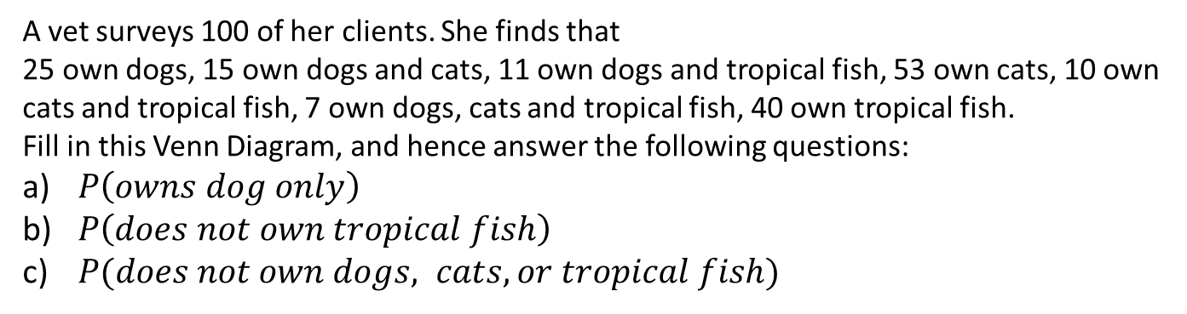



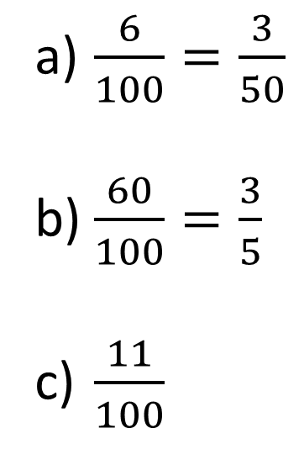




Venn Diagrams
A vet surveys 100 of her clients. She finds that
25 own dogs, 15 own dogs and cats, 11 own dogs and tropical fish, 53 own cats, 10 own cats and tropical fish, 7 own dogs, cats and tropical fish, 40 own tropical fish.
Fill in this Venn Diagram, and hence answer the following questions:
$P\left(owns dog only\right)$
$P\left(does not own tropical fish\right)$
$P(does not own dogs, cats, or tropical fish)$
Tip: Start from the centre frequency and work your way outwards using subtraction.
$$S$$
$$C$$
$\frac{6}{100}=\frac{3}{50}$
$\frac{60}{100}=\frac{3}{5}$
$\frac{11}{100}$
$$35$$
$$11$$
$$8$$
$$3$$
$$D$$
$$7$$
$$F$$
$$6$$
$$4$$
$$26$$
Dr Frost’s cat “Pippin”

Slide 11
Exercise 5B
Pearson Pure Mathematics Year 1/AS
Pages 74-75
Complete before the lesson Q1-2
In Class:
Green Q3
Amber Q4
Red Q5-7 & Challenge

