Slide 1

CorePure1 Chapter 7 ::
Linear Transformations
jfrost@tiffin.kingston.sch.uk
www.drfrostmaths.com
@DrFrostMaths
Last modified: 14th September 2018

Slide 2








www.drfrostmaths.com
Everything is completely free.
Why not register?
Register now to interactively practise questions on this topic, including past paper questions and extension questions (including MAT + UKMT).
Teachers: you can create student accounts (or students can register themselves), to set work, monitor progress and even create worksheets.
With questions by:
Dashboard with points, trophies, notifications and student progress.
Questions organised by topic, difficulty and past paper.
Teaching videos with topic tests to check understanding.

Slide 3
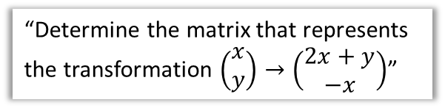

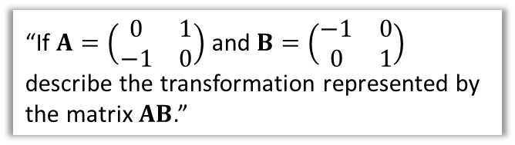
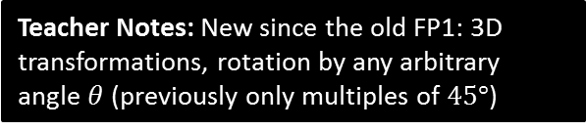
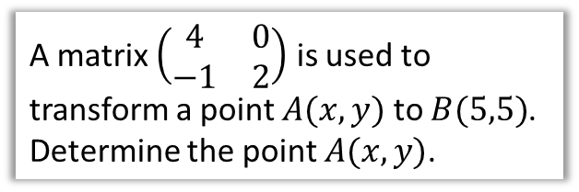
Chapter Overview
Those who have done IGCSE Further Mathematics would have encountered some of this content. Otherwise it will be completely new!
1:: Use of matrices to represent linear transformations.
2:: Use matrices to represent reflections, rotations (about the origin) and enlargements.
“Determine the matrix that represents the transformation $\left(\begin{matrix}x \\ y\end{matrix}\right)→\left(\begin{matrix}2x+y \\ −x\end{matrix}\right)$”
“Describe the geometrical transformation represented by the matrix $\left(\begin{matrix}0 & 1 \\ −1 & 0\end{matrix}\right)$”
3:: Carry out successive transformations using matrix products.
4:: Use inverse matrices to represent reverse transformations.
“If $A=\left(\begin{matrix}0 & 1 \\ −1 & 0\end{matrix}\right)$ and $B=\left(\begin{matrix}−1 & 0 \\ 0 & 1\end{matrix}\right)$ describe the transformation represented by the matrix $AB$.”
A matrix $\left(\begin{matrix}4 & 0 \\ −1 & 2\end{matrix}\right)$ is used to transform a point $A(x,y)$ to $B(5,5)$. Determine the point $A(x,y)$.
Teacher Notes: New since the old FP1: 3D transformations, rotation by any arbitrary angle $θ$ (previously only multiples of $45°$)

Slide 4
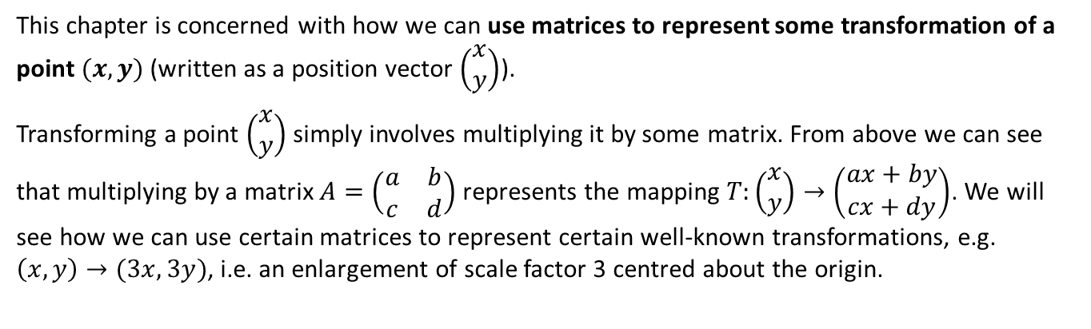



Linear Transformations
?
$$\left(\begin{matrix}a & b \\ c & d\end{matrix}\right)\left(\begin{matrix}x \\ y\end{matrix}\right)=\left(\begin{matrix}ax+by \\ cx+dy\end{matrix}\right)$$
This chapter is concerned with how we can use matrices to represent some transformation of a point $(x,y)$ (written as a position vector $\left(\begin{matrix}x \\ y\end{matrix}\right)$).
Transforming a point $\left(\begin{matrix}x \\ y\end{matrix}\right)$ simply involves multiplying it by some matrix. From above we can see that multiplying by a matrix $A=\left(\begin{matrix}a & b \\ c & d\end{matrix}\right)$ represents the mapping $T:\left(\begin{matrix}x \\ y\end{matrix}\right)→\left(\begin{matrix}ax+by \\ cx+dy\end{matrix}\right)$. We will see how we can use certain matrices to represent certain well-known transformations, e.g. $\left(x,y\right)→(3x,3y)$, i.e. an enlargement of scale factor 3 centred about the origin.
$ax+by$ is known as a linear combination of $x$ and $y$ (an algebraic form we saw in Pure Year 1 straight line equations). Each row of the matrix we’re multiplying by provides an instruction of how to generate each dimension of the new coordinate system, in terms of the old dimensions $x,$ $y$…
e.g. given $\left(\begin{matrix}2 & 3 \\ 1 & 1\end{matrix}\right)\left(\begin{matrix}x \\ y\end{matrix}\right)=\left(\begin{matrix}2x+3y \\ x+y\end{matrix}\right)$ , the new $x$ value is $2x+3y$ and the new $y$ value is $x+y$, i.e. linear combinations of the old $x$ and $y$ values.
A function $f(a)$, where $a$ is a vector, is linear if it has the following properties:
$f\left(ka\right)=kf(a)$ for a constant $k$, i.e. scaling the original vector scales the image vector.
$f\left(a+b\right)=f\left(a\right)+f(b)$
It is possible to prove that $f\left[\left(\begin{matrix}x \\ y\end{matrix}\right)\right]=ax+by$ is linear, i.e. satisfies the above restrictions.

Slide 5

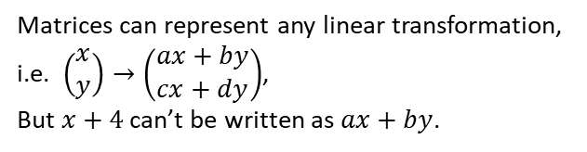

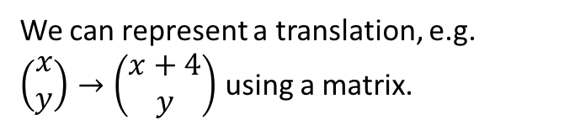


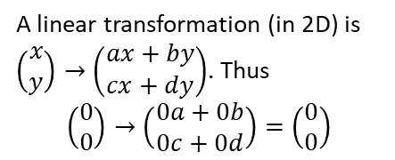
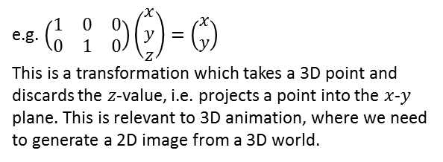

True or false?
1
We can represent a translation, e.g. $\left(\begin{matrix}x \\ y\end{matrix}\right)→\left(\begin{matrix}x+4 \\ y\end{matrix}\right)$ using a matrix.
True
False
Matrices can represent any linear transformation, i.e. $\left(\begin{matrix}x \\ y\end{matrix}\right)→\left(\begin{matrix}ax+by \\ cx+dy\end{matrix}\right)$,
But $x+4$ can’t be written as $ax+by$.
2
Matrices can represent transformations which increase or decrease the number of dimensions (e.g. transform a 3D point to get a 2D point).
True
False
$$z$$
$$(3,5,2)$$
e.g. $\left(\begin{matrix}1 & 0 & 0 \\ 0 & 1 & 0\end{matrix}\right)\left(\begin{matrix}x \\ y \\ z\end{matrix}\right)=\left(\begin{matrix}x \\ y\end{matrix}\right)$
This is a transformation which takes a 3D point and discards the $z$-value, i.e. projects a point into the $x$-$y$ plane. This is relevant to 3D animation, where we need to generate a 2D image from a 3D world.
$$y$$
$$(3,5)$$
$$x$$
3
The origin is unaffected by any linear transformation.
True
False
A linear transformation (in 2D) is $\left(\begin{matrix}x \\ y\end{matrix}\right)→\left(\begin{matrix}ax+by \\ cx+dy\end{matrix}\right)$. Thus
$$\left(\begin{matrix}0 \\ 0\end{matrix}\right)→\left(\begin{matrix}0a+0b \\ 0c+0d\end{matrix}\right)=\left(\begin{matrix}0 \\ 0\end{matrix}\right)$$

Slide 6
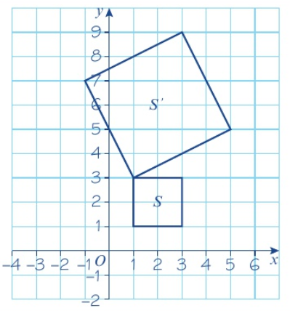


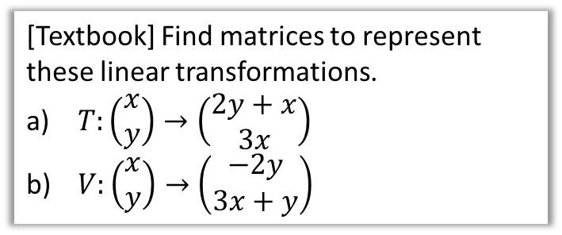
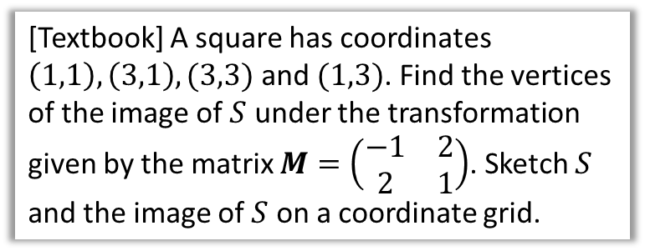


Examples
[Textbook] Find matrices to represent these linear transformations.
$T:\left(\begin{matrix}x \\ y\end{matrix}\right)→\left(\begin{matrix}2y+x \\ 3x\end{matrix}\right)$
$V:\left(\begin{matrix}x \\ y\end{matrix}\right)→\left(\begin{matrix}−2y \\ 3x+y\end{matrix}\right)$
[Textbook] A square has coordinates $\left(1,1\right),\left(3,1\right),(3,3)$ and $(1,3)$. Find the vertices of the image of $S$ under the transformation given by the matrix $M=\left(\begin{matrix}−1 & 2 \\ 2 & 1\end{matrix}\right)$. Sketch $S$ and the image of $S$ on a coordinate grid.
$$\left(\begin{matrix}−1 & 2 \\ 2 & 1\end{matrix}\right)\left(\begin{matrix}1 \\ 1\end{matrix}\right)=\left(\begin{matrix}1 \\ 3\end{matrix}\right)$$
And transforming the other points, we obtain the vertices of the image of $S$, $S′$:
$$\left(1,3\right),\left(−1,7\right),\left(3,9\right),\left(5,5\right)$$
As mentioned before, we write coordinates as position vectors to enable matrix multiplication.
$$T:\left(\begin{matrix}x \\ y\end{matrix}\right)→\left(\begin{matrix}1x+2y \\ 3x+0y\end{matrix}\right)$$
Matrix is $\left(\begin{matrix}1 & 2 \\ 3 & 0\end{matrix}\right)$
? Points
a
?
Write in form $\left(\begin{matrix}ax+by \\ cx+dy\end{matrix}\right)$. This enables to read the coefficients straight off to get the matrix.
? Sketch
b
?
Fro Note: By transforming multiple points, it’s easier to see the effect that a transformation represented by a matrix has. We can see there’s a mixture of enlargement and rotation here.
$$V:\left(\begin{matrix}x \\ y\end{matrix}\right)→\left(\begin{matrix}0x−2y \\ 3x+y\end{matrix}\right)$$
Matrix is $\left(\begin{matrix}0 & −2 \\ 3 & 1\end{matrix}\right)$

Slide 7
Exercise 7A
Pearson Pure Mathematics Year 1/AS
Pages 129-130
Complete before the lesson Q1-3
In Class:
Green Q4-6
Amber Q7-8
Red Q9-10 & challenge

Slide 8

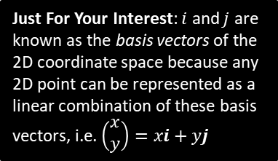


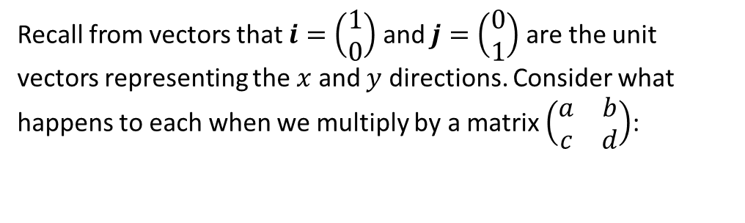





Determining a matrix for a transformation
Recall from vectors that $i=\left(\begin{matrix}1 \\ 0\end{matrix}\right)$ and $j=\left(\begin{matrix}0 \\ 1\end{matrix}\right)$ are the unit vectors representing the $x$ and $y$ directions. Consider what happens to each when we multiply by a matrix $\left(\begin{matrix}a & b \\ c & d\end{matrix}\right)$:
Just For Your Interest: $i$ and $j$ are known as the basis vectors of the 2D coordinate space because any 2D point can be represented as a linear combination of these basis vectors, i.e. $\left(\begin{matrix}x \\ y\end{matrix}\right)=xi+yj$
$$\left(\begin{matrix}a & b \\ c & d\end{matrix}\right)\left(\begin{matrix}1 \\ 0\end{matrix}\right)=\left(\begin{matrix}a \\ c\end{matrix}\right)$$
$$\left(\begin{matrix}a & b \\ c & d\end{matrix}\right)\left(\begin{matrix}0 \\ 1\end{matrix}\right)=\left(\begin{matrix}b \\ d\end{matrix}\right)$$
What can we conclude about the columns of a matrix?
They tell us where each of the coordinate axes end up under the transformation.
?
“Find a $2×2$ matrix that represents a reflection in the $y$-axis.”
$$\left(\begin{matrix}0 \\ 1\end{matrix}\right)$$
?
$$\left(\begin{matrix}0 \\ 1\end{matrix}\right)$$
The coordinates of these can then be read off to form the columns of the matrix.
Consider where each of the coordinate axes ($i,j$) end up.
?
$$\left(\begin{matrix}−1 & 0 \\ 0 & 1\end{matrix}\right)$$
$$\left(\begin{matrix}1 \\ 0\end{matrix}\right)$$
$$\left(\begin{matrix}−1 \\ 0\end{matrix}\right)$$

Slide 9


















Further Examples
Rotation $90°$ about the origin.
$$A=\left(\begin{matrix}0 & −1 \\ 1 & 0\end{matrix}\right)$$
Note: Rotations by default are anticlockwise.
?
$$\left(\begin{matrix}0 \\ 1\end{matrix}\right)$$
$$\left(\begin{matrix}0 \\ 1\end{matrix}\right)$$
?
$$\left(\begin{matrix}1 \\ 0\end{matrix}\right)$$
?
$$\left(\begin{matrix}−1 \\ 0\end{matrix}\right)$$
$$x$$
$$x$$
Rotation $θ$ about the origin.
$$A=\left(\begin{matrix}\cos{θ} & −\sin{θ} \\ \sin{θ} & \cos{θ}\end{matrix}\right)$$
!
?
$$\left(\begin{matrix}−sin{θ} \\ \cos{θ}\end{matrix}\right)$$
Rotation by an arbitrary angle $θ$ is new to the A Level 2017 syllabus.
?
$$\left(\begin{matrix}0 \\ 1\end{matrix}\right)$$
?
$$\left(\begin{matrix}\cos{θ} \\ \sin{θ}\end{matrix}\right)$$
$$\left(\begin{matrix}1 \\ 0\end{matrix}\right)$$
$$θ$$
$$x$$
$$x$$

Slide 10


















Test Your Understanding So Far
Find the matrix representing a reflection in the line $y=x$.
$$y$$
$$y$$
?
$$\left(\begin{matrix}0 \\ 1\end{matrix}\right)$$
$$\left(\begin{matrix}0 \\ 1\end{matrix}\right)$$
$$A=\left(\begin{matrix}0 & 1 \\ 1 & 0\end{matrix}\right)$$
$$\left(\begin{matrix}1 \\ 0\end{matrix}\right)$$
$$x$$
$$x$$
$$\left(\begin{matrix}1 \\ 0\end{matrix}\right)$$
Find the matrix representing a rotation by $270°$.
?
$$y$$
$$y$$
$$\left(\begin{matrix}0 \\ 1\end{matrix}\right)$$
$$A=\left(\begin{matrix}0 & 1 \\ −1 & 0\end{matrix}\right)$$
$$\left(\begin{matrix}1 \\ 0\end{matrix}\right)$$
$$x$$
$$x$$
$$\left(\begin{matrix}1 \\ 0\end{matrix}\right)$$
$$\left(\begin{matrix}0 \\ −1\end{matrix}\right)$$

Slide 11
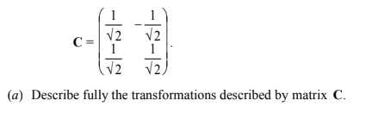







Further Test Your Understanding
Edexcel FP1(Old) Jan 2009 Q10
Fro Hint: It looks like a rotation matrix, so perhaps we could use
$$\left(\begin{matrix}\cos{θ} & −\sin{θ} \\ \sin{θ} & \cos{θ}\end{matrix}\right)$$
?
?
Alternative Method
$$\left(\begin{matrix}\cos{θ} & −\sin{θ} \\ \sin{θ} & \cos{θ}\end{matrix}\right)=\left(\begin{matrix}\frac{1}{\sqrt{2}} & −\frac{1}{\sqrt{2}} \\ \frac{1}{\sqrt{2}} & \frac{1}{\sqrt{2}}\end{matrix}\right)$$
If $\cos{θ}=\frac{1}{\sqrt{2}}$, then $θ=45°$ or $θ=315°$
But $\sin{θ}=\frac{1}{\sqrt{2}}$, so $θ=45°$ or $θ=135°$
Therefore a rotation anticlockwise of $45°$ about the origin.
Alternative method: Plot the two columns as vectors from the origin.
$$y$$
$$\left(\begin{matrix}\frac{1}{\sqrt{2}} \\ \frac{1}{\sqrt{2}}\end{matrix}\right)$$
$$\left(\begin{matrix}−\frac{1}{\sqrt{2}} \\ \frac{1}{\sqrt{2}}\end{matrix}\right)$$
$$45°$$
$$x$$

Slide 12
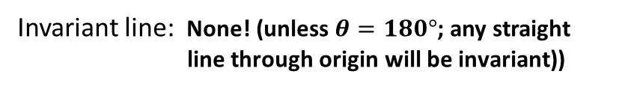
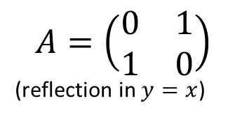



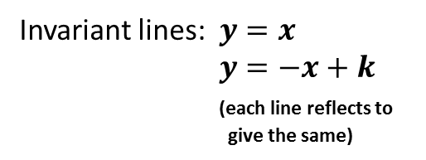

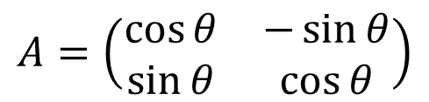
Invariant points and lines
An invariant point is one which is unaffected by a transformation.
An invariant line is when each point on the line transformed to give another point on the same line.
$$y$$
$$y$$
$$A=\left(\begin{matrix}0 & 1 \\ 1 & 0\end{matrix}\right)$$
(reflection in $y=x$)
$$A=\left(\begin{matrix}\cos{θ} & −\sin{θ} \\ \sin{θ} & \cos{θ}\end{matrix}\right)$$
invariant line
invariant line
$$x$$
$$x$$
Invariant lines: $y=x$
$y=−x+k$
(each line reflects to
give the same)
?
?
Invariant line: None! (unless $θ=180°$; any straight
line through origin will be invariant))
Invariant point: (0, 0)
?

Slide 13
Exercise 7B
Pearson Pure Mathematics Year 1/AS
Pages 134-135
Complete before the lesson Q1-3
In Class:
Green Q4-6
Amber Q7-8
Red Q9-10 & challenge

Slide 14
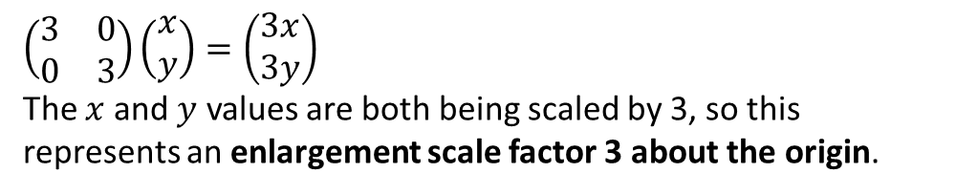

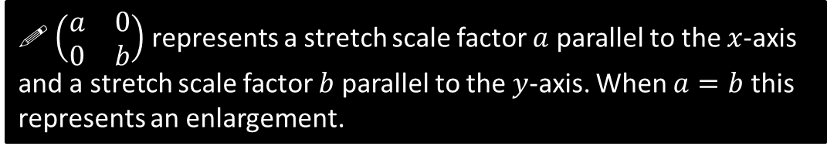
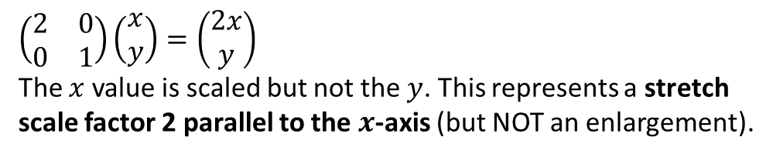
Enlargements
Describe the effect of the following matrices.
$$\left(\begin{matrix}3 & 0 \\ 0 & 3\end{matrix}\right) \left(\begin{matrix}2 & 0 \\ 0 & 1\end{matrix}\right)$$
a
$$\left(\begin{matrix}3 & 0 \\ 0 & 3\end{matrix}\right)\left(\begin{matrix}x \\ y\end{matrix}\right)=\left(\begin{matrix}3x \\ 3y\end{matrix}\right)$$
The $x$ and $y$ values are both being scaled by 3, so this represents an enlargement scale factor 3 about the origin.
?
b
?
$$\left(\begin{matrix}2 & 0 \\ 0 & 1\end{matrix}\right)\left(\begin{matrix}x \\ y\end{matrix}\right)=\left(\begin{matrix}2x \\ y\end{matrix}\right)$$
The $x$ value is scaled but not the $y$. This represents a stretch scale factor 2 parallel to the $x$-axis (but NOT an enlargement).
! $\left(\begin{matrix}a & 0 \\ 0 & b\end{matrix}\right)$ represents a stretch scale factor $a$ parallel to the $x$-axis and a stretch scale factor $b$ parallel to the $y$-axis. When $a=b$ this represents an enlargement.

Slide 15

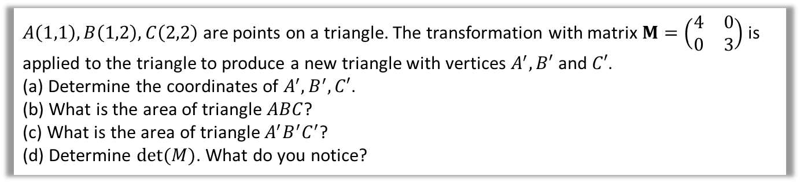






Using $\det\left(A\right)$
$A\left(1,1\right),B\left(1,2\right),C\left(2,2\right)$ are points on a triangle. The transformation with matrix $M=\left(\begin{matrix}4 & 0 \\ 0 & 3\end{matrix}\right)$ is applied to the triangle to produce a new triangle with vertices $A^{′},B′$ and $C′$.
(a) Determine the coordinates of $A^{′}, B^{′},C′$.
(b) What is the area of triangle $ABC$?
(c) What is the area of triangle $A^{′}B^{′}C^{′}$?
(d) Determine $det⁡(M)$. What do you notice?
a
Transform each of the vertices in turn:
$$\left(\begin{matrix}4 & 0 \\ 0 & 3\end{matrix}\right)\left(\begin{matrix}1 \\ 1\end{matrix}\right)=\left(\begin{matrix}4 \\ 3\end{matrix}\right) → A′(4,3) \\ \left(\begin{matrix}4 & 0 \\ 0 & 3\end{matrix}\right)\left(\begin{matrix}1 \\ 2\end{matrix}\right)=\left(\begin{matrix}4 \\ 6\end{matrix}\right) → B′(4,6) \\ \left(\begin{matrix}4 & 0 \\ 0 & 3\end{matrix}\right)\left(\begin{matrix}2 \\ 2\end{matrix}\right)=\left(\begin{matrix}8 \\ 6\end{matrix}\right) → C′(8,6)$$
Area of $ABC$ $=\frac{1}{2}×1×1=\frac{1}{2}$
Area of $A^{′}B^{′}C^{′}=\frac{1}{2}×4×3=6$
$$\left|M\right|=\left(4×3\right)−\left(0×0\right)=12$$
The scale factor of area ($6÷\frac{1}{2}=12$) is equal to the determinant. Holy Smurf!
?
$$B′\left(4,6\right)$$
$$C′\left(8,6\right)$$
$$B\left(1,2\right)$$
$$C\left(2,2\right)$$
b
?
c
?
$$A\left(1,1\right)$$
$$A′\left(4,3\right)$$
d
?

Slide 16
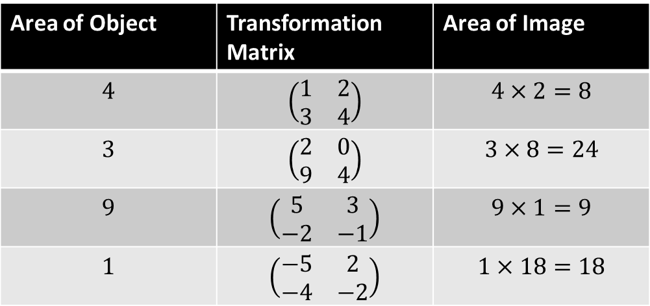
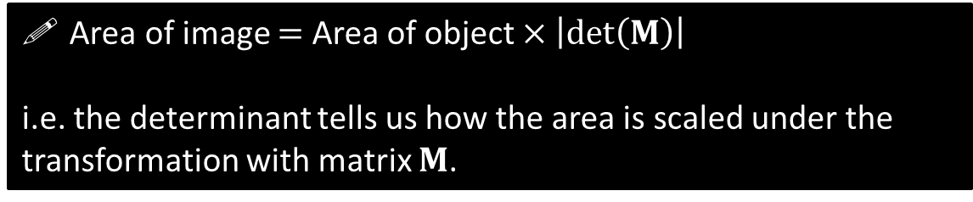
Area scale factor
We saw in this example that:
Area of image $=$ Area of object $×\left|\det\left(M\right)\right|$
i.e. the determinant tells us how the area is scaled under the transformation with matrix $M$.
(The proof of this is not covered here)
Area of Object | Transformation Matrix | Area of Image
$$4$$ | $$\left(\begin{matrix}1 & 2 \\ 3 & 4\end{matrix}\right)$$ | $$4×2=8$$
$$3$$ | $$\left(\begin{matrix}2 & 0 \\ 9 & 4\end{matrix}\right)$$ | $$3×8=24$$
$$9$$ | $$\left(\begin{matrix}5 & 3 \\ −2 & −1\end{matrix}\right)$$ | $$9×1=9$$
$$1$$ | $$\left(\begin{matrix}−5 & 2 \\ −4 & −2\end{matrix}\right)$$ | $$1×18=18$$
?
?
?
?

Slide 17
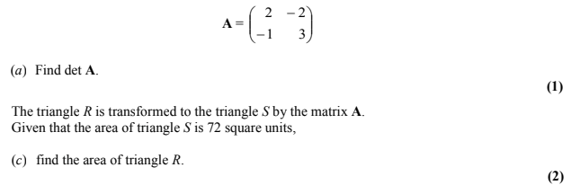
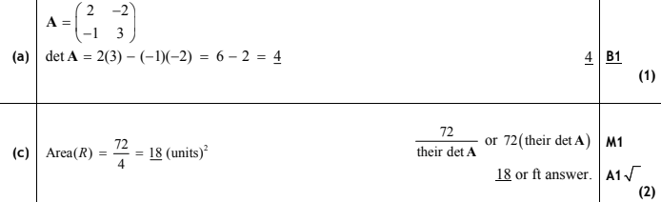
Test Your Understanding
Edexcel Jan 2011 Q8
?
?

Slide 18
Exercise 7C
Pearson Pure Mathematics Year 1/AS
Pages 138-140
Complete before the lesson Q1-3
In Class:
Green Q4-6
Amber Q7-8
Red Q9-10 & challenge

Slide 19

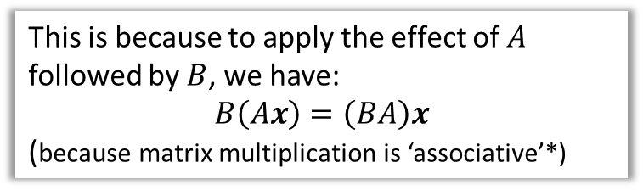

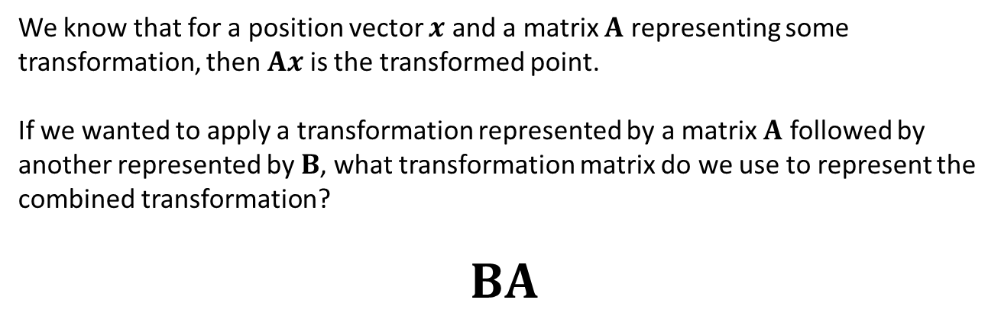


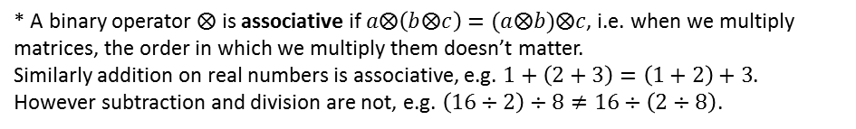

Combined Transformations
We know that for a position vector $x$ and a matrix $A$ representing some transformation, then $Ax$ is the transformed point.
If we wanted to apply a transformation represented by a matrix $A$ followed by another represented by $B$, what transformation matrix do we use to represent the combined transformation?
$$BA$$
?
Fro Tip: Ensure that you put these matrices in the right order – the first that gets applied is on the right!
This is because to apply the effect of $A$ followed by $B$, we have:
$$B\left(Ax\right)=\left(BA\right)x$$
(because matrix multiplication is ‘associative’*)
$$BA$$
$$A$$
$$B$$
* A binary operator $⨂$ is associative if $a⨂\left(b⨂c\right)=(a⨂b)⨂c$, i.e. when we multiply matrices, the order in which we multiply them doesn’t matter.
Similarly addition on real numbers is associative, e.g. $1+\left(2+3\right)=\left(1+2\right)+3$. However subtraction and division are not, e.g. $\left(16÷2\right)÷8≠16÷\left(2÷8\right)$.
$$x$$
$$y$$

Slide 20
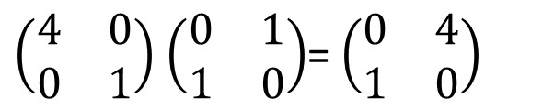
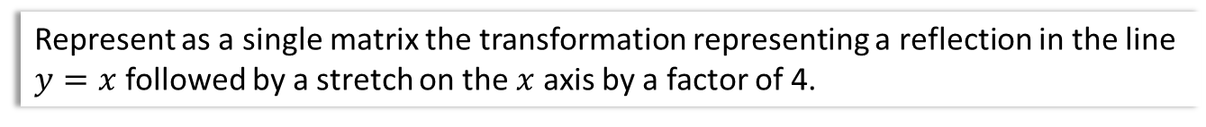

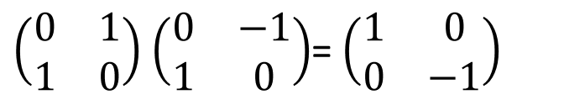

Combined Transformations
Represent as a single matrix the transformation representing a reflection in the line $y=x$ followed by a stretch on the $x$ axis by a factor of 4.
$\left(\begin{matrix}4 & 0 \\ 0 & 1\end{matrix}\right)$ $\left(\begin{matrix}0 & 1 \\ 1 & 0\end{matrix}\right)$= $\left(\begin{matrix}0 & 4 \\ 1 & 0\end{matrix}\right)$
?
?
?
Represent as a single matrix the transformation representing a rotation $90°$ anticlockwise about the point $\left(0,0\right)$ followed by a reflection in the line $y=x$.
$\left(\begin{matrix}0 & 1 \\ 1 & 0\end{matrix}\right)$ $\left(\begin{matrix}0 & −1 \\ 1 & 0\end{matrix}\right)$= $\left(\begin{matrix}1 & 0 \\ 0 & −1\end{matrix}\right)$
?
?
?
What single transformation is this?
Reflection in the $x$ axis.
?

Slide 21
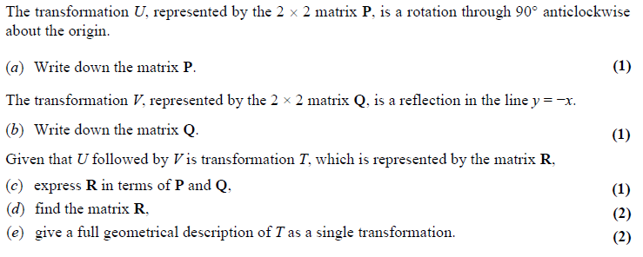
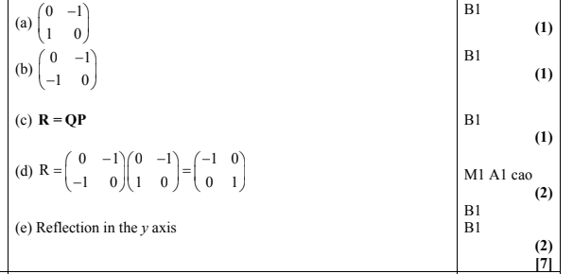
Test Your Understanding
Edexcel Jan 2013 Q4
?
?
?
?
?

Slide 22
Exercise 7D
Pearson Pure Mathematics Year 1/AS
Pages 141-143
Complete before the lesson Q1-4
In Class:
Green Q5-7
Amber Q8-11
Red Q12-14 & challenge

Slide 23














Linear transformations in 3D
We saw earlier that we could determine the matrix corresponding to a transformation by transforming each of the unit vectors (i.e. the axes) and using these as the columns of the matrix. This works in 3D too!
$$z$$
$$z$$
? Diagram
Reflect in the plane $z=0$.
$$k$$
$$\left(\begin{matrix}0 \\ 1 \\ 0\end{matrix}\right)$$
$$y$$
$$j$$
$$y$$
$$i$$
$$\left(\begin{matrix}1 \\ 0 \\ 0\end{matrix}\right)$$
$$x$$
$$\left(\begin{matrix}0 \\ 0 \\ −1\end{matrix}\right)$$
$$x$$
$$\left(\begin{matrix}1 & 0 & 0 \\ 0 & 1 & 0 \\ 0 & 0 & −1\end{matrix}\right)$$
? Matrix

Slide 24



















Linear transformations in 3D
Reminder: The rotation is anticlockwise relative to the positive $y$ axis.
$$z$$
Rotate by angle $θ$ about the $y$-axis.
$$z$$
? Diagram
$$\left(\begin{matrix}sin θ \\ 0 \\ cos θ\end{matrix}\right)$$
$$\left(\begin{matrix}0 \\ 1 \\ 0\end{matrix}\right)$$
$$k$$
$$j$$
$$y$$
$$θ$$
$$y$$
$$i$$
$$θ$$
$$x$$
$$\left(\begin{matrix}cos θ \\ 0 \\ −sin θ\end{matrix}\right)$$
$$x$$
? Matrix
$$\left(\begin{matrix}\cos{θ} & 0 & \sin{θ} \\ 0 & 1 & 0 \\ −\sin{θ} & 0 & \cos{θ}\end{matrix}\right)$$
! Rotation $θ$ about $x$-axis: $\left(\begin{matrix}1 & 0 & 0 \\ 0 & \cos{θ} & −\sin{θ} \\ 0 & \sin{θ} & \cos{θ}\end{matrix}\right)$
Rotation $θ$ about $y$-axis: $\left(\begin{matrix}\cos{θ} & 0 & \sin{θ} \\ 0 & 1 & 0 \\ −\sin{θ} & 0 & \cos{θ}\end{matrix}\right)$
Rotation $θ$ about $z$-axis: $\left(\begin{matrix}\cos{θ} & −\sin{θ} & 0 \\ \sin{θ} & \cos{θ} & 0 \\ 0 & 0 & 1\end{matrix}\right)$
Fro Tip: You can tell whether it’s a rotation in the $x$, $y$ or $z$ axes by looking whether the 1 is in the 1st, 2nd of 3rd row/column.

Slide 25


Test Your Understanding
[Textbook] $M=\left(\begin{matrix}\frac{\sqrt{3}}{2} & 0 & \frac{1}{2} \\ 0 & 1 & 0 \\ −\frac{1}{2} & 0 & \frac{\sqrt{3}}{2}\end{matrix}\right)$
(a) Describe the transformation represented by $M$.
(b) Find the image of the point with coordinates $\left(−1,−2,1\right)$ under the transformation represented by $M$.
a
?
Rotation about $y$-axis (1 is in second column)
$\cos{θ=\frac{\sqrt{3}}{2} → θ=30°}$or $330°$
$\sin{θ}=\frac{1}{2}$ (using top right) $→ θ=30°$ or $150°$
Therefore rotation about $y$-axis through $30°$.
$\left(\begin{matrix}\frac{\sqrt{3}}{2} & 0 & \frac{1}{2} \\ 0 & 1 & 0 \\ −\frac{1}{2} & 0 & \frac{\sqrt{3}}{2}\end{matrix}\right)\left(\begin{matrix}−1 \\ −2 \\ 1\end{matrix}\right)=\left(\begin{matrix}\frac{1−\sqrt{3}}{2} \\ −2 \\ \frac{1+\sqrt{3}}{2}\end{matrix}\right)$ $→ \left(\frac{1−\sqrt{3}}{2},−2,\frac{1+\sqrt{3}}{2}\right)$
b
?

Slide 26
Exercise 7E
Pearson Pure Mathematics Year 1/AS
Pages 146-147
Complete before the lesson Q1-2
In Class:
Green Q3-4
Amber Q5-6
Red Q7 & challenge

Slide 27



Inverse matrices for inverse transformations
! Suppose $x$ and $y$ are column vectors. Then if $Ax=y$, then $x=A^{−1}y$.
The inverse matrix therefore allows us to retrieve the original point/position vector before a transformation.
The triangle $T$ has vertices at $A$, $B$ and $C$. The matrix $M=\left(\begin{matrix}4 & −1 \\ 3 & 1\end{matrix}\right)$ transforms $T$ to the triangle $T′$ with vertices at $A′\left(4,3\right), B′\left(4,10\right)$ and $C′\left(−4,−3\right)$. Determine the coordinates of $A$, $B$ and $C$.
?
$$M^{−1}=\frac{1}{7}\left(\begin{matrix}1 & 1 \\ −3 & 4\end{matrix}\right)$$
$$A=\frac{1}{7}\left(\begin{matrix}1 & 1 \\ −3 & 4\end{matrix}\right)\left(\begin{matrix}4 \\ 3\end{matrix}\right)=\left(\begin{matrix}1 \\ 0\end{matrix}\right) → A(1,0)$$
$$B=\frac{1}{7}\left(\begin{matrix}1 & 1 \\ −3 & 4\end{matrix}\right)\left(\begin{matrix}4 \\ 10\end{matrix}\right)=\left(\begin{matrix}2 \\ 4\end{matrix}\right) → B\left(2,4\right)$$
$$C=\frac{1}{7}\left(\begin{matrix}1 & 1 \\ −3 & 4\end{matrix}\right)\left(\begin{matrix}−4 \\ −3\end{matrix}\right)=\left(\begin{matrix}−1 \\ 0\end{matrix}\right) → C\left(−1,0\right)$$
As we can use the matrix $M$ to transform $A,B,C$ to $A^{′},B^{′},C′$, we can similarly use $M^{−1}$ to transform $A^{′},B^{′},C′$ to $A,B,C$

Slide 28



Test Your Understanding
Edexcel June 2012 Q9
?
?
Fro Tip: If $M=BA$, make sure you multiply the end of each by $A^{−1}$ :
$$MA^{−1}=BAA^{−1} \\ MA^{−1}=BI=B$$
?

Slide 29
Exercise 7F
Pearson Pure Mathematics Year 1/AS
Pages 148-150
Complete before the lesson Q1-3
In Class:
Green Q4-6
Amber Q7-9
Red Q10-12

