Slide 1




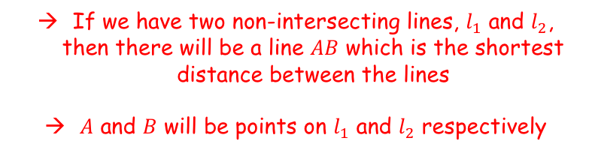


Vectors
You need to be able to find the perpendicular distance between:
Two lines
A point and a line
A point and a plane
The perpendicular distance will be the shortest distance between the lines/planes/points indicated…
$$z$$
$$l_{1}$$
$$A$$
$$B$$
$$l_{2}$$
$$O$$
$$y$$
$$x$$
If we have two non-intersecting lines, $l_{1}$ and $l_{2}$, then there will be a line $AB$ which is the shortest distance between the lines
$A$ and $B$ will be points on $l_{1}$ and $l_{2}$ respectively
9F

Slide 2

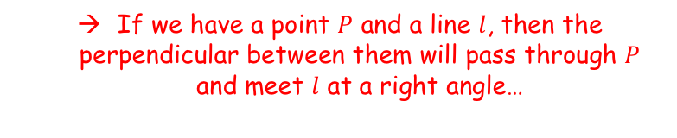
Vectors
You need to be able to find the perpendicular distance between:
Two lines
A point and a line
A point and a plane
The perpendicular distance will be the shortest distance between the lines/planes/points indicated…
$$z$$
$$P$$
$$l$$
$$O$$
$$y$$
$$x$$
If we have a point $P$ and a line $l$, then the perpendicular between them will pass through $P$ and meet $l$ at a right angle…
9F

Slide 3


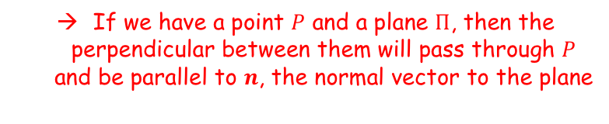

Vectors
$$n$$
You need to be able to find the perpendicular distance between:
Two lines
A point and a line
A point and a plane
The perpendicular distance will be the shortest distance between the lines/planes/points indicated…
$$z$$
$$P$$
$$Π$$
$$O$$
$$y$$
$$x$$
If we have a point $P$ and a plane $Π$, then the perpendicular between them will pass through $P$ and be parallel to $n$, the normal vector to the plane
9F

Slide 4
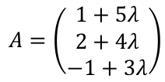


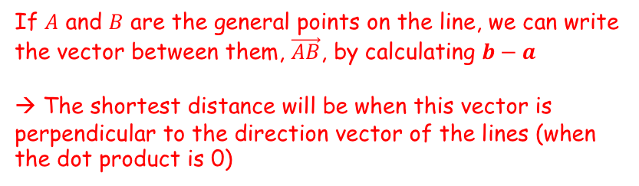

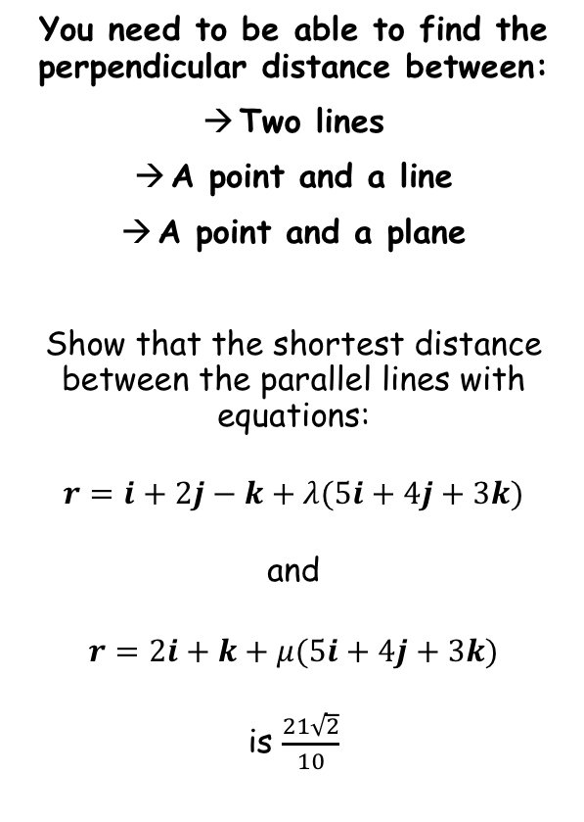

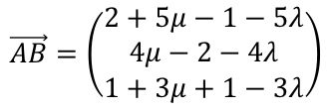



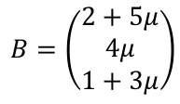
Vectors
$$r=\left(\begin{matrix}1 \\ 2 \\ −1\end{matrix}\right)+λ\left(\begin{matrix}5 \\ 4 \\ 3\end{matrix}\right)$$
$$A$$
You need to be able to find the perpendicular distance between:
Two lines
A point and a line
A point and a plane
Show that the shortest distance between the parallel lines with equations:
$$r=i+2j−k+λ(5i+4j+3k)$$
and
$$r=2i+k+μ(5i+4j+3k)$$
is $\frac{21\sqrt{2}}{10}$
$$r=\left(\begin{matrix}2 \\ 0 \\ 1\end{matrix}\right)+μ\left(\begin{matrix}5 \\ 4 \\ 3\end{matrix}\right)$$
$$B$$
If $A$ and $B$ are the general points on the line, we can write the vector between them, $\vec{AB}$, by calculating $b−a$
→ The shortest distance will be when this vector is perpendicular to the direction vector of the lines (when the dot product is 0)
$$A=\left(\begin{matrix}1+5λ \\ 2+4λ \\ −1+3λ\end{matrix}\right)$$
$$B=\left(\begin{matrix}2+5μ \\ 4μ \\ 1+3μ\end{matrix}\right)$$
Start with A and B, the general points on the lines
$$\vec{AB}=b−a$$
Sub in $b$ and $a$ using points $A$ and $B$
$$\vec{AB}=\left(\begin{matrix}2+5μ−1−5λ \\ 4μ−2−4λ \\ 1+3μ+1−3λ\end{matrix}\right)$$
$$\vec{AB}=\left(\begin{matrix}1+5\left(μ−λ\right) \\ −2+4(μ−λ) \\ 2+3(μ−λ)\end{matrix}\right)$$
Simplify / rewrite
9F

Slide 5

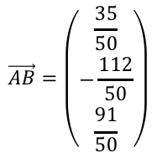
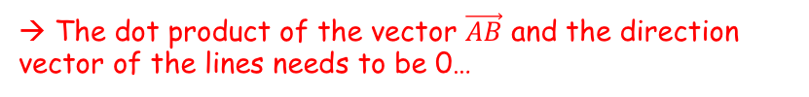



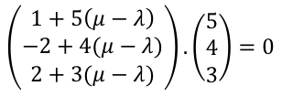
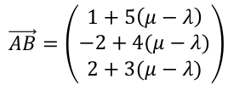
Vectors
$$r=\left(\begin{matrix}1 \\ 2 \\ −1\end{matrix}\right)+λ\left(\begin{matrix}5 \\ 4 \\ 3\end{matrix}\right)$$
$$A$$
You need to be able to find the perpendicular distance between:
Two lines
A point and a line
A point and a plane
Show that the shortest distance between the parallel lines with equations:
$$r=i+2j−k+λ(5i+4j+3k)$$
and
$$r=2i+k+μ(5i+4j+3k)$$
is $\frac{21\sqrt{2}}{10}$
$$\vec{AB}=\left(\begin{matrix}1+5\left(μ−λ\right) \\ −2+4(μ−λ) \\ 2+3(μ−λ)\end{matrix}\right)$$
$$r=\left(\begin{matrix}2 \\ 0 \\ 1\end{matrix}\right)+μ\left(\begin{matrix}5 \\ 4 \\ 3\end{matrix}\right)$$
$$B$$
→ The dot product of the vector $\vec{AB}$ and the direction vector of the lines needs to be 0…
$$\left(\begin{matrix}1+5\left(μ−λ\right) \\ −2+4(μ−λ) \\ 2+3(μ−λ)\end{matrix}\right).\left(\begin{matrix}5 \\ 4 \\ 3\end{matrix}\right)=0$$
Work out dot product
$$\left(5\right)\left(−1+5\left(μ−λ\right)\right)+\left(4\right)\left(2+4\left(μ−λ\right)\right)+\left(3\right)\left(−2+3\left(μ−λ\right)\right)=0$$
Simplify left side
$$3+50(μ−λ)=0$$
Rearrange
$$\vec{AB}=\left(\begin{matrix}1+5\left(μ−λ\right) \\ −2+4(μ−λ) \\ 2+3(μ−λ)\end{matrix}\right)$$
$$μ−λ=−\frac{3}{50}$$
$$\vec{AB}=\left(\begin{matrix}\frac{35}{50} \\ −\frac{112}{50} \\ \frac{91}{50}\end{matrix}\right)$$
Sub in $\left(μ−λ\right)$ and calculate
9F

Slide 6





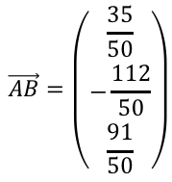

Vectors
$$r=\left(\begin{matrix}1 \\ 2 \\ −1\end{matrix}\right)+λ\left(\begin{matrix}5 \\ 4 \\ 3\end{matrix}\right)$$
$$A$$
You need to be able to find the perpendicular distance between:
Two lines
A point and a line
A point and a plane
Show that the shortest distance between the parallel lines with equations:
$$r=i+2j−k+λ(5i+4j+3k)$$
and
$$r=2i+k+μ(5i+4j+3k)$$
is $\frac{21\sqrt{2}}{10}$
$$\vec{AB}=\left(\begin{matrix}1+5\left(μ−λ\right) \\ −2+4(μ−λ) \\ 2+3(μ−λ)\end{matrix}\right)$$
$$r=\left(\begin{matrix}2 \\ 0 \\ 1\end{matrix}\right)+μ\left(\begin{matrix}5 \\ 4 \\ 3\end{matrix}\right)$$
$$B$$
→ We now have the vector $\vec{AB}$. We can use this to find it’s distance…
$$\vec{AB}=\left(\begin{matrix}\frac{35}{50} \\ −\frac{112}{50} \\ \frac{91}{50}\end{matrix}\right)$$
$$\left|AB\right|=\sqrt{\frac{{\left(35\right)}^{2}+{\left(−112\right)}^{2}+{(91)}^{2}}{{(50)}^{2}}}$$
Calculate numerator and denominator
$$\left|AB\right|=\frac{\sqrt{22050}}{50}$$
Split the numerator
$$\left|AB\right|=\frac{\sqrt{11025}\sqrt{2}}{50}$$
Square root
$$\left|AB\right|=\frac{105\sqrt{2}}{50}$$
$$\left|AB\right|=\frac{21\sqrt{2}}{10}$$
Simplify
9F

Slide 7

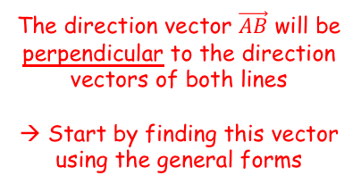

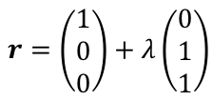



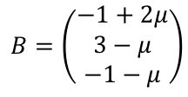
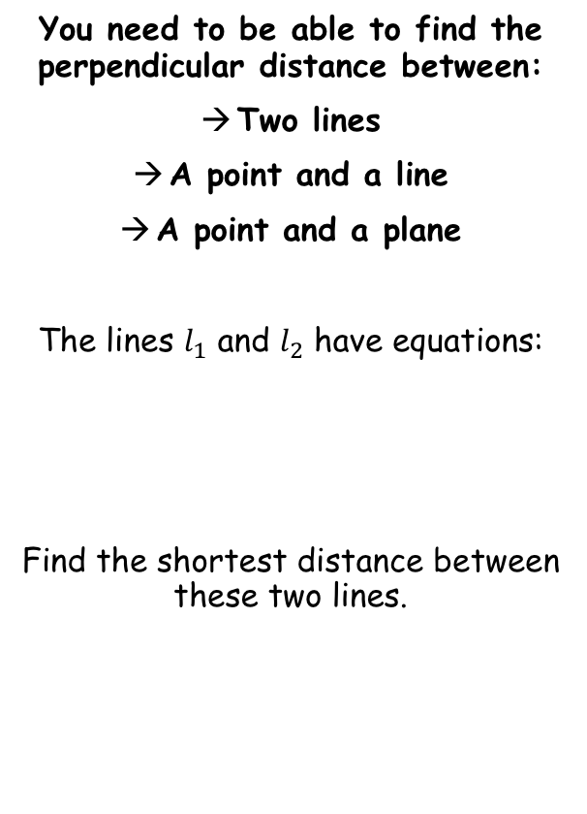
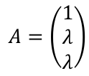





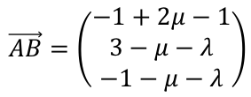
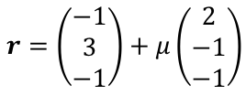

Vectors
$$z$$
$$l_{1}$$
The direction vector $\vec{AB}$ will be perpendicular to the direction vectors of both lines
→ Start by finding this vector using the general forms
$$A$$
You need to be able to find the perpendicular distance between:
Two lines
A point and a line
A point and a plane
The lines $l_{1}$ and $l_{2}$ have equations:
Find the shortest distance between these two lines.
$$B$$
$$l_{2}$$
$$O$$
$$y$$
$$x$$
For $l_{1}$
For $l_{2}$
$$A=\left(\begin{matrix}1 \\ λ \\ λ\end{matrix}\right)$$
$$B=\left(\begin{matrix}−1+2μ \\ 3−μ \\ −1−μ\end{matrix}\right)$$
$$r=\left(\begin{matrix}1 \\ 0 \\ 0\end{matrix}\right)+λ\left(\begin{matrix}0 \\ 1 \\ 1\end{matrix}\right)$$
$$r=\left(\begin{matrix}−1 \\ 3 \\ −1\end{matrix}\right)+μ\left(\begin{matrix}2 \\ −1 \\ −1\end{matrix}\right)$$
$$\vec{AB}=b−a$$
Sub in $b$ and $a$ using points $A$ and $B$
$$\vec{AB}=\left(\begin{matrix}−1+2μ−1 \\ 3−μ−λ \\ −1−μ−λ\end{matrix}\right)$$
Simplify / rewrite
$$\vec{AB}=\left(\begin{matrix}−2+2μ \\ 3−μ−λ \\ −1−μ−λ\end{matrix}\right)$$
9F

Slide 8



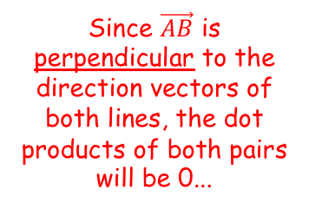


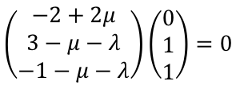
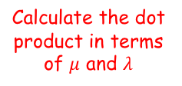
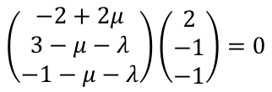

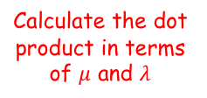
Vectors
$$\vec{AB}=\left(\begin{matrix}−2+2μ \\ 3−μ−λ \\ −1−μ−λ\end{matrix}\right)$$
$$z$$
Since $\vec{AB}$ is perpendicular to the direction vectors of both lines, the dot products of both pairs will be 0...
$$l_{1}$$
$$A$$
You need to be able to find the perpendicular distance between:
Two lines
A point and a line
A point and a plane
The lines $l_{1}$ and $l_{2}$ have equations:
Find the shortest distance between these two lines.
$$B$$
$$l_{2}$$
$$O$$
$$y$$
Dot product of $\vec{AB}$ and $l_{1}$
$$\left(\begin{matrix}−2+2μ \\ 3−μ−λ \\ −1−μ−λ\end{matrix}\right)\left(\begin{matrix}0 \\ 1 \\ 1\end{matrix}\right)=0$$
Calculate the dot product in terms of $μ$ and $λ$
$$r=\left(\begin{matrix}1 \\ 0 \\ 0\end{matrix}\right)+λ\left(\begin{matrix}0 \\ 1 \\ 1\end{matrix}\right)$$
$$r=\left(\begin{matrix}−1 \\ 3 \\ −1\end{matrix}\right)+μ\left(\begin{matrix}2 \\ −1 \\ −1\end{matrix}\right)$$
$$3−μ−λ−1−μ−λ=0$$
Some rearranging later…
$$μ+λ=1$$
Dot product of $\vec{AB}$ and $l_{2}$
$$\left(\begin{matrix}−2+2μ \\ 3−μ−λ \\ −1−μ−λ\end{matrix}\right)\left(\begin{matrix}2 \\ −1 \\ −1\end{matrix}\right)=0$$
Calculate the dot product in terms of $μ$ and $λ$
$$−4+4μ−3+μ+λ+1+μ+λ=0$$
Some rearranging later…
$$3μ+λ=3$$
9F

Slide 9
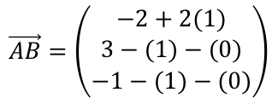
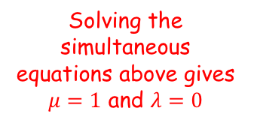

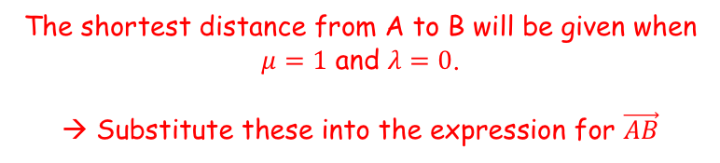

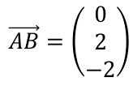

Vectors
$$\vec{AB}=\left(\begin{matrix}−2+2μ \\ 3−μ−λ \\ −1−μ−λ\end{matrix}\right)$$
$$z$$
$$l_{1}$$
$$μ+λ=1$$
$$A$$
You need to be able to find the perpendicular distance between:
Two lines
A point and a line
A point and a plane
The lines $l_{1}$ and $l_{2}$ have equations:
Find the shortest distance between these two lines.
$$3μ+λ=3$$
$$B$$
$$l_{2}$$
Solving the simultaneous equations above gives $μ=1$ and $λ=0$
$$O$$
$$y$$
The shortest distance from A to B will be given when $μ=1$ and $λ=0$.
→ Substitute these into the expression for $\vec{AB}$
$$r=\left(\begin{matrix}1 \\ 0 \\ 0\end{matrix}\right)+λ\left(\begin{matrix}0 \\ 1 \\ 1\end{matrix}\right)$$
$$r=\left(\begin{matrix}−1 \\ 3 \\ −1\end{matrix}\right)+μ\left(\begin{matrix}2 \\ −1 \\ −1\end{matrix}\right)$$
$$\vec{AB}=\left(\begin{matrix}−2+2μ \\ 3−μ−λ \\ −1−μ−λ\end{matrix}\right)$$
Sub in values
$$\vec{AB}=\left(\begin{matrix}−2+2(1) \\ 3−(1)−(0) \\ −1−(1)−(0)\end{matrix}\right)$$
Calculate
$$\vec{AB}=\left(\begin{matrix}0 \\ 2 \\ −2\end{matrix}\right)$$
9F

Slide 10


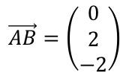
Vectors
$$\vec{AB}=\left(\begin{matrix}−2+2μ \\ 3−μ−λ \\ −1−μ−λ\end{matrix}\right)$$
$$z$$
$$l_{1}$$
$$μ+λ=1$$
$$A$$
You need to be able to find the perpendicular distance between:
Two lines
A point and a line
A point and a plane
The lines $l_{1}$ and $l_{2}$ have equations:
Find the shortest distance between these two lines.
$$3μ+λ=3$$
$$B$$
$$l_{2}$$
Solving the simultaneous equations above gives $μ=1$ and $λ=0$
$$O$$
$$y$$
$$\vec{AB}=\left(\begin{matrix}0 \\ 2 \\ −2\end{matrix}\right)$$
Find the magnitude of this vector
$$r=\left(\begin{matrix}1 \\ 0 \\ 0\end{matrix}\right)+λ\left(\begin{matrix}0 \\ 1 \\ 1\end{matrix}\right)$$
$$r=\left(\begin{matrix}−1 \\ 3 \\ −1\end{matrix}\right)+μ\left(\begin{matrix}2 \\ −1 \\ −1\end{matrix}\right)$$
$$\left|AB\right|=\sqrt{{(0)}^{2}+{(2)}^{2}+{(−2)}^{2}}$$
Simplify
$$\left|AB\right|=2\sqrt{2}$$
9F

Slide 11





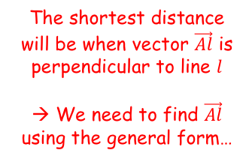
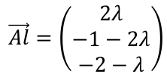
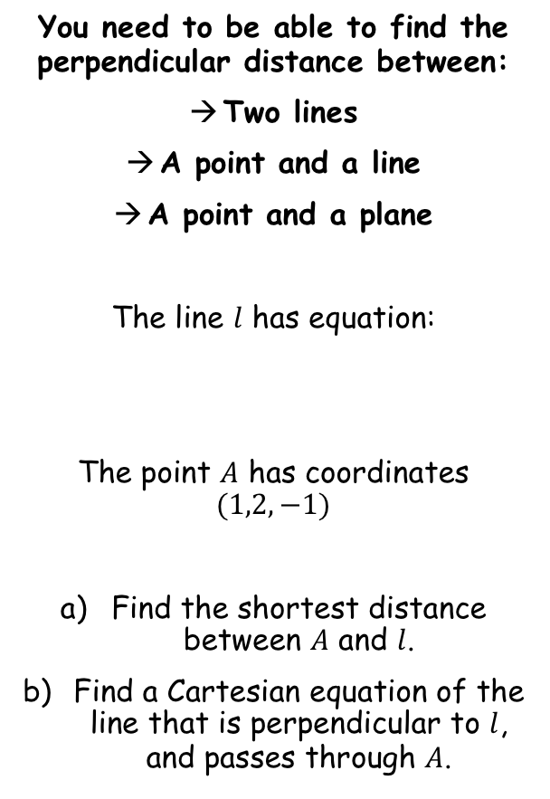
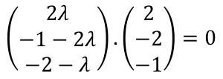







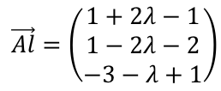
Vectors
$$z$$
$$\left(\begin{matrix}1 \\ 2 \\ −1\end{matrix}\right)$$
The shortest distance will be when vector $\vec{Al}$ is perpendicular to line $l$
→ We need to find $\vec{Al}$ using the general form…
$$A$$
You need to be able to find the perpendicular distance between:
Two lines
A point and a line
A point and a plane
The line $l$ has equation:
The point $A$ has coordinates $(1,2,−1)$
Find the shortest distance between $A$ and $l$.
Find a Cartesian equation of the line that is perpendicular to $l$, and passes through $A$.
$$r=\left(\begin{matrix}1 \\ 1 \\ −3\end{matrix}\right)+λ\left(\begin{matrix}2 \\ −2 \\ −1\end{matrix}\right)$$
$$O$$
$$l$$
$$y$$
$$x$$
$$\vec{Al}=l−a$$
Sub in the general form of $l$, and $A$
$$\vec{Al}=\left(\begin{matrix}1+2λ−1 \\ 1−2λ−2 \\ −3−λ+1\end{matrix}\right)$$
$$\frac{x−1}{2}=\frac{y−1}{−2}=\frac{z+3}{−1}$$
Simplify
$$\vec{Al}=\left(\begin{matrix}2λ \\ −1−2λ \\ −2−λ\end{matrix}\right)$$
The dot product of this vector and the direction of line $l$ will be equal to 1
$$\left(\begin{matrix}2λ \\ −1−2λ \\ −2−λ\end{matrix}\right).\left(\begin{matrix}2 \\ −2 \\ −1\end{matrix}\right)=0$$
Write out the dot product
$$4λ+2+4λ+2+λ=0$$
$$λ=−\frac{4}{9}$$
Calculate
9F

Slide 12
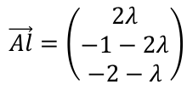

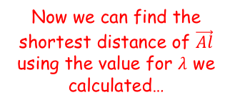
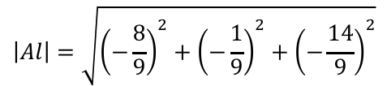
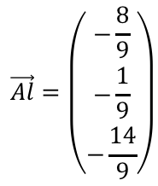

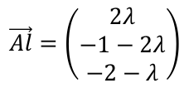


Vectors
$$z$$
$$\left(\begin{matrix}1 \\ 2 \\ −1\end{matrix}\right)$$
$$A$$
You need to be able to find the perpendicular distance between:
Two lines
A point and a line
A point and a plane
The line $l$ has equation:
The point $A$ has coordinates $(1,2,−1)$
Find the shortest distance between $A$ and $l$.
Find a Cartesian equation of the line that is perpendicular to $l$, and passes through $A$.
$$\vec{Al}=\left(\begin{matrix}2λ \\ −1−2λ \\ −2−λ\end{matrix}\right)$$
$$r=\left(\begin{matrix}1 \\ 1 \\ −3\end{matrix}\right)+λ\left(\begin{matrix}2 \\ −2 \\ −1\end{matrix}\right)$$
$$O$$
$$l$$
$$y$$
$$λ=−\frac{4}{9}$$
$$x$$
Now we can find the shortest distance of $\vec{Al}$ using the value for $λ$ we calculated…
$$\vec{Al}=\left(\begin{matrix}2λ \\ −1−2λ \\ −2−λ\end{matrix}\right)$$
$$\frac{x−1}{2}=\frac{y−1}{−2}=\frac{z+3}{−1}$$
$$\vec{Al}=\left(\begin{matrix}−\frac{8}{9} \\ −\frac{1}{9} \\ −\frac{14}{9}\end{matrix}\right)$$
Sub in $λ=−\frac{4}{9}$
Find the magnitude of this vector
$$\left|Al\right|=\sqrt{{\left(−\frac{8}{9}\right)}^{2}+{\left(−\frac{1}{9}\right)}^{2}+{\left(−\frac{14}{9}\right)}^{2}}$$
$$\frac{\sqrt{29}}{3}$$
Calculate
$$\left|Al\right|=\frac{\sqrt{29}}{3}$$
9F

Slide 13

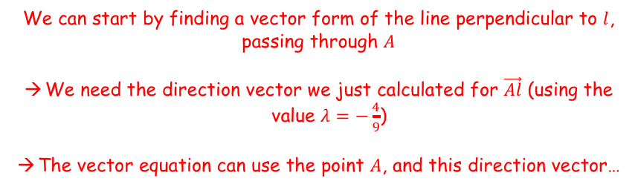
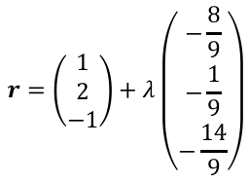


Vectors
$$z$$
$$\left(\begin{matrix}1 \\ 2 \\ −1\end{matrix}\right)$$
$$A$$
$$\vec{Al}=\left(\begin{matrix}−\frac{8}{9} \\ −\frac{1}{9} \\ −\frac{14}{9}\end{matrix}\right)$$
You need to be able to find the perpendicular distance between:
Two lines
A point and a line
A point and a plane
The line $l$ has equation:
The point $A$ has coordinates $(1,2,−1)$
Find the shortest distance between $A$ and $l$.
Find a Cartesian equation of the line that is perpendicular to $l$, and passes through $A$.
$$\vec{Al}=\left(\begin{matrix}2λ \\ −1−2λ \\ −2−λ\end{matrix}\right)$$
$$r=\left(\begin{matrix}1 \\ 1 \\ −3\end{matrix}\right)+λ\left(\begin{matrix}2 \\ −2 \\ −1\end{matrix}\right)$$
$$O$$
$$l$$
$$y$$
$$λ=−\frac{4}{9}$$
$$x$$
We can start by finding a vector form of the line perpendicular to $l$, passing through $A$
We need the direction vector we just calculated for $\vec{Al}$ (using the value $λ=−\frac{4}{9}$)
The vector equation can use the point $A$, and this direction vector…
$$\frac{x−1}{2}=\frac{y−1}{−2}=\frac{z+3}{−1}$$
$$r=\left(\begin{matrix}1 \\ 2 \\ −1\end{matrix}\right)+λ\left(\begin{matrix}−\frac{8}{9} \\ −\frac{1}{9} \\ −\frac{14}{9}\end{matrix}\right)$$
You can multiply the direction vector by -9 to simplify it (it will still be the same direction)
$$\frac{\sqrt{29}}{3}$$
$$r=\left(\begin{matrix}1 \\ 2 \\ −1\end{matrix}\right)+λ\left(\begin{matrix}8 \\ 1 \\ 14\end{matrix}\right)$$
Write in Cartesian form
$$\frac{x−1}{8}=y−2=\frac{z+1}{14}$$
9F

Slide 14



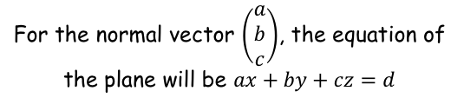
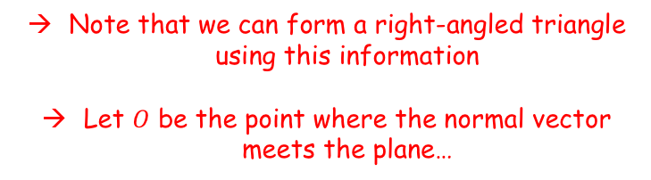







Vectors
$$a.b=\left|a\right||b|cosθ$$
For the normal vector $\left(\begin{matrix}a \\ b \\ c\end{matrix}\right)$, the equation of the plane will be $ax+by+cz=d$
$$P(α,β,γ)$$
$$\left(\begin{matrix}a \\ b \\ c\end{matrix}\right)$$
$$\left(\begin{matrix}a \\ b \\ c\end{matrix}\right)$$
$$n$$
$$n$$
You need to be able to find the perpendicular distance between:
Two lines
A point and a line
A point and a plane
$$Π$$
$$O$$
$$A(x,y,z)$$
Note that we can form a right-angled triangle using this information
Let $O$ be the point where the normal vector meets the plane…
Let $P(α,β,γ)$ be a point which does not lie in the plane $Π$
Let $A$ be a point in the plane itself
Let the normal vector to the plane be $\left(\begin{matrix}a \\ b \\ c\end{matrix}\right)$
We need to find the length of the normal vector to the plane, from the plane to point $P$
9F

Slide 15
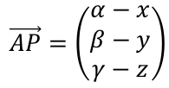








Vectors
$$a.b=\left|a\right||b|cosθ$$
For the normal vector $\left(\begin{matrix}a \\ b \\ c\end{matrix}\right)$, the equation of the plane will be $ax+by+cz=d$
$$P(α,β,γ)$$
$$\vec{AP}=\left(\begin{matrix}α−x \\ β−y \\ γ−z\end{matrix}\right)$$
$$θ$$
$$\left(\begin{matrix}a \\ b \\ c\end{matrix}\right)$$
$$n$$
You need to be able to find the perpendicular distance between:
Two lines
A point and a line
A point and a plane
Hyp
Adj
$$Π$$
$$O$$
$$A(x,y,z)$$
We can add the vector from $A$ to $P$ on the diagram…
We can label the angle at the top as $Cosθ$
$$Adj=Hyp×Cosθ$$
The hypotenuse is the magnitude of vector $\vec{AP}$
$$Distance=\left|AP\right|Cosθ$$
Multiply the right hand side by the magnitude of the normal vector, and divide it by the magnitude of the normal vector…
$$Distance=\frac{\left|n\right|\left|AP\right|Cosθ }{\left|n\right|}$$
The top is just the dot product of $n$ and $\vec{AP}$!
$$Distance=\frac{n.\vec{AP} }{\left|n\right|}$$
9F

Slide 16




Vectors
$$a.b=\left|a\right||b|cosθ$$
For the normal vector $\left(\begin{matrix}a \\ b \\ c\end{matrix}\right)$, the equation of the plane will be $ax+by+cz=d$
$$P(α,β,γ)$$
$$\vec{AP}=\left(\begin{matrix}α−x \\ β−y \\ γ−z\end{matrix}\right)$$
$$θ$$
$$\left(\begin{matrix}a \\ b \\ c\end{matrix}\right)$$
$$n$$
You need to be able to find the perpendicular distance between:
Two lines
A point and a line
A point and a plane
Hyp
Adj
$$Π$$
$$O$$
$$A(x,y,z)$$
$$Distance=\frac{n.\vec{AP} }{\left|n\right|}$$
Replace the vectors on the top, and the calculation for the magnitude on the bottom
$$Distance=\frac{\left(\begin{matrix}a \\ b \\ c\end{matrix}\right).\left(\begin{matrix}α−x \\ β−y \\ γ−z\end{matrix}\right)}{\sqrt{a^{2}+b^{2}+c^{2}}}$$
Work out the dot product
$$Distance=\frac{aα+bβ+cγ−ax−by−cz}{\sqrt{a^{2}+b^{2}+c^{2}}}$$
Rewrite the numerator
$$Distance=\frac{aα+bβ+cγ−(ax+by+cz)}{\sqrt{a^{2}+b^{2}+c^{2}}}$$
9F

Slide 17







Vectors
$$a.b=\left|a\right||b|cosθ$$
$$\frac{\left|\text{a}\text{α}\text{ + }\text{b}\text{β}\text{ + }\text{c}\text{γ}−d\right|}{\sqrt{a^{2}+b^{2}+c^{2}}}$$
For the normal vector $\left(\begin{matrix}a \\ b \\ c\end{matrix}\right)$, the equation of the plane will be $ax+by+cz=d$
$$P(α,β,γ)$$
$$\vec{AP}=\left(\begin{matrix}x−x_{A} \\ y−y_{A} \\ z−z_{A}\end{matrix}\right)$$
$$θ$$
$$\left(\begin{matrix}a \\ b \\ c\end{matrix}\right)$$
$$n$$
You need to be able to find the perpendicular distance between:
Two lines
A point and a line
A point and a plane
Hyp
Adj
$$Π$$
$$O$$
$$A(x,y,z)$$
$$Distance=\frac{aα+bβ+cγ−(ax+by+cz)}{\sqrt{a^{2}+b^{2}+c^{2}}}$$
The key step here is that since point $(x,y,z)$is in the specified plane, this part can be replaced with the value of $d$ which would be in the equation for this plane
$$Distance=\frac{\text{a}\text{α}\text{ + }\text{b}\text{β}\text{ + }\text{c}\text{γ}−d}{\sqrt{a^{2}+b^{2}+c^{2}}}$$
Since the numerator could be negative, we usually include a modulus sign. This ensures that our answer is positive, which it should be as it is a distance
$$Distance=\frac{\left|\text{a}\text{α}\text{ + }\text{b}\text{β}\text{ + }\text{c}\text{γ}−d\right|}{\sqrt{a^{2}+b^{2}+c^{2}}}$$
So if you have a plane with Cartesian equation $ax+by+cz=d$, and a coordinate $(α,β,γ)$ which is not in the plane, then the formula above will give the shortest distance from the point to the plane…
9F

Slide 18







Vectors
$$a.b=\left|a\right||b|cosθ$$
$$Shortest distance from the$$
$$origin to a plane$$
$$\frac{d}{\sqrt{a^{2}+b^{2}+c^{2}}}$$
$$\frac{\left|\text{a}\text{α}\text{ + }\text{b}\text{β}\text{ + }\text{c}\text{γ}−d\right|}{\sqrt{a^{2}+b^{2}+c^{2}}}$$
For the normal vector $\left(\begin{matrix}a \\ b \\ c\end{matrix}\right)$, the equation of the plane will be $ax+by+cz=d$
You need to be able to find the perpendicular distance between:
Two lines
A point and a line
A point and a plane
$$\frac{\left|\text{a}\text{α}\text{ + }\text{b}\text{β}\text{ + }\text{c}\text{γ}−d\right|}{\sqrt{a^{2}+b^{2}+c^{2}}}$$
If the coordinate we are using is the origin, then since $x$, $y$ and $z$ are all 0, only $d$ will remain on the numerator
$$\frac{\left|−d\right|}{\sqrt{a^{2}+b^{2}+c^{2}}}$$
So the numerator will always be the positive value of $−d$
$$\frac{d}{\sqrt{a^{2}+b^{2}+c^{2}}}$$
9F

Slide 19






Vectors
$$a.b=\left|a\right||b|cosθ$$
$$Shortest distance from the$$
$$origin to a plane$$
$$\frac{d}{\sqrt{a^{2}+b^{2}+c^{2}}}$$
$$\frac{\left|\text{a}\text{α}\text{ + }\text{b}\text{β}\text{ + }\text{c}\text{γ}−d\right|}{\sqrt{a^{2}+b^{2}+c^{2}}}$$
For the normal vector $\left(\begin{matrix}a \\ b \\ c\end{matrix}\right)$, the equation of the plane will be $ax+by+cz=d$
You need to be able to find the perpendicular distance between:
Two lines
A point and a line
A point and a plane
You will hopefully remember this formula from a few lessons ago…
$$r. n=k$$
Remember what $r.n$ represents?
$$\left(\begin{matrix}x \\ y \\ z\end{matrix}\right). \left(\begin{matrix}a \\ b \\ c\end{matrix}\right)=k$$
Write the dot product for the left side
$$ax+by+cz=k$$
Normal vector to the plane
Compare this with the form above
A general point
$ax+by+cz=d$
Essentially, $k$ and $d$ represent the same thing!
9F

Slide 20




Vectors
$$a.b=\left|a\right||b|cosθ$$
$$Shortest distance from the$$
$$origin to a plane$$
$$\frac{d}{\sqrt{a^{2}+b^{2}+c^{2}}}$$
$$\frac{\left|\text{a}\text{α}\text{ + }\text{b}\text{β}\text{ + }\text{c}\text{γ}−d\right|}{\sqrt{a^{2}+b^{2}+c^{2}}}$$
For the normal vector $\left(\begin{matrix}a \\ b \\ c\end{matrix}\right)$, the equation of the plane will be $ax+by+cz=d$
You need to be able to find the perpendicular distance between:
Two lines
A point and a line
A point and a plane
You will hopefully remember this formula from a few lessons ago…
$$r. n=k$$
Remember what $r.n$ represents?
$$\left(\begin{matrix}x \\ y \\ z\end{matrix}\right). \left(\begin{matrix}a \\ b \\ c\end{matrix}\right)=k$$
$$\left(\begin{matrix}x \\ y \\ z\end{matrix}\right). \left(\begin{matrix}a \\ b \\ c\end{matrix}\right)=d$$
We can replace the $k$ with a $d$
$$\left(\begin{matrix}x \\ y \\ z\end{matrix}\right). \left(\begin{matrix}\frac{a}{\sqrt{a^{2}+b^{2}+c^{2}}} \\ \frac{b}{\sqrt{a^{2}+b^{2}+c^{2}}} \\ \frac{c}{\sqrt{a^{2}+b^{2}+c^{2}}}\end{matrix}\right)=\frac{d}{\sqrt{a^{2}+b^{2}+c^{2}}}$$
We can divide both sides by $\sqrt{a^{2}+b^{2}+c^{2}}$
We can see that this side represents the distance from the origin to the plane…
But what does this represent??
9F

Slide 21








Vectors
$$a.b=\left|a\right||b|cosθ$$
$$Shortest distance from the$$
$$origin to a plane$$
$$\frac{d}{\sqrt{a^{2}+b^{2}+c^{2}}}$$
$$\frac{\left|\text{a}\text{α}\text{ + }\text{b}\text{β}\text{ + }\text{c}\text{γ}−d\right|}{\sqrt{a^{2}+b^{2}+c^{2}}}$$
For the normal vector $\left(\begin{matrix}a \\ b \\ c\end{matrix}\right)$, the equation of the plane will be $ax+by+cz=d$
Imagine we represent the vector $ai+bj$ (in 2 dimensions) using a right angled triangle, and calculate its magnitude
You need to be able to find the perpendicular distance between:
Two lines
A point and a line
A point and a plane
$$\sqrt{a^{2}+b^{2}}$$
$$b$$
$$a$$
Divide all sides by $\sqrt{a^{2}+b^{2}}$
$$1$$
$$\frac{b}{\sqrt{a^{2}+b^{2}}}$$
The second triangle is a unit vector (meaning it has a magnitude of 1), but in the same direction as the original vector…
$$\frac{a}{\sqrt{a^{2}+b^{2}}}$$
9F

Slide 22
Vectors
$$a.b=\left|a\right||b|cosθ$$
$$Shortest distance from the$$
$$origin to a plane$$
$$\frac{d}{\sqrt{a^{2}+b^{2}+c^{2}}}$$
$$\frac{\left|\text{a}\text{α}\text{ + }\text{b}\text{β}\text{ + }\text{c}\text{γ}−d\right|}{\sqrt{a^{2}+b^{2}+c^{2}}}$$
For the normal vector $\left(\begin{matrix}a \\ b \\ c\end{matrix}\right)$, the equation of the plane will be $ax+by+cz=d$
You need to be able to find the perpendicular distance between:
Two lines
A point and a line
A point and a plane
You will hopefully remember this formula from a few lessons ago…
$$r. n=k$$
Remember what $r.n$ represents?
$$\left(\begin{matrix}x \\ y \\ z\end{matrix}\right). \left(\begin{matrix}a \\ b \\ c\end{matrix}\right)=k$$
$$\left(\begin{matrix}x \\ y \\ z\end{matrix}\right). \left(\begin{matrix}a \\ b \\ c\end{matrix}\right)=d$$
We can replace the $k$ with a $d$
$$\left(\begin{matrix}x \\ y \\ z\end{matrix}\right). \left(\begin{matrix}\frac{a}{\sqrt{a^{2}+b^{2}+c^{2}}} \\ \frac{b}{\sqrt{a^{2}+b^{2}+c^{2}}} \\ \frac{c}{\sqrt{a^{2}+b^{2}+c^{2}}}\end{matrix}\right)=\frac{d}{\sqrt{a^{2}+b^{2}+c^{2}}}$$
We can divide both sides by $\sqrt{a^{2}+b^{2}+c^{2}}$
So this represents the unit vector parallel to the normal to the plane
9F

Slide 23



Vectors
$$a.b=\left|a\right||b|cosθ$$
$$r. \hat{n}=k$$
$$Shortest distance from the$$
$$origin to a plane$$
$$\frac{d}{\sqrt{a^{2}+b^{2}+c^{2}}}$$
$$\frac{\left|\text{a}\text{α}\text{ + }\text{b}\text{β}\text{ + }\text{c}\text{γ}−d\right|}{\sqrt{a^{2}+b^{2}+c^{2}}}$$
For the normal vector $\left(\begin{matrix}a \\ b \\ c\end{matrix}\right)$, the equation of the plane will be $ax+by+cz=d$
You need to be able to find the perpendicular distance between:
Two lines
A point and a line
A point and a plane
You will hopefully remember this formula from a few lessons ago…
$$r. n=k$$
If the normal vector is a unit vector, then it is written in this way…
$$r. \hat{n}=k$$
If you are given the vector equation of a plane in this form, then the value of $k$ is the distance from the plane to the origin!
The formulae you have just seen are all given in the booklet and can be used without proof…
9F

Slide 24





Vectors
$$a.b=\left|a\right||b|cosθ$$
$$r. \hat{n}=k$$
$$Shortest distance from the$$
$$origin to a plane$$
$$\frac{d}{\sqrt{a^{2}+b^{2}+c^{2}}}$$
$$\frac{\left|\text{a}\text{α}\text{ + }\text{b}\text{β}\text{ + }\text{c}\text{γ}−d\right|}{\sqrt{a^{2}+b^{2}+c^{2}}}$$
For the normal vector $\left(\begin{matrix}a \\ b \\ c\end{matrix}\right)$, the equation of the plane will be $ax+by+cz=d$
You need to be able to find the perpendicular distance between:
Two lines
A point and a line
A point and a plane
Find the perpendicular distance from the point with coordinates $(3,2,−1)$ to the plane with equation $2x−3y+z=5$
→ Use the formula to the top right, since the coordinate given is not the origin…
$$\frac{\left|\text{a}\text{α}\text{ + }\text{b}\text{β}\text{ + }\text{c}\text{γ}−d\right|}{\sqrt{a^{2}+b^{2}+c^{2}}}$$
Sub in values
$$=\frac{\left|\text{(2)(3)+ (−3)(2) + (1)}(−1)−5\right|}{\sqrt{{(2)}^{2}+{(−3)}^{2}+{(1)}^{2}}}$$
Calculate
$$=\frac{\left|−6\right|}{\sqrt{14}}$$
Use the modulus if necessary…
$$=\frac{6}{\sqrt{14}}$$
9F

Slide 25






Vectors
$$a.b=\left|a\right||b|cosθ$$
$$r. \hat{n}=k$$
$$Shortest distance from the$$
$$origin to a plane$$
$$\frac{d}{\sqrt{a^{2}+b^{2}+c^{2}}}$$
$$\frac{\left|\text{a}\text{α}\text{ + }\text{b}\text{β}\text{ + }\text{c}\text{γ}−d\right|}{\sqrt{a^{2}+b^{2}+c^{2}}}$$
For the normal vector $\left(\begin{matrix}a \\ b \\ c\end{matrix}\right)$, the equation of the plane will be $ax+by+cz=d$
You need to be able to find the perpendicular distance between:
Two lines
A point and a line
A point and a plane
The plane $Π$ has equation:
$r.\left(i+2j+2k\right)=5$
The point $P$ has coordinates:
$$(1,3,−2)$$
Find the shortest distance between $P$ and $Π$
As before, use the formula to the top right…
$$\frac{\left|\text{a}\text{α}\text{ + }\text{b}\text{β}\text{ + }\text{c}\text{γ}−d\right|}{\sqrt{a^{2}+b^{2}+c^{2}}}$$
Sub in values
→ The normal vector and $d$ are both in the vector form given…
$$=\frac{\left|\text{(1)(1)+ (2)(3) + (2)}(−2)−5\right|}{\sqrt{{(1)}^{2}+{(2)}^{2}+{(2)}^{2}}}$$
Calculate
$$=\frac{\left|\text{−2}\right|}{\sqrt{9}}$$
Simplify
$$=\frac{2}{3}$$
$$=\frac{2}{3}$$
9F

Slide 26








Vectors
$$a.b=\left|a\right||b|cosθ$$
$$r. \hat{n}=k$$
$$Shortest distance from the$$
$$origin to a plane$$
$$\frac{d}{\sqrt{a^{2}+b^{2}+c^{2}}}$$
$$\frac{\left|\text{a}\text{α}\text{ + }\text{b}\text{β}\text{ + }\text{c}\text{γ}−d\right|}{\sqrt{a^{2}+b^{2}+c^{2}}}$$
For the normal vector $\left(\begin{matrix}a \\ b \\ c\end{matrix}\right)$, the equation of the plane will be $ax+by+cz=d$
$$Q(x_{1},y_{1},z_{1})$$
You need to be able to find the perpendicular distance between:
Two lines
A point and a line
A point and a plane
The plane $Π$ has equation:
$r.\left(i+2j+2k\right)=5$
The point $P$ has coordinates:
$$(1,3,−2)$$
Find the shortest distance between $P$ and $Π$
b) The point $Q$ is a reflection of $P$ in $Π$. Find the coordinates of $Q$.
$$\left(\begin{matrix}1 \\ 2 \\ 2\end{matrix}\right)$$
$$Π$$
$$n$$
$$M$$
$$P(1,3,−2)$$
Draw a diagram to represent the problem
$P$ and $Q$ will be the same distance either side of the plane
Let $M$ be their midpoint, which will lie in the plane
The line connecting $P$ and $Q$ will be parallel to the normal vector to the plane
$$=\frac{2}{3}$$
9F

Slide 27



Vectors
$$a.b=\left|a\right||b|cosθ$$
$$r. \hat{n}=k$$
$$Shortest distance from the$$
$$origin to a plane$$
$$\frac{d}{\sqrt{a^{2}+b^{2}+c^{2}}}$$
$$\frac{\left|\text{a}\text{α}\text{ + }\text{b}\text{β}\text{ + }\text{c}\text{γ}−d\right|}{\sqrt{a^{2}+b^{2}+c^{2}}}$$
For the normal vector $\left(\begin{matrix}a \\ b \\ c\end{matrix}\right)$, the equation of the plane will be $ax+by+cz=d$
$$M=\left(\begin{matrix}1+λ \\ 3+2λ \\ −2+2λ\end{matrix}\right)$$
$$Q(x_{1},y_{1},z_{1})$$
You need to be able to find the perpendicular distance between:
Two lines
A point and a line
A point and a plane
The plane $Π$ has equation:
$r.\left(i+2j+2k\right)=5$
The point $P$ has coordinates:
$$(1,3,−2)$$
Find the shortest distance between $P$ and $Π$
b) The point $Q$ is a reflection of $P$ in $Π$. Find the coordinates of $Q$.
$$\left(\begin{matrix}1 \\ 2 \\ 2\end{matrix}\right)$$
$$Π$$
$$n$$
$$M$$
$$P(1,3,−2)$$
The vector equation for the line from $P$ to $Q$ will be given by:
$$\left(\begin{matrix}1 \\ 3 \\ −2\end{matrix}\right)+λ\left(\begin{matrix}1 \\ 2 \\ 2\end{matrix}\right)$$
$$=\frac{2}{3}$$
So the coordinate $M$ can be represented by:
$$\left(\begin{matrix}1+λ \\ 3+2λ \\ −2+2λ\end{matrix}\right)$$
9F

Slide 28








Vectors
$$a.b=\left|a\right||b|cosθ$$
$$r. \hat{n}=k$$
$$Shortest distance from the$$
$$origin to a plane$$
$$\frac{d}{\sqrt{a^{2}+b^{2}+c^{2}}}$$
$$\frac{\left|\text{a}\text{α}\text{ + }\text{b}\text{β}\text{ + }\text{c}\text{γ}−d\right|}{\sqrt{a^{2}+b^{2}+c^{2}}}$$
For the normal vector $\left(\begin{matrix}a \\ b \\ c\end{matrix}\right)$, the equation of the plane will be $ax+by+cz=d$
$$M=\left(\begin{matrix}1+λ \\ 3+2λ \\ −2+2λ\end{matrix}\right)$$
$$Q(x_{1},y_{1},z_{1})$$
You need to be able to find the perpendicular distance between:
Two lines
A point and a line
A point and a plane
The plane $Π$ has equation:
$r.\left(i+2j+2k\right)=5$
The point $P$ has coordinates:
$$(1,3,−2)$$
Find the shortest distance between $P$ and $Π$
b) The point $Q$ is a reflection of $P$ in $Π$. Find the coordinates of $Q$.
$$λ=\frac{2}{9}$$
$$\left(\begin{matrix}1 \\ 2 \\ 2\end{matrix}\right)$$
$$Π$$
$$n$$
$$M$$
$$P(1,3,−2)$$
Coordinate $M$ is also in the plane, so should satisfy that equation too (use the coordinate in $λ$ that we just calculated)
$$r.\left(\begin{matrix}1 \\ 2 \\ 2\end{matrix}\right)=5$$
Sub in the expression for $M$ (since$r$represents any point in the plane)
$$=\frac{2}{3}$$
$$\left(\begin{matrix}1+λ \\ 3+2λ \\ −2+2λ\end{matrix}\right).\left(\begin{matrix}1 \\ 2 \\ 2\end{matrix}\right)=5$$
Find the dot product and simplify
$$3+9λ=5$$
$$λ=\frac{2}{9}$$
Calculate $λ$
9F

Slide 29





Vectors
$$a.b=\left|a\right||b|cosθ$$
$$r. \hat{n}=k$$
$$Shortest distance from the$$
$$origin to a plane$$
$$\frac{d}{\sqrt{a^{2}+b^{2}+c^{2}}}$$
$$\frac{\left|\text{a}\text{α}\text{ + }\text{b}\text{β}\text{ + }\text{c}\text{γ}−d\right|}{\sqrt{a^{2}+b^{2}+c^{2}}}$$
For the normal vector $\left(\begin{matrix}a \\ b \\ c\end{matrix}\right)$, the equation of the plane will be $ax+by+cz=d$
$$M=\left(\begin{matrix}1+λ \\ 3+2λ \\ −2+2λ\end{matrix}\right)$$
$$Q(x_{1},y_{1},z_{1})$$
You need to be able to find the perpendicular distance between:
Two lines
A point and a line
A point and a plane
The plane $Π$ has equation:
$r.\left(i+2j+2k\right)=5$
The point $P$ has coordinates:
$$(1,3,−2)$$
Find the shortest distance between $P$ and $Π$
b) The point $Q$ is a reflection of $P$ in $Π$. Find the coordinates of $Q$.
$$λ=\frac{2}{9}$$
$$\left(\begin{matrix}1 \\ 2 \\ 2\end{matrix}\right)$$
$$Π$$
$$n$$
$$M$$
$$P(1,3,−2)$$
So the position of $M$ from $P$ would be calculated by the following:
$$M=\left(\begin{matrix}1 \\ 3 \\ −2\end{matrix}\right)+\frac{2}{9}\left(\begin{matrix}1 \\ 2 \\ 2\end{matrix}\right)$$
$Q$ will be double the distance away from point $P$, compared to $M$ (This works since we have used $P$ as the fixed point in the equation)
$$=\frac{2}{3}$$
$$Q=\left(\begin{matrix}1 \\ 3 \\ −2\end{matrix}\right)+\frac{4}{9}\left(\begin{matrix}1 \\ 2 \\ 2\end{matrix}\right)$$
Calculate
$$Q=\left(\frac{13}{9},\frac{35}{9},−\frac{10}{9}\right)$$
9F

Slide 30












Vectors
$$a.b=\left|a\right||b|cosθ$$
$$r. \hat{n}=k$$
$$Shortest distance from the$$
$$origin to a plane$$
$$\frac{d}{\sqrt{a^{2}+b^{2}+c^{2}}}$$
$$\frac{\left|\text{a}\text{α}\text{ + }\text{b}\text{β}\text{ + }\text{c}\text{γ}−d\right|}{\sqrt{a^{2}+b^{2}+c^{2}}}$$
For the normal vector $\left(\begin{matrix}a \\ b \\ c\end{matrix}\right)$, the equation of the plane will be $ax+by+cz=d$
$$r=\left(\begin{matrix}2 \\ 4 \\ −6\end{matrix}\right)+λ\left(\begin{matrix}2 \\ −2 \\ 1\end{matrix}\right)$$
$$l_{1}$$
You need to be able to find the perpendicular distance between:
Two lines
A point and a line
A point and a plane
The line $l_{1}$ has equation:
$$\frac{x−2}{2}=\frac{y−4}{−2}=\frac{z+6}{1}$$
The plane $Π$ has equation:
$$2x−3y+z=8$$
The line $l_{2}$ is a reflection of $l_{1}$ in the plane $Π$. Find a vector equation of the line $l_{2}$.
$$\left(2,4,−6\right)$$
$$M$$
$$Π$$
$$2x−3y+z=8$$
$$\left(\begin{matrix}2 \\ −3 \\ 1\end{matrix}\right)$$
$$l_{2}$$
Write in vector form…
$$n$$
$$r=\left(\begin{matrix}2 \\ 4 \\ −6\end{matrix}\right)+λ\left(\begin{matrix}2 \\ −2 \\ 1\end{matrix}\right)$$
If we draw on line $l_{1}$, it will pass through the plane somewhere
If we draw on the line $l_{2}$, it will pass through the same point in the plane…
→ We need two points on $l_{2}$ to be able to calculate its equation. One will be where $l_{1}$ meets the plane. The other can be the reflection of a point on $l_{1}$ (as in the previous example)
9F

Slide 31










Vectors
$$a.b=\left|a\right||b|cosθ$$
$$r. \hat{n}=k$$
$$Shortest distance from the$$
$$origin to a plane$$
$$\frac{d}{\sqrt{a^{2}+b^{2}+c^{2}}}$$
$$\frac{\left|\text{a}\text{α}\text{ + }\text{b}\text{β}\text{ + }\text{c}\text{γ}−d\right|}{\sqrt{a^{2}+b^{2}+c^{2}}}$$
For the normal vector $\left(\begin{matrix}a \\ b \\ c\end{matrix}\right)$, the equation of the plane will be $ax+by+cz=d$
$$r=\left(\begin{matrix}2 \\ 4 \\ −6\end{matrix}\right)+λ\left(\begin{matrix}2 \\ −2 \\ 1\end{matrix}\right)$$
$$l_{1}$$
You need to be able to find the perpendicular distance between:
Two lines
A point and a line
A point and a plane
$$\left(2,4,−6\right)$$
$$A$$
$$(6,0,−4)$$
$$M$$
$$Π$$
$$2x−3y+z=8$$
$$\left(\begin{matrix}2 \\ −3 \\ 1\end{matrix}\right)$$
$$l_{2}$$
Finding where $l_{1}$ meets the plane
$$n$$
Let $A$ be where line $l_{1}$ meets the plane
This can be represented using $λ$ from the vector equation for $l_{1}$
Point $A$ must also satisfy the equation of the plane…
$$2x−3y+z=8$$
Sub in values from the expression for A
$$A=\left(\begin{matrix}2+2λ \\ 4−2λ \\ −6+λ\end{matrix}\right)$$
$$A=\left(\begin{matrix}6 \\ 0 \\ −4\end{matrix}\right)$$
$$2(2+2λ)−3(4−2λ)+(−6+λ)=8$$
Calculate
$$λ=2$$
Now we know that $λ=2$
9F

Slide 32











Vectors
$$a.b=\left|a\right||b|cosθ$$
$$r. \hat{n}=k$$
$$Shortest distance from the$$
$$origin to a plane$$
$$\frac{d}{\sqrt{a^{2}+b^{2}+c^{2}}}$$
$$\frac{\left|\text{a}\text{α}\text{ + }\text{b}\text{β}\text{ + }\text{c}\text{γ}−d\right|}{\sqrt{a^{2}+b^{2}+c^{2}}}$$
For the normal vector $\left(\begin{matrix}a \\ b \\ c\end{matrix}\right)$, the equation of the plane will be $ax+by+cz=d$
$$r=\left(\begin{matrix}2 \\ 4 \\ −6\end{matrix}\right)+λ\left(\begin{matrix}2 \\ −2 \\ 1\end{matrix}\right)$$
$$l_{1}$$
You need to be able to find the perpendicular distance between:
Two lines
A point and a line
A point and a plane
$$P$$
$$\left(2,4,−6\right)$$
$$A$$
$$(6,0,−4)$$
$$M$$
$$Π$$
$$2x−3y+z=8$$
$$\left(\frac{58}{7},−\frac{38}{7},−\frac{20}{7}\right)$$
$$Q$$
Finding a reflected point
$$\left(\begin{matrix}2 \\ −3 \\ 1\end{matrix}\right)$$
$$l_{2}$$
$$n$$
We can do this as in the previous example
Let the reflected coordinates on the diagram be $P$ and $Q$
Using point $P$ and the normal vector, we can form an expression for point $M$
This coordinate M must also lie in the plane
$$2x−3y+z=8$$
Sub in values from the expression for M
$$2\left(2+2λ\right)−3(4−3λ)+(−6+λ)=8$$
$$M=\left(\begin{matrix}2 \\ 4 \\ −6\end{matrix}\right)+λ\left(\begin{matrix}2 \\ −3 \\ 1\end{matrix}\right)$$
$$λ=\frac{11}{7}$$
Calculate
$$M=\left(\begin{matrix}2 \\ 4 \\ −6\end{matrix}\right)+\frac{11}{7}\left(\begin{matrix}2 \\ −3 \\ 1\end{matrix}\right)$$
$$Q=\left(\begin{matrix}2 \\ 4 \\ −6\end{matrix}\right)+\frac{22}{7}\left(\begin{matrix}2 \\ −3 \\ 1\end{matrix}\right)$$
$Q$ is twice the distance from $P$…
$$Q=\left(\frac{58}{7},−\frac{38}{7},−\frac{20}{7}\right)$$
9F

Slide 33







Vectors
$$a.b=\left|a\right||b|cosθ$$
$$r. \hat{n}=k$$
$$Shortest distance from the$$
$$origin to a plane$$
$$\frac{d}{\sqrt{a^{2}+b^{2}+c^{2}}}$$
$$\frac{\left|\text{a}\text{α}\text{ + }\text{b}\text{β}\text{ + }\text{c}\text{γ}−d\right|}{\sqrt{a^{2}+b^{2}+c^{2}}}$$
For the normal vector $\left(\begin{matrix}a \\ b \\ c\end{matrix}\right)$, the equation of the plane will be $ax+by+cz=d$
$$r=\left(\begin{matrix}2 \\ 4 \\ −6\end{matrix}\right)+λ\left(\begin{matrix}2 \\ −2 \\ 1\end{matrix}\right)$$
$$l_{1}$$
You need to be able to find the perpendicular distance between:
Two lines
A point and a line
A point and a plane
$$P$$
$$\left(2,4,−6\right)$$
$$A$$
$$(6,0,−4)$$
$$M$$
$$Π$$
$$2x−3y+z=8$$
$$\left(\frac{58}{7},−\frac{38}{7},−\frac{20}{7}\right)$$
$$Q$$
Finally, to find the equation of $l_{2}$, we first need to find the direction vector from $A$ to $Q$
$$\left(\begin{matrix}2 \\ −3 \\ 1\end{matrix}\right)$$
$$l_{2}$$
$$n$$
$$\vec{AQ}=q−a$$
$$\left(\begin{matrix}\frac{58}{7} \\ −\frac{38}{7} \\ −\frac{20}{7}\end{matrix}\right)$$
Sub in coordinates
$$−\left(\begin{matrix}6 \\ 0 \\ −4\end{matrix}\right)$$
$$\vec{AQ}=$$
$$\left(\begin{matrix}\frac{16}{7} \\ −\frac{38}{7} \\ \frac{8}{7}\end{matrix}\right)$$
Calculate
$$\vec{AQ}=$$
9F

Slide 34






Vectors
$$a.b=\left|a\right||b|cosθ$$
$$r. \hat{n}=k$$
$$Shortest distance from the$$
$$origin to a plane$$
$$\frac{d}{\sqrt{a^{2}+b^{2}+c^{2}}}$$
$$\frac{\left|\text{a}\text{α}\text{ + }\text{b}\text{β}\text{ + }\text{c}\text{γ}−d\right|}{\sqrt{a^{2}+b^{2}+c^{2}}}$$
For the normal vector $\left(\begin{matrix}a \\ b \\ c\end{matrix}\right)$, the equation of the plane will be $ax+by+cz=d$
$$r=\left(\begin{matrix}2 \\ 4 \\ −6\end{matrix}\right)+λ\left(\begin{matrix}2 \\ −2 \\ 1\end{matrix}\right)$$
$$l_{1}$$
You need to be able to find the perpendicular distance between:
Two lines
A point and a line
A point and a plane
$$P$$
$$\left(2,4,−6\right)$$
$$A$$
$$(6,0,−4)$$
$$M$$
$$Π$$
$$2x−3y+z=8$$
$$\left(\frac{58}{7},−\frac{38}{7},−\frac{20}{7}\right)$$
$$Q$$
Finally, to find the equation of $l_{2}$, we first need to find the direction vector from $A$ to $Q$
$$\left(\begin{matrix}2 \\ −3 \\ 1\end{matrix}\right)$$
$$l_{2}$$
$$n$$
$$\left(\begin{matrix}\frac{16}{7} \\ −\frac{38}{7} \\ \frac{8}{7}\end{matrix}\right)$$
So an equation of line $l_{2}$ is…
$$\vec{AQ}=$$
$$r=\left(\begin{matrix}6 \\ 0 \\ −4\end{matrix}\right)+λ\left(\begin{matrix}8 \\ −19 \\ 4\end{matrix}\right)$$
Multiply each value by $\frac{7}{2}$ to simplify it
$$\vec{AQ}=\left(\begin{matrix}8 \\ −19 \\ 4\end{matrix}\right)$$
9F

Slide 35
Exercise 9F
Pearson Pure Mathematics Year 1/AS
Pages 3-5
Complete before the lesson Q1-3
In Class:
Green Q4-6
Amber Q7-9
Red Q10-12

