Slide 1
Year 1 Pure Mathematics
Measure of Location and Spread
– Quartiles and Percentiles
Chapter 2
(Part 3 of 5)

Slide 2
Quartiles – Listed Data
You need to be able to find the quartiles
(Q₁ lower and Q₃ upper) from listed data.
$$2, 4, 5, 7, 8, 9, 11$$
Q₁
= 4
Median
= 7
Q₃
= 9
$$2, 4, 5, 7, 8, 9, 11, 12$$
Q₁
= 4.5
Median
= 8
Q₃
= 10

Slide 3
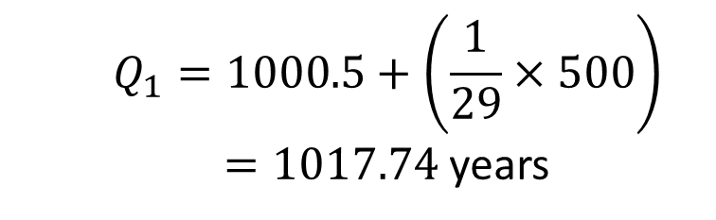
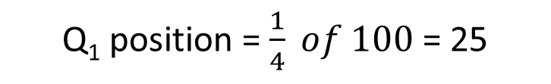

Quartiles - Tables
Find${ Q}_{1}$
Age of relic (years) | Frequency
0-1000 | 24
1001-1500 | 29
1501-1700 | 12
1701-2000 | 35
 | 100
C.F.
24
53
65
100
Q₁ position = $\frac{1}{4} of 100$ = 25
1000.5
Q₁
1500.5
24
25
53
$$Q_{1}=1000.5+\left(\frac{1}{29}×500\right)$$
$=1017.74$ years
Notes:
There’s a slip to print out here.

Slide 4
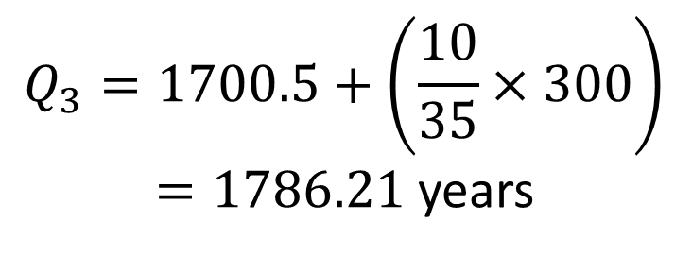
Quartiles - Tables
Find${ Q}_{3}$ and $IQR$
Age of relic (years) | Frequency
0-1000 | 24
1001-1500 | 29
1501-1700 | 12
1701-2000 | 35
C.F.
24
53
65
100
$$Q_{3}=1700.5+\left(\frac{10}{35}×300\right)$$
$=1786.21$ years
$$IQR=1786.21 −1017.74= 768.47$$
Notes:
There’s a slip to print out here.

Slide 5
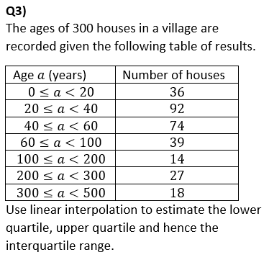
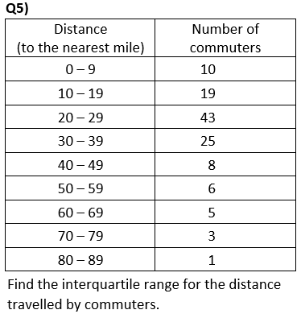
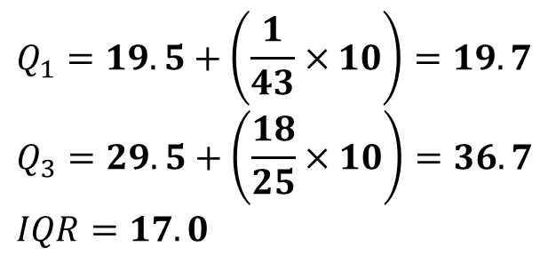
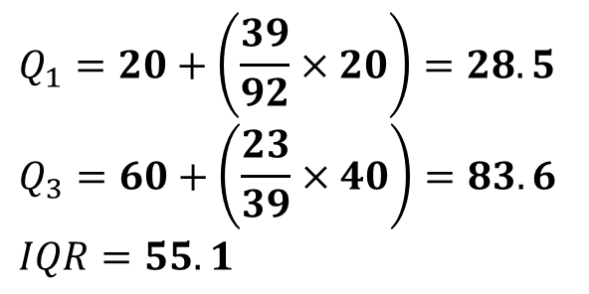
Quartiles – Exam Questions
$$Q_{1}=20+\left(\frac{39}{92}×20\right)=28.5 \\ Q_{3}=60+\left(\frac{23}{39}×40\right)=83.6$$
$$IQR=55.1$$
$$Q_{1}=19.5+\left(\frac{1}{43}×10\right)=19.7 \\ Q_{3}=29.5+\left(\frac{18}{25}×10\right)=36.7 \\ IQR=17.0$$

Slide 6
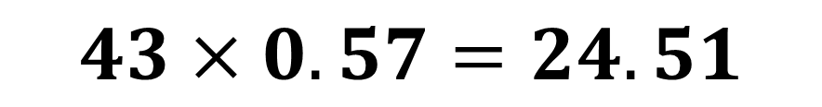

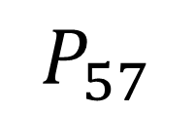
Percentiles
The LQ, median and UQ give you 25%, 50% and 75% respectively.
But we can have any percentage you like!
$$n=43$$
Data item to use for 57th percentile?
$$43×0.57=24.51$$
57th Percentile:
$$P_{57}$$

Slide 7
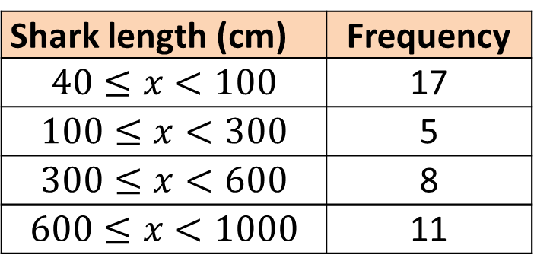
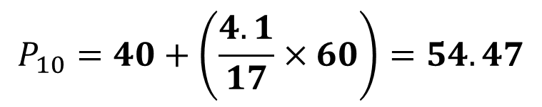
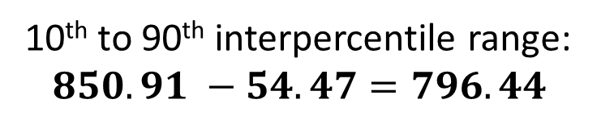
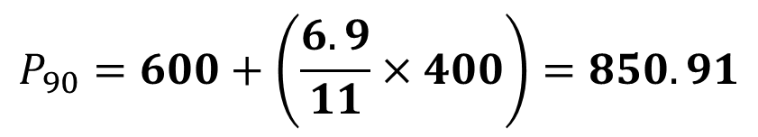
Percentiles
Find $P_{10}$ $P_{90 }$and $IPR$
Shark length (cm) | Frequency
$$40≤x<100$$ | 17
$$100≤x<300$$ | 5
$$300≤x<600$$ | 8
$$600≤x<1000$$ | 11
C.F.
17
32
40
51
$$P_{10}=40+\left(\frac{4.1}{17}×60\right)=54.47$$
$$P_{90}=600+\left(\frac{6.9}{11}×400\right)=850.91$$
10th to 90th interpercentile range:
$850.91 −54.47=796.44$
Notes:
There’s a slip to print out here.

Slide 8
Exercises 2C/2D
Pearson Statistics & Mechanics Year 1/AS
Pages 27-28
Ex 2C: Q1b, 2, 4b-d, 5b-c, 6
Ex 2D
Again, there is also a supplementary worksheet consisting of S1 exam questions (see next slides).
Complete before the lesson Q1
In Class:
Green Q2
Amber Q3-4

