Slide 1
Year 1 Pure Mathematics
Forces and Friction
– Friction
Chapter 5
(Part 3 of 3)

Slide 2
Friction
Smooth Surface
Driving Force
Rough Surface
Friction Force
Driving Force
Friction force will always oppose
the direction of motion.

Slide 3





Friction
Friction $=μR$
$μ$ is the coefficient of friction
$R$ is the normal reaction
$$R$$
$$μR$$
Driving Force

Slide 4
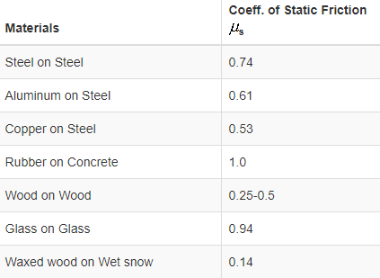
Friction
Examples of the value of $μ$ (the coefficient of friction):

Slide 5

Friction
$$F_{max}=μR$$
The friction force will always have a
maximum value.
This ‘maximum friction’ depends on 2 things:
- how rough the surface is
- the mass of the particle

Slide 6













Friction
$$R$$
5g x 0.1 = 9.8
Max Friction Force =
$$μ=0.1$$
5$g$
Driving Force = 5N
$$R$$
Friction Force =
5N
$$F$$
$$D$$
Resultant Force =
0N
$$μ=0.1$$
5$g$
Driving Force = 8N
$$R$$
Friction Force =
8N
$$F$$
Resultant Force =
$$D$$
0N
$$μ=0.1$$
5$g$
Driving Force = 10N
$$R$$
9.8N
Friction Force =
$$F$$
$$D$$
0.2N
Resultant Force =
$$μ=0.1$$
5$g$

Slide 7
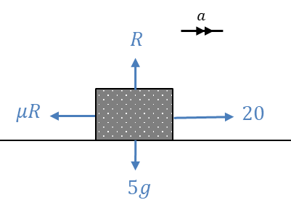
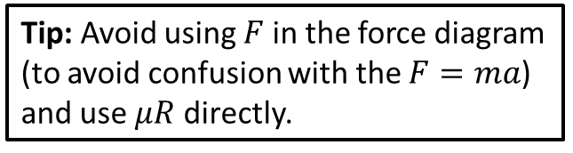
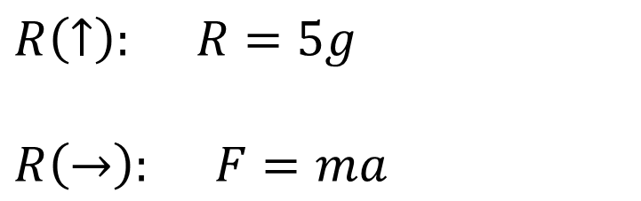
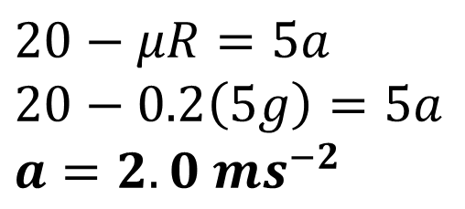
Friction - Example
A particle of mass 5kg is pulled along a rough horizontal surface by a horizontal force of magnitude 20N. The coefficient of friction between the particle and the floor is 0.2. Calculate:
the magnitude of frictional force
the acceleration of the particle.
$R\left(↑\right): R=5g$
$$R\left(→\right): F=ma$$
$20−μR=5a$
$20−0.2\left(5g\right)=5a$
$a=2.0 ms^{−2}$
Tip: Avoid using $F$ in the force diagram (to avoid confusion with the $F=ma$) and use $μR$ directly.

Slide 8
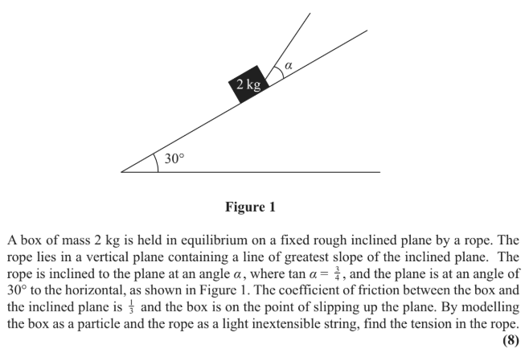
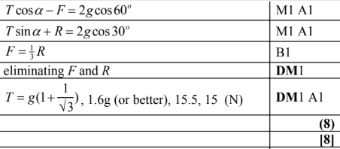
Test Your Understanding
Edexcel M1(Old) May 2013 Q3
?

Slide 9
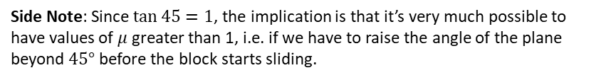

Exercise 5C
Pearson Stats/Mechanics Year 2
Pages 103-104
Additional question:
Before Q1 all parts
In Class:
Green Q2-3
Amber Q4-5
Red Q6-7 & Ext & Challenge
1
A block lies on a rough plane at an incline of $θ$. The coefficient of friction between the block and plane is $μ$. If the block is on the verge of sliding down the plane, prove that $μ=\tan{θ}$.
Let mass of block be $m$.
$$R\left(↖\right): R=mg\cos{θ} \\ R\left(↙\right): mg\sin{θ}=μR \\ mg\sin{θ}=μmg\cos{θ} \\ μ=\frac{mg\sin{θ}}{mg\cos{θ}}=\tan{θ}$$
?
Side Note: Since $\tan{45}=1$, the implication is that it’s very much possible to have values of $μ$ greater than 1, i.e. if we have to raise the angle of the plane beyond $45°$ before the block starts sliding.

