Slide 1




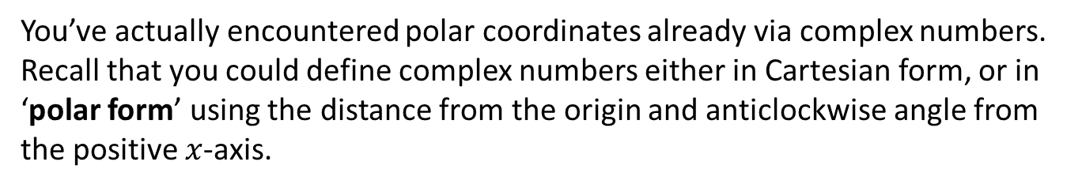
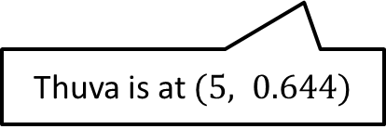
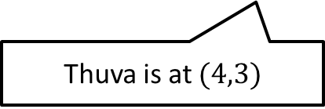


What the devil are polar coordinates?
You’ve actually encountered polar coordinates already via complex numbers.
Recall that you could define complex numbers either in Cartesian form, or in ‘polar form’ using the distance from the origin and anticlockwise angle from the positive $x$-axis.
$$r$$
$$θ$$
initial line
Cartesian Mike
Polar Mike
Thuva is at $(4,3)$
Thuva is at $(5, 0.644)$
?
Cartesian Form: $(x,y)$
Polar Form: $(r,θ)$

Slide 2
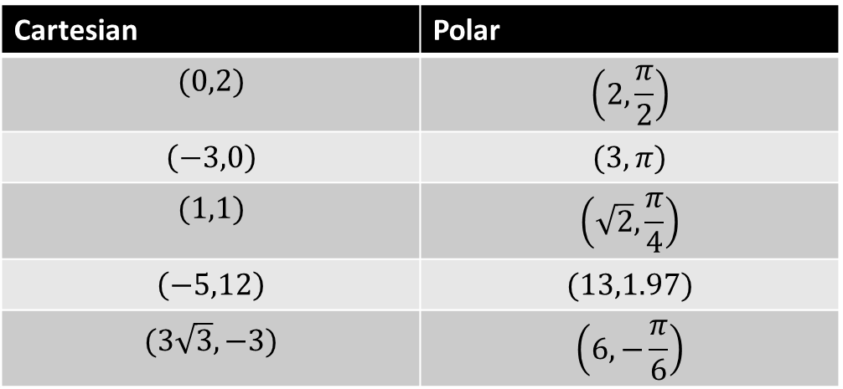


Converting to/from polar coordinates
You should already know how to do this from Chapter 1.
But a reminder:
$$x=r\cos{θ} y=r\sin{θ} r^{2}=x^{2}+y^{2} \\ θ=\tan^{−1}\left(\frac{y}{x}\right)$$
For 1st and 4th quadrants – use a diagram for others
Quickfire Questions:
Cartesian | Polar
$$(0,2)$$ | $$\left(2,\frac{π}{2}\right)$$
$$\left(−3,0\right)$$ | $$(3,π)$$
$$(1,1)$$ | $$\left(\sqrt{2},\frac{π}{4}\right)$$
$$\left(−5,12\right)$$ | $$(13,1.97)$$
$$(3\sqrt{3}, −3)$$ | $$\left(6,−\frac{π}{6}\right)$$
?
?
?
$$π−\tan^{−1}\left(\frac{12}{5}\right)$$
?
?

Slide 3
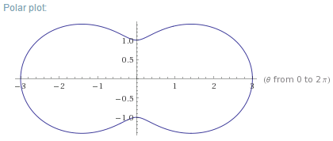
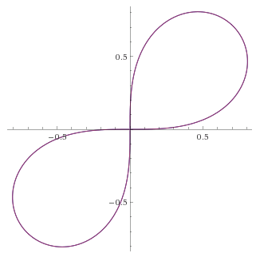
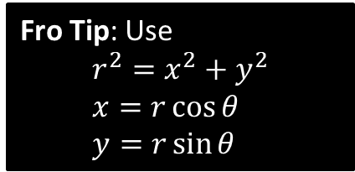

Polar equation $→$ Cartesian equation
Sometimes it is possible to switch from a Cartesian equation to a polar one.
Find Cartesian equations for the following:
Fro Tip: Use
$$r^{2}=x^{2}+y^{2} \\ x=r\cos{θ} \\ y=r\sin{θ}$$
$$r=5 \\ \sqrt{x^{2}+y^{2}}=5 \\ x^{2}+y^{2}=25$$
$$r=2+\cos{2θ} \\ r=2+2\cos^{2}θ{−1}=1+2\cos^{2}{θ} \\ r=1+\frac{2x^{2}}{r^{2}} \\ r^{3}=r^{2}+2x^{2} \\ {\left(x^{2}+y^{2}\right)}^{\frac{3}{2}}=x^{2}+y^{2}+2x^{2}=3x^{2}+y^{2}$$
$$r^{2}=\sin{2θ} \\ r^{2}=2\sin{θ}\cos{θ} \\ r^{2}=2\left(\frac{y}{r}\right)\left(\frac{x}{r}\right)=\frac{2xy}{r^{2}} \\ r^{4}=2xy \\ {\left(x^{2}+y^{2}\right)}^{2}=2xy$$
?
?
Note that the polar form is much more elegant!
?

Slide 4
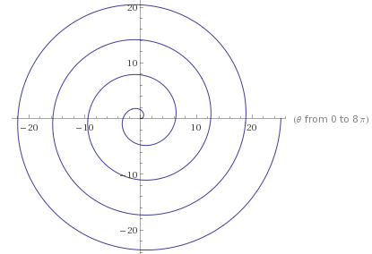
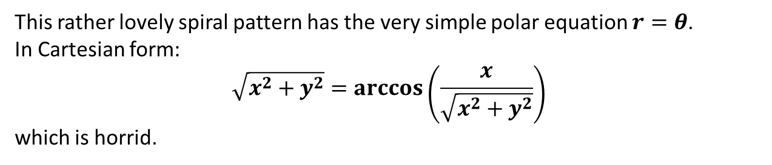

Why polar form sometimes kicks Cartesian’s butt
$$r^{2}=x^{2}+y^{2} \\ x=r\cos{θ} \\ y=r\sin{θ}$$
Think why
This rather lovely spiral pattern has the very simple polar equation $r=θ$.
In Cartesian form:
$$\sqrt{x^{2}+y^{2}}=\arccos\left(\frac{x}{\sqrt{x^{2}+y^{2}}}\right)$$
which is horrid.
?

Slide 5

Cartesian equation $→$ Polar equation
Converting to polar is easier, but the harder part is often finding how to simplify the expression. Know your double angle formulae!
$$r^{2}=x^{2}+y^{2} \\ x=r\cos{θ} \\ y=r\sin{θ}$$
Find polar equations for the following:
$$y^{2}=4x \\ r^{2}\sin^{2}{θ}=4r\cos{θ} \\ r=4\cot{θ}\operatorname{cosec}{θ}$$
$$x^{2}−y^{2}=5 \\ r^{2}\cos^{2}{θ}−r^{2}\sin^{2}{θ}=5 \\ r^{2}\left(\cos^{2}{θ−\sin^{2}{θ}}\right)=5 \\ r^{2}\cos{2θ}=5 \\ r^{2}=5\sec{2θ}$$
$$y\sqrt{3}=x+4 \\ r\sqrt{3} \sin{θ}=r\cos{θ}+4 \\ r\left(\sqrt{3}\sin{θ}−\cos{θ}\right)=4 \\ r\sin\left(θ−\frac{π}{6}\right)=2$$
?
?
?
We know how to simplify expressions like this from Pure Year 2.

Slide 6
Exercise 5A
Pearson Core Pure Year 2
Page 104
Complete before the lesson Q1-2
In Class:
Green Q3
Amber Q4
Red Challenge

Slide 7
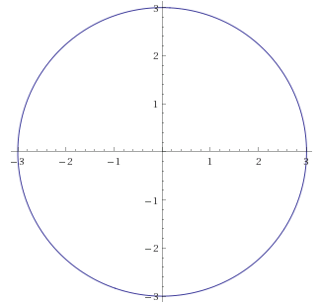







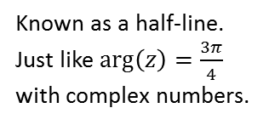
Sketching Curves of Polar Equations
How would you sketch each of the following?
$$r=a$$
$$θ=α$$
$$r=aθ$$
?
?
?
e.g. $r=3$
e.g. $θ=\frac{3π}{4}$
e.g. $r=θ$
(This is just like when we were sketching say $\left|z\right|=3$)
Known as a half-line.
Just like $\arg\left(z\right)=\frac{3π}{4}$ with complex numbers.

Slide 8
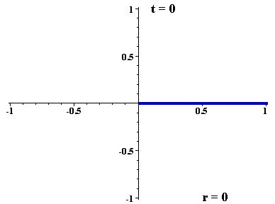


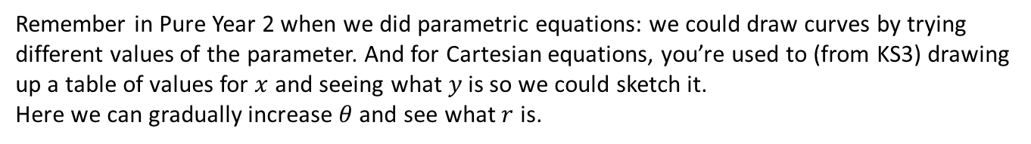
Sketching using tables of values
Remember in Pure Year 2 when we did parametric equations: we could draw curves by trying different values of the parameter. And for Cartesian equations, you’re used to (from KS3) drawing up a table of values for $x$ and seeing what $y$ is so we could sketch it.
Here we can gradually increase $θ$ and see what $r$ is.
The $t$ here means $θ$
$$r=sin(4θ)$$
(Note: In this animation $r$ is allowed to be negative, but in Core Pure Yr2 negative $r$ values are ignored. More on this later)

Slide 9
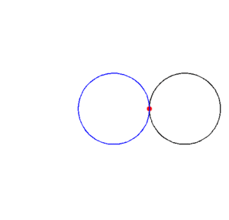
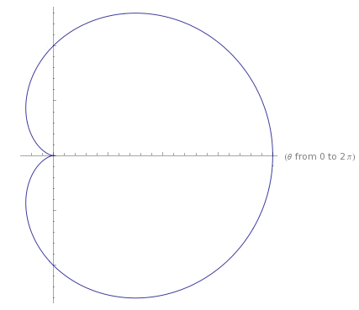
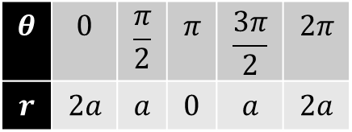

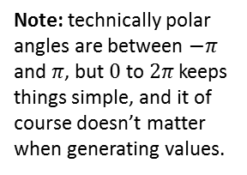






Sketching using tables of values
Note: technically polar angles are between $−π$ and $π$, but $0$ to $2π$ keeps things simple, and it of course doesn’t matter when generating values.
$$r=a\left(1+\cos{θ}\right)$$
This is a cardioid, and this animation shows how it could emerge in practice!
$$θ$$ | $$0$$ | $$\frac{π}{2}$$ | $$π$$ | $$\frac{3π}{2}$$ | $$2π$$
$$r$$ | $$2a$$ | $$a$$ | $$0$$ | $$a$$ | $$2a$$
?
$$θ=\frac{π}{2}$$
Sketch ?
$$a$$
$$θ=π$$
$$θ=0$$
$$2a$$
$$a$$

Slide 10
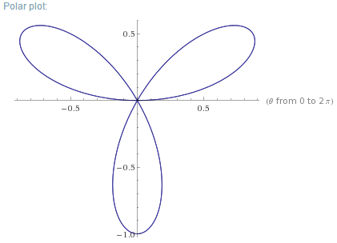
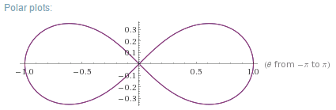
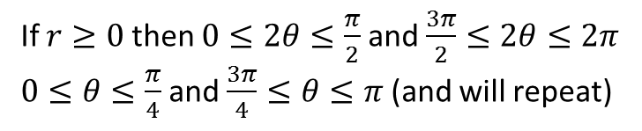
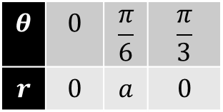
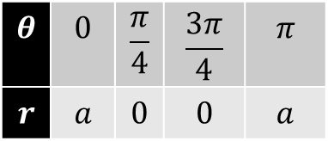


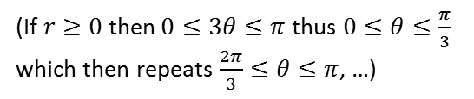
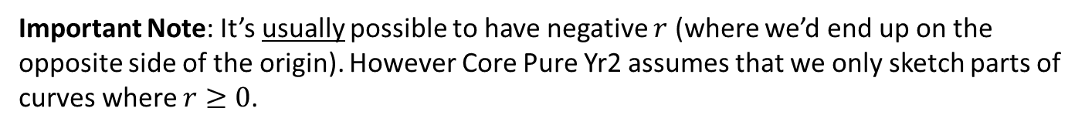
More sketchies
Important Note: It’s usually possible to have negative $r$ (where we’d end up on the opposite side of the origin). However Core Pure Yr2 assumes that we only sketch parts of curves where $r≥0$.
$$r=\sin{3θ}$$
$$r^{2}=a^{2}\cos{2θ}$$
?
If $r≥0$ then $0≤2θ≤\frac{π}{2}$ and $\frac{3π}{2}≤2θ≤2π$
$0≤θ≤\frac{π}{4}$ and $\frac{3π}{4}≤θ≤π$ (and will repeat)
(If $r≥0$then$0≤3θ≤π$ thus $0≤θ≤\frac{π}{3}$ which then repeats $\frac{2π}{3}≤θ≤π$, …)
?
?
$$θ$$ | $$0$$ | $$\frac{π}{6}$$ | $$\frac{π}{3}$$
$$r$$ | $$0$$ | $$a$$ | $$0$$
?
$$θ$$ | $$0$$ | $$\frac{π}{4}$$ | $$\frac{3π}{4}$$ | $$π$$
$$r$$ | $$a$$ | $$0$$ | $$0$$ | $$a$$
?
?
?
Sketch ?
Sketch ?
(Known as a ‘polar rose’)

Slide 11
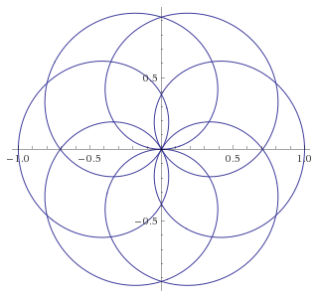
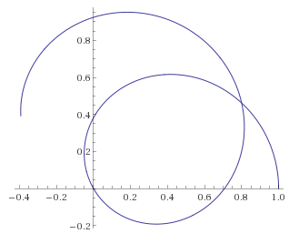
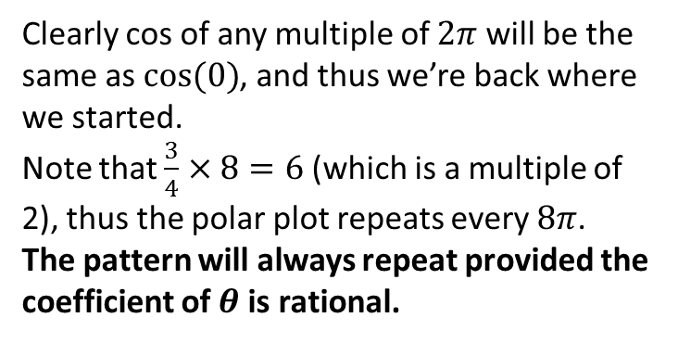
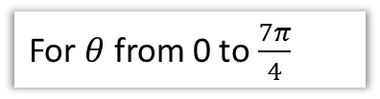
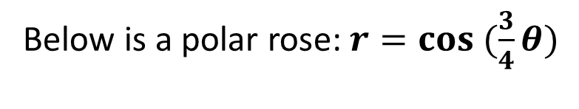



Just for fun… (not in the syllabus)
Below is a polar rose: $r=cos (\frac{3}{4}θ)$
For $θ$ from 0 to $\frac{7π}{4}$
For $θ$ from 0 to $8π$
$$θ=\frac{2}{3}π$$
Clearly cos of any multiple of $2π$ will be the same as $cos⁡(0)$, and thus we’re back where we started.
Note that $\frac{3}{4}×8=6$ (which is a multiple of 2), thus the polar plot repeats every $8π$.
The pattern will always repeat provided the coefficient of $θ$ is rational.
As previously discussed, usually $r$ is allowed to be negative. At $θ=\frac{2}{3}π$, $\cos{(\frac{3}{4}θ)}$ will be 0. So even though the half line is sweeping further anticlockwise, we end up in this region on the wrong side of the origin.

Slide 12
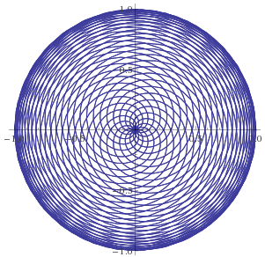
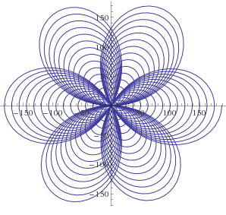
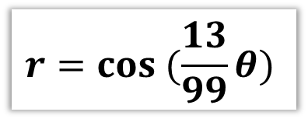
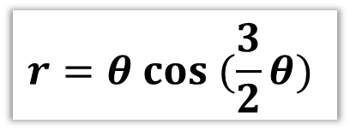
Just for fun… (not in the syllabus)
And it can get rather pretty…
$$r=θ cos (\frac{3}{2}θ)$$
$$r=cos (\frac{13}{99}θ)$$
(This is a spiral combined with a polar rose)

Slide 13
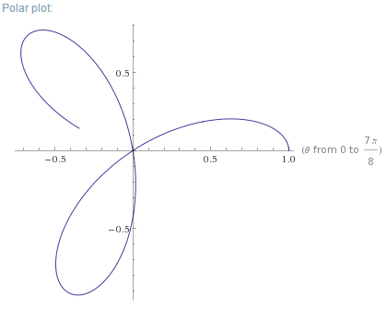
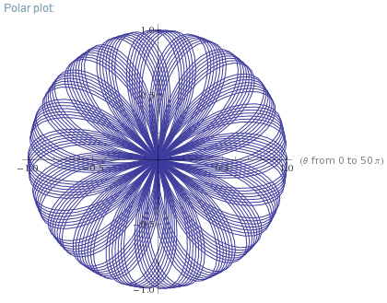


Just for fun… (not in the syllabus)
$$r=cos (eθ)$$
Here however $e$ is irrational, so it will NEVER repeat!
For $θ$ from 0 to $\frac{7π}{8}$
For $θ$ from 0 to $50π$

Slide 14
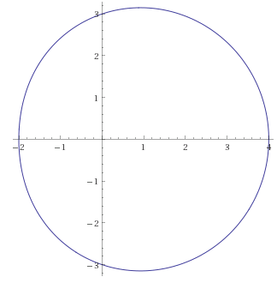
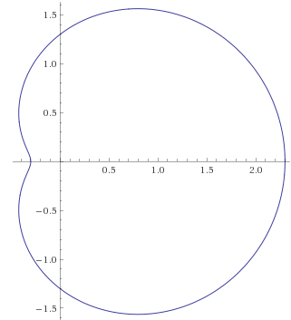
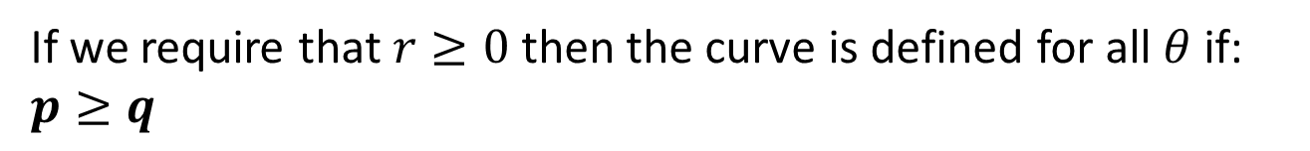
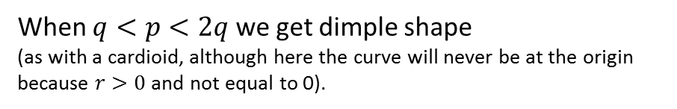


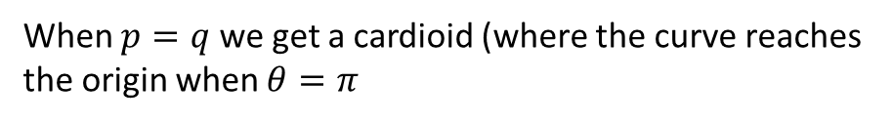
Egg vs Dimple
$$r=a\left(p+q\cos{θ}\right)$$
If we require that $r≥0$ then the curve is defined for all $θ$ if: $p≥q$
?
Case 1
When $p=q$ we get a cardioid (where the curve reaches the origin when $θ=π$
Case 2
When $p≥2q$ we get an egg shape
(and if $q=0$, a circle centred at the origin).
Case 3
When $q<p<2q$ we get dimple shape
(as with a cardioid, although here the curve will never be at the origin because $r>0$ and not equal to 0).
(We will see why we get the ‘egg’ vs ‘dimple’ later.)

Slide 15




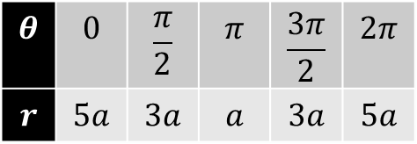







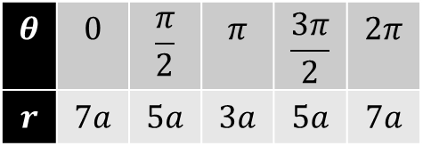


Egg vs Dimple
$$r=a\left(p+q\cos{θ}\right)$$
Egg if $p≥2q$
Sketch $r=a\left(5+2\cos{θ}\right)$
Sketch $r=a\left(3+2\cos{θ}\right)$
$$θ$$ | $$0$$ | $$\frac{π}{2}$$ | $$π$$ | $$\frac{3π}{2}$$ | $$2π$$
$$r$$ | $$7a$$ | $$5a$$ | $$3a$$ | $$5a$$ | $$7a$$
$$θ$$ | $$0$$ | $$\frac{π}{2}$$ | $$π$$ | $$\frac{3π}{2}$$ | $$2π$$
$$r$$ | $$5a$$ | $$3a$$ | $$a$$ | $$3a$$ | $$5a$$
?
?
$$y$$
Sketch ?
Sketch ?
$$3a$$
$$5a$$
$$θ=0$$
$$7a$$
$$θ=0$$
$$5a$$
$$3a$$
$$5a$$
$$3a$$

Slide 16

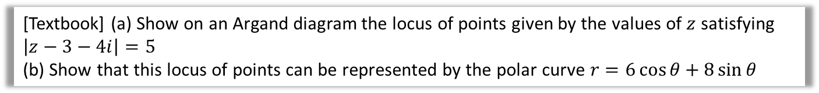
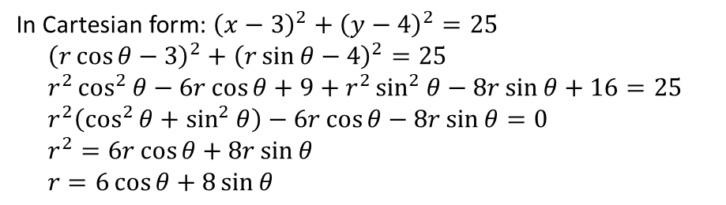
Final Example
[Textbook] (a) Show on an Argand diagram the locus of points given by the values of $z$ satisfying $\left|z−3−4i\right|=5$
(b) Show that this locus of points can be represented by the polar curve $r=6\cos{θ}+8\sin{θ}$
? a
? b
8
In Cartesian form: ${\left(x−3\right)}^{2}+{\left(y−4\right)}^{2}=25$
$${\left(r\cos{θ}−3\right)}^{2}+{\left(r\sin{θ}−4\right)}^{2}=25 \\ r^{2}\cos^{2}{θ}−6r\cos{θ}+9+r^{2}\sin^{2}{θ}−8r\sin{θ}+16=25 \\ r^{2}\left(\cos^{2}{θ}+\sin^{2}{θ}\right)−6r\cos{θ}−8r\sin{θ}=0 \\ r^{2}=6r\cos{θ}+8r\sin{θ} \\ r=6\cos{θ}+8\sin{θ}$$
$$3+4i$$
6

Slide 17
Exercise 5B
Pearson Core Pure Year 2
Page 108-109
Complete before the lesson Q1
In Class:
Green Q2
Amber Q3
Red Q4

Slide 18

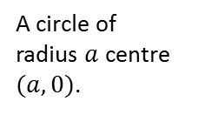











Summary so Far
$$r=a$$
$$θ=α$$
Fro Helping Hand:
You can prove these by converting equation to Cartesian.
?
?
$$a$$
$$θ=α$$
$$θ=0$$
$$a$$
$$a$$
Fro Exam Tip:
I lifted each of these forms directly out of the Edexcel specification.
$$a$$
$$r=2a\cos{θ}$$
$$r=kθ$$
?
?
A circle of radius $a$ centre $(a,0)$.
$$a$$
$$2a$$

Slide 19












Summary so Far
$$r=a\left(1+\cos{θ}\right)$$
$$r=a\left(1−\cos{θ}\right)$$
?
?
(special name: cardioid)
$$θ=\frac{π}{2}$$
$$r=a$$
Think about it: now when $θ=0$, $1−cosθ=0$ so we start at the origin. And when $θ=π$, $r$ will be at its maximum.
$$θ=π$$
$$θ=0$$
$$r=2a$$
$$r=a$$
$$r=a\left(3+2\cos{θ}\right)$$
?
$p<2q$ therefore dimpled.

Slide 20













Summary so Far
$$r=a\cos{2θ}$$
$$r^{2}=a^{2}\cos{2θ}$$
$$a$$
?
?
However because FP2 requires that $r≥0$, we won’t see top and bottom petals.
$$a$$
However because the LHS is squared $∴$ positive, it forces the RHS to be positive, so regardless of whether we restrict $r>0$, those other two petals won’t be there.
$$r=p\sec\left(α−θ\right)$$
$$r=a\sec\left(θ\right)$$
?
?
Converting to Cartesian:
$$y=p\operatorname{cosec}{α}−\left(\cot{α}\right) x$$
$$x=r\cos{θ} \\ ∴r=x\sec{θ} \\ ∴x\sec{θ=a\sec{θ}} \\ ∴x=a$$
$$a$$

Slide 21












Integration
When integrating normal Cartesian 2D areas, we know we’re summing a bunch of infinitely thin rectangles:
Similarly in Core Pure Years 1 and 2, we could get a volume of revolution by summing the volumes of infinitely thin cylinders:
Area of each rectangle:
Volume of each cylinder
?
?
$$=π {f(x)}^{2} dx$$
$$=f\left(x\right) dx$$
Adding them all for total volume:
Adding them all for area:
$$\int_{a}^{b}{π {f(x)}^{2} dx }$$
$$\int_{a}^{b}{f\left(x\right) dx}$$
?
?
$$f(x)$$
$$a$$
$$b$$
$$dx$$
$$f(x)$$
$$a$$
$$b$$
Fro Exam Note: Historically in FP2, these last two sections: integration and tangents/normal, are what exam questions were almost always based on. This emphasis may or may not have shifted for the new A Level.
$$dx$$

Slide 22







Integration
Can we apply to same principle to find the area bound between a polar curve and two half lines $θ=α$ and $θ=β$?
Area of each sector:
?
$$=\frac{1}{2}r^{2}dθ$$
$$θ=β$$
$$dθ$$
$$r$$
Adding them all for total area:
$$θ=α$$
$$\frac{1}{2}\int_{α}^{β}{r^{2} dθ}$$
?

Slide 23




Example
Find the area enclosed by the cardioid with equation $r=a\left(1+\cos{θ}\right)$
We could always just integrate between $0$ and $π$ and then double the area (since it’s repeated):
$$A=2×\frac{1}{2}a^{2}\int_{0}^{π}{{\left(1+\cos{θ}\right)}^{2}}dθ \\ =a^{2}\int_{0}^{π}{(1+2\cos{θ}+\cos^{2}{θ})}dθ \\ =a^{2}{\left[θ+2\sin{θ}+\frac{1}{2}θ+\frac{1}{4}\sin{2θ}\right]}_{0}^{π} \\ =\frac{3a^{2}π}{2}$$
?
?
?
?
$$A=\frac{1}{2}\int_{α}^{β}{r^{2} dθ}$$
Fro Tip: Because they come up all the time, you should memorise:
$\cos^{2}{x}=\frac{1}{2}+\frac{1}{2}\cos{2x}$ and $\sin^{2}{x}=\frac{1}{2}−\frac{1}{2}\cos{2x}$

Slide 24


Another Example
Find the area of one loop of the polar rose $r=a\sin{4θ}$
$$A=\frac{a^{2}}{2}\int_{0}^{\frac{π}{4}}{\sin^{2}{4θ dθ}} \\ =\frac{a^{2}}{4}\int_{0}^{\frac{π}{4}}{1−cos 8θ{ dθ}} \\ =\frac{a^{2}π}{16}$$
?
$\cos^{2}{x}=\frac{1}{2}+\frac{1}{2}\cos{2x}$ and $\sin^{2}{x}=\frac{1}{2}−\frac{1}{2}\cos{2x}$

Slide 25



Test Your Understanding So Far
Edexcel FP2(Old) June 2009 Q4
Figure 1 shows a sketch of the curve with polar equation
$$r=a+3\cos{θ}, a>0, 0≤θ<2π$$
The area enclosed by the curve is $\frac{107}{2}π$.
Find the value of $a$.
(8)
?

Slide 26






Intersecting Areas
When polar curves intersect we have to consider which curve we’re finding the area under for each value of $θ$.
On the same diagram sketch the curves with equations $r=2+\cos{θ}$ and $r=5\cos{θ}$
Find the polar coordinates of the points of intersection of these two curves.
Find the exact value of the area of the finite region bound between the two curves.
We have to find areas A and B separately because the curve we’re under suddenly changes at a particular value of $θ$ (we’ll find in (b)).
(a) ?
(b) ?
$$2+\cos{θ}=5\cos{θ} \\ \cos{θ}=\frac{1}{2} \\ θ=±\frac{π}{3} \\ \left(2.5,−\frac{π}{3}\right),\left(2.5,\frac{π}{3}\right)$$
$$A=2×\left[\frac{1}{2}\int_{0}^{\frac{π}{3}}{{\left(2+\cos{θ}\right)}^{2}dθ}+\frac{1}{2}\int_{\frac{π}{3}}^{\frac{π}{2}}{{\left(5\cos{θ}\right)}^{2}}dθ\right] \\ =… \\ =\frac{43π}{12}−\sqrt{3}$$
A
B
$$θ=0$$
(c) ?
No dimple because $p≥2q$
($2≥2(1)$)
(Use your ClassWiz to check!)

Slide 27


Test Your Understanding
FP2 June 2010 Q5
Figure 1 shows the curves given by the polar equations
$$r=2, 0≤θ<\frac{π}{2} \\ r=1.5+\sin{3θ} 0≤θ≤\frac{π}{2}$$
Find the coordinates of the points where the curves intersect. (3)
The region $S$ for which $r>2$ and $r<1.5+\sin{3θ}$ is shown. Find, by integration, area of $S$ giving your answer in the form $aπ+b\sqrt{3}$ where $a$ and $b$ are simplified fractions. (7)
(a) ?
(b) ?

Slide 28
Exercise 5C
Pearson Core Pure Year 2
Page 111-112
Complete before the lesson Q1
In Class:
Green Q2-3
Amber Q4-5
Red Q6-9 & Challenge

Slide 29




Tangents and Normals
Remember how you found the gradient given equations in parametric form?
$$x=\cos{t}, y=\sin{t} \\ \frac{dy}{dx}=\frac{\left(\frac{dy}{dt}\right)}{\left(\frac{dx}{dt}\right)}=\frac{\cos{t}}{−\sin{t}}=−\cot{t}$$
?
We know that in the polar world:
$$x=r\cos{θ} y=r\sin{θ}$$
! When parallel to the initial line, $\frac{dy}{dθ}=0$
?
! When perpendicular to the initial line, $\frac{dx}{dθ}=0$
?

Slide 30




Example
Find the coordinates of the points on $r=a\left(1+\cos{θ}\right)$ where the tangents are parallel to the initial line $θ=0$.
?
Since we’re about to find $\frac{dy}{dθ}$, start with $y=r\sin{θ}$
and ensure expression is only in terms of $θ$.
$$y=r\sin{θ} \\ =\left(a\left(1+\cos{θ}\right)\right)\sin{θ}=a\left(\sin{θ+\sin{θ}\cos{θ}}\right)$$
$$∴\frac{dy}{dθ}=a\left(\cos{θ}+\cos^{2}{θ}−\sin^{2}{θ}\right)=0 \\ 2\cos^{2}{θ}+\cos{θ}−1=0 \\ \left(2\cos{θ}−1\right)\left(\cos{θ}+1\right)=0 \\ \cos{θ}=\frac{1}{2} ⇒ θ=±\frac{π}{3}$$
$$∴r=a\left(1+\frac{1}{2}\right)=\frac{3}{2}a$$
Coordinates: $\left(\frac{3}{2}a, −\frac{π}{3}\right)$ and $\left(\frac{3}{2}a,\frac{π}{3}\right)$
Use $\frac{dy}{dθ}=0$

Slide 31


Test Your Understanding So Far
Edexcel FP2(Old) June 2012 Q2
The curve $C$ has polar equation
$$r=1+2\cos{θ}, 0≤θ≤\frac{π}{2}$$
At the point $P$ on $C$, the tangent to $C$ is parallel to the initial line.
Given that $O$ is the pole, find the exact length of the line $OP$.
?

Slide 32



Example
Find the equations and the points of contact of the tangents to the curve
$$r=a\sin{2θ, 0≤θ≤\frac{π}{2}}$$
that are (a) parallel to the initial line and (b) perpendicular to the initial line.
$$y=r\sin{θ} \\ y=a\sin{2θ}\sin{θ} \\ \frac{dy}{dθ}=2a\sin{θ}\left(\cos^{2}{θ}+\cos^{2}{θ}−\sin^{2}{θ}\right) \\ \sin{θ=0} or 2\cos^{2}{θ }−\sin^{2}{θ}=0$$
$$\sin{θ}=0 → θ=0 \\ 2\cos^{2}{θ}−\sin^{2}{θ}=0 \\ 2 \cos^{2}θ=\sin^{2}{θ} \\ \tan^{2}{θ}=2 → \tan{θ}=\sqrt{2} \\ θ=0.955$$
We need to find $r$. If $\tan{θ=}\sqrt{2}$, then using a right-angled triangle, $\sin{θ}=\frac{\sqrt{2}}{\sqrt{3}},\cos{θ}=\frac{1}{\sqrt{3}}$
$$r=2a sin θ\cos{θ}=2a\frac{\sqrt{2}}{3}$$
Thus points are $\left(0,0\right), \left(\frac{2a\sqrt{3}}{3}, 0.955\right)$
(a) tangent?
(a) point?
The equation of the tangent through $(0,0)$ is the initial line:
$$θ=0$$
Thus equation of the tangent through $\left(\frac{2a\sqrt{3}}{3}, 0.955\right)$ in Cartesian form: (using $y=r\sin{θ}$ for this particular angle):
$$y=\frac{2a\sqrt{3}}{3}×\frac{\sqrt{2}}{\sqrt{3}}=\frac{4a}{3\sqrt{3}}$$
Thus:
$$y=r\sin{θ} \\ \frac{4a}{3\sqrt{3}}=r\sin{θ} \\ r=\frac{4a}{3\sqrt{3}} cosec θ$$

Slide 33


Example
Find the equations and the points of contact of the tangents to the curve
$$r=a\sin{2θ, 0≤θ≤\frac{π}{2}}$$
that are (a) parallel to the initial line and (b) perpendicular to the initial line.
?
$$x=r\cos{θ} \\ =a\cos{θ}\sin{2θ} \\ \frac{dx}{dθ}=2a\cos{θ}\left(\cos^{2}{θ}−2\sin^{2}{θ}\right)=0$$
…
Tangents at $\left(0,\frac{π}{2}\right)$ and $\left(\frac{2a\sqrt{2}}{3}, 0.615\right)$
One tangent is the $y$-axis:
$$θ=\frac{π}{2}$$
The other is $x=r\cos{θ}=\frac{2a\sqrt{2}}{3}×\frac{\sqrt{2}}{\sqrt{3}}=\frac{4a}{3\sqrt{3}}$
So $\frac{4a\sqrt{2}}{3\sqrt{3}}=r\cos{θ}$
$$r=\frac{4a}{3\sqrt{3}}\sec{θ}$$
Fro Tip: There’s two skills we used here which are less obvious:
If you know one of tan, sin or cos, you can find the others by constructing an appropriate triangle.
Once you’ve found your point $\left(r,θ\right)$, if you’re finding the line parallel to the initial line, use $y=r\sin{θ}$ using your specific $θ$ to find $y$.
Then use $y=r\sin{θ}$ AGAIN, using your $y$, where $θ$ is again general, to turn your Cartesian equation into a polar one.
?

Slide 34

Proof of dimple vs egg
Prove that for $r=p+q\cos{θ}$ we have a ‘dimple’ if $p<2q$.
What’s the difference in terms of tangents?
The first has 2 tangents perpendicular to the initial line. The second has 3!
$$x=r\cos{θ}=\left(p+q\cos{θ}\right)\cos{θ}=p\cos{θ}+q\cos^{2}{θ} \\ \frac{dx}{dθ}=0 ⇒ −p\sin{θ}−2q\sin{θ}\cos{θ}=0 \\ −\sin{θ}\left(p+2q\cos{θ}\right)=0 \\ \sin{θ=0} or\cos{θ=−\frac{p}{2q}}$$
The first corresponds to the left and right-most tangents (where $θ=0$ and $θ=π$).
If $p>2q$ then $\cos{θ<−1}$ which has no solutions, so there will be no other tangent.
If $p=2q$ then $\cos{θ=−1}$ which gives us $θ=π$, i.e. there is no extra solution.
?
?

Slide 35
Exercise 5D
Pearson Core Pure Year 2
Page 115-116
(Note: I have included an Edexcel FP2 (Old Spec) compilation of Polar Coordinate questions with the download for these slides)
Complete before the lesson Q1
In Class:
Green Q2-3
Amber Q4-6
Red Q7-8

