Slide 1

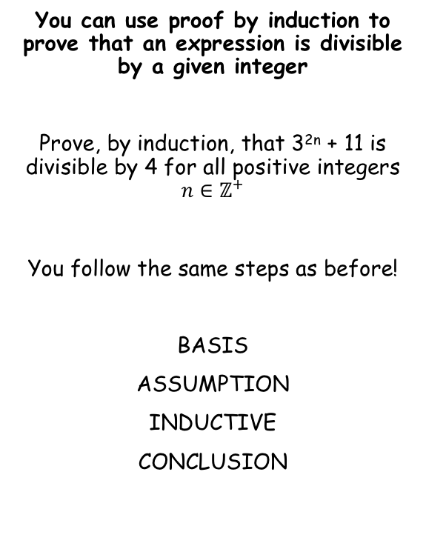


Proof by Induction
BASIS
You can use proof by induction to prove that an expression is divisible by a given integer
Prove, by induction, that 3^{2n} + 11 is divisible by 4 for all positive integers $n∈{\text{ℤ}}^{+}$
You follow the same steps as before!
BASIS
ASSUMPTION
INDUCTIVE
CONCLUSION
→ Show that the statement is true for n = 1
$$f\left(n\right)=3^{2n}+11$$
Sub in n = 1
$$f\left(1\right)=3^{2(1)}+11$$
Calculate
$$=20$$
20 is divisible by 4, so the statement is true for n = 1
8B

Slide 2






Proof by Induction
ASSUMPTION
You can use proof by induction to prove that an expression is divisible by a given integer
Prove, by induction, that 3^{2n} + 11 is divisible by 4 for all positive integers $n∈{\text{ℤ}}^{+}$
You follow the same steps as before!
BASIS
ASSUMPTION
INDUCTIVE
CONCLUSION
→ Assume the statement is true for n = k
$$f\left(k\right)=3^{2k}+11$$
$$is divisible by 4 for k∈{\text{ℤ}}^{+}$$
INDUCTIVE
→ Show that the statement is then true for n = (k + 1)
$$f\left(k+1\right)=3^{2(k+1)}+11$$
Multiply out the bracket
$$f\left(k+1\right)=3^{2k+2}+11$$
3^{2k+2} = 3^{2k} x 3² (adding powers when multiplying)
$$f\left(k+1\right)=3^{2k}×3^{2}+11$$
So we have 9 lots of 3^{2k}
$$f\left(k+1\right)={9(3}^{2k})+11$$
At this point we will combine the expressions for f(k) and f(k + 1) in order to prove that the statement is always divisible by 4
8B

Slide 3









Proof by Induction
You can use proof by induction to prove that an expression is divisible by a given integer
Prove, by induction, that 3^{2n} + 11 is divisible by 4 for all positive integers $n∈{\text{ℤ}}^{+}$
You follow the same steps as before!
BASIS
ASSUMPTION
INDUCTIVE
CONCLUSION
INDUCTIVE
→ Show that the statement is then true for n = (k + 1)
$$f\left(k\right)=3^{2k}+11$$
$$f\left(k+1\right)={9(3}^{2k})+11$$
Subtract f(k) from f(k + 1), using the expressions above
$$f\left(k+1\right)−f(k)=$$
$$\left[9\left(3^{2k}\right)+11\right]−\left[3^{2k}+11\right]$$
Group terms on the right side
$$f\left(k+1\right)−f(k)=$$
$$8(3^{2k})$$
Take out 4 as a factor
$$f\left(k+1\right)−f(k)=$$
$$4\left[2(3^{2k}) \right]$$
Add f(k)
$$f\left(k+1\right)=$$
$$f\left(k\right) + 4\left[2(3^{2k}) \right]$$
This shows that f(k + 1) is just f(k) with an expression added on
We assumed f(k) was divisible by 4
The expression to be added is divisible by 4
So the answer must be divisible by 4, if f(k) is!
As the first case (n = 1) was divisible by 4, the statement must be true!
CONCLUSION
8B

Slide 4

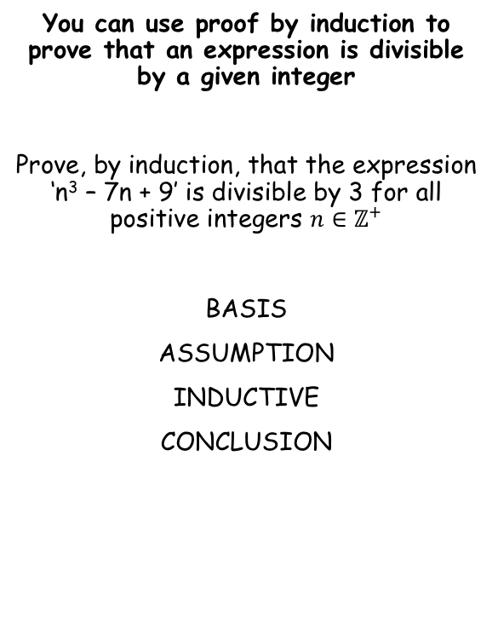


Proof by Induction
BASIS
You can use proof by induction to prove that an expression is divisible by a given integer
Prove, by induction, that the expression ‘n³ – 7n + 9’ is divisible by 3 for all positive integers $n∈{\text{ℤ}}^{+}$
BASIS
ASSUMPTION
INDUCTIVE
CONCLUSION
→ Show that the statement is true for n = 1
$$f\left(n\right)=n^{3}−7n+9$$
Sub in n = 1
$$f\left(1\right)={(1)}^{3}−7(1)+9$$
Calculate
$$=3$$
3 is divisible by 3, so the statement is true for n = 1
8B

Slide 5




Proof by Induction
ASSUMPTION
You can use proof by induction to prove that an expression is divisible by a given integer
Prove, by induction, that the expression ‘n³ – 7n + 9’ is divisible by 3 for all positive integers $n∈{\text{ℤ}}^{+}$
BASIS
ASSUMPTION
INDUCTIVE
CONCLUSION
→ Assume the statement is true for n = k
$$f\left(k\right)=k^{3}−7k+9$$
$$is divisible by 3 for k∈{\text{ℤ}}^{+}$$
INDUCTIVE
→ Show that the statement is then true for n = (k + 1)
$$f\left(k+1\right)={(k+1)}^{3}−7(k+1)+9$$
Multiply out the brackets
$$f\left(k+1\right)=k^{3}+3k^{2}+3k+1−7k−7+9$$
Group up terms
$$f\left(k+1\right)=k^{3}+3k^{2}−4k+3$$
8B

Slide 6











Proof by Induction
You can use proof by induction to prove that an expression is divisible by a given integer
Prove, by induction, that the expression ‘n³ – 7n + 9’ is divisible by 3 for all positive integers $n∈{\text{ℤ}}^{+}$
BASIS
ASSUMPTION
INDUCTIVE
CONCLUSION
INDUCTIVE
→ Show that the statement is then true for n = (k + 1)
$$f\left(k\right)=k^{3}−7k+9$$
$$f\left(k+1\right)=k^{3}+3k^{2}−4k+3$$
Subtract f(k) from f(k + 1), using the expressions above
$$f\left(k+1\right)−f\left(k\right)=$$
$$\left(k^{3}+3k^{2}−4k+3 \right)$$
$$− \left(k^{3}−7k+9 \right)$$
Multiply by the bracket
$$f\left(k+1\right)−f\left(k\right)=$$
$$k^{3}+3k^{2}−4k+3$$
$$− k^{3}+7k−9$$
Group terms
$$f\left(k+1\right)−f\left(k\right)=$$
$$3k^{2}+3k−6$$
Take out 3 as a factor
$$f\left(k+1\right)−f\left(k\right)=$$
$$3(k^{2}+k−2)$$
Add f(k)
$$f\left(k+1\right)=$$
$$f\left(k\right)+3(k^{2}+k−2)$$
This shows that f(k + 1) is just f(k) with an expression added on
We assumed f(k) was divisible by 3
The expression to be added is divisible by 3
So the answer must be divisible by 3, if f(k) is!
As the first case (n = 1) was divisible by 3, the statement must be true!
CONCLUSION
8B

Slide 7

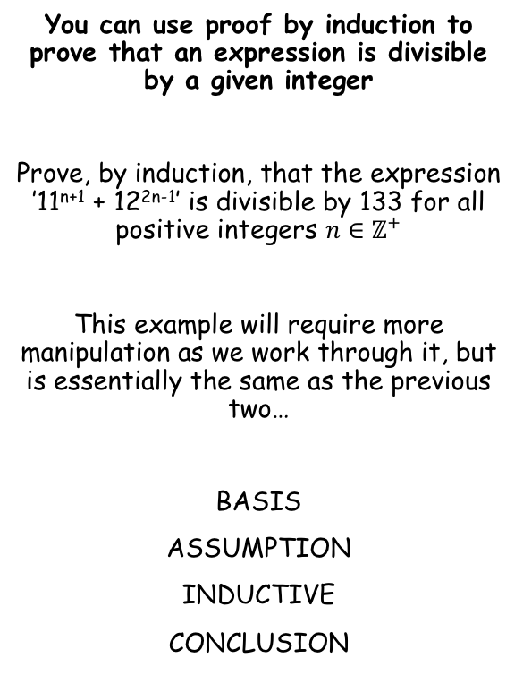


Proof by Induction
BASIS
You can use proof by induction to prove that an expression is divisible by a given integer
Prove, by induction, that the expression ’11^{n+1} + 12^{2n-1}’ is divisible by 133 for all positive integers $n∈{\text{ℤ}}^{+}$
This example will require more manipulation as we work through it, but is essentially the same as the previous two…
BASIS
ASSUMPTION
INDUCTIVE
CONCLUSION
→ Show that the statement is true for n = 1
$$f\left(n\right)={11}^{n+1}+{12}^{2n−1}$$
Sub in n = 1
$$f\left(1\right)={11}^{2}+{12}^{1}$$
Calculate
$$=133$$
133 is divisible by 133, so the statement is true for n = 1
8B

Slide 8








Proof by Induction
ASSUMPTION
You can use proof by induction to prove that an expression is divisible by a given integer
Prove, by induction, that the expression ’11^{n+1} + 12^{2n-1}’ is divisible by 133 for all positive integers $n∈{\text{ℤ}}^{+}$
This example will require more manipulation as we work through it, but is essentially the same as the previous two…
BASIS
ASSUMPTION
INDUCTIVE
CONCLUSION
→ Assume the statement is true for n = k
$$f\left(k\right)={11}^{k+1}+{12}^{2k−1}$$
$$is divisible by 133 for k∈{\text{ℤ}}^{+}$$
INDUCTIVE
→ Show that the statement is then true for n = (k + 1)
$$f\left(k+1\right)={11}^{(k+1)+1}+{12}^{2(k+1)−1}$$
Simplify powers
$$f\left(k+1\right)={11}^{k+2}+{12}^{2k+1}$$
Rewrite
*
11^{k+2} = 11 x 11^{k+1}
$$f\left(k+1\right)=11×{11}^{k+1}$$
$$+ {12}^{2}×{12}^{2k−1}$$
12^{2k+1} = 12² x 12^{2k-1}
Simplify
$$f\left(k+1\right)=11({11}^{k+1})$$
$$+ 144({12}^{2k−1})$$
*
They have been re-written in this way so that, on the next step, the 11s and 12s have the same powers as in the f(k) expression and therefore can be grouped up!
8B

Slide 9







Proof by Induction
INDUCTIVE
You can use proof by induction to prove that an expression is divisible by a given integer
Prove, by induction, that the expression ’11^{n+1} + 12^{2n-1}’ is divisible by 133 for all positive integers $n∈{\text{ℤ}}^{+}$
This example will require more manipulation as we work through it, but is essentially the same as the previous two…
BASIS
ASSUMPTION
INDUCTIVE
CONCLUSION
→ Show that the statement is then true for n = (k + 1)
$$f\left(k\right)={11}^{k+1}+{12}^{2k−1}$$
$$f\left(k+1\right)=11({11}^{k+1})+ 144({12}^{2k−1})$$
Subtract f(k) from f(k + 1), using the expressions above
$$f\left(k+1\right)−f\left(k\right)=$$
$$\left[11({11}^{k+1})+ 144({12}^{2k−1}) \right]$$
$$− \left[{11}^{k+1}+{12}^{2k−1}\right]$$
Group terms
$$f\left(k+1\right)−f\left(k\right)=$$
$$10({11}^{k+1})+ 143({12}^{2k−1})$$
Split the 143 into 2 parts
$$f\left(k+1\right)−f\left(k\right)=$$
$$10\left({11}^{k+1}\right)+ 10\left({12}^{2k−1}\right)+133\left({12}^{2k−1}\right)$$
The first 2 terms are just 10 lots of f(k)
$$f\left(k+1\right)−f\left(k\right)=10f\left(k\right)+133({12}^{2k−1})$$
Add f(k)
$$f\left(k+1\right)=11f\left(k\right)+133({12}^{2k−1})$$
→ If f(k) is divisible by 133, so is 11f(k)
133(12^{2k-1}) is divisible by 133
Therefore f(k+1) will also be divisible by 133
As f(1) was divisible by 133, the statement is therefore true!
Make sure you practise enough so you can spot how and when to manipulate in this way!
8B

Slide 10
Exercise 8B
Pearson Pure Mathematics Year 1/AS
Pages 3-5
Complete before the lesson Q1
In Class:
Green Q2
Amber Q3-4
Red Q5-6

