Slide 1
Vectors
You need to be able to determine whether two lines meet or not, and if they do, find their point of intersection
When operating in 2D, two straight lines with different gradients will always intersect somewhere
It is possible that two lines in 3D will not interest at all, but pass by each other (imagine two roads where one passes over the other)
9E

Slide 2

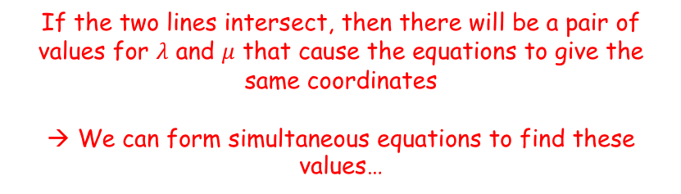


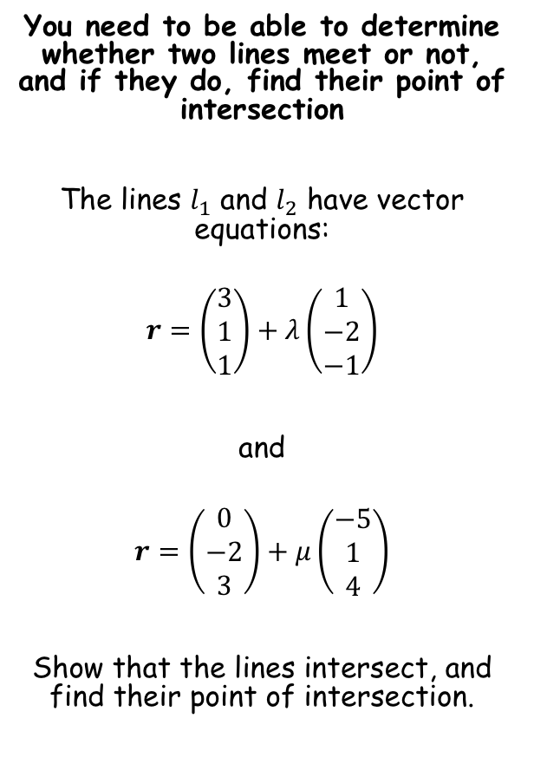






Vectors
You need to be able to determine whether two lines meet or not, and if they do, find their point of intersection
The lines $l_{1}$ and $l_{2}$ have vector equations:
$$r=\left(\begin{matrix}3 \\ 1 \\ 1\end{matrix}\right)+λ\left(\begin{matrix}1 \\ −2 \\ −1\end{matrix}\right)$$
and
$$r=\left(\begin{matrix}0 \\ −2 \\ 3\end{matrix}\right)+μ\left(\begin{matrix}−5 \\ 1 \\ 4\end{matrix}\right)$$
Show that the lines intersect, and find their point of intersection.
If the two lines intersect, then there will be a pair of values for $λ$ and $μ$ that cause the equations to give the same coordinates
→ We can form simultaneous equations to find these values…
$$3+λ=−5μ$$
$$1−2λ=−2+μ$$
$$1−λ=3+4μ$$
Let’s rearrange the first 2…
$$λ+5μ=−3$$
$$μ+2λ=3$$
Solving these gives…
$$λ=2$$
$$μ=−1$$
Sub these into the third equation
$$1−2=3+4(−1)$$
$$−1=−1$$
Since this is true, the lines must intersect…
9E

Slide 3
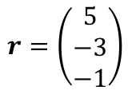

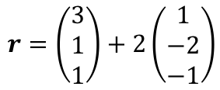
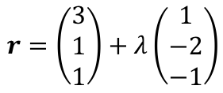




Vectors
You need to be able to determine whether two lines meet or not, and if they do, find their point of intersection
The lines $l_{1}$ and $l_{2}$ have vector equations:
$$r=\left(\begin{matrix}3 \\ 1 \\ 1\end{matrix}\right)+λ\left(\begin{matrix}1 \\ −2 \\ −1\end{matrix}\right)$$
and
$$r=\left(\begin{matrix}0 \\ −2 \\ 3\end{matrix}\right)+μ\left(\begin{matrix}−5 \\ 1 \\ 4\end{matrix}\right)$$
Show that the lines intersect, and find their point of intersection.
To find the point of intersection, you can then substitute either $λ$ or $μ$ into their corresponding equation…
$$r=\left(\begin{matrix}3 \\ 1 \\ 1\end{matrix}\right)+λ\left(\begin{matrix}1 \\ −2 \\ −1\end{matrix}\right)$$
Sub in $λ=2$
$$r=\left(\begin{matrix}3 \\ 1 \\ 1\end{matrix}\right)+2\left(\begin{matrix}1 \\ −2 \\ −1\end{matrix}\right)$$
Calculate
$$r=\left(\begin{matrix}5 \\ −3 \\ −1\end{matrix}\right)$$
So the lines intersect at $(5,−3,−1)$
$$λ=2$$
$$μ=−1$$
9E

Slide 4
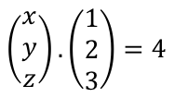
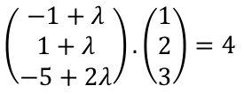
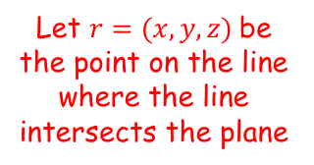
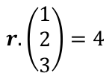

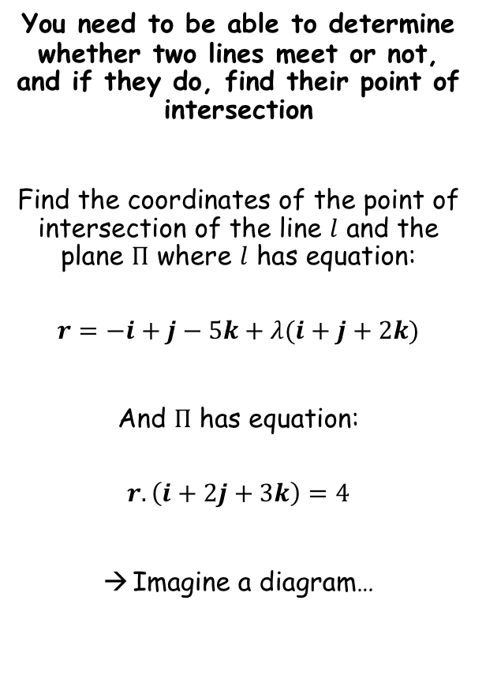
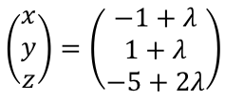
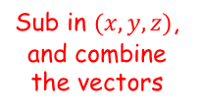
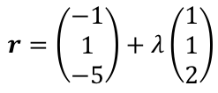




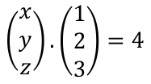
Vectors
$$l$$
You need to be able to determine whether two lines meet or not, and if they do, find their point of intersection
Find the coordinates of the point of intersection of the line $l$ and the plane $Π$ where $l$ has equation:
$$r=−i+j−5k+λ(i+j+2k)$$
And $Π$ has equation:
$$r.\left(i+2j+3k\right)=4$$
Imagine a diagram…
Let $r=(x,y,z)$be the point on the line where the line intersects the plane
$$Π$$
$$\left(x,y,z\right)$$
For the line
For the plane
$$r=\left(\begin{matrix}−1 \\ 1 \\ −5\end{matrix}\right)+λ\left(\begin{matrix}1 \\ 1 \\ 2\end{matrix}\right)$$
$$r.\left(\begin{matrix}1 \\ 2 \\ 3\end{matrix}\right)=4$$
Sub in $(x,y,z)$, and combine the vectors
Sub in $(x,y,z)$
$$\left(\begin{matrix}x \\ y \\ z\end{matrix}\right)=\left(\begin{matrix}−1+λ \\ 1+λ \\ −5+2λ\end{matrix}\right)$$
$$\left(\begin{matrix}x \\ y \\ z\end{matrix}\right).\left(\begin{matrix}1 \\ 2 \\ 3\end{matrix}\right)=4$$
We can therefore substitute the expression from the line, into the expression for the plane…
$$\left(\begin{matrix}x \\ y \\ z\end{matrix}\right).\left(\begin{matrix}1 \\ 2 \\ 3\end{matrix}\right)=4$$
Sub in the vector for $(x,y,z)$
$$\left(\begin{matrix}−1+λ \\ 1+λ \\ −5+2λ\end{matrix}\right).\left(\begin{matrix}1 \\ 2 \\ 3\end{matrix}\right)=4$$
9E

Slide 5

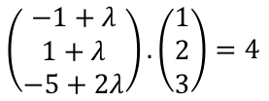








Vectors
$$r=\left(\begin{matrix}−1 \\ 1 \\ −5\end{matrix}\right)+λ\left(\begin{matrix}1 \\ 1 \\ 2\end{matrix}\right)$$
$$l$$
You need to be able to determine whether two lines meet or not, and if they do, find their point of intersection
Find the coordinates of the point of intersection of the line $l$ and the plane $Π$ where $l$ has equation:
$$r=−i+j−5k+λ(i+j+2k)$$
And $Π$ has equation:
$$r.\left(i+2j+3k\right)=4$$
Imagine a diagram…
Let $r=(x,y,z)$be the point on the line where the line intersects the plane
$$Π$$
$$r.\left(\begin{matrix}1 \\ 2 \\ 3\end{matrix}\right)=4$$
$$\left(x,y,z\right)$$
$$\left(\begin{matrix}−1+λ \\ 1+λ \\ −5+2λ\end{matrix}\right).\left(\begin{matrix}1 \\ 2 \\ 3\end{matrix}\right)=4$$
Write the dot product
$$\left(−1+λ\right)\left(1\right)+\left(1+λ\right)\left(2\right)+(−5+2λ)(3)=4$$
Simplify
$$9λ−14=4$$
Calculate
$$λ=2$$
Substitute this into the equation for the line…
$$r=\left(\begin{matrix}−1 \\ 1 \\ −5\end{matrix}\right)+λ\left(\begin{matrix}1 \\ 1 \\ 2\end{matrix}\right)$$
Sub in $λ=2$
$$r=\left(\begin{matrix}1 \\ 3 \\ −1\end{matrix}\right)$$
So the line intersects the plane at $(1,3,−1)$
$$r=\left(\begin{matrix}−1 \\ 1 \\ −5\end{matrix}\right)+2\left(\begin{matrix}1 \\ 1 \\ 2\end{matrix}\right)$$
9E

Slide 6

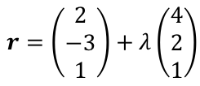

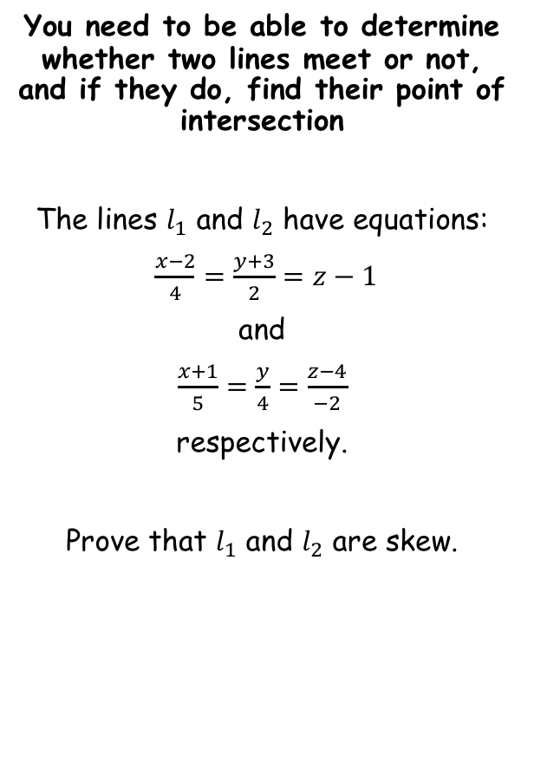



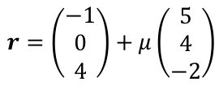

Vectors
$$\frac{x−a_{1}}{b_{1}}=\frac{y−a_{2}}{b_{2}}=\frac{z−a_{3}}{b_{3}}$$
$$r=\left(\begin{matrix}a_{1} \\ a_{2} \\ a_{3}\end{matrix}\right)+λ\left(\begin{matrix}b_{1} \\ b_{2} \\ b_{3}\end{matrix}\right)$$
We need to compare the direction vectors to show that they are not parallel.
We also need to show that the lines do not intersect
Writing the lines as vector equations can help with this…
You need to be able to determine whether two lines meet or not, and if they do, find their point of intersection
The lines $l_{1}$ and $l_{2}$ have equations:
$\frac{x−2}{4}=\frac{y+3}{2}=z−1$
and
$\frac{x+1}{5}=\frac{y}{4}=\frac{z−4}{−2}$
respectively.
Prove that $l_{1}$ and $l_{2}$ are skew.
For $l_{1}$
For $l_{2}$
$$r=\left(\begin{matrix}2 \\ −3 \\ 1\end{matrix}\right)+λ\left(\begin{matrix}4 \\ 2 \\ 1\end{matrix}\right)$$
$$r=\left(\begin{matrix}−1 \\ 0 \\ 4\end{matrix}\right)+μ\left(\begin{matrix}5 \\ 4 \\ −2\end{matrix}\right)$$
Compare the direction vectors…
$$\left(\begin{matrix}4 \\ 2 \\ 1\end{matrix}\right)$$
$$\left(\begin{matrix}5 \\ 4 \\ −2\end{matrix}\right)$$
and
As these are not scalar multiples of one another, the two lines are not parallel
Lines which are ‘skew’ are not parallel, and do not intersect…
9E

Slide 7






Vectors
$$\frac{x−a_{1}}{b_{1}}=\frac{y−a_{2}}{b_{2}}=\frac{z−a_{3}}{b_{3}}$$
$$r=\left(\begin{matrix}a_{1} \\ a_{2} \\ a_{3}\end{matrix}\right)+λ\left(\begin{matrix}b_{1} \\ b_{2} \\ b_{3}\end{matrix}\right)$$
We need to compare the direction vectors to show that they are not parallel.
We also need to show that the lines do not intersect
Writing the lines as vector equations can help with this…
You need to be able to determine whether two lines meet or not, and if they do, find their point of intersection
The lines $l_{1}$ and $l_{2}$ have equations:
$\frac{x−2}{4}=\frac{y+3}{2}=z−1$
and
$\frac{x+1}{5}=\frac{y}{4}=\frac{z−4}{−2}$
respectively.
Prove that $l_{1}$ and $l_{2}$ are skew.
For $l_{1}$
For $l_{2}$
$$r=\left(\begin{matrix}2 \\ −3 \\ 1\end{matrix}\right)+λ\left(\begin{matrix}4 \\ 2 \\ 1\end{matrix}\right)$$
$$r=\left(\begin{matrix}−1 \\ 0 \\ 4\end{matrix}\right)+μ\left(\begin{matrix}5 \\ 4 \\ −2\end{matrix}\right)$$
Form and solve simultaneous equations using $λ$ and $μ$.
$$2+4λ=−1+5μ$$
$$−3+2λ=4μ$$
$$1+λ=4−2μ$$
Not parallel
Solving the first pair gives $λ=−4.5$ and $μ=−3$
$$1+λ=4−2μ$$
Sub values into the 3rd equation
Lines which are ‘skew’ are not parallel, and do not intersect…
$$1+(−4.5)=4−2(−3)$$
Calculate
$$−3.5=10$$
So the lines do not intersect, and hence, they are skew.
9E

Slide 8
Exercise 9E
Pearson Pure Mathematics Year 1/AS
Pages 3-5
Complete before the lesson Q1-3
In Class:
Green Q4-6
Amber Q7-8
Red Q9-11

