Slide 1
Year 1 Pure Mathematics
Algebraic Methods
- Algebraic Long Division
Chapter 7
(Part 2 of 4)

Slide 2
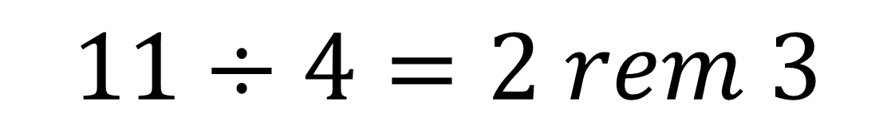
Algebraic Long Division
$$11÷4=2 rem 3$$
dividend
quotient
divisor
remainder

Slide 3
Algebraic Long Division
3
8 .
11
4 2 3 . 0 0 0 0
3 3
1. We found how many whole number of times (i.e. the quotient) the divisor went into the dividend.
9 3
8 8
5 0
2. We multiplied the quotient by the dividend.
3. …in order to find the remainder.
4. Find we ‘brought down’ the next number.

Slide 4
Algebraic Long Division
How to do algebraic long division :
https://www.examsolutions.net/tutorials/algebraic-long-division/?level=AS&board=Edexcel&module=Pure%20Maths%20AS&topic=1064

Slide 5
Exercise 7B
Pearson Pure Mathematics Year 1/AS
Pages 141-142
Complete before the lesson Q1-3 a-d only
Green Q7-10
Amber Q11-14
Red Q15-19

Slide 6
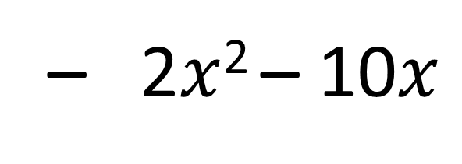
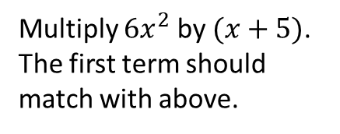
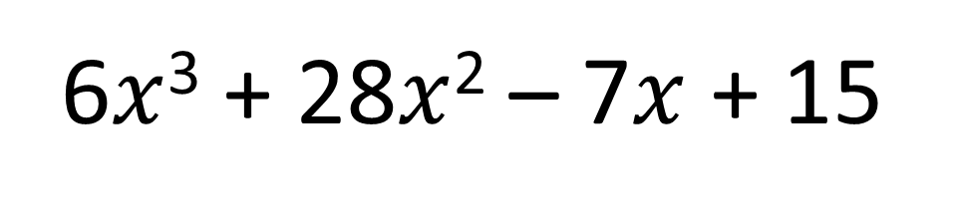
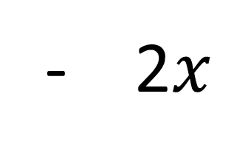

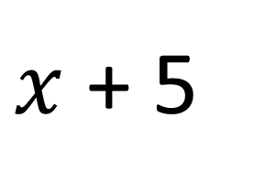
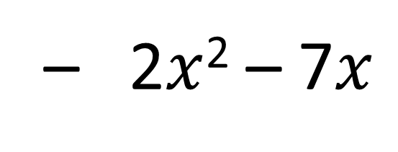
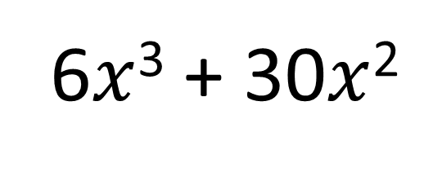
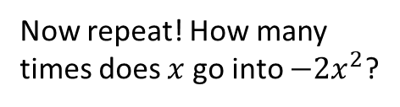
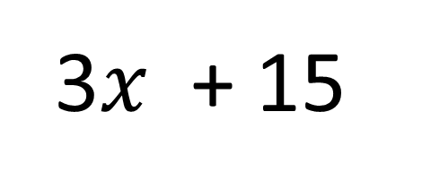
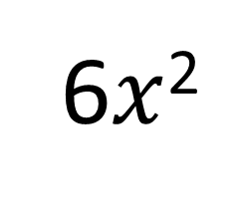
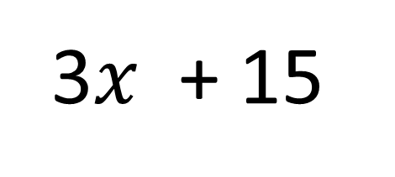
How many times does $x$ go into $6x^{3}$?
Now repeat! How many times does $x$ go into $−2x^{2}$?
6$x$²
- 2$x$
+ 3
$x$ + 5
6$x$³ + 28$x$² – 7$x$ + 15
6$x$³ + 30$x$²
Subtract and carry down next term.
Multiply $6x^{2}$ by $(x+5)$. The first term should match with above.
– 2$x$² – 7$x$
– 2$x$² – 10$x$
3$x$ + 15
3$x$ + 15
This is the remainder.
0

Slide 7
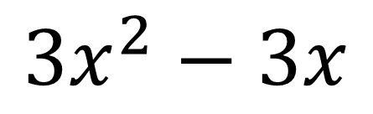

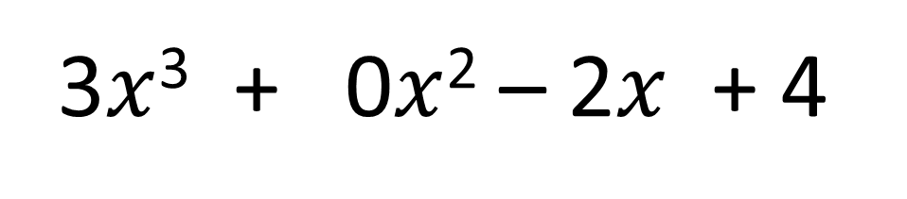
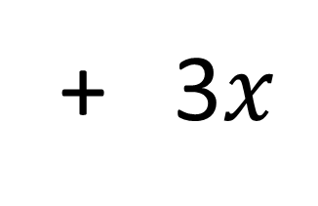
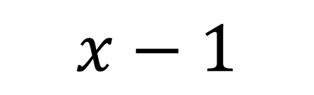
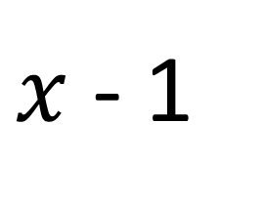
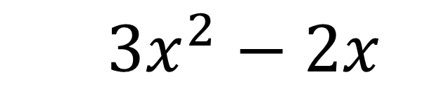
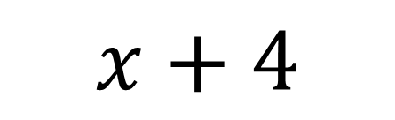
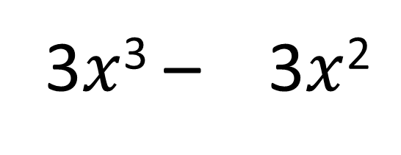
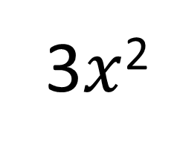
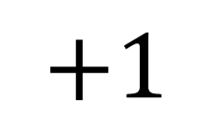
Algebraic Long Division
Find the remainder when $3x^{3}−2x+4$ is divided by $x−1$.
3$x$²
+ 3$x$
$$+1$$
$x$ - 1
3$x$³ + 0$x$² – 2$x$ + 4
3$x$³ – 3$x$²
$3x^{2}−2x$
$$3x^{2}−3x$$
$$x+4$$
$$x−1$$
$$5$$
The remainder is 5.

Slide 8
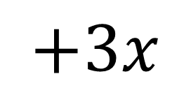
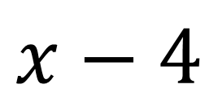
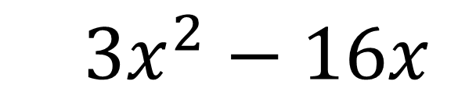
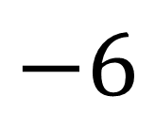
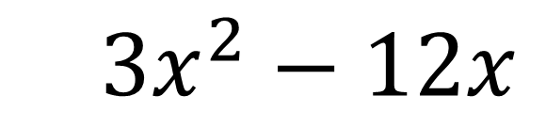
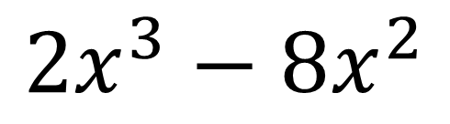
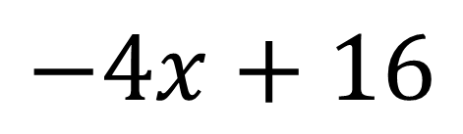
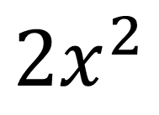
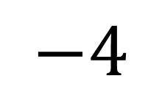
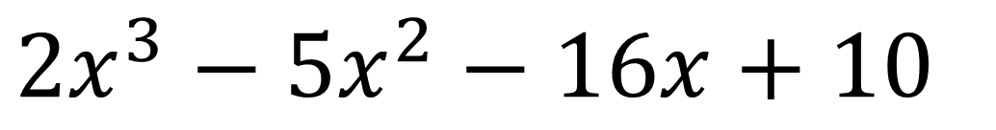
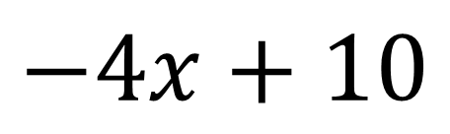
Algebraic Long Division
Find the remainder when $2x^{3}−5x^{2}−16x+10$ is divided by $x−4$.
$$2x^{2}$$
$$+3x$$
$$−4$$
$$x−4$$
$$2x^{3}−5x^{2}−16x+10$$
$$2x^{3}−8x^{2}$$
$3x^{2}−16x$
$3x^{2}−12x$
$$−4x+10$$
$$−4x+16$$
$$−6$$
The remainder is -6.

Slide 9
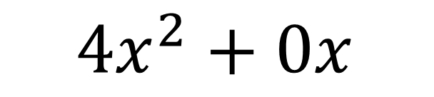
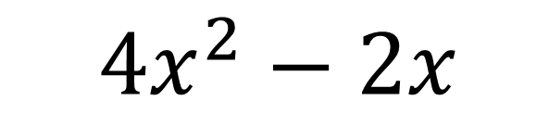
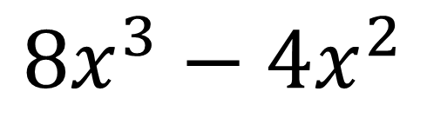
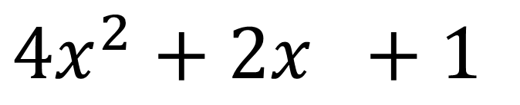
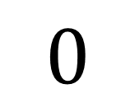
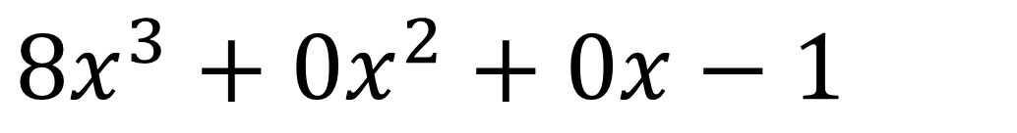
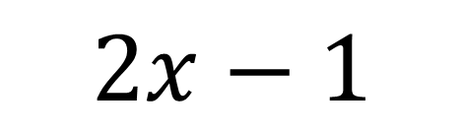
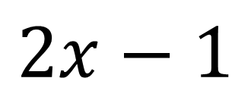
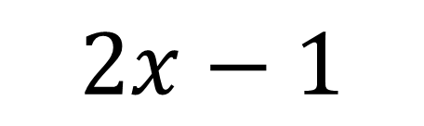
Algebraic Long Division
Divide $8x^{3}−1$ by $2x−1$.
$$4x^{2}+2x +1$$
$$2x−1$$
$$8x^{3}+0x^{2}+0x−1$$
$$8x^{3}−4x^{2}$$
$4x^{2}+0x$
$4x^{2}−2x$
$$2x−1$$
$$2x−1$$
$$0$$

Slide 10
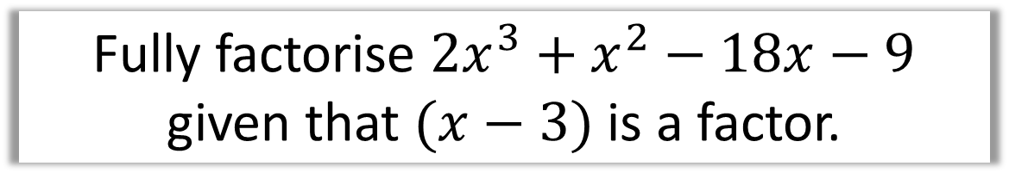
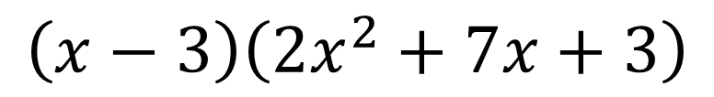
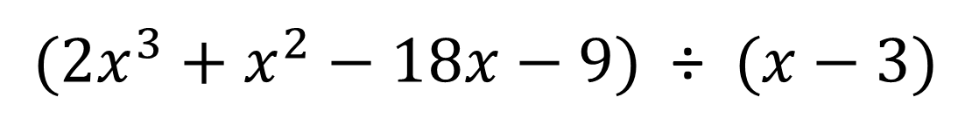
Fully Factorise
Fully factorise $2x^{3}+x^{2}−18x−9$
given that $(x−3)$ is a factor.
$(2x^{3}+x^{2}−18x−9)$ ÷$(x−3)$
Use long division to get:
$$\left(x−3\right)\left(2x^{2}+7x+3\right)$$
Factorise the quadratic:
$$=(x−3)(2x+1)(x+3)$$

