Slide 1
Year 2 Pure Mathematics
Trig Functions
- Prove and Equations
Chapter 6
(Part 2 of 5)

Slide 2
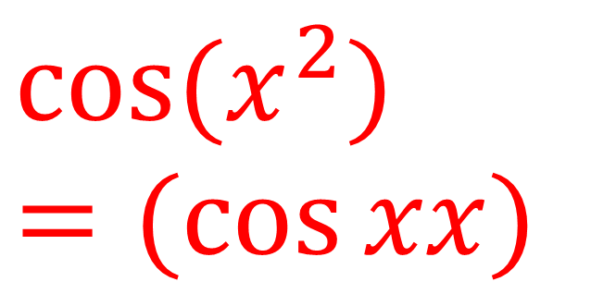
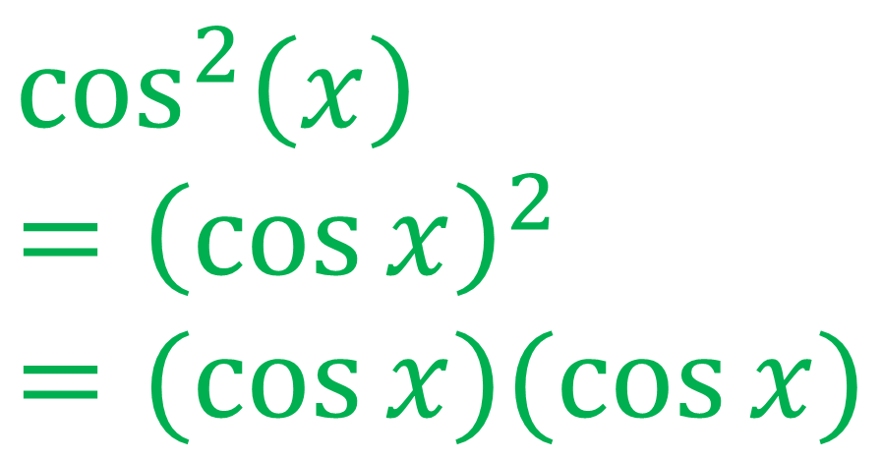
Trigonometric Functions - Reciprocal
Notation to be aware of:
$$\cos^{2}\left(x\right)$$
$$={\left(\cos{x}\right)}^{2}$$
$$=(\cos{x)(\cos{x)}}$$
$$\cos{(x^{2})}$$
$$=(\cos{xx)}$$

Slide 3
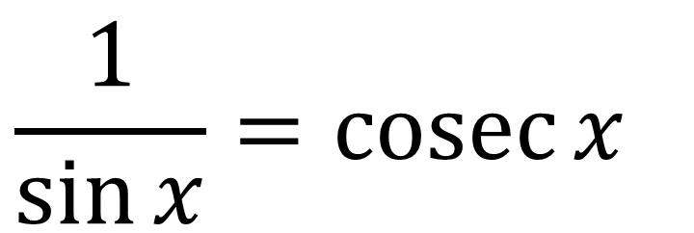
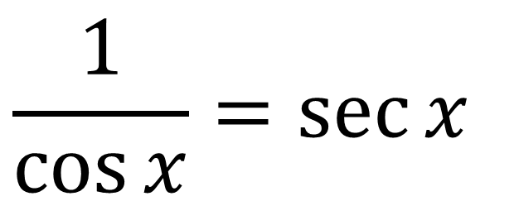
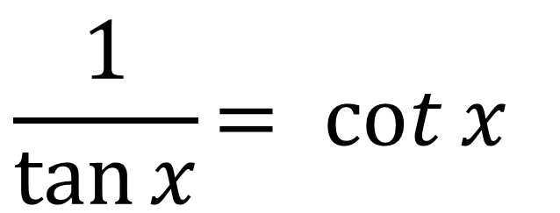
Trigonometric Functions - Reciprocal
$$\frac{1}{\cos{x}}=\sec{x}$$
$$\frac{1}{\sin{x}}=\operatorname{cosec}{x}$$
$$\frac{1}{\tan{x}}= cot{x}$$

Slide 4
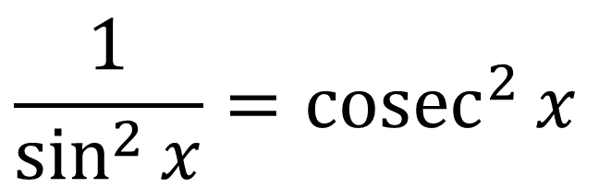
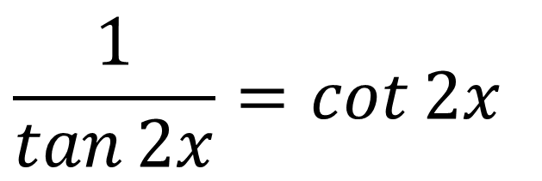
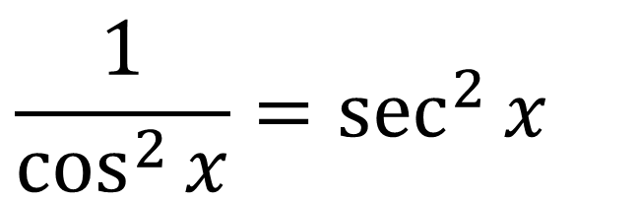
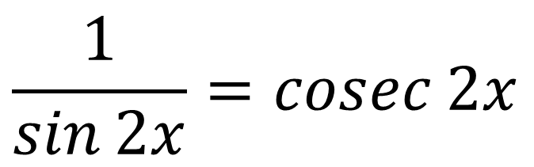
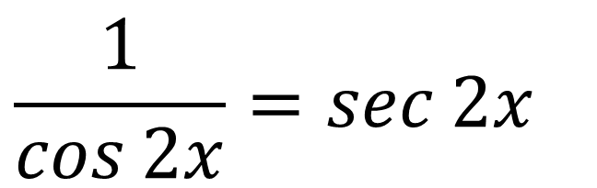
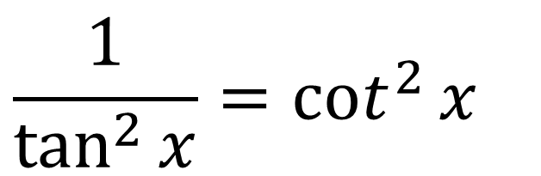
Trigonometric Functions - Reciprocal
$$\frac{1}{\cos^{2}{x}}=\sec^{2}{x}$$
$$\frac{1}{\cos{2x}}=\sec{2x}$$
$$\frac{1}{\sin^{2}{x}}={cosec}^{2}{x}$$
$$\frac{1}{\sin{2x}}=\operatorname{cosec}{2x}$$
$$\frac{1}{\tan^{2}{x}}=\cot^{2}{x}$$
$$\frac{1}{\tan{2x}}=\cot{2x}$$

Slide 5
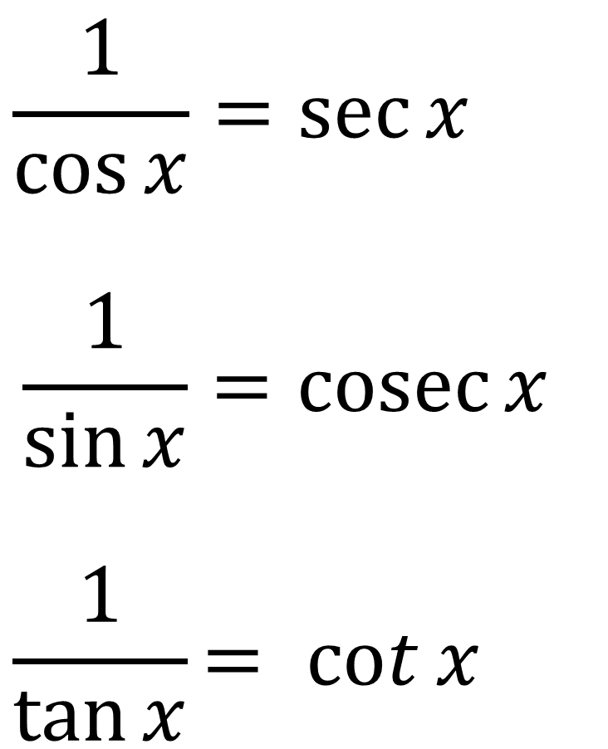
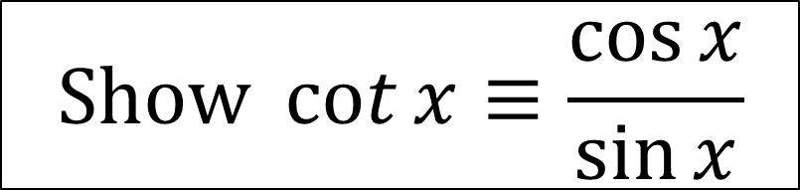
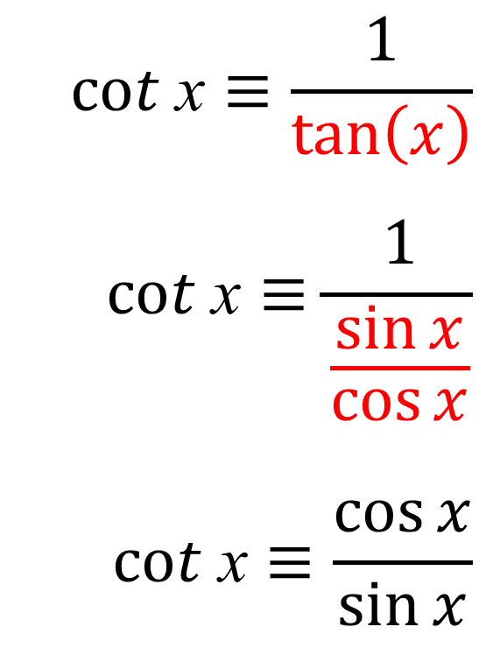
Trigonometric Functions - Reciprocal
$$Show\cot{x≡\frac{\cos{x}}{\sin{x}}}$$
$$cot \text{x}≡\frac{1}{\tan\left(x\right)}$$
$$cot \text{x}≡\frac{1}{\frac{\sin{x}}{\cos{x}}}$$
$$cot \text{x}≡\frac{\cos{x}}{\sin{x}}$$

Slide 6
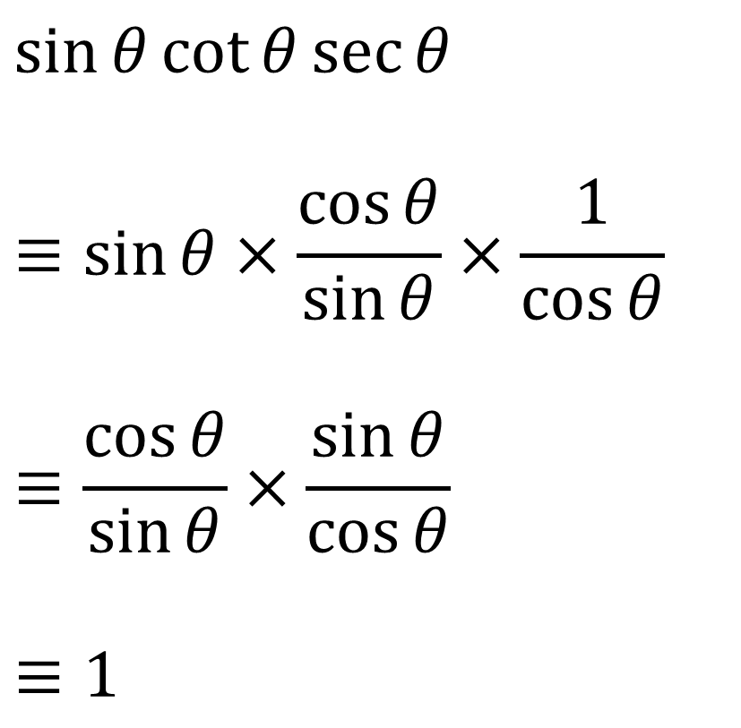
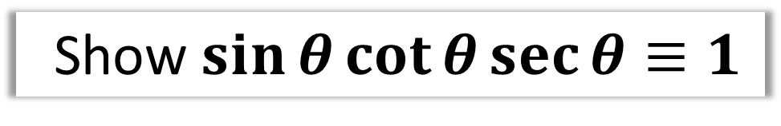
Using $sec,cosec,cot$
Show $\sin{θ}\cot{θ}\sec{θ}≡1$
$$\sin{θ}\cot{θ}\sec{θ}$$
$$≡\sin{θ}×\frac{\cos{θ}}{\sin{θ}}×\frac{1}{\cos{θ}}$$
$$≡\frac{\cos{θ}}{\sin{θ}}×\frac{\sin{θ}}{\cos{θ}}$$
$$≡1$$

Slide 7
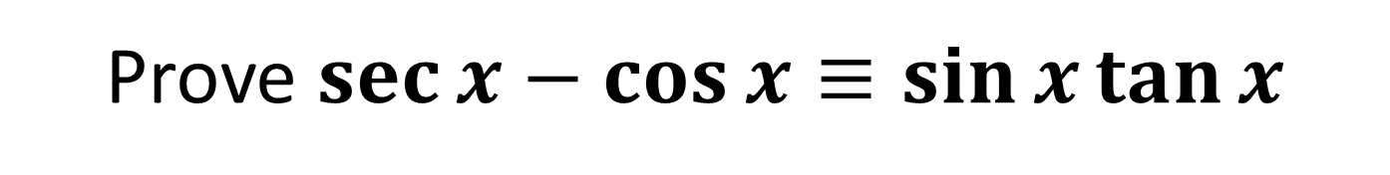
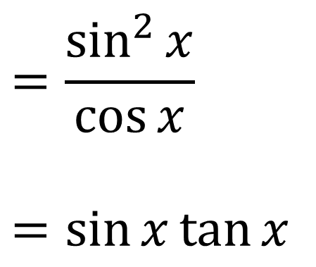
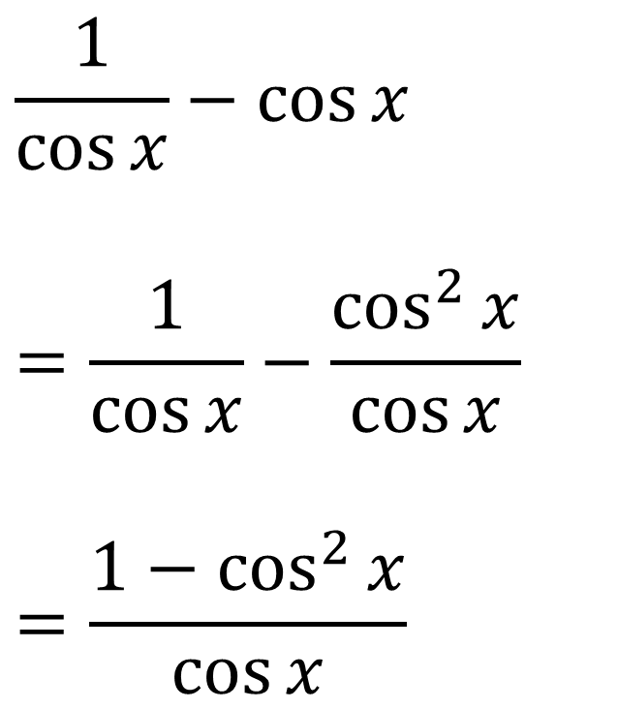
Using $sec,cosec,cot$
Prove $\sec{x}−\cos{x}≡\sin{x}\tan{x}$
$$\frac{1}{\cos{x}}−\cos{x}$$
$$=\frac{1}{\cos{x}}−\frac{\cos^{2}{x}}{\cos{x}}$$
$$=\frac{1−\cos^{2}{x}}{\cos{x}}$$
$$=\frac{\sin^{2}{x}}{\cos{x}}$$
$$=\sin{x}\tan{x}$$

Slide 8
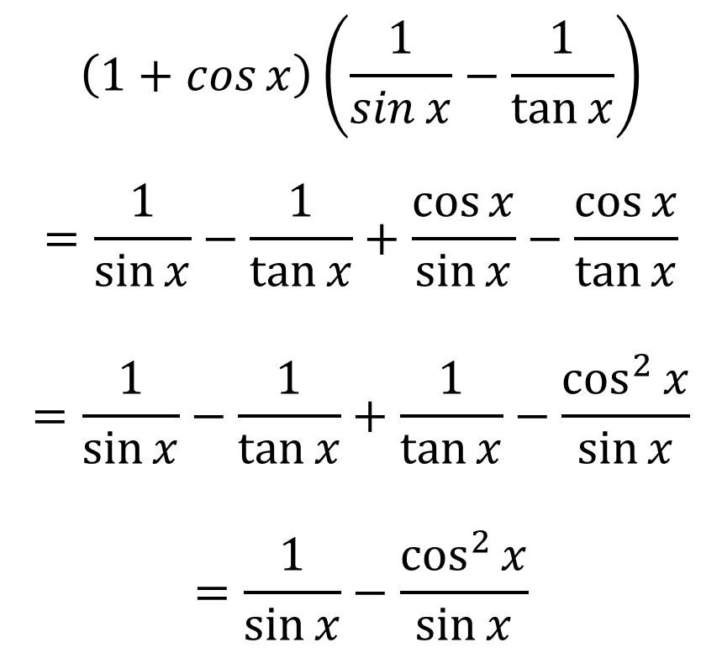
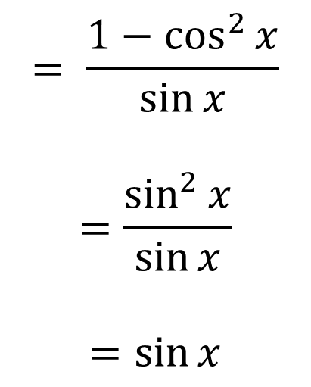
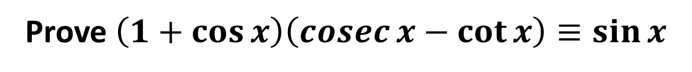
Using $sec,cosec,cot$
Prove $\left(1+\cos{x}\right)\left(\operatorname{cosec}{x}−\cot{x}\right)≡\sin{x}$
$$\left(1+\cos{x}\right)\left(\frac{1}{\sin{x}}−\frac{1}{\tan{x}}\right)$$
$$=\frac{1}{\sin{x}}−\frac{1}{\tan{x}}+\frac{\cos{x}}{\sin{x}}−\frac{\cos{x}}{\tan{x}}$$
$$=\frac{1}{\sin{x}}−\frac{1}{\tan{x}}+\frac{1}{\tan{x}}−\frac{\cos^{2}{x}}{\sin{x}}$$
$$=\frac{1}{\sin{x}}−\frac{\cos^{2}{x}}{\sin{x}}$$
$$= \frac{1−\cos^{2}{x}}{\sin{x}}$$
$$=\frac{\sin^{2}{x}}{\sin{x}}$$
$$=\sin{x}$$

Slide 9
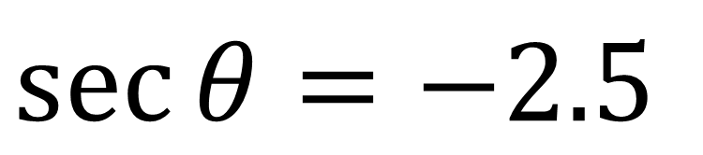
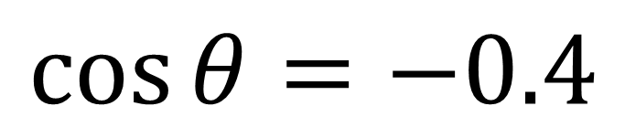
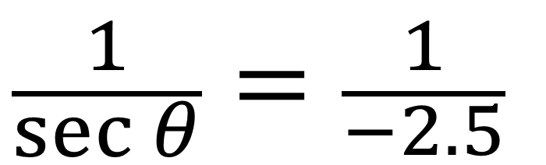
Solving Equations $sec,cosec,cot$
When asked to solve equations involving sec, cosec, cot
you need to look to write the equation in terms of sin, cos or tan.
$$\sec{θ}=−2.5$$
$$\frac{1}{\sec{θ}}=\frac{1}{−2.5}$$
$$\cos{θ}=−0.4$$

Slide 10
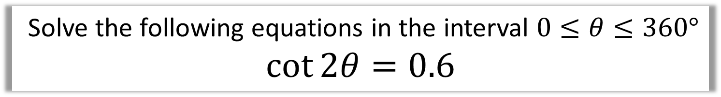
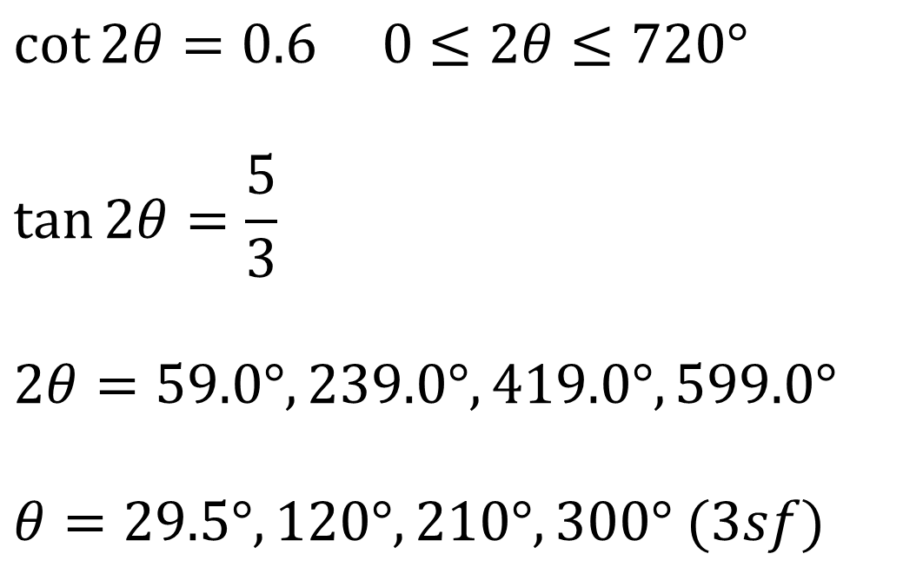
Solving Equations $sec,cosec,cot$
Solve the following equations in the interval $0≤θ≤360°$
$$\cot{2θ}=0.6$$
$$\cot{2θ}=0.6 0≤2θ≤720°$$
$$\tan{2θ}=\frac{5}{3}$$
$$2θ=59.0°, 239.0°, 419.0°, 599.0°$$
$$θ=29.5°, 120°, 210°, 300° (3sf)$$

Slide 11
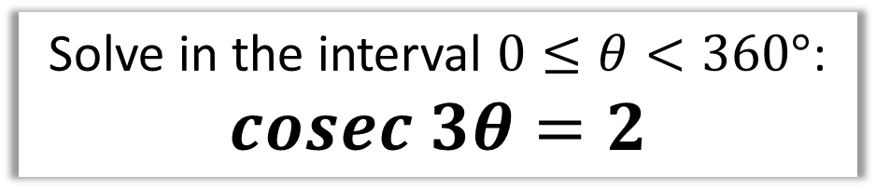
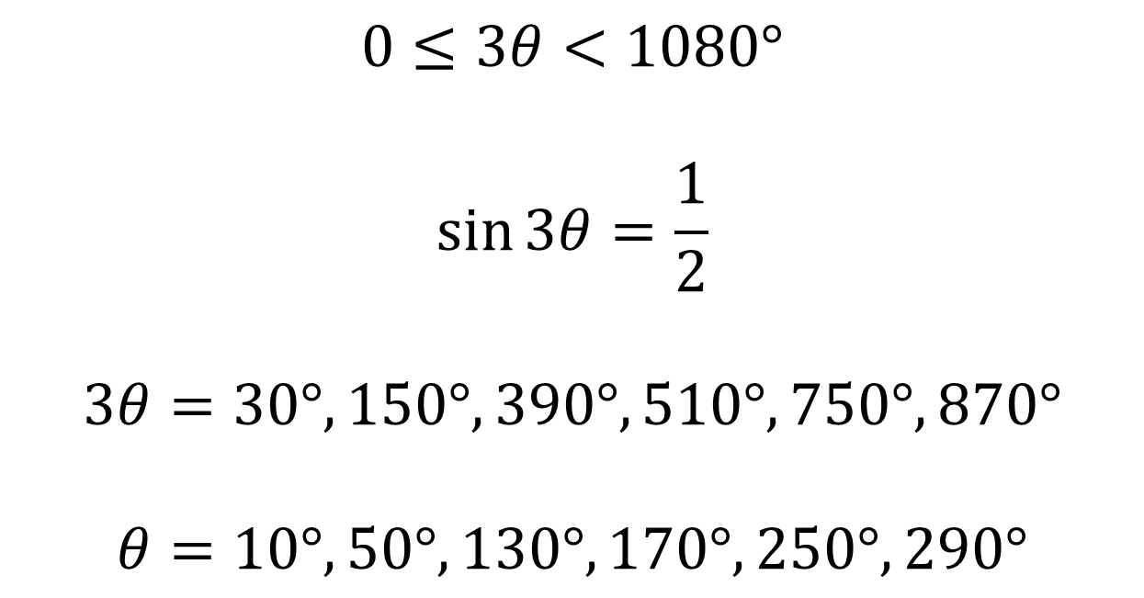
Solving Equations $sec,cosec,cot$
Solve in the interval $0≤θ<360°$:
$$cosec 3θ=2$$
$$0≤3θ<1080°$$
$$\sin{3θ}=\frac{1}{2}$$
$$3θ=30°, 150°, 390°, 510°,750°, 870°$$
$$θ=10°, 50°,130°, 170°,250°,290°$$

Slide 12
Exercises 6C
Pearson Pure Mathematics Year 2/AS
Page 152
Complete before the lesson Q1-3
In Class:
Green Q4-7
Amber Q8
Red Q9-11

