Slide 1
Year 1 Pure Mathematics
Trigonometric Identities
and Equations
- Trigonometric Identities
Chapter 10
(Part 3 of 4)

Slide 2
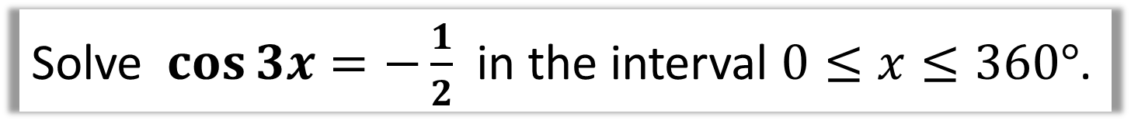
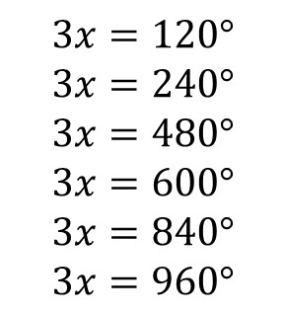
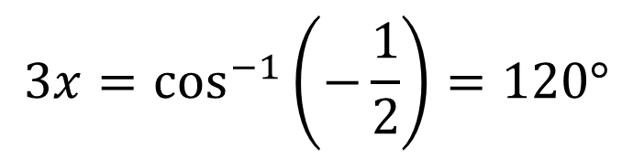

Harder Trigonometric Equations
Solve $\cos{3x=−\frac{1}{2}}$ in the interval $0≤x≤360°$.
STEP 1: Adjust the range to match
$$0≤3x≤1080°$$
STEP 2: Solve for 3x
BEFORE dividing by 3
find all solutions in the interval.
$$3x=\cos^{−1}\left(−\frac{1}{2}\right)=120°$$
$$3x=120°$$
$$3x=240°$$
$$3x=480°$$
$$3x=600°$$
$$3x=840°$$
$$3x=960°$$
STEP 3: Dividing by 3 to find x
$$x=40°,80°,160°,200°,280°,320°$$

Slide 3
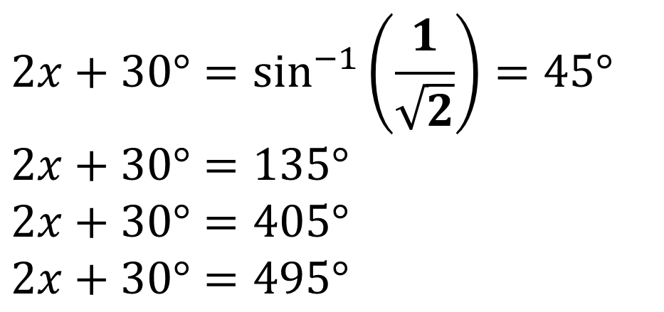

Harder Trigonometric Equations
Solve $\sin{(2x+30°)=\frac{1}{\sqrt{2}}}$ in the interval $0≤x≤360°$
$$30≤2x+30≤750°$$
$$2x+30°=\sin^{−1}\left(\frac{1}{\sqrt{2}}\right)=45°$$
$$2x+30°=135°$$
$$2x+30°=405°$$
$$2x+30°=495°$$
$$x=7.5°,52.5°,187.5°,232.5°$$

Slide 4
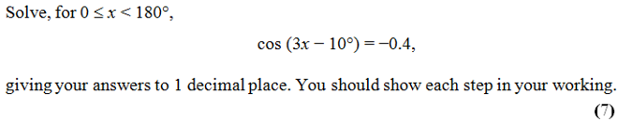
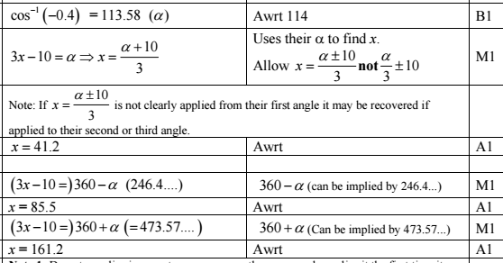
Harder Trigonometric Equations

Slide 5

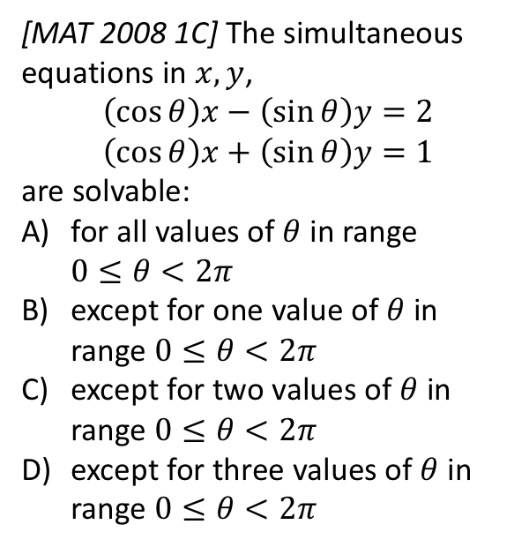
Exercise 10C
Complete before the lesson Q1-3
Amber Q4-5
Red Q6-12
Pearson Pure Mathematics
Page 211-212
Extension:
?
For convenience let $s=\sin{θ}$ and $c=\cos{θ}$. As we’d usually do for simultaneous equations, we could make coefficients of $x$ terms the same:
$$scx−s^{2}y=2s \\ scx+c^{2}y=c$$
Then subtracting:
$$\left(s^{2}+c^{2}\right)y=c−2s \\ ∴y=c−2s$$
Similarly making $y$ terms the same, we yield $x=2c+s$
$x,y$ are defined for every value of $θ$, so the answer is (A). Why might it have not been (A)? Suppose $x=\frac{2\cos{θ}+sinθ}{sin θ}$. This would not be defined whenever $sin θ=0$.
[MAT 2008 1C] The simultaneous equations in $x,y$,
$$\left(\cos{θ}\right)x−\left(\sin{θ}\right)y=2 \\ \left(\cos{θ}\right)x+\left(\sin{θ}\right)y=1$$
are solvable:
for all values of $θ$ in range
$0≤θ<2π$
except for one value of $θ$ in range $0≤θ<2π$
except for two values of $θ$ in range $0≤θ<2π$
except for three values of $θ$ in range $0≤θ<2π$

Slide 6
Exercise 10E
Pearson Pure Mathematics Year 1/AS
Page 218-219
Complete before the lesson Q1-2
Amber Q3-5
Red Q6-7 &Challenge

