Slide 1
Methods in
Differential Equations
Twitter: @Owen134866
www.mathsfreeresourcelibrary.com

Slide 2
Teachings for
Exercise 7B

Slide 3
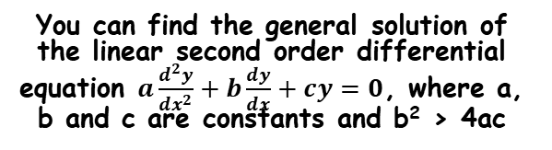
Methods in Differential Equations
You can find the general solution of the linear second order differential equation $a\frac{d^{2}y}{{dx}^{2}}+b\frac{dy}{dx}+cy=0$, where a, b and c are constants and b² > 4ac
Second order differential equations will contain a second derivative
When set equal to 0, like this, they are know as ‘non-homogenous’
7B

Slide 4





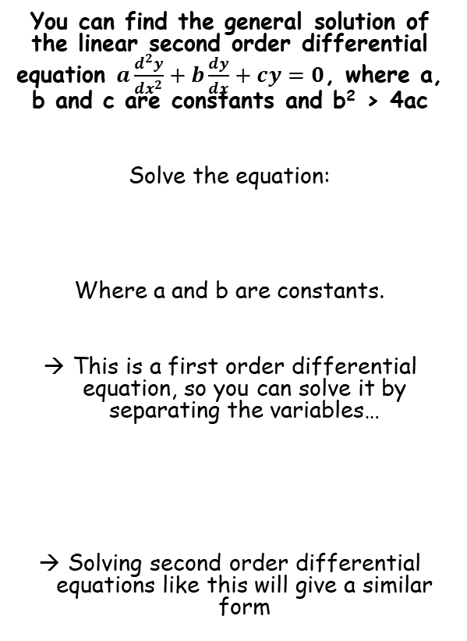





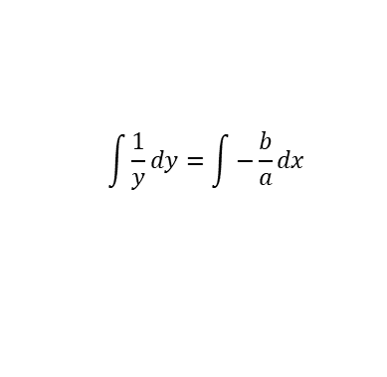

Methods in Differential Equations
$$a\frac{dy}{dx}+by=0$$
You can find the general solution of the linear second order differential equation $a\frac{d^{2}y}{{dx}^{2}}+b\frac{dy}{dx}+cy=0$, where a, b and c are constants and b² > 4ac
Solve the equation:
Where a and b are constants.
This is a first order differential equation, so you can solve it by separating the variables…
Solving second order differential equations like this will give a similar form
Divide all by a
$$\frac{dy}{dx}+\frac{b}{a}y=0$$
Divide all by y
$$\frac{1}{y}\frac{dy}{dx}+\frac{b}{a}=0$$
Subtract ^{b}/_{a}
$$a\frac{dy}{dx}+by=0$$
$$\frac{1}{y}\frac{dy}{dx}=−\frac{b}{a}$$
Multiply by dx (now the variables are separated)
$$\frac{1}{y}dy=−\frac{b}{a}dx$$
Integrate each side
$$\int{\frac{1}{y}dy}=\int{−\frac{b}{a}dx }$$
Calculate the Integrals, using lnA to represent the constant
$$lny=−\frac{b}{a}x+lnA$$
$$y=Ae^{−\frac{b}{a}x }$$
Exponentials of each side
$$y=e^{−\frac{b}{a}x+lnA}$$
You can think of the powers of e as a multiplication
$$y=e^{lnA}e^{−\frac{b}{a}x }$$
$$y=Ae^{−\frac{b}{a}x }$$
e^{lnA} = A as they cancel out
7B

Slide 5

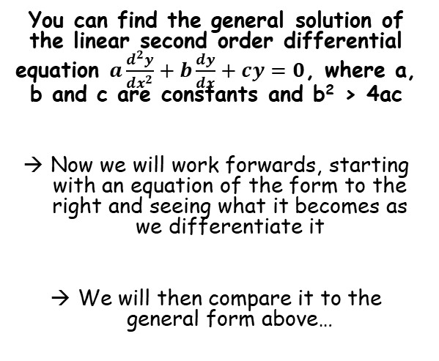

Methods in Differential Equations
$$a\frac{dy}{dx}+by=0$$
$$y=Ae^{−\frac{b}{a}x }$$
You can find the general solution of the linear second order differential equation $a\frac{d^{2}y}{{dx}^{2}}+b\frac{dy}{dx}+cy=0$, where a, b and c are constants and b² > 4ac
Now we will work forwards, starting with an equation of the form to the right and seeing what it becomes as we differentiate it
We will then compare it to the general form above…
As the solution to the first order differential equation looks like this, it implies that the second order differential will take a similar form
(because we would essentially solve it in a similar way)
7B

Slide 6



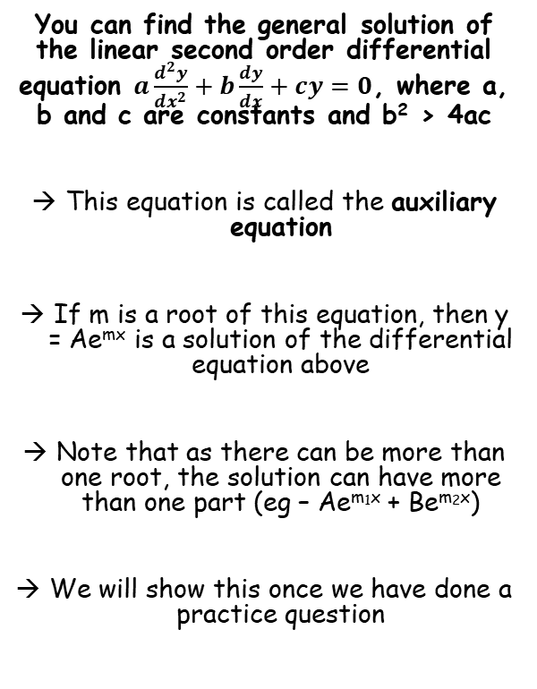






Methods in Differential Equations
You can find the general solution of the linear second order differential equation $a\frac{d^{2}y}{{dx}^{2}}+b\frac{dy}{dx}+cy=0$, where a, b and c are constants and b² > 4ac
This equation is called the auxiliary equation
If m is a root of this equation, then y = Ae^{mx} is a solution of the differential equation above
Note that as there can be more than one root, the solution can have more than one part (eg – Ae^{m1x} + Be^{m2x})
We will show this once we have done a practice question
$$y=Ae^{mx}$$
Differentiate (for e you differentiate the power and multiply by that)
$$\frac{dy}{dx}=Ame^{mx}$$
Differentiate again
$$\frac{d^{2}y}{dx^{2}}=Am^{2}e^{mx}$$
Now we can replace these in the equation to the left:
$$a\frac{d^{2}y}{{dx}^{2}}+b\frac{dy}{dx}+cy=0$$
Replace each part based on the above
$$aAm^{2}e^{mx}+$$
$$bAme^{mx}+$$
$$cAe^{mx}=0$$
Factorise as Ae^{mx} is a factor of all terms
$${Ae}^{mx}\left(am^{2}+bm+c\right)=0$$
e^{mx} must be greater than 0, so the bracket must be 0
$$am^{2}+bm+c=0$$
7B

Slide 7





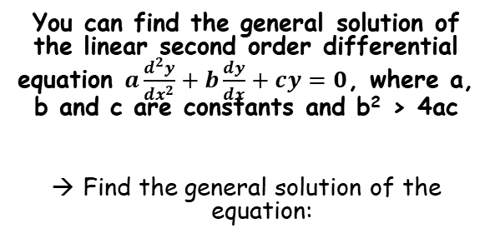







Methods in Differential Equations
$$a\frac{d^{2}y}{{dx}^{2}}+b\frac{dy}{dx}+cy=0$$
$${am}^{2}+bm+c=0$$
$$Ae^{m_{1}x}+Be^{m_{2}x}$$
If 2 real roots
You can find the general solution of the linear second order differential equation $a\frac{d^{2}y}{{dx}^{2}}+b\frac{dy}{dx}+cy=0$, where a, b and c are constants and b² > 4ac
Find the general solution of the equation:
$$\frac{d^{2}y}{{dx}^{2}}−7\frac{dy}{dx}+12y=0$$
Form the auxiliary equation
$$m^{2}−7m+12=0$$
Factorise it
$$(m−3)(m−4)=0$$
Solve
$$\frac{d^{2}y}{{dx}^{2}}−7\frac{dy}{dx}+12y=0$$
$$m=3 or 4$$
Now we can substitute the roots into the form above
$$y=Ae^{3x}+Be^{4x}$$
$$Ae^{m_{1}x}+Be^{m_{2}x}$$
m₁ = 3 and m₂ = 4
At this point we do not have enough information to work out the values of A and B (they are equivalent to the +C you get when integrating!)
$$Ae^{3x}+Be^{4x}$$
$$y=Ae^{3x}+Be^{4x}$$
7B

Slide 8




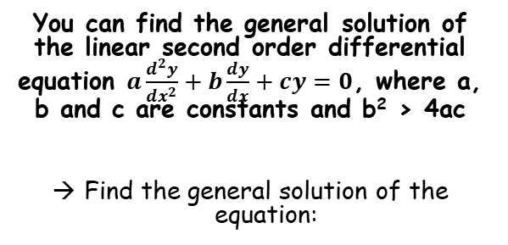







Methods in Differential Equations
$$a\frac{d^{2}y}{{dx}^{2}}+b\frac{dy}{dx}+cy=0$$
$${am}^{2}+bm+c=0$$
$$Ae^{m_{1}x}+Be^{m_{2}x}$$
If 2 real roots
You can find the general solution of the linear second order differential equation $a\frac{d^{2}y}{{dx}^{2}}+b\frac{dy}{dx}+cy=0$, where a, b and c are constants and b² > 4ac
Find the general solution of the equation:
$$y=Ae^{3x}+Be^{4x}$$
Differentiate
$$\frac{dy}{dx}=3Ae^{3x}+4Be^{4x}$$
Differentiate again
$$\frac{d^{2}y}{{dx}^{2}}=9Ae^{3x}+16Be^{4x}$$
$$\frac{d^{2}y}{{dx}^{2}}−7\frac{dy}{dx}+12y=0$$
$$\frac{d^{2}y}{{dx}^{2}}−7\frac{dy}{dx}+12y=0$$
Replace the differentials
$$\left(9Ae^{3x}+16Be^{4x}\right)$$
$$− 7\left(3Ae^{3x}+4Be^{4x}\right)$$
$$+ 12\left(Ae^{3x}+Be^{4x}\right)=0$$
Multiply out brackets
$$y=Ae^{3x}+Be^{4x}$$
$$9Ae^{3x}+16Be^{4x}$$
$$− 21Ae^{3x}−28Be^{4x}$$
$$+ 12Ae^{3x}+12Be^{4x}=0$$
All the terms cancel out!
Now to show this works, we will start with y and differentiate it
We can now substitute these into the equation above to show it will give us 0
$$0=0$$
So you can see that the form of our answers solves the differential equation we started with!
7B

Slide 9








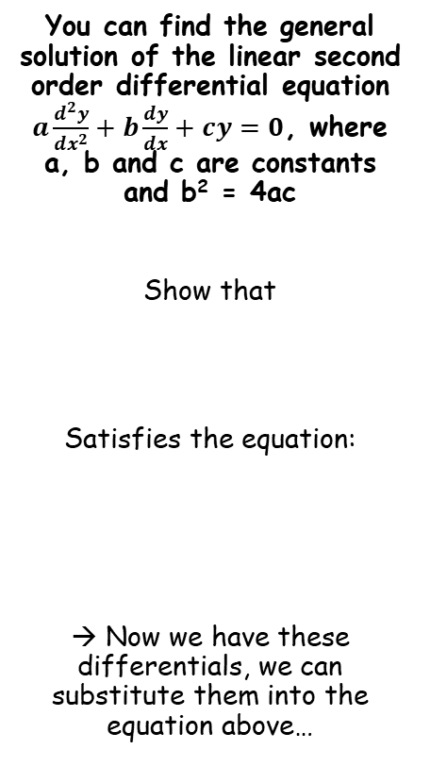














Methods in Differential Equations
$$y=(A+Bx)e^{3x}$$
You can find the general solution of the linear second order differential equation $a\frac{d^{2}y}{{dx}^{2}}+b\frac{dy}{dx}+cy=0$, where a, b and c are constants and b² = 4ac
Show that
Satisfies the equation:
→ Now we have these differentials, we can substitute them into the equation above…
Multiply out the bracket
$$y=Ae^{3x}+Bxe^{3x}$$
Differentiate – the second term needs the product rule…
$$\frac{dy}{dx}=$$
$$3Ae^{3x}$$
$$+ 3Bxe^{3x}$$
$$+ Be^{3x}$$
Differentiate again, using the product rule where needed
$$\frac{d^{2}y}{{dx}^{2}}=$$
$$9Ae^{3x}$$
$$+ 9Bxe^{3x}$$
$$+ 3Be^{3x}$$
$$+ 3Be^{3x}$$
$$\frac{d^{2}y}{{dx}^{2}}=$$
Simplify
$$y=(A+Bx)e^{3x}$$
$$9Ae^{3x}$$
$$+ 9Bxe^{3x}$$
$$+ 6Be^{3x}$$
Product rule for 3Bxe^{3x}
$$\frac{d^{2}y}{{dx}^{2}}−6\frac{dy}{dx}+9y=0$$
Product rule for Bxe^{3x}
$$u=Bx$$
$$v=e^{3x}$$
$$u=3Bx$$
$$v=e^{3x}$$
$$\frac{du}{dx}=B$$
$$\frac{dv}{dx}=3e^{3x}$$
$$\frac{du}{dx}=3B$$
$$\frac{dv}{dx}=3e^{3x}$$
7B

Slide 10












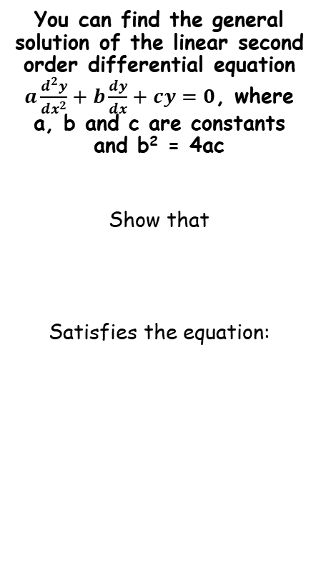


Methods in Differential Equations
$$\frac{dy}{dx}=$$
$$3Ae^{3x}$$
$$+ 3Bxe^{3x}$$
$$+ Be^{3x}$$
$$y=Ae^{3x}+Bxe^{3x}$$
You can find the general solution of the linear second order differential equation $a\frac{d^{2}y}{{dx}^{2}}+b\frac{dy}{dx}+cy=0$, where a, b and c are constants and b² = 4ac
Show that
Satisfies the equation:
$$\frac{d^{2}y}{{dx}^{2}}=$$
$$9Ae^{3x}$$
$$+ 9Bxe^{3x}$$
$$+ 6Be^{3x}$$
$$\frac{d^{2}y}{{dx}^{2}}−6\frac{dy}{dx}+9y=0$$
Replace the differentials
$$\left(9Ae^{3x}+9Bxe^{3x}+6Be^{3x}\right)$$
$$− 6\left(3Ae^{3x}+3Bxe^{3x}+Be^{3x}\right)$$
$$+ 9\left(Ae^{3x}+Bxe^{3x}\right)=0$$
$$y=(A+Bx)e^{3x}$$
Multiply out the brackets
$$9Ae^{3x}+9Bxe^{3x}+6Be^{3x}$$
$$− 18Ae^{3x}−18Bxe^{3x}−6Be^{3x}$$
$$+ 9Ae^{3x}+9Bxe^{3x}=0$$
All terms cancel out
$$\frac{d^{2}y}{{dx}^{2}}−6\frac{dy}{dx}+9y=0$$
$$0=0$$
So y = (A + Bx)e^{3x} satisfies the stated equation!
7B

Slide 11





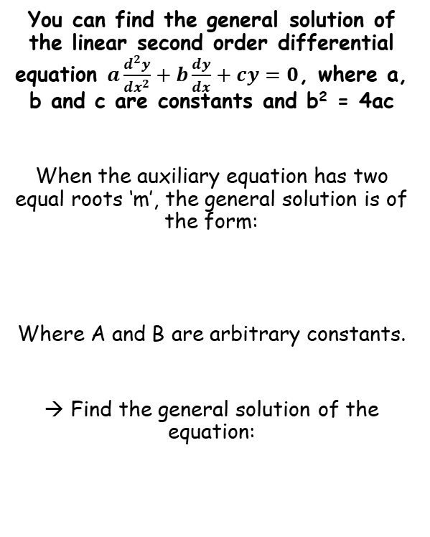





Methods in Differential Equations
$$a\frac{d^{2}y}{{dx}^{2}}+b\frac{dy}{dx}+cy=0$$
$${am}^{2}+bm+c=0$$
$$\left(A+Bx\right)e^{mx}$$
If repeated roots
You can find the general solution of the linear second order differential equation $a\frac{d^{2}y}{{dx}^{2}}+b\frac{dy}{dx}+cy=0$, where a, b and c are constants and b² = 4ac
When the auxiliary equation has two equal roots ‘m’, the general solution is of the form:
Where A and B are arbitrary constants.
→ Find the general solution of the equation:
$$\frac{d^{2}y}{{dx}^{2}}+8\frac{dy}{dx}+16y=0$$
Form the auxiliary equation
$$m^{2}+8m+16=0$$
Factorise
$${\left(m+4\right)}^{2}=0$$
Solve
$$m=−4$$
$$y=\left(A+Bx\right)e^{mx}$$
Now we can substitute the root into the form above:
$$\left(A+Bx\right)e^{mx}$$
m = -4
$$\left(A+Bx\right)e^{−4x}$$
$$\frac{d^{2}y}{{dx}^{2}}+8\frac{dy}{dx}+16y=0$$
$$y=\left(A+Bx\right)e^{−4x}$$
7B

Slide 12







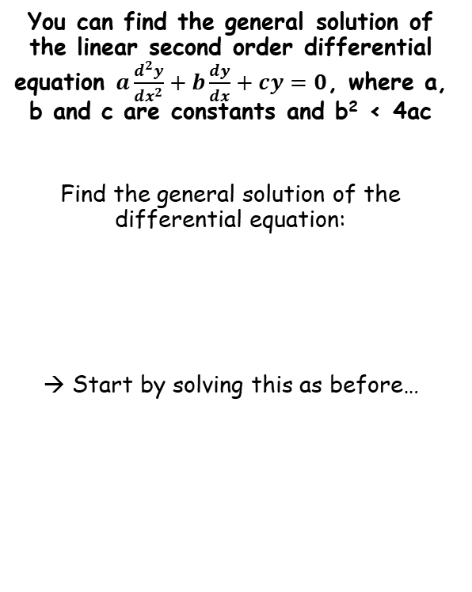






Methods in Differential Equations
$$a\frac{d^{2}y}{{dx}^{2}}+b\frac{dy}{dx}+cy=0$$
$${am}^{2}+bm+c=0$$
$$Ae^{m_{1}x}+Be^{m_{2}x}$$
If 2 roots
$$\frac{d^{2}y}{dx^{2}}+16y=0$$
You can find the general solution of the linear second order differential equation $a\frac{d^{2}y}{{dx}^{2}}+b\frac{dy}{dx}+cy=0$, where a, b and c are constants and b² < 4ac
Find the general solution of the differential equation:
→ Start by solving this as before…
Form the auxiliary equation
$$m^{2}+16=0$$
Subtract 16
$$m^{2}=−16$$
Square root both sides
$$m=±\sqrt{−16}$$
√-16 = √16√-1 = ±4i
$$m=±4i$$
$$\frac{d^{2}y}{dx^{2}}+16y=0$$
Now we can substitute the roots into the form above:
$$Ae^{m_{1}x}+Be^{m_{2}x}$$
Replace m₁ and m₂
$$Ae^{4ix}+Be^{−4ix}$$
From chapter 3, e^{nix} = (cos(nx) + isin(nx))
$$A(cos4x+isin4x)$$
$$+ B(\cos\left(−4x\right)+isin\left(−4x\right))$$
The second can be rewritten as a subtraction
$$A(cos4x+isin4x)$$
$$+ B(\cos{4x}−isin4x)$$
Group up terms in cos and sin
$$\left(A+B\right)cos4x+i\left(A−B\right)sin4x$$
(A + B) and i(A – B) are just constants and can be represented with different letters (you could actually use just A and B as well if you went straight to the solution)
$$Pcos4x+Qsin4x$$
7B
5C

Slide 13

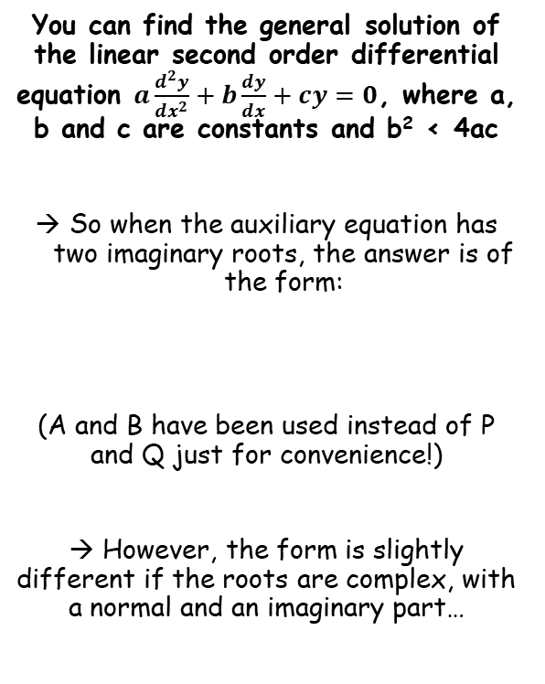
Methods in Differential Equations
$$a\frac{d^{2}y}{{dx}^{2}}+b\frac{dy}{dx}+cy=0$$
$${am}^{2}+bm+c=0$$
$$Ae^{m_{1}x}+Be^{m_{2}x}$$
If 2 roots
You can find the general solution of the linear second order differential equation $a\frac{d^{2}y}{{dx}^{2}}+b\frac{dy}{dx}+cy=0$, where a, b and c are constants and b² < 4ac
So when the auxiliary equation has two imaginary roots, the answer is of the form:
(A and B have been used instead of P and Q just for convenience!)
→ However, the form is slightly different if the roots are complex, with a normal and an imaginary part…
$$Acosmx+Bsinmx$$
7B

Slide 14



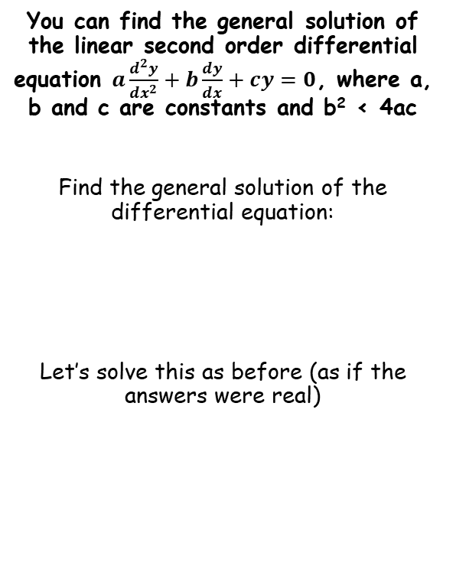





Methods in Differential Equations
$$a\frac{d^{2}y}{{dx}^{2}}+b\frac{dy}{dx}+cy=0$$
$${am}^{2}+bm+c=0$$
$$Ae^{m_{1}x}+Be^{m_{2}x}$$
If 2 roots
$$\frac{d^{2}y}{{dx}^{2}}−6\frac{dy}{dx}+34y=0$$
You can find the general solution of the linear second order differential equation $a\frac{d^{2}y}{{dx}^{2}}+b\frac{dy}{dx}+cy=0$, where a, b and c are constants and b² < 4ac
Find the general solution of the differential equation:
Let’s solve this as before (as if the answers were real)
Form the auxiliary equation
$$m^{2}−6m+34=0$$
Factorise (or use the quadratic formula)
→ Completing the square is often effective in these questions!
$${\left(m−3\right)}^{2}−9+34=0$$
Group terms
$${\left(m−3\right)}^{2}+25=0$$
$$\frac{d^{2}y}{{dx}^{2}}−6\frac{dy}{dx}+34y=0$$
Subtract 25
$${\left(m−3\right)}^{2}=−25$$
Square root
$$m−3=±5i$$
Add 3
$$m=3±5i$$
7B

Slide 15








Methods in Differential Equations
$$a\frac{d^{2}y}{{dx}^{2}}+b\frac{dy}{dx}+cy=0$$
$${am}^{2}+bm+c=0$$
$$Ae^{m_{1}x}+Be^{m_{2}x}$$
If 2 roots
You can find the general solution of the linear second order differential equation $a\frac{d^{2}y}{{dx}^{2}}+b\frac{dy}{dx}+cy=0$, where a, b and c are constants and b² < 4ac
Find the general solution of the differential equation:
Let’s solve this as before (as if the answers were real)
Now we can substitute the roots into the form above:
$$Ae^{m_{1}x}+Be^{m_{2}x}$$
Sub in the two solutions m₁ and m₂
$$Ae^{(3+5i)x}+Be^{(3−5i)x}$$
Think of the powers of e as a multiplication
$$Ae^{3x}e^{5ix}+Be^{3x}e^{−5ix}$$
Factorise as e^{3x} is common to both
$$\frac{d^{2}y}{{dx}^{2}}−6\frac{dy}{dx}+34y=0$$
$$e^{3x}\left(Ae^{5ix}+Be^{−5ix}\right)$$
The part in the bracket can be rewritten as you have just seen
(like in the previous example, we can use new constants to replace the terms we would get through expansion)
$$e^{3x}\left(Pcos5x+Qsin5x\right)$$
$$m=3±5i$$
So if the root is of the form:
$$m=p±qi$$
The solution will be of the form:
(This is the rule to remember (don’t confuse it with the letters in the example above!)
$$e^{px}\left(Acosqx+Bsinqx\right)$$
7B

Slide 16

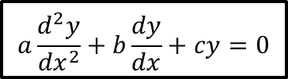



Methods in Differential Equations
A summary of what you have seen up to this point:
$$a\frac{d^{2}y}{{dx}^{2}}+b\frac{dy}{dx}+cy=0$$
$${am}^{2}+bm+c=0$$
Real roots, m₁ and m₂
Imaginary roots, p ± qi
Repeated root, m
$$Ae^{m_{1}x}+Be^{m_{2}x}$$
$$(A+Bx)e^{mx}$$
$$e^{px}\left(Acosqx+Bsinqx\right)$$
If the root is imaginary only, p = 0 hence e^{px} = 1 and will not be included in the answer!
7B

Slide 17
Exercise 7B
Pearson Core Pure Year 2
Pages 156-157
Complete before the lesson Q1
In Class:
Green Q2-4
Amber Q5-7
Red Challenge

