Slide 1
Year 1 Applied Mathematics
Forces and Motions
F = ma
Chapter 10
(Part 1 of 4)

Slide 2

Forces – Horizontal
The particle is moving from left to right on the table.
What forces could be acting on the particle?
acceleration
Reaction Force
Resistance Force
m
Driving Force
Weight (mg)

Slide 3
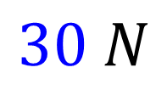
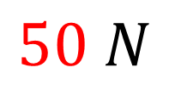

Forces – Horizontal
The ‘resultant force’ is the overall force
acting on the object.
$$30 N$$
$$50 N$$
$$20 N$$

Slide 4
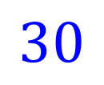
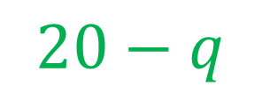
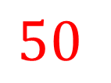
Forces – Horizontal
What is the resultant force acting on the object?
q
$$50$$
$$30$$
$$20−q$$

Slide 5
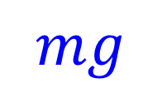
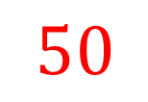

Forces – Vertical
What is the resultant force acting on the object?
$$50$$
$$50 −mg$$
acceleration
m
m
$$mg$$

Slide 6
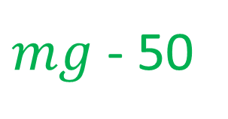
Forces – Vertical
What is the resultant force acting on the object?
$$50$$
acceleration
m
m
$$mg$$
$mg$ - 50

Slide 7
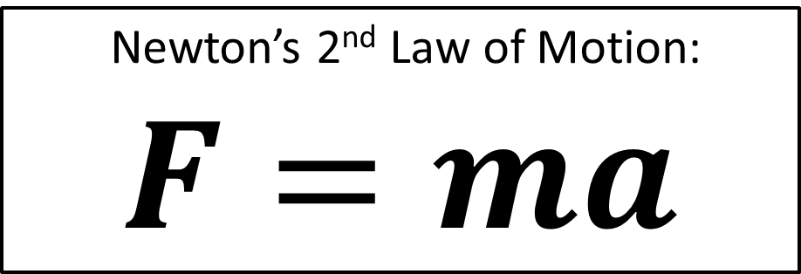
Forces – Newton’s 2nd Law of Motion
Newton’s 2nd Law of Motion:
$F=ma$
F = resultant force
m = mass
a = acceleration
F = Driving Forces – Resistance Forces

Slide 8
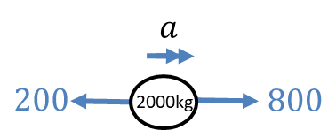
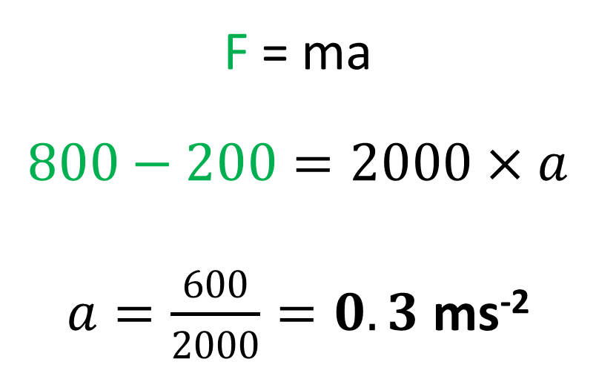
Forces – Newton’s 2nd Law of Motion
A car of 2000kg has a driving force of 800N
and forces of 200N resisting its motion.
Determine its acceleration.
F = ma
$$800−200=2000×a$$
$a=\frac{600}{2000}=0.3$ms⁻²

Slide 9
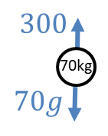
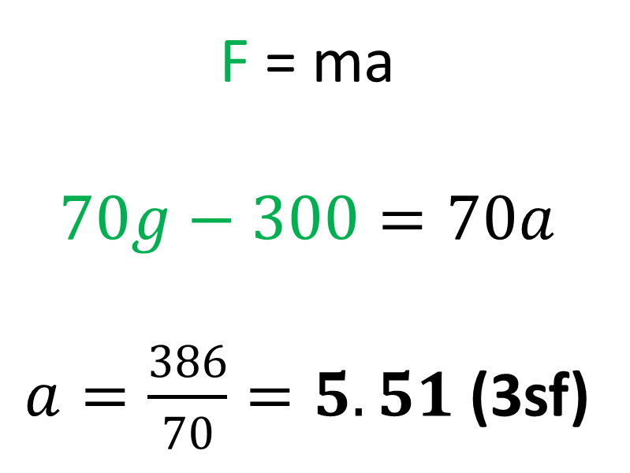
Forces – Newton’s 2nd Law of Motion
A falling rock of mass 70kg experiences air resistance of 300 N. Determine the rocks’s acceleration as it plummets towards the ground.
F = ma
$$70g−300=70a$$
$a=\frac{386}{70}=5.51$(3sf)

Slide 10
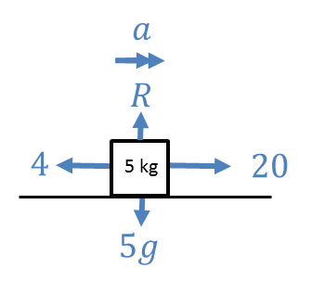
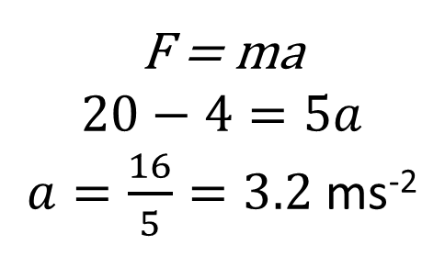
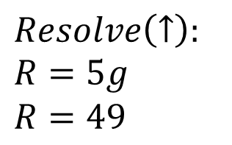
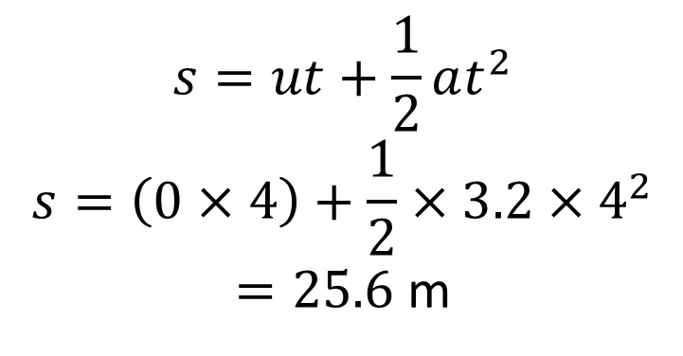
Forces - Combining $F=ma$ with $suvat$ equations
A body of mass 5kg is pulled along a rough horizontal table by a horizontal force of magnitude 20N against a constant friction force of magnitude 4N.
Given that the body is initially at rest, find:
the acceleration of the body
the distance travelled by the body in the first 4 seconds
the magnitude of the normal reaction between the body and the table
$$s=ut+\frac{1}{2}at^{2} \\ s=\left(0×4\right)+\frac{1}{2}×3.2×4^{2}$$
$=25.6$ m
b
F = ma
$$20−4=5a$$
$a=\frac{16}{5}=3.2$ ms⁻²
a
c
$$Resolve\left(↑\right):$$
$$R=5g$$
$R=49$

Slide 11
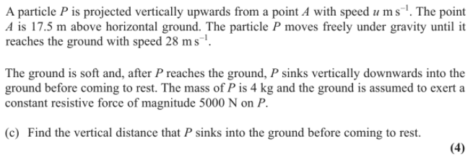
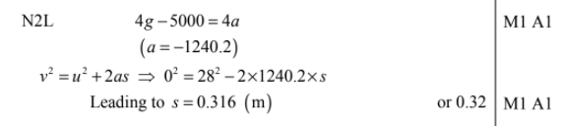
Forces - Combining $F=ma$ with $suvat$ equations

Slide 12
Exercise 10A
Pearson Stats/Mechanics Year 1
Pages 158-159
Complete before the lesson
Q1-5
In Class:
Green Q6-9
Red Q10-14

Slide 13

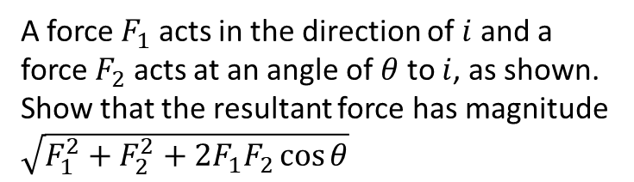



Exercise 10B
Pearson Stats/Mechanics Year 1
Pages 161-162
Extension
A force $F_{1}$ acts in the direction of $i$ and a force $F_{2}$ acts at an angle of $θ$ to $i$, as shown.
Show that the resultant force has magnitude $\sqrt{F_{1}^{2}+F_{2}^{2}+2F_{1}F_{2}\cos{θ}}$
$$F_{2}$$
$$θ$$
$$F_{1}$$
Force vector: $\left(\begin{matrix}F_{1}+F_{2}\cos{θ} \\ F_{2}\sin{θ}\end{matrix}\right)$
Magnitude:
$$\sqrt{{\left(F_{1}+F_{2}cosθ\right)}^{2}+F_{2}^{2}\sin^{2}{θ}} \\ =\sqrt{F_{1}^{2}+2F_{1}F_{2}\cos{θ}+F_{2}^{2}\cos^{2}{θ}+F_{2}^{2}\sin^{2}{θ}} \\ =\sqrt{F_{1}^{2}+2F_{1}F_{2}\cos{θ}+F_{2}^{2}\left(\cos^{2}{θ}+\sin^{2}{θ}\right)} \\ =\sqrt{F_{1}^{2}+F_{2}^{2}+2F_{1}F_{2}\cos{θ}}$$
?
Complete before the lesson
Q1-2
In Class:
Green Q3-5
Amber Q6-7
Red Q8-9 & Challenge

Slide 14
Exercise 10C
Pearson Stats/Mechanics Year 1
Pages 164-166
Complete before the lesson Q1-3
In Class:
Green Q4-7
Amber Q8
Red Q9-11 & Challenge

