Slide 1
Year 2 Applied Mathematics
Projectiles
- Introduction
Chapter 6
(Part 1 of 3)

Slide 2
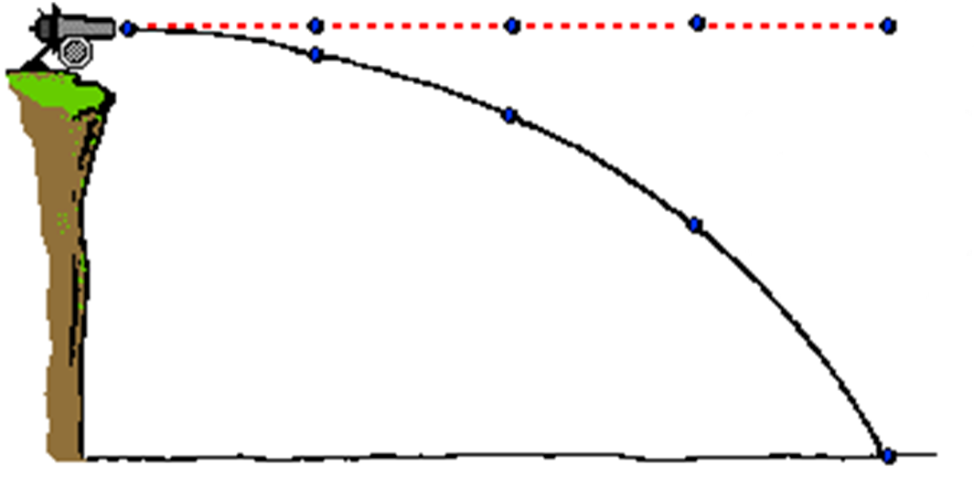
Projectiles
What do the two paths show?
Path if not effected by gravity
Path if effected by gravity

Slide 3
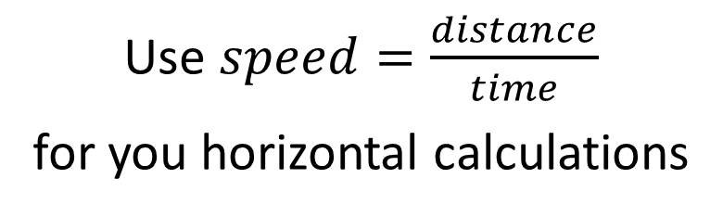
Projectiles
When calculating with projectiles you should split your calculations into vertical and horizontal motion.
Vertical Motion
Horizontal Motion
Acceleration is -9.8 ms⁻²
Constant Velocity
Use SUVAT equations
for your vertical calculations
Acceleration is 0 ms⁻²
Use $speed=\frac{distance}{time}$
for you horizontal calculations

Slide 4
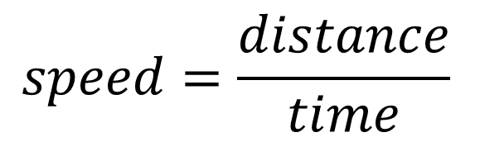
Projectiles
The only value that can be transferred between
the vertical calculations and the horizontal calculations
is time.
Vertical Motion
Horizontal Motion
S = vertical displacement
U_{v} = vertical component of U
V_{v} = vertical component of V
A = -9.8
T = time
Distance = horizontal displacement
Speed = Horizontal component
Time = time
$$speed=\frac{distance}{time}$$

Slide 5
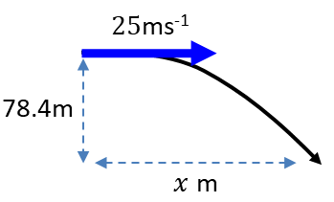
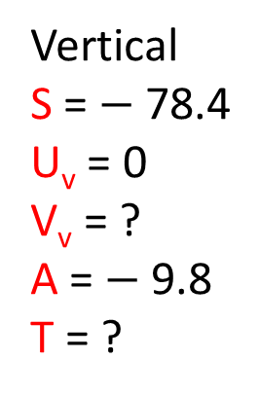
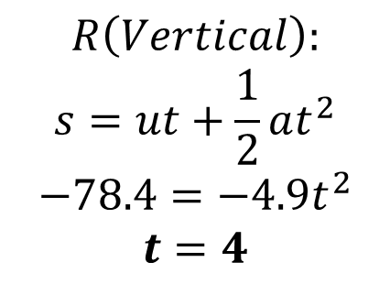
Projectiles
A particle is project horizontally at 25 ms⁻¹ from a point 78.4 metres above a horizontal surface. Find:
the time taken by the particle to reach the surface
Vertical
S = $−$78.4
U_{v} = 0
V_{v} = ?
A = $−$9.8
T = ?
Horizontal
Dis = x
Speed = 25
Time = ?
$$R\left(Vertical\right):$$
$$s=ut+\frac{1}{2}at^{2} \\ −78.4=−4.9t^{2} \\ t=4$$

Slide 6

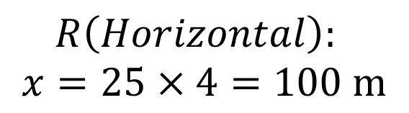
Projectiles
A particle is project horizontally at 25 ms⁻¹ from a point 78.4 metres above a horizontal surface. Find:
(b) the horizontal distance travelled in that time.
Vertical
S = -78.4
U_{v} = 0
V_{v} = ?
A = -9.8
T = 4
Horizontal
Dis = x
Speed = 25 Time = 4
$$R\left(Horizontal\right):$$
$$x=25×4=100 m$$

Slide 7
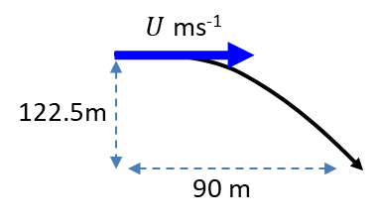
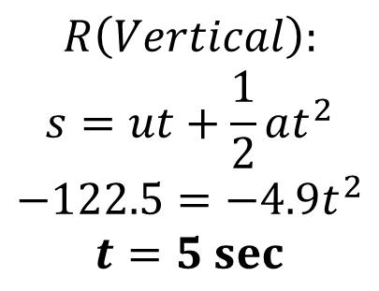
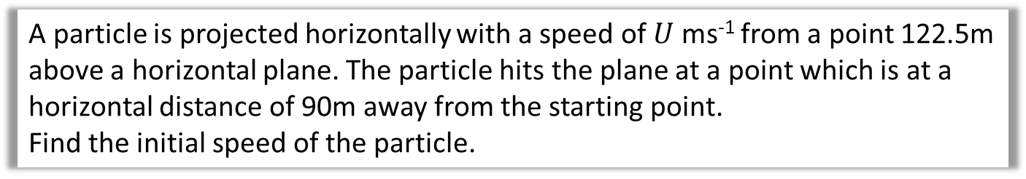
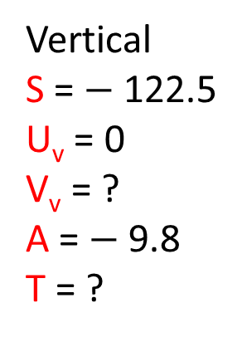
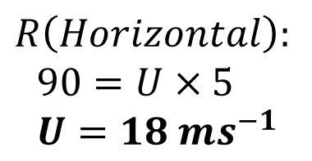
Projectiles
A particle is projected horizontally with a speed of $U$ ms⁻¹ from a point 122.5m above a horizontal plane. The particle hits the plane at a point which is at a horizontal distance of 90m away from the starting point.
Find the initial speed of the particle.
Vertical
S = $−$122.5
U_{v} = 0
V_{v} = ?
A = $−$9.8
T = ?
Horizontal
Dis = x
Speed = U
Time = ?
$$R\left(Vertical\right):$$
$$s=ut+\frac{1}{2}at^{2} \\ −122.5=−4.9t^{2} \\ t=5 sec$$
$$R\left(Horizontal\right):$$
$$90=U×5 \\ U=18 ms^{−1}$$

Slide 8
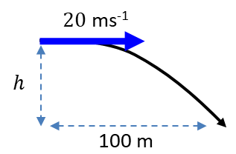
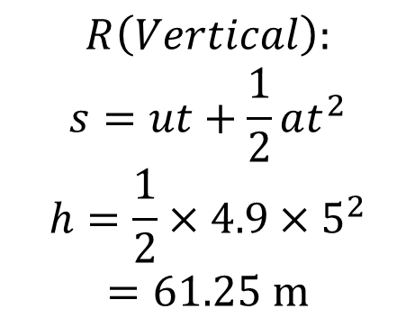
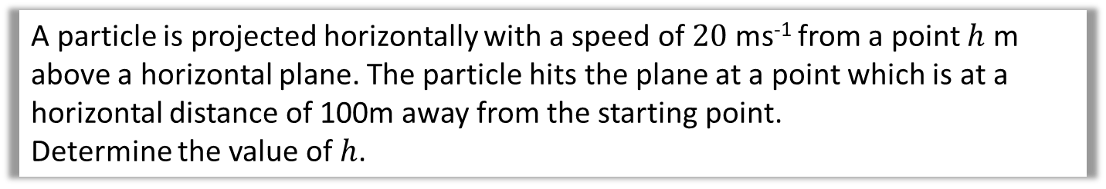
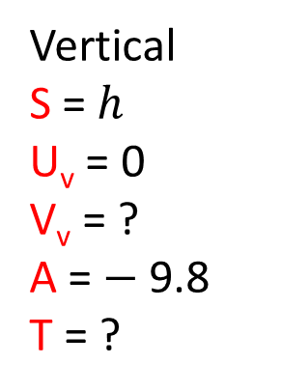
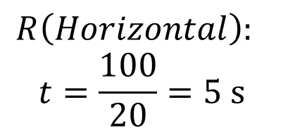
Projectiles
A particle is projected horizontally with a speed of $20$ ms⁻¹ from a point $h$ m above a horizontal plane. The particle hits the plane at a point which is at a horizontal distance of 100m away from the starting point.
Determine the value of $h$.
Horizontal
Dis = 100
Speed = 20
Time = ?
Vertical
S = $h$
U_{v} = 0
V_{v} = ?
A = $−$9.8
T = ?
$$R\left(Horizontal\right):$$
$$t=\frac{100}{20}=5 s$$
$$R\left(Vertical\right):$$
$$s=ut+\frac{1}{2}at^{2} \\ h=\frac{1}{2}×4.9×5^{2} \\ =61.25 m$$

Slide 9
Exercise 6A
Pearson Stats/Mechanics Year 2
Pages 110-111
Complete before the lesson Q1-3
In Class:
Green Q4
Amber Q5
Red Q6-7

