Slide 1
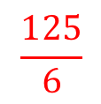


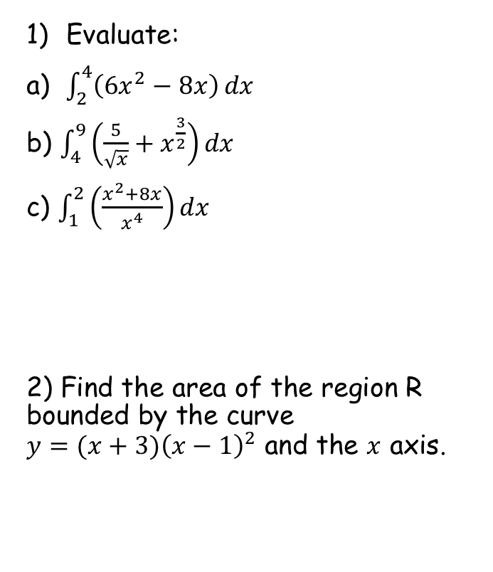



Prior Knowledge Check
Evaluate:
a) $\int_{2}^{4}{\left({6x}^{2}−8x\right)}dx$
b) $\int_{4}^{9}{\left(\frac{5}{\sqrt{x}}+x^{\frac{3}{2}}\right)}dx$
c) $\int_{1}^{2}{\left(\frac{x^{2}+8x}{x^{4}}\right)}dx$
2) Find the area of the region R bounded by the curve $y=(x+3){\left(x−1\right)}^{2}$ and the $x$ axis.
3) Find the area of the finite region bounded by the curve $y=−x^{2}+6x+4$ and the line $x+y=10$.
$$64$$
$$\frac{472}{5}$$
$$\frac{125}{6}$$
$$\frac{7}{2}$$
$$\frac{64}{3}$$

Slide 2
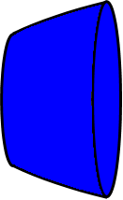

Volumes of Revolution
You need to be able to calculate the volume of a solid created by revolving a shape around the x-axis
y
y
$$y=\sqrt{x}$$
This would be the solid formed
x
x
a
b
You already know how to find the area under a curve by Integration
In this section you will learn how to find the volume of any solid created in this way. It also involves Integration!
Imagine we rotated the area shaded around the x-axis
→ What would be the shape of the solid formed?
5A

Slide 3













Volumes of Revolution
$$x+δx,f(x+δx)$$
You need to be able to calculate the volume of a solid created by revolving a shape around the x-axis
Imagine we already have the volume of a solid created this way
A small increase in the value of x will lead to a small increase in the volume of the solid
We can label some coordinates
The increase in the volume will be between two values, both of which can be calculated as volumes of cylinders…
Volume of a cylinder = $πr^{2}h$
$$x,f(x)$$
$$f(x+δx)$$
$$y=f(x)$$
$$f(x)$$
$$δV$$
$$V$$
$$x$$
$$δx$$
$$x+δx$$
$$δV≥π{\left[f(x)\right]}^{2}δx$$
$$δV≤π{\left[f(x+δx)\right]}^{2}δx$$
$$π{\left[f(x)\right]}^{2}δx≤δV≤π{\left[f(x+δx)\right]}^{2}δx$$
5A

Slide 4



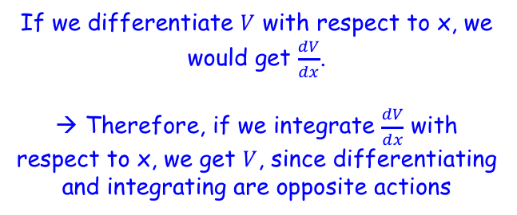





Volumes of Revolution
$$x+δx,f(x+δx)$$
You need to be able to calculate the volume of a solid created by revolving a shape around the x-axis
So we now have the relationship as shown…
$$x,f(x)$$
$$y=f(x)$$
$$δV$$
$$V$$
$$π{\left[f(x)\right]}^{2}δx≤δV≤π{\left[f(x+δx)\right]}^{2}δx$$
$$x$$
$$x+δx$$
Divide by $δx$
$$π{\left[f(x)\right]}^{2}≤\frac{δV}{δx}≤π{\left[f(x+δx)\right]}^{2}$$
Let$δx→0$, and the notation changes to $d$ (to indicate that tending to 0 has happened)
$$π{\left[f(x)\right]}^{2}≤\frac{dV}{dx}≤π{\left[f(x)\right]}^{2}$$
There is only one logical conclusion here…
$$\frac{dV}{dx}=π{\left[f(x)\right]}^{2}$$
If we differentiate $V$ with respect to x, we would get $\frac{dV}{dx}$.
→ Therefore, if we integrate $\frac{dV}{dx}$ with respect to x, we get $V$, since differentiating and integrating are opposite actions
Integrate both sides with respect to $x$
$$V=\int{π{\left[f(x)\right]}^{2} dx}$$
5A

Slide 5


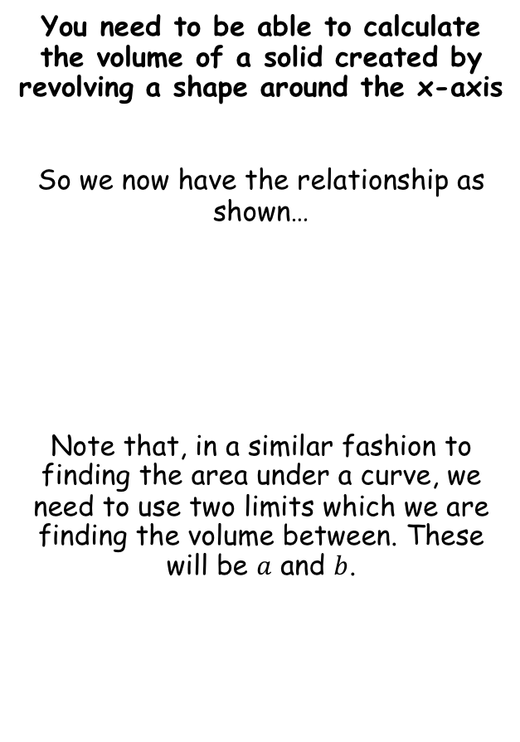
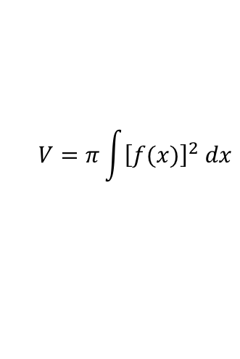

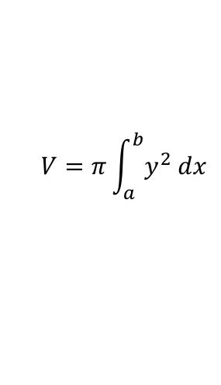
Volumes of Revolution
$$x+δx,f(x+δx)$$
You need to be able to calculate the volume of a solid created by revolving a shape around the x-axis
So we now have the relationship as shown…
Note that, in a similar fashion to finding the area under a curve, we need to use two limits which we are finding the volume between. These will be $a$ and $b$.
$$x,f(x)$$
$$y=f(x)$$
$$δV$$
$$V$$
$$V=\int{π{\left[f(x)\right]}^{2} dx}$$
$$x$$
$$x+δx$$
The $π$ can be factorised out
$$V=π\int{{\left[f(x)\right]}^{2} dx}$$
$$V=π\int_{a}^{b}{{\left[f(x)\right]}^{2} dx}$$
$$V=π\int_{a}^{b}{y^{2} dx}$$
Usually written using y
5A

Slide 6


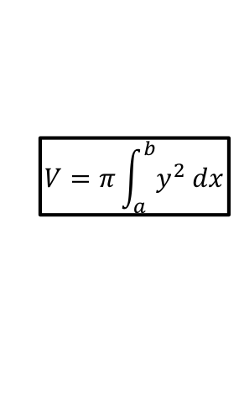


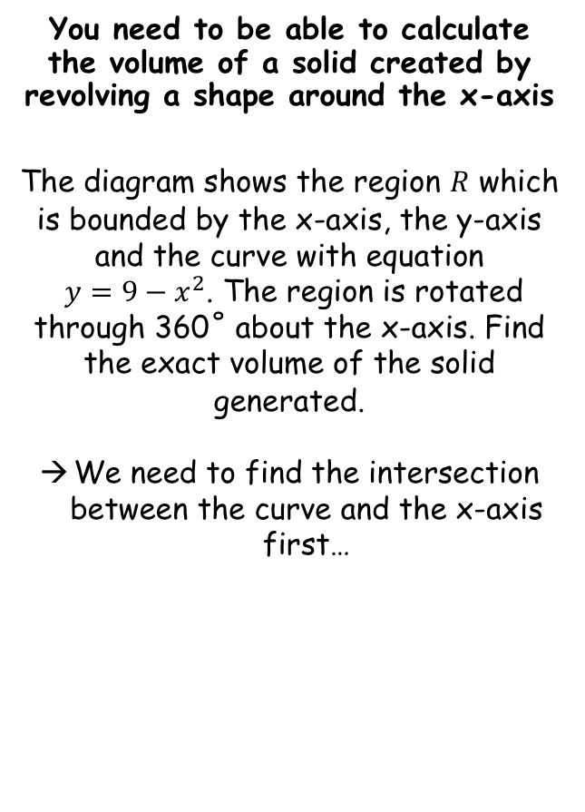






Volumes of Revolution
$$V=π\int_{a}^{b}{y^{2} dx}$$
$$y$$
You need to be able to calculate the volume of a solid created by revolving a shape around the x-axis
The diagram shows the region $R$ which is bounded by the x-axis, the y-axis and the curve with equation
$y=9−x^{2}$. The region is rotated through 360˚ about the x-axis. Find the exact volume of the solid generated.
We need to find the intersection between the curve and the x-axis first…
$$y=9−x^{2}$$
$$R$$
$$O$$
$$3$$
$$x$$
$$y=9−x^{2}$$
Set y = 0
$$0=9−x^{2}$$
Factorise
$$0=(3+x)(3−x)$$
Solve
$x=3$ or $−3$
5A

Slide 7

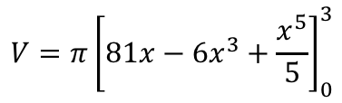
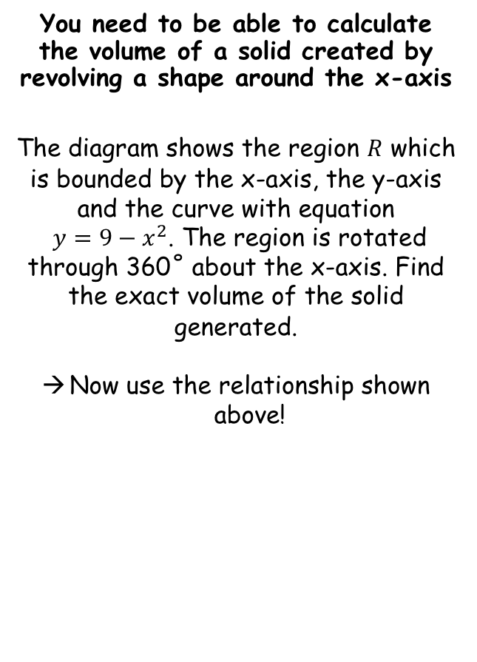
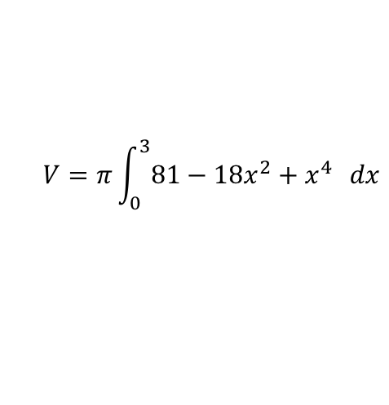

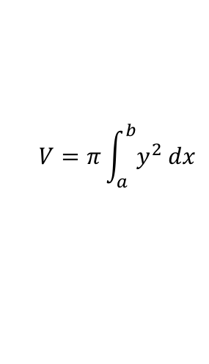

Volumes of Revolution
$$V=π\int_{a}^{b}{y^{2} dx}$$
$$y$$
You need to be able to calculate the volume of a solid created by revolving a shape around the x-axis
The diagram shows the region $R$ which is bounded by the x-axis, the y-axis and the curve with equation
$y=9−x^{2}$. The region is rotated through 360˚ about the x-axis. Find the exact volume of the solid generated.
Now use the relationship shown above!
$$y=9−x^{2}$$
$$R$$
$$V=π\int_{a}^{b}{y^{2} dx}$$
$$O$$
$$x$$
$$3$$
Sub in the equation
$$V=π\int_{0}^{3}{{\left(9−x^{2}\right)}^{2} dx}$$
Square the bracket (do not forget this!)
$$V=π\int_{0}^{3}{81−18x^{2}+x^{4}} dx$$
Integrate and use a square bracket
$$V=π{\left[81x−6x^{3}+\frac{x^{5}}{5}\right]}_{0}^{3}$$
Write as a subtraction
$$V=π\left(81(3)−6{(3)}^{3}+\frac{{(3)}^{5}}{5}\right)−π\left(81(0)−6{(0)}^{3}+\frac{{(0)}^{5}}{5}\right)$$
Calculate
$$V=\frac{648π}{5}$$
5A

Slide 8
Exercise 5A
Pearson Further Core Mathematics Year 1/AS
Complete before the lesson Q1-2
In Class:
Green Q3-4
Amber Q5-7
Red Q8-9 & challenge

