Slide 1
Year 2 Pure Mathematics
Numerical Solutions
- Newton Raphson Process
Chapter 10
(Part 3 of 4)

Slide 2
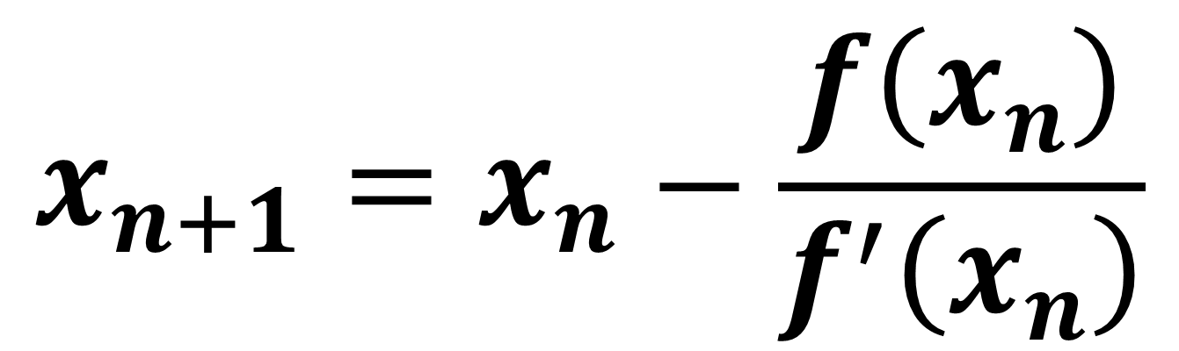
The Newton-Raphson Process
Newton–Raphson method,
named after Isaac Newton and Joseph Raphson,
is a method for finding successively better approximations to the roots of a function.
$$x_{n+1}=x_{n}−\frac{f\left(x_{n}\right)}{f^{′}\left(x_{n}\right)}$$
It is in the formulae booklet.

Slide 3
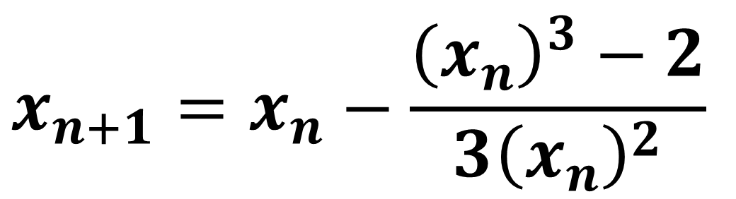
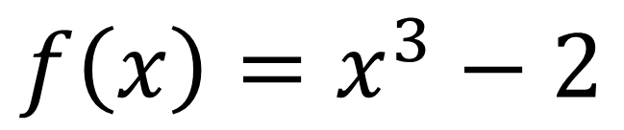
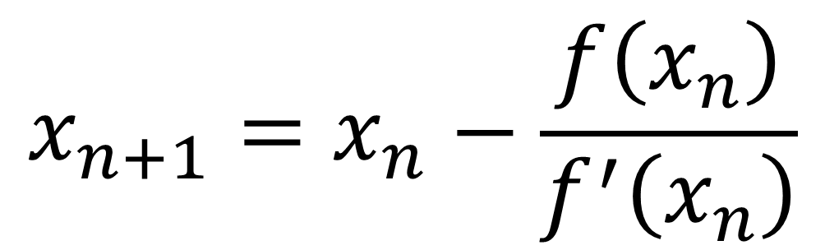
The Newton-Raphson Process
$$f\left(x\right)=x^{3}−2$$
$$x_{n+1}=x_{n}−\frac{f\left(x_{n}\right)}{f^{′}\left(x_{n}\right)}$$
$$x_{n+1}=x_{n}−\frac{{\left(x_{n}\right)}^{3}−2}{3{\left(x_{n}\right)}^{2}}$$

Slide 4
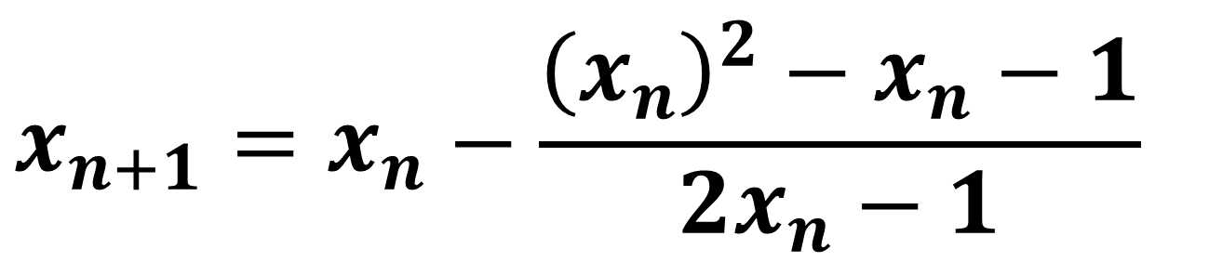

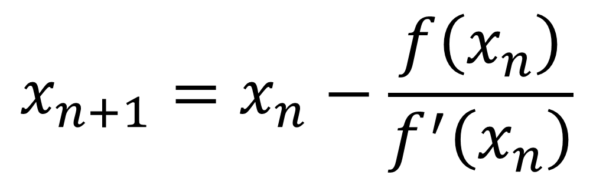
The Newton-Raphson Process
$$f\left(x\right)=x^{2}−x−1$$
$$x_{n+1}=x_{n}−\frac{f\left(x_{n}\right)}{f^{′}\left(x_{n}\right)}$$
$$x_{n+1}=x_{n}−\frac{{\left(x_{n}\right)}^{2}−x_{n}−1}{2x_{n}−1}$$

Slide 5
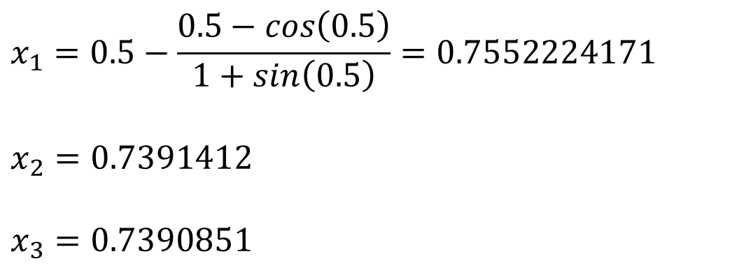

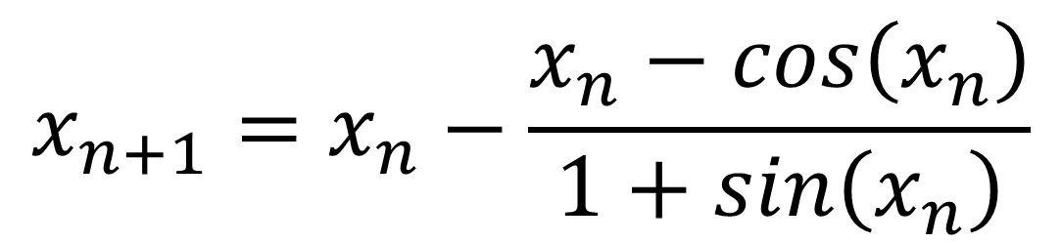
The Newton-Raphson Process
$f(x)=x − cos\left(x\right)$
Let $x_{0}=0.5$ find${ x}_{1}$ $x_{2} x_{3}$
$$x_{n+1}=x_{n}−\frac{x_{n}−cos\left(x_{n}\right)}{1+sin\left(x_{n}\right)}$$
$$x_{1}=0.5−\frac{0.5−cos\left(0.5\right)}{1+sin\left(0.5\right)}=0.7552224171$$
$$x_{2}=0.7391412$$
$$x_{3}=0.7390851$$

Slide 6
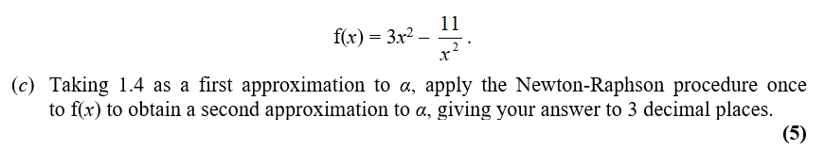

The Newton-Raphson Process – Exam Question

Slide 7


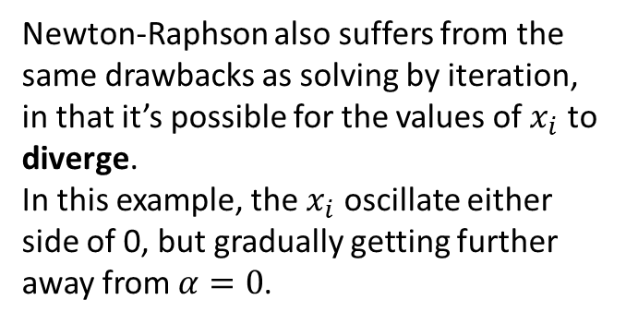




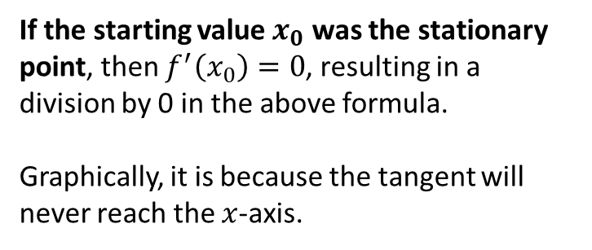




When does Newton-Raphson fail?
$$y$$
If the starting value $x_{0}$ was the stationary point, then $f^{′}\left(x_{0}\right)=0$, resulting in a division by 0 in the above formula.
Graphically, it is because the tangent will never reach the $x$-axis.
tangent
$$x_{0}$$
$$x$$
$$y=\frac{x}{\sqrt{1+x^{2}}}$$
$$y$$
Newton-Raphson also suffers from the same drawbacks as solving by iteration, in that it’s possible for the values of $x_{i}$ to diverge.
In this example, the $x_{i}$ oscillate either side of 0, but gradually getting further away from $α=0$.
$$x_{1}$$
$$x_{0}$$
$$x$$
$$x_{2}$$

Slide 8
Exercise 10C
Pearson Pure Mathematics Year 2/AS
Pages 284-285
Complete before the lesson Q1-2
In Class:
Green Q3-4
Amber Q5
Red Q6-7 & Challenge

