Slide 1
Year 1 Pure Mathematics
Exponentials and Logs
- Equations
Chapter 14
(Part 6 of 7)

Slide 2
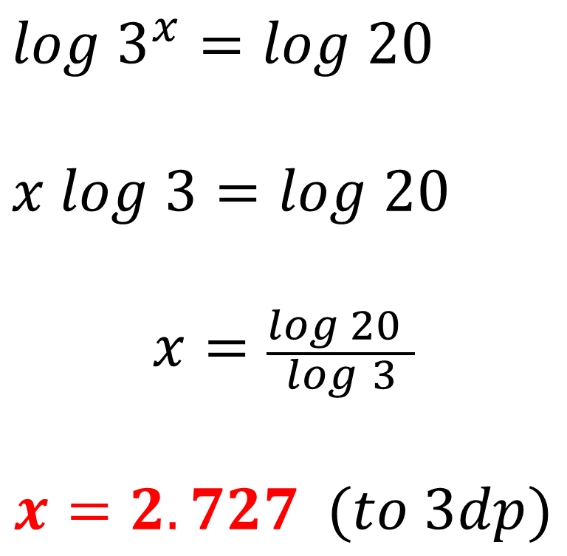
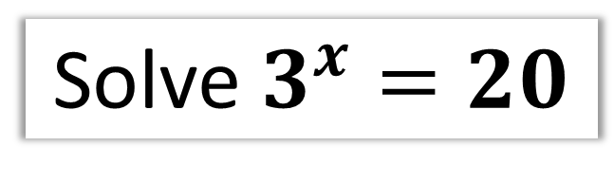
Solving Exponentials Equations
Solve $3^{x}=20$
$log$ $3^{x}=log 20$
$x log$ $3=log 20$
$$x=\frac{log 20 }{log 3}$$
$$x=2.727 (to 3dp)$$
logs of both sides
Power law

Slide 3
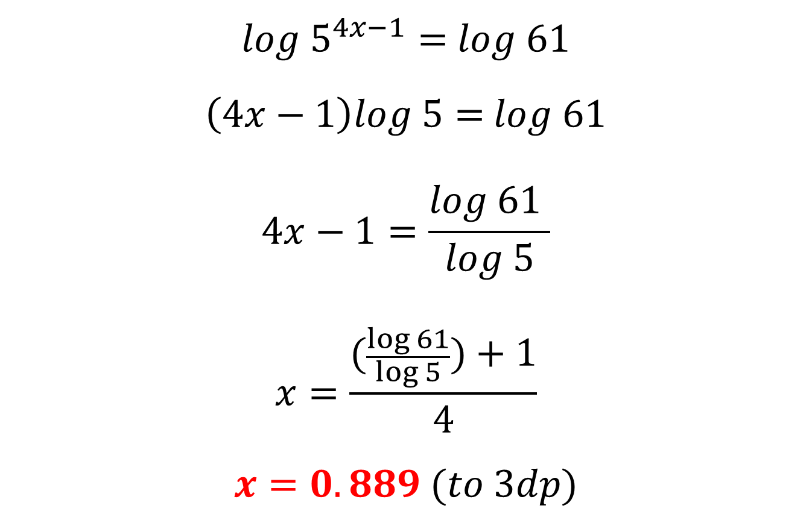
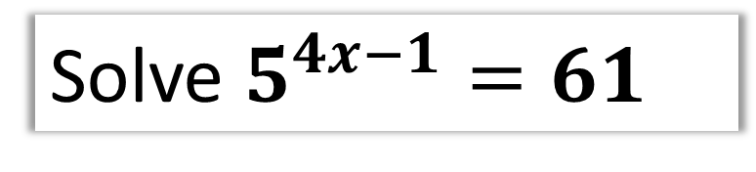
Solving Exponentials Equations
Solve $5^{4x−1}=61$
$log{ 5}^{4x−1}=$ $log$ 61
$\left(4x−1\right)log \text{5}=$ $log$ 61
$$4x−1=\frac{log \text{61} }{log 5}$$
$$x=\frac{(\frac{\log{61}}{\log{5}})+1}{4}$$
$$x=0.889 (to 3dp)$$
logs of both sides
Power law

Slide 4
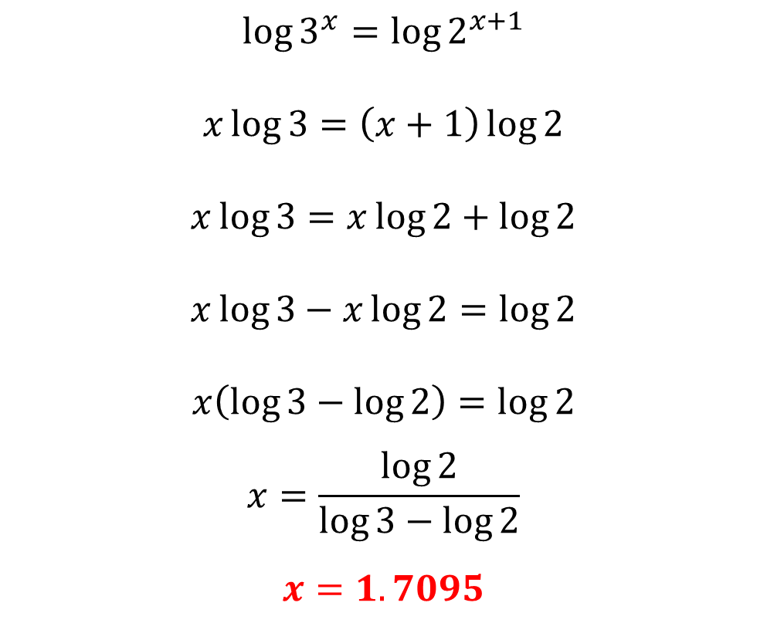
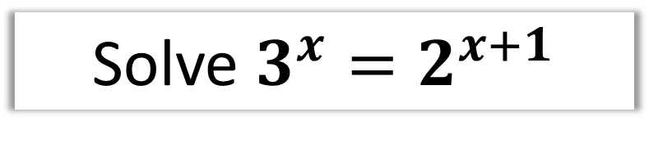
Solving Exponentials Equations
Solve $3^{x}=2^{x+1}$
$$\log{3^{x}}=\log{2^{x+1}}$$
$$x\log{3}=\left(x+1\right)\log{2}$$
$$x\log{3}=x\log{2}+\log{2}$$
$$x\log{3}−x\log{2}=\log{2}$$
$$x\left(\log{3}−\log{2}\right)=\log{2}$$
$$x=\frac{\log{2}}{\log{3}−\log{2}}$$
$$x=1.7095$$

Slide 5
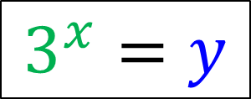
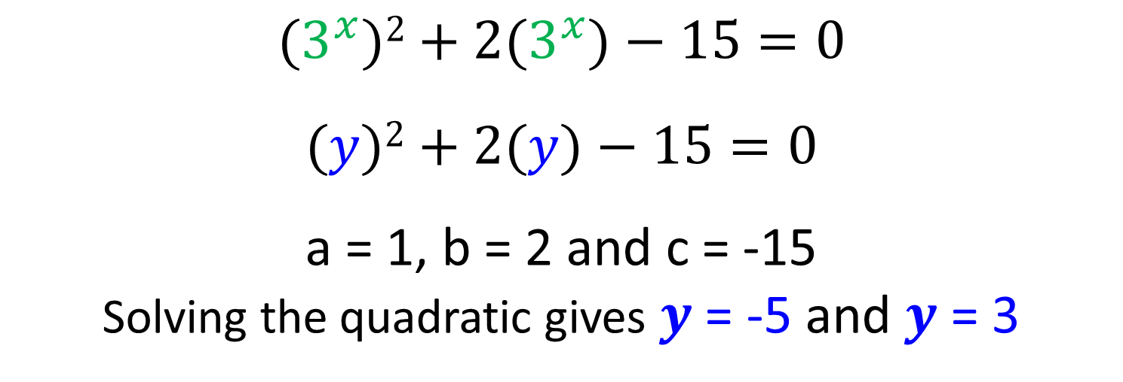
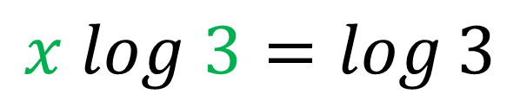
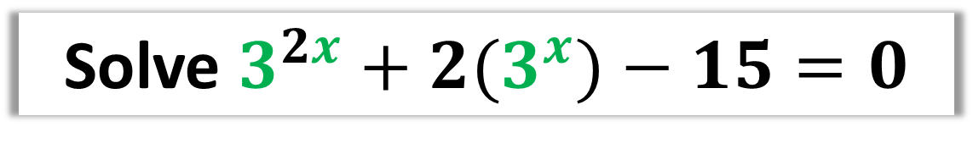
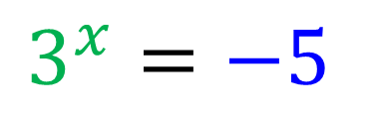
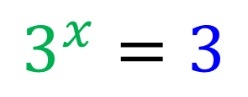
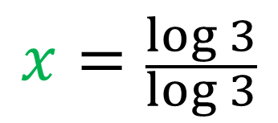
Solving Exponentials - Quadratic Equations
Solve $3^{2x}+2(3^{x})−15=0$
$${(3}^{x})2+2{(3}^{x})−15=0$$
$$(y)2+2(y)−15=0$$
a = 1, b = 2 and c = -15
Solving the quadratic gives $y$= -5 and $y$ = 3
$$3^{x}=y$$
$$3^{x}=−5$$
$$3^{x}=3$$
$$x log 3=\log{3}$$
No solution ,
you cant log a negative
$$x=\frac{\log{3}}{\log{3}}$$

Slide 6
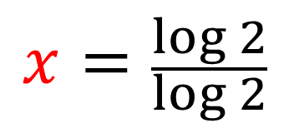
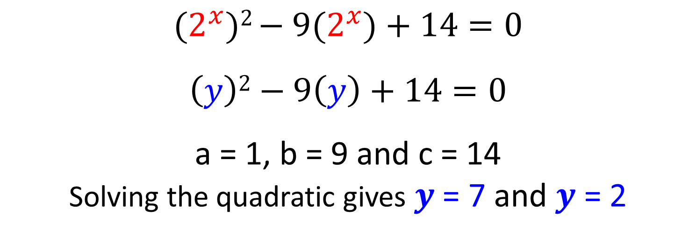
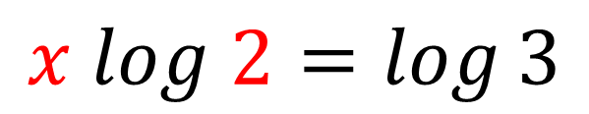
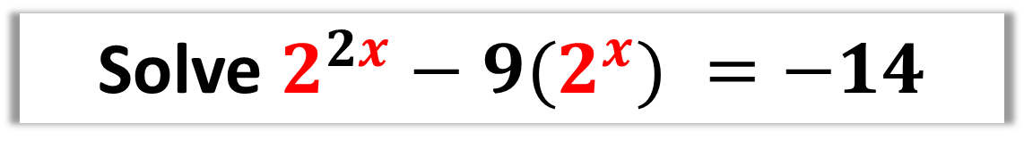
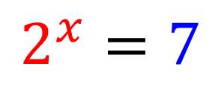

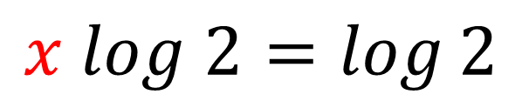
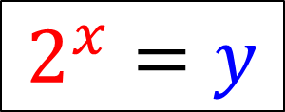
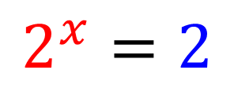
Solving Exponentials - Quadratic Equations
Solve $2^{2x}−9(2^{x}) =−14$
$${(2}^{x})2 {− 9(2}^{x})+14=0$$
$$\left(y\right)2−9\left(y\right)+14=0$$
a = 1, b = 9 and c = 14
Solving the quadratic gives $y$= 7 and $y$ = 2
$$2^{x}=y$$
$$2^{x}=7$$
$$2^{x}=2$$
$$x log 2=\log{3}$$
$$x log 2=\log{2}$$
$$x=\frac{\log{3}}{\log{2}}$$
$$x=\frac{\log{2}}{\log{2}}$$

Slide 7
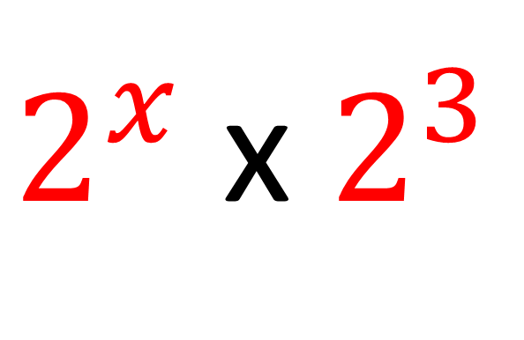
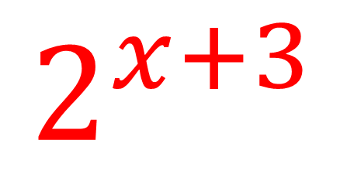
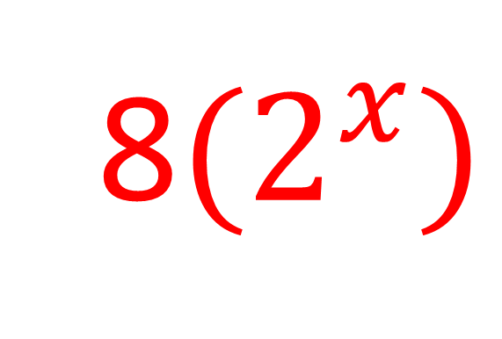


Solving Exponentials - Quadratic Equations
$2^{x}$ x $2^{3}$
=
$$2^{x+3}$$
$$2^{x+3}$$
=
$2^{x}$ x $2^{3}$
=
8${(2}^{x})$

Slide 8
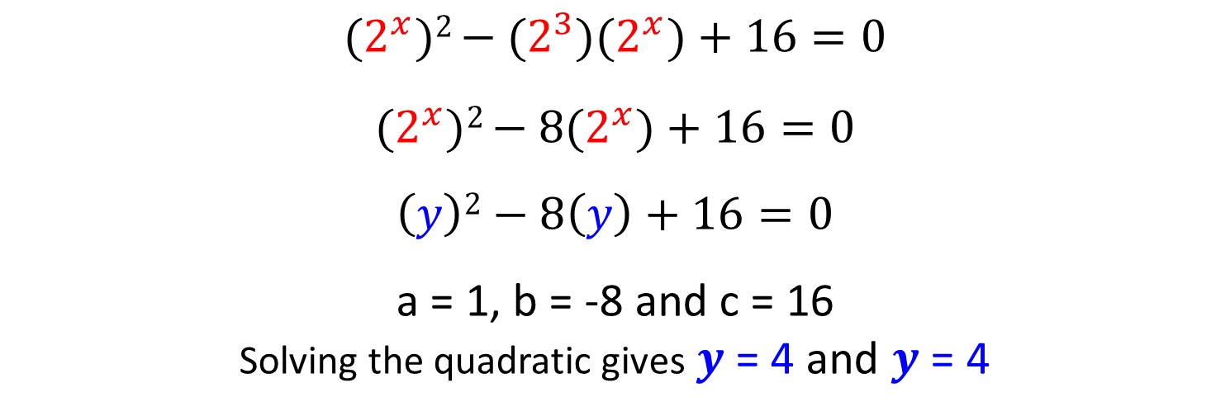
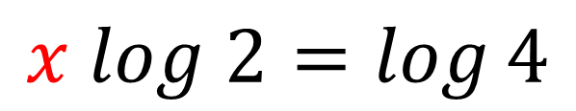
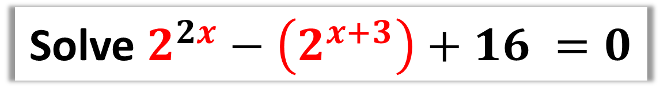


Solving Exponentials - Quadratic Equations
Solve $2^{2x}−\left(2^{x+3}\right)+16 =0$
$${(2}^{x})2 {− (2^{3})(2}^{x})+16=0$$
$${(2}^{x})2 {− 8(2}^{x})+16=0$$
$$\left(y\right)2−8\left(y\right)+16=0$$
a = 1, b = -8 and c = 16
Solving the quadratic gives $y$= 4 and $y$ = 4
$$2^{x}=y$$
$$2^{x}=4$$
$$x log 2=\log{4}$$
$$x=\frac{\log{4}}{\log{2}}$$

Slide 9

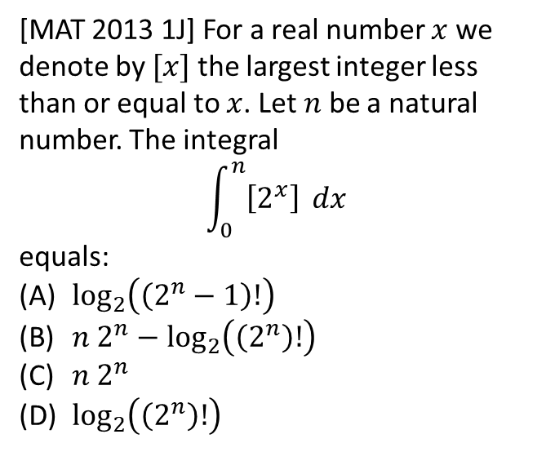

Exercise 14F
Complete before the lesson Q1
Green Q2
Amber Q3
Red
Pearson Pure Mathematics
Page 325
Extension
2
[MAT 2013 1J] For a real number $x$ we denote by $[x]$ the largest integer less than or equal to $x$. Let $n$ be a natural number. The integral
$$\int_{0}^{n}{\left[2^{x}\right]} dx$$
equals:
$\log_{2}\left(\left(2^{n}−1\right)!\right)$
$n 2^{n}−\log_{2}\left(\left(2^{n}\right)!\right)$
$n 2^{n}$
$\log_{2}\left(\left(2^{n}\right)!\right)$
1
[MAT 2011 1H] How many positive values $x$ which satisfy the equation:
$$x=8^{\log_{2}{x}}−9^{\log_{3}{x}}−4^{\log_{2}{x}}+\log_{0.5}{0.25}$$
$$x={\left(2^{3}\right)}^{\log_{2}{x}}−{\left(3^{2}\right)}^{\log_{3}{x}}−{\left(2^{2}\right)}^{\log_{2}{x}}+2 \\ x=2^{3\log_{2}{x}}−3^{2\log_{3}{x}}−2^{2\log_{2}{x}}+2 \\ x=2^{\log_{2}{x^{3}}}−3^{\log_{3}{x^{2}}}−2^{\log_{2}{x^{2}}}+2 \\ x=x^{3}−x^{2}−x^{2}+2 \\ x^{3}−2x^{2}−x+2=0 \\ x^{2}\left(x−2\right)−1\left(x−2\right)=0 \\ \left(x^{2}−1\right)\left(x−2\right)=0 \\ \left(x+1\right)\left(x−1\right)\left(x−2\right)=0$$
This has 2 positive solutions.
?
(Warning: This one really is very challenging, even for MAT)

