Slide 1

Stats1 Chapter 3 :: Representations of Data
jfrost@tiffin.kingston.sch.uk
www.drfrostmaths.com
@DrFrostMaths
Last modified: 15th February 2019

Slide 2
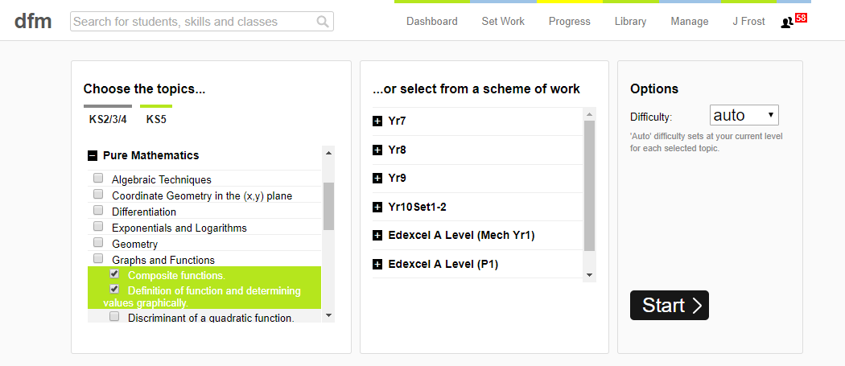
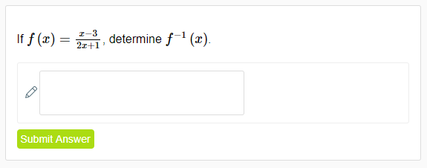
Use of DrFrostMaths for practice
Register for free at:
www.drfrostmaths.com/homework
Practise questions by chapter, including past paper Edexcel questions and extension questions (e.g. MAT).
Teachers: you can create student accounts (or students can register themselves).

Slide 3

Experimental
i.e. Dealing with collected data.
Chp2: Measures of Location/Spread
Chp3: Representation of Data
Chp1: Data Collection
Statistics used to summarise data, including mean, standard deviation, quartiles, percentiles. Use of linear interpolation for estimating medians/quartiles.
Producing and interpreting visual representations of data, including box plots and histograms.
Methods of sampling, types of data, and populations vs samples.
Chp4: Correlation
Measuring how related two variables are, and using linear regression to predict values.
Theoretical
Deal with probabilities and modelling to make inferences about what we ‘expect’ to see or make predictions, often using this to reason about/contrast with experimentally collected data.
Chp5: Probability
Chp6: Statistical Distributions
Chp7: Hypothesis Testing
Venn Diagrams, mutually exclusive + independent events, tree diagrams.
Common distributions used to easily find probabilities under certain modelling conditions, e.g. binomial distribution.
Determining how likely observed data would have happened ‘by chance’, and making subsequent deductions.

Slide 4
This Chapter Overview
We’ve seen so far how data is collected and calculations can be made. We now concentrate on how the processed data can be displayed.
BOX PLOTS AND OUTLIERS
CUMULATIVE FREQ DIAGRAMS
*NEW since GCSE!* Outliers.
Cumulative Frequency
HISTOGRAMS
Height
Changes since the old ‘S1’ syllabus:
Stem and leaf diagrams have been cut. (THANK GOD FOR THAT)
‘Skew’ has been cut.
Cumulative frequency diagrams have been added.
Turning histogram into frequency polygon.
*NEW since GCSE!* Area is not necessarily equal to frequency.
Forming a frequency polygon by joining midpoints.

Slide 5
Box Plot recap
Box Plots allow us to visually represent the distribution of the data.
Minimum | Lower Quartile | Median | Upper Quartile | Maximum
3 | 15 | 17 | 22 | 27
Sketch
Sketch
Sketch
Sketch
Sketch
range
IQR
0 5 10 15 20 25 30
How is the IQR represented in this diagram?
Sketch
How is the range represented in this diagram?
Sketch

Slide 6
Interpreting a Box Plot
0 5 10 15 20 25 30
Age (years)
True or false: (click your answer)
“The right box represents more people than the left box.”
False
True
Each box represents 25% of people, i.e. the same number of people!
“The ages are more spread out above the median.”
False
True
The wider the box or whisker, the more spread out the values are within that 25% of the data. We’d say that the data has “positive skew”, but you are not required to know this term.

Slide 7
Outliers
An outlier is: an extreme value.
?
Outliers beyond this point
0 5 10 15 20 25 30
One common definition of an outlier is when we’re 1.5 IQRs beyond the lower and upper quartiles.
(But you will be told in the exam if the rule differs from this)

Slide 8
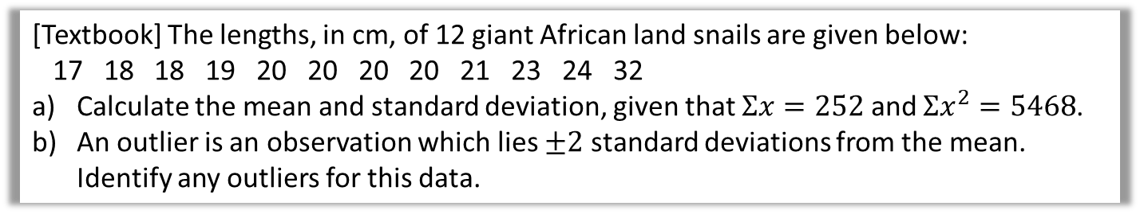
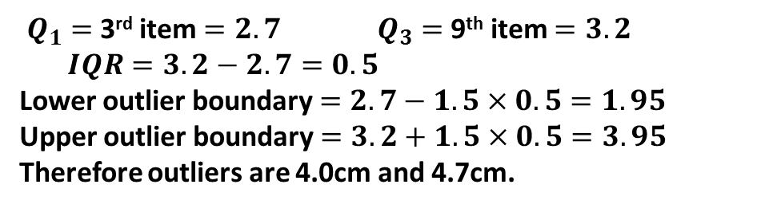

Examples
The diameters of 11 different Roman coins are measured in centimetres:
2.2 2.5 2.7 2.7 2.8 3.0 3.1 3.1 3.2 4.0 4.7
Determine the quartiles and hence any outliers.
?
$Q_{1}=$3rd item $=2.7$ $Q_{3}=$9th item $=3.2$
$IQR=3.2−2.7=0.5$
Lower outlier boundary $=2.7−1.5×0.5=1.95$
Upper outlier boundary $=3.2+1.5×0.5=3.95$
Therefore outliers are 4.0cm and 4.7cm.
[Textbook] The lengths, in cm, of 12 giant African land snails are given below:
17 18 18 19 20 20 20 20 21 23 24 32
Calculate the mean and standard deviation, given that $Σx=252$ and $Σx^{2}=5468$.
An outlier is an observation which lies $±2$ standard deviations from the mean. Identify any outliers for this data.
? a
Context: Recall that the standard deviation is, roughly speaking, the average distance of each value from the mean. So the outlier definition is saying we’re at least twice this average distance, which seems like a sensible definition.
In Year 2, you will encounter the normal distribution, which can be used to model data which is clustered about some mean and tails off symmetrical in either direction. If this data was approximately normally distributed, then there is a 5% chance a random observation would fall outside 2 standard deviations within the mean. You will learn then how to make such probability calculations.
$$\overline{x}=\frac{252}{12}=21 cm \\ σ=\sqrt{\frac{5468}{12}−{21}^{2}}=3.83 (3sf)$$
Outlier boundaries: $21−2×3.83=13.34$
$$21+2×3.83=28.66$$
? b

Slide 9
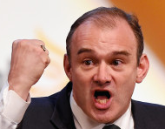

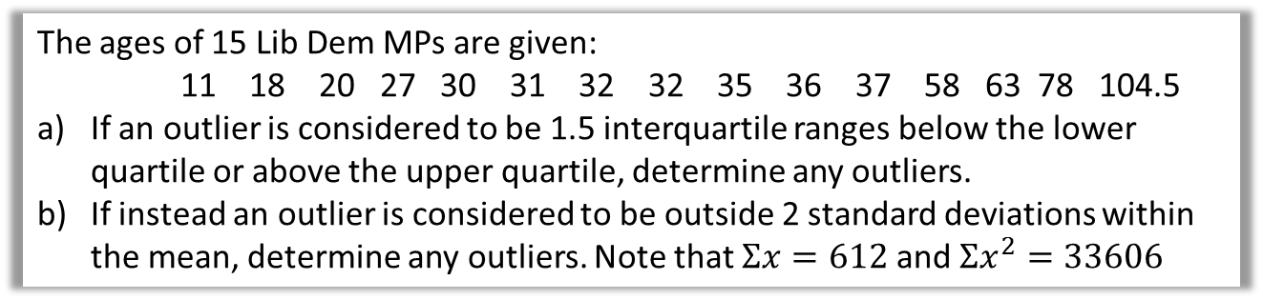
Test Your Understanding
The ages of 15 Lib Dem MPs are given:
11 18 20 27 30 31 32 32 35 36 37 58 63 78 104.5
If an outlier is considered to be 1.5 interquartile ranges below the lower quartile or above the upper quartile, determine any outliers.
If instead an outlier is considered to be outside 2 standard deviations within the mean, determine any outliers. Note that $Σx=612$ and $Σx^{2}=33606$
? a
$$Q_{1}=27, Q_{3}=58 , IQR=31$$
Boundaries: $27−1.5×31=−19.5$
$$58+1.5×31=104.5$$
Therefore the 105 year old is an outlier.
$$\overline{x}=\frac{612}{15}=40.8 \\ σ=\sqrt{\frac{33606}{15}−{40.8}^{2}}=24.0 (3sf)$$
Boundaries: $40.8+24.0×2=88.8$
$$40.8−24.0×2=−7.2$$
Therefore the 104 year old is an outlier.
? b

Slide 10

Box Plot Example
Smallest values | Largest values | Lower Quartile | Median | Upper Quartile
0, 3 | 21, 27 | 8 | 10 | 14
Draw a box plot to represent the above data.
?
$$IQR=14−8=6$$
Outlier boundaries:
$$14+\left(1.5×6\right)=23 \\ 8−\left(1.5×6\right)=−1$$
Fro Exam Tip: You MUST show your outlier boundary calculations.
When there’s an outlier at one end, there’s two allowable places to put the end of the whisker:
Use a cross for each outlier.
?
The maximum value not an outlier, 21 (I think this one makes most sense).
OR the outlier boundary, 23.
Use one or the other (not both).
0 5 10 15 20 25 30

Slide 11
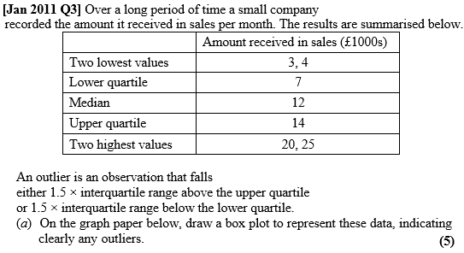
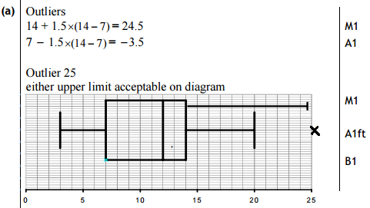

Test Your Understanding
a ?
(c) The company claims that for 75% of the months, the amount received per month is greater than £10 000. Comment on this claim, giving a reason for your answer. (2)
c ?

Slide 12
Comparing Box Plots
Box Plot comparing house prices of Croydon and Kingston-upon-Thames:
Croydon
Kingston
£400k £450k £500k £550k £600k £650k £700k £750k
“Compare the prices of houses in Croydon with those in Kingston”. (2 marks)
For 1 mark, one of:
In interquartile range of house prices in Kingston is greater than Croydon.
The range of house prices in Kingston is greater than Croydon.
For 1 mark:
“The median house price in Kingston was greater than that in Croydon.”
?
?
Include some measure of location (median is best).
Include some measure of spread.

Slide 13
Exercise 3A/3B
Pearson Pure Mathematics Year 1/AS
Pages 42-43, 45
Complete before the lesson Ex3A Q1 & Ex3B Q1-2
In Class:
Green Ex3A Q2-4
Amber Ex3B Q3-4

Slide 14
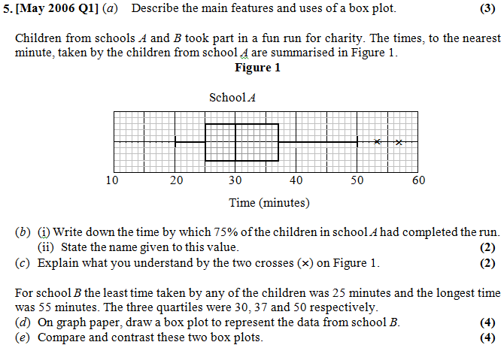
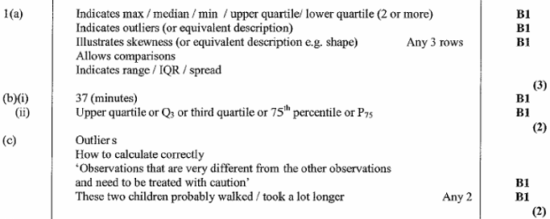
Supplementary Questions:
(Solutions to (d) and (e) on next slide)
?
?
?

Slide 15
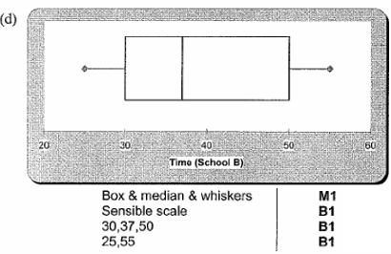
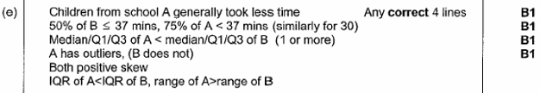
Supplementary Questions:
?
?

Slide 16
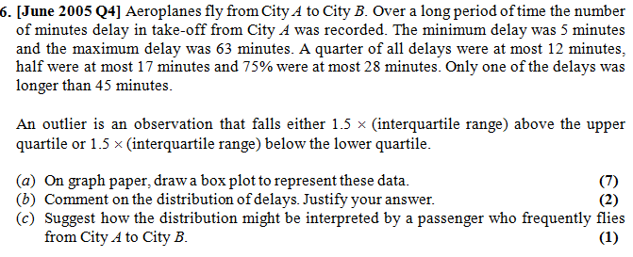
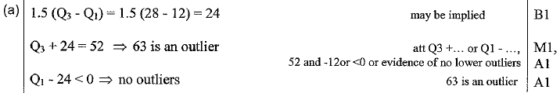

Supplementary Questions:
(on your printed sheet)
?
45
5
52
63
12
17
28
?
?

Slide 17
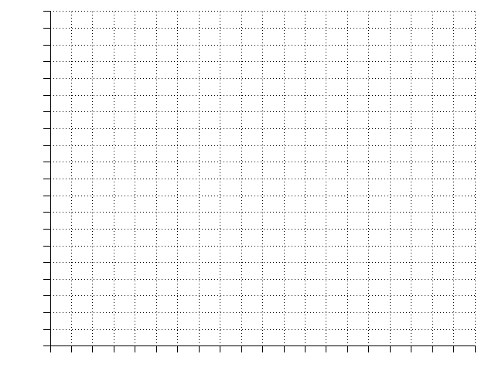
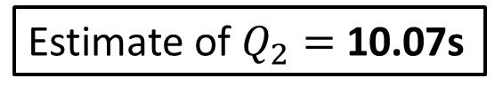
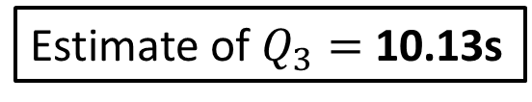
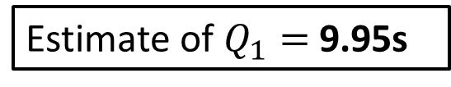
Cumulative Frequency Diagrams
Time (s) | Frequency | Cum Freq
9.6 < t ≤ 9.7 | 1 | 1
9.7 < t ≤ 9.9 | 4 | 5
9.9 < t ≤ 10.05 | 10 | 15
10.05 < t ≤ 10.2 | 17 | 32
These graphs are intended to show the running total of people/things up to a particular value, and are particularly useful in estimating the median and quartiles.
Plot
32
28
24
20
16
12
8
4
0
Plot
Plot
Estimate of $Q_{2}=$ 10.07s
Plot
?
?
Estimate of $Q_{1}=$ 9.95s
Cumulative Frequency
?
Estimate of $Q_{3}=$ 10.13s
Interquartile Range
= 0.18s
?
9.5 9.6 9.7 9.8 9.9 10.0 10.1 10.2 10.3
Time (s)

Slide 18
Cumulative Frequency Diagrams
Estimate how many runners had a time less than 10.15s.
26 runners
Estimate how many runners had a time more than 9.95
32 – 8 = 24 runners
Estimate how many runners had a time between 9.8s and 10s
11 – 3 = 8 runners
32
28
24
20
16
12
8
4
0
?
Cumulative Frequency
?
?
9.5 9.6 9.7 9.8 9.9 10.0 10.1 10.2 10.3
Time (s)

Slide 19
Exercise 3C
Pearson Pure Mathematics Year 1/AS
Pages 47-48
(Students already confident with cumulative frequency graphs may want to skip this exercise)
Complete before the lesson Q2
In Class:
Green Q3
Amber Q4

Slide 20
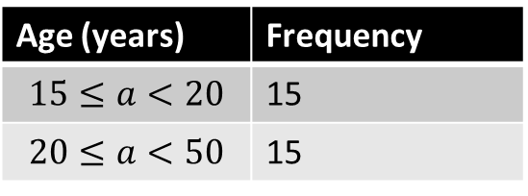
Histograms
Pablo is hosting a party. He counts how many people are between 15 and 20, and 20 and 50.
Age (years) | Frequency
$$15≤a<20$$ | 15
$$20≤a<50$$ | 15
Why is below graph somewhat unhelpful.
How could we fix it?
Click to Start Fro-animation
15
The 15 people in the second group are more spread out in age, but this graph seems to suggest that people’s ages are spread out uniformly between 15 and 50.
Frequency
10 20 30 40 50
Age

Slide 21
Let’s presume that within each age group, the ages are evenly spread.
Then there would 3 people of each age in
the 15-20 group, and 0.5 people of each age in the 20-50 group.
Age (years) | Frequency
15 ≤ a < 20 | 15
20 ≤ a < 50 | 15
?
?
Click to Start Fro-animation
3
2
1
The resulting diagram is known as a histogram; it allows us to display the ‘concentration’ (i.e. density) of people per unit value.
The ‘frequency per age’ is known as the ‘frequency density’. In general, given the frequency and class width, we can calculate it using:
Frequency Density
Estimated Frequency
Frequency
Class Width
Frequency Density =
?
10 20 30 40 50
Age

Slide 22
Bar Charts vs Histograms
Histograms
For continuous data.
Data divided into (potentially uneven) intervals.
[GCSE definition] Frequency given by area of bars.*
No gaps between bars.
Bar Charts
For discrete data.
Frequency given by height of bars.
?
?
?
?
Use this as a reason whenever you’re asked to justify use of a histogram.
Frequency
Frequency Density
6 7 8 9
1.0m 1.2m 1.4m 1.6m 1.8m
Shoe Size
Height
* Not necessarily true. We’ll correct this in a sec.

Slide 23
Bar Charts vs Histograms
Q1
Still using the incorrect GCSE formula:
Weight (w kg) | Frequency | Frequency Density
0 < w ≤ 10 | 40 | 4
10 < w ≤ 15 | 6 | 1.2
15 < w ≤ 35 | 52 | 2.6
35 < w ≤ 45 | 10 | 1
?
?
Freq
?
?
F.D.
Width
Q2
Frequency = 40
5
4
3
2
1
?
Frequency = 15
?
Frequency = 25
?
Frequency Density
Frequency = 30
?
10 20 30 40 50
Height (m)

Slide 24
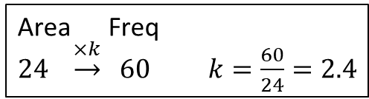
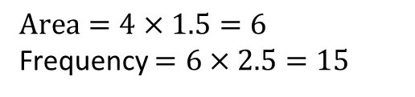
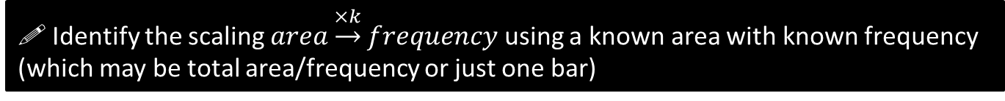
SKILL #1 :: Area = frequency?
Unlike at GCSE, the area of a bar is not necessarily equal to the frequency; there are just proportional.
! Identify the scaling $area\underset{→}{×k}frequency$ using a known area with known frequency (which may be total area/frequency or just one bar)
There were 60 runners in a 100m race. The following histogram represents their times. Determine the number of runners with times above 14s.
5
4
3
2
1
0
Total frequency is known; therefore find total area and hence the ‘scaling’.
?
Total area = 15 + 9 = 24
Area Freq
$24 \underset{→}{×k} 60$ $k=\frac{60}{24}=2.4$
Frequency Density
Then use this scaling along with the desired area.
?
$$Area=4×1.5=6$$
Frequency $=6×2.5=15$
9
12
18
Time (s)

Slide 25

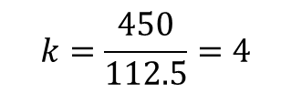



Test Your Understanding
(on your printed sheet)
Edexcel S1 May 2012 Q5
A policeman records the speed of the traffic on a busy road with a 30 mph speed limit. He records the speeds of a sample of 450 cars. The histogram in Figure 2 represents the results.
(a) Calculate the number of cars that were exceeding the speed limit by at least 5 mph in the sample. (4 marks)
Fro Tip: We can make the frequency density scale what we like.
M1 A1: Determine what one small square or one large square is worth.
7
6
5
4
3
2
1
(i.e. work out $area→freq$ scaling)
$$k=\frac{450}{112.5}=4$$
?
Area Freq
$$112.5 \underset{→}{×k} 450$$
M1 A1: Use this to find number of cars travelling >35mph.
?
Area Freq
$$22.5 \underset{→}{×4} 90$$
Write: $22.5×4=90$

Slide 26
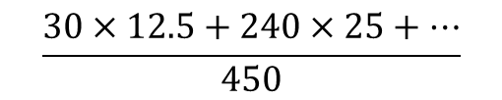

Test Your Understanding
(on your printed sheet)
(b) Estimate the value of the mean speed of the cars in the sample. (3 marks)
M1 M1: Use histogram to construct sum of speeds.
?
$$\frac{30×12.5+240×25+…}{450}$$
A1 Correct value
?
$$=28.8$$
Fro Tip: Whenever you are asked to calculate mean, median or quartiles from a histogram, form a grouped frequency table. Use your scaling factor to work out the frequency of each bar.

Slide 27
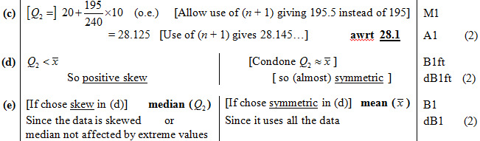
Test Your Understanding
(on your printed sheet)
(c) Estimate, to 1 decimal place, the value of the median speed of the cars in the sample.(2)
(d) Comment on the shape of the distribution. Give a reason for your answer. (2)
(e) State, with a reason, whether the estimate of the mean or the median is a better representation of the average speed of the traffic on the road. (2)
(crossed out questions would not appear in new syllabus)
?
?
?

Slide 28
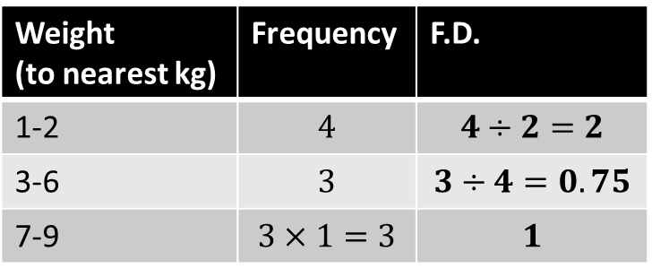
SKILL #2 :: Gaps!
Weight (to nearest kg) | Frequency | F.D.
1-2 | $$4$$ | $$4÷2=2$$
3-6 | $$3$$ | $$3÷4=0.75$$
7-9 | $$3×1=3$$ | $$1$$
Note the gaps affects class width!
Remember the frequency density axis is only correct to scale, so there may be some scaling. However in an exam scaling is unlikely to be required for F.D. if the F.D. scale is already given.
?
?
?
?
For simplicity we can set the scaling between area and frequency to be 1.
2
1
0
Frequency Density
?
1 2 3 4 5 6 7 8 9 10
Time (s)

Slide 29
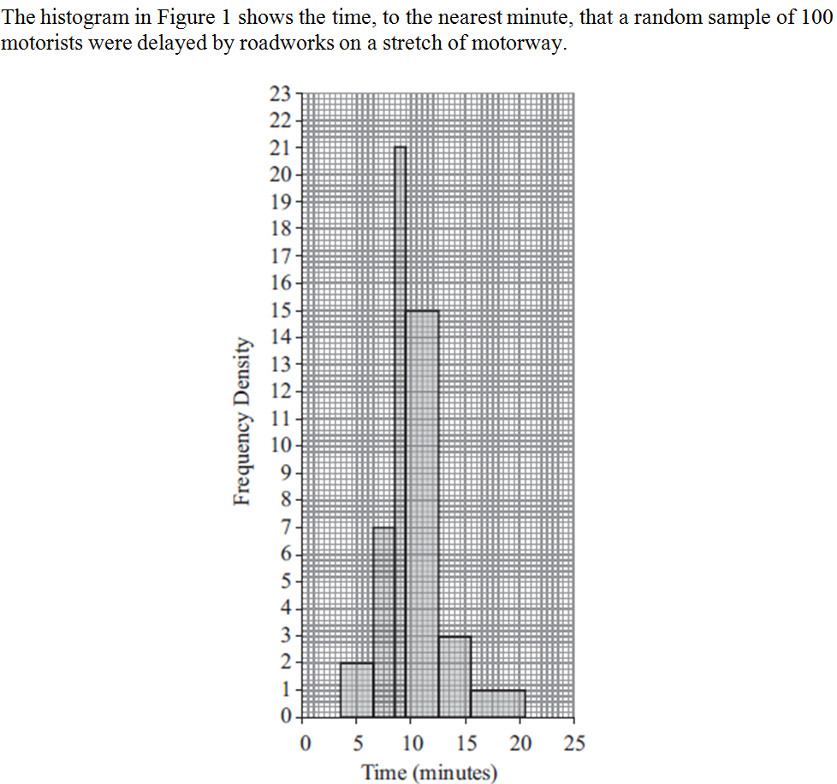
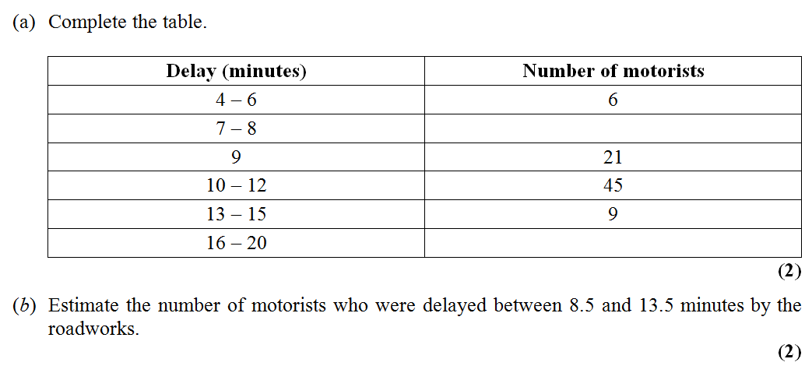
Test Your Understanding
(on your printed sheet)
Jan 2012 Q1
Fro Tip: Be careful that you use the correct class widths!
14
?
5
?
?
21 + 45 + 3 = 69
Notes:
Be sure to ask first what they notice about the ranges in the table (i.e. gaps!)

Slide 30

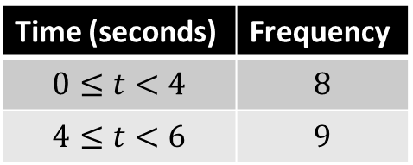
SKILL #3 :: Width and height on diagram
An exam favourite is to ask what width and height we’d draw a bar in a drawn histogram.
Q: The frequency table shows some running times. On a histogram the bar for 0-4 seconds is drawn with width 6cm and height 8cm. Find the width and height of the bar for 4-6 seconds.
Time (seconds) | Frequency
$$0≤t<4$$ | $$8$$
$$4≤t<6$$ | $$9$$
! Bro Tip: Find the scaling for class width to drawn width and frequency density to
drawn height.
Strategy ?
Solution ?
For 0-4 bar:
Class width $=4$
Frequency density $=8÷4=2$
$∴$ Scaling for width: 1.5
Scaling for height: 4
4-6 bar: class width 2, frequency density 4.5
$$Width=2×1.5=3cm \\ Height=4.5×4=18cm$$

Slide 31
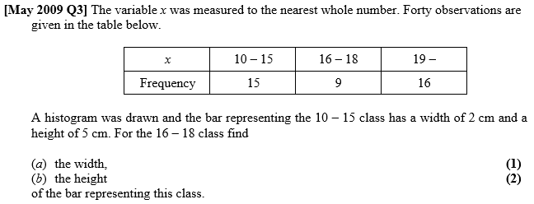
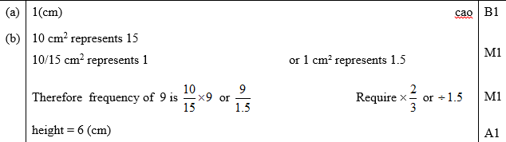
Test Your Understanding
(on your printed sheet)
?
?

Slide 32
SKILL #4 :: Forming a frequency polygon
Recall that a frequency polygon can be drawn by using the midpoint of each interval. This corresponds to the midpoint of the top of each bar in a histogram.
Click to Sketch
Note that the frequency in this interval is 0. That needs to be reflected in the frequency polygon.

Slide 33
Exercise 3D
Pearson Pure Mathematics Year 1/AS
Pages 47-48
There is a supplementary exercise (available as a separate file for printing) with solutions on the next slides…
Complete before the lesson Q1-2
In Class:
Green Q3-4
Amber Q5
Red Q6-7

Slide 34
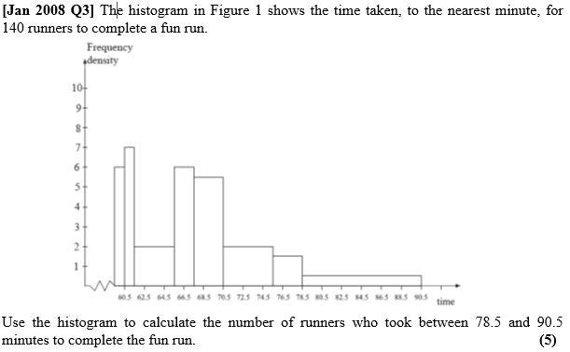
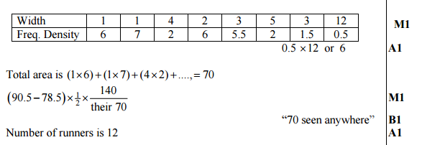
Supplementary Exercise
(on your printed sheet)
Q1
?

Slide 35
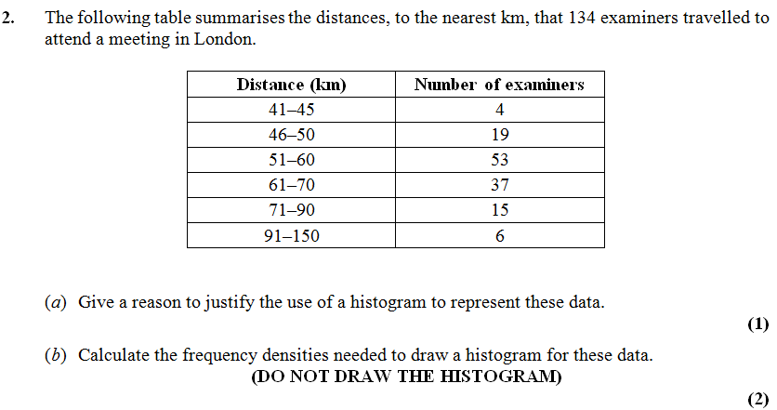
Supplementary Exercise
(on your printed sheet)
Q2
Answer: Distance is continuous
?
?
Note that gaps in the class intervals!
4 / 5 = 0.8
19 / 5 = 3.8
53 / 10 = 5.3
...

Slide 36
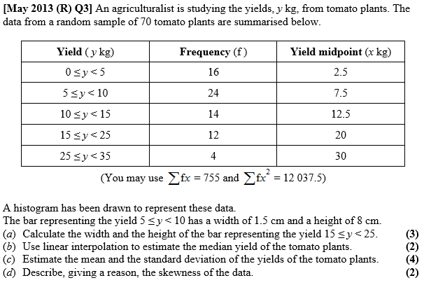
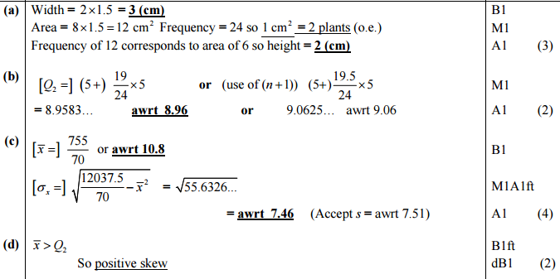
Supplementary Exercise
(on your printed sheet)
Q3
?
?
?
?

Slide 37
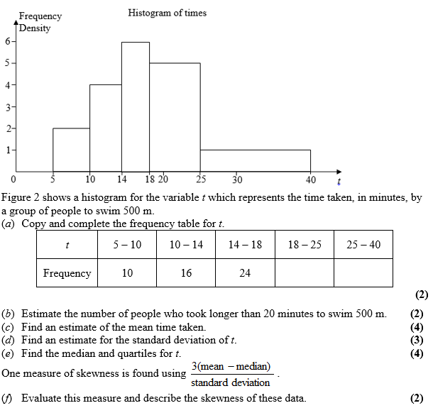
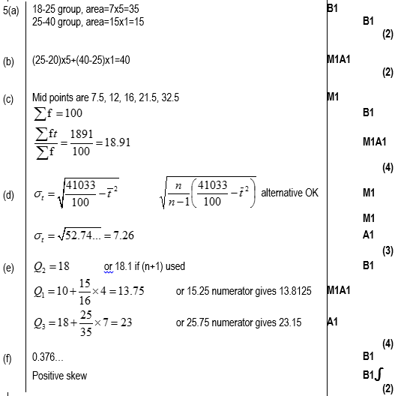
Supplementary Exercise
(on your printed sheet)
Q4
[June 2007 Q5]
?
?
?
?
?
?

Slide 38
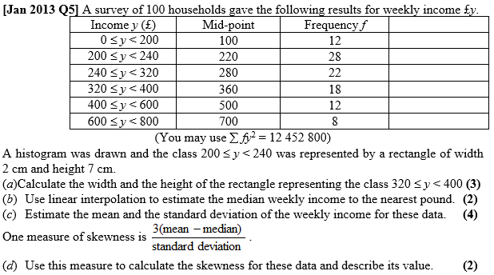
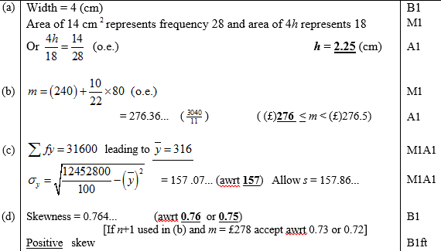
Supplementary Exercise
(on your printed sheet)
Q5
?
?
?
?

Slide 39
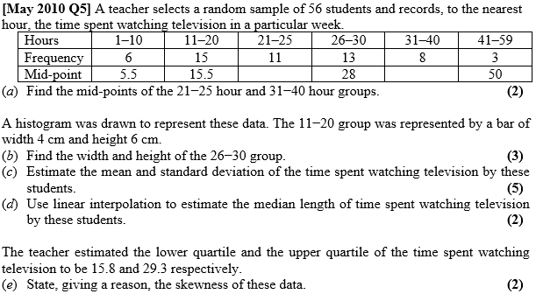
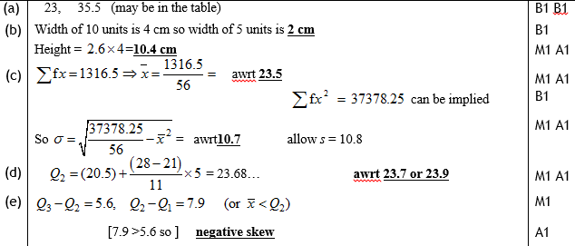
Supplementary Exercise
(on your printed sheet)
Q6
?
?
?
?
?

Slide 40
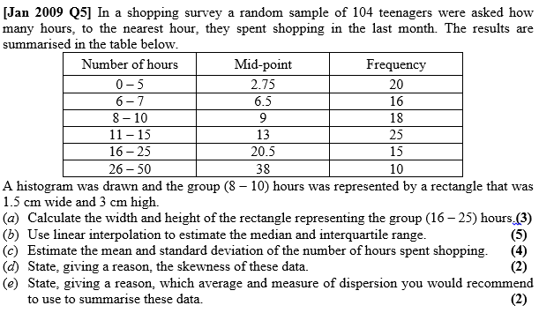
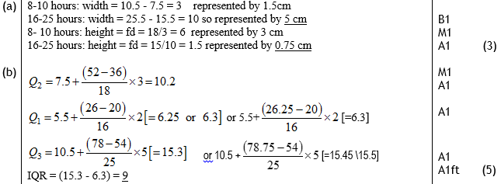

Supplementary Exercise
(on your printed sheet)
Q7
a ?
c ?
b ?
d ?
e ?

