Slide 1
Polar Coordinates
Twitter: @Owen134866
www.mathsfreeresourcelibrary.com

Slide 2
Teachings for
Exercise 5C

Slide 3





Polar Coordinates
You can use Integration to find areas of sectors of curves, given their Polar equations
Reminder of formula for the area of a sector, when $θ$ is in radians
A
$$r$$
$$A=\frac{1}{2}r^{2}θ$$
$$θ$$
O
$$r$$
B
5C

Slide 4



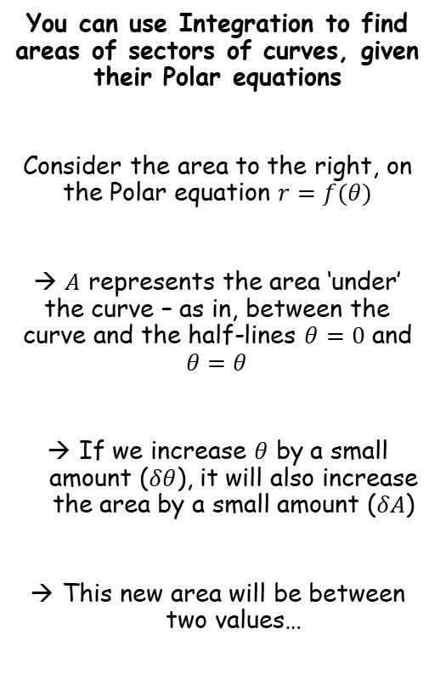



Polar Coordinates
$$A=\frac{1}{2}r^{2}θ$$
You can use Integration to find areas of sectors of curves, given their Polar equations
Consider the area to the right, on the Polar equation $r=f(θ)$
→ $A$ represents the area ‘under’ the curve – as in, between the curve and the half-lines $θ=0$ and $θ=θ$
If we increase $θ$ by a small amount ($δθ$), it will also increase the area by a small amount ($δA$)
This new area will be between two values…
$$δA$$
$$δθ$$
$$A$$
$$θ$$
$$r=f(θ)$$
5C

Slide 5





Polar Coordinates
$$A=\frac{1}{2}r^{2}θ$$
You can use Integration to find areas of sectors of curves, given their Polar equations
Consider the area to the right, on the Polar equation $r=f(θ)$
→ $A$ represents the area ‘under’ the curve – as in, between the curve and the half-lines $θ=0$ and $θ=θ$
If we increase $θ$ by a small amount ($δθ$), it will also increase the area by a small amount ($δA$)
This new area will be between two values…
$$r=f(θ)$$
$$δA$$
$$r$$
$$δθ$$
$$r$$
$$A$$
$$θ$$
$$r=f(θ)$$
$$δA≥\frac{1}{2}r^{2}×δθ$$
In terms of $θ$
$$δA≥\frac{1}{2}{\left[f(θ)\right]}^{2}×δθ$$
$$δA≥\frac{1}{2}{\left[f(θ)\right]}^{2}×δθ$$
5C

Slide 6





Polar Coordinates
$$A=\frac{1}{2}r^{2}θ$$
You can use Integration to find areas of sectors of curves, given their Polar equations
Consider the area to the right, on the Polar equation $r=f(θ)$
→ $A$ represents the area ‘under’ the curve – as in, between the curve and the half-lines $θ=0$ and $θ=θ$
If we increase $θ$ by a small amount ($δθ$), it will also increase the area by a small amount ($δA$)
This new area will be between two values…
$$r=f(θ+δθ)$$
$$δA$$
$$r$$
$$r$$
$$δθ$$
$$A$$
$$θ$$
$$r=f(θ)$$
$$δA≤\frac{1}{2}r^{2}×δθ$$
In terms of $θ$
$$δA≤\frac{1}{2}{\left[f(θ+δθ)\right]}^{2}×δθ$$
$$δA≥\frac{1}{2}{\left[f(θ)\right]}^{2}×δθ$$
$$δA≤\frac{1}{2}{\left[f(θ+δθ)\right]}^{2}×δθ$$
5C

Slide 7
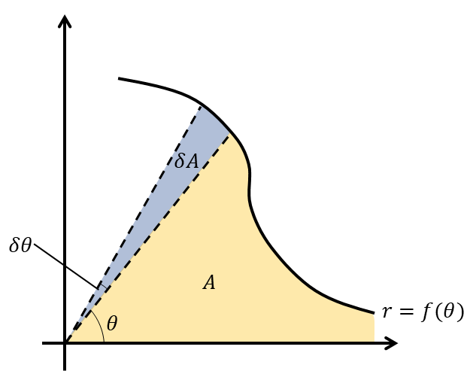






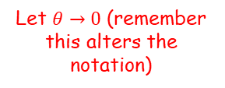




Polar Coordinates
$$A=\frac{1}{2}r^{2}θ$$
$$\frac{1}{2}{\left[f(θ)\right]}^{2}×δθ≤δA≤\frac{1}{2}{\left[f(θ+δθ)\right]}^{2}×δθ$$
You can use Integration to find areas of sectors of curves, given their Polar equations
Consider the area to the right, on the Polar equation $r=f(θ)$
→ $A$ represents the area ‘under’ the curve – as in, between the curve and the half-lines $θ=0$ and $θ=θ$
If we increase $θ$ by a small amount ($δθ$), it will also increase the area by a small amount ($δA$)
This new area will be between two values…
Divide all parts by $δθ$
$$\frac{1}{2}{\left[f(θ)\right]}^{2}≤\frac{δA}{δθ}≤\frac{1}{2}{\left[f(θ+δθ)\right]}^{2}$$
Let $θ→0$ (remember this alters the notation)
$$\frac{1}{2}{\left[f(θ)\right]}^{2}≤\frac{dA}{dθ}≤\frac{1}{2}{\left[f(θ)\right]}^{2}$$
The logical conclusion is…
$$\frac{dA}{dθ}=\frac{1}{2}{\left[f(θ)\right]}^{2}$$
Integrate both sides with respect to $θ$
$$A=\int{\frac{1}{2}{\left[f(θ)\right]}^{2}} dθ$$
The half can be factored out
$$A=\frac{1}{2}\int{{\left[f(θ)\right]}^{2}} dθ$$
You will often see it with $r$ written instead
$$A=\frac{1}{2}\int{r^{2}} dθ$$
So this is how we find the area ‘under’ a Polar curve!
$$δA≥\frac{1}{2}{\left[f(θ)\right]}^{2}×δθ$$
$$δA≤\frac{1}{2}{\left[f(θ+δθ)\right]}^{2}×δθ$$
5C

Slide 8
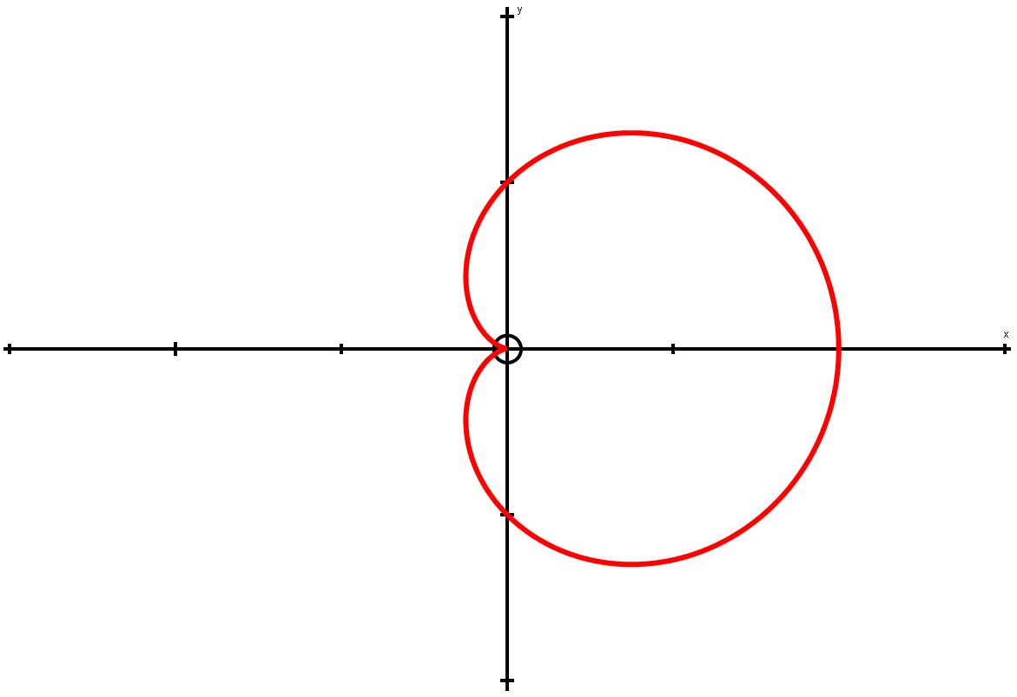
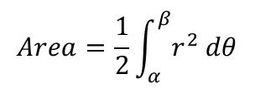
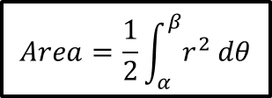
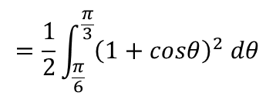

Polar Coordinates
$$Area=\frac{1}{2}\int_{α}^{β}{r^{2} dθ}$$
π 2
π 3
You can use Integration to find areas of sectors of curves, given their Polar equations
The process is similar to that of regular Integration for finding an area.
To find the area enclosed by the curve, and the half lines θ = α and θ = β, you can use the formula below:
(you might notice the ¹/₂r²θ being familiar as the formula for the area of a sector)
π 6
π
0, 2π
$$Area=\frac{1}{2}\int_{α}^{β}{r^{2} dθ}$$
$$r=1+cosθ$$
3π 2
So for the example above, we would calculate the shaded area by doing:
$$=\frac{1}{2}\int_{\frac{π}{6}}^{\frac{π}{3}}{{\left(1+cosθ\right)}^{2} dθ}$$
5C

Slide 9




Polar Coordinates
$$Area=\frac{1}{2}\int_{α}^{β}{r^{2} dθ}$$
π 2
You can use Integration to find areas of sectors of curves, given their Polar equations
Find the area enclosed by the cardioid with equation:
r = a(1 + cosθ)
Sketch the graph (you won’t always be asked to do this, but you should do as it helps visualise the question…)
We are going to find the area enclosed by the curve
→ As the curve has reflective symmetry, we can find the area above the x-axis, then double it…
π
0
π
0, 2π
3π 2
So for this question:
$$r=a(1+cosθ)$$
$$α=0$$
$$β=π$$
We will now substitute these into the formula for the area, given earlier:
$$Area=\frac{1}{2}\int_{α}^{β}{r^{2} dθ}$$
5C

Slide 10
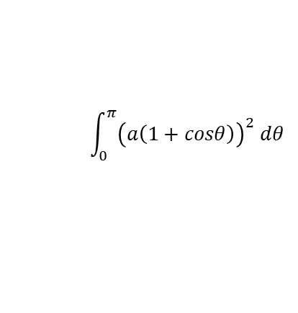


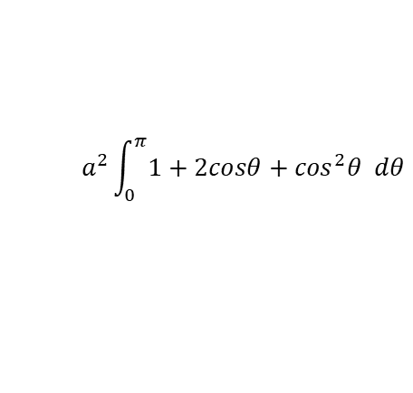

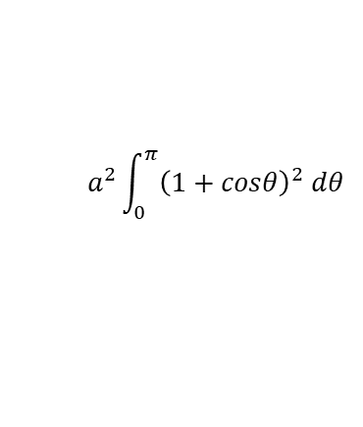
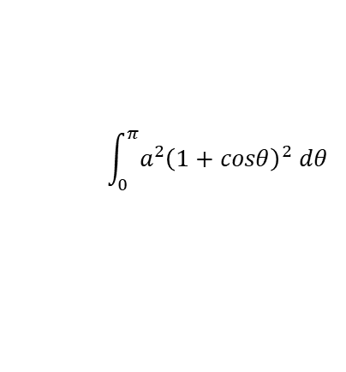
Polar Coordinates
$$Area=\frac{1}{2}\int_{α}^{β}{r^{2} dθ}$$
$$\frac{1}{2}\int_{α}^{β}{r^{2} dθ}$$
You can use Integration to find areas of sectors of curves, given their Polar equations
Find the area enclosed by the cardioid with equation:
r = a(1 + cosθ)
Sketch the graph (you won’t always be asked to do this, but you should do as it helps visualise the question…)
As we will be doubling our answer at the end, we can just remove the ‘¹/₂’ now to save us doing it later!
$$\int_{α}^{β}{r^{2} dθ}$$
Sub in values
$$\int_{0}^{π}{{\left(a\left(1+cosθ\right)\right)}^{2} dθ}$$
Square it all
$$\int_{0}^{π}{a^{2}{\left(1+cosθ\right)}^{2} dθ}$$
You can put the ‘a²’ term outside the integral, since it is a constant
$$a^{2}\int_{0}^{π}{{\left(1+cosθ\right)}^{2} dθ}$$
Multiply the bracket out
$$r=a(1+cosθ)$$
$$a^{2}\int_{0}^{π}{1+2cosθ+\cos^{2}θ dθ}$$
$$α=0$$
$$β=π$$
We will need to rewrite the cos² term so we can integrate it (using ‘standard patterns’ from the regular Maths course will not work here as we would get additional terms other than cos…)
5C

Slide 11


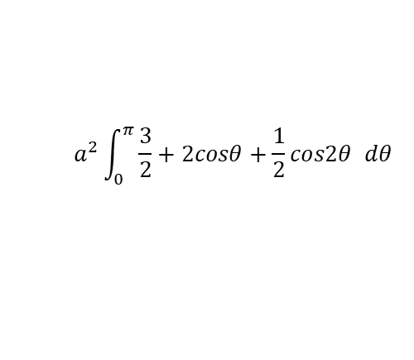
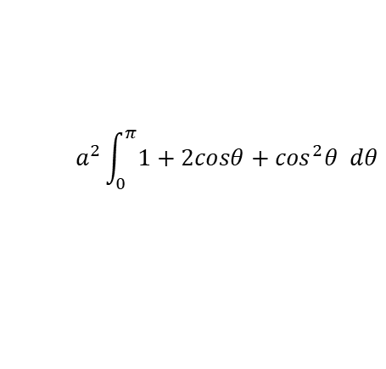
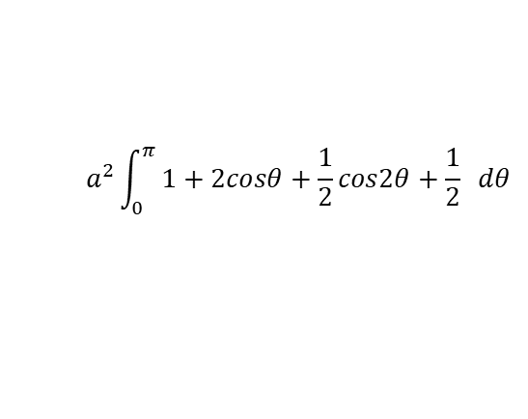


Polar Coordinates
$$Area=\frac{1}{2}\int_{α}^{β}{r^{2} dθ}$$
$$cos2θ=2\cos^{2}θ−1$$
$$a^{2}\int_{0}^{π}{1+2cosθ+\cos^{2}θ dθ}$$
You can use Integration to find areas of sectors of curves, given their Polar equations
Find the area enclosed by the cardioid with equation:
r = a(1 + cosθ)
Sketch the graph (you won’t always be asked to do this, but you should do as it helps visualise the question…)
Replace cos²θ
$$a^{2}\int_{0}^{π}{1+2cosθ+\frac{1}{2}cos2θ+\frac{1}{2} dθ}$$
Group like terms
$$a^{2}\int_{0}^{π}{\frac{3}{2}+2cosθ+\frac{1}{2}cos2θ dθ}$$
Now we can think about actually Integrating!
To replace cos²θ, we can use the formula for cos2θ from Pure Maths…
$$cos2θ=2\cos^{2}θ−1$$
$$r=a(1+cosθ)$$
Add 1
$$cos2θ+1=2\cos^{2}θ$$
$$α=0$$
$$β=π$$
Divide by 2
$$\frac{1}{2}cos2θ+\frac{1}{2}=\cos^{2}θ$$
5C

Slide 12



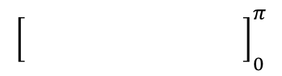


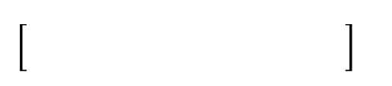





Polar Coordinates
$$Area=\frac{1}{2}\int_{α}^{β}{r^{2} dθ}$$
$$cos2θ=2\cos^{2}θ−1$$
$$a^{2}\int_{0}^{π}{1+2cosθ+\cos^{2}θ dθ}$$
You can use Integration to find areas of sectors of curves, given their Polar equations
Find the area enclosed by the cardioid with equation:
r = a(1 + cosθ)
Sketch the graph (you won’t always be asked to do this, but you should do as it helps visualise the question…)
Replace cos²θ
$$a^{2}\int_{0}^{π}{1+2cosθ+\frac{1}{2}cos2θ+\frac{1}{2} dθ}$$
Group like terms
$$a^{2}\int_{0}^{π}{\frac{3}{2}+2cosθ+\frac{1}{2}cos2θ dθ}$$
Integrate each term with respect to θ, using the ‘standard patterns’ technique
ie) Think about what would differentiate to give these, then adjust it to give the correct coefficient
$${\left[\begin{matrix} \\ \end{matrix} \right]}_{0}^{π}$$
$$a^{2}$$
$$\frac{3}{2}θ$$
$$+ 2sinθ$$
$$+ \frac{1}{4}sin2θ$$
Sub π in and 0 in separately, and subtract
$$\frac{3}{2}π+0+0$$
$$−\left(\begin{matrix} \\ \end{matrix} \right)$$
$$a^{2}$$
$$0+0+0$$
$$r=a(1+cosθ)$$
$$α=0$$
$$β=π$$
Calculate
$$\frac{3πa^{2}}{2}$$
Show full workings, even if it takes a while. It is very easy to make mistakes here!
5C

Slide 13
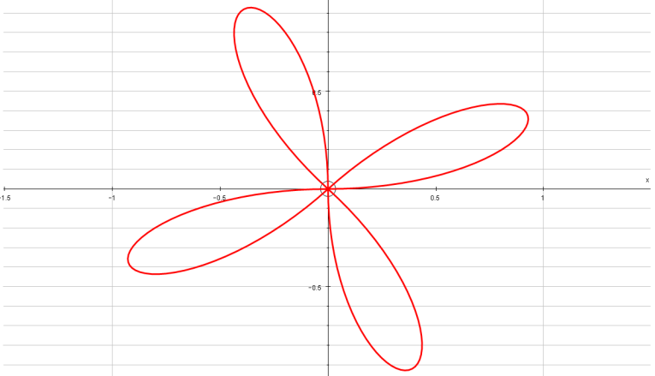
Polar Coordinates
$$Area=\frac{1}{2}\int_{α}^{β}{r^{2} dθ}$$
Think about plotting r = asin4θ
You can use Integration to find areas of sectors of curves, given their Polar equations
Find the area of one loop of the curve with polar equation:
r = asin4θ
Start by sketching it…
From the patterns you have seen, you might recognise that this will have 4 ‘loops’
1
Sinθ
0
-1
^{π}/₂
π
^{3π}/₂
2π
→ From the Sine graph, you can see that r will be positive between 0 and π
As the graph repeats, r will also be positive between 2π and 3π, 4π and 5π, and 6π and 7π
So we would plot r for the following ranges of 4θ
0 ≤ 4θ ≤ π
2π ≤ 4θ ≤ 3π
4π ≤ 4θ ≤ 5π
6π ≤ 4θ ≤ 7π
0 ≤ θ ≤ ^{π}/₄
^{π}/₂ ≤ θ ≤ ^{3π}/₄
π ≤ θ ≤ ^{5π}/₄
^{3π}/₂ ≤ θ ≤ ^{7π}/₄
^{3π}/₄
^{π}/₂
^{π}/₄
Sometimes it helps to plot the ‘limits’ for positive values of r on your diagram!
π
0
^{5π}/₄
^{3π}/₂
^{7π}/₄
5C

Slide 14
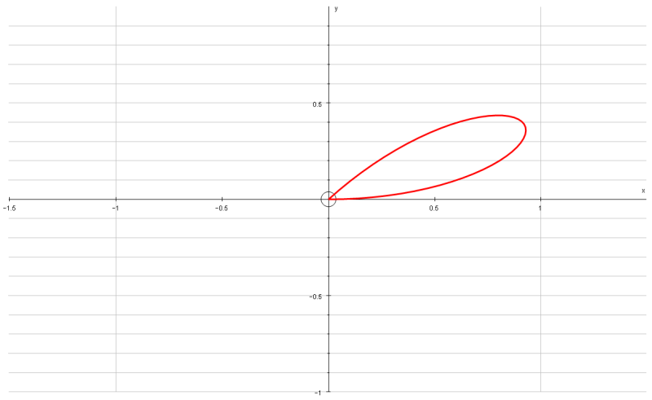




Polar Coordinates
$$Area=\frac{1}{2}\int_{α}^{β}{r^{2} dθ}$$
^{3π}/₄
^{π}/₂
^{π}/₄
You can use Integration to find areas of sectors of curves, given their Polar equations
Find the area of one loop of the curve with polar equation:
r = asin4θ
Start by sketching it…
From the patterns you have seen, you might recognise that this will have 4 ‘loops’
We only need to sketch one loop as this is what we need to find the area of (so this saves time!)
π
0
^{5π}/₄
^{3π}/₂
^{7π}/₄
So the values we need to use for one loop are:
$$r=asin4θ$$
$$α=0$$
$$β=\frac{π}{4}$$
We will substitute these into the formula for the area…
$$Area=\frac{1}{2}\int_{α}^{β}{r^{2} dθ}$$
5C

Slide 15
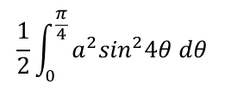

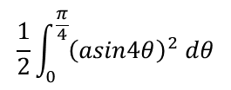


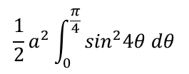
Polar Coordinates
$$Area=\frac{1}{2}\int_{α}^{β}{r^{2} dθ}$$
$$\frac{1}{2}\int_{α}^{β}{r^{2} dθ}$$
You can use Integration to find areas of sectors of curves, given their Polar equations
Find the area of one loop of the curve with polar equation:
r = asin4θ
Replace r and the limits we worked out
$$\frac{1}{2}\int_{0}^{\frac{π}{4}}{{\left(asin4θ\right)}^{2} dθ}$$
Square the bracket
$$\frac{1}{2}\int_{0}^{\frac{π}{4}}{a^{2}\sin^{2}4θ dθ}$$
Similar to last time, you can take the ‘a²’ term and put it outside the integral
$$\frac{1}{2}a^{2}\int_{0}^{\frac{π}{4}}{\sin^{2}4θ dθ}$$
$$r=asin4θ$$
$$α=0$$
$$β=\frac{π}{4}$$
We will need to write sin²4θ so that we can integrate it (by writing is as sin or cos without any powers)
5C

Slide 16

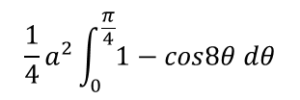

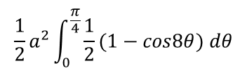
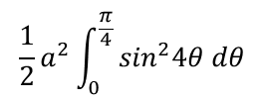



Polar Coordinates
$$Area=\frac{1}{2}\int_{α}^{β}{r^{2} dθ}$$
$$cos2θ=1−2\sin^{2}θ$$
$$\frac{1}{2}a^{2}\int_{0}^{\frac{π}{4}}{\sin^{2}4θ dθ}$$
You can use Integration to find areas of sectors of curves, given their Polar equations
Find the area of one loop of the curve with polar equation:
r = asin4θ
Replace sin²4θ
$$\frac{1}{2}a^{2}\int_{0}^{\frac{π}{4}}{\frac{1}{2}(1−cos8θ) dθ}$$
Before integrating, you can take the ‘¹/₂’ outside the integral as well…
$$\frac{1}{4}a^{2}\int_{0}^{\frac{π}{4}}{1−cos8θ dθ}$$
$$β=\frac{π}{4}$$
Now this has been set up, we can actually Integrate it!
$$r=asin4θ$$
$$α=0$$
To replace sin²4θ, we can use another formula for cos2θ from C3…
$$cos2θ=1−2\sin^{2}θ$$
Rearrange
$$2\sin^{2}θ=1−cos2θ$$
$$\sin^{2}θ=\frac{1}{2}\left(1−cos2θ\right)$$
Divide by 2
Multiply the θ terms by 4
$$\sin^{2}4θ=\frac{1}{2}(1−cos8θ)$$
5C

Slide 17


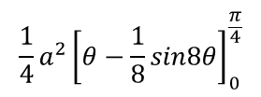
Polar Coordinates
$$Area=\frac{1}{2}\int_{α}^{β}{r^{2} dθ}$$
$$cos2θ=1−2\sin^{2}θ$$
$$\frac{1}{2}a^{2}\int_{0}^{\frac{π}{4}}{\sin^{2}4θ dθ}$$
You can use Integration to find areas of sectors of curves, given their Polar equations
Find the area of one loop of the curve with polar equation:
r = asin4θ
Replace sin²4θ
$$\frac{1}{2}a^{2}\int_{0}^{\frac{π}{4}}{\frac{1}{2}(1−cos8θ) dθ}$$
Before integrating, you can take the ‘¹/₂’ outside the integral as well…
$$\frac{1}{4}a^{2}\int_{0}^{\frac{π}{4}}{1−cos8θ dθ}$$
Integrate using the ‘standard patterns’ technique
$$β=\frac{π}{4}$$
$$\frac{1}{4}a^{2}{\left[θ−\frac{1}{8}sin8θ\right]}_{0}^{\frac{π}{4}}$$
$$r=asin4θ$$
$$α=0$$
Sub in ^{π}/₄ (subbing in 0 will cancel all terms, so we don’t really need to work this part out
→ Remember that if you have ‘cos’, you would need to sub in 0!
$$\frac{1}{4}a^{2}\left[\frac{π}{4}−\frac{1}{8}sin2π\right]$$
Work out the exact value
$$=\frac{{πa}^{2}}{16}$$
Important points:
You sometimes have to do a lot of rearranging/substitution before you can Integrate
Your calculator might not give you exact values, so you need to find them yourself by manipulating the fractions
5C

Slide 18
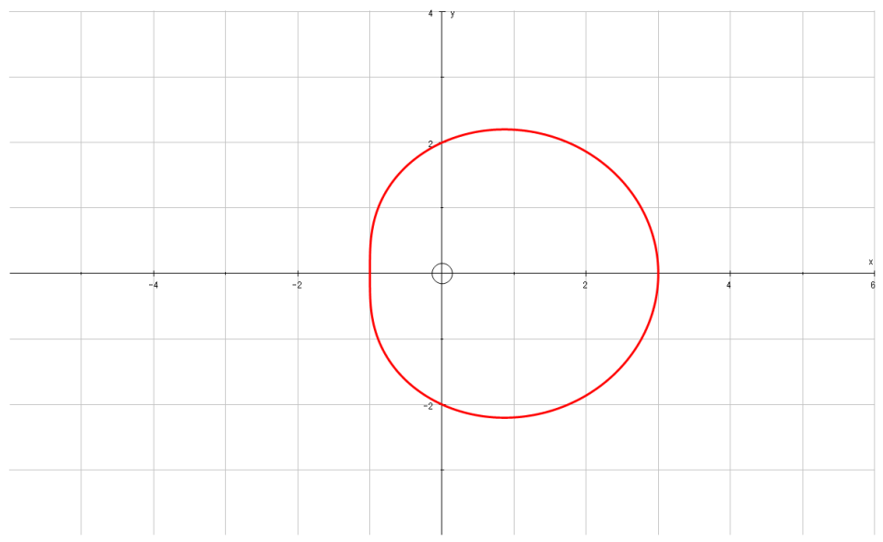

Polar Coordinates
$$Area=\frac{1}{2}\int_{α}^{β}{r^{2} dθ}$$
π 2
You can use Integration to find areas of sectors of curves, given their Polar equations
a) On the same diagram, sketch the curves with equations:
r = 2 + cosθ
r = 5cosθ
b) Find the polar coordinates of the intersection of these curves
c) Find the exact value of the finite region bounded by the 2 curves
2
$$r=2+cosθ$$
π
1
3
0, 2π
2
3π 2
Start by plotting the graph of r = 2 + cosθ
→ Use a table if it helps, to work out values when θ is 0, ^{π}/₂, π and ^{3π}/₂
5C

Slide 19
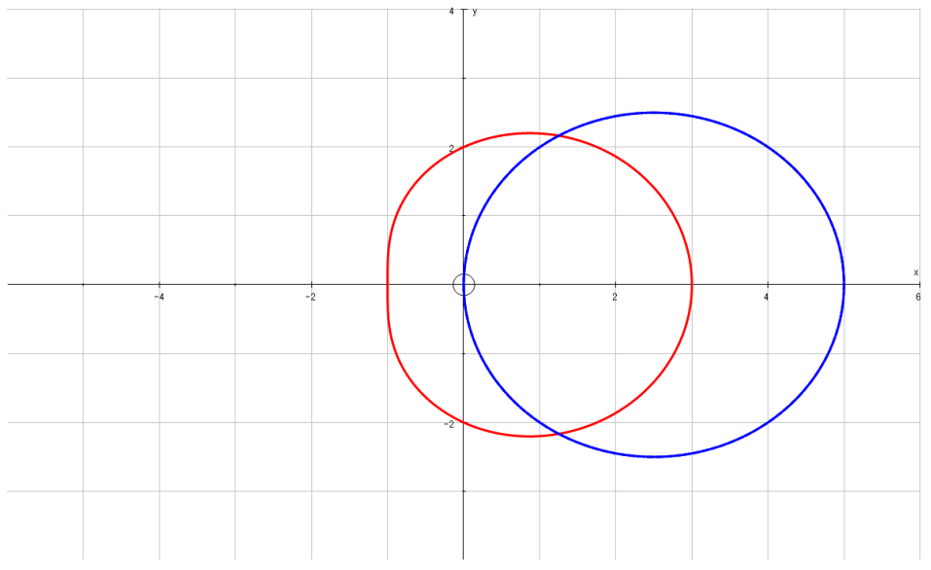

Polar Coordinates
$$Area=\frac{1}{2}\int_{α}^{β}{r^{2} dθ}$$
π 2
You can use Integration to find areas of sectors of curves, given their Polar equations
a) On the same diagram, sketch the curves with equations:
r = 2 + cosθ
r = 5cosθ
b) Find the polar coordinates of the intersection of these curves
c) Find the exact value of the finite region bounded by the 2 curves
(^{π}/₄,^{5√2}/₂)
2
$$r=2+cosθ$$
π
0
5
1
3
0, 2π
2
$$r=5cosθ$$
(^{7π}/₄,^{5√2}/₂)
3π 2
Now plot the graph of r = 5cosθ
A Cos graph may be useful here as some values will be undefined…
Work out values of cos for 0, ^{π}/₄ and ^{π}/₂, as well as ^{3π}/₂, ^{7π}/₄ and 2π
(this way we will have enough points to use to work out the shape…)
1
Cosθ
0
-1
^{π}/₂
π
^{3π}/₂
2π
5C

Slide 20




Polar Coordinates
$$Area=\frac{1}{2}\int_{α}^{β}{r^{2} dθ}$$
π 2
You can use Integration to find areas of sectors of curves, given their Polar equations
a) On the same diagram, sketch the curves with equations:
r = 2 + cosθ
r = 5cosθ
b) Find the polar coordinates of the intersection of these curves
c) Find the exact value of the finite region bounded by the 2 curves
(2.5,^{π}/₃)
$$r=2+cosθ$$
π
0, 2π
$$r=5cosθ$$
(2.5,-^{π}/₃)
3π 2
To find the intersection, we can use the two equations we were given:
$$2+cosθ=5cosθ$$
Subtract cosθ
Using these values of θ, we can work out that r = 2.5 at these points
$$2=4cosθ$$
Divide by 4
$$0.5=cosθ$$
Inverse cos (and work out the other possible answer)
$$θ=\frac{π}{3}, −\frac{π}{3}$$
5C

Slide 21
Polar Coordinates
$$Area=\frac{1}{2}\int_{α}^{β}{r^{2} dθ}$$
π 2
You can use Integration to find areas of sectors of curves, given their Polar equations
a) On the same diagram, sketch the curves with equations:
r = 2 + cosθ
r = 5cosθ
b) Find the polar coordinates of the intersection of these curves
c) Find the exact value of the finite region bounded by the 2 curves
(2.5,^{π}/₃)
$$r=2+cosθ$$
π
0, 2π
$$r=5cosθ$$
(2.5,-^{π}/₃)
3π 2
The region we are finding the area of is highlighted in green
→ We can calculate the area of just the top part, and then double it (since the area is symmetrical)
5C

Slide 22
Polar Coordinates
$$Area=\frac{1}{2}\int_{α}^{β}{r^{2} dθ}$$
π 2
π 3
You can use Integration to find areas of sectors of curves, given their Polar equations
a) On the same diagram, sketch the curves with equations:
r = 2 + cosθ
r = 5cosθ
b) Find the polar coordinates of the intersection of these curves
c) Find the exact value of the finite region bounded by the 2 curves
$$r=2+cosθ$$
π
0
$$r=5cosθ$$
3π 2
You need to imagine the top part as two separate sections
Draw on the ‘limits’, and a line through the intersection, and you can see that this is two different areas
The area under the red curve with limits 0 and ^{π}/₃
The area under the blue curve with limits ^{π}/₃ and ^{π}/₂
We need to work both of these out and add them together!
5C

Slide 23






Polar Coordinates
$$Area=\frac{1}{2}\int_{α}^{β}{r^{2} dθ}$$
π 2
π 3
You can use Integration to find areas of sectors of curves, given their Polar equations
a) On the same diagram, sketch the curves with equations:
r = 2 + cosθ
r = 5cosθ
b) Find the polar coordinates of the intersection of these curves
c) Find the exact value of the finite region bounded by the 2 curves
$$r=2+cosθ$$
π
0
$$r=5cosθ$$
3π 2
For the red curve:
For the blue curve:
$$r=2+cosθ$$
$$r=5cosθ$$
$$α=0$$
$$α=\frac{π}{3}$$
$$β=\frac{π}{3}$$
$$β=\frac{π}{2}$$
5C

Slide 24




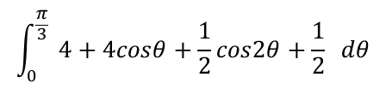

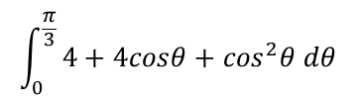

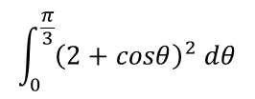


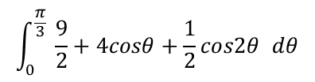
Polar Coordinates
$$Area=\frac{1}{2}\int_{α}^{β}{r^{2} dθ}$$
$$cos2θ=2\cos^{2}θ−1$$
For the red curve:
For the blue curve:
You can use Integration to find areas of sectors of curves, given their Polar equations
a) On the same diagram, sketch the curves with equations:
r = 2 + cosθ
r = 5cosθ
b) Find the polar coordinates of the intersection of these curves
c) Find the exact value of the finite region bounded by the 2 curves
→ Red curve first! Sub the values into the area equation
$$r=2+cosθ$$
$$r=5cosθ$$
$$α=0$$
$$β=\frac{π}{3}$$
$$α=\frac{π}{3}$$
$$β=\frac{π}{2}$$
$$\frac{1}{2}\int_{α}^{β}{r^{2} dθ}$$
Sub in the values from above
→ Also, remove the ‘¹/₂’ since we will be doubling our answer anyway!
$$\int_{0}^{\frac{π}{3}}{{\left(2+cosθ\right)}^{2} dθ}$$
$$\int_{0}^{\frac{π}{3}}{4+4cosθ+\cos^{2}θ dθ}$$
Square the bracket
Replace the cos²θ term with an equivalent expression (using the equation for cos2θ above)
$$\int_{0}^{\frac{π}{3}}{ 4+4cosθ+\frac{1}{2}cos2θ+\frac{1}{2} dθ}$$
Group like terms, and then we can integrate!
$$\int_{0}^{\frac{π}{3}}{ \frac{9}{2}+4cosθ+\frac{1}{2}cos2θ dθ}$$
5C

Slide 25


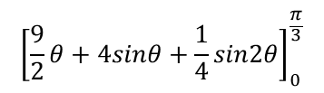

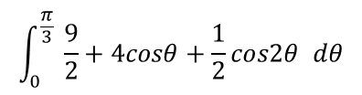

Polar Coordinates
$$Area=\frac{1}{2}\int_{α}^{β}{r^{2} dθ}$$
$$cos2θ=2\cos^{2}θ−1$$
For the red curve:
For the blue curve:
You can use Integration to find areas of sectors of curves, given their Polar equations
a) On the same diagram, sketch the curves with equations:
r = 2 + cosθ
r = 5cosθ
b) Find the polar coordinates of the intersection of these curves
c) Find the exact value of the finite region bounded by the 2 curves
→ Red curve first! Sub the values into the area equation
$$r=2+cosθ$$
$$r=5cosθ$$
$$α=0$$
$$β=\frac{π}{3}$$
$$α=\frac{π}{3}$$
$$β=\frac{π}{2}$$
$$\int_{0}^{\frac{π}{3}}{ \frac{9}{2}+4cosθ+\frac{1}{2}cos2θ dθ}$$
Integrate each term, using ‘standard patterns’ where needed…
$${\left[\frac{9}{2}θ+4sinθ+\frac{1}{4}sin2θ\right]}_{0}^{\frac{π}{3}}$$
Sub in the limits separately (as subbing in 0 will give 0 overall here, we can just ignore it!)
$$\frac{9}{2}\left(\frac{π}{3}\right)+4sin\left(\frac{π}{3}\right)+\frac{1}{4}sin\left(\frac{2π}{3}\right)$$
Calculate each part (your calculator may give you a decimal answer if you type the whole sum in)
$$\frac{3π}{2}+2\sqrt{3}+\frac{\sqrt{3}}{8}$$
Write with a common denominator
$$\frac{12π}{8}+\frac{16\sqrt{3}}{8}+\frac{\sqrt{3}}{8}$$
Group up
$$\frac{12π+17\sqrt{3}}{8}$$
5C

Slide 26

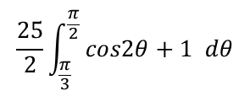
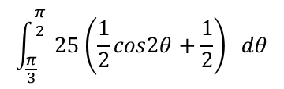
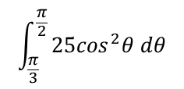
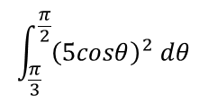
Polar Coordinates
$$Area=\frac{1}{2}\int_{α}^{β}{r^{2} dθ}$$
$$cos2θ=2\cos^{2}θ−1$$
For the red curve:
For the blue curve:
You can use Integration to find areas of sectors of curves, given their Polar equations
a) On the same diagram, sketch the curves with equations:
r = 2 + cosθ
r = 5cosθ
b) Find the polar coordinates of the intersection of these curves
c) Find the exact value of the finite region bounded by the 2 curves
→ Now we can do the same for the blue part…
$$r=5cosθ$$
$$Area=\frac{12π+17\sqrt{3}}{8}$$
$$α=\frac{π}{3}$$
$$β=\frac{π}{2}$$
$$\frac{1}{2}\int_{α}^{β}{r^{2} dθ}$$
Sub in the values from above
→ Also, remove the ‘¹/₂’ since we will be doubling our answer anyway!
$$\int_{\frac{π}{3}}^{\frac{π}{2}}{{\left(5cosθ\right)}^{2} dθ}$$
$$\int_{\frac{π}{3}}^{\frac{π}{2}}{25\cos^{2}θ dθ}$$
Square the bracket
Replace the cos²θ term with an equivalent expression (using the equation for cos 2θ above)
$$\int_{\frac{π}{3}}^{\frac{π}{2}}{ 25\left(\frac{1}{2}cos2θ+\frac{1}{2}\right) dθ}$$
We can move the ‘¹/₂’ and the 25 outside to make the integration a little easier
$$\frac{25}{2}\int_{\frac{π}{3}}^{\frac{π}{2}}{ cos2θ+1 dθ}$$
5C

Slide 27
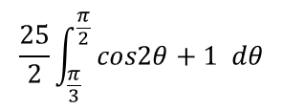




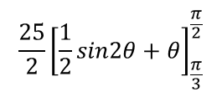
Polar Coordinates
$$Area=\frac{1}{2}\int_{α}^{β}{r^{2} dθ}$$
$$cos2θ=2\cos^{2}θ−1$$
For the red curve:
For the blue curve:
You can use Integration to find areas of sectors of curves, given their Polar equations
a) On the same diagram, sketch the curves with equations:
r = 2 + cosθ
r = 5cosθ
b) Find the polar coordinates of the intersection of these curves
c) Find the exact value of the finite region bounded by the 2 curves
→ Now we can do the same for the blue part…
$$r=5cosθ$$
$$Area=\frac{12π+17\sqrt{3}}{8}$$
$$α=\frac{π}{3}$$
$$β=\frac{π}{2}$$
$$\frac{25}{2}\int_{\frac{π}{3}}^{\frac{π}{2}}{ cos2θ+1 dθ}$$
Integrate each term, using ‘standard patterns’ if needed…
$$\frac{25}{2}{\left[\frac{1}{2}sin2θ+θ\right]}_{\frac{π}{3}}^{\frac{π}{2}}$$
Sub in the limits (we do need to include both this time as neither will cancel a whole section out!)
$$\frac{25}{2}\left[\left(\frac{1}{2}sinπ+\frac{π}{2}\right)−\left(\frac{1}{2}sin\frac{2π}{3}+\frac{π}{3}\right)\right]$$
Calculate each part as an exact value
$$\frac{25}{2}\left[\left(\frac{π}{2}\right)−\left(\frac{\sqrt{3}}{4}+\frac{π}{3}\right)\right]$$
Write with common denominators
$$\frac{25}{2}\left[\left(\frac{6π}{12}\right)−\left(\frac{3\sqrt{3}}{12}+\frac{4π}{12}\right)\right]$$
Group up and multiply by ²⁵/₂
$$\frac{50π−75\sqrt{3}}{24}$$
5C

Slide 28





Polar Coordinates
$$Area=\frac{1}{2}\int_{α}^{β}{r^{2} dθ}$$
$$cos2θ=2\cos^{2}θ−1$$
For the red curve:
For the blue curve:
You can use Integration to find areas of sectors of curves, given their Polar equations
a) On the same diagram, sketch the curves with equations:
r = 2 + cosθ
r = 5cosθ
b) Find the polar coordinates of the intersection of these curves
c) Find the exact value of the finite region bounded by the 2 curves
$$Area=\frac{12π+17\sqrt{3}}{8}$$
$$Area=\frac{50π−75\sqrt{3}}{24}$$
Add these two areas together to get the total area!
$$\frac{12π+17\sqrt{3}}{8}+\frac{50π−75\sqrt{3}}{24}$$
Write with a common denominator
$$\frac{36π+51\sqrt{3}}{24}+\frac{50π−75\sqrt{3}}{24}$$
Add the numerators
$$\frac{86π−24\sqrt{3}}{24}$$
Divide all by 2
$$\frac{43π−12\sqrt{3}}{12}$$
These questions are often worth a lot of marks!
Your calculate might not give you exact values for long sums, so you will need to be able to deal with the surds and fractions yourself!
5C

Slide 29
Exercise 5C
Pearson Core Pure Year 2
Page 111-112
Complete before the lesson Q1
In Class:
Green Q2-3
Amber Q4-5
Red Q6-9 & Challenge

