Slide 1

Further Stats 1 ::
Discrete Random Variables
jfrost@tiffin.kingston.sch.uk
www.drfrostmaths.com
@DrFrostMaths
Last modified: 16th July 2018

Slide 2



Register at: www.drfrostmaths.com
Everything is completely free.
Practise questions by chapter, including past paper questions and extension questions (e.g. MAT).
Teachers: you can create student accounts (or students can register themselves).

Slide 3
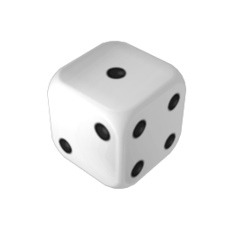
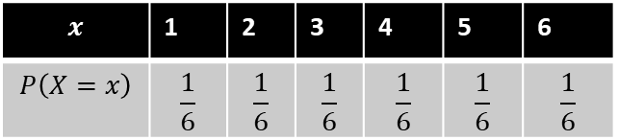
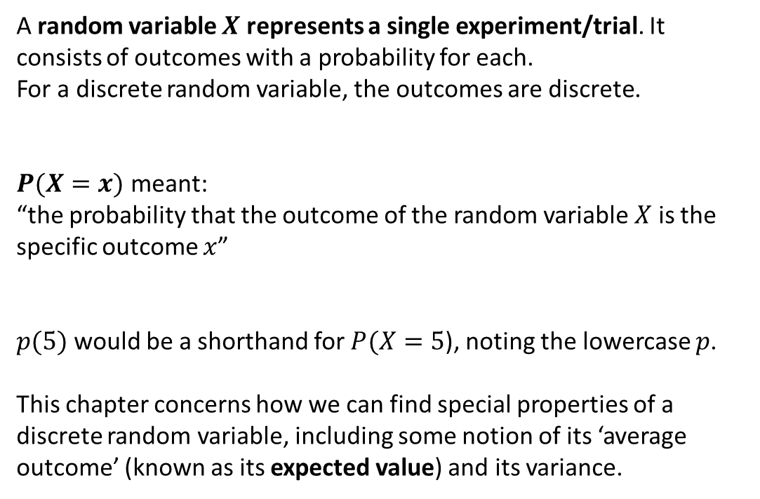
Recap of Discrete Random Variables
$$x$$ | 1 | 2 | 3 | 4 | 5 | 6
$$P\left(X=x\right)$$ | $$\frac{1}{6}$$ | $$\frac{1}{6}$$ | $$\frac{1}{6}$$ | $$\frac{1}{6}$$ | $$\frac{1}{6}$$ | $$\frac{1}{6}$$
A random variable $X$ represents a single experiment/trial. It consists of outcomes with a probability for each.
For a discrete random variable, the outcomes are discrete.
$P(X=x)$ meant:
“the probability that the outcome of the random variable $X$ is the specific outcome $x$”
$p(5)$ would be a shorthand for $P(X=5$), noting the lowercase $p$.
This chapter concerns how we can find special properties of a discrete random variable, including some notion of its ‘average outcome’ (known as its expected value) and its variance.
?

Slide 4
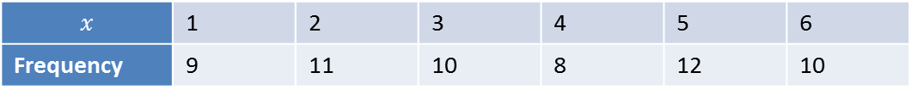
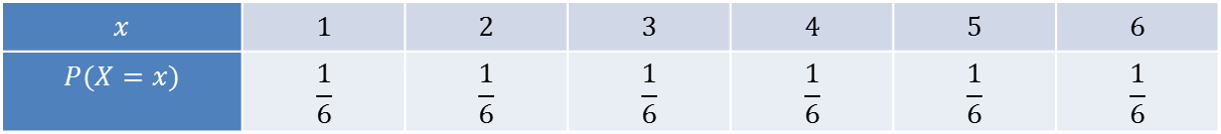
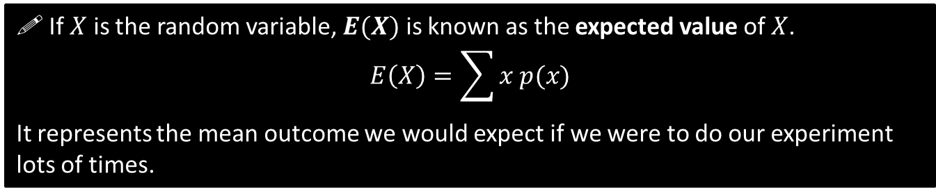
Expected Value, $E\left(X\right)$
Suppose that we throw a single fair die 60 times, and see the following outcomes:
$$x$$ | $$1$$ | $$2$$ | $$3$$ | $$4$$ | $$5$$ | $$6$$
$$P(X=x)$$ | $$\frac{1}{6}$$ | $$\frac{1}{6}$$ | $$\frac{1}{6}$$ | $$\frac{1}{6}$$ | $$\frac{1}{6}$$ | $$\frac{1}{6}$$
Throw a lot of times.
$$x$$ | 1 | 2 | 3 | 4 | 5 | 6
Frequency | 9 | 11 | 10 | 8 | 12 | 10
What is the mean outcome based on our sample? $\overline{x}=3.55$
?
But using the actual probabilities of each outcome (i.e. 1/6 for each), what would we expect the average outcome to be?
3.5
?
! If $X$ is the random variable, $E(X)$ is known as the expected value of $X$.
$$E\left(X\right)=\sum{x p(x)}$$
It represents the mean outcome we would expect if we were to do our experiment lots of times.
For our fair die: $E\left(X\right)=\left(1×\frac{1}{6}\right)+\left(2×\frac{1}{6}\right)+\left(3×\frac{1}{6}\right)+\left(4×\frac{1}{6}\right)+\left(5×\frac{1}{6}\right)+\left(6×\frac{1}{6}\right)=3.5$
?

Slide 5


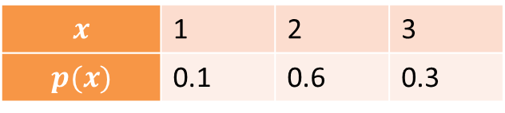
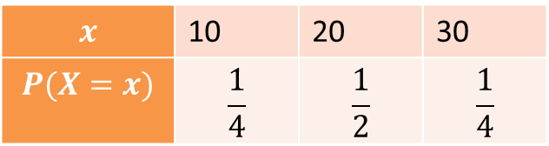

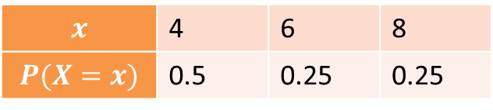
Quickfire E[X]
Find the expected value of the following distributions (in your head!).
$$x$$ | 1 | 2 | 3
$$p(x)$$ | 0.1 | 0.6 | 0.3
$$x$$ | 4 | 6 | 8
$$P(X=x)$$ | 0.5 | 0.25 | 0.25
$$E\left(X\right)=2.2$$
$$E\left(X\right)=5.5$$
?
?
Fro Tip: Suppose you treated the probabilities as frequencies then found the mean of the ‘frequency table’. What do you notice?
$$x$$ | 10 | 20 | 30
$$P(X=x)$$ | $$\frac{1}{4}$$ | $$\frac{1}{2}$$ | $$\frac{1}{4}$$
$$E\left(X\right)=20$$
?
Fro Tip: If the distribution is ‘symmetrical’, i.e. both the outcomes and probabilities are symmetrical about the centre, then the expected value is this central value.

Slide 6

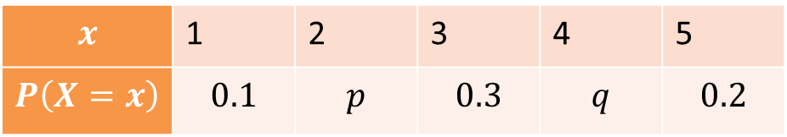
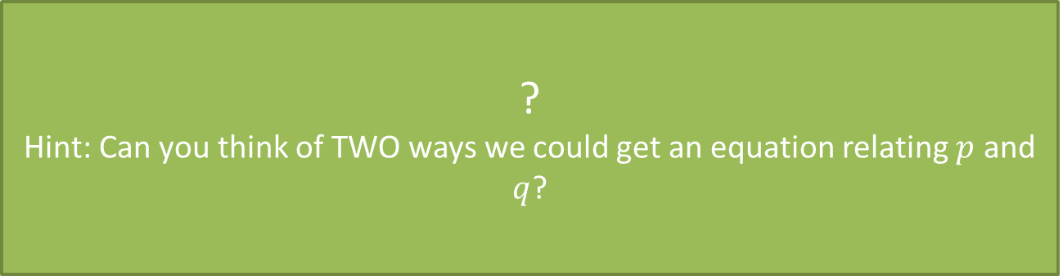
Harder Example
$$x$$ | 1 | 2 | 3 | 4 | 5
$$P\left(X=x\right)$$ | $$0.1$$ | $$p$$ | $$0.3$$ | $$q$$ | $$0.2$$
Given that $E\left(X\right)=3$, find the values of $p$ and $q$.
Probabilities add to 1: $p+q+0.1+0.3+0.2=1$
Expected value: $0.1+2p+0.9+4q+1=3$
Solving simultaneous equations:
$$p=0.3, q=0.1$$
?
Hint: Can you think of TWO ways we could get an equation relating $p$ and $q$?

Slide 7
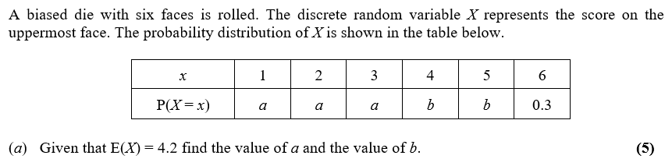
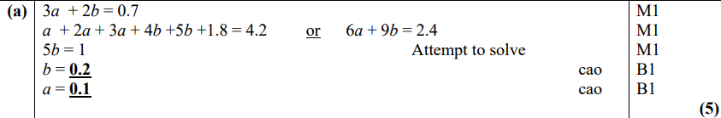
Test Your Understanding So Far
Edexcel S1(Old) June 2013 Q5
?

Slide 8
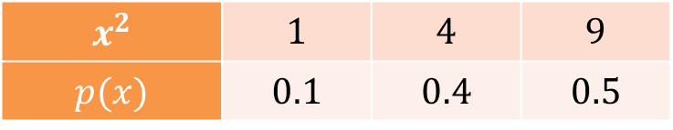
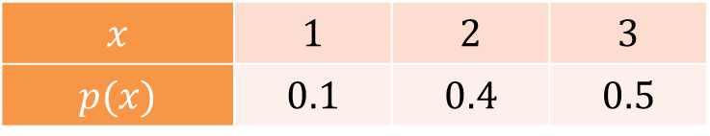

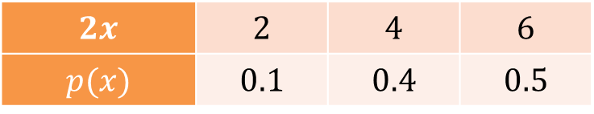


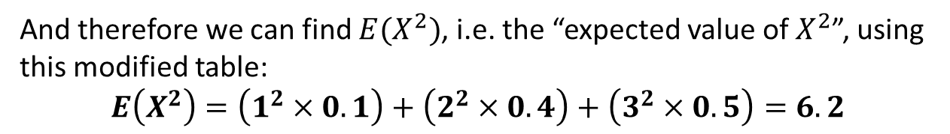
Calculating $E\left(X^{2}\right), E\left(2X\right), …$
If $X$ is the original random variable:
$$x$$ | $$1$$ | $$2$$ | $$3$$
$$p(x)$$ | $$0.1$$ | $$0.4$$ | $$0.5$$
then $2X$ would represent:
$$2x$$ | $$2$$ | $$4$$ | $$6$$
$$p(x)$$ | $$0.1$$ | $$0.4$$ | $$0.5$$
the same distribution but with each outcome replaced with double its value (note that the probabilities are unaffected)
and similarly $X^{2}$ would be:
$$x^{2}$$ | $$1$$ | $$4$$ | $$9$$
$$p(x)$$ | $$0.1$$ | $$0.4$$ | $$0.5$$
And therefore we can find $E(X^{2})$, i.e. the “expected value of $X^{2}$”, using this modified table:
$$E\left(X^{2}\right)=\left(1^{2}×0.1\right)+\left(2^{2}×0.4\right)+\left(3^{2}×0.5\right)=6.2$$
?

Slide 9
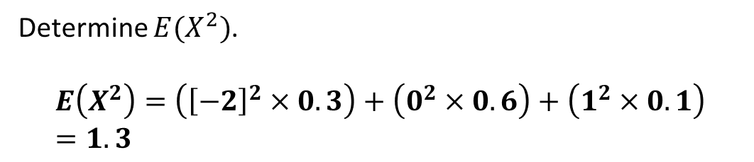
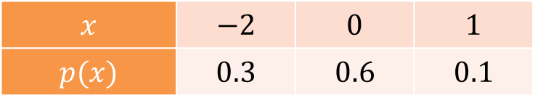
Test Your Understanding
$$x$$ | $$−2$$ | $$0$$ | $$1$$
$$p(x)$$ | $$0.3$$ | $$0.6$$ | $$0.1$$
Determine $E(X^{2})$.
$$E\left(X^{2}\right)=\left({\left[−2\right]}^{2}×0.3\right)+\left(0^{2}×0.6\right)+\left(1^{2}×0.1\right) \\ =1.3$$
?

Slide 10
Exercise 1A
Pearson Pure Mathematics Year 1/AS
Pages 4-5
Complete before the lesson Q2
In Class:
Green Q3-4
Amber Q5-6
Red Q7-9 & Challenge

Slide 11
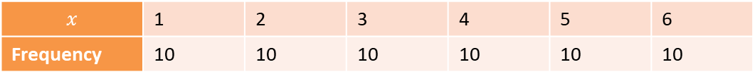
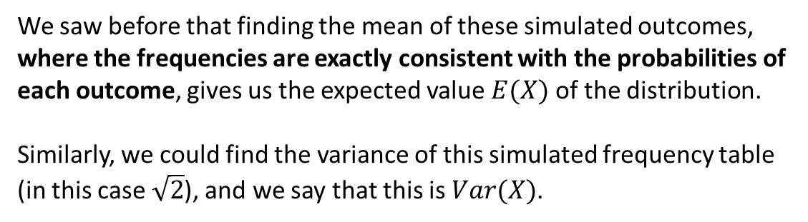
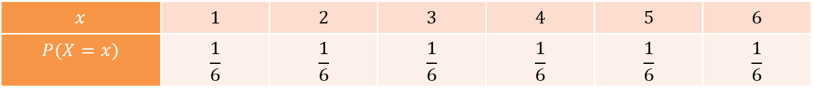
Variance $Var\left(X\right)$
Again, imagine that we throw a fair die 60 times, and that we get the ‘expected’ frequencies for each outcome.
$$x$$ | $$1$$ | $$2$$ | $$3$$ | $$4$$ | $$5$$ | $$6$$
$$P(X=x)$$ | $$\frac{1}{6}$$ | $$\frac{1}{6}$$ | $$\frac{1}{6}$$ | $$\frac{1}{6}$$ | $$\frac{1}{6}$$ | $$\frac{1}{6}$$
Throw 60 times.
$$x$$ | 1 | 2 | 3 | 4 | 5 | 6
Frequency | 10 | 10 | 10 | 10 | 10 | 10
We saw before that finding the mean of these simulated outcomes, where the frequencies are exactly consistent with the probabilities of each outcome, gives us the expected value $E(X)$ of the distribution.
Similarly, we could find the variance of this simulated frequency table (in this case $\sqrt{2}$), and we say that this is $Var(X)$.

Slide 12
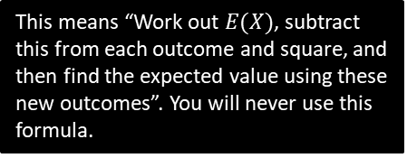
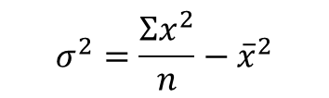

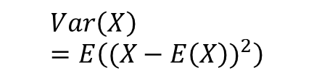
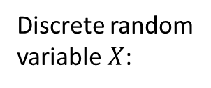
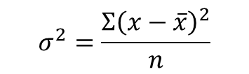
Formulae for $Var(X)$
Based on original definition of variance:
“The average squared distance from the mean.”
Simplified formula:
“Mean of the squares minus the square of the mean.”
?
?
$$σ^{2}=\frac{Σ{\left(x−\overline{x}\right)}^{2}}{n}$$
$$σ^{2}=\frac{Σx^{2}}{n}−{\overline{x}}^{2}$$
Listed data:
Discrete random variable $X$:
?
$$Var\left(X\right)=E\left((X−E{\left(X\right))}^{2}\right)$$
$$Var\left(X\right)=E\left(X^{2}\right)−E{\left(X\right)}^{2}$$
?
This means “Work out $E(X)$, subtract this from each outcome and square, and then find the expected value using these new outcomes”. You will never use this formula.

Slide 13
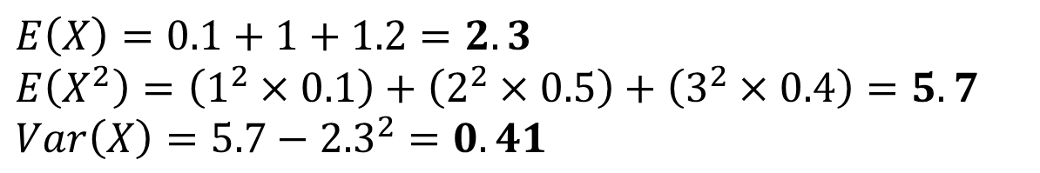
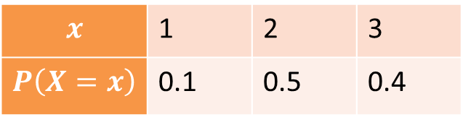
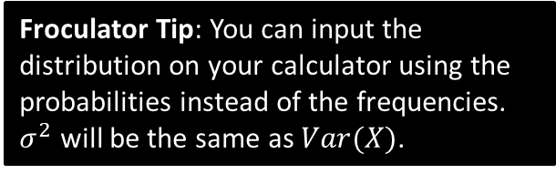
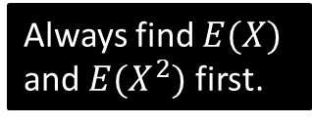
Example
$$x$$ | 1 | 2 | 3
$$P\left(X=x\right)$$ | 0.1 | 0.5 | 0.4
Always find $E(X)$ and $E(X^{2})$ first.
?
$$E\left(X\right)=0.1+1+1.2=2.3$$
$E\left(X^{2}\right)=\left(1^{2}×0.1\right)+\left(2^{2}×0.5\right)+\left(3^{2}×0.4\right)=5.7$
$$Var\left(X\right)=5.7−{2.3}^{2}=0.41$$
?
?
Froculator Tip: You can input the distribution on your calculator using the probabilities instead of the frequencies. $σ^{2}$ will be the same as $Var(X)$.

Slide 14
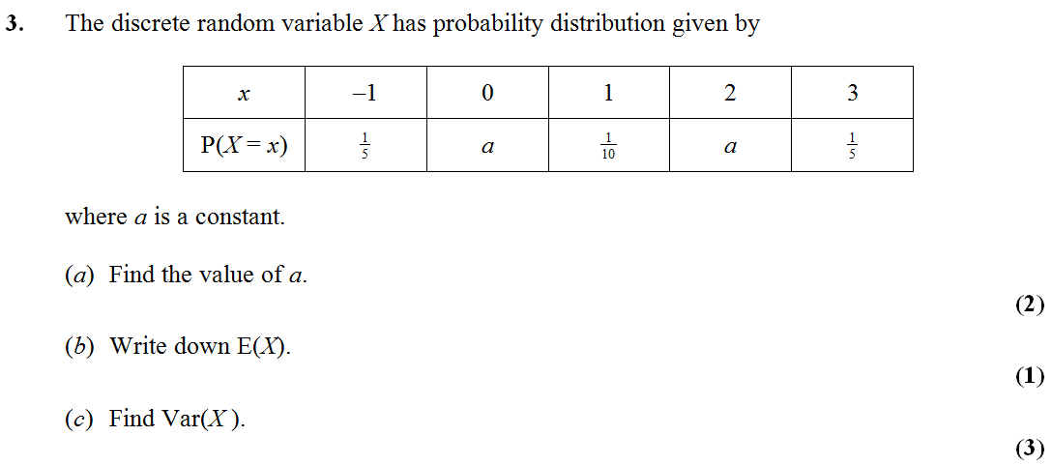
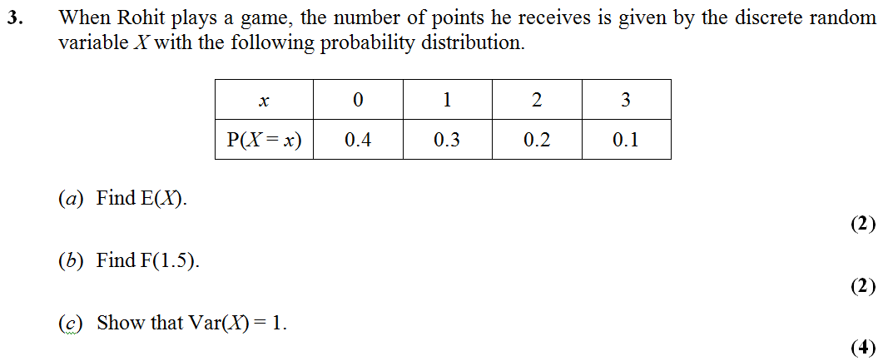




Test Your Understanding
Edexcel S1(Old) May 2010
$$a=\frac{1}{4}$$
?
?
$$E\left(X\right)=1$$
?
$E\left(X^{2}\right)=3.1$ So $Var\left(X\right)=3.1−1^{2}=2.1$
Edexcel S1(Old) Jan 2009
?
= 1
?
$E\left(X^{2}\right)=2$. So $Var\left(X\right)=2−1^{2}=1$

Slide 15
Exercise 1B
Pearson Pure Mathematics Year 1/AS
Pages 6-7
Complete before the lesson Q2
In Class:
Green Q3
Amber Q4-5
Red Q6-7

Slide 16

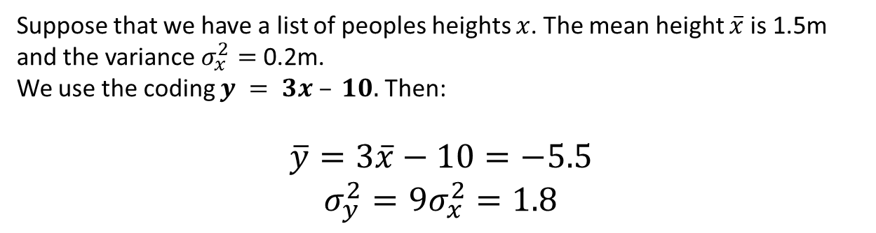
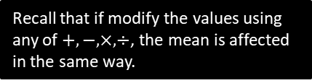
Coding
Recap
Suppose that we have a list of peoples heights $x$. The mean height $\overline{x}$ is 1.5m and the variance $σ_{x}^{2}=$ 0.2m.
We use the coding $y = 3x – 10.$ Then:
$$\overline{y}=3\overline{x}−10=−5.5$$
$$σ_{y}^{2}=9σ_{x}^{2}=1.8$$
Recall that if modify the values using any of $+,−,×,÷$, the mean is affected in the same way.
?
?
Recall that adding and subtracting doesn’t affect the variance, but multiplying or dividing by a constant has this affect using the square of this scale factor.
The same applies to $E(X)$ and $Var(X)$:
$E\left(X+10\right)=E\left(X\right)+10$
$$E\left(3X\right)=3E\left(X\right) \\ Var\left(3X\right)=9Var\left(X\right)$$
?
?
Adding 10 to all values adds 10 to the expected value.
?

Slide 17

Quickfire Coding
Express these in terms of the original $E\left(X\right)$ and $Var\left(X\right)$.
?
$$E\left(4X+1\right)=4E\left(X\right)+1 \\ E\left(1−X\right)=1−E\left(X\right) \\ Var\left(4X\right)=16Var\left(X\right) \\ Var\left(X+1\right)=Var\left(X\right) \\ Var\left(3X+2\right)=9Var\left(X\right) \\ E\left(\frac{X−1}{2}\right)=\frac{E\left(X\right)−1}{2} \\ Var\left(\frac{X−1}{2}\right)=\frac{1}{4}Var\left(X\right)$$
?
?
?
?
?
?

Slide 18
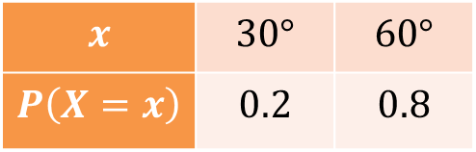
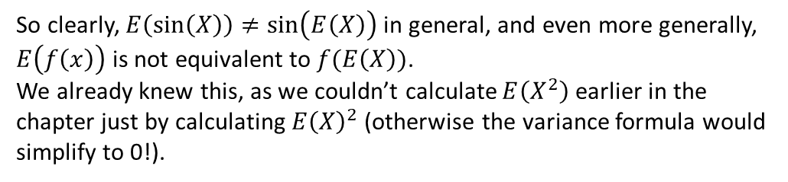
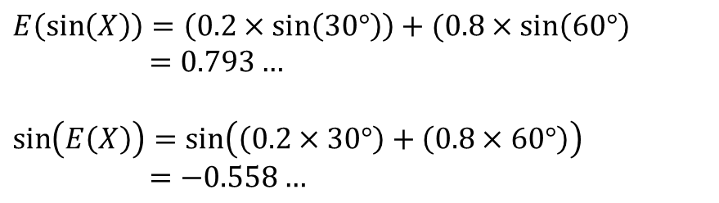
But this only applies to linear codings…
You might wonder if applies to all codings, including non-linear ones.
Is for example $E\left(\sin\left(X\right)\right)=sin⁡(E\left(X\right))$ in the same way that $E\left(2X\right)=2E(X)$?
$$x$$ | $$30°$$ | $$60°$$
$$P\left(X=x\right)$$ | $$0.2$$ | $$0.8$$
$$E\left(\sin\left(X\right)\right)=\left(0.2×\sin\left(30°\right)\right)+(0.8×\sin\left(60°\right) \\ =0.793…$$
$$\sin\left(E\left(X\right)\right)=\sin\left(\left(0.2×30°\right)+\left(0.8×60°\right)\right) \\ =−0.558…$$
?
?
So clearly, $E\left(\sin\left(X\right)\right)≠\sin\left(E\left(X\right)\right)$ in general, and even more generally, $E\left(f\left(x\right)\right)$ is not equivalent to $f(E\left(X\right))$.
We already knew this, as we couldn’t calculate $E\left(X^{2}\right)$ earlier in the chapter just by calculating $E{\left(X\right)}^{2}$ (otherwise the variance formula would simplify to 0!).

Slide 19
Exercise 1C
Pearson Pure Mathematics Year 1/AS
Pages 10-11
Complete before the lesson Q1
In Class:
Green Q2-4
Amber Q5
Red Q6-9 & Challenge

Slide 20
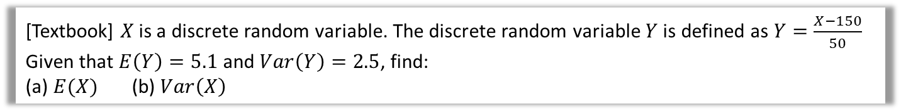
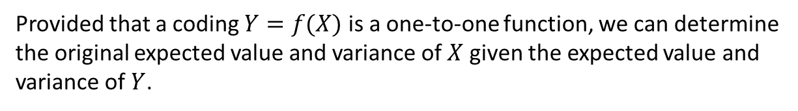

Problem Solving
Provided that a coding $Y=f(X)$ is a one-to-one function, we can determine the original expected value and variance of $X$ given the expected value and variance of $Y$.
[Textbook] $X$ is a discrete random variable. The discrete random variable $Y$ is defined as $Y=\frac{X−150}{50}$
Given that $E\left(Y\right)=5.1$ and $Var\left(Y\right)=2.5$, find:
(a) $E(X)$ (b) $Var\left(X\right)$
?
a
$$E\left(Y\right)=E\left(\frac{X−150}{50}\right)=\frac{E\left(X\right)−150}{50} \\ ∴E\left(X\right)=\left(50×5.1\right)+150=405$$
$$Var\left(Y\right)=\frac{Var\left(X\right)}{{50}^{2}} \\ ∴Var\left(X\right)=2.5×{50}^{2}=6250$$
b
?

Slide 21
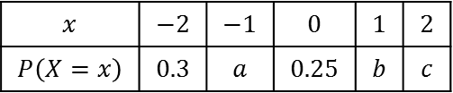
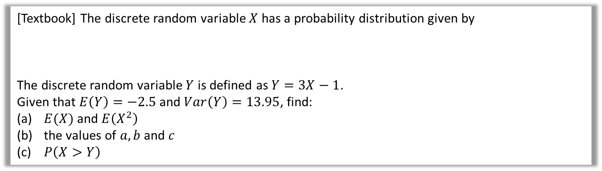



Problem Solving
[Textbook] The discrete random variable $X$ has a probability distribution given by
The discrete random variable $Y$ is defined as $Y=3X−1$.
Given that $E\left(Y\right)=−2.5$ and $Var\left(Y\right)=13.95$, find:
$E(X)$ and $E\left(X^{2}\right)$
the values of $a, b$ and $c$
$P\left(X>Y\right)$
$$x$$ | $$−2$$ | $$−1$$ | $$0$$ | $$1$$ | $$2$$
$$P\left(X=x\right)$$ | $$0.3$$ | $$a$$ | $$0.25$$ | $$b$$ | $$c$$
a
?
b
Probabilities add to 1:
$$0.3+a+0.25+b+c=1 \\ ∴a+b+c=0.45$$
Using $E\left(X\right)=−0.5$:
$$−0.6−a+b+2c=−0.5 \\ ∴−a+b+2c=0.1$$
Using $E\left(X^{2}\right)=1.8$:
$$\left({\left(−2\right)}^{2}×0.3\right)+…=1.8 \\ ∴a+b+4c=0.6$$
We have 3 simultaneous equations. Either solve using elimination or via matrix inverse.
$$a+b+c=0.45 \left(1\right) \\ −a+b+2c=0.1 \left(2\right) \\ a+b+4c=0.6 \left(3\right)$$
$$\left(1\right)+\left(2\right): 2b+3c=0.55 \\ \left(3\right)−\left(2\right):3c=0.15$$
$$…$$
$$a=0.2, b=0.2, c=0.05$$
$$P\left(X>Y\right)=P\left(X>3X−1\right)=P\left(X<\frac{1}{2}\right)=0.3+0.2+0.25=0.75$$
$$E\left(Y\right)=3E\left(X\right)−1 \\ ∴E\left(X\right)=\frac{−2.5+1}{3}=−0.5 \\ Var\left(Y\right)=9 Var\left(X\right) \\ ∴Var\left(X\right)=\frac{13.95}{9}=1.55$$
$$Var\left(X\right)=E\left(X^{2}\right)−E{\left(X\right)}^{2} \\ ∴E\left(X^{2}\right)=Var\left(X\right)+E{\left(X\right)}^{2} \\ =1.55+{\left(−0.5\right)}^{2}=1.8$$
?
c
?

Slide 22
Exercise 1D
Pearson Pure Mathematics Year 1/AS
Pages 13-14
Complete before the lesson Q1
In Class:
Green Q2
Amber Q3-4
Red Q5-6

