Slide 1



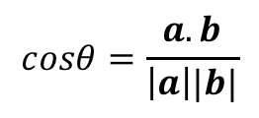

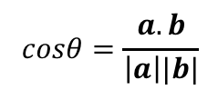

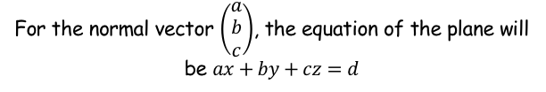
Vectors
$$a.b=\left|a\right||b|cosθ$$
$$a.b=x_{2}x_{1}+y_{2}y_{1}+z_{2}z_{1}$$
For the normal vector $\left(\begin{matrix}a \\ b \\ c\end{matrix}\right)$, the equation of the plane will be $ax+by+cz=d$
$$cosθ=\left|\frac{a.b}{\left|a\right||b|}\right|$$
$$cosθ=\frac{a.b}{\left|a\right||b|}$$
You need to be able to calculate the angle between two straight lines, or a straight line and a plane
You have already seen the formula below:
A slight modification will cause it to always give the acute angle between two lines, rather than an obtuse one…
$$cosθ=\left|\frac{a.b}{\left|a\right||b|}\right|$$
0.9
y = Cosθ
-0.9
$$cosθ=\frac{a.b}{\left|a\right||b|}$$
Imagine the value we had for the right side was -0.9
We would then get 154.2˚ as the angle
If we used the overall modulus to give 0.9 instead…
We would get 25.8˚
These add to 180, so are the obtuse and acute pair between the lines given!
$$cosθ=\left|\frac{a.b}{\left|a\right||b|}\right|$$
9D

Slide 2




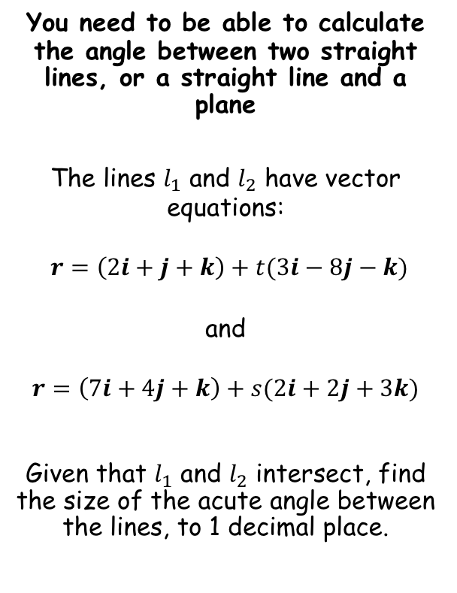





Vectors
$$a.b=\left|a\right||b|cosθ$$
$$a.b=x_{2}x_{1}+y_{2}y_{1}+z_{2}z_{1}$$
For the normal vector $\left(\begin{matrix}a \\ b \\ c\end{matrix}\right)$, the equation of the plane will be $ax+by+cz=d$
$$cosθ=\left|\frac{a.b}{\left|a\right||b|}\right|$$
You need to be able to calculate the angle between two straight lines, or a straight line and a plane
The lines $l_{1}$ and $l_{2}$ have vector equations:
$r=\left(2i+j+k\right)+t(3i−8j−k)$
and
$$r=\left(7i+4j+k\right)+s(2i+2j+3k)$$
Given that $l_{1}$ and $l_{2}$ intersect, find the size of the acute angle between the lines, to 1 decimal place.
Remember that to calculate this, we only need the direction vectors…
$$a=(3i−8j−k)$$
$$b=(2i+2j+3k)$$
We need the dot product
$$a.b=x_{2}x_{1}+y_{2}y_{1}+z_{2}z_{1}$$
$$a.b=\left(3\right)\left(2\right)+\left(−8\right)\left(2\right)+(−1)(3)$$
$$a.b=−13$$
We also need the magnitude of each
$$\left|a\right|=\sqrt{{\left(3\right)}^{2}+{\left(−8\right)}^{2}+{\left(−1\right)}^{2}}$$
$$\left|a\right|=\sqrt{74}$$
$$\left|b\right|=\sqrt{{\left(2\right)}^{2}+{\left(2\right)}^{2}+{\left(3\right)}^{2}}$$
$$\left|b\right|=\sqrt{17}$$
9D

Slide 3


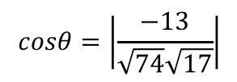
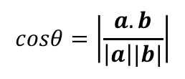


Vectors
$$a.b=\left|a\right||b|cosθ$$
$$a.b=x_{2}x_{1}+y_{2}y_{1}+z_{2}z_{1}$$
For the normal vector $\left(\begin{matrix}a \\ b \\ c\end{matrix}\right)$, the equation of the plane will be $ax+by+cz=d$
$$cosθ=\left|\frac{a.b}{\left|a\right||b|}\right|$$
You need to be able to calculate the angle between two straight lines, or a straight line and a plane
The lines $l_{1}$ and $l_{2}$ have vector equations:
$r=\left(2i+j+k\right)+t(3i−8j−k)$
and
$$r=\left(7i+4j+k\right)+s(2i+2j+3k)$$
Given that $l_{1}$ and $l_{2}$ intersect, find the size of the acute angle between the lines, to 1 decimal place.
Remember that to calculate this, we only need the direction vectors…
$$a=(3i−8j−k)$$
$$b=(2i+2j+3k)$$
$$a.b=−13$$
$$\left|a\right|=\sqrt{74}$$
$$\left|b\right|=\sqrt{17}$$
$$cosθ=\left|\frac{a.b}{\left|a\right||b|}\right|$$
Sub in values
$$cosθ=\left|\frac{−13}{\sqrt{74}\sqrt{17}}\right|$$
Calculate
$$θ=68.5^{°}$$
9D

Slide 4




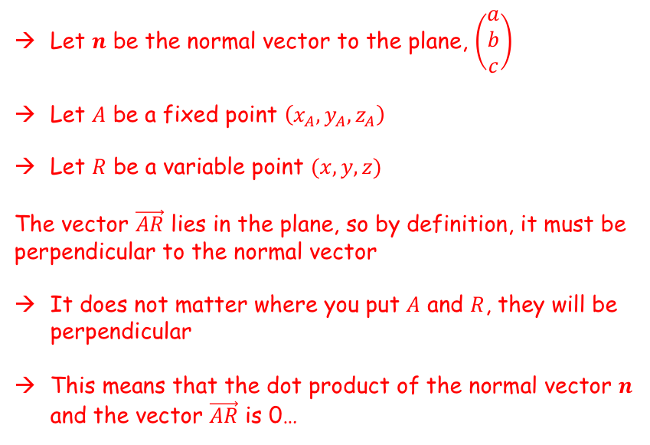
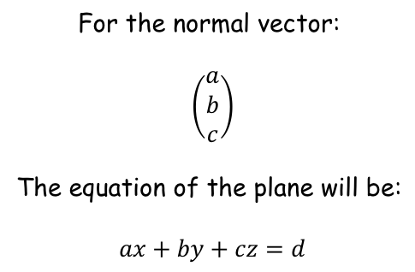

Vectors
$$a.b=\left|a\right||b|cosθ$$
$$a.b=x_{2}x_{1}+y_{2}y_{1}+z_{2}z_{1}$$
For the normal vector $\left(\begin{matrix}a \\ b \\ c\end{matrix}\right)$, the equation of the plane will be $ax+by+cz=d$
$$cosθ=\left|\frac{a.b}{\left|a\right||b|}\right|$$
$$\left(\begin{matrix}a \\ b \\ c\end{matrix}\right)$$
$$n$$
You need to be able to calculate the angle between two straight lines, or a straight line and a plane
In section 9B, you learnt the following rule linking the normal to a plane and the equation of the plane:
We can now prove this result is true using the scalar product…
$$R(x,y,z)$$
$$A(x_{A},y_{A},z_{A})$$
$$A(x_{A},y_{A},z_{A})$$
Let $n$ be the normal vector to the plane, $\left(\begin{matrix}a \\ b \\ c\end{matrix}\right)$
Let $A$ be a fixed point $\left(x_{A},y_{A},z_{A}\right)$
Let $R$ be a variable point $(x,y,z)$
The vector $\vec{AR}$ lies in the plane, so by definition, it must be perpendicular to the normal vector
It does not matter where you put $A$ and $R$, they will be perpendicular
This means that the dot product of the normal vector $n$ and the vector $\vec{AR}$ is 0…
For the normal vector:
$\left(\begin{matrix}a \\ b \\ c\end{matrix}\right)$
The equation of the plane will be:
$ax+by+cz=d$
9C

Slide 5
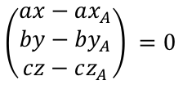
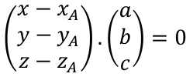

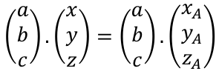
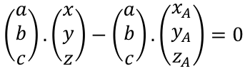
Vectors
$$a.b=\left|a\right||b|cosθ$$
$$a.b=x_{2}x_{1}+y_{2}y_{1}+z_{2}z_{1}$$
For the normal vector $\left(\begin{matrix}a \\ b \\ c\end{matrix}\right)$, the equation of the plane will be $ax+by+cz=d$
$$cosθ=\left|\frac{a.b}{\left|a\right||b|}\right|$$
$$\left(\begin{matrix}a \\ b \\ c\end{matrix}\right)$$
$$n$$
You need to be able to calculate the angle between two straight lines, or a straight line and a plane
In section 9B, you learnt the following rule linking the normal to a plane and the equation of the plane:
We can now prove this result is true using the scalar product…
$$R(x,y,z)$$
$$A(x_{A},y_{A},z_{A})$$
$$\vec{AR}.n=0$$
For the normal vector:
$\left(\begin{matrix}a \\ b \\ c\end{matrix}\right)$
The equation of the plane will be:
$ax+by+cz=d$
$$\left(\begin{matrix}x−x_{A} \\ y−y_{A} \\ z−z_{A}\end{matrix}\right).\left(\begin{matrix}a \\ b \\ c\end{matrix}\right)=0$$
Sub in the vectors
Calculate the dot product
$$\left(\begin{matrix}ax−ax_{A} \\ by−by_{A} \\ cz−cz_{A}\end{matrix}\right) =0$$
This can be re-written as two separate dot products…
$$\left(\begin{matrix}a \\ b \\ c\end{matrix}\right). \left(\begin{matrix}x \\ y \\ z\end{matrix}\right)−\left(\begin{matrix}a \\ b \\ c\end{matrix}\right). \left(\begin{matrix}x_{A} \\ y_{A} \\ z_{A}\end{matrix}\right)=0$$
$$\left(\begin{matrix}a \\ b \\ c\end{matrix}\right). \left(\begin{matrix}x \\ y \\ z\end{matrix}\right)=\left(\begin{matrix}a \\ b \\ c\end{matrix}\right). \left(\begin{matrix}x_{A} \\ y_{A} \\ z_{A}\end{matrix}\right)$$
Rearrange
9C

Slide 6

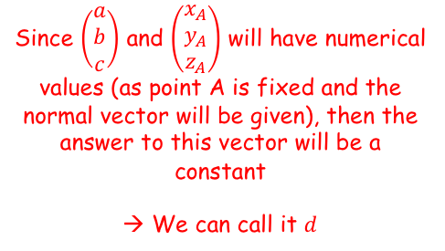
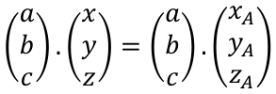
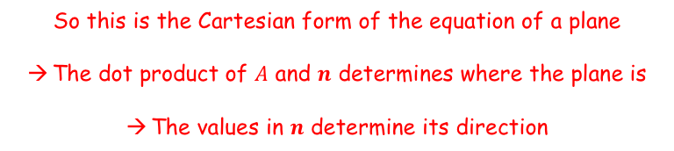

Vectors
$$a.b=\left|a\right||b|cosθ$$
$$a.b=x_{2}x_{1}+y_{2}y_{1}+z_{2}z_{1}$$
For the normal vector $\left(\begin{matrix}a \\ b \\ c\end{matrix}\right)$, the equation of the plane will be $ax+by+cz=d$
$$cosθ=\left|\frac{a.b}{\left|a\right||b|}\right|$$
$$\left(\begin{matrix}a \\ b \\ c\end{matrix}\right)$$
$$n$$
You need to be able to calculate the angle between two straight lines, or a straight line and a plane
In section 9B, you learnt the following rule linking the normal to a plane and the equation of the plane:
We can now prove this result is true using the scalar product…
$$R(x,y,z)$$
$$A(x_{A},y_{A},z_{A})$$
Since $\left(\begin{matrix}a \\ b \\ c\end{matrix}\right)$ and $\left(\begin{matrix}x_{A} \\ y_{A} \\ z_{A}\end{matrix}\right)$ will have numerical values (as point A is fixed and the normal vector will be given), then the answer to this vector will be a constant
→ We can call it $d$
$$\left(\begin{matrix}a \\ b \\ c\end{matrix}\right). \left(\begin{matrix}x \\ y \\ z\end{matrix}\right)=\left(\begin{matrix}a \\ b \\ c\end{matrix}\right). \left(\begin{matrix}x_{A} \\ y_{A} \\ z_{A}\end{matrix}\right)$$
For the normal vector:
$\left(\begin{matrix}a \\ b \\ c\end{matrix}\right)$
The equation of the plane will be:
$ax+by+cz=d$
$$\left(\begin{matrix}a \\ b \\ c\end{matrix}\right). \left(\begin{matrix}x \\ y \\ z\end{matrix}\right)=d$$
Calculate the dot product of the left side
$$ax+by+cz=d$$
So this is the Cartesian form of the equation of a plane
The dot product of $A$ and $n$ determines where the plane is
The values in $n$ determine its direction
9C

Slide 7
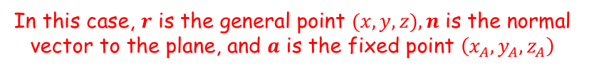





Vectors
$$a.b=\left|a\right||b|cosθ$$
$$a.b=x_{2}x_{1}+y_{2}y_{1}+z_{2}z_{1}$$
For the normal vector $\left(\begin{matrix}a \\ b \\ c\end{matrix}\right)$, the equation of the plane will be $ax+by+cz=d$
$$cosθ=\left|\frac{a.b}{\left|a\right||b|}\right|$$
$$r. n=a.n$$
$$r. n=k$$
$$\left(\begin{matrix}a \\ b \\ c\end{matrix}\right)$$
$$n$$
You need to be able to calculate the angle between two straight lines, or a straight line and a plane
In section 9B, you learnt the following rule linking the normal to a plane and the equation of the plane:
We can now prove this result is true using the scalar product…
$$R(x,y,z)$$
$$A(x_{A},y_{A},z_{A})$$
$$\left(\begin{matrix}a \\ b \\ c\end{matrix}\right). \left(\begin{matrix}x \\ y \\ z\end{matrix}\right)=\left(\begin{matrix}a \\ b \\ c\end{matrix}\right). \left(\begin{matrix}x_{A} \\ y_{A} \\ z_{A}\end{matrix}\right)$$
For the normal vector:
$\left(\begin{matrix}a \\ b \\ c\end{matrix}\right)$
The equation of the plane will be:
$ax+by+cz=d$
Sometimes the equation for a plane is written in ‘scalar product form’
$$r. n=a.n$$
In this case, $r$ is the general point $(x,y,z), n$ is the normal vector to the plane, and $a$ is the fixed point $\left(x_{A},y_{A},z_{A}\right)$
$$r. n=a.n$$
Since $a.n$ will give a scalar value, this form can also be used…
$$r. n=k$$
9C

Slide 8

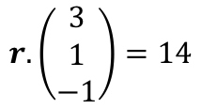
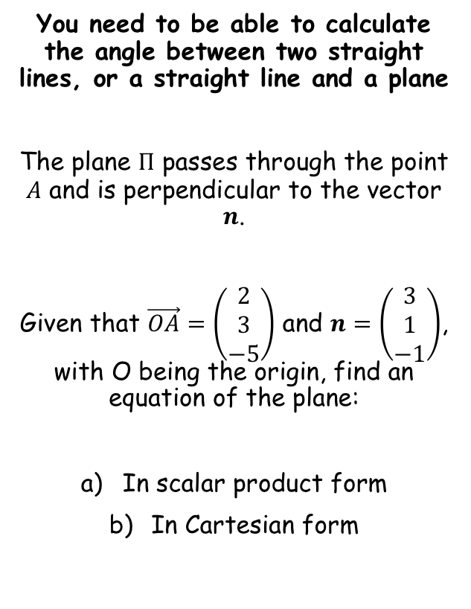

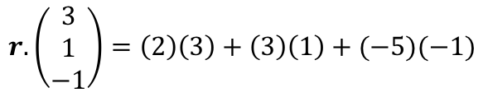
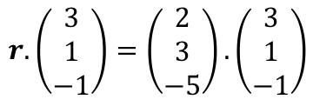

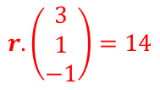
Vectors
$$a.b=\left|a\right||b|cosθ$$
$$a.b=x_{2}x_{1}+y_{2}y_{1}+z_{2}z_{1}$$
For the normal vector $\left(\begin{matrix}a \\ b \\ c\end{matrix}\right)$, the equation of the plane will be $ax+by+cz=d$
$$cosθ=\left|\frac{a.b}{\left|a\right||b|}\right|$$
$$r. n=a.n$$
$$r. n=k$$
You need to be able to calculate the angle between two straight lines, or a straight line and a plane
The plane $Π$ passes through the point $A$ and is perpendicular to the vector $n$.
Given that $\vec{OA}=\left(\begin{matrix}2 \\ 3 \\ −5\end{matrix}\right)$ and $n=\left(\begin{matrix}3 \\ 1 \\ −1\end{matrix}\right)$, with O being the origin, find an equation of the plane:
In scalar product form
In Cartesian form
$$r. n=a.n$$
Replace $n$ and $a$ with their vectors
$$r. \left(\begin{matrix}3 \\ 1 \\ −1\end{matrix}\right)=\left(\begin{matrix}2 \\ 3 \\ −5\end{matrix}\right).\left(\begin{matrix}3 \\ 1 \\ −1\end{matrix}\right)$$
Calculate the dot product on the right side
$$r. \left(\begin{matrix}3 \\ 1 \\ −1\end{matrix}\right)=\left(2\right)\left(3\right)+\left(3\right)\left(1\right)+(−5)(−1)$$
Simplify
$$r. \left(\begin{matrix}3 \\ 1 \\ −1\end{matrix}\right)=14$$
This is the scalar product form!
$$r. \left(\begin{matrix}3 \\ 1 \\ −1\end{matrix}\right)=14$$
9C

Slide 9


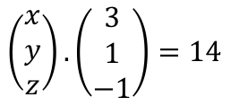
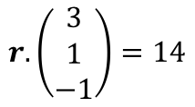
Vectors
$$a.b=\left|a\right||b|cosθ$$
$$a.b=x_{2}x_{1}+y_{2}y_{1}+z_{2}z_{1}$$
For the normal vector $\left(\begin{matrix}a \\ b \\ c\end{matrix}\right)$, the equation of the plane will be $ax+by+cz=d$
$$cosθ=\left|\frac{a.b}{\left|a\right||b|}\right|$$
$$r. n=a.n$$
$$r. n=k$$
$$r. \left(\begin{matrix}3 \\ 1 \\ −1\end{matrix}\right)=14$$
You need to be able to calculate the angle between two straight lines, or a straight line and a plane
The plane $Π$ passes through the point $A$ and is perpendicular to the vector $n$.
Given that $\vec{OA}=\left(\begin{matrix}2 \\ 3 \\ −5\end{matrix}\right)$ and $n=\left(\begin{matrix}3 \\ 1 \\ −1\end{matrix}\right)$, with O being the origin, find an equation of the plane:
In scalar product form
In Cartesian form
To get to the Cartesian form, replace $r$ with the general vector $\left(\begin{matrix}x \\ y \\ z\end{matrix}\right)$
$$\left(\begin{matrix}x \\ y \\ z\end{matrix}\right). \left(\begin{matrix}3 \\ 1 \\ −1\end{matrix}\right)=14$$
Calculate the dot product
$$3x+y−z=14$$
This is the Cartesian form!
$$r. \left(\begin{matrix}3 \\ 1 \\ −1\end{matrix}\right)=14$$
9C

Slide 10
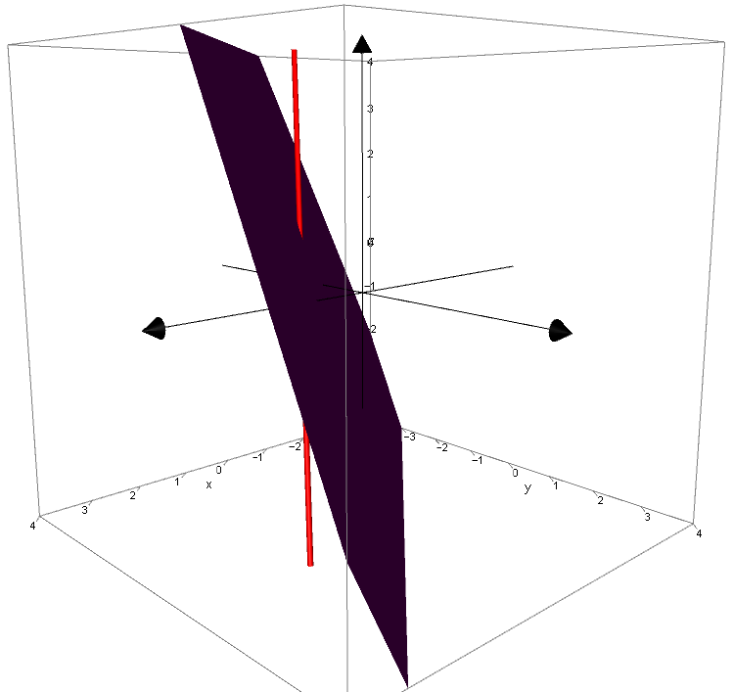
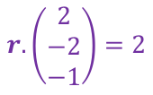
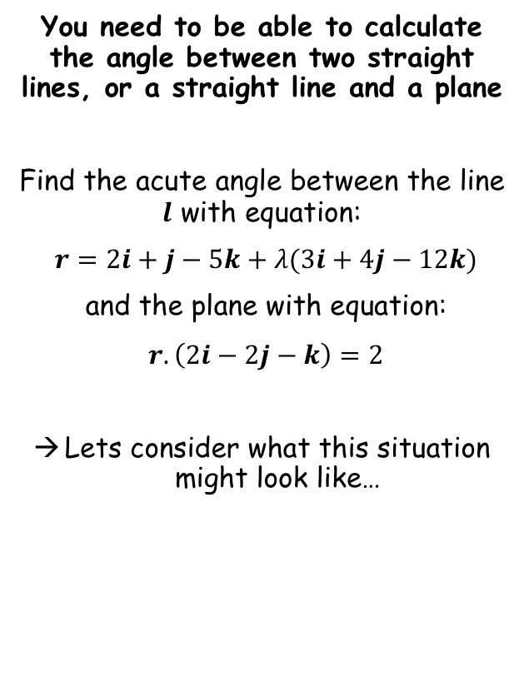

Vectors
$$a.b=\left|a\right||b|cosθ$$
$$a.b=x_{2}x_{1}+y_{2}y_{1}+z_{2}z_{1}$$
For the normal vector $\left(\begin{matrix}a \\ b \\ c\end{matrix}\right)$, the equation of the plane will be $ax+by+cz=d$
$$cosθ=\left|\frac{a.b}{\left|a\right||b|}\right|$$
$$r. n=a.n$$
$$r. n=k$$
You need to be able to calculate the angle between two straight lines, or a straight line and a plane
Find the acute angle between the line $l$ with equation:
$r=2i+j−5k+λ(3i+4j−12k)$
and the plane with equation:
$r.\left(2i−2j−k\right)=2$
Lets consider what this situation might look like…
$$r.\left(\begin{matrix}2 \\ −2 \\ −1\end{matrix}\right)=2$$
$$r=\left(\begin{matrix}2 \\ 1 \\ −5\end{matrix}\right)+λ\left(\begin{matrix}3 \\ 4 \\ −12\end{matrix}\right)$$
CLICK
9C

Slide 11
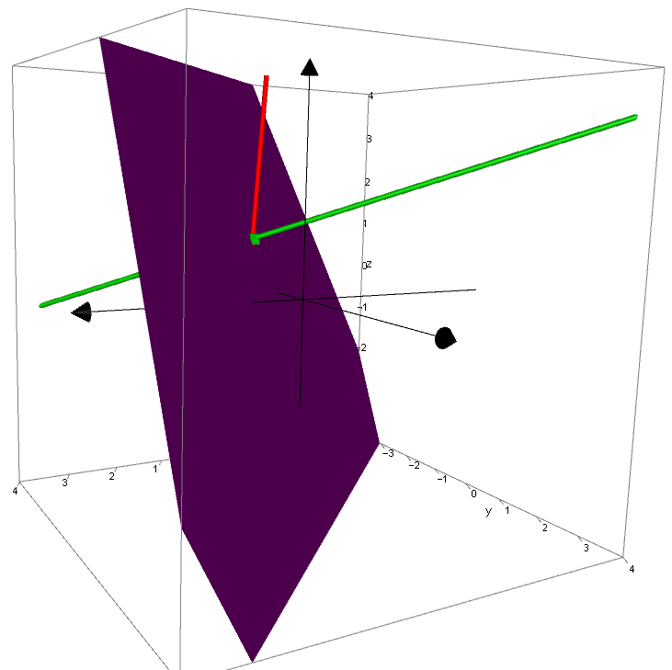
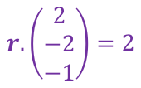

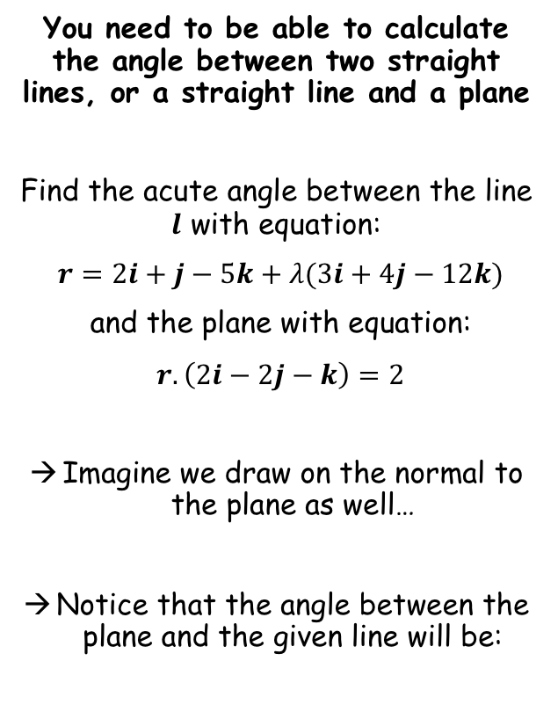

Vectors
$$a.b=\left|a\right||b|cosθ$$
$$a.b=x_{2}x_{1}+y_{2}y_{1}+z_{2}z_{1}$$
For the normal vector $\left(\begin{matrix}a \\ b \\ c\end{matrix}\right)$, the equation of the plane will be $ax+by+cz=d$
$$cosθ=\left|\frac{a.b}{\left|a\right||b|}\right|$$
$$r. n=a.n$$
$$r. n=k$$
$$r=\left(\begin{matrix}2 \\ 1 \\ −5\end{matrix}\right)+λ\left(\begin{matrix}3 \\ 4 \\ −12\end{matrix}\right)$$
You need to be able to calculate the angle between two straight lines, or a straight line and a plane
Find the acute angle between the line $l$ with equation:
$r=2i+j−5k+λ(3i+4j−12k)$
and the plane with equation:
$r.\left(2i−2j−k\right)=2$
Imagine we draw on the normal to the plane as well…
Notice that the angle between the plane and the given line will be:
$$\left(\begin{matrix}2 \\ −2 \\ −1\end{matrix}\right)$$
$$r.\left(\begin{matrix}2 \\ −2 \\ −1\end{matrix}\right)=2$$
CLICK
$$90^{°}−(angle between the given line and the normal to the plane)$$
9C

Slide 12
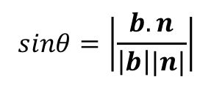
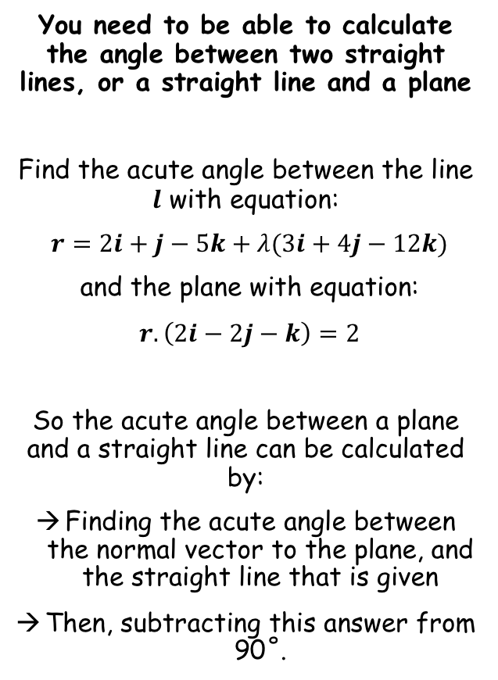

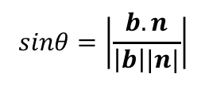

Vectors
$$a.b=\left|a\right||b|cosθ$$
$$a.b=x_{2}x_{1}+y_{2}y_{1}+z_{2}z_{1}$$
For the normal vector $\left(\begin{matrix}a \\ b \\ c\end{matrix}\right)$, the equation of the plane will be $ax+by+cz=d$
$$cosθ=\left|\frac{a.b}{\left|a\right||b|}\right|$$
$$r. n=a.n$$
$$r. n=k$$
$$sinθ=\left|\frac{b.n}{\left|b\right||n|}\right|$$
You need to be able to calculate the angle between two straight lines, or a straight line and a plane
Find the acute angle between the line $l$ with equation:
$r=2i+j−5k+λ(3i+4j−12k)$
and the plane with equation:
$r.\left(2i−2j−k\right)=2$
So the acute angle between a plane and a straight line can be calculated by:
Finding the acute angle between the normal vector to the plane, and the straight line that is given
Then, subtracting this answer from 90˚.
Alternatively, since $sinθ=cos\left(90−θ\right)$, we can use a different formula…
$$sinθ=\left|\frac{b.n}{\left|b\right||n|}\right|$$
In this case, $n$ is the normal vector to the plane, and $b$ is the direction vector of the straight line being considered…
9C

Slide 13


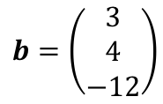
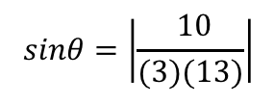
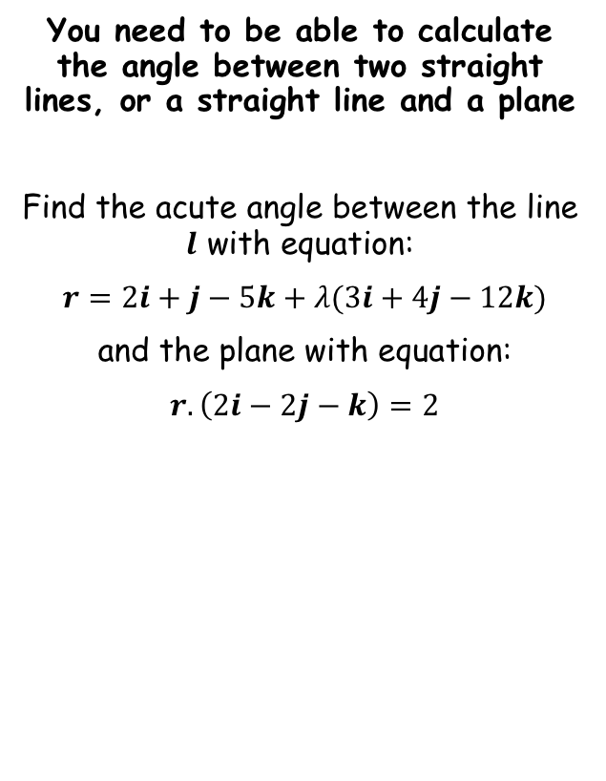
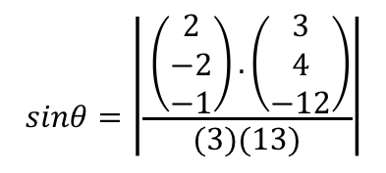
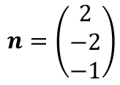

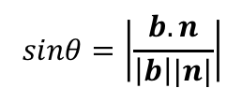

Vectors
$$a.b=\left|a\right||b|cosθ$$
$$a.b=x_{2}x_{1}+y_{2}y_{1}+z_{2}z_{1}$$
For the normal vector $\left(\begin{matrix}a \\ b \\ c\end{matrix}\right)$, the equation of the plane will be $ax+by+cz=d$
$$cosθ=\left|\frac{a.b}{\left|a\right||b|}\right|$$
$$r. n=a.n$$
$$r. n=k$$
$$sinθ=\left|\frac{b.n}{\left|b\right||n|}\right|$$
You need to be able to calculate the angle between two straight lines, or a straight line and a plane
Find the acute angle between the line $l$ with equation:
$r=2i+j−5k+λ(3i+4j−12k)$
and the plane with equation:
$r.\left(2i−2j−k\right)=2$
$$sinθ=\left|\frac{b.n}{\left|b\right||n|}\right|$$
$$sinθ=\left|\frac{ \left(\begin{matrix}2 \\ −2 \\ −1\end{matrix}\right).\left(\begin{matrix}3 \\ 4 \\ −12\end{matrix}\right)}{(3)(13)}\right|$$
Sub in values
Simplify
$$sinθ=\left|\frac{ 10}{(3)(13)}\right|$$
So $n$ is the normal vector to the plane, and $b$ is the direction vector of the straight line
Calculate
$$θ=14.9^{°}$$
$$n=\left(\begin{matrix}2 \\ −2 \\ −1\end{matrix}\right)$$
$$b=\left(\begin{matrix}3 \\ 4 \\ −12\end{matrix}\right)$$
$$\left|n\right|=3$$
$$\left|b\right|=13$$
9C

Slide 14
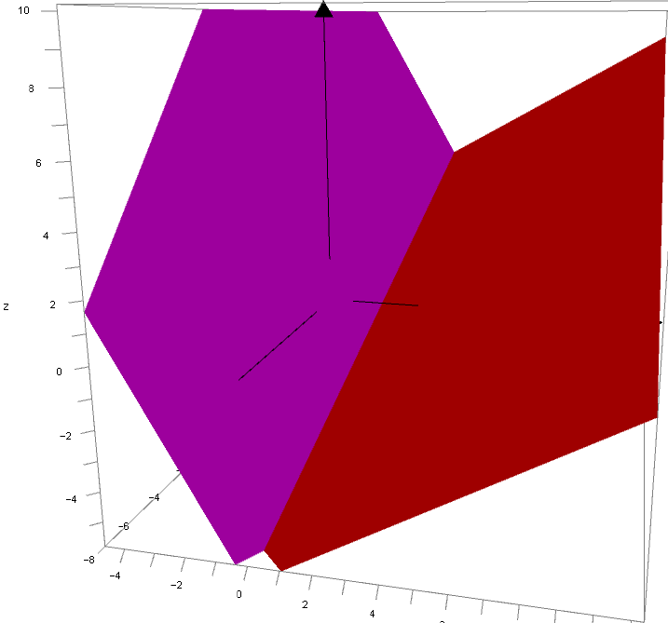
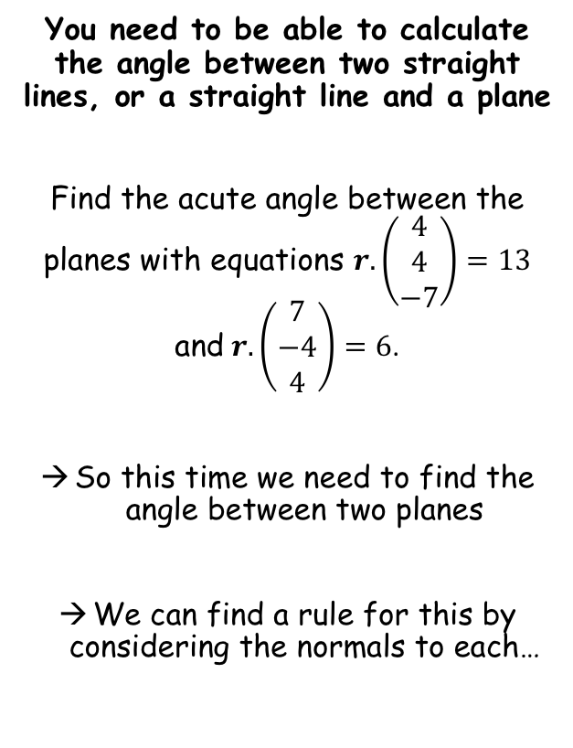

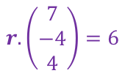
Vectors
$$a.b=\left|a\right||b|cosθ$$
$$a.b=x_{2}x_{1}+y_{2}y_{1}+z_{2}z_{1}$$
For the normal vector $\left(\begin{matrix}a \\ b \\ c\end{matrix}\right)$, the equation of the plane will be $ax+by+cz=d$
$$cosθ=\left|\frac{a.b}{\left|a\right||b|}\right|$$
$$r. n=a.n$$
$$r. n=k$$
$$sinθ=\left|\frac{b.n}{\left|b\right||n|}\right|$$
$$r.\left(\begin{matrix}7 \\ −4 \\ 4\end{matrix}\right)=6$$
You need to be able to calculate the angle between two straight lines, or a straight line and a plane
Find the acute angle between the planes with equations $r.\left(\begin{matrix}4 \\ 4 \\ −7\end{matrix}\right)=13$ and $r.\left(\begin{matrix}7 \\ −4 \\ 4\end{matrix}\right)=6$.
So this time we need to find the angle between two planes
We can find a rule for this by considering the normals to each…
$$r.\left(\begin{matrix}4 \\ 4 \\ −7\end{matrix}\right)=13$$
CLICK
9C

Slide 15
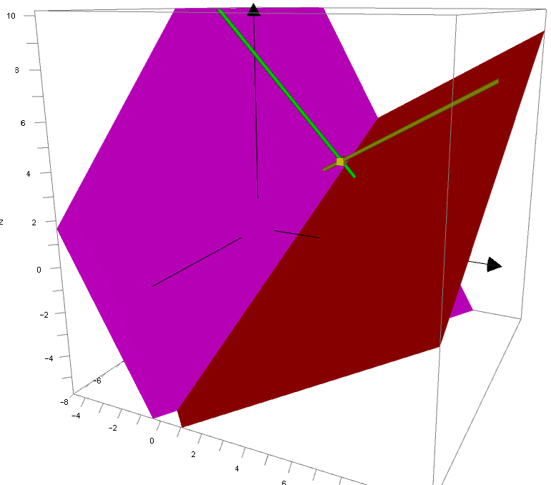
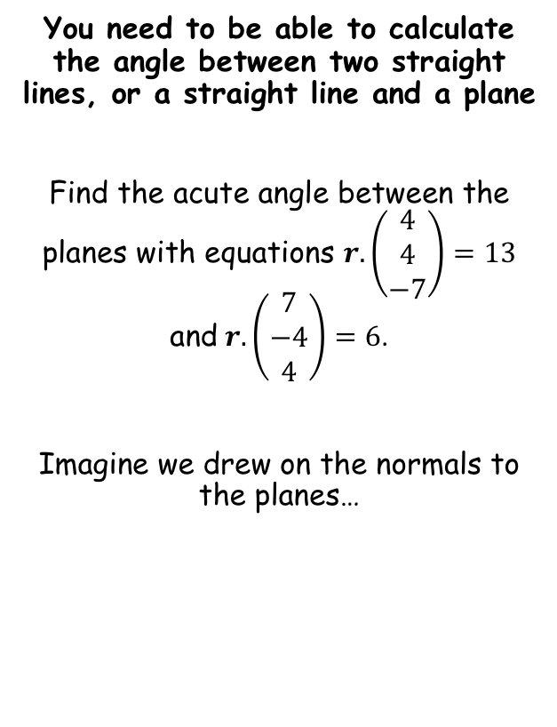


Vectors
$$a.b=\left|a\right||b|cosθ$$
$$a.b=x_{2}x_{1}+y_{2}y_{1}+z_{2}z_{1}$$
For the normal vector $\left(\begin{matrix}a \\ b \\ c\end{matrix}\right)$, the equation of the plane will be $ax+by+cz=d$
$$cosθ=\left|\frac{a.b}{\left|a\right||b|}\right|$$
$$r. n=a.n$$
$$r. n=k$$
$$sinθ=\left|\frac{b.n}{\left|b\right||n|}\right|$$
You need to be able to calculate the angle between two straight lines, or a straight line and a plane
Find the acute angle between the planes with equations $r.\left(\begin{matrix}4 \\ 4 \\ −7\end{matrix}\right)=13$ and $r.\left(\begin{matrix}7 \\ −4 \\ 4\end{matrix}\right)=6$.
Imagine we drew on the normals to the planes…
$$r.\left(\begin{matrix}7 \\ −4 \\ 4\end{matrix}\right)=6$$
$$r.\left(\begin{matrix}4 \\ 4 \\ −7\end{matrix}\right)=13$$
CLICK
9C

Slide 16






Vectors
$$a.b=\left|a\right||b|cosθ$$
$$a.b=x_{2}x_{1}+y_{2}y_{1}+z_{2}z_{1}$$
For the normal vector $\left(\begin{matrix}a \\ b \\ c\end{matrix}\right)$, the equation of the plane will be $ax+by+cz=d$
$$cosθ=\left|\frac{a.b}{\left|a\right||b|}\right|$$
$$r. n=a.n$$
$$r. n=k$$
$$sinθ=\left|\frac{b.n}{\left|b\right||n|}\right|$$
You need to be able to calculate the angle between two straight lines, or a straight line and a plane
Find the acute angle between the planes with equations $r.\left(\begin{matrix}4 \\ 4 \\ −7\end{matrix}\right)=13$ and $r.\left(\begin{matrix}7 \\ −4 \\ 4\end{matrix}\right)=6$.
Consider a 2D drawing of the situation…
Plane 1
$$180−θ$$
$$n_{2}$$
$$180−θ$$
$$θ$$
Plane 2
$$θ$$
$$n_{1}$$
If we want to find the acute angle between two planes, their normals will produce an obtuse angle
The acute angle between the planes will therefore be given by 180 - this angle
However, this is actually the same as the acute angle between the normals
So we can just use the cosine formula from before, using the normals to the planes!
9C

Slide 17








Vectors
$$a.b=\left|a\right||b|cosθ$$
$$a.b=x_{2}x_{1}+y_{2}y_{1}+z_{2}z_{1}$$
For the normal vector $\left(\begin{matrix}a \\ b \\ c\end{matrix}\right)$, the equation of the plane will be $ax+by+cz=d$
$$cosθ=\left|\frac{a.b}{\left|a\right||b|}\right|$$
$$r. n=a.n$$
$$r. n=k$$
$$sinθ=\left|\frac{b.n}{\left|b\right||n|}\right|$$
You need to be able to calculate the angle between two straight lines, or a straight line and a plane
Find the acute angle between the planes with equations $r.\left(\begin{matrix}4 \\ 4 \\ −7\end{matrix}\right)=13$ and $r.\left(\begin{matrix}7 \\ −4 \\ 4\end{matrix}\right)=6$.
Let the normals be $a$ and $b$.
$$cosθ=\left|\frac{a.b}{\left|a\right||b|}\right|$$
Sub in values
$$cosθ=\left|\frac{\left(\begin{matrix}4 \\ 4 \\ −7\end{matrix}\right).\left(\begin{matrix}7 \\ −4 \\ 4\end{matrix}\right)}{(9)(9)}\right|$$
Calculate
$$θ=78.6^{°}$$
$$a=\left(\begin{matrix}4 \\ 4 \\ −7\end{matrix}\right)$$
$$b=\left(\begin{matrix}7 \\ −4 \\ 4\end{matrix}\right)$$
$$\left|a\right|=9$$
$$\left|b\right|=9$$
9C

Slide 18
Exercise 9D
Pearson Pure Mathematics Year 1/AS
Pages 3-5
Complete before the lesson Q1-3
In Class:
Green Q4-8
Amber Q9-11
Red Q12-14

