Slide 1

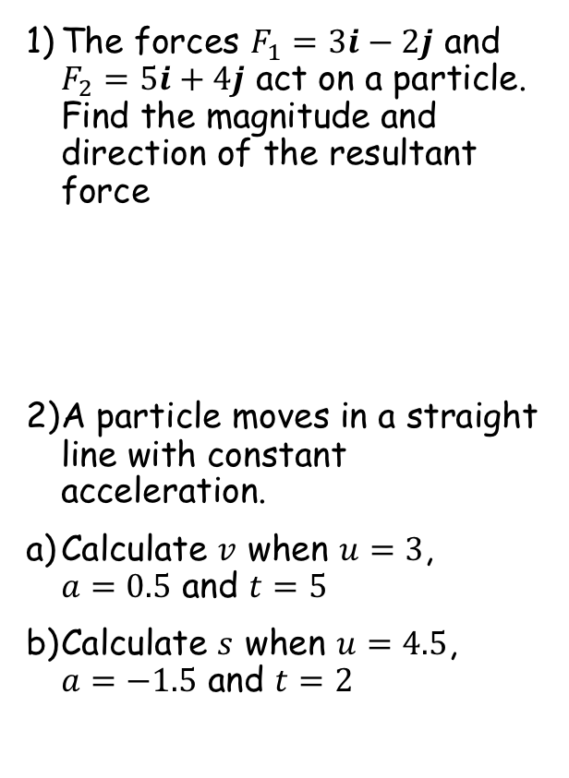


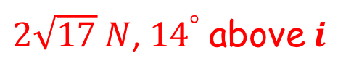

Prior Knowledge Check
The forces $F_{1}=3i−2j$ and $F_{2}=5i+4j$ act on a particle. Find the magnitude and direction of the resultant force
A particle moves in a straight line with constant acceleration.
Calculate $v$ when $u=3$, $a=0.5$ and $t=5$
Calculate $s$ when $u=4.5$, $a=−1.5$ and $t=2$
3) A body of mass 2kg is acted on by a force $F$ N. The body starts from rest and moves in a straight line. After 5 seconds, the displacement of the body is 20m. Find the magnitude of $F$.
$2\sqrt{17} N$, ${14}^{°}$ above $i$
$$3.2N$$
$$5.5{ms}^{−1}$$
$$6m$$

Slide 2
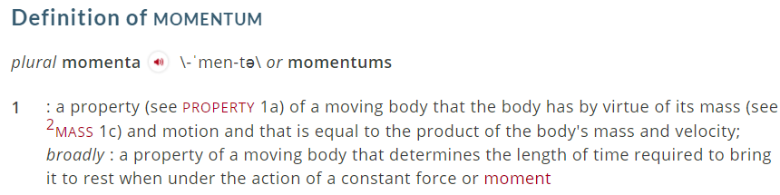






Momentum and Impulse
You can calculate the momentum of a particle and the impulse of a force
The momentum of a body of mass m which is moving with velocity v is given by mv
If the mass is in kg and the velocity is in ms⁻¹ then the momentum will be in kgms⁻¹
kgms⁻¹ can be written as (kgms⁻²)s
As kgms⁻² is Newtons…
kgms⁻¹ can be written as Ns
These are both acceptable units for momentum
Find the magnitude of the momentum of:
a) A cricket ball of mass 400g moving at 18ms⁻¹
$$Momentum=mv$$
Sub in units (remember to use kg)
$$Momentum=0.4×18$$
Calculate
$$Momentum=7.2Ns$$
b) A lorry of mass 5 tonnes moving at 12ms⁻¹
$$Momentum=mv$$
Sub in units (remember to use kg)
$$Momentum=5000×12$$
Calculate
$$Momentum=60,000kgms^{−1}$$
Either Ns or kgms⁻¹ are acceptable units (make sure you read the question in case you’re asked for one specifically!)
Merriam-webster’s definition
1A

Slide 3
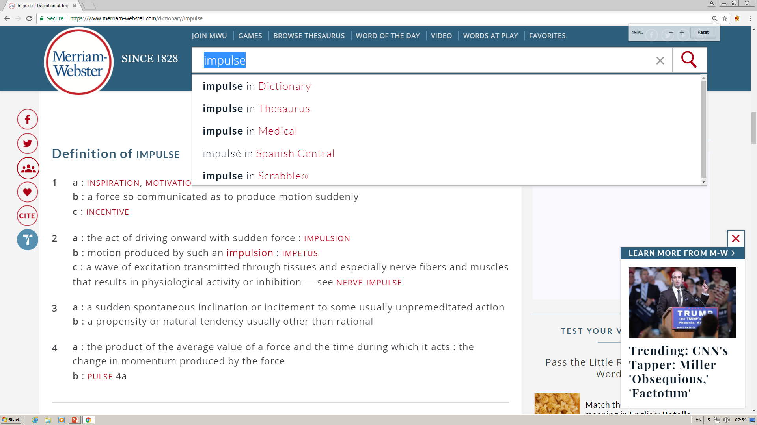







Momentum and Impulse
$$Momentum=mv$$
You can calculate the momentum of a particle and the impulse of a force
If a constant force F acts for time t we define the impulse of the force to be Ft
If force is measured in N and time in seconds, then the units of impulse are Ns
An example of impulse would be a cricket bat hitting a ball
→ In this case, the time the force is exerted over is small, but if the force is big enough it will transfer noticeable impulse to the ball
Remember that the acceleration of an object is given by:
$$a=\frac{v−u}{t}$$
$$F=ma$$
Replace acceleration with the above
$$F=m\left(\frac{v−u}{t}\right)$$
Multiply by t
$$Ft=m\left(v−u\right)$$
Multiply the bracket out
$$Ft=mv−mu$$
Force x time = Impulse!
$$I=mv−mu$$
So Impulse = Final momentum – Initial momentum
So Impulse = Change in momentum
Merriam-webster’s definition
This is the Impulse-Momentum Principle!
1A

Slide 4








Momentum and Impulse
$$Momentum=mv$$
$$Impulse=mv−mu$$
$$Impulse=Ft$$
You can calculate the momentum of a particle and the impulse of a force
A body of mass 2kg is initially at rest on a smooth horizontal plane. A horizontal force of magnitude 4.5N acts on the body for 6s. Find:
The magnitude of the impulse given to the body by the force
The final speed of the body
a)
$$Impulse=Ft$$
Sub in values
$$Impulse=6×4.5$$
Calculate
$$Impulse=27Ns$$
b)
$$Impulse=mv−mu$$
Sub in impulse, the mass and the initial velocity
27Ns
$$27=(2×v)−(2×0)$$
Calculate
13.5ms⁻¹
$$13.5=v$$
1A

Slide 5




Momentum and Impulse
$$Momentum=mv$$
$$Impulse=mv−mu$$
$$Impulse=Ft$$
You can calculate the momentum of a particle and the impulse of a force
A ball of mass 0.2kg hits a vertical wall at right angles with a speed of 3.5ms⁻¹. The ball rebounds from the wall with speed 2.5ms⁻¹. Find the magnitude of the impulse the ball exerts on the wall.
The wall does not move and as such you cannot apply the Impulse-momentum principle to it.
→ You can however apply the principle to the ball and use Newton’s third law to deduce that the Impulse from the wall must be equal and opposite…
3.5ms⁻¹
As always, draw a diagram!
I
0.2kg
2.5ms⁻¹
$$Impulse=mv−mu$$
Sub in values, taking the final direction as positive
$$Impulse=(0.2×2.5)−(0.2×−3.5)$$
Careful with negatives!
$$Impulse=0.5+0.7$$
Calculate
$$Impulse=1.2Ns$$
1A

Slide 6
Exercise 1A
Pearson Pure Mathematics Year 1/AS
Pages 3-5
Complete before the lesson Q1
In Class:
Green Q2-3
Amber Q4-5

