Slide 1
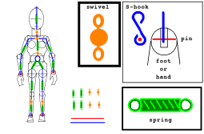






Elastic Strings and Springs
$$T=\frac{λx}{l}$$
$$EPE=\frac{λx^{2}}{2l}$$
$$Energy Losses=Energy Gains$$
$$Work done against Friction=Overall loss in Energy$$
$$W=Fd$$
You can solve problems involving elastic energy using the conservation of energy principle and the work-energy principle
Hopefully you remember the conservation of energy principle and the work-energy principle from before?
“When no external forces (other than gravity) act on a particle, the sum of its potential and kinetic energies remain constant.”
(This is called the principle of the conservation of mechanical energy)
“The change in total energy of a particle is equal to the work done on the particle.”
(This is called the ‘work-energy’ principle)
If gravity is the only force acting on a particle:
$$Decrease in PE=Increase in KE$$
This is what you saw in M2
→ As a general rule: Energy Losses = Energy Gains
If another force (usually friction) is acting on the particle:
$$Total loss of energy=KE lost−PE gained$$
$$Work done=KE lost−PE gained$$
In M2, PE represented potential energy due to the height of an object
→ In M3, we can also use EPE, elastic potential energy
3D

Slide 2









Elastic Strings and Springs
$$T=\frac{λx}{l}$$
$$EPE=\frac{λx^{2}}{2l}$$
$$Energy Losses=Energy Gains$$
$$Work done against Friction=Overall loss in Energy$$
$$KE=\frac{1}{2}mv^{2}$$
$$W=Fd$$
2ms⁻¹
0ms⁻¹
You can solve problems involving elastic energy using the conservation of energy principle and the work-energy principle
A light elastic string, of natural length 1.6m and modulus of elasticity 10N, has one end fixed at a point A on a smooth horizontal table. A particle of mass 2kg is attached to the other end of the string. The particle is held at point A and projected horizontally across the table with speed 2ms⁻¹. Find how far it travels before first coming to instantaneous rest.
The particle is projected from A. After 1.6m the string will be taut, but the particle will stretch a bit farther before instantaneously stopping, making the distance travelled ‘1.6 + x’
There is no friction so we can just set losses = gains
A
1.6 + x
As the particle slows down it loses Kinetic Energy
→ This is balanced by it gaining EPE!
$$Energy Losses=Energy Gains$$
Replace these with the types of energy
$$KE lost=EPE gained$$
Use the relevant formulae
$$\frac{1}{2}mv^{2}=\frac{λx^{2}}{2l}$$
Sub in all the values we know
$$\frac{1}{2}\left(2\right){\left(2\right)}^{2}=\frac{(10)x^{2} }{2(1.6)}$$
$$4=\frac{10x^{2} }{3.2}$$
Simplify parts
Rearrange for x²
$$x^{2}=1.28$$
Square root
$$x=1.13$$
Add on the original length
$$Distance Travelled=2.73m$$
3D

Slide 3
Elastic Strings and Springs
$$T=\frac{λx}{l}$$
$$EPE=\frac{λx^{2}}{2l}$$
$$Energy Losses=Energy Gains$$
$$Work done against Friction=Overall loss in Energy$$
$$KE=\frac{1}{2}mv^{2}$$
$$W=Fd$$
2ms⁻¹
0ms⁻¹
You can solve problems involving elastic energy using the conservation of energy principle and the work-energy principle
A light elastic string, of natural length 1.6m and modulus of elasticity 10N, has one end fixed at a point A on a smooth horizontal table. A particle of mass 2kg is attached to the other end of the string. The particle is held at point A and projected horizontally across the table with speed 2ms⁻¹. Find how far it travels before first coming to instantaneous rest.
The particle is projected from A. After 1.6m the string will be taut, but the particle will stretch a bit farther before instantaneously stopping, making the distance travelled ‘1.6 + x’
There is no friction so we can just set losses = gains
A
1.6 + x
Useful points to consider
→ Instantaneous rest is NOT the same as equilibrium, so we cannot use just forces to solve it
→ As the particle moves from a speed to rest, it ends up losing all of its kinetic energy, so we can just use ¹/₂mv² to represent the energy
Remember if it still had a speed, you would have to use the difference between the energies at the different speeds
Always read the question carefully, sometimes a particle is projected from different positions and this might affect your answer!
3D

Slide 4



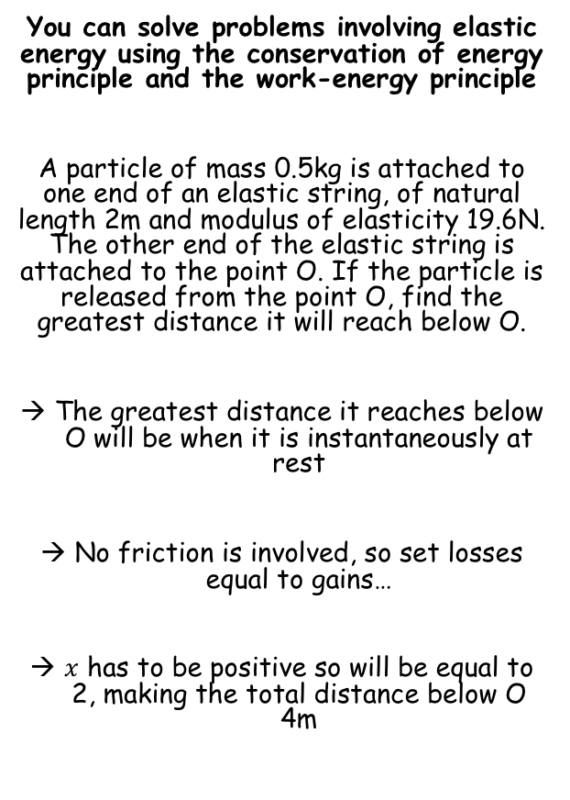






Elastic Strings and Springs
$$T=\frac{λx}{l}$$
$$EPE=\frac{λx^{2}}{2l}$$
$$Energy Losses=Energy Gains$$
$$Work done against Friction=Overall loss in Energy$$
$$KE=\frac{1}{2}mv^{2}$$
$$PE=mgh$$
$$W=Fd$$
Note that in this example, the particle is released from rest, and we are finding when it is again at rest
Hence the kinetic energy will not be involved
As the height has changed, we can use the gravitational potential energy instead…
O
You can solve problems involving elastic energy using the conservation of energy principle and the work-energy principle
A particle of mass 0.5kg is attached to one end of an elastic string, of natural length 2m and modulus of elasticity 19.6N. The other end of the elastic string is attached to the point O. If the particle is released from the point O, find the greatest distance it will reach below O.
The greatest distance it reaches below O will be when it is instantaneously at rest
No friction is involved, so set losses equal to gains…
$x$ has to be positive so will be equal to 2, making the total distance below O 4m
0ms⁻¹
2 + x
0ms⁻¹
$$Loss in PE=Gain in EPE$$
Replace with appropriate formulae
$$mgh=\frac{λx^{2}}{2l}$$
$$(0.5)(9.8)(2+x)=\frac{19.6x^{2}}{2(2)}$$
Sub in values
Calculate parts/Simplify
$$4.9(2+x)=4.9x^{2}$$
Divide by 4.9
$$2+x=x^{2}$$
Set equal to 0
$$0=x^{2}−x−2$$
Factorise
$$0=(x−2)(x+1)$$
Solve
$$x=2 or −1$$
3D

Slide 5





Elastic Strings and Springs
$$T=\frac{λx}{l}$$
$$EPE=\frac{λx^{2}}{2l}$$
$$Energy Losses=Energy Gains$$
$$Work done against Friction=Overall loss in Energy$$
$$KE=\frac{1}{2}mv^{2}$$
$$PE=mgh$$
$$W=Fd$$
A
You can solve problems involving elastic energy using the conservation of energy principle and the work-energy principle
A light elastic spring, of natural length 1m and modulus of elasticity 20N, has one end attached to a fixed point A. A particle of mass 2kg is attached to the other end of the spring and is held at a point B which is 0.8m vertically below A. The particle is projected vertically downwards from B with speed 2ms⁻¹. Find the distance it falls before first coming to rest.
Again, we can set the final speed to 0ms⁻¹
In this example we lose both Kinetic and Potential energy, in exchange for Elastic potential energy…
No friction to consider, so just set losses equal to gains
As the spring was already compressed, we need to subtract this from the overall gain when stretched
(Final EPE – Initial EPE)
0.8m
2ms⁻¹
B
0.2m + x
0ms⁻¹
$$Loss in PE+Loss in KE=Gain in EPE$$
Replace with appropriate formulae
$$mgh+\frac{1}{2}mv^{2}=\frac{λx_{2}^{2}}{2l}−\frac{λx_{1}^{2}}{2l}$$
Sub in values carefully
$$\left(2\right)\left(9.8\right)\left(0.2+x\right)+\frac{1}{2}\left(2\right){\left(2\right)}^{2}=\frac{(20)x^{2} }{2(1)}−\frac{(20){(0.2)}^{2} }{2(1)}$$
Work out/Simplify parts
$$19.6x+7.92=10x^{2}−0.4$$
Set equal to 0
$$10x^{2}−19.6x−7.52=0$$
We can use the Quadratic formula to solve this...
3D

Slide 6





Elastic Strings and Springs
$$T=\frac{λx}{l}$$
$$EPE=\frac{λx^{2}}{2l}$$
$$Energy Losses=Energy Gains$$
$$Work done against Friction=Overall loss in Energy$$
$$KE=\frac{1}{2}mv^{2}$$
$$PE=mgh$$
$$W=Fd$$
A
You can solve problems involving elastic energy using the conservation of energy principle and the work-energy principle
A light elastic spring, of natural length 1m and modulus of elasticity 20N, has one end attached to a fixed point A. A particle of mass 2kg is attached to the other end of the spring and is held at a point B which is 0.8m vertically below A. The particle is projected vertically downwards from B with speed 2ms⁻¹. Find the distance it falls before first coming to rest.
Again, we can set the final speed to 0ms⁻¹
In this example we lose both Kinetic and Potential energy, in exchange for Elastic potential energy…
No friction to consider, so just set losses equal to gains
As the spring was already compressed, we need to subtract this from the overall gain when stretched
0.8m
2ms⁻¹
B
0.2m + x
0ms⁻¹
$$10x^{2}−19.6x−7.52=0$$
$$x=\frac{−b±\sqrt{b^{2}−4ac}}{2a}$$
Sub in a = 10, b = -19.6 and c = -7.52
$$x=\frac{19.6±\sqrt{{(−19.6)}^{2}− 4(10)(−7.52)}}{2(10)}$$
Calculate both answers
$$x=2.288 or −0.328$$
Add 0.2 to the positive answer as it has fallen this length as well as the extended part
$$Distance it falls=2.488m$$
3D

Slide 7



Elastic Strings and Springs
$$T=\frac{λx}{l}$$
$$EPE=\frac{λx^{2}}{2l}$$
$$Energy Losses=Energy Gains$$
$$Work done against Friction=Overall loss in Energy$$
$$KE=\frac{1}{2}mv^{2}$$
$$PE=mgh$$
$$W=Fd$$
0.8g
R
You can solve problems involving elastic energy using the conservation of energy principle and the work-energy principle
A light elastic spring, of natural length 0.5m and modulus of elasticity 10N, has one end attached to a point A on a rough horizontal plane. The other end is attached to a particle P of mass 0.8kg. The coefficient of friction between the particle and the plane is 0.4. The particle initially lies on the plane with AP = 0.5m and is then projected with speed 2ms⁻¹ away from A, along the plane. Find the distance travelled by P before it first comes to rest.
Summarise the situation (sometimes it might be a good idea to do a ‘before’ and ‘after’ diagram!)
As friction is involved, include the mass/normal reaction…
A
F_{MAX}
0.32g
0.8g
0.5m
x
2ms⁻¹
0ms⁻¹
Remember that whenever friction is involved, we work it our first!
→ The normal reaction is going to be 0.8g as the weight is the only vertical force…
$$F_{MAX}=μR$$
Sub in μ and R
$$F_{MAX}=0.4×0.8g$$
Simplify
$$F_{MAX}=0.32g$$
3D

Slide 8




Elastic Strings and Springs
$$T=\frac{λx}{l}$$
$$EPE=\frac{λx^{2}}{2l}$$
$$Energy Losses=Energy Gains$$
$$Work done against Friction=Overall loss in Energy$$
$$KE=\frac{1}{2}mv^{2}$$
$$PE=mgh$$
$$W=Fd$$
0.8g
You can solve problems involving elastic energy using the conservation of energy principle and the work-energy principle
A light elastic spring, of natural length 0.5m and modulus of elasticity 10N, has one end attached to a point A on a rough horizontal plane. The other end is attached to a particle P of mass 0.8kg. The coefficient of friction between the particle and the plane is 0.4. The particle initially lies on the plane with AP = 0.5m and is then projected with speed 2ms⁻¹ away from A, along the plane. Find the distance travelled by P before it first comes to rest.
We need to use the formula including friction from above
The overall loss in energy = losses - gains
A
0.32g
0.8g
0.5m
x
2ms⁻¹
0ms⁻¹
$$Work done against Friction=Overall loss in Energy$$
Losses - gains
$$Work done against Friction=loss in KE−gain in EPE$$
Replace with appropriate formulae
$$Fd=\frac{1}{2}mv^{2}−\frac{λx^{2}}{2l}$$
Sub in values carefully
$$\left(0.32g\right)\left(x\right)=\frac{1}{2}\left(0.8\right){\left(2\right)}^{2}−\frac{(10)x^{2}}{2(0.5)}$$
Simplify/calculate
$$3.136x=1.6−10x^{2}$$
Set equal to 0
$$10x^{2}+3.136x−1.6=0$$
As with the last example, we can use the Quadratic formula…
3D

Slide 9



Elastic Strings and Springs
$$T=\frac{λx}{l}$$
$$EPE=\frac{λx^{2}}{2l}$$
$$Energy Losses=Energy Gains$$
$$Work done against Friction=Overall loss in Energy$$
$$KE=\frac{1}{2}mv^{2}$$
$$PE=mgh$$
$$W=Fd$$
0.8g
You can solve problems involving elastic energy using the conservation of energy principle and the work-energy principle
A light elastic spring, of natural length 0.5m and modulus of elasticity 10N, has one end attached to a point A on a rough horizontal plane. The other end is attached to a particle P of mass 0.8kg. The coefficient of friction between the particle and the plane is 0.4. The particle initially lies on the plane with AP = 0.5m and is then projected with speed 2ms⁻¹ away from A, along the plane. Find the distance travelled by P before it first comes to rest.
A
0.32g
0.8g
0.5m
x
2ms⁻¹
0ms⁻¹
$$10x^{2}+3.136x−1.6=0$$
$$x=\frac{−b±\sqrt{b^{2}−4ac}}{2a}$$
Sub in a = 10, b = 3.136 and c = -1.6
$$x=\frac{−3.136±\sqrt{{(3.136)}^{2}− 4(10)(−1.6)}}{2(10)}$$
Calculate both answers
$$x=0.2728 or −0.586$$
We only need the positive value
$$Distance P moves before coming to rest=0.27m$$
3D

Slide 10


Elastic Strings and Springs
$$T=\frac{λx}{l}$$
$$EPE=\frac{λx^{2}}{2l}$$
$$Energy Losses=Energy Gains$$
$$Work done against Friction=Overall loss in Energy$$
$$KE=\frac{1}{2}mv^{2}$$
$$PE=mgh$$
$$W=Fd$$
You can solve problems involving elastic energy using the conservation of energy principle and the work-energy principle
Overall pointers for this section:
If there is no friction involved, just use:
If friction is involved, use:
A good starting point is to write out the formula you’ll be using in the correct places and just work through, filling in values you know as you go along!
$$Energy Losses=Energy Gains$$
$$Work done against Friction=Overall loss in Energy$$
$$Energy Losses −Energy Gains$$
3D

Slide 11
Summary
We have learnt how to use Hooke’s law in questions involving Tension
We have seen how to calculate extensions and the amount of potential energy in a stretched/compressed string/spring
We have also seen how to use the conservation of energy principle and the work-energy principle in answering extended questions

Slide 12
Exercise 3D
Pearson Further Mechanics 1
Pages 54-55
Complete before the lesson Q1-2
In Class:
Green Q3-4
Amber Q5-6
Red Q7-8 & challenge & Ext

