Slide 1
Year 2 Applied Mathematics
Projectiles
- Components
Chapter 6
(Part 2 of 3)

Slide 2

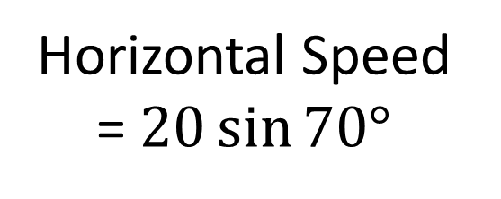

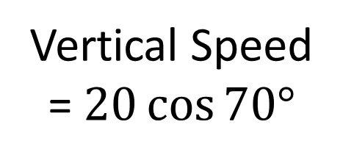


Components
Split the initial velocity into components.
$20$ ms⁻¹
$20\sin{70°}$ ms⁻¹
$$70°$$
$20\cos{70°}$ ms⁻¹
Vertical Speed
= $20\cos{70°}$
Horizontal Speed
= $20\sin{70°}$

Slide 3
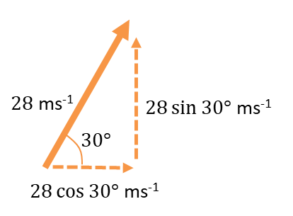
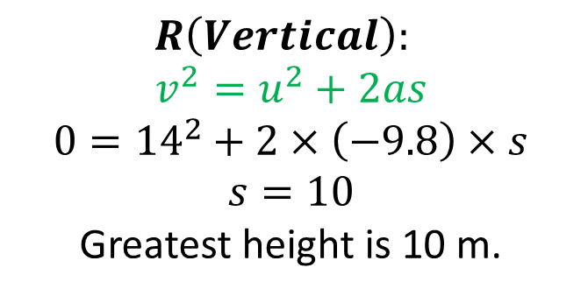
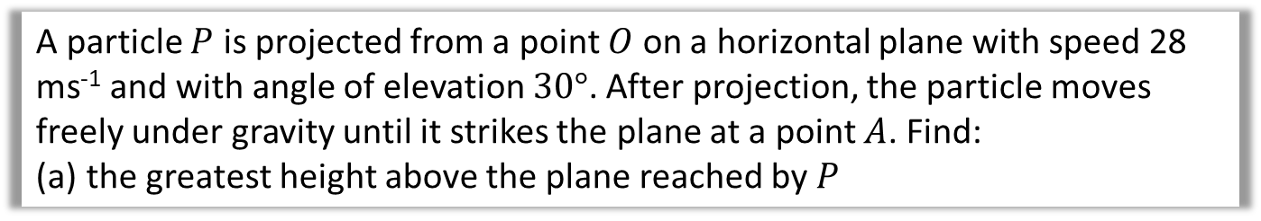
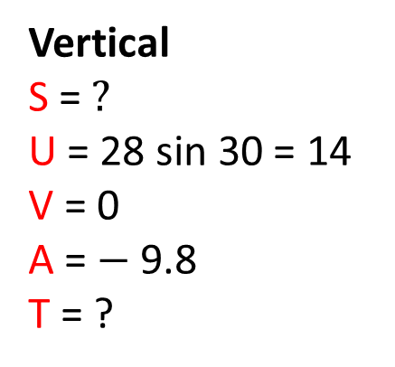
Components – Example A
A particle $P$ is projected from a point $O$ on a horizontal plane with speed 28 ms⁻¹ and with angle of elevation $30°$. After projection, the particle moves freely under gravity until it strikes the plane at a point $A$. Find:
the greatest height above the plane reached by $P$
Vertical
S = $?$
U = 28 sin 30 = 14
V = 0
A = $−$9.8
T = ?
Horizontal
Distance = ?
Speed = 28 cos 30
Time = ?
$$R\left(Vertical\right):$$
$$v^{2}=u^{2}+2as \\ 0={14}^{2}+2×\left(−9.8\right)×s$$
$$s=10$$
Greatest height is 10 m.

Slide 4

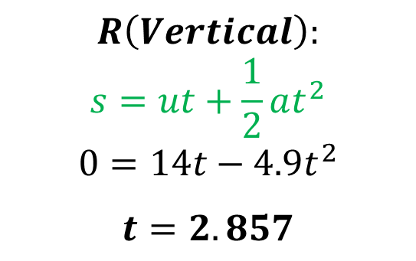
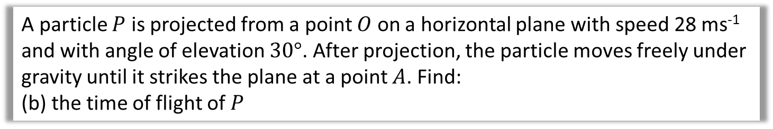
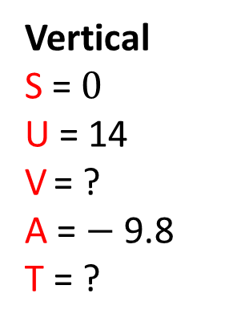
Components – Example A
A particle $P$ is projected from a point $O$ on a horizontal plane with speed 28 ms⁻¹ and with angle of elevation $30°$. After projection, the particle moves freely under gravity until it strikes the plane at a point $A$. Find:
(b) the time of flight of $P$
Vertical
S = $0$
U = 14
V = ?
A = $−$9.8
T = ?
$$R\left(Vertical\right):$$
$$s=ut+\frac{1}{2}at^{2} \\ 0=14t−4.9t^{2}$$
$$t=2.857$$

Slide 5
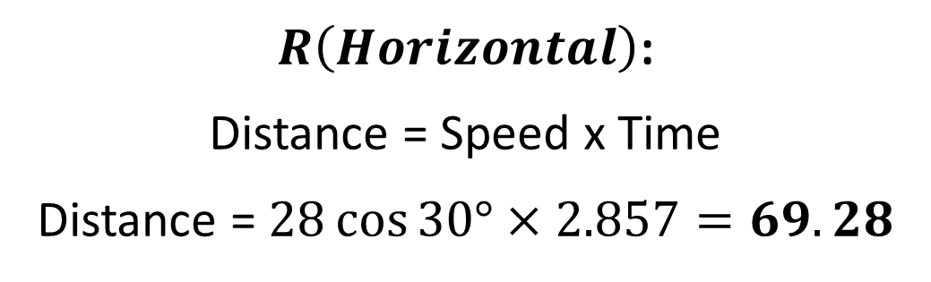
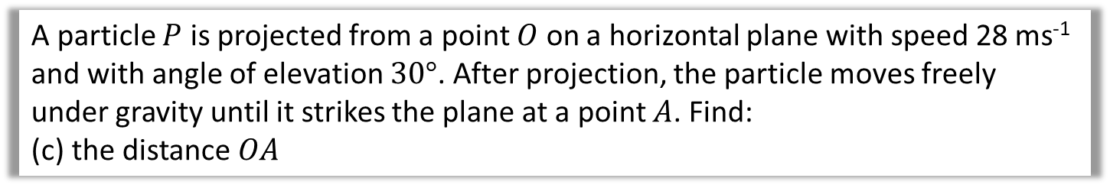
Components – Example A
A particle $P$ is projected from a point $O$ on a horizontal plane with speed 28 ms⁻¹ and with angle of elevation $30°$. After projection, the particle moves freely under gravity until it strikes the plane at a point $A$. Find:
(c) the distance $OA$
Horizontal
Distance = ?
Speed = 28 cos 30
Time = 2.857
$R\left(Horizontal\right)$:
Distance = Speed x Time
Distance = $28\cos{30°}×2.857=69.28$

Slide 6



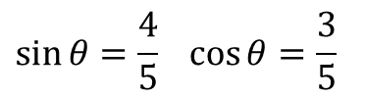

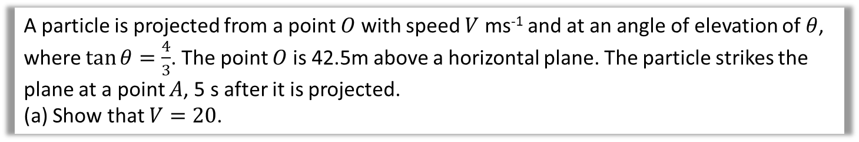



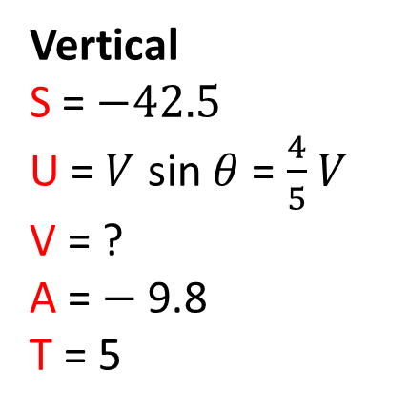



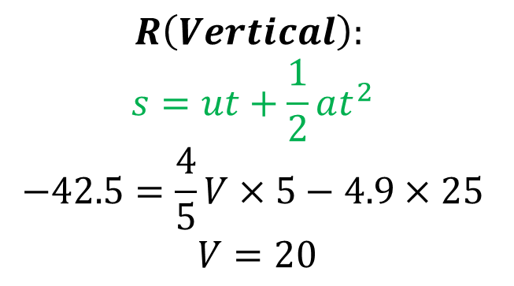
Components – Example B
A particle is projected from a point $O$ with speed $V$ ms⁻¹ and at an angle of elevation of $θ$, where $\tan{θ=\frac{4}{3}}$. The point $O$ is 42.5m above a horizontal plane. The particle strikes the plane at a point $A$, 5 s after it is projected.
(a) Show that $V=20$.
Vertical
S = $−42.5$
U = $V$ sin $θ$ = $\frac{4}{5}$ $V$
V = ?
A = $−$9.8
T = 5
$V$ ms⁻²
$$θ$$
$$O$$
$$42.5m$$
$$t=5$$
$$R\left(Vertical\right):$$
$$s=ut+\frac{1}{2}at^{2} \\ −42.5=\frac{4}{5}V×5−4.9×25 \\ V=20$$
$$A$$
$$5$$
$$\sin{θ}=\frac{4}{5} \cos{θ}=\frac{3}{5}$$
$$4$$
$$θ$$
$$3$$

Slide 7
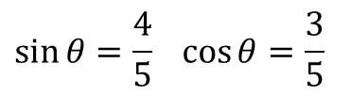
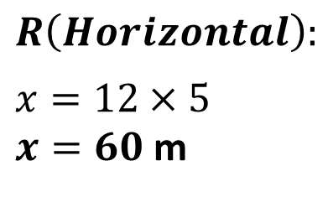


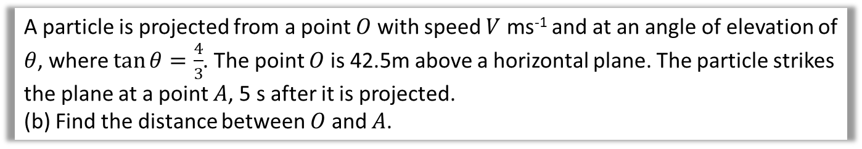








Components – Example B
A particle is projected from a point $O$ with speed $V$ ms⁻¹ and at an angle of elevation of $θ$, where $\tan{θ=\frac{4}{3}}$. The point $O$ is 42.5m above a horizontal plane. The particle strikes the plane at a point $A$, 5 s after it is projected.
(b) Find the distance between $O$ and $A$.
$V$ ms⁻²
Horizontal
Distance = ?
Speed = 20 cos $θ=\frac{3}{5}\left(20\right)$ = 12
Time = 5
$$θ$$
$$O$$
$$42.5m$$
$$R\left(Horizontal\right):$$
$$x=12×5$$
$x=60$ m
$x$
$$t=5$$
$$A$$
$$5$$
$$\sin{θ}=\frac{4}{5} \cos{θ}=\frac{3}{5}$$
$$4$$
$$θ$$
$$3$$

Slide 8

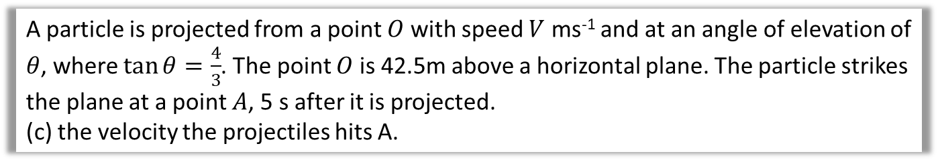
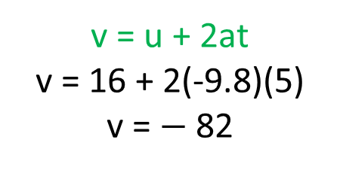
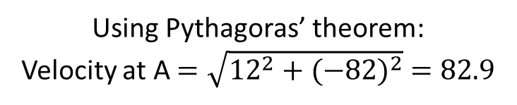
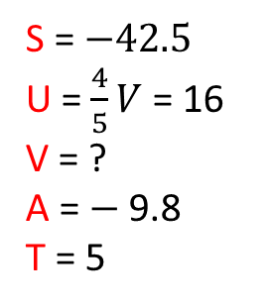
Components – Example B
A particle is projected from a point $O$ with speed $V$ ms⁻¹ and at an angle of elevation of $θ$, where $\tan{θ=\frac{4}{3}}$. The point $O$ is 42.5m above a horizontal plane. The particle strikes the plane at a point $A$, 5 s after it is projected.
(c) the velocity the projectiles hits A.
Horizontal Velocity at A = 12
$V$ ms⁻²
$$θ$$
S = $−42.5$
U = $\frac{4}{5}V$ = 16
V = ?
A = $−$9.8
T = 5
Vertical Velocity at A
$$O$$
v = u + 2at
v = 16 + 2(-9.8)(5)
v = $−$82
$$42.5m$$
$$t=5$$
12
$$A$$
$$A$$
-82
Using Pythagoras’ theorem:
Velocity at A $=\sqrt{{12}^{2}+{(−82)}^{2}} =82.9$

Slide 9
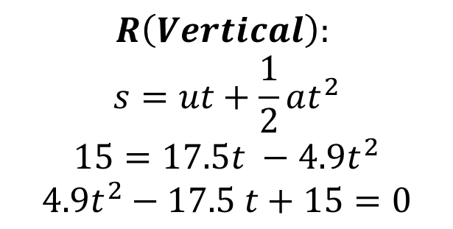
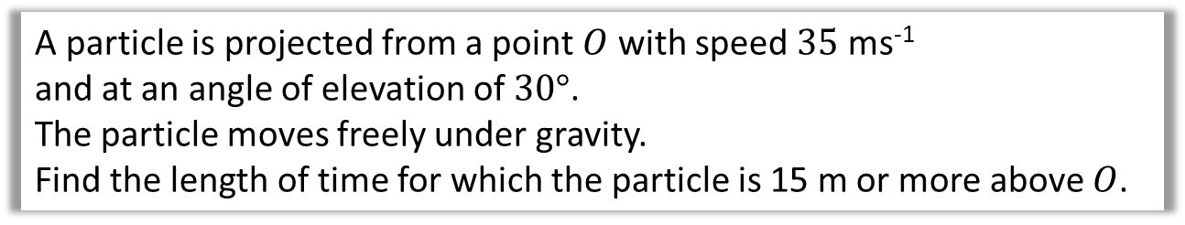
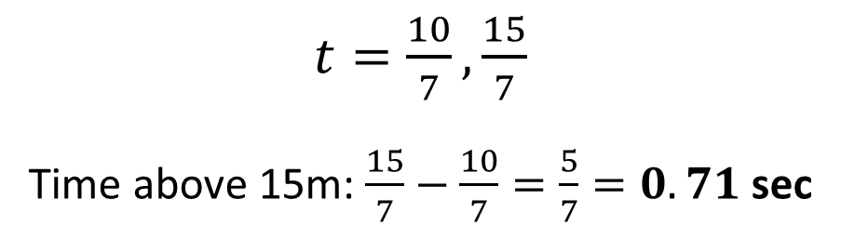
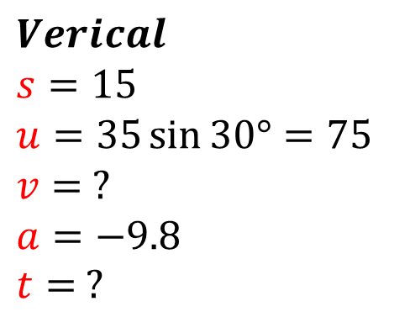
Components – Example C
A particle is projected from a point $O$ with speed $35$ ms⁻¹
and at an angle of elevation of $30°$.
The particle moves freely under gravity.
Find the length of time for which the particle is 15 m or more above $O$.
The key is to find the two times at which the particle is 15m above ground.
The time above 15m will then be the difference between these times.
$$Verical$$
$$s=15$$
$$u=35\sin{30°=75}$$
$$v= ?$$
$$a=−9.8$$
$t=$ ?
$$R\left(Vertical\right):$$
$$s=ut+\frac{1}{2}at^{2} \\ 15=17.5t −4.9t^{2} \\ 4.9t^{2}−17.5 t+15=0$$
$t=\frac{10}{7},\frac{15}{7}$
Time above 15m: $\frac{15}{7}−\frac{10}{7}=\frac{5}{7}=0.71$ sec

Slide 10
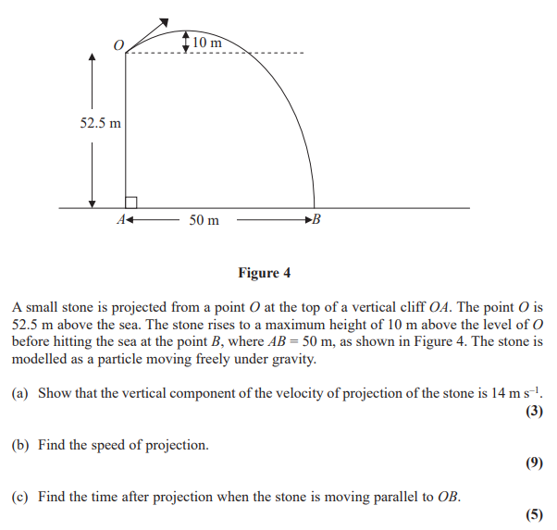
Components - Exam Question

Slide 11

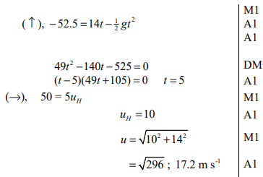
Components - Exam Question (Answers)
a
b

Slide 12
Exercise 6C
Pearson Stats/Mechanics Year 2
Pages 117-120
Complete before the lesson Ex6b Q6 & Q1-2
In Class:
Green Q3-8
Amber Q9-12
Red Q13-16 & Challenge

