Slide 1

CorePure1 Chapter 2 ::
Argand Diagrams
jfrost@tiffin.kingston.sch.uk
www.drfrostmaths.com
@DrFrostMaths
Last modified: 14th September 2018

Slide 2








www.drfrostmaths.com
Everything is completely free.
Why not register?
Register now to interactively practise questions on this topic, including past paper questions and extension questions (including MAT + UKMT).
Teachers: you can create student accounts (or students can register themselves), to set work, monitor progress and even create worksheets.
With questions by:
Dashboard with points, trophies, notifications and student progress.
Questions organised by topic, difficulty and past paper.
Teaching videos with topic tests to check understanding.

Slide 3
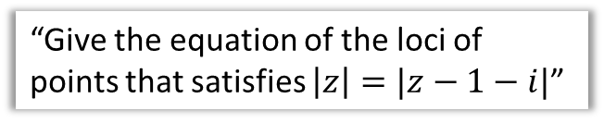

Chapter Overview
1:: Represent complex numbers on an Argand Diagram.
2:: Put a complex number in modulus-argument form.
“Put $1+i$ in modulus-argument form.”
3:: Identify loci and regions.
“Give the equation of the loci of points that satisfies $\left|z\right|=|z−1−i|$”

Slide 4

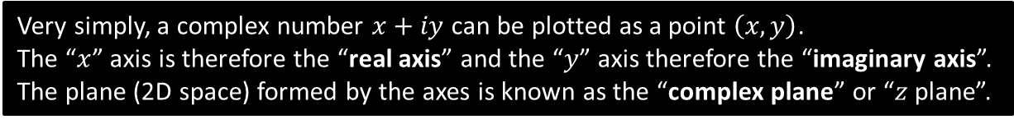



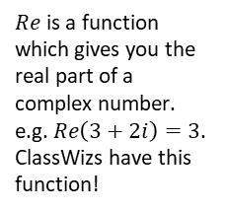


Argand Diagrams
Just as $x$-$y$ axes were a useful way to visualise coordinates, an Argand diagram allows us to visualise complex numbers.
Very simply, a complex number $x+iy$ can be plotted as a point $\left(x,y\right)$.
The “$x$” axis is therefore the “real axis” and the “$y$” axis therefore the “imaginary axis”.
The plane (2D space) formed by the axes is known as the “complex plane” or “$z$ plane”.
$$Im(z)$$
Click to move.
3
2
1
-1
-2
-3
$Re$ is a function which gives you the real part of a complex number. e.g. $Re\left(3+2i\right)=3$. ClassWizs have this function!
$$1+i$$
$$2−3i$$
$$Re(z)$$
-3 -2 -1 1 2 3
$$−1+2i$$
$$−2i$$

Slide 5
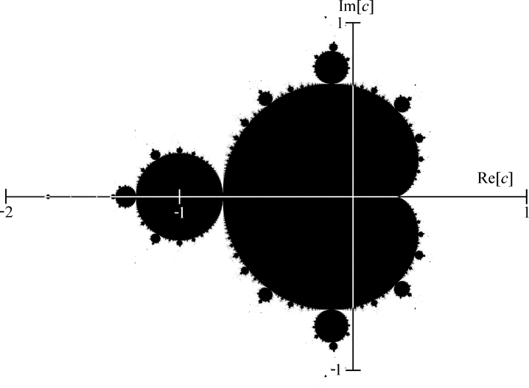
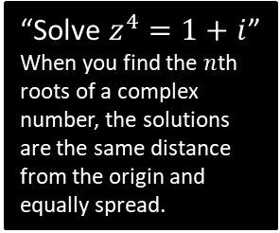





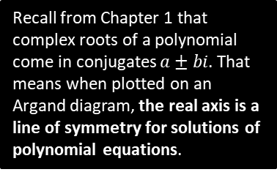
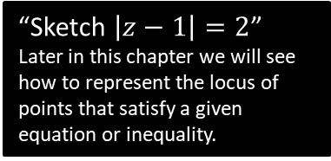


But why visualise complex numbers?
Just as with standard 2D coordinates, Argand diagrams help us interpret the relationship between complex numbers in a geometric way:
$$Im[z]$$
“Solve $z^{4}=1+i$”
When you find the $n$th roots of a complex number, the solutions are the same distance from the origin and equally spread.
$$Im[z]$$
$$Re[z]$$
$$Re[z]$$
Recall from Chapter 1 that complex roots of a polynomial come in conjugates $a±bi$. That means when plotted on an Argand diagram, the real axis is a line of symmetry for solutions of polynomial equations.
$$Im[z]$$
$$Re[z]$$
“Sketch $\left|z−1\right|=2$”
Later in this chapter we will see how to represent the locus of points that satisfy a given equation or inequality.
$$−1$$
$$1$$
$$3$$
You may recognise images like the ones above. They are Mandelbrot sets, and are plotted on an Argand diagram.

Slide 6
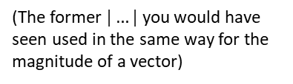


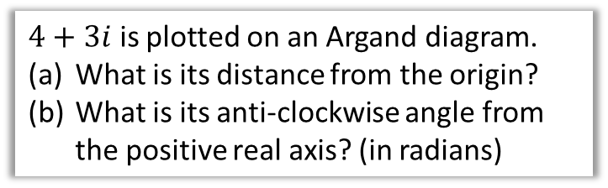


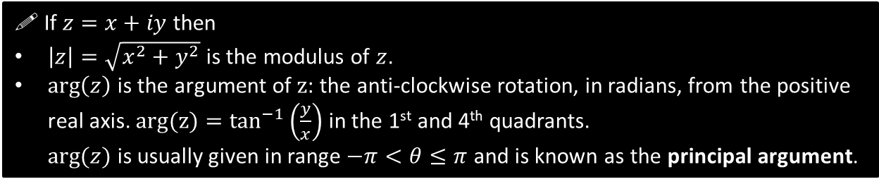
Modulus and Argument
$$Im[z]$$
$4+3i$ is plotted on an Argand diagram.
What is its distance from the origin?
What is its anti-clockwise angle from the positive real axis? (in radians)
3
$$θ$$
$$Re[z]$$
a
Using Pythagoras:
$$\sqrt{3^{2}+4^{2}}=5$$
Using trigonometry:
$θ=\tan^{−1}\left(\frac{3}{4}\right)=0.644$ (to 3sf)
4
?
b
?
These are respectively known as the modulus $|z|$ and argument $arg⁡(z)$ of a complex number.
(The former $|…|$ you would have seen used in the same way for the magnitude of a vector)
! If $z=x+iy$ then
$\left|z\right|=\sqrt{x^{2}+y^{2}}$ is the modulus of $z$.
$\arg\left(z\right)$ is the argument of $z$: the anti-clockwise rotation, in radians, from the positive real axis. $arg(z)=\tan^{−1}\left(\frac{y}{x}\right)$ in the 1st and 4th quadrants.
$arg⁡(z)$ is usually given in range $−π<θ≤π$ and is known as the principal argument.
$$π$$
$$−π$$

Slide 7


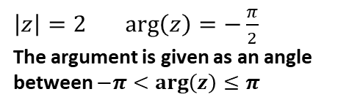
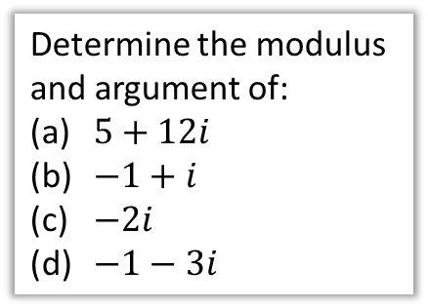
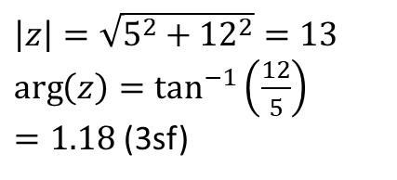


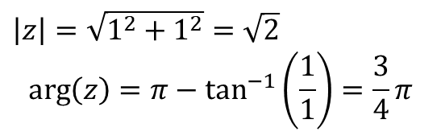
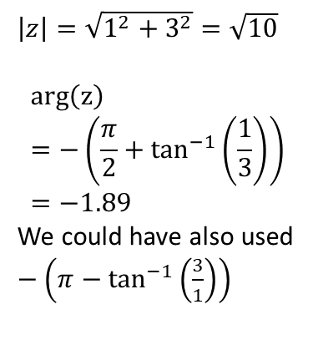
Examples
b
$$Im[z]$$
?
Determine the modulus and argument of:
$5+12i$
$−1+i$
$−2i$
$−1−3i$
$$Im[z]$$
d
?
1
$$θ$$
$$Re[z]$$
$$θ$$
$$Re[z]$$
3
1
$\left|z\right|=\sqrt{1^{2}+1^{2}}=\sqrt{2}$
$$\arg\left(z\right)=π−\tan^{−1}\left(\frac{1}{1}\right)=\frac{3}{4}π$$
1
$\left|z\right|=\sqrt{1^{2}+3^{2}}=\sqrt{10}$
$$arg\left(z\right)=−\left(\frac{π}{2}+\tan^{−1}\left(\frac{1}{3}\right)\right)=−1.89$$
We could have also used $−\left(π−\tan^{−1}\left(\frac{3}{1}\right)\right)$
a
?
$$Im[z]$$
12
c
?
$$Im[z]$$
$$θ$$
$$Re[z]$$
5
$$Re[z]$$
2
$$θ$$
$\left|z\right|=\sqrt{5^{2}+{12}^{2}}=13$
$\arg\left(z\right)=\tan^{−1}\left(\frac{12}{5}\right)$
$=1.18$ (3sf)
$\left|z\right|=2$ $\arg\left(z\right)=−\frac{π}{2}$
The argument is given as an angle between $−π<\arg\left(z\right)≤π$

Slide 8
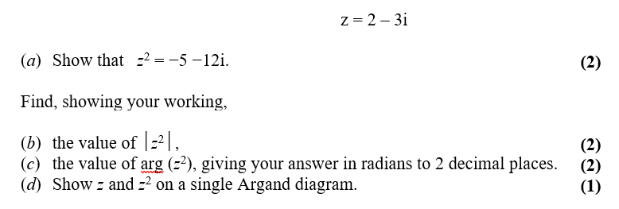
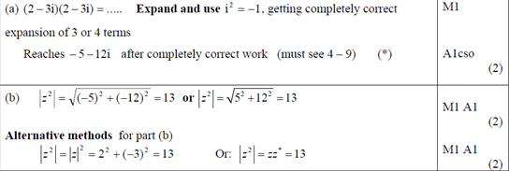
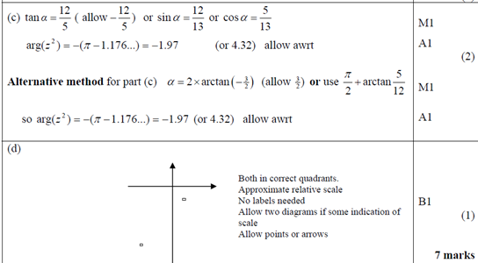
Test Your Understanding
Edexcel FP1(Old) June 2010 Q1
? a
? b
? c
? d

Slide 9
Exercise 2B
Pearson Pure Mathematics Year 1/AS
Pages 21-23
Complete before the lesson Q1-2
In Class:
Green Q3-4
Amber Q5-8
Red Q9-12

Slide 10


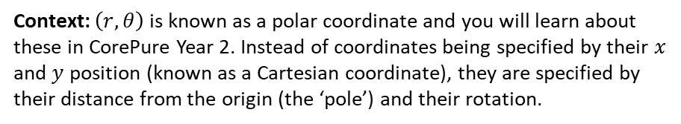

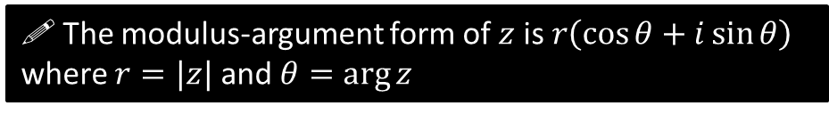


Modulus-Argument Form
$$Im[z]$$
If we let $r=\left|z\right|$ and $θ=arg⁡(z)$, can you think of a way of expressing $z$ in terms of just $r$ and $θ$?
$$r$$
?
$$θ$$
$$y$$
By trigonometry:
$$x=r\cos{θ} \\ y=r\sin{θ}$$
Therefore:
$$z=x+iy \\ z=r\cos{θ}+\left(r\sin{θ}\right)i \\ z=r\left(\cos{θ}+i\sin{θ}\right)$$
$$Re[z]$$
$$x$$
! The modulus-argument form of $z$ is $r\left(\cos{θ}+i\sin{θ}\right)$
where $r=|z|$ and $θ=\arg{z}$
Context: $\left(r,θ\right)$ is known as a polar coordinate and you will learn about these in CorePure Year 2. Instead of coordinates being specified by their $x$ and $y$ position (known as a Cartesian coordinate), they are specified by their distance from the origin (the ‘pole’) and their rotation.

Slide 11







Example
Express $z=−\sqrt{3}+i$ in the form $r\left(\cos{θ}+i\sin{θ}\right)$ where $−π<θ≤π$
?
$$r=\sqrt{{\left(\sqrt{3}\right)}^{2}+1^{2}}=2 \\ θ=π−\tan^{−1}\left(\frac{1}{\sqrt{3}}\right)=\frac{5π}{6}$$
$$∴r=2\left(\cos\left(\frac{5π}{6}\right)+i\sin\left(\frac{5π}{6}\right)\right)$$
$$Im[z]$$
1
$$θ$$
$$Re[z]$$
$$−\sqrt{3}$$
Test Your Understanding
Express $z=−1−\sqrt{3}i$ in the form $r\left(\cos{θ}+i\sin{θ}\right)$ where $−π<θ≤π$
$$Im[z]$$
$$r=2 \\ θ=−\left(π−\tan^{−1}\left(\sqrt{3}\right)\right)=−\frac{2π}{3}$$
$$∴r=2\left(\cos\left(−\frac{2π}{3}\right)+i\sin\left(−\frac{2π}{3}\right)\right)$$
?
$$1$$
$$Re[z]$$
$$\sqrt{3}$$
$$θ$$

Slide 12
Exercise 2C
Pearson Pure Mathematics Year 1/AS
Page 24
Complete before the lesson Q1&3
In Class:
Green Q2&4
Amber Q5
Red Q6

Slide 13

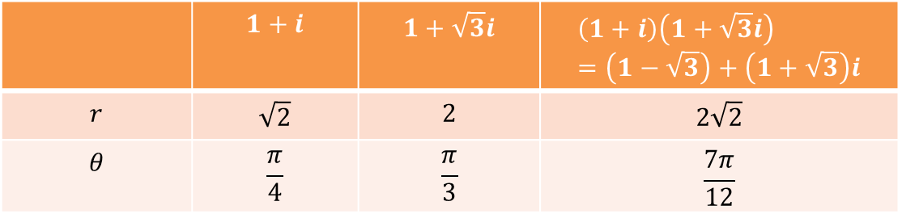
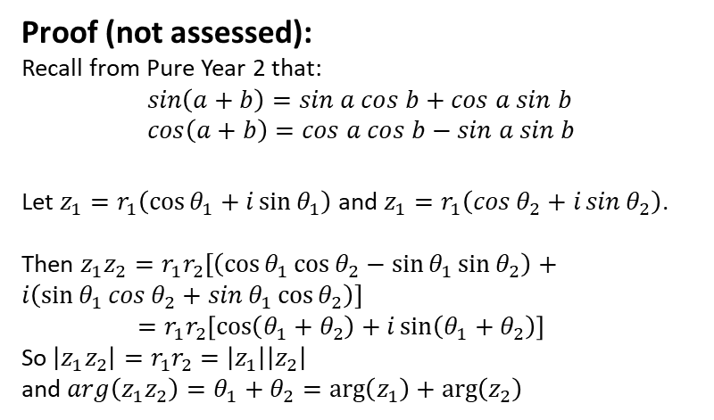
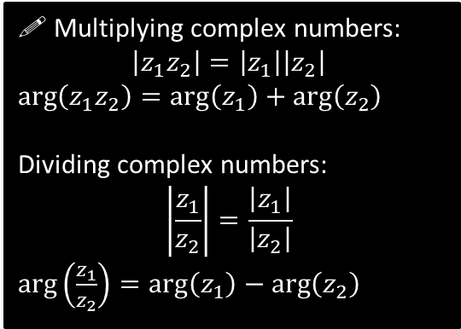
Multiplying and Dividing Complex Numbers
Find the modulus and argument of $1+i$ and $1+\sqrt{3}$.
When you multiply these complex numbers together, do you notice anything about the modulus and argument of the result?
 | $$1+i$$ | $$1+\sqrt{3}i$$ | $$\left(1+i\right)\left(1+\sqrt{3}i\right) \\ =\left(1−\sqrt{3}\right)+\left(1+\sqrt{3}\right)i$$
$$r$$ | $$\sqrt{2}$$ | $$2$$ | $$2\sqrt{2}$$
$$θ$$ | $$\frac{π}{4}$$ | $$\frac{π}{3}$$ | $$\frac{7π}{12}$$
?
?
?
?
?
?
?
Observation: The moduli have been multiplied, and the arguments have been added!
! Multiplying complex numbers:
$$\left|z_{1}z_{2}\right|=\left|z_{1}\right|\left|z_{2}\right|$$
$\arg\left(z_{1}z_{2}\right)=\arg\left(z_{1}\right)+\arg\left(z_{2}\right)$
Dividing complex numbers:
$$\left|\frac{z_{1}}{z_{2}}\right|=\frac{\left|z_{1}\right|}{\left|z_{2}\right|}$$
$\arg\left(\frac{z_{1}}{z_{2}}\right)=\arg\left(z_{1}\right)−\arg\left(z_{2}\right)$
Proof (not assessed):
Recall from Pure Year 2 that:
$$sin\left(a+b\right)=sin a cos b+cos a sin b \\ cos\left(a+b\right)=cos a cos b−sin a sin b$$
Let $z_{1}=r_{1}\left(\cos{θ_{1}}+i\sin{θ_{1}}\right)$ and $z_{1}=r_{1}\left(\cos{θ_{2}}+i\sin{θ_{2}}\right)$.
Then $z_{1}z_{2}=r_{1}r_{2}\left[\left(\cos{θ_{1}}\cos{θ_{2}}−\sin{θ_{1}}\sin{θ_{2}}\right)+i\left(\sin{θ_{1}}\cos{θ_{2}}+\sin{θ_{1}}\cos{θ_{2}}\right)\right]$
$=r_{1}r_{2}\left[\cos\left(θ_{1}+θ_{2}\right)+i\sin\left(θ_{1}+θ_{2}\right)\right]$
So $\left|z_{1}z_{2}\right|=r_{1}r_{2}=\left|z_{1}\right|\left|z_{2}\right|$
and $arg\left(z_{1}z_{2}\right)=θ_{1}+θ_{2}=\arg\left(z_{1}\right)+\arg\left(z_{2}\right)$

Slide 14


Multiplying and Dividing Complex Numbers
[Textbook] Express $\frac{\sqrt{2}\left(\cos{\frac{π}{12}}+i\sin{\frac{π}{12}}\right)}{2\left(\cos{\frac{5π}{6}}+i\sin{\frac{5π}{6}}\right)}$ in the form $x+iy$
?
$$=\frac{\sqrt{2}}{2}\left(\cos\left(\frac{π}{12}−\frac{5π}{6}\right)+i\sin\left(\frac{π}{12}−\frac{5π}{6}\right)\right) \\ =\frac{\sqrt{2}}{2}\left(\cos\left(−\frac{3π}{4}\right)+i\sin\left(−\frac{3π}{4}\right)\right) \\ \sqrt{2}\left(−\frac{1}{\sqrt{2}}+i\left(−\frac{1}{\sqrt{2}}\right)\right) \\ =−\frac{1}{2}−\frac{1}{2}i$$

Slide 15
Exercise 2D
Pearson Pure Mathematics Year 1/AS
Pages 27-28
Complete before the lesson Q1-2
In Class:
Green Q3
Amber Q4
Red Q5 & challenge

Slide 16


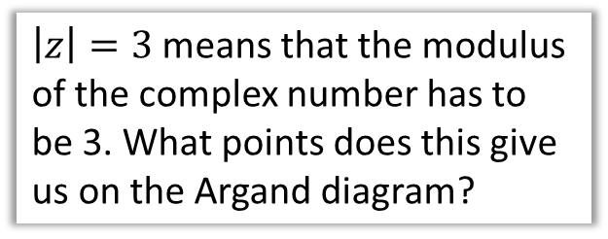
Loci
You have already encountered loci at GCSE as a set of points (possibly forming a line or region) which satisfy some restriction.
The definition of a circle for example is “a set of points equidistant from a fixed centre”.
$$Im$$
3
$\left|z\right|=3$ means that the modulus of the complex number has to be 3. What points does this give us on the Argand diagram?
-3
3
$$Re$$
Click to Frosketch >
-3

Slide 17
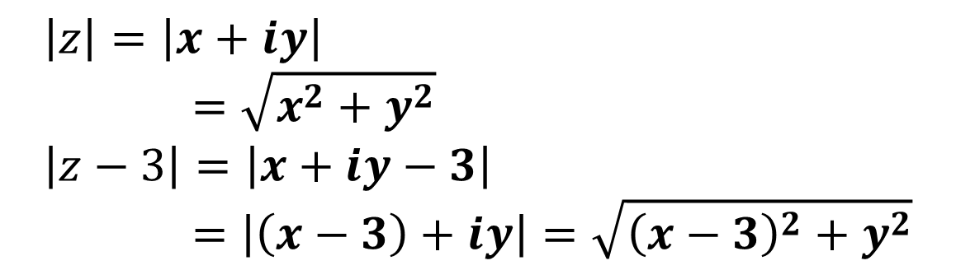
A quick reminder…
$$\left|z\right|=\left|x+iy\right| \\ =\sqrt{x^{2}+y^{2}} \\ \left|z−3\right|=\left|x+iy−3\right| \\ =\left|\left(x−3\right)+iy\right|=\sqrt{{\left(x−3\right)}^{2}+y^{2}}$$
?
?

Slide 18



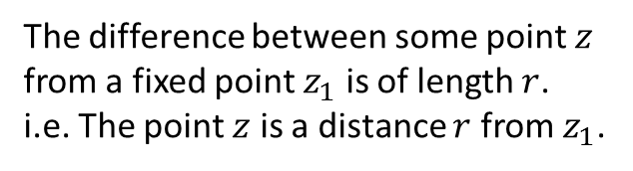

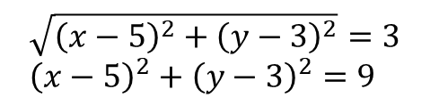



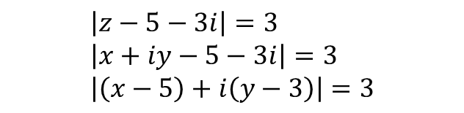


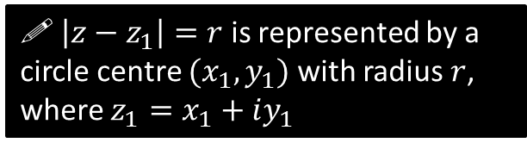

Loci of form $\left|z−z_{1}\right|=r$
$$Im$$
What does $\left|z−z_{1}\right|=r$ mean?
?
$$r$$
The difference between some point $z$ from a fixed point $z_{1}$ is of length $r$.
i.e. The point $z$ is a distance $r$ from $z_{1}$.
$$z_{1}$$
! $\left|z−z_{1}\right|=r$ is represented by a circle centre $(x_{1},y_{1})$ with radius $r$, where $z_{1}=x_{1}+iy_{1}$
$$Re$$
$$Im$$
Sketch the locus of points represented by $\left|z−5−3i\right|=3$
$$\left(5,3\right)$$
?
$$Re$$
$$\left|z−5−3i\right|→|z−\left(5+3i\right)|$$
Find the Cartesian equation of this locus.
$$\left|z−5−3i\right|=3 \\ \left|x+iy−5−3i\right|=3 \\ \left|\left(x−5\right)+i\left(y−3\right)\right|=3$$
Group by real/imaginary.
?
$$\sqrt{{\left(x−5\right)}^{2}+{\left(y−3\right)}^{2}}=3 \\ {\left(x−5\right)}^{2}+{\left(y−3\right)}^{2}=9$$

Slide 19
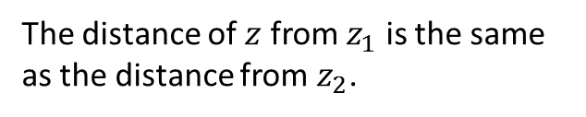










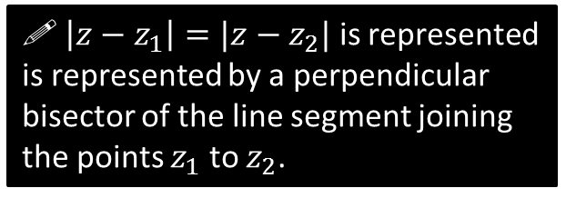

Loci of form $\left|z−z_{1}\right|=\left|z−z_{2}\right|$
What does $\left|z−z_{1}\right|=\left|z−z_{2}\right|$ mean?
$$Im$$
?
The distance of $z$ from $z_{1}$ is the same as the distance from $z_{2}$.
$$z_{2}$$
! $\left|z−z_{1}\right|=|z−z_{2}|$ is represented is represented by a perpendicular bisector of the line segment joining the points $z_{1}$ to $z_{2}$.
$$Re$$
$$z_{1}$$
Sketch the locus of points represented by $\left|z\right|=|z−6i|$. Write its equation.
$$Im$$
$$(0,6)$$
Click to Frosketch >
(The equation is obviously $y=3$, but let’s do it the same algebraic way)
$$\left|x+iy\right|=\left|x+i\left(y−6\right)\right| \\ \sqrt{x^{2}+y^{2}}=\sqrt{x^{2}+{\left(y−6\right)}^{2}} \\ x^{2}+y^{2}=x^{2}+{\left(y−6\right)}^{2} \\ y=3$$
Equation ?
$$(0,0)$$
$$Re$$

Slide 20

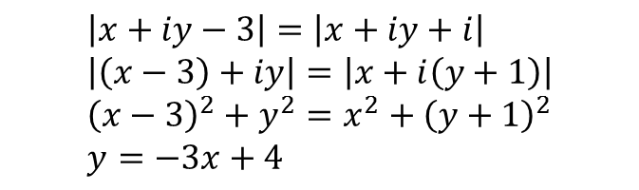






Test Your Understanding So Far
Find the Cartesian equation of the locus of $z$ if $\left|z−3\right|=|z+i|$, and sketch the locus of $z$ on an Argand diagram.
Equation ?
Argand Diagram ?
$$y$$
$$\left|x+iy−3\right|=\left|x+iy+i\right| \\ \left|\left(x−3\right)+iy\right|=\left|x+i\left(y+1\right)\right| \\ {\left(x−3\right)}^{2}+y^{2}=x^{2}+{\left(y+1\right)}^{2} \\ y=−3x+4$$
$$4$$
$$\frac{4}{3}$$
$$(3,0)$$
$$(0,−1)$$
What if we also required that $Re\left(z\right)=0$?
?
This restricts our line to points where the real part is 0. This is just (0,4), i.e. $4i$.

Slide 21


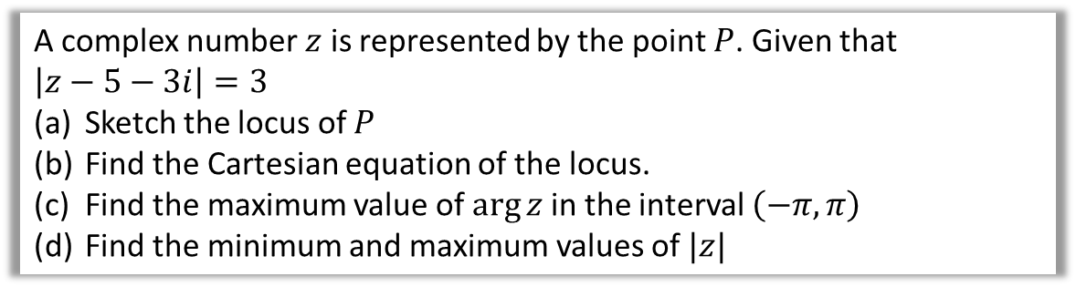












Minimising/Maximising $arg⁡(z)$ and $|z|$
A complex number $z$ is represented by the point $P$. Given that $\left|z−5−3i\right|=3$
Sketch the locus of $P$
Find the Cartesian equation of the locus.
Find the maximum value of $\arg{z}$ in the interval $\left(−π,π\right)$
Find the minimum and maximum values of $|z|$
$$Im$$
d
We did this earlier…
c
?
?
a
The minimum and maximum $\left|z\right|$ can be found be drawing a line between the origin and the centre of circle, and seeing where the line intersects the circle. Note that we do not need the actual $z$ themselves!
Max $\left|z\right|=\sqrt{34}+3$
Min $\left|z\right|=\sqrt{34}−3$
$$Im$$
$$3$$
$$\left(5,3\right)$$
$$C$$
$$\left(5,3\right)$$
$$α$$
$$α$$
$$O$$
$$Re$$
$$Re$$
The maximum argument occurs when a line from the origin is tangent to the circle.
$$OC=\sqrt{3^{2}+5^{2}}=\sqrt{34} \\ ∴α=\sin^{−1}\left(\frac{3}{\sqrt{34}}\right)=0.5404 \\ ∴\arg\left(z\right)=2×0.5404=1.0808$$
b
$${\left(x−5\right)}^{2}+{\left(y−3\right)}^{2}=9$$

Slide 22


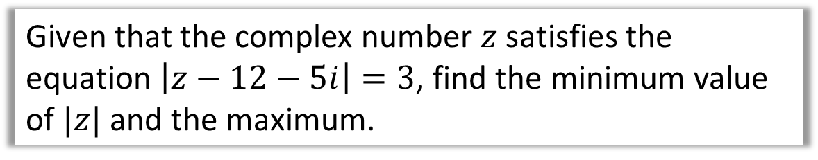



Quickfire Test Your Understanding
Given that the complex number $z$ satisfies the equation $\left|z−12−5i\right|=3$, find the minimum value of $|z|$ and the maximum.
?
Minimum = 10
Maximum = 16
$$y$$
$$(12,5)$$
$$13$$
$$3$$
$$x$$

Slide 23

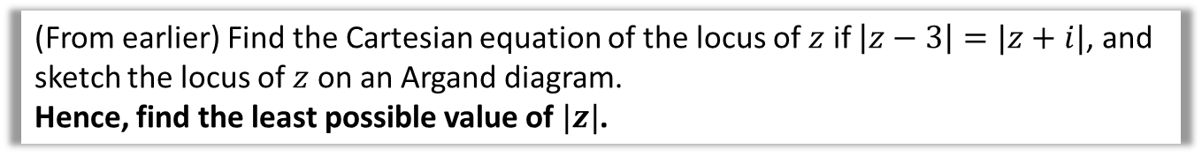



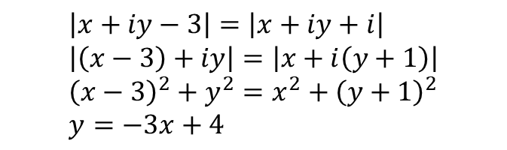
Minimising $|z|$ with perpendicular bisectors
(From earlier) Find the Cartesian equation of the locus of $z$ if $\left|z−3\right|=|z+i|$, and sketch the locus of $z$ on an Argand diagram.
Hence, find the least possible value of $|z|$.
$$\left|x+iy−3\right|=\left|x+iy+i\right| \\ \left|\left(x−3\right)+iy\right|=\left|x+i\left(y+1\right)\right| \\ {\left(x−3\right)}^{2}+y^{2}=x^{2}+{\left(y+1\right)}^{2} \\ y=−3x+4$$
? Min Distance to Origin
The minimum distance is the perpendicular distance from the origin.
Easiest strategy is coordinate geometry:
Gradient of loci: $−3$
Gradient of perpendicular line: $\frac{1}{3}$
Equation of perpendicular line:
$$y=\frac{1}{3}x$$
$$\frac{1}{3}x=−3x+4 \\ → x=\frac{6}{5}, y=\frac{2}{5}$$
Distance $=\sqrt{{\left(\frac{6}{5}\right)}^{2}+{\left(\frac{2}{5}\right)}^{2}}=\frac{2\sqrt{10}}{5}$
$$y$$
$$4$$
$$\frac{4}{3}$$

Slide 24



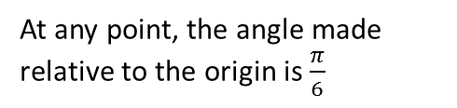

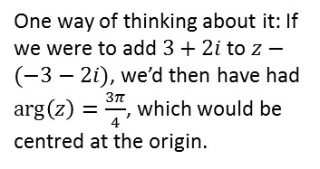
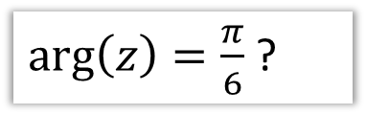


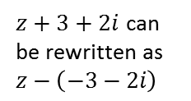




$\arg\left(z−z_{1}\right)=θ$
$$y$$
Click to Frosketch >
$\arg\left(z\right)=\frac{π}{6}$ ?
At any point, the angle made relative to the origin is $\frac{π}{6}$
$$\arg\left(z\right)=\frac{π}{6} \\ \arg\left(x+iy\right)=\frac{π}{6} \\ \frac{y}{x}=\tan\left(\frac{π}{6}\right)=\frac{1}{\sqrt{3}} \\ y=\frac{1}{\sqrt{3}}x, x>0,y>0$$
This bit is important. The locus is referred to as a ‘half line’, because it extends to infinity only in one direction.
Equation ?
$$\frac{π}{6}$$
$$x$$
$$y$$
Click to Frosketch >
$\arg\left(z+3+2i\right)=\frac{3π}{4}$ ?
$z+3+2i$ can be rewritten as $z−\left(−3−2i\right)$
Equation ?
$$\arg\left(x+iy+3+2i\right)=\frac{3π}{4} \\ \arg\left(\left(x+3\right)+i\left(y+2\right)\right)=\frac{3π}{4} \\ \frac{y+2}{x+3}=\tan\left(\frac{3π}{4}\right)=−1 \\ y=−x−5, x<−3,y≻2$$
$$\frac{3π}{4}$$
$$x$$
One way of thinking about it: If we were to add $3+2i$ to $z−(−3−2i)$, we’d then have had $\arg\left(z\right)=\frac{3π}{4}$, which would be centred at the origin.
$$(−3,−2)$$

Slide 25
Exercise 2E
Pearson Pure Mathematics Year 1/AS
Pages 34-36
Complete before the lesson Q1-2
In Class:
Green Q3
Amber Q4
Red Q5 & challenge

Slide 26















Regions
How would you describe each of the following in words? Therefore draw each of the regions on an Argand diagram.
$$\left|z−4−2i\right|≤2$$
$$\left|z−4\right|<|z−6|$$
?
?
“The distance from $4+2i$ is less than 2”.
“The distance from $4$ is less than from $6$.”
$$y$$
$$(4,2)$$
$$x=5$$
$$x$$
$$4$$
$$4$$
$$6$$
$$0≤\arg\left(z−2−2i\right)≤\frac{π}{4}$$
$\left|z−4−2i\right|≤2$, $\left|z−4\right|<|z−6|$
and $0≤\arg\left(z−2−2i\right)≤\frac{π}{4}$
?
?
An intersection of the three other regions.
$$\frac{π}{4}$$
(I couldn’t be bothered to draw this. Sorry)
$$(2,2)$$

Slide 27


Test Your Understanding
P6 June 2003 Q4(i)(b)
Shade the region for which
$\left|z−1\right|≤1$ and $\frac{π}{12}≤\arg\left(z+1\right)≤\frac{π}{2}$
?

Slide 28
Exercise 2F
Pearson Pure Mathematics Year 1/AS
Page 38
Complete before the lesson Q1 & Finish up from Ex2E
In Class:
Green Q2-3
Amber Q4-5
Red Q6 & challenge

