Slide 1
Year 1 Pure Mathematics
Algebraic Expressions
- Indices
Chapter 1
(Part 1 of 3)

Slide 2
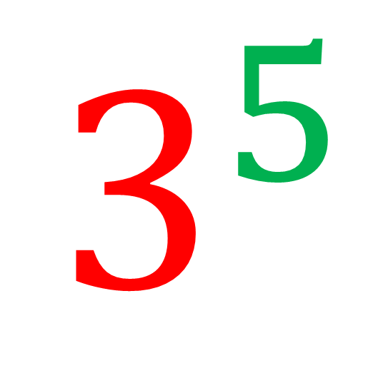
Indices - Laws
Exponent or Power or Index
(Plural: Indices)
$$3^{5}$$
Base Value

Slide 3
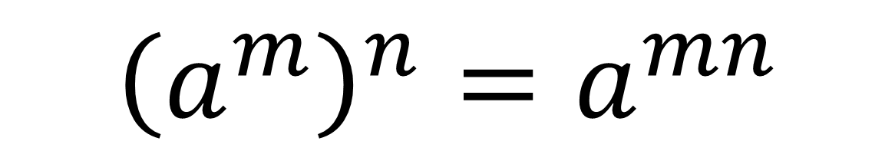
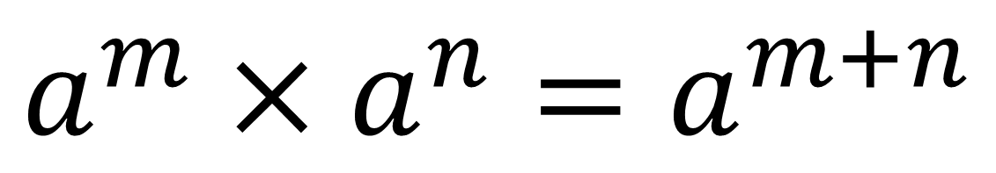
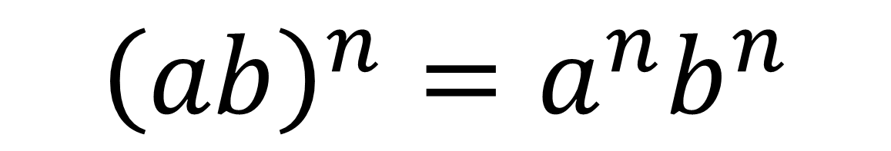
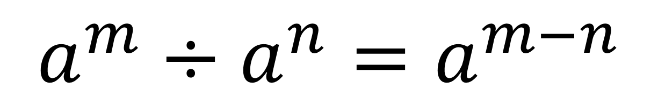
Indices - Laws
$$a^{m}×a^{n}=a^{m+n}$$
$$a^{m}÷a^{n}=a^{m−n}$$
$${\left(a^{m}\right)}^{n}=a^{mn}$$
$${\left(ab\right)}^{n}=a^{n}b^{n}$$

Slide 4
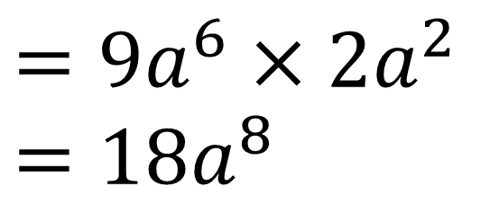
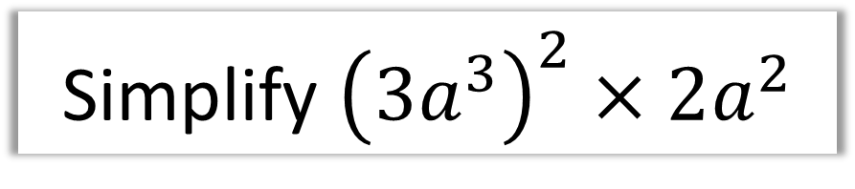
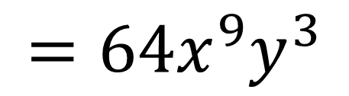
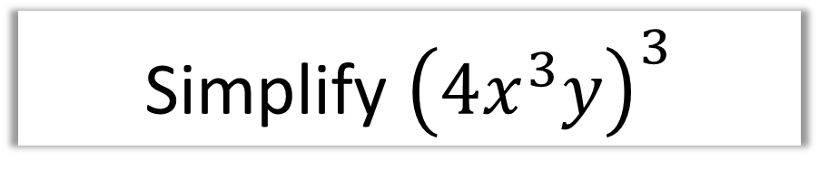
Indices - Laws
Simplify ${\left({3a}^{3}\right)}^{2}×2a^{2}$
$$={9a}^{6}×2a^{2}$$
$$=18a^{8}$$
Simplify ${\left(4x^{3}y\right)}^{3}$
$$=64x^{9}y^{3}$$

Slide 5
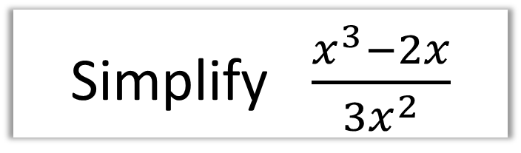
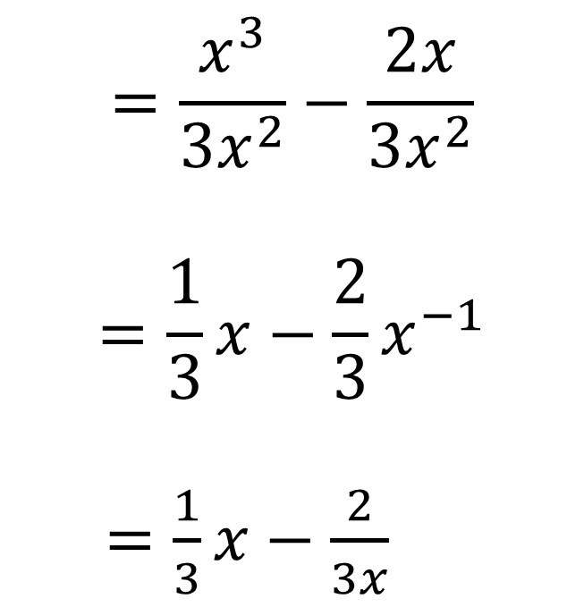
Indices - Laws
Simplify $\frac{x^{3}−2x}{3x^{2}}$
$$=\frac{x^{3}}{{3x}^{2}}−\frac{2x}{3x^{2}}$$
$$=\frac{1}{3}x−\frac{2}{3}x^{−1}$$
$=\frac{1}{3}x−\frac{2}{3x}$

Slide 6
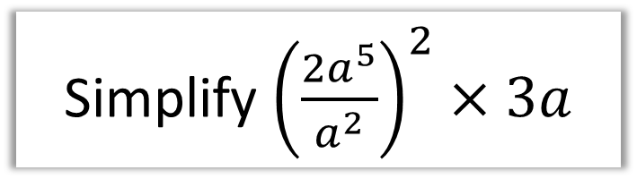
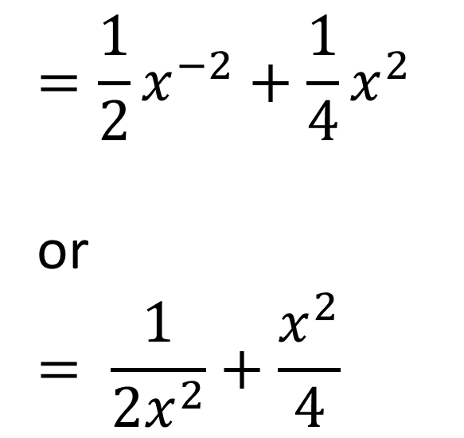
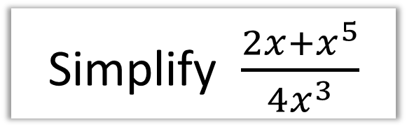
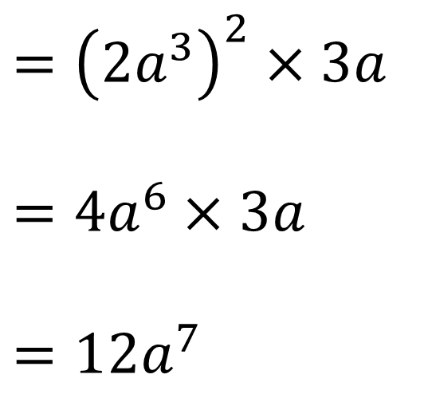
Indices - Laws
Simplify ${\left(\frac{2a^{5}}{a^{2}}\right)}^{2}×3a$
Simplify $\frac{2x+x^{5}}{4x^{3}}$
$$=\frac{1}{2}x^{−2}+\frac{1}{4}x^{2}$$
or
$$= \frac{1}{2x^{2}}+\frac{x^{2}}{4}$$
$$={\left(2a^{3}\right)}^{2}×3a$$
$$=4a^{6}×3a$$
$$=12a^{7}$$

Slide 7
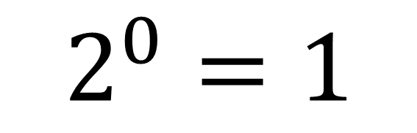
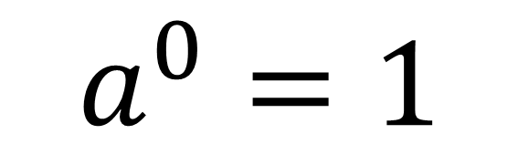
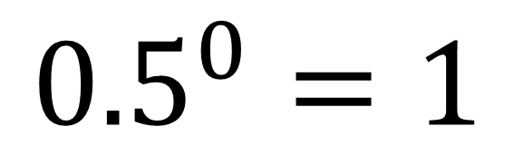
Indices - Negative and Fractional Indices
Zero Indices
$$a^{0}=1$$
$$2^{0}=1$$
$${0.5}^{0}=1$$

Slide 8
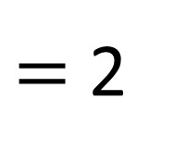
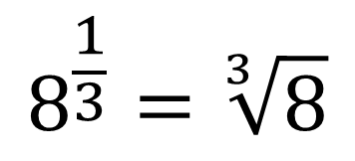
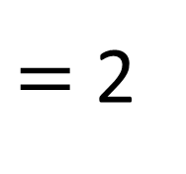
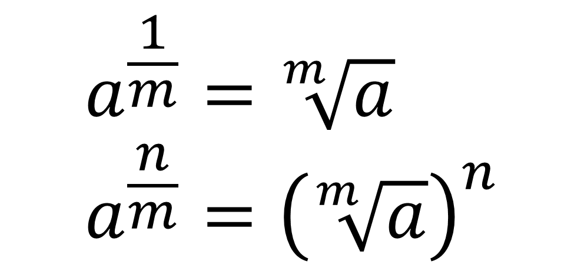
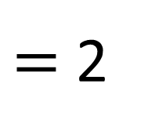
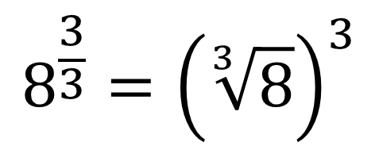
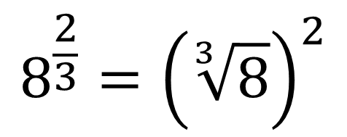
Indices - Negative and Fractional Indices
Fractional Indices
$$a^{\frac{1}{m}}=\sqrt[m]{a} \\ a^{\frac{n}{m}}={\left(\sqrt[m]{a}\right)}^{n}$$
$$8^{\frac{1}{3}}=\sqrt[3]{8}$$
$$8^{\frac{2}{3}}={\left(\sqrt[3]{8}\right)}^{2}$$
$$8^{\frac{3}{3}}={\left(\sqrt[3]{8}\right)}^{3}$$
$=$ 2
$=$ 2
$=$ 2

Slide 9
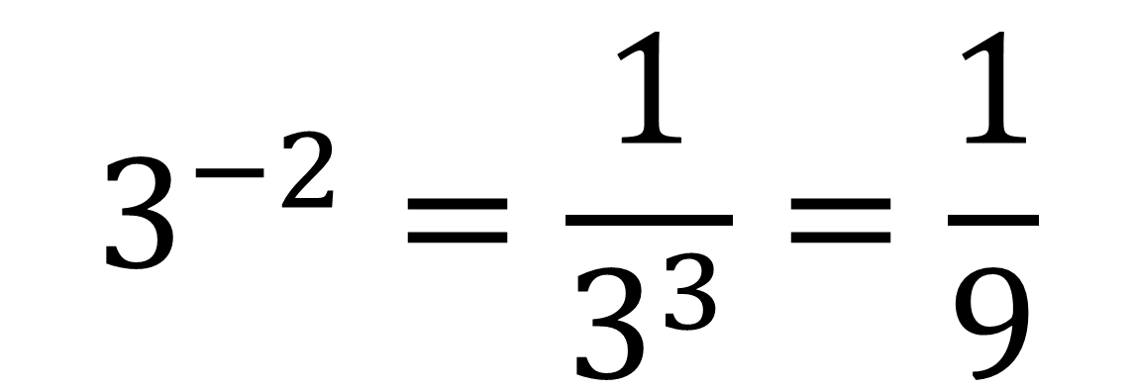
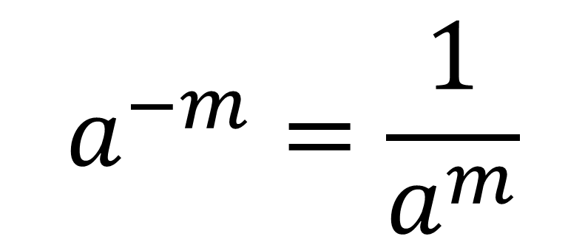
Indices - Negative and Fractional Indices
Negative Indices
$$a^{−m}=\frac{1}{a^{m}}$$
$$3^{−2}=\frac{1}{3^{3}}=\frac{1}{9}$$

Slide 10
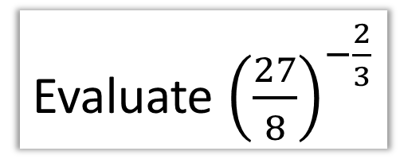
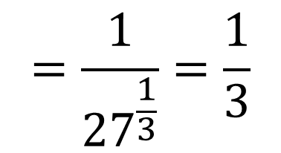
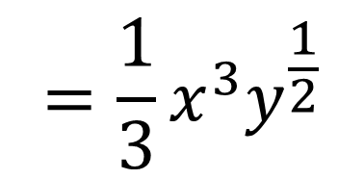
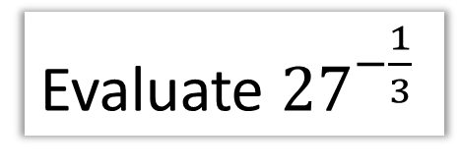
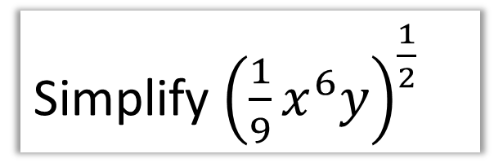

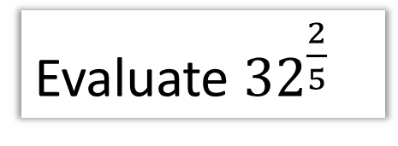
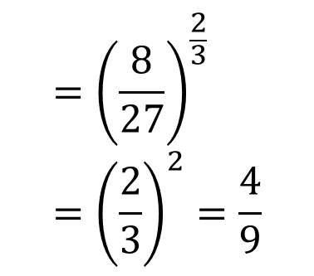
Indices - Negative and Fractional Indices
Evaluate ${27}^{−\frac{1}{3}}$
Evaluate ${32}^{\frac{2}{5}}$
$$=\frac{1}{{27}^{\frac{1}{3}}}=\frac{1}{3}$$
$$=2^{2}=4$$
Simplify ${\left(\frac{1}{9}x^{6}y\right)}^{\frac{1}{2}}$
Evaluate ${\left(\frac{27}{8}\right)}^{−\frac{2}{3}}$
$$={\left(\frac{8}{27}\right)}^{\frac{2}{3}}={\left(\frac{2}{3}\right)}^{2}=\frac{4}{9}$$
$$=\frac{1}{3}x^{3}y^{\frac{1}{2}}$$

Slide 11
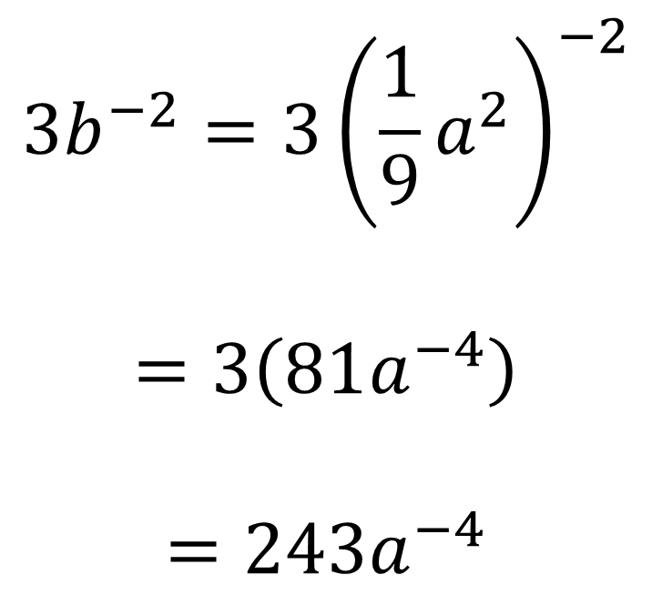
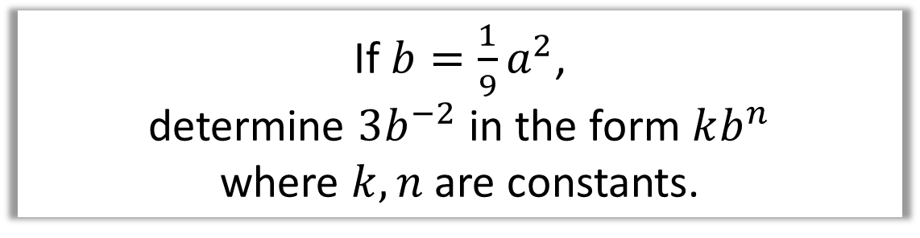
Indices - Negative and Fractional Indices
If $b=\frac{1}{9}a^{2}$,
determine $3b^{−2}$ in the form $kb^{n}$
where $k,n$ are constants.
$$3b^{−2}=3{\left(\frac{1}{9}a^{2}\right)}^{−2}$$
$$=3\left(81a^{−4}\right)$$
$$=243a^{−4}$$

Slide 12
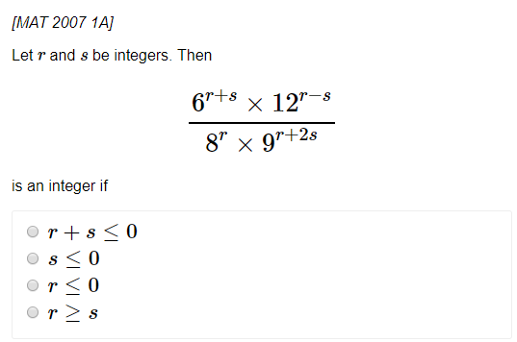
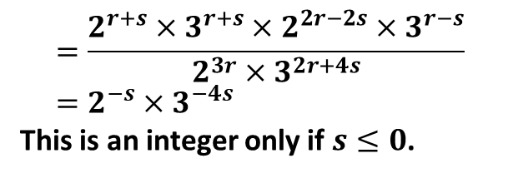
Exercise 1A&D
Pearson Pure Mathematics Year 1/AS
Page 11
Extension (Full Database: http://www.drfrostmaths.com/resources/resource.php?rid=268 )
?
$$=\frac{2^{r+s}×3^{r+s}×2^{2r−2s}×3^{r−s}}{2^{3r}×3^{2r+4s}} \\ =2^{−s}×3^{−4s}$$
This is an integer only if $s≤0$.
Complete before the lesson Ex1A
In Class:
Green Q1-2
Amber Q3-5
Red Extension

