Slide 1
Year 1 Applied Mathematics
Hypothesis Testing
- Actual Significant Level
Chapter 7
(Part 5 of 5)

Slide 2
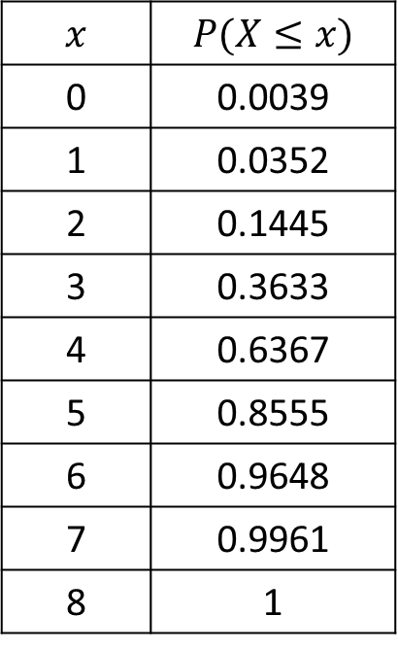
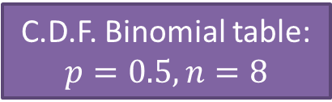
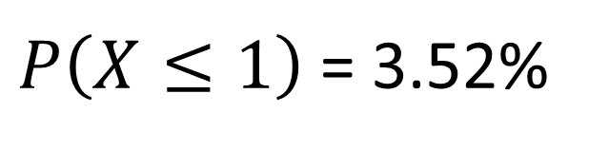
Actual Significance Level
The actual significance level is the
actual probability of being in the critical region.
C.D.F. Binomial table:
$$p=0.5, n=8$$
Significant level is 5%
Hence critical region is
1 outcome or less.
$$x$$ | $$P(X≤x)$$
0 | 0.0039
1 | 0.0352
2 | 0.1445
3 | 0.3633
4 | 0.6367
5 | 0.8555
6 | 0.9648
7 | 0.9961
8 | 1
$P\left(X≤1\right)$ = 3.52%
Therefore the actual significant level is 3.52%

Slide 3
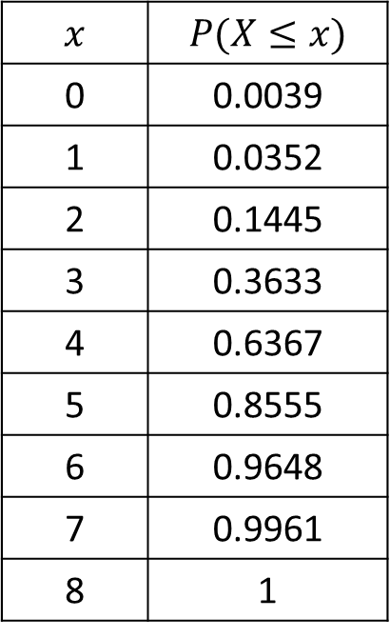
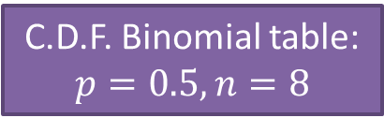
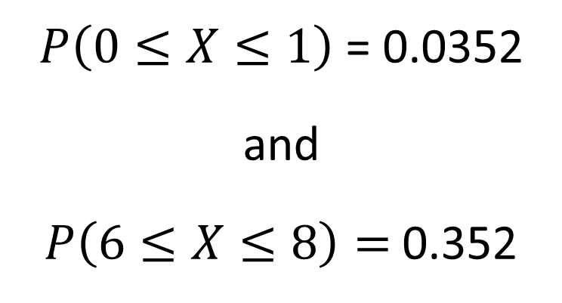
Actual Significance Level
Significant level is 10% and two tailed.
Hence that the critical region is
C.D.F. Binomial table:
$$p=0.5, n=8$$
$P\left(0≤X≤1\right)$ = 0.0352
and
$P\left(6≤X≤8\right)=$ 0.352
$$x$$ | $$P(X≤x)$$
0 | 0.0039
1 | 0.0352
2 | 0.1445
3 | 0.3633
4 | 0.6367
5 | 0.8555
6 | 0.9648
7 | 0.9961
8 | 1
Actual significant level is
0.0352 + 0.0352 = 0.0704

Slide 4
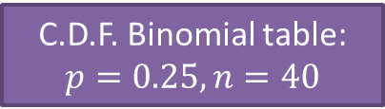
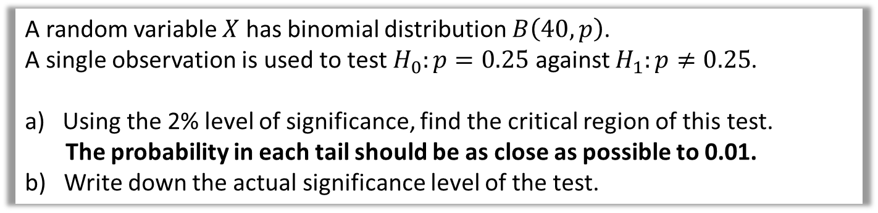
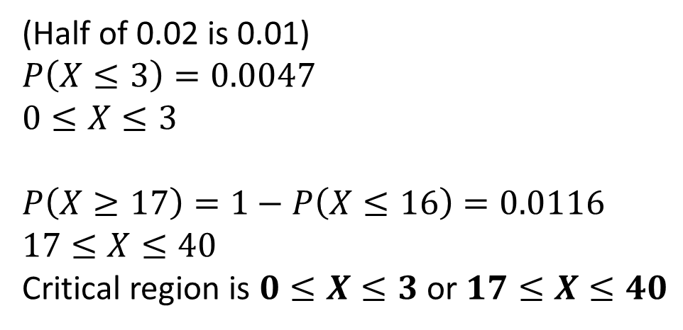
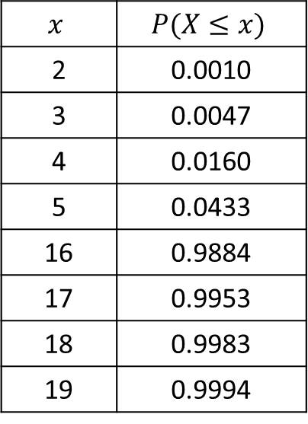
Actual Significance Level
A random variable $X$ has binomial distribution $B\left(40,p\right)$.
A single observation is used to test $H_{0}:p=0.25$ against $H_{1}:p≠0.25$.
a) Using the 2% level of significance, find the critical region of this test.
The probability in each tail should be as close as possible to 0.01.
b) Write down the actual significance level of the test.
C.D.F. Binomial table:
$$p=0.25, n=40$$
a
(Half of 0.02 is 0.01)
$$P\left(X≤3\right)=0.0047$$
$$0≤X≤3$$
$$P\left(X≥17\right)=1−P\left(X≤16\right)=0.0116$$
$$17≤X≤40$$
Critical region is $0≤X≤3$ or $17≤X≤40$
$$x$$ | $$P(X≤x)$$
2 | 0.0010
3 | 0.0047
4 | 0.0160
5 | 0.0433
16 | 0.9884
17 | 0.9953
18 | 0.9983
19 | 0.9994
b
$$0.0047+0.0116=0.0163=1.63\%$$

