Slide 1

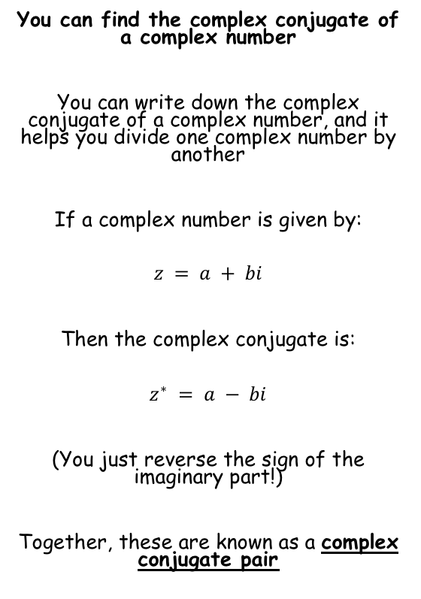





Complex Numbers
You can find the complex conjugate of a complex number
You can write down the complex conjugate of a complex number, and it helps you divide one complex number by another
If a complex number is given by:
$$z = a + bi$$
Then the complex conjugate is:
$$z^{∗} = a − bi$$
(You just reverse the sign of the imaginary part!)
Together, these are known as a complex conjugate pair
Write down the complex conjugate of:
a)
$$2+3i$$
Reverse the sign of the imaginary term
$$=2−3i$$
b)
$$5−2i$$
Reverse the sign of the imaginary term
$$=5+2i$$
c)
$$1−i\sqrt{5}$$
Reverse the sign of the imaginary term
$$=1+i\sqrt{5}$$
1D

Slide 2








Complex Numbers
You can find the complex conjugate of a complex number
Find z + z*, and zz*, given that:
z = 2 – 7i
→ z* = 2 + 7i
$$z+z^{∗}$$
Replace z and z*
$$=\left(2−7i\right)+(2+7i)$$
Group terms
$$=4$$
$$zz^{∗}$$
Replace z and z*
$$=\left(2−7i\right)(2+7i)$$
Multiply out
$$=4+14i−14i−49i^{2}$$
The i terms cancel out, replace i² with -1
$$=4−49(−1)$$
Simplify
$$=53$$
1D

Slide 3








Complex Numbers
You can find the complex conjugate of a complex number
Find z + z*, and zz*, given that:
z = 2√2 + i√2
→ z* = 2√2 - i√2
$$z+z^{∗}$$
Replace z and z*
$$=\left(2\sqrt{2}+i\sqrt{2}\right)+(2\sqrt{2}−i\sqrt{2})$$
Group terms
$$=4\sqrt{2}$$
$$zz^{∗}$$
Replace z and z*
$$=\left(2\sqrt{2}+i\sqrt{2}\right)(2\sqrt{2}−i\sqrt{2})$$
Multiply out
$$=4\sqrt{4}+2i\sqrt{4}−2i\sqrt{4}−i^{2}\sqrt{4}$$
Some terms cancel out, replace i² with -1
$$=8−(−1)(2)$$
Simplify
$$=10$$
1D

Slide 4

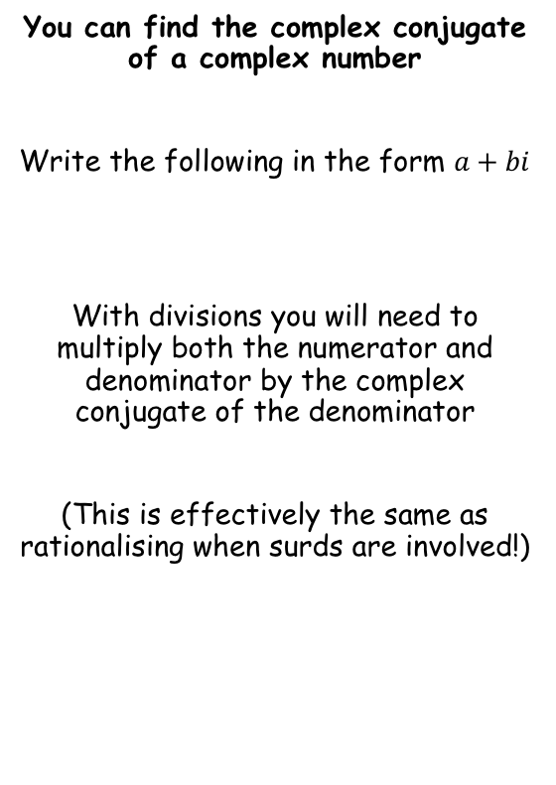







Complex Numbers
You can find the complex conjugate of a complex number
Write the following in the form $a+bi$
With divisions you will need to multiply both the numerator and denominator by the complex conjugate of the denominator
(This is effectively the same as rationalising when surds are involved!)
$$\frac{10+5i}{1+2i}$$
$$× \frac{1−2i}{1−2i}$$
Multiply by the complex conjugate of the denominator
$$=\frac{(10+5i)(1−2i)}{(1+2i)(1−2i)}$$
$$\frac{(10+5i)}{(1+2i) }$$
Expand both brackets
$$=\frac{10+5i−20i−10i^{2}}{1+2i−2i−4i^{2}}$$
Group i terms, replace the i² terms with -1 (use brackets to avoid mistakes)
$$=\frac{10−15i−10(−1)}{1−4(−1)}$$
Simplify terms
$$=\frac{20−15i}{5}$$
Divide by 5
$$=4−3i$$
1D

Slide 5








Complex Numbers
You can find the complex conjugate of a complex number
Write the following in the form $a+bi$
With divisions you will need to multiply both the numerator and denominator by the complex conjugate of the denominator
(This is effectively the same as rationalising when surds are involved!)
$$\frac{5+4i}{2−3i}$$
$$× \frac{2+3i}{2+3i}$$
Multiply by the complex conjugate of the denominator
$$=\frac{(5+4i)(2+3i)}{(2−3i)(2+3i)}$$
$$\frac{(5+4i)}{(2−3i) }$$
Expand both brackets
$$=\frac{10+8i+15i+12i^{2}}{4+6i−6i−9i^{2}}$$
Group i terms, replace the i² terms with -1 (use brackets to avoid mistakes)
$$=\frac{10+23i+12(−1)}{4−9(−1)}$$
Simplify terms
$$=\frac{−2+23i}{13}$$
Split into two parts (this is useful for later topics!)
$$=−\frac{2}{13}+\frac{23}{13}i$$
1D

Slide 6
Exercise 1D
Pearson Further Core Mathematics Year 1/AS
Complete before the lesson Q1-3
In Class:
Green Q4-6
Amber Q7-10
Red Q11-14

