Slide 1
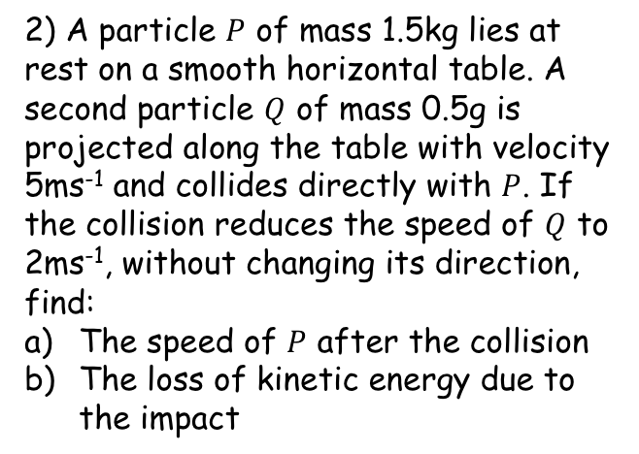
Prior Knowledge Check
A small smooth sphere of mass 0.25kg is moving on a smooth horizontal table with a speed of 8ms⁻¹ when it collides normally with a fixed smooth wall. It rebounds with a speed of 6ms⁻¹. Find the coefficient of restitution between the sphere and the wall.
2) A particle $P$ of mass 1.5kg lies at rest on a smooth horizontal table. A second particle $Q$ of mass 0.5g is projected along the table with velocity 5ms⁻¹ and collides directly with $P$. If the collision reduces the speed of $Q$ to 2ms⁻¹, without changing its direction, find:
The speed of $P$ after the collision
The loss of kinetic energy due to the impact
0.75
1ms⁻¹
4.5J lost

Slide 2





Elastic Collisions in two dimensions
You need to be able to solve problems involving the oblique impact of a smooth sphere on a smooth fixed surface
An oblique impact is one where an object does not strike a surface normally (ie perpendicular to)
When a smooth sphere collides with a smooth surface and bounces away, the velocity will change, and hence the momentum also changes
The impulse on the sphere will act perpendicular to the surface, through the centre of the sphere
→ Note that the sphere will not necessarily bounce away at the same angle with which it hit the surface – why not?
$$I$$
$$v$$
$$u$$
$$β$$
$$α$$
5A

Slide 3








Elastic Collisions in two dimensions
You need to be able to solve problems involving the oblique impact of a smooth sphere on a smooth fixed surface
Why does the angle change?
$$u$$
$$u$$
$$v$$
$$usinα$$
$$v$$
$$vsinβ$$
$$α$$
$$β$$
$$ucosα$$
$$vcosβ$$
If a sphere collides with a surface normally (perpendicular to), then the coefficient of restitution will mean it bounces away at a lower velocity
When the collision is oblique, the velocity is split into two components, parallel to the plane, and perpendicular to it
The parallel component’s actual velocity will not change after the impact, since the surfaces are smooth
The perpendicular component will however be reduced by the coefficient of restitution, hence the angle changes
5A

Slide 4














Elastic Collisions in two dimensions
$$vcosβ=ucosα$$
$$vsinβ=eusinα$$
$$tanβ=etanα$$
You need to be able to solve problems involving the oblique impact of a smooth sphere on a smooth fixed surface
$$u$$
$$usinα$$
$$v$$
$$vsinβ$$
$$α$$
$$β$$
$$ucosα$$
$$vcosβ$$
This relationship leads to several formulae…
The horizontal component of the velocity does not change
The speed of separation is the speed of approach, multiplied by the coefficient of restitution
You can divide the second equation by the first…
$$vcosβ=ucosα$$
$$\frac{vsinβ}{vcosβ}=\frac{eusinα }{ucosα }$$
$$vsinβ=eusinα$$
$$tanβ=etanα$$
5A

Slide 5
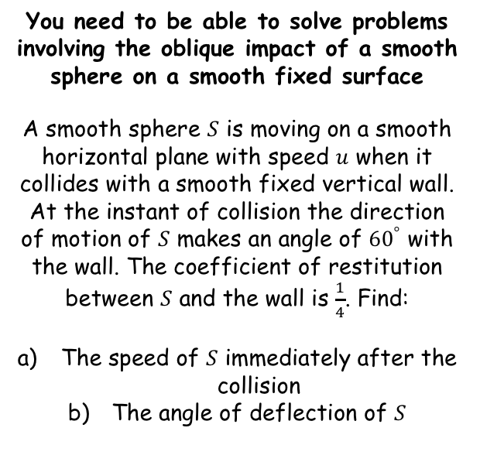
Elastic Collisions in two dimensions
$$vcosβ=ucosα$$
$$vsinβ=eusinα$$
$$tanβ=etanα$$
You need to be able to solve problems involving the oblique impact of a smooth sphere on a smooth fixed surface
A smooth sphere $S$ is moving on a smooth horizontal plane with speed $u$ when it collides with a smooth fixed vertical wall. At the instant of collision the direction of motion of $S$ makes an angle of ${60}^{°}$ with the wall. The coefficient of restitution between $S$ and the wall is $\frac{1}{4}$. Find:
The speed of $S$ immediately after the collision
The angle of deflection of $S$
Wall
Plane
Sphere
Since the ball is moving in a horizontal plane, we will be ignoring gravity
→ Remember this when we do a sketch – it is essentially an overhead view of the situation!
5A

Slide 6















Elastic Collisions in two dimensions
$$vcosβ=ucosα$$
$$vsinβ=eusinα$$
$$tanβ=etanα$$
$$vcosβ=ucosα$$
You need to be able to solve problems involving the oblique impact of a smooth sphere on a smooth fixed surface
A smooth sphere $S$ is moving on a smooth horizontal plane with speed $u$ when it collides with a smooth fixed vertical wall. At the instant of collision the direction of motion of $S$ makes an angle of ${60}^{°}$ with the wall. The coefficient of restitution between $S$ and the wall is $\frac{1}{4}$. Find:
The speed of $S$ immediately after the collision
The angle of deflection of $S$
We know $α$
$$vcosβ=ucos60$$
$$u$$
$${60}^{°}$$
Calculate
$$vcosβ=\frac{1}{2}u$$
$$v$$
$$β$$
$$vsinβ=eusinα$$
We know $α$ and $e$
$$vsinβ=\left(\frac{1}{4}\right)usin60$$
Calculate
$$vsinβ=\frac{\sqrt{3}}{8}u$$
→ We can eliminate $β$ by using one of the trigonometrical identities. We will need to square both equations first…
→ You can form simultaneous equations to help solve part a
$$vcosβ=\frac{1}{2}u$$
$$vsinβ=\frac{\sqrt{3}}{8}u$$
Square
Square
$$v^{2}\cos^{2}β=\frac{1}{4}u^{2}$$
$$v^{2}\sin^{2}β=\frac{3}{64}u^{2}$$
5A

Slide 7





Elastic Collisions in two dimensions
$$vcosβ=ucosα$$
$$vsinβ=eusinα$$
$$tanβ=etanα$$
You need to be able to solve problems involving the oblique impact of a smooth sphere on a smooth fixed surface
A smooth sphere $S$ is moving on a smooth horizontal plane with speed $u$ when it collides with a smooth fixed vertical wall. At the instant of collision the direction of motion of $S$ makes an angle of ${60}^{°}$ with the wall. The coefficient of restitution between $S$ and the wall is $\frac{1}{4}$. Find:
The speed of $S$ immediately after the collision
The angle of deflection of $S$
$$u$$
$${60}^{°}$$
$$v$$
$$β$$
$$v^{2}\cos^{2}β=\frac{1}{4}u^{2}$$
$$v^{2}\sin^{2}β=\frac{3}{64}u^{2}$$
Add both equations together!
$$v^{2}\cos^{2}β+v^{2}\sin^{2}β=\frac{1}{4}u^{2}+\frac{3}{64}u^{2}$$
Factorise left side
→ You can form simultaneous equations to help solve part a
$$v^{2}\left(\cos^{2}β+\sin^{2}β\right)=\frac{19}{64}u^{2}$$
The bracketed part = 1
$$v^{2}=\frac{19}{64}u^{2}$$
Square root both sides
$$v=\frac{\sqrt{19}}{64}u$$
5A

Slide 8


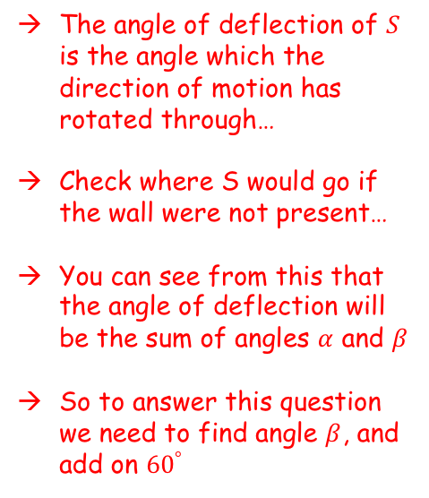

Elastic Collisions in two dimensions
$$vcosβ=ucosα$$
$$vsinβ=eusinα$$
$$tanβ=etanα$$
The angle of deflection of $S$ is the angle which the direction of motion has rotated through…
Check where S would go if the wall were not present…
You can see from this that the angle of deflection will be the sum of angles $α$ and $β$
So to answer this question we need to find angle $β$, and add on ${60}^{°}$
You need to be able to solve problems involving the oblique impact of a smooth sphere on a smooth fixed surface
A smooth sphere $S$ is moving on a smooth horizontal plane with speed $u$ when it collides with a smooth fixed vertical wall. At the instant of collision the direction of motion of $S$ makes an angle of ${60}^{°}$ with the wall. The coefficient of restitution between $S$ and the wall is $\frac{1}{4}$. Find:
The speed of $S$ immediately after the collision
The angle of deflection of $S$
$$u$$
$${60}^{°}$$
$$v$$
$$u$$
$$β$$
$${60}^{°}$$
$$v=\frac{\sqrt{19}}{64}u$$
5A

Slide 9





Elastic Collisions in two dimensions
$$vcosβ=ucosα$$
$$vsinβ=eusinα$$
$$tanβ=etanα$$
You need to be able to solve problems involving the oblique impact of a smooth sphere on a smooth fixed surface
A smooth sphere $S$ is moving on a smooth horizontal plane with speed $u$ when it collides with a smooth fixed vertical wall. At the instant of collision the direction of motion of $S$ makes an angle of ${60}^{°}$ with the wall. The coefficient of restitution between $S$ and the wall is $\frac{1}{4}$. Find:
The speed of $S$ immediately after the collision
The angle of deflection of $S$
$$tanβ=etanα$$
Sub in values
$$u$$
$${60}^{°}$$
$$tanβ=\left(\frac{1}{4}\right)tan60$$
Calculate
$$v$$
$$tanβ=\frac{\sqrt{3}}{4}$$
$$β$$
Calculate
$$β=23.{41}^{°}$$
Add on ${60}^{°}$ to find the angle of deflection
$$Angle of deflection=83.{41}^{°}$$
$$v=\frac{\sqrt{19}}{64}u$$
5A

Slide 10



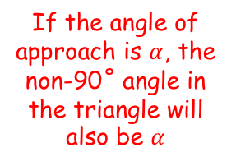





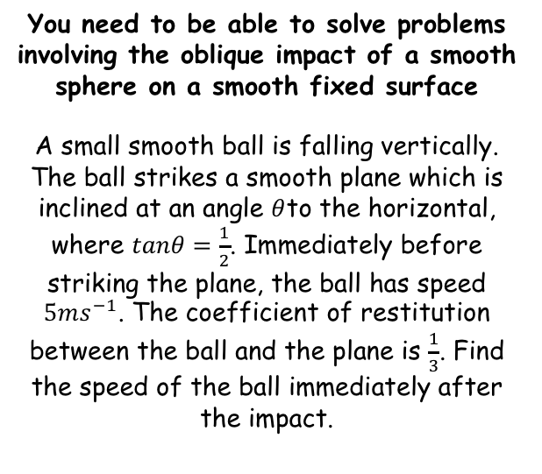









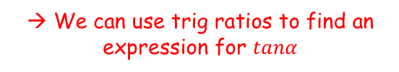

Elastic Collisions in two dimensions
$$vcosβ=ucosα$$
$$vsinβ=eusinα$$
$$tanβ=etanα$$
You need to be able to solve problems involving the oblique impact of a smooth sphere on a smooth fixed surface
A small smooth ball is falling vertically. The ball strikes a smooth plane which is inclined at an angle $θ$to the horizontal, where $tanθ=\frac{1}{2}$. Immediately before striking the plane, the ball has speed $5ms^{−1}$. The coefficient of restitution between the ball and the plane is $\frac{1}{3}$. Find the speed of the ball immediately after the impact.
$$Tanα=2$$
$$Sinα=\frac{2}{\sqrt{5}}$$
$$5{ms}^{−1}$$
$$Cosα=\frac{1}{\sqrt{5}}$$
$$α$$
$$v$$
$$β$$
$$α$$
$$θ$$
If the angle of approach is $α$, the non-90˚ angle in the triangle will also be $α$
$$tanβ=etanα$$
$$tanβ=\left(\frac{1}{3}\right)(2)$$
Sub in values
Simplify
→ We can use trig ratios to find an expression for $tanα$
$$tanβ=\frac{2}{3}$$
$$Tanθ=\frac{1}{2}$$
$$\sqrt{5}$$
$$Sinα=\frac{2}{\sqrt{5}}$$
$$α$$
1
$$θ$$
$$Cosα=\frac{1}{\sqrt{5}}$$
$$Tanα=2$$
2
5A

Slide 11


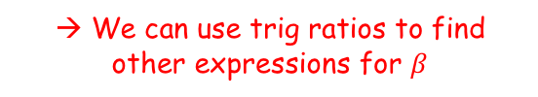



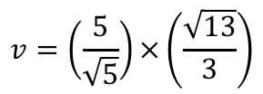




Elastic Collisions in two dimensions
$$vcosβ=ucosα$$
$$vsinβ=eusinα$$
$$tanβ=etanα$$
You need to be able to solve problems involving the oblique impact of a smooth sphere on a smooth fixed surface
A small smooth ball is falling vertically. The ball strikes a smooth plane which is inclined at an angle $θ$to the horizontal, where $tanθ=\frac{1}{2}$. Immediately before striking the plane, the ball has speed $5ms^{−1}$. The coefficient of restitution between the ball and the plane is $\frac{1}{3}$. Find the speed of the ball immediately after the impact.
$$Tanα=2$$
$$Sinα=\frac{2}{\sqrt{5}}$$
$$5{ms}^{−1}$$
$$Cosα=\frac{1}{\sqrt{5}}$$
$$α$$
$$v$$
$$β$$
$$α$$
$$Tanβ=\frac{2}{3}$$
$$θ$$
$$vcosβ=ucosα$$
Sub in values
$$v\left(\frac{3}{\sqrt{13}}\right)=(5)\left(\frac{1}{\sqrt{5}}\right)$$
→ We can use trig ratios to find other expressions for $β$
Rearrange
$$v=\left(\frac{5}{\sqrt{5}}\right)×\left(\frac{\sqrt{13}}{3}\right)$$
$$Tanβ=\frac{2}{3}$$
$$\sqrt{13}$$
$$Sinβ=\frac{2}{\sqrt{13}}$$
Simplify
2
$$v=\frac{2\sqrt{15}}{3}{ms}^{−1}$$
$$β$$
$$Cosβ=\frac{3}{\sqrt{13}}$$
3
5A

Slide 12






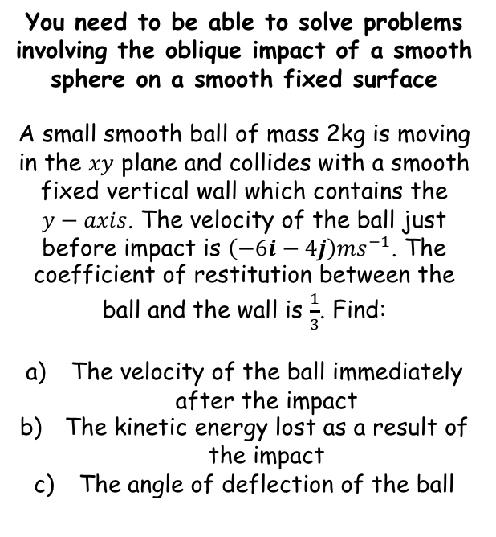





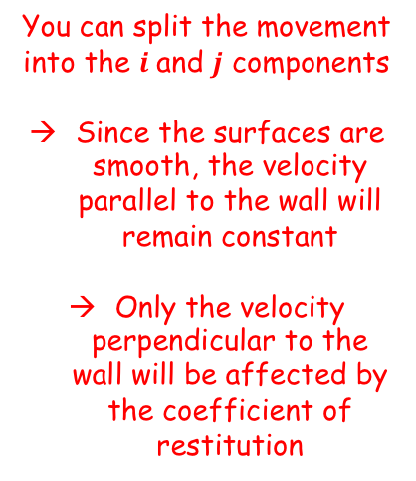



Elastic Collisions in two dimensions
$$vcosβ=ucosα$$
$$vsinβ=eusinα$$
$$tanβ=etanα$$
You can split the movement into the $i$and $j$ components
Since the surfaces are smooth, the velocity parallel to the wall will remain constant
Only the velocity perpendicular to the wall will be affected by the coefficient of restitution
$$−6i$$
You need to be able to solve problems involving the oblique impact of a smooth sphere on a smooth fixed surface
A small smooth ball of mass 2kg is moving in the $xy$ plane and collides with a smooth fixed vertical wall which contains the $y−axis$. The velocity of the ball just before impact is $\left(−6i−4j\right){ms}^{−1}$. The coefficient of restitution between the ball and the wall is $\frac{1}{3}$. Find:
The velocity of the ball immediately after the impact
The kinetic energy lost as a result of the impact
The angle of deflection of the ball
$$−4j$$
$$α$$
$$\left(−6i−4j\right) {ms}^{−1}$$
$$qj$$
$$−4j$$
$$β$$
$$\left(pi+qj\right) {ms}^{−1}$$
$$pi$$
$$2i$$
$$e=\frac{v}{u}$$
Sub in values. The value of $u$ is taken as positive since it is the speed of approach (not velocity)
$$\frac{1}{3}=\frac{v}{6}$$
Calculate
$$2=v$$
5A

Slide 13






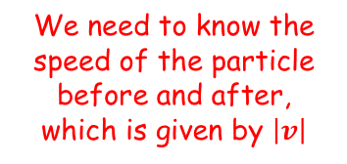

Elastic Collisions in two dimensions
$$vcosβ=ucosα$$
$$vsinβ=eusinα$$
$$tanβ=etanα$$
$$−6i$$
We need to know the speed of the particle before and after, which is given by $\left|v\right|$
You need to be able to solve problems involving the oblique impact of a smooth sphere on a smooth fixed surface
A small smooth ball of mass 2kg is moving in the $xy$ plane and collides with a smooth fixed vertical wall which contains the $y−axis$. The velocity of the ball just before impact is $\left(−6i−4j\right){ms}^{−1}$. The coefficient of restitution between the ball and the wall is $\frac{1}{3}$. Find:
The velocity of the ball immediately after the impact
The kinetic energy lost as a result of the impact
The angle of deflection of the ball
$$−4j$$
$$α$$
$$\left(−6i−4j\right) {ms}^{−1}$$
$$\left|u\right|=\sqrt{{\left(−6\right)}^{2}+{\left(−4\right)}^{2}}$$
$$−4j$$
$$β$$
$$\left(pi+qj\right) {ms}^{−1}$$
$$\left|u\right|=\sqrt{52}$$
$$2i$$
$$\left|v\right|=\sqrt{{\left(2\right)}^{2}+{\left(−4\right)}^{2}}$$
$$\left|v\right|=\sqrt{20}$$
$$Change in KE=\frac{1}{2}mv^{2}−\frac{1}{2}mu^{2}$$
Sub in values
$$Change in KE=\frac{1}{2}(2){\left(20\right)}^{2}−\frac{1}{2}(2){\left(\sqrt{52}\right)}^{2}$$
Calculate
$$Change in KE=−20J$$
So 20J of energy has been lost due to the impact
5A

Slide 14
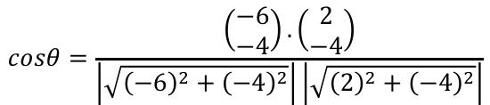







Elastic Collisions in two dimensions
$$vcosβ=ucosα$$
$$vsinβ=eusinα$$
$$tanβ=etanα$$
$$cosθ=\frac{u.v}{\left|u\right|\left|v\right|}$$
You need to be able to solve problems involving the oblique impact of a smooth sphere on a smooth fixed surface
A small smooth ball of mass 2kg is moving in the $xy$ plane and collides with a smooth fixed vertical wall which contains the $y−axis$. The velocity of the ball just before impact is $\left(−6i−4j\right){ms}^{−1}$. The coefficient of restitution between the ball and the wall is $\frac{1}{3}$. Find:
The velocity of the ball immediately after the impact
The kinetic energy lost as a result of the impact
The angle of deflection of the ball
As seen earlier, the angle of deflection is the angle which the direction of motion has turned though
→ You can calculate these angles separately, or you can use the scalar product (the angle between two vectors)
$$α$$
$$\left(−6i−4j\right) {ms}^{−1}$$
$$α$$
$$β$$
$$\left(2i−4j\right) {ms}^{−1}$$
$$cosθ=\frac{u.v}{\left|u\right|\left|v\right|}$$
Sub in values
$$cosθ=\frac{\left(\begin{matrix}−6 \\ −4\end{matrix}\right).\left(\begin{matrix}2 \\ −4\end{matrix}\right)}{\left|\sqrt{{\left(−6\right)}^{2}+{\left(−4\right)}^{2}}\right|\left|\sqrt{{\left(2\right)}^{2}+{\left(−4\right)}^{2}}\right|}$$
Write the dot product as a calculation
$$cosθ=\frac{\left(−6\right)\left(2\right)+(−4)(4)}{\left|\sqrt{{\left(−6\right)}^{2}+{\left(−4\right)}^{2}}\right|\left|\sqrt{{\left(2\right)}^{2}+{\left(−4\right)}^{2}}\right|}$$
Calculate
$$cosθ=0.124…$$
Inverse cos
$$θ=82.9^{°}$$
5A

Slide 15
Exercise 5A
Pearson Further Mechanics 1
Pages 99-101 questions 1 - 14
Complete before the lesson Q1-3
In Class:
Green Q4-8
Amber Q9-14
Red Q15-18 & challenge

