Slide 1

CorePure1 Chapter 5 ::
Volumes of Revolution
jfrost@tiffin.kingston.sch.uk
www.drfrostmaths.com
@DrFrostMaths
Last modified: 14th September 2018

Slide 2








www.drfrostmaths.com
Everything is completely free.
Why not register?
Register now to interactively practise questions on this topic, including past paper questions and extension questions (including MAT + UKMT).
Teachers: you can create student accounts (or students can register themselves), to set work, monitor progress and even create worksheets.
With questions by:
Dashboard with points, trophies, notifications and student progress.
Questions organised by topic, difficulty and past paper.
Teaching videos with topic tests to check understanding.

Slide 3
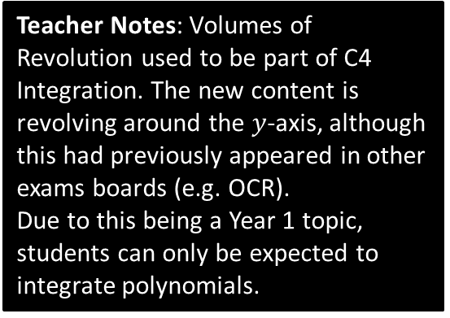
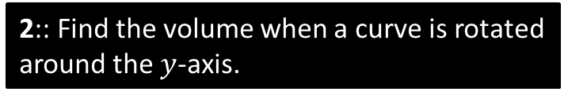
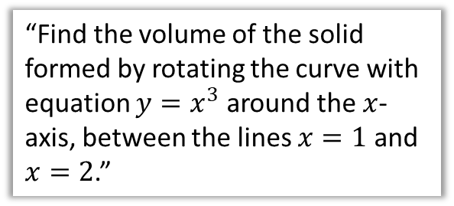
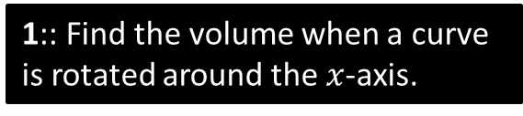
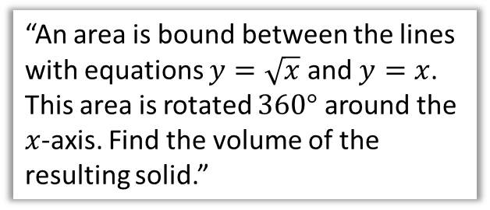
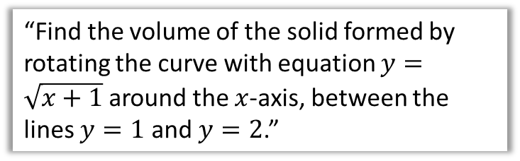
Chapter Overview
This chapter concerns how we can find the volume of a solid when a curve is ‘revolved around either the $x$ or $y$ axis.
1:: Find the volume when a curve is rotated around the $x$-axis.
2:: Find the volume when a curve is rotated around the $y$-axis.
“Find the volume of the solid formed by rotating the curve with equation $y=x^{3}$ around the $x$-axis, between the lines $x=1$ and $x=2$.”
“Find the volume of the solid formed by rotating the curve with equation $y=\sqrt{x+1}$ around the $x$-axis, between the lines $y=1$ and $y=2$.”
Teacher Notes: Volumes of Revolution used to be part of C4 Integration. The new content is revolving around the $y$-axis, although this had previously appeared in other exams boards (e.g. OCR).
Due to this being a Year 1 topic, students can only be expected to integrate polynomials.
3:: Find more complex volumes by adding/subtracting.
“An area is bound between the lines with equations $y=\sqrt{x}$ and $y=x$. This area is rotated $360°$ around the $x$-axis. Find the volume of the resulting solid.”

Slide 4


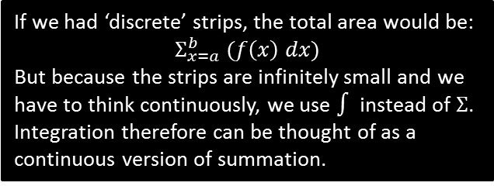
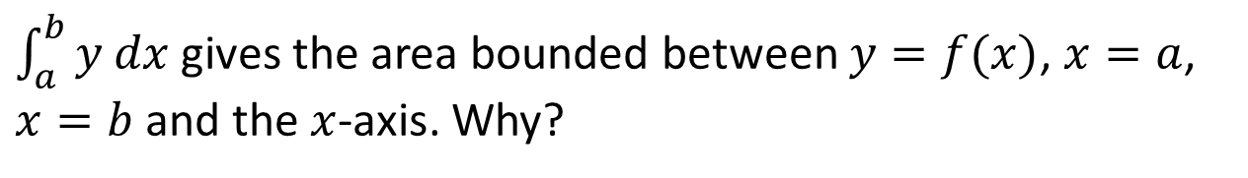
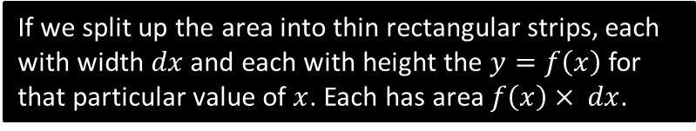





Area under a graph
$\int_{a}^{b}{y dx}$ gives the area bounded between $y=f(x)$, $x=a$, $x=b$ and the $x$-axis. Why?
If we split up the area into thin rectangular strips, each with width $dx$ and each with height the $y=f\left(x\right)$ for that particular value of $x$. Each has area $f\left(x\right)× dx$.
$$y$$
If we had ‘discrete’ strips, the total area would be:
$$Σ_{x=a}^{b} (f\left(x\right) dx)$$
But because the strips are infinitely small and we have to think continuously, we use $∫$ instead of $Σ$.
Integration therefore can be thought of as a continuous version of summation.
$$y_{1}$$
$$y_{2}$$
$$b$$
$$x$$
$$a$$
$$dx dx dx dx dx$$

Slide 5



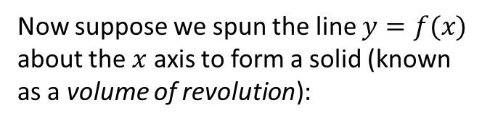

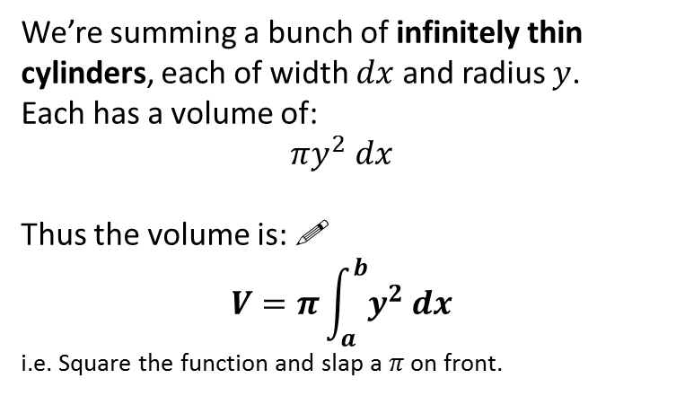


Volumes of Revolution
$$y$$
Now suppose we spun the line $y=f(x)$ about the $x$ axis to form a solid (known as a volume of revolution):
Click to Start Fromanimation
$$y$$
How could we use the same principle as before to express the volume? What should we use instead of strips?
$$a$$
$$b$$
$$x$$
Reveal >>
We’re summing a bunch of infinitely thin cylinders, each of width $dx$ and radius $y$.
Each has a volume of:
$$πy^{2} dx$$
Thus the volume is: !
$$V=π\int_{a}^{b}{y^{2} dx}$$
i.e. Square the function and slap a $π$ on front.
$$dx$$
?
?

Slide 6


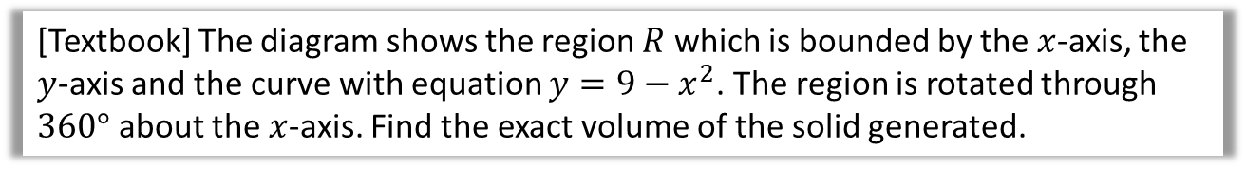



Example
[Textbook] The diagram shows the region $R$ which is bounded by the $x$-axis, the $y$-axis and the curve with equation $y=9−x^{2}$. The region is rotated through $360°$ about the $x$-axis. Find the exact volume of the solid generated.
?
$$y$$
Find roots first:
$$9−x^{2}=0 → x=±3$$
Volume:
$$V=π\int_{0}^{3}{{\left(9−x^{2}\right)}^{2} dx} \\ =π\int_{0}^{3}{81−18x^{2}+x^{4} dx} \\ =π{\left[81x−6x^{3}+\frac{1}{5}x^{5}\right]}_{0}^{3} \\ =π\left(\frac{648}{5}−0\right)=\frac{648π}{5}$$
$$y=9−x^{2}$$
$$R$$
$$x$$

Slide 7
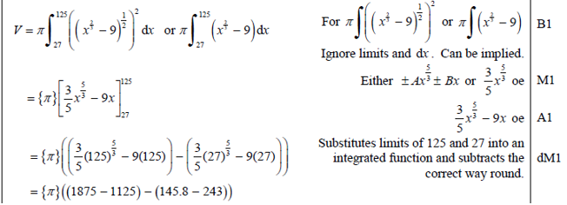
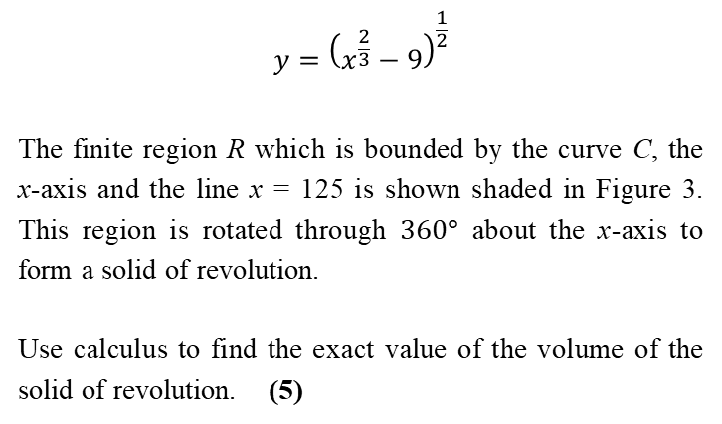
Test Your Understanding
Edexcel C4 June 2013(R) Q7c
$$y={\left(x^{\frac{2}{3}}−9\right)}^{\frac{1}{2}}$$
The finite region R which is bounded by the curve C, the x-axis and the line x = 125 is shown shaded in Figure 3. This region is rotated through $360°$ about the x-axis to form a solid of revolution.
Use calculus to find the exact value of the volume of the solid of revolution. (5)
?

Slide 8
Exercise 5A
Pearson Core Pure Mathematics Year 1
Pages 73-75
Complete before the lesson Q1-2
In Class:
Green Q3-4
Amber Q5-7
Red Q8-9 & challenge

Slide 9









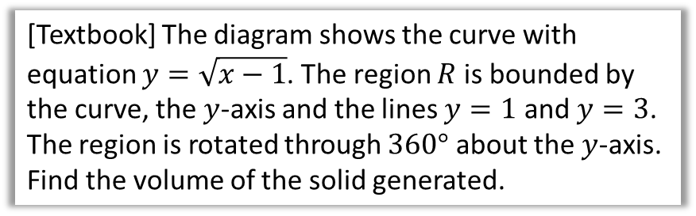


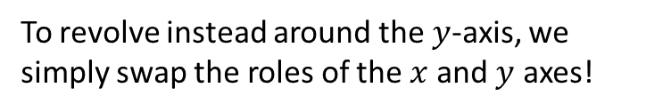

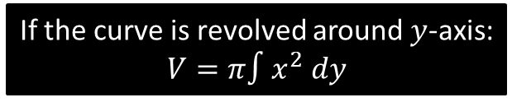

Revolving around the $y$-axis
To revolve instead around the $y$-axis, we simply swap the roles of the $x$ and $y$ axes!
$$a$$
$$b$$
$$y$$
If the curve is revolved around $y$-axis:
$$V=π∫x^{2} dy$$
$$x$$
$$dy$$
$$x$$
[Textbook] The diagram shows the curve with equation $y=\sqrt{x−1}$. The region $R$ is bounded by the curve, the $y$-axis and the lines $y=1$ and $y=3$. The region is rotated through $360°$ about the $y$-axis. Find the volume of the solid generated.
?
$$x=y^{2}+1 \\ ∴V=π\int_{1}^{3}{{\left(y^{2}+1\right)}^{2} dy} \\ =… \\ =\frac{1016π}{15}$$
$$y$$
$$3$$
$$y=\sqrt{x−1}$$
$$R$$
$$1$$
$$x$$

Slide 10

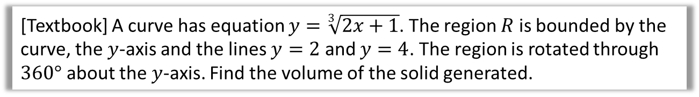
Test Your Understanding
[Textbook] A curve has equation $y=\sqrt[3]{2x+1}$. The region $R$ is bounded by the curve, the $y$-axis and the lines $y=2$ and $y=4$. The region is rotated through $360°$ about the $y$-axis. Find the volume of the solid generated.
?
$$y^{3}=2x+1 \\ x=\frac{1}{2}y^{3}−\frac{1}{2} \\ V=π\int_{2}^{4}{{\left(\frac{1}{2}y^{3}−\frac{1}{2}\right)}^{2}dy} \\ =… \\ =\frac{7715π}{14}$$

Slide 11
Exercise 5B
Pearson Core Pure Mathematics Year 1
Pages 77-78
Complete before the lesson Q1-2
In Class:
Green Q3-4
Amber Q5-6
Red Q7-8

Slide 12








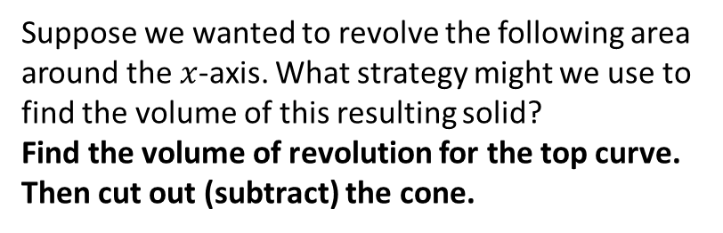

Adding and Subtracting Volumes
$$y$$
Suppose we wanted to revolve the following area around the $x$-axis. What strategy might we use to find the volume of this resulting solid?
Find the volume of revolution for the top curve. Then cut out (subtract) the cone.
$$R$$
This bit is a cone.
?
$$x$$
GCSE Reminders:
?
?
$$V=\frac{1}{3}πr^{2}h$$
$$h$$
$$h$$
$$V=πr^{2}h$$
$$r$$
$$r$$

Slide 13






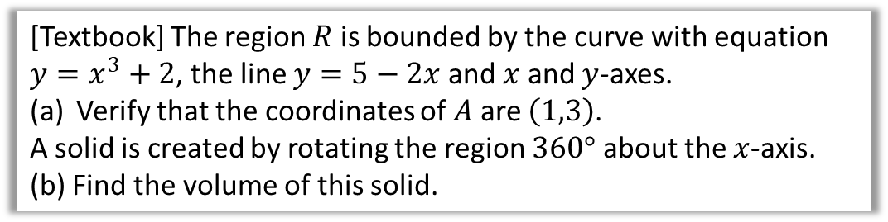








Example
[Textbook] The region $R$ is bounded by the curve with equation $y=x^{3}+2$, the line $y=5−2x$ and $x$ and $y$-axes.
Verify that the coordinates of $A$ are $\left(1,3\right)$.
A solid is created by rotating the region $360°$ about the $x$-axis.
(b) Find the volume of this solid.
$$y$$
$$y=x^{3}+2$$
$$A$$
$$R$$
$$y=5−2x$$
? a
$$O$$
$$x$$
$1^{3}+2=3, 5−2\left(1\right)=3$ ✓
? b
Find the two volumes separately:
$$V_{1}=π\int_{0}^{1}{{\left(x^{3}+2\right)}^{2} dx}=…=\frac{36π}{7}$$
$5−2x$ intersects the $x$-axis at 2.5
$$V_{2}=\frac{1}{3}π×3^{2}×1.5=\frac{9π}{2}$$
$$V_{overall}=\frac{36π}{7}+\frac{9π}{2}=\frac{135π}{14}$$
$$y$$
$$y=x^{3}+2$$
$$A$$
$$R_{1}$$
$$y=5−2x$$
It’s a cone!
$$R_{2}$$
$$O$$
$$x$$
$$1$$
$$2.5$$

Slide 14



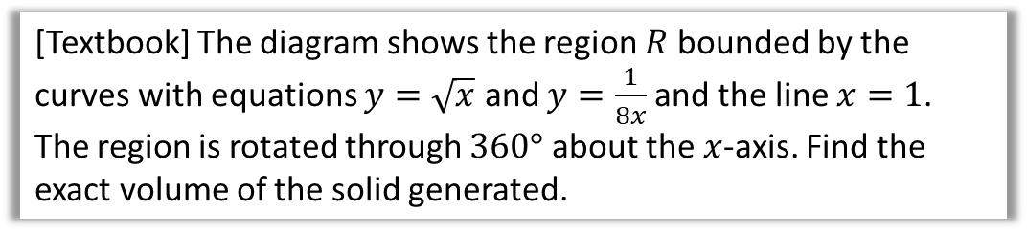



Volumes by Subtraction
[Textbook] The diagram shows the region $R$ bounded by the curves with equations $y=\sqrt{x}$ and $y=\frac{1}{8x}$ and the line $x=1$.
The region is rotated through $360°$ about the $x$-axis. Find the exact volume of the solid generated.
$$y$$
$$y=\frac{1}{8x}$$
$$y=\sqrt{x}$$
$$R$$
?
Do volume under top curve and subtract volume under bottom curve.
Point of intersection:
$$\frac{1}{8x}=\sqrt{x} → 8x^{\frac{3}{2}}=1 → x=\frac{1}{4}$$
$$V_{1}=π\int_{\frac{1}{4}}^{1}{{\left(\sqrt{x}\right)}^{2} dx}=…=\frac{15π}{32} \\ V_{2}=π\int_{\frac{1}{4}}^{1}{{\left(\frac{1}{8x}\right)}^{2} dx}=…=\frac{3π}{64} \\ V_{R}=\frac{15π}{32}−\frac{3π}{64}=\frac{27π}{64}$$
$$x$$
$$1$$

Slide 15



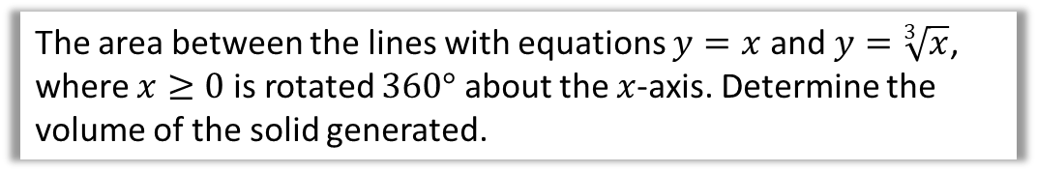



Test Your Understanding
$$y$$
The area between the lines with equations $y=x$ and $y=\sqrt[3]{x}$, where $x≥0$ is rotated $360°$ about the $x$-axis. Determine the volume of the solid generated.
$$y=\sqrt[3]{x}$$
$$R$$
$$y=x$$
?
$$x=x^{\frac{1}{3}} → x^{3}=x \\ x^{3}−x=0 \\ x\left(x−1\right)\left(x+1\right)=0$$
Intersect at $x=−1, 0, 1$
$$V_{1}=π\int_{0}^{1}{{\left(x^{\frac{1}{3}}\right)}^{2}}dx=…=\frac{3π}{5} \\ V_{2}=\frac{1}{3}π\left(1^{2}\right)\left(1\right)=\frac{π}{3} \\ V_{R}=\frac{3π}{5}−\frac{π}{3}=\frac{4π}{15}$$
$$x$$

Slide 16
Exercise 5C
Pearson Core Pure Mathematics Year 1
Pages 81-83
Complete before the lesson Q1-2
In Class:
Green Q3-6
Amber Q7-8
Red Q9 & challenge

Slide 17
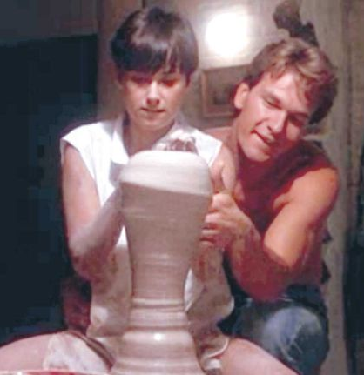
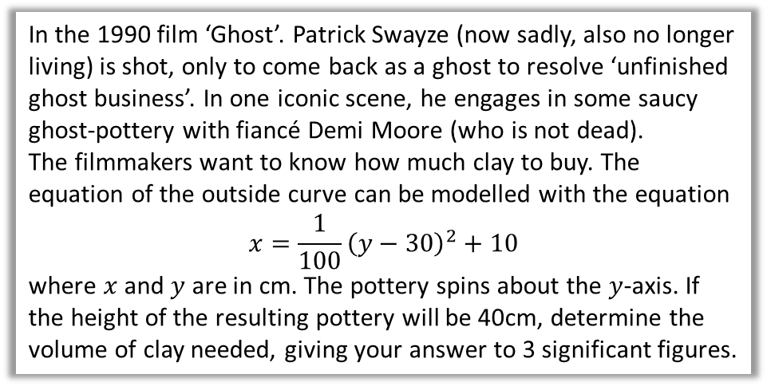
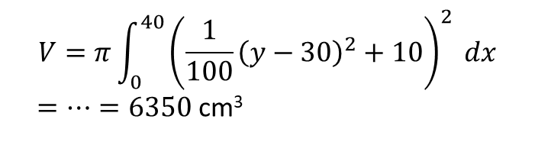
Modelling
In the 1990 film ‘Ghost’. Patrick Swayze (now sadly, also no longer living) is shot, only to come back as a ghost to resolve ‘unfinished ghost business’. In one iconic scene, he engages in some saucy ghost-pottery with fiancé Demi Moore (who is not dead).
The filmmakers want to know how much clay to buy. The equation of the outside curve can be modelled with the equation
$$x=\frac{1}{100}{\left(y−30\right)}^{2}+10$$
where $x$ and $y$ are in cm. The pottery spins about the $y$-axis. If the height of the resulting pottery will be 40cm, determine the volume of clay needed, giving your answer to 3 significant figures.
#paramountpicturespleasedontsue
?
$$V=π\int_{0}^{40}{{\left(\frac{1}{100}{\left(y−30\right)}^{2}+10\right)}^{2} dx}$$
$=…=6350$ cm³
Real-life Maths!

Slide 18

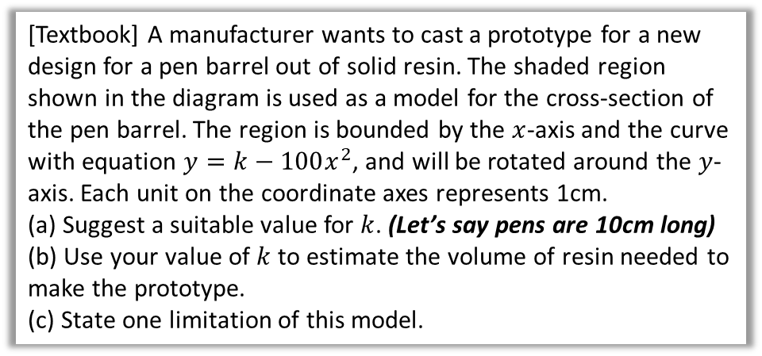



Test Your Understanding
[Textbook] A manufacturer wants to cast a prototype for a new design for a pen barrel out of solid resin. The shaded region shown in the diagram is used as a model for the cross-section of the pen barrel. The region is bounded by the $x$-axis and the curve with equation $y=k−100x^{2}$, and will be rotated around the $y$-axis. Each unit on the coordinate axes represents 1cm.
(a) Suggest a suitable value for $k$. (Let’s say pens are 10cm long)
(b) Use your value of $k$ to estimate the volume of resin needed to make the prototype.
(c) State one limitation of this model.
$$y$$
$$y=k−100x^{2}$$
$$x$$
$k=10$ (pens are around 10-15cm long)
$$y=10−100x^{2} \\ x=\sqrt{\frac{10−y}{100}} \\ V=π\int_{0}^{10}{{\left(\sqrt{\frac{10−y}{100}}\right)}^{2}}dx=π\int_{0}^{10}{\frac{10−y}{100}}dx \\ =…=\frac{π}{2}≈1.57 cm^{3}$$
c
The cross-section of the pen is unlikely to match the curve exactly.
a
?
?
b
?

Slide 19
Exercise 5D
Pearson Core Pure Mathematics Year 1
Pages 84-86
Complete before the lesson Q1-2
In Class:
Green Q3-4
Amber Q5-6
Red Q7 & challenge

